Slide 1
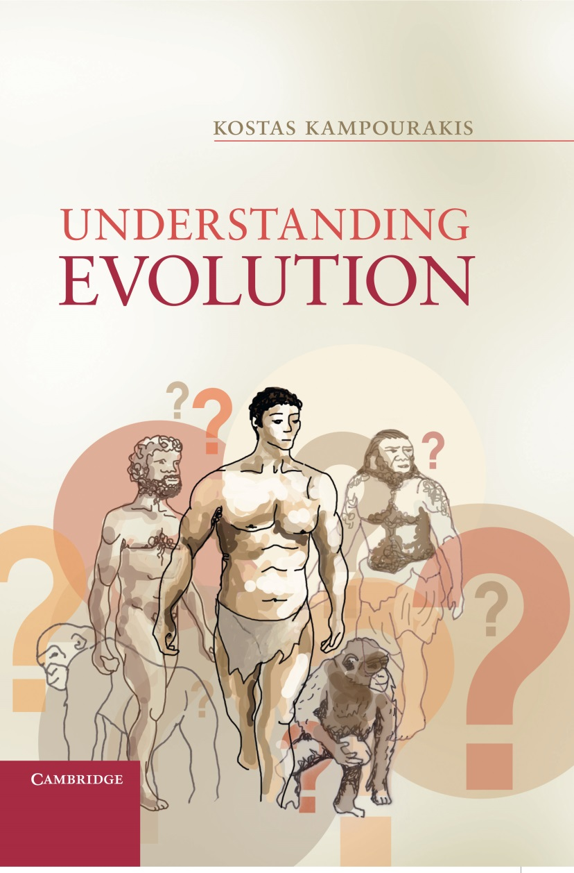
Chapter 1
An evolving world

Slide 2
Figure 1.1
The skeletons of gibbons, gorillas, chimpanzees, orangutans, and humans. A picture like this was included in Huxley’s book, serving as evidence for the similarities in skeletal structure among these groups. Image © Morphant Creation.

Slide 3
Figure 1.2
One of the usual misrepresentations and wrong portrayals of evolution in general and human evolution in particular.

Slide 4
Figure 1.3
a) Humans and chimpanzees are depicted as the most closely related genera because their common ancestor (CaHP) is closer to the present. These also share a common ancestor with the gorillas (Ca[HP]G), while the orangutans are the less related to humans since the share the oldest among the common ancestors (Ca[[HP]G]P) (adapted from Fabre, Rodrigues & Douzery 2009) (Homo: humans; Pan: chimpanzees and bonobos; Pongo: orangutans). b) Chimpanzees and gorillas are depicted as the most related genera, sharing a relatively recent common ancestor (CaGP). Humans are depicted closer to orangutans, having diverged from their common ancestor (CaPH) at earlier times, compared to chimpanzees and gorillas. Finally, the two pairs share a common ancestor (Ca[PH][GP]) from which each genus evolved (adapted from Grehan & Schwartz 2009) (Homo: humans; Pan: chimpanzees and bonobos; Pongo: orangutans). How evolutionary trees are constructed and what kinds of information they provide is discussed in detail in Chapter 5.

Slide 5
Figure 1.4
This is not an evolutionary tree as the ones depicted in Figure 1.3, because species are not connected with lines. We only have fragmented data about human evolution; much is still missing. The various boxes have different lengths which correspond to the time length (millions of years) during which scientists have found fossils of these species. The various species are not connected with lines because scientists do not know the exact evolutionary relationships (adapted from Wood 2010). Missing details notwithstanding, we still have a good sense of how our evolution took place. In this figure two words are used to indicate the name of each species; the first refers to the genus whereas the second the species. Our species is described as Homo sapiens: the word Homo indicates the genus and the Homo sapiens the species.

Slide 6
Figure 1.5
The fossils of Tiktaalik were found where they were predicted to be and provide evidence about how the transition from fish to tetrapods could have taken place (based on Shubin et al., 2006; Daeschler et al., 2006). Note that this figure does not present the actual transition but only how it could have been possible. Tiktaalik is not the intermediate form or the “missing link”, but one that resembles that.

Slide 7
Figure 1.6
Selection and migration; in each case ratios rather than actual numbers of organisms of each type are depicted (see text for the details of the processes).

Slide 8
Figure 1.7
Two populations of beetles living in two different areas. This is the outcome of an evolutionary process and an evolutionary biologist would ask how closely related these populations are, i.e. whether they belong in the same species or not, and how (and when) they diverged from their common ancestor.

Slide 9
Figure 1.8
Hypothetical evolutionary scenario for the evolution of the two beetle species (green and brown) from a common ancestor. Evolutionary biologists develop such scenarios and then test them against evidence. In each case ratios rather than actual numbers of organisms of each type are depicted. The initial population consists of brown and green beetles. At a) a new predator causes selection and more green than brown beetles die. In b) some beetles migrate to a new environment where green beetles have an advantage over brown beetles. Because of different kinds of selection in both environments brown beetles become predominant in the old are and green ones become predominant in the new are (c). The population may diverge further (d-e) and eventually two new species (B and G) evolve (f) which are distinct both from each other and from the initial one (A).

Slide 10
Figure 1.9
Hypothetical evolutionary scenario for the evolution of dogs, which includes both natural and artificial selection (see main text for details).

Slide 11
Figure 1.10
The evolution of HIV in its host. Note that new variants are constantly produced while T-cells become less with time (the proportion of viruses and cells is not accurate; the figure only shows the viral particles at stable numbers and the numbers of T-cells decreasing).

Slide 12
Figure 1.11
Evolution of multi-drug resistance (see text for details)

