Slide 1
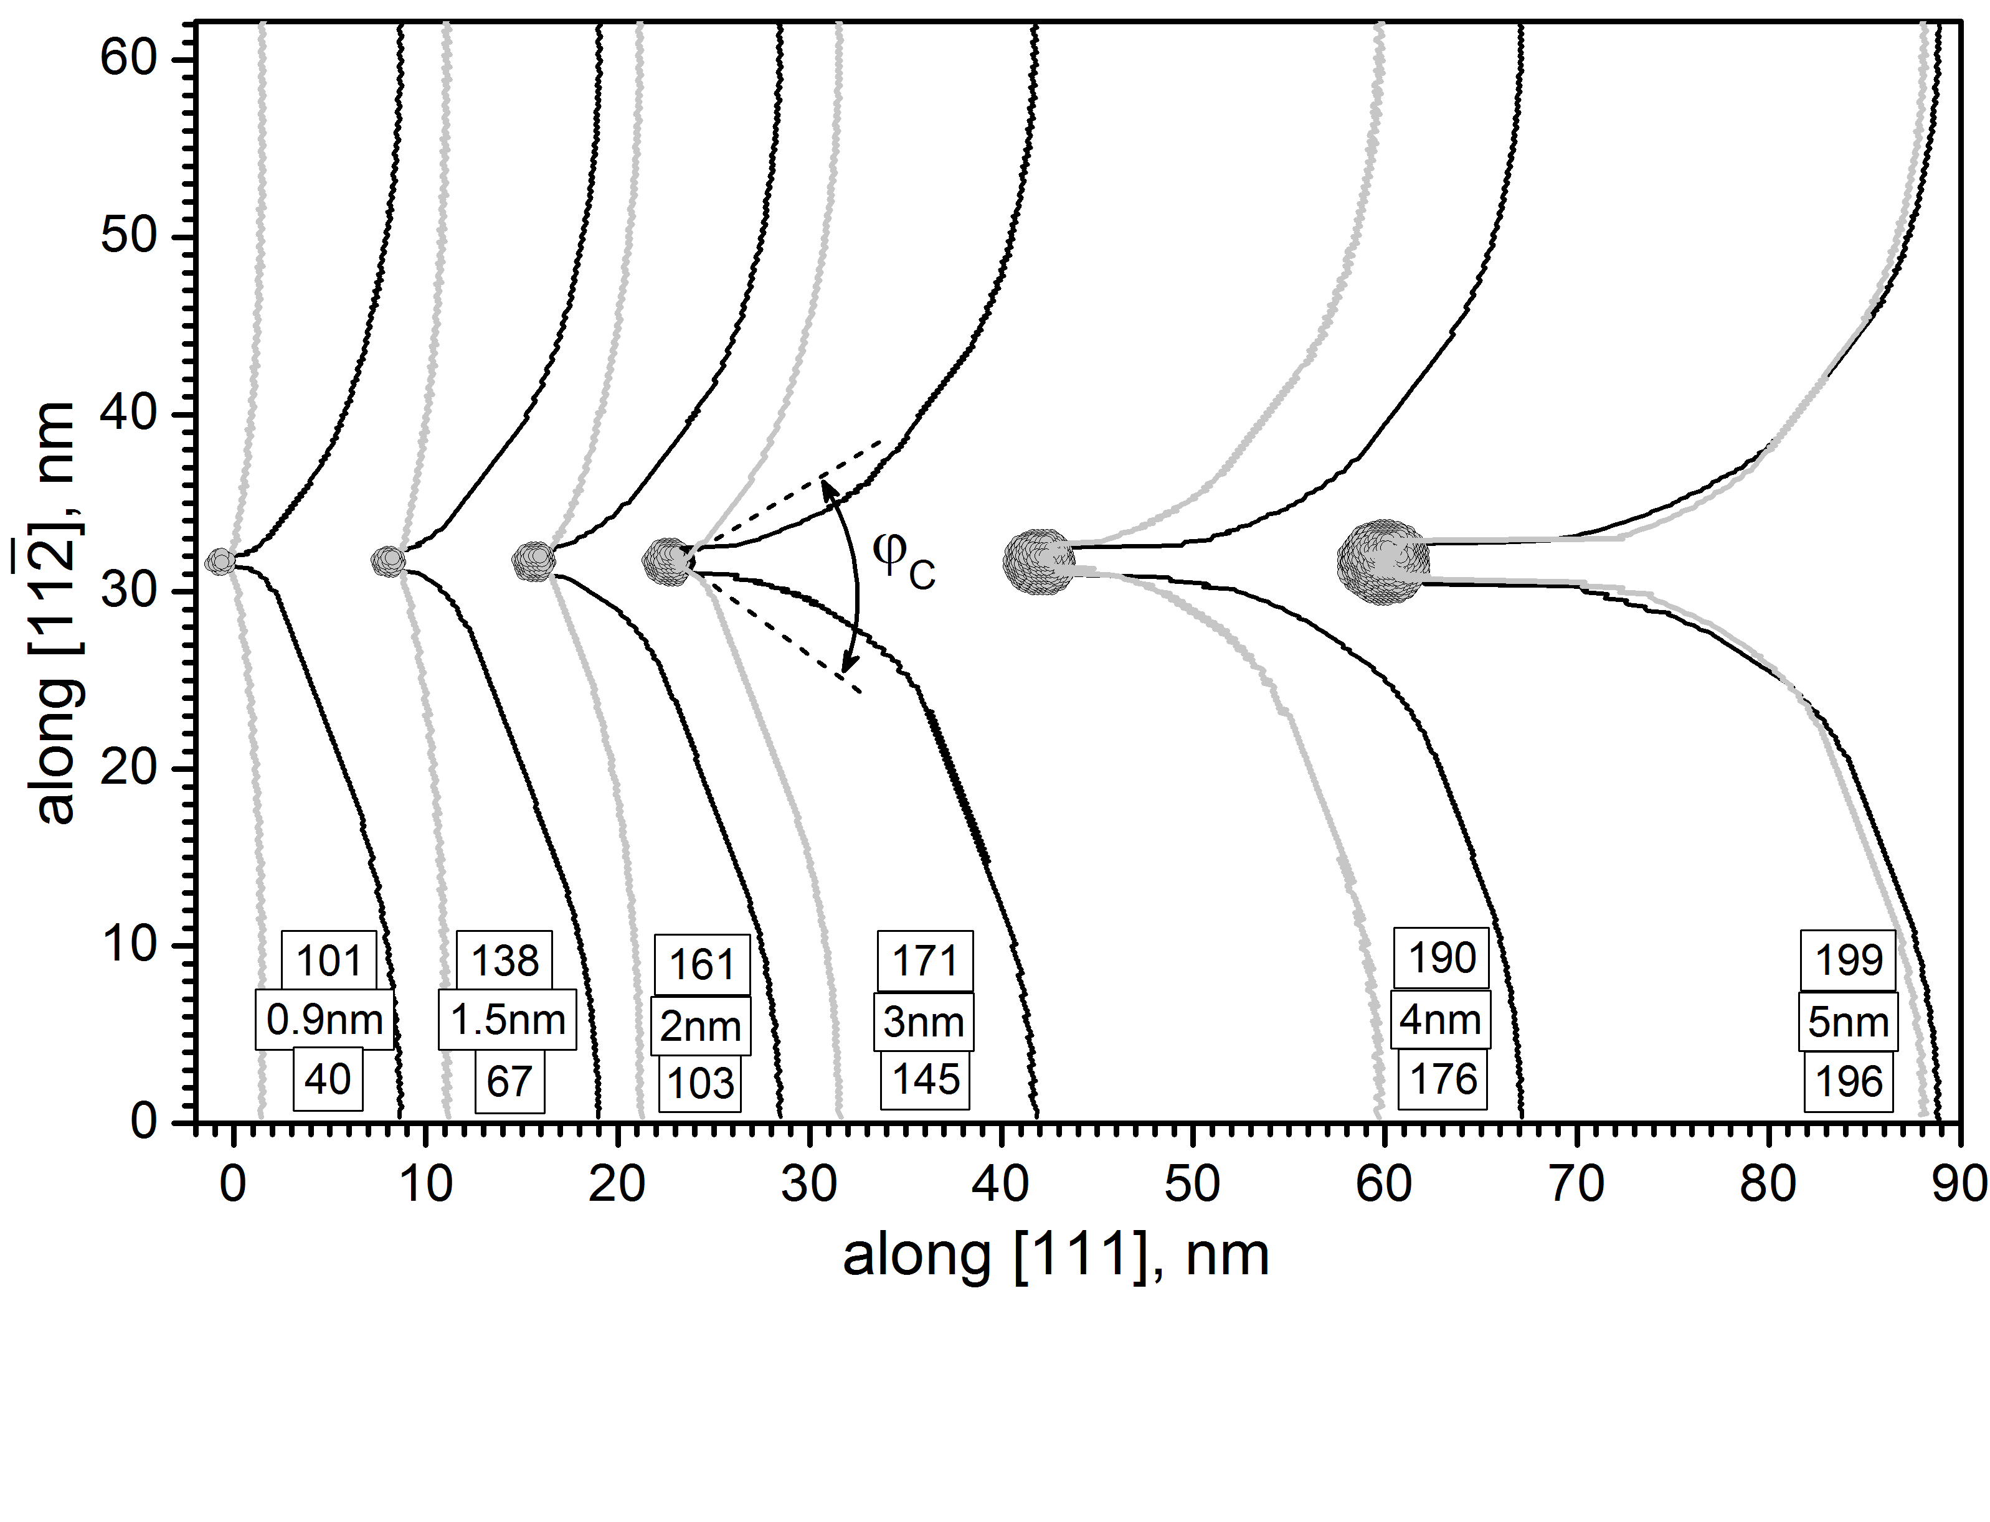
d = 0.9 nm
1.5
2
3
4
5
10 nm
[111]
10 nm
A
A’
precipitate
void
τ_{c}(MPa)
40
101
67
138
103
163
145
171
176
190
196
199

Slide 2
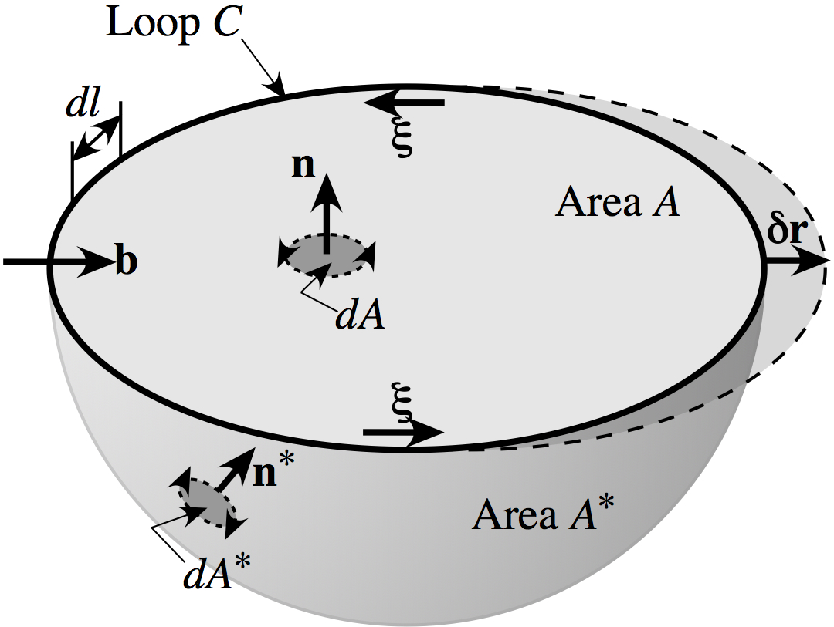
Notes:
2.26” x 3”, jpg.

Slide 3
y
(3)
(2)
(1)
x
Notes:
3.16” x 3”, tiff.

Slide 4
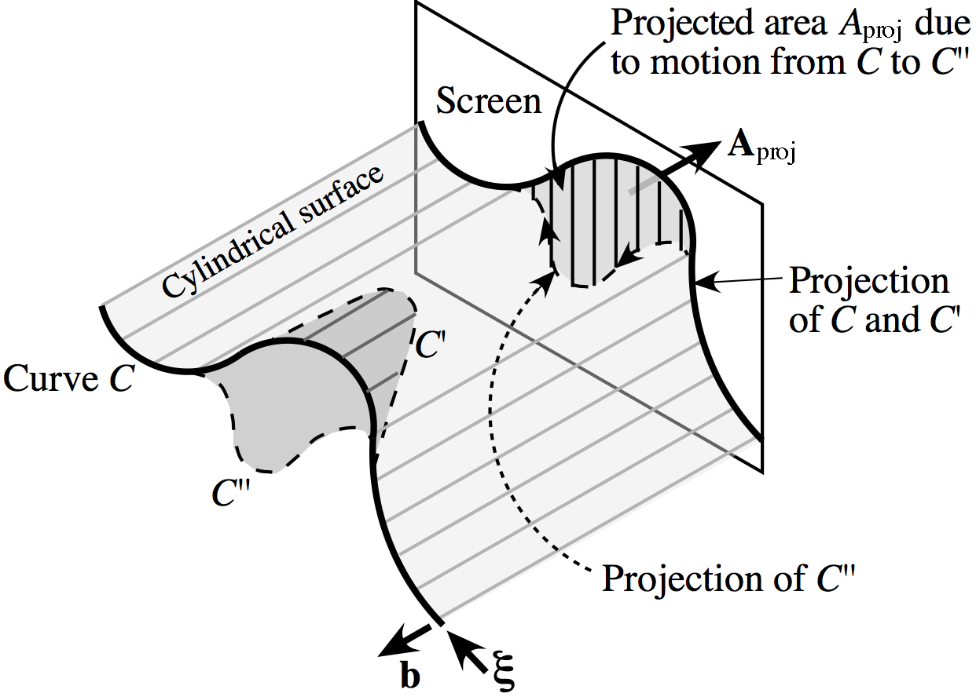
Notes:
3.58” x 5”, jpg.

Slide 5
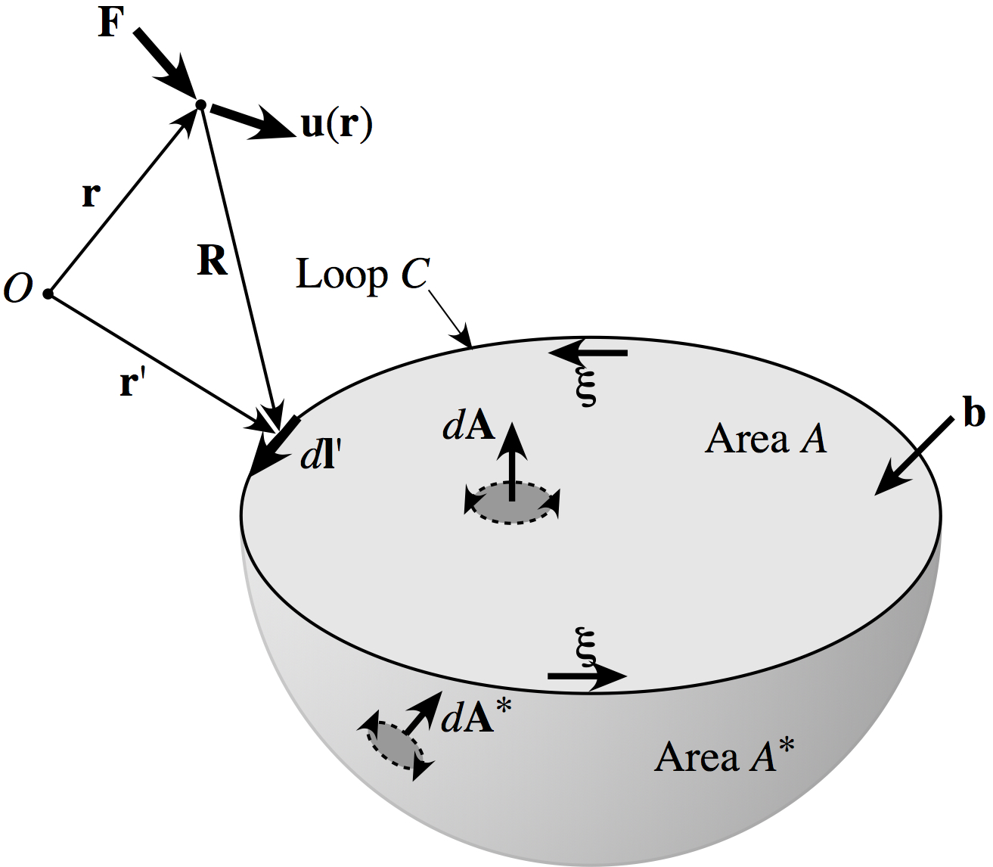
F
u(r)
r
O
R
r'
Notes:
2.62” x 3”, jpg.

Slide 6
O
r'
r
δA
R
δl'
δr'
Notes:
2.26” x 3”, tiff.

Slide 7
ξ₁
C₁
C₂
A₁
b₁
A₂
r₁
ξ₂
r₂
b₂
O
Notes:
2.13” x 3”, jpg.

Slide 8
B'
B''
C
A'
A''
B
ξ
A
b
Notes:
2.14” x 3”, tiff.

