Slide 1
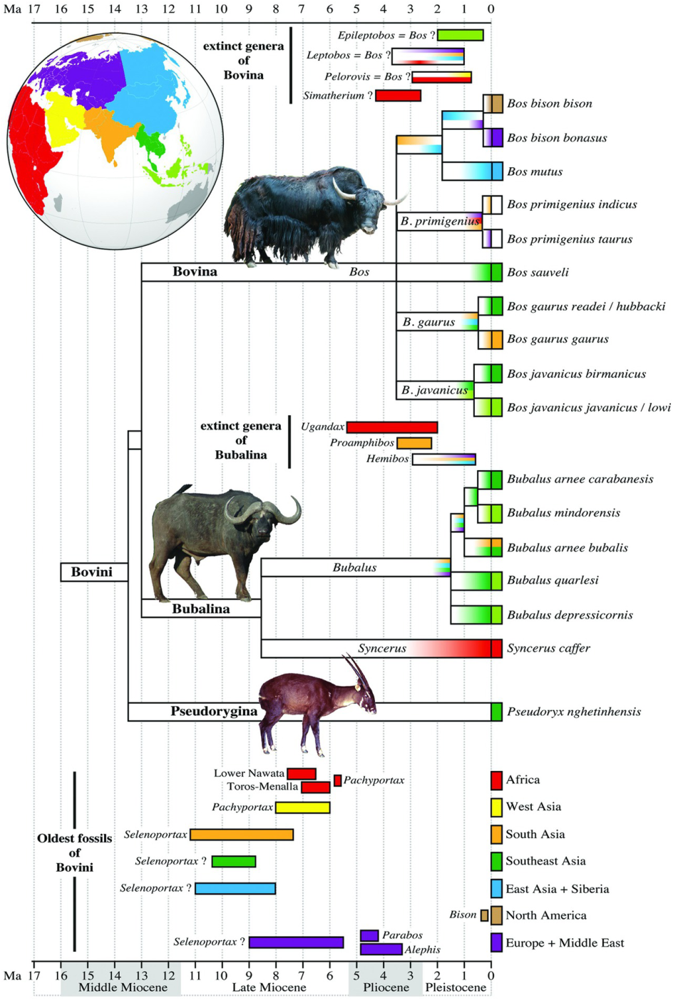
Figure 1.4. Timetree of Bovini
The chronogram summarizes the divergence dates recently estimated from DNA sequences using a Bayesian relaxed molecular clock approach (Hassanin et al. 2012; Hassanin et al. submitted). The time scale comes from the Geological Society of America (2009, available at http://www.geosociety.org/science/timescale/timescl.pdf).The coloured rectangles at the left of species names indicate the geographic distribution of extant taxa. Internal branches are coloured according to the fossil record. Most paleontological data were interpreted from Bibi (2009), the Paleobiology database (http://www.paleodb.org/), and references cited in the text. The oldest fossils assigned to the tribe Bovini are indicated at the bottom for each geographic regions (i.e. Africa, West Asia, South Asia, Southeast Asia, East Asia + Siberia, North America, and Europe + Middle East; see the globe for the geographic regions). The age and geographic distribution of extinct genera assigned to Bovina and Bubalina are also detailed. (Photo of Saola by William G. Robichaud).

