Slide 1
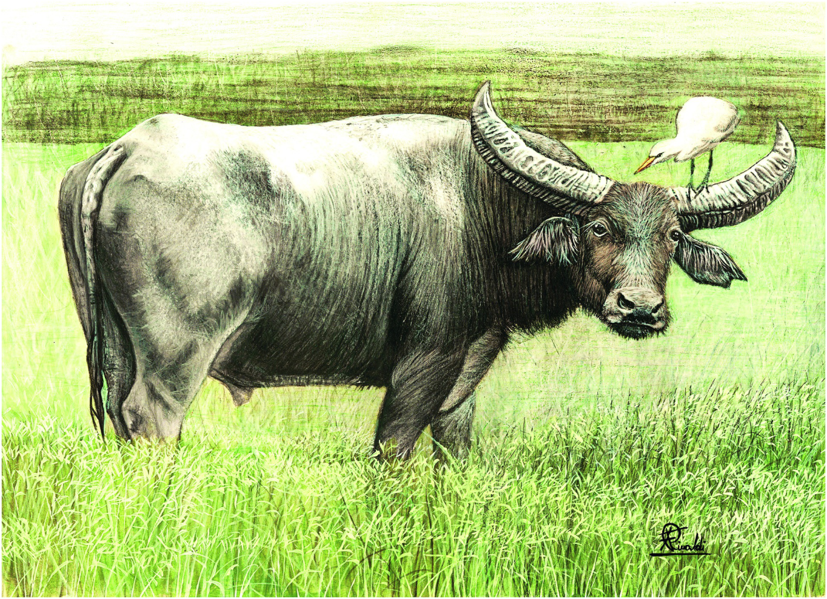
Plate 19
Wild water buffalo (illustration by Francesco Rinaldi)

Slide 2
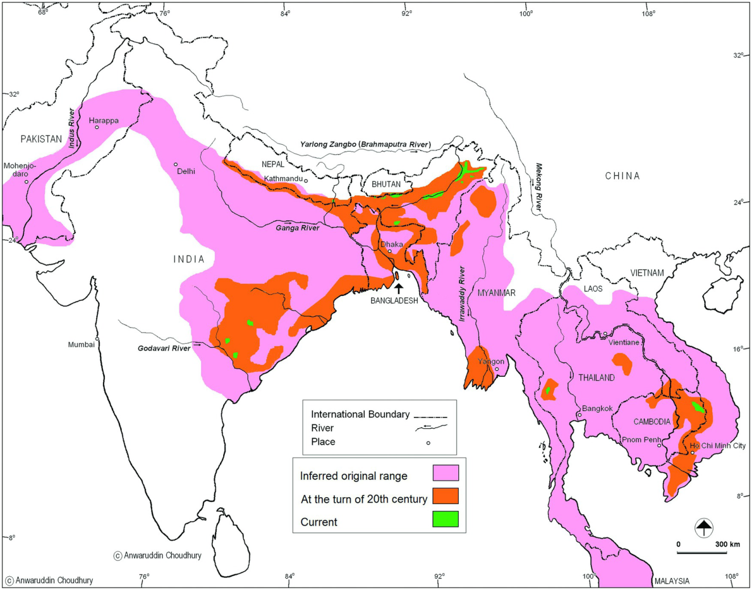
Figure 16.1
Past and present range of the Wild water buffalo.

Slide 3
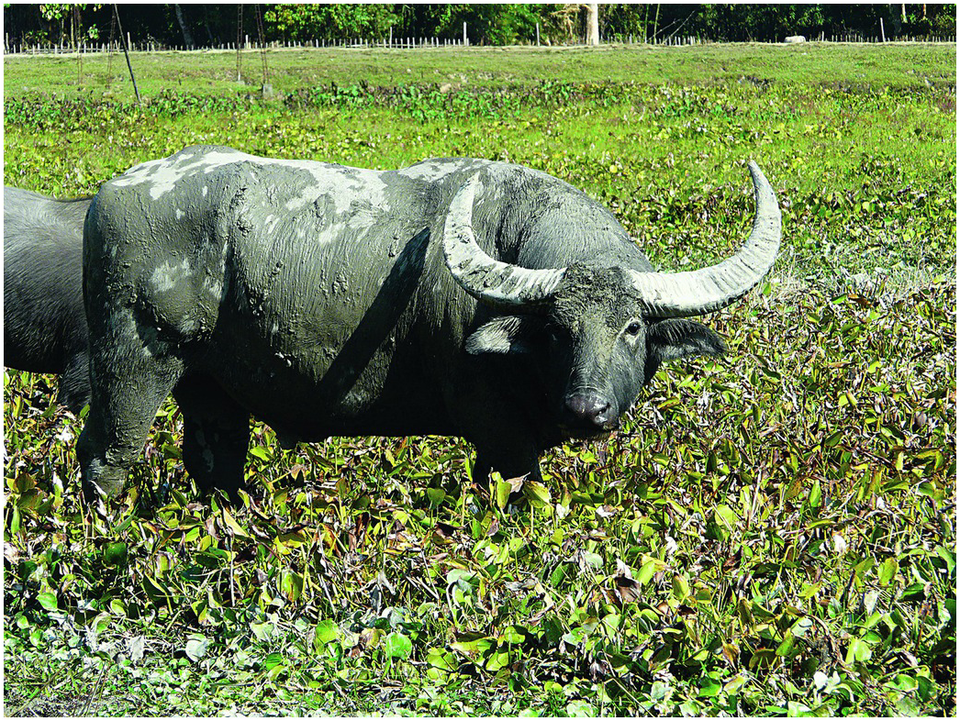
Figure 16.3
A Wild water buffalo of Kollolua-Jokai area, Assam.

Slide 4
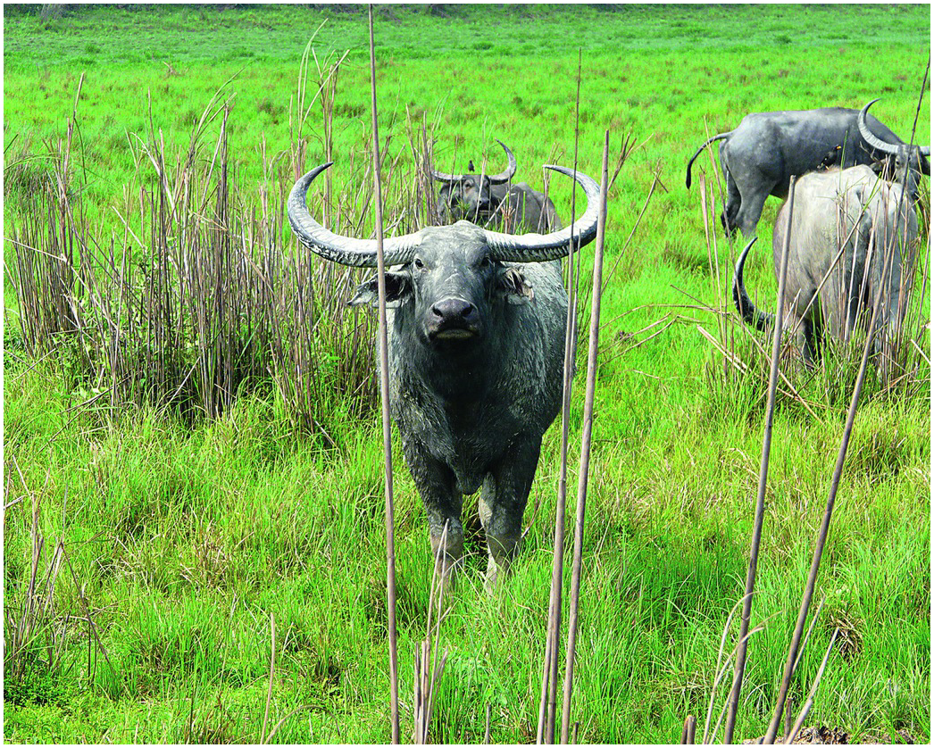
Figure 16.4
A bull and some cows in Kaziranga National Park, Assam

Slide 5
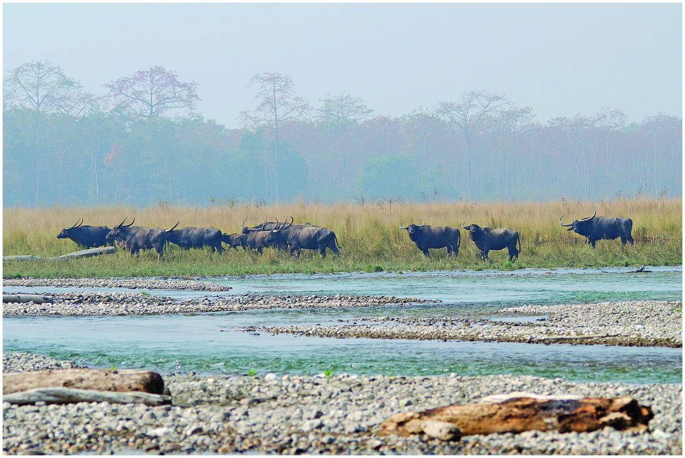
Figure 16.5
A herd of Wild water buffalo in Manas National Park, Assam

Slide 6
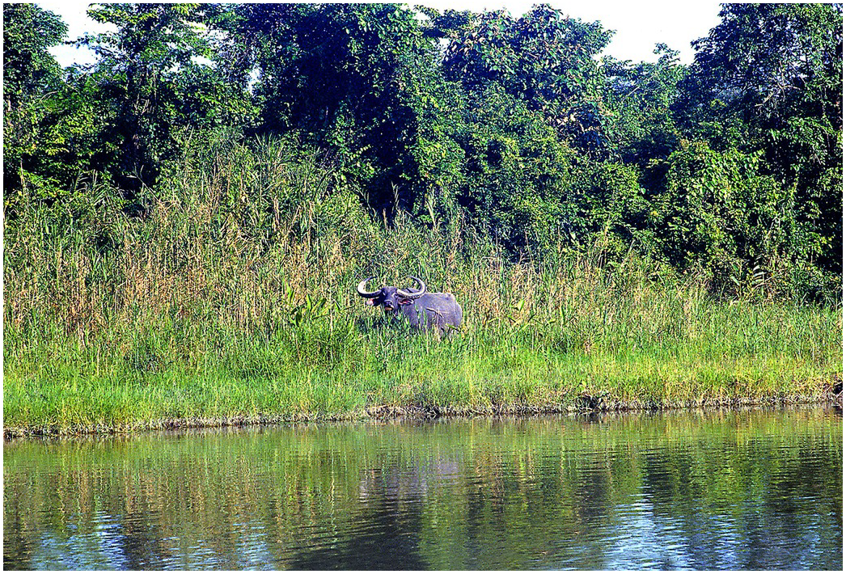
Figure 16.6
A typical Dibru-Saikhowa habitat, Assam.

Slide 7
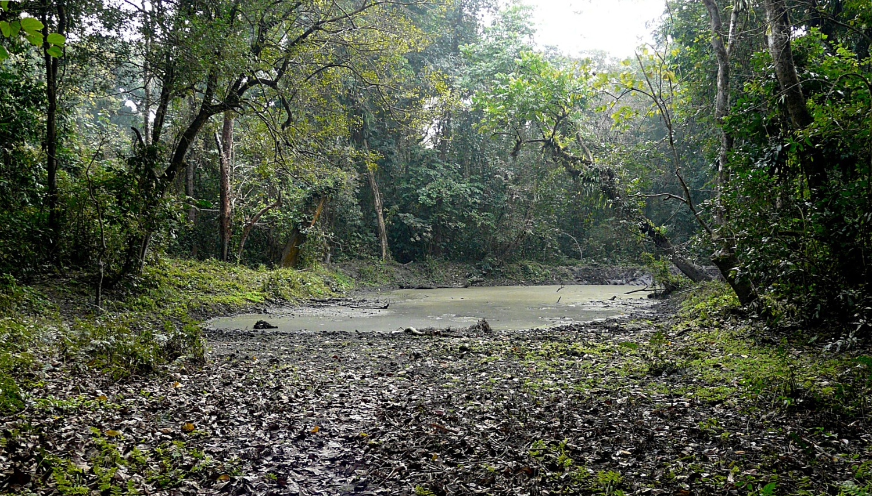
Figure 16.7
Such pools inside forest provide much needed water for drinking and also a site for wallow (seen here is a pool in Buxa Tiger Reserve, Bengal).

Slide 8
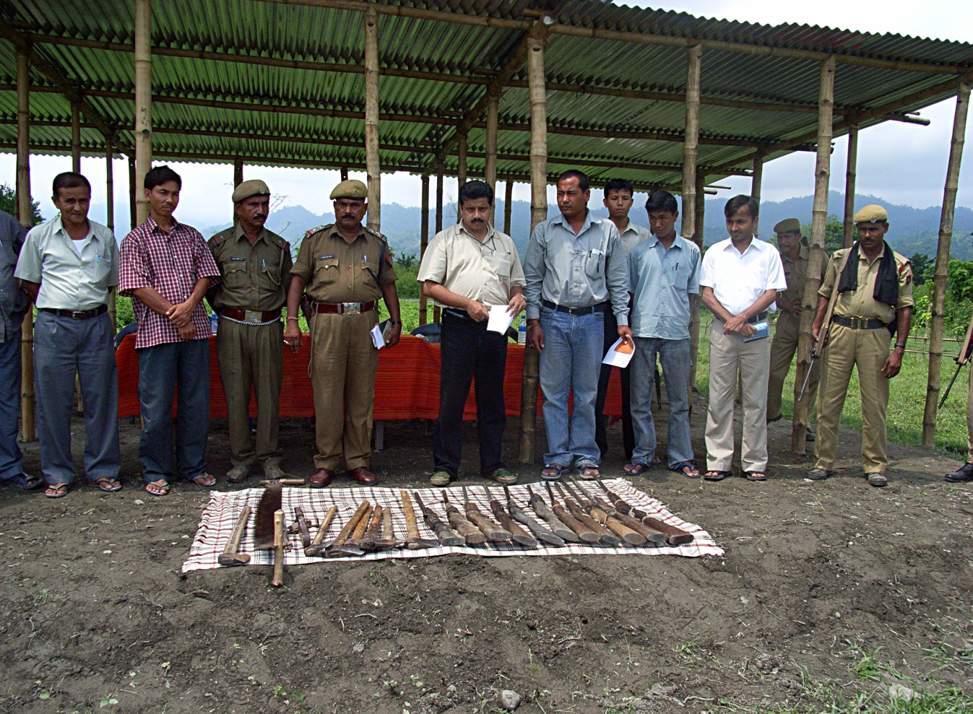
Figure 16.8
Poachers handed over arms to the author (centre) who was then District Magistrate, Baksa in Assam where bulk of Manas National Park is located.

Slide 9
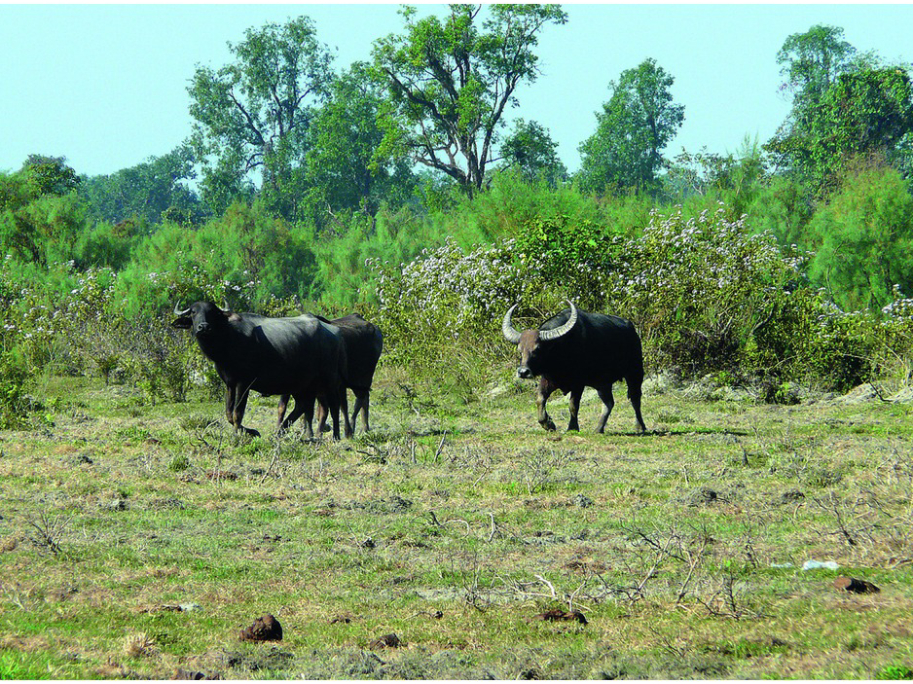
Figure 16.9
A wild bull pursuing domestic cows near Dibru-Saikhowa, Assam.

Slide 10
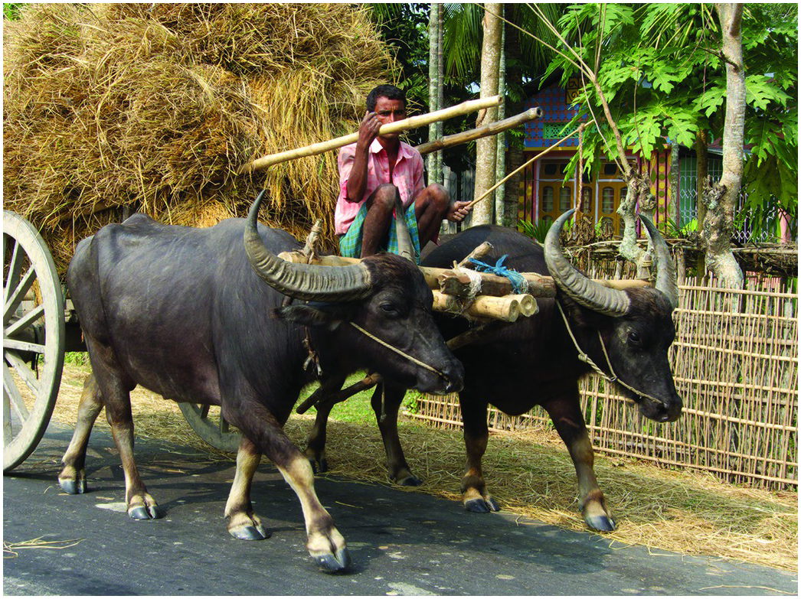
Figure 16.10
Many domestic water buffaloes in Assam closely resemble their wild cousins owing to presence of Wild buffaloes in different areas.

Slide 11
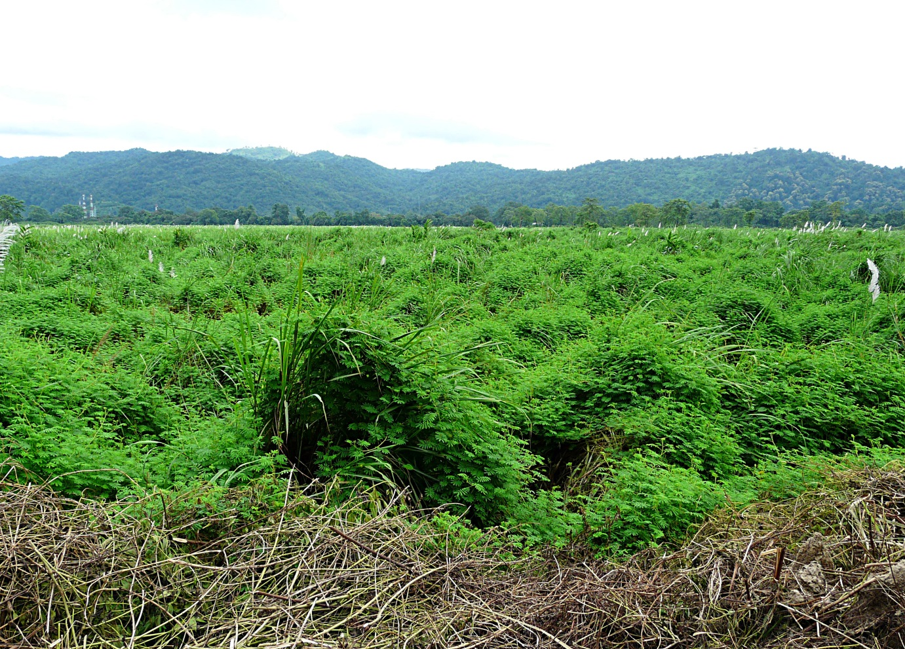
Figure 16.11
Invasion of exotic weeds of Mimosa spp., has destroyed a chunk of habitat in areas such as Kaziranga National Park.

