Slide 1
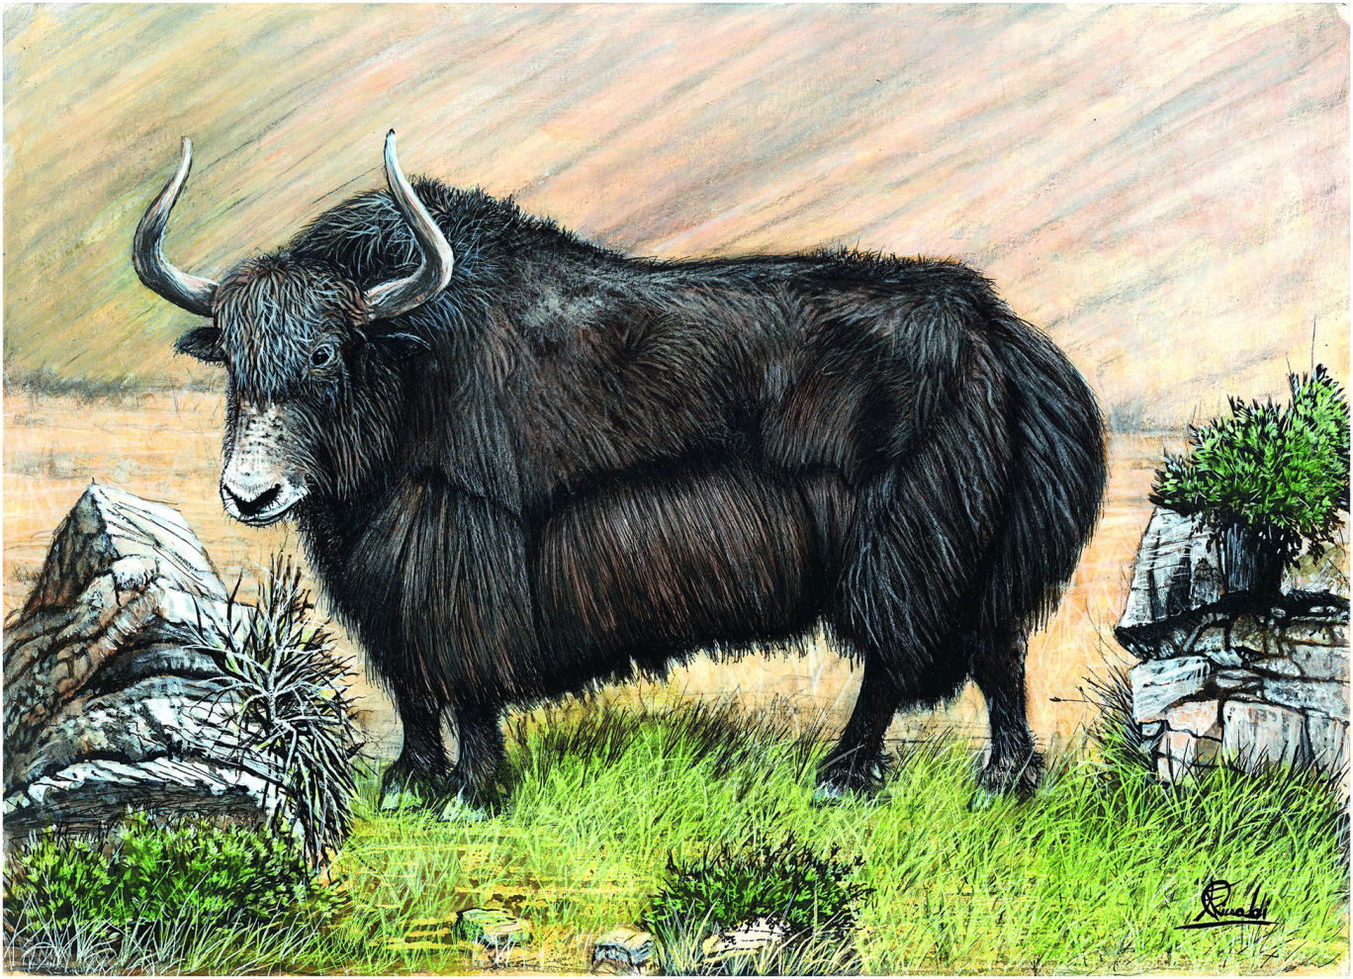
Plate 15
Wild yak (illustration by Francesco Rinaldi)

Slide 2
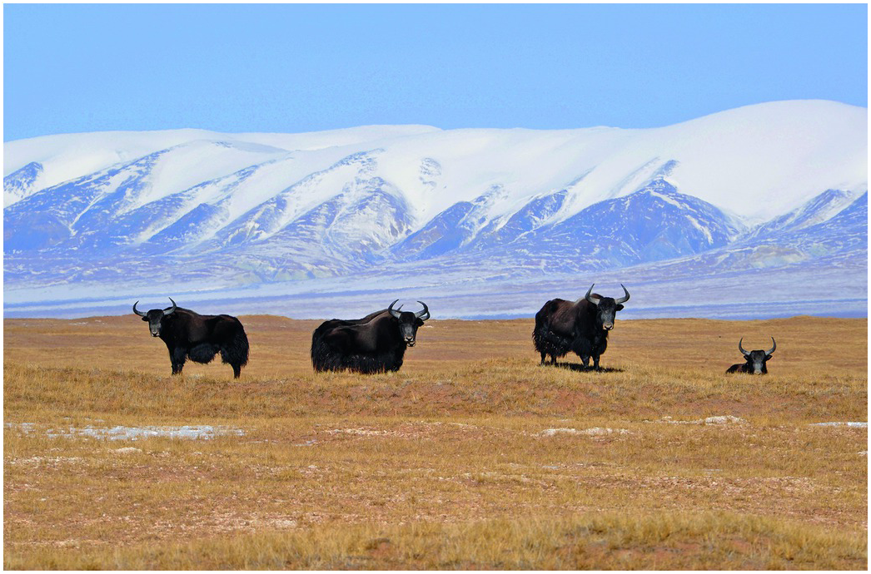
Figure 12.1
A group of wild yak around Budongquan station (elevation at 4611 meters above sea level). Photo was taken in Kekexili Nature Reserve, western Qinghai, China in late November 2009 (Photo by Damin He).

Slide 3
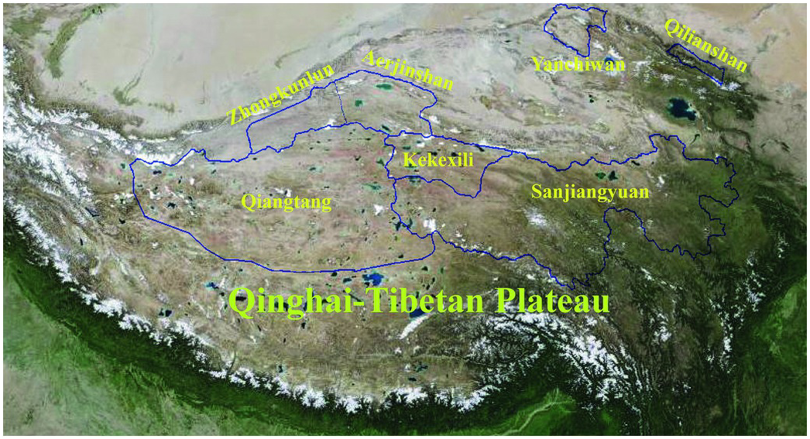
Figure 12.4
Geographic localities and relative sizes of the six major nature reserves where the majority of wild yak are distributed in China.

Slide 4
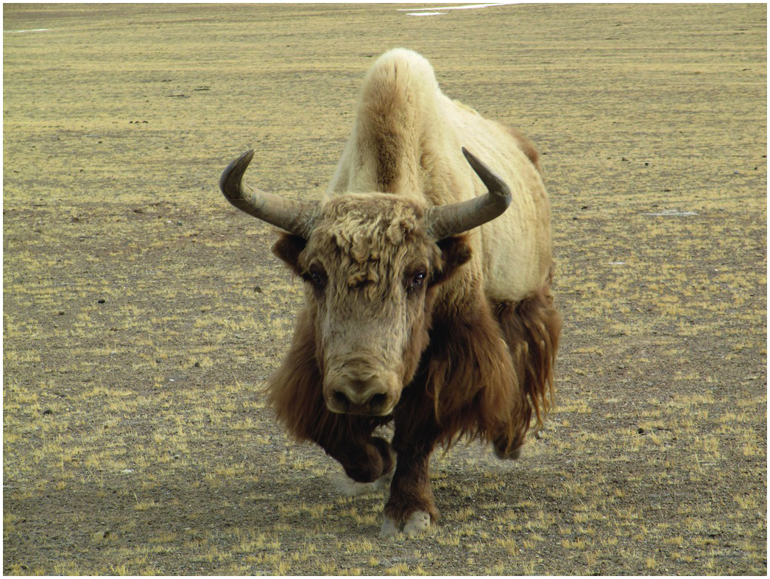
Figure 12.5
A wild yak bull with an atypical light coat in Qiangtang Nature Reserve. Photo was taken in Ritu, Tibet, China in March 2010 (Photo by Yong Wang).

Slide 5
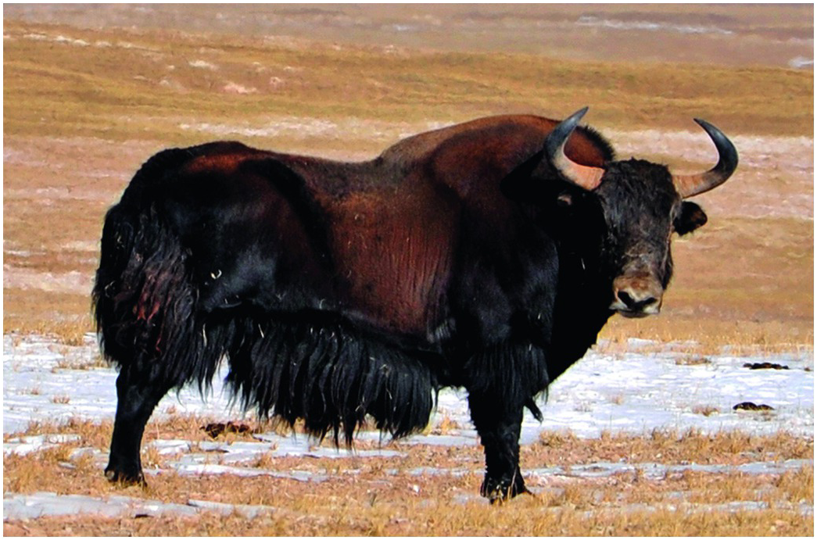
Figure 12.6
A wild yak bull in Kekexili Nature Reserve, western Qinghai, China in late November 2009 (Photo by Damin He).

Slide 6
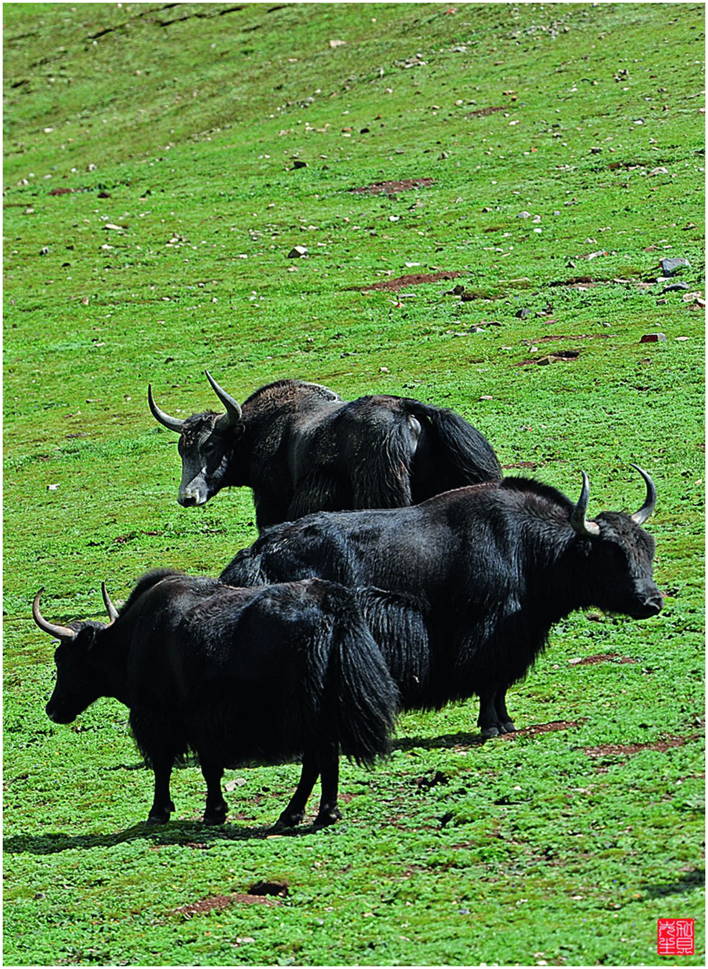
Figure 12.8
Semi-wild yak bulls in Zhiduo county of western Qinghai, China in August 2012 (Photo by Damin He).

