Slide 1
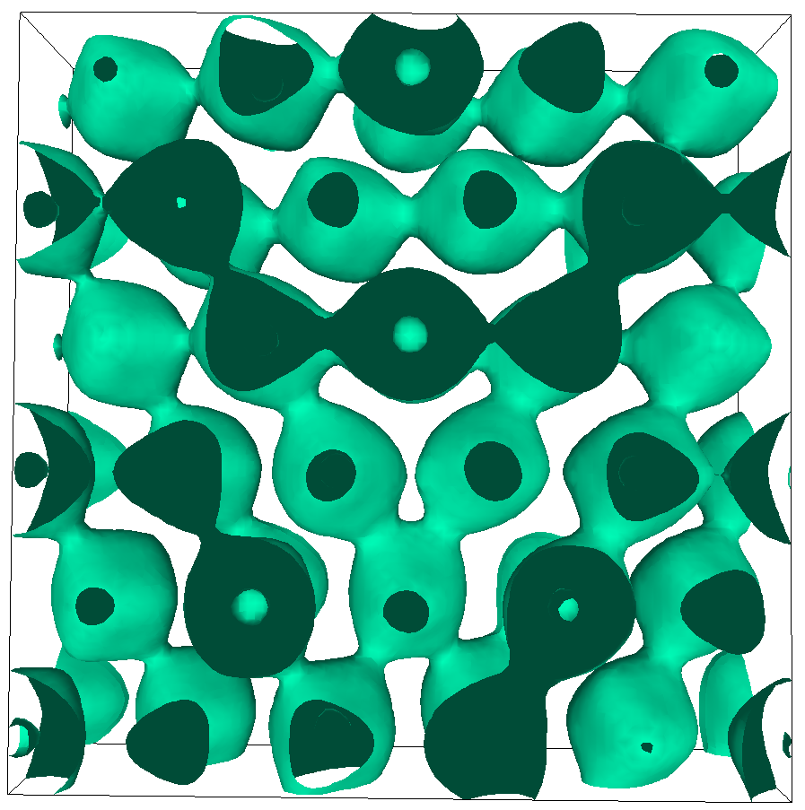
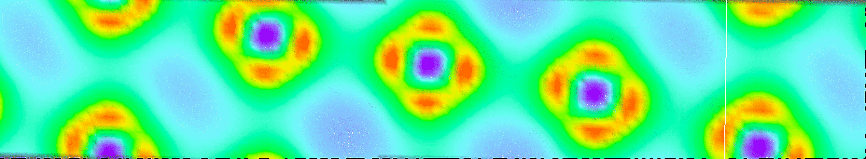

Slide 2
C
b₃
C₅
b₅
C₃
b₂
b₆
C₂
D
C₆
b₄
A
b₁
C₄
C₁
B
Notes:
2.54” x 3”, tiff.

Slide 3
R
R−r
r
(2)
(1)
Notes:
3.11” x 3”, tiff.

Slide 4
(2)
b/[2 sin(θ/2)]
θ
b
b/[2 sin(θ/2)]
(1)
Notes:
2.82” x 3”, tiff.

Slide 5
Plane 2
(x₃ = 0)
e₍₂₎
y
disl. 2
ξ₂
y₁
dy
y₂
b₂
Plane 1
(x₃ = z)
O
e₍₁₎
θ
z
e₍₃₎
R = x_{α}e_{α}
O'
disl. 1
x₁
x
x₂
b₁
dx
ξ₁
Notes:
2.04” x 3”, tiff.

Slide 6
ξ₂
y₁
dy
y₂
y
η
e₂
x₁
dx
x₂
x
ξ₁
Notes:
1.93” x 4”, tiff.

Slide 7
y
dl
R
R'
ϕ
dl₀
ϕ₀
x
b
ξ
Notes:
3.12” x 3”, tiff.

Slide 8
y
B
C
ξ
A
D
x
b
F
L
E
Notes:
2.59” x 3”, tiff.

Slide 9
C
ξ
L'/2
E
A
ϕ
B
b
F
M
L
M
Notes:
1.18” x 4”, tiff.

Slide 10
L
L
C
D
A
B
E
F
M
2L
M
Notes:
1.64” x 3”, tiff.

Slide 11
b
A
B
(a)
y
A
δn
B
x
dl
dl
S⁻
R
S⁺
dθ
dθ
(b)
Notes:
3.47” x 3”, jpg.

Slide 12
δx
θ
Notes:
2.3” x 3”, tiff.

Slide 13
z
n
ϕ
b
ξ
y
x
Notes:
2.98” x 3”, tiff.

