Slide 1
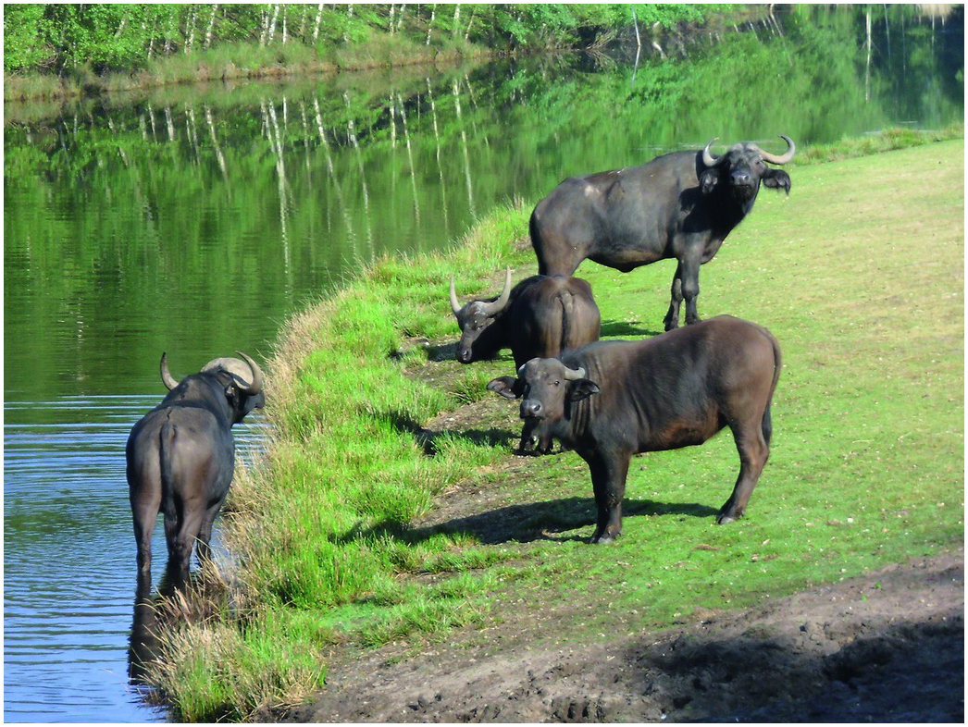
Figure 27.2
African buffalo (Syncerus caffer caffer) held in Safaripark Beekse Bergen – Hilvarenbeek (Photo by Rolf Veenhuizen, Safaripark Beekse Bergen, Hilvarenbeek).

Slide 2
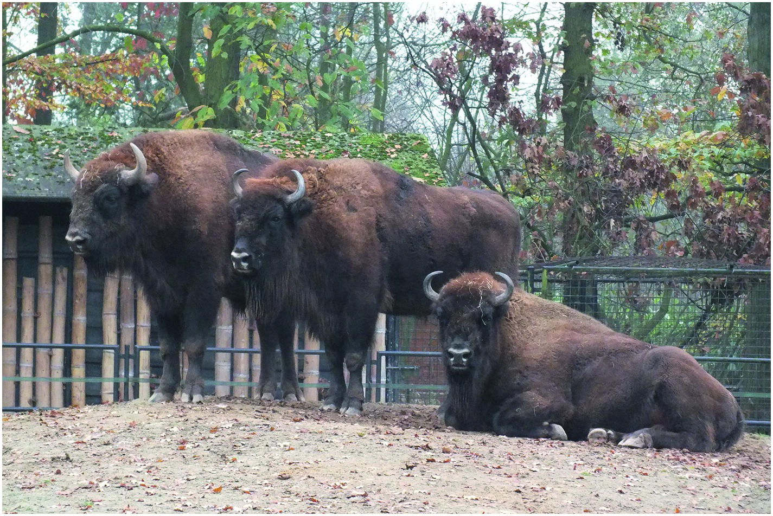
Figure 27.3
European bison (Bison bonasus) held in Dierenpark Planckendael – Mechelen
(Photo by H. Schram, Antwerp).

Slide 3

Figure 27.4
EAZA/IUCN SCC Southeast Asia campaign logo.

Slide 4
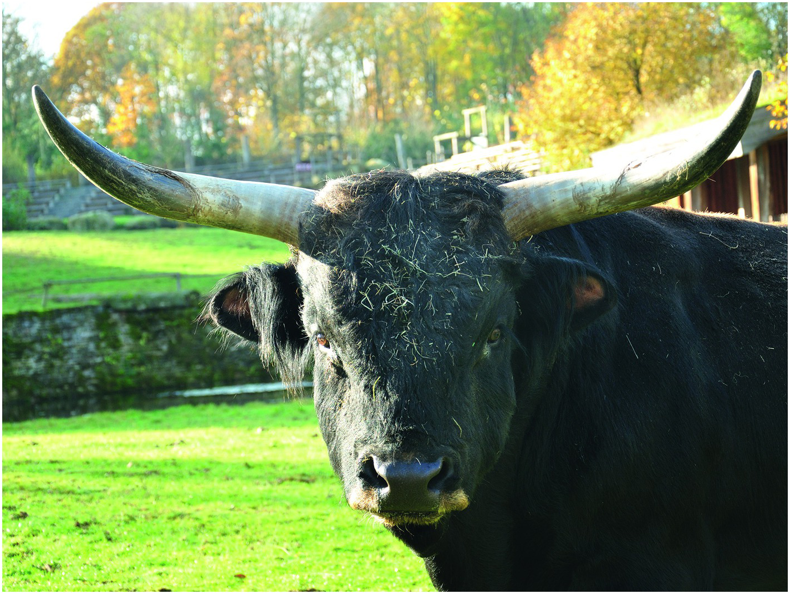
Figure 27.5
Re-created Aurochs held at Gaiazoo Kerkrade, the Netherlands
(Photo by Gaiazoo Kerkrade).

