Slide 1
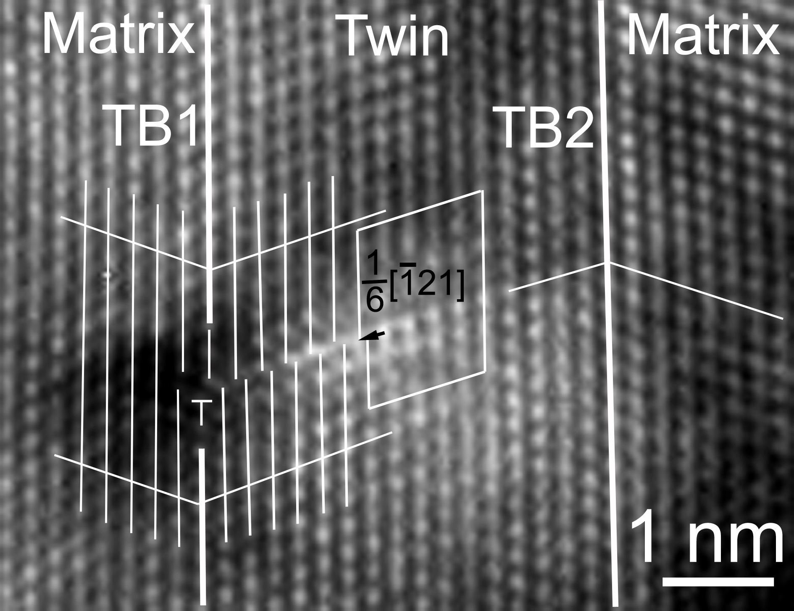
matrix
twin

Slide 2
Notes:
1.61” x 3”, tiff.

Slide 3
K₂
η₂
η₁
s
K₁
Notes:
1.61” x 3”, jpg.

Slide 4
K₁
η₁
η₂
(a)
(b)
Notes:
1.15” x 5”, tiff.

Slide 5
ξ
b₂
b₁
b₂
η₁
b₁
(a)
(b)
Notes:
1.95” x 5”, tiff.

Slide 6
(a)
(d)
(b)
(c)
Notes:
4.75” x 5”, jpg.

Slide 7
x
z
x', y'
z
z
(a)
(b)
O
(c)
O
y
x, y
x, y
z'
Notes:
1.52” x 5”, jpg.

Slide 8
(112)
(a)
(b)
A
B
(c)
C
D
Notes:
2.68” x 5”, tiff.

Slide 9
A
F
F
E
(a)
E
D
D
C
C
B
B
A
A
A
D
F
F
C
E
(b)
3
E
B
D
1
D
2
C
C
C
4
B
B
B
A
A
A
A
E
F
6
5
F
D
E
(c)
1
E
C
D
3
4
D
D
C
2
C
C
B
B
B
A
A
A
Notes:
5.6” x 5”, jpg.

Slide 10
sessile
b = C'A
Notes:
3.07” x 5”, tiff.

Slide 11
[0001]
sessile
b
(a)
(b)
Notes:
1.61” x 5”, tiff.

Slide 12
δA
Aγ
Bδ
BA
δγ
αC
αC
BC/Aα
δα/BC
γα/BC
Bδ
(a)
(b)
δA
A
Aδ
AC
Aγ
αA
C
D
B
δC
δα
γδ
γα
Cα
(c)
(d)
Cα
Notes:
4.26” x 5”, tiff.

Slide 13
(112)
Notes:
2.57” x 3”, tiff.

Slide 14
b = [001]
(a)
(b)
dipole
(c)
(d)
Notes:
2.25” x 5”, tiff.

Slide 15
αδ
αδ
δA
Dα
δA
Dα
Bδ
αB
Bδ
αδ
δA
Dα
δA
Dα
Bδ
αB
Bδ
αδ
δA
Dα
δA
δB
Dα
δB
Notes:
2.08” x 5”, tiff.

Slide 16
[112]
(a)
(b)
z
y
z
(c)
x
C
(d)
A
B
x
y
Notes:
4.11” x 5”, tiff.

Slide 17
emissary
slip traces
sub-boundary
h
twin
Notes:
1.23” x 3”, tiff.

Slide 18
surface
accom.
band
twin
Notes:
1.64” x 3”, tiff.

Slide 19
Parent
Twin
[111]
Parent
(a)
(b)
σ
σ
(c)
Notes:
4.96” x 3”, tiff.

Slide 20
Twin
[111]
(a)
(b)
Notes:
1.24” x 5”, tiff.

