Slide 1
Photo-Acoustic Spectroscopy with DFB Lasers
Principles and Techniques

Slide 2
Acoustic Wave Equation
where p is the gas pressure and H(v,t) is the rate of heat generation per unit volume in the gas through absorption:
where I(ν,t) is the intensity which is function of time with intensity modulation of the laser, C is the gas concentration, α(ν) is the absorption coefficient and ν is a function of time with laser wavelength modulation.

Slide 3
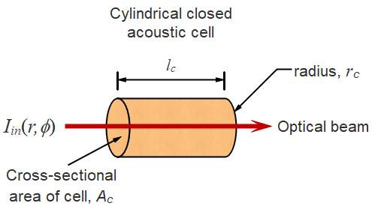
Non-Resonant Solution for a Closed Photo-Acoustic Cell
Non-resonant solution of wave equation with laser power modulated at frequency ω_{m}:
where τ_{th} is the thermal damping time and ΔP is the amplitude of the laser power modulation.

Slide 4
Acoustic Resonant Modes of Cells
The spatial distribution of an acoustic mode is characterised by the integers (l, m, q):
where the resonant frequency is given by:

Slide 5
Approximate values of α_{lm}
α_{lm} is the l^{th} value of (x/π) for which:
 | m=0 | m=1 | m=2
l=0 | 0 | 0.59 | 0.97
l=1 | 1.22 | 1.70 | 2.13
l=2 | 2.23 | 2.72 | 3.17

Slide 6
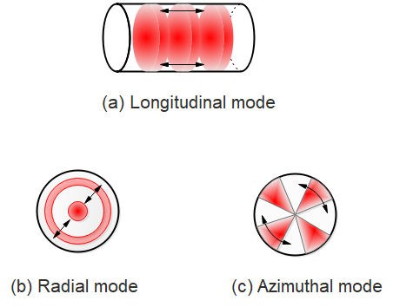
Acoustic Modes Showing Direction of Acoustic Vibrations

Slide 7
Excitation of Acoustic Modes with a Current-Modulated DFB Laser Source
The heat generation function, taking into account both the intensity and wavelength modulation from the DFB laser is:
where the harmonic components are given in terms of the Fourier coefficients as:

Slide 8
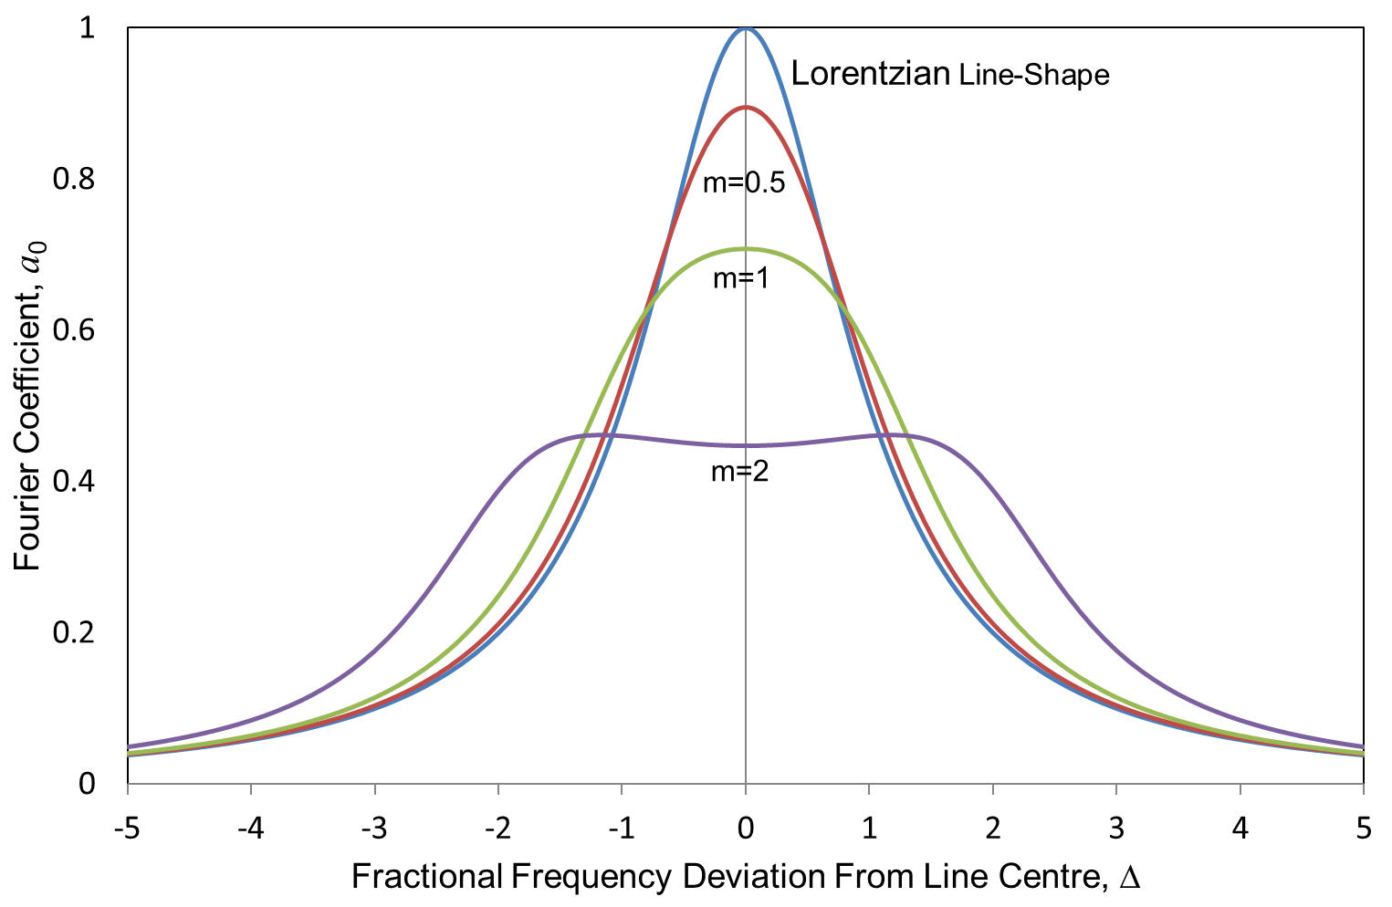
Fourier Coefficient a₀

Slide 9
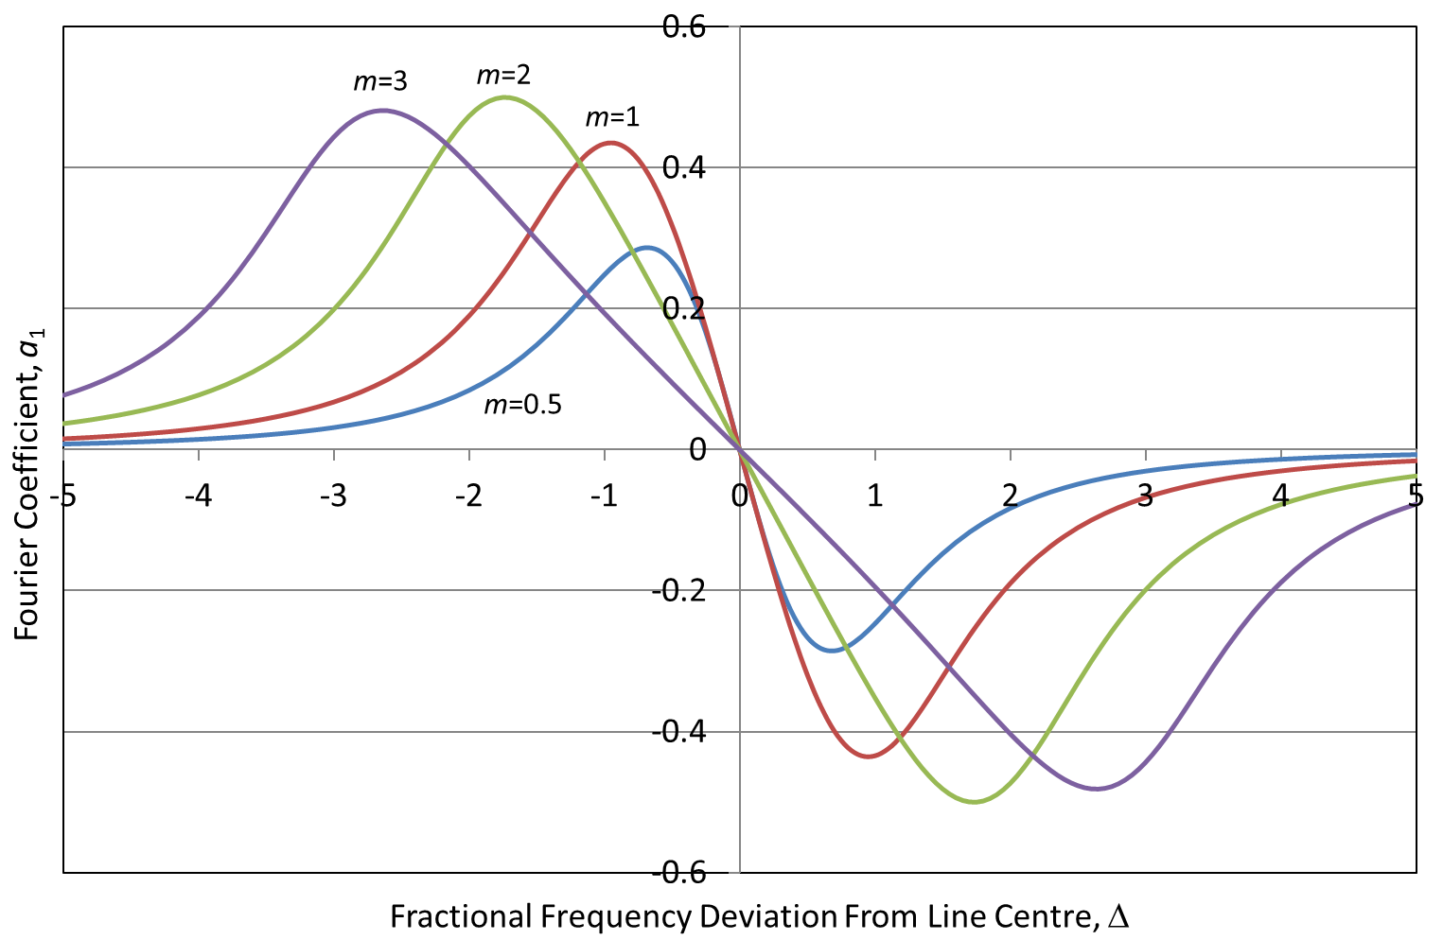
Fourier Coefficient a₁

Slide 10
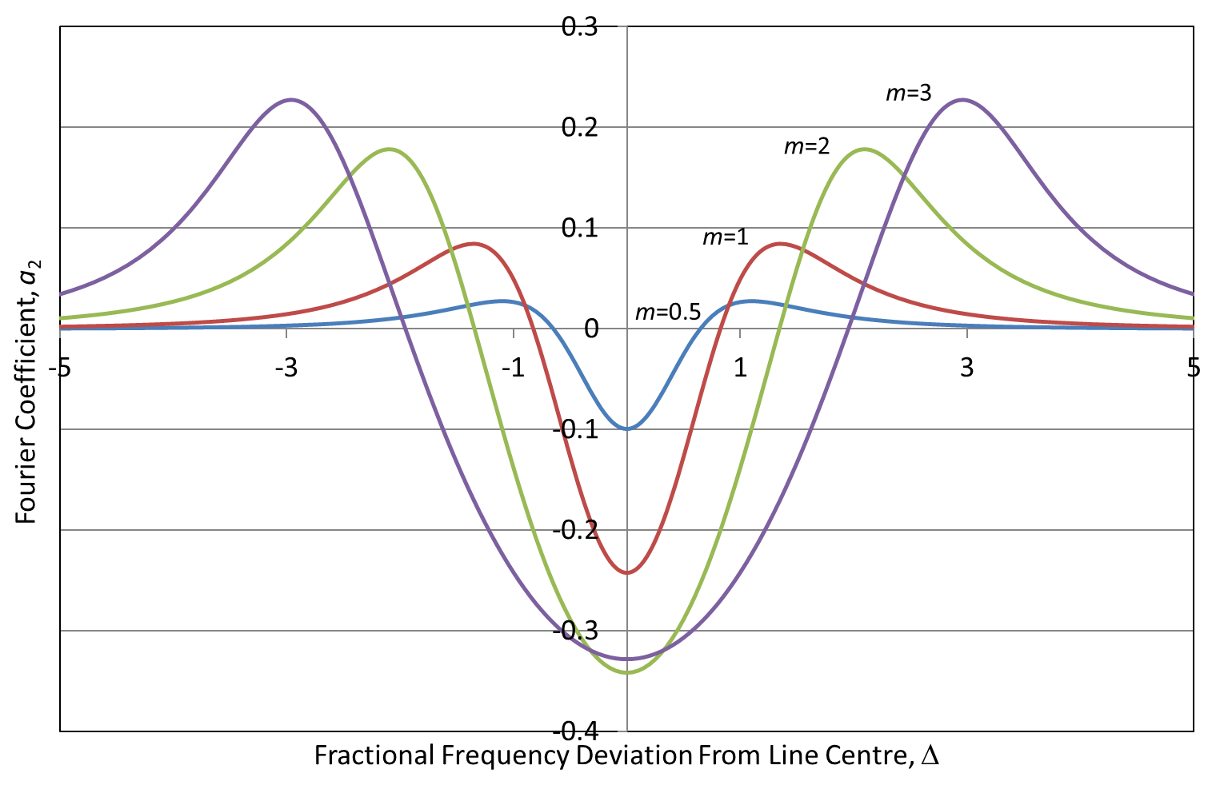
Fourier Coefficient a₂

Slide 11
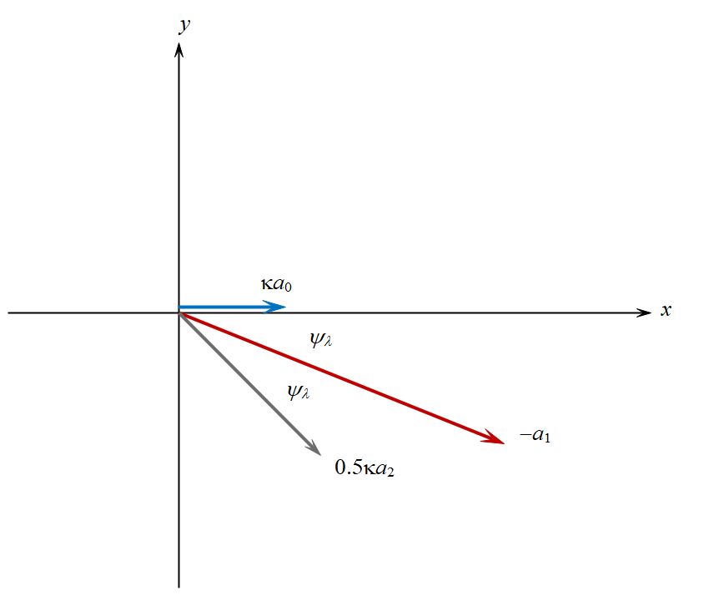
Phasor Components of 1st Harmonic

Slide 12
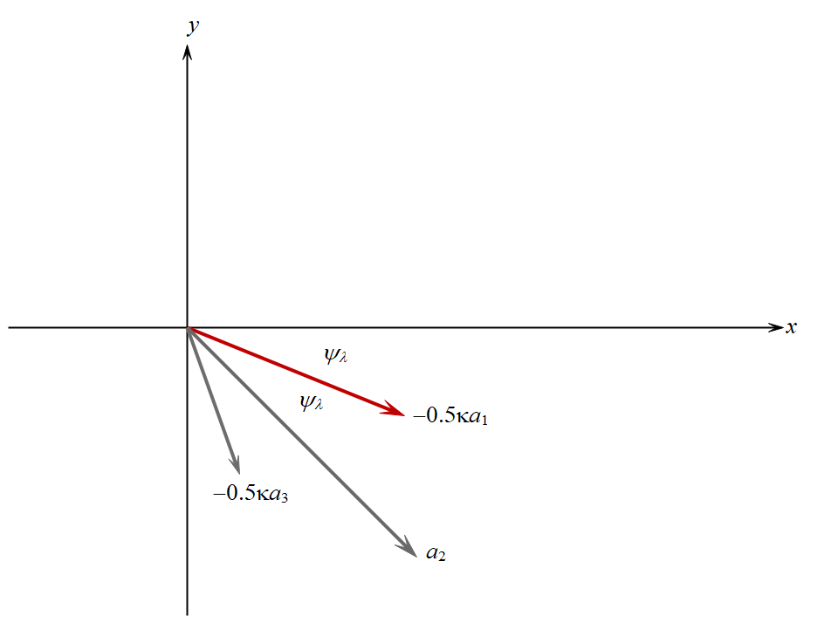
Phasor Components of 2nd Harmonic

Slide 13
Amplitude of Acoustic Modes Excited by the Harmonics of the Heat Generation Function
In general, the amplitude of the k^{th} acoustic mode of the cavity excited by the n^{th} harmonic of the modulation frequency is:
where Q_{k} is the Q-factor for the k^{th} mode and Δ_{kn} is the deviation of the n^{th} harmonic from the k^{th} resonant frequency:
F_{k} is the (dimensionless) spatial overlap of the optical intensity distribution with the acoustic mode distribution:

Slide 14
Open-Ended Photo-Acoustic Resonator with Buffer Regions
Odd order (q=1, 3, 5,….) pure longitudinal modes may be excited in the open ended resonator with the following parameters:
l_{c}
Resonant frequency:
where:
Overlap factor:

Slide 15
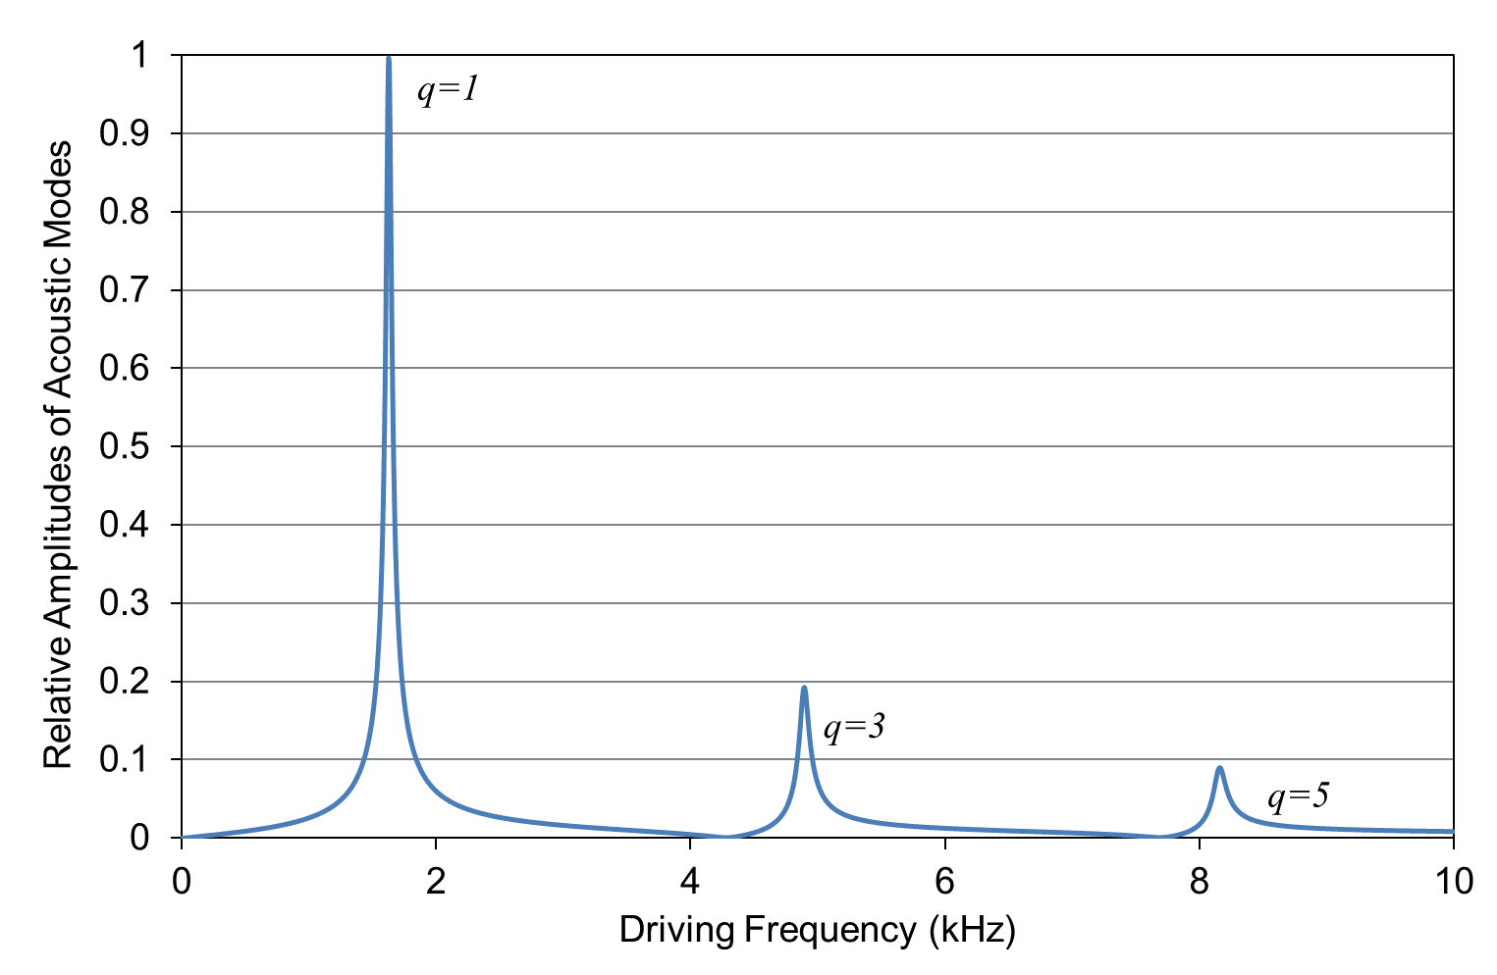
Relative Amplitudes of Longitudinal Modes in Open-Ended Resonator
100mm length & 3mm radius resonator cell
If the modulation frequency for the DFB laser is set at the q=1 resonant frequency of the cell, then the typical acoustic signal amplitudes generated in the cell are:

Slide 16
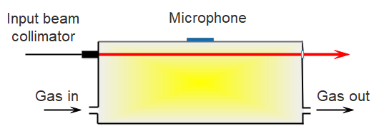
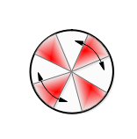
Azimuthal Acoustic Mode Excitation Using an Off-Axis Beam

Slide 17
Radial Acoustic Mode Excitation
Typical amplitude of the radial mode generated with a 20mm radius, 100mm length acoustic cell at a 10kHz resonant frequency:

Slide 18
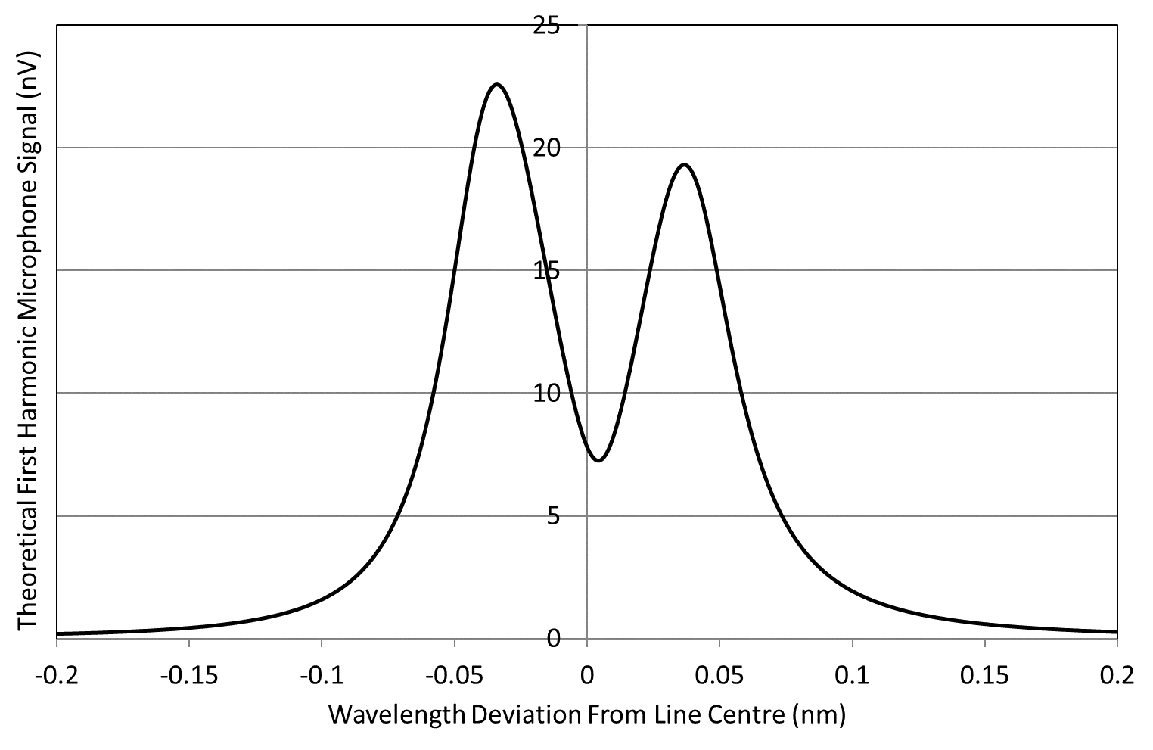
Typical Magnitude of 1st Harmonic Signal for 100ppm CO₂ (1572.3nm absorption line, half-linewidth of 2.5GHz)
Miniaturised photoacoustic cell: resonator length of ~10mm and radius of 1mm.
1st order longitudinal mode resonance at ~15kHz, microphone sensitivity 12.6mV/Pa.
DFB laser modulation frequency set to the resonance frequency.

Slide 19
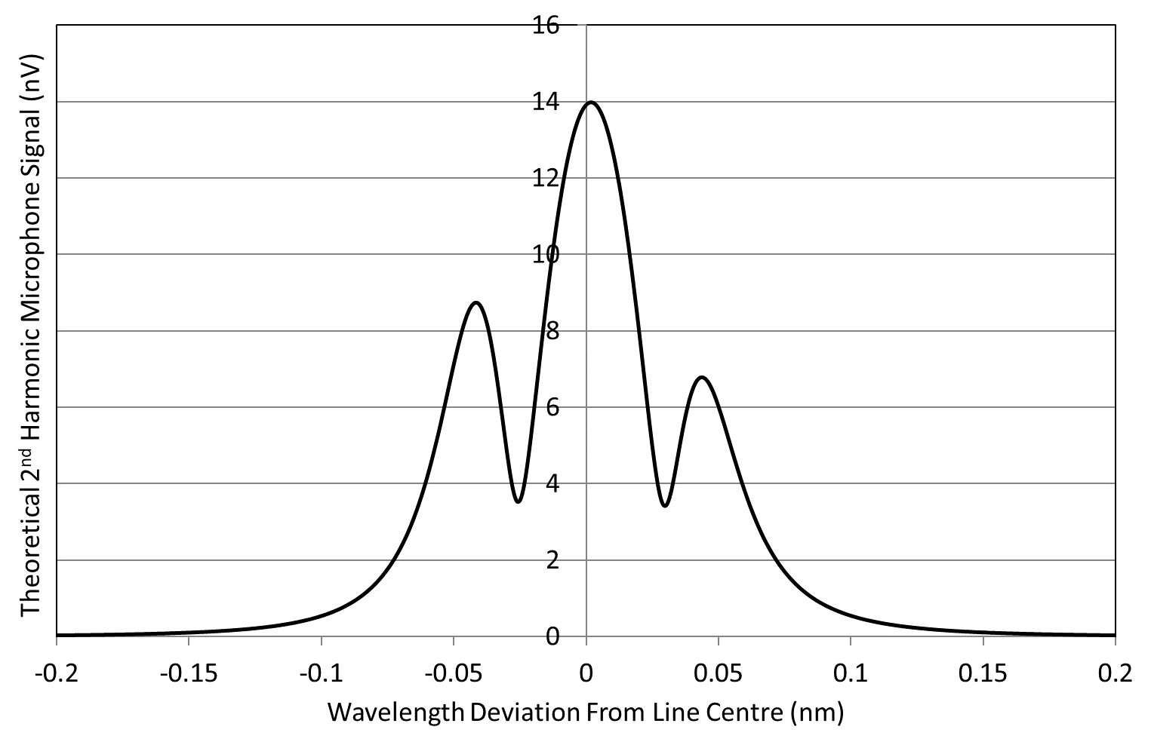
Typical Magnitude of 2nd Harmonic Signal for 100ppm CO₂ (1572.3nm absorption line, half-linewidth of 2.5GHz)
Miniaturised photoacoustic cell: resonator length of ~10mm and radius of 1mm.
1st order longitudinal mode resonance at ~15kHz, microphone sensitivity 12.6mV/Pa.
DFB laser modulation frequency set to half the resonance frequency.

Slide 20
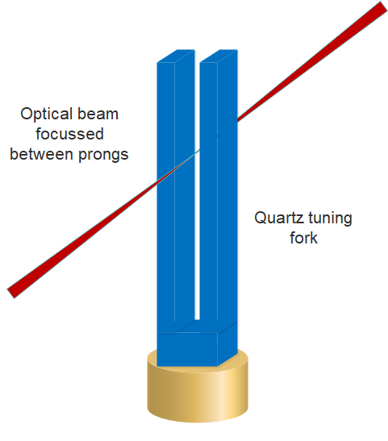
Quartz-enhanced photoacoustic spectroscopy (beam focussed between prongs of tuning fork)
In QEPAS, the acoustic cell and microphone are replaced by a quartz tuning fork

Slide 21
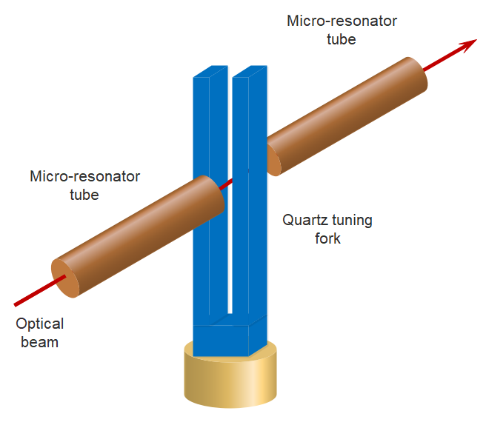
Quartz-enhanced photoacoustic spectroscopy (with micro-resonator tubes)
The QEPAS signal may be enhanced by the use of micro-resonator tubes

Slide 22
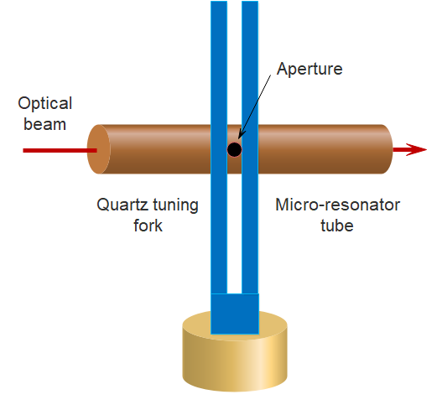
Quartz-enhanced photoacoustic spectroscopy (micro-resonator tube with aperture)

Slide 23
Summary & Conclusions
The excitation of acoustic modes in photoacoustic cells and the theoretical harmonic signals generated from gas absorption through modulation of DFB laser sources have been derived from first principles.
High sensitivity can be achieved with PAS by use of high optical powers in contrast to standard WMS which is limited by detector saturation.
Also, in contrast to standard WMS, PAS has a low first harmonic background level.
However, referencing and calibration present greater challenges with PAS compared with standard WMS.

