Slide 1
DFB Lasers for Near-IR Spectroscopy
Wavelength Tuning & Modulation Properties

Slide 2
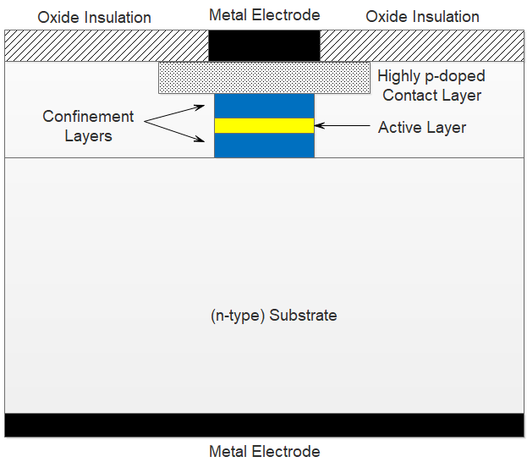
Buried Double Heterostructure (BDH) Laser Diode

Slide 3
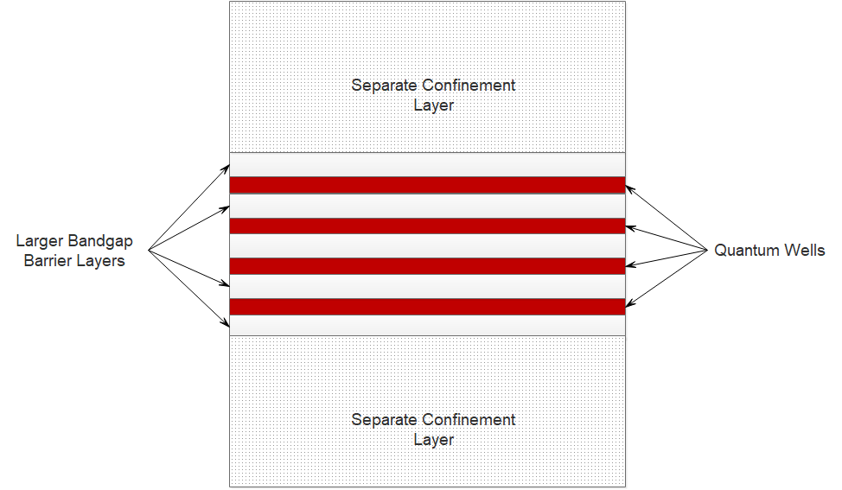
Multiple Quantum Well Laser Diode Separate Confinement Heterostructure

Slide 4
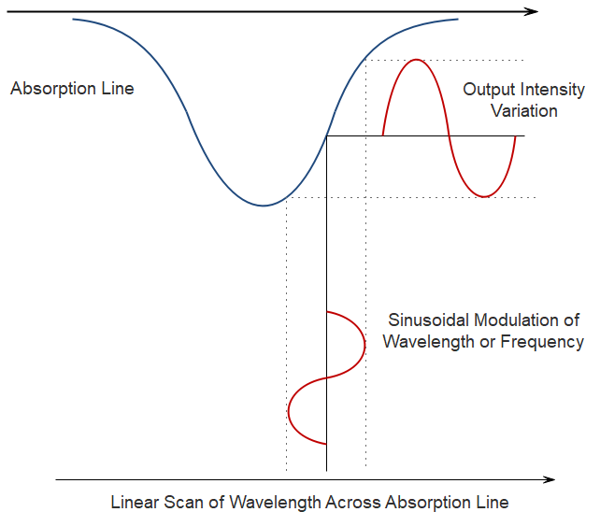
Wavelength Modulation Spectroscopy
Contains fundamental and harmonics of the modulation frequency

Slide 5
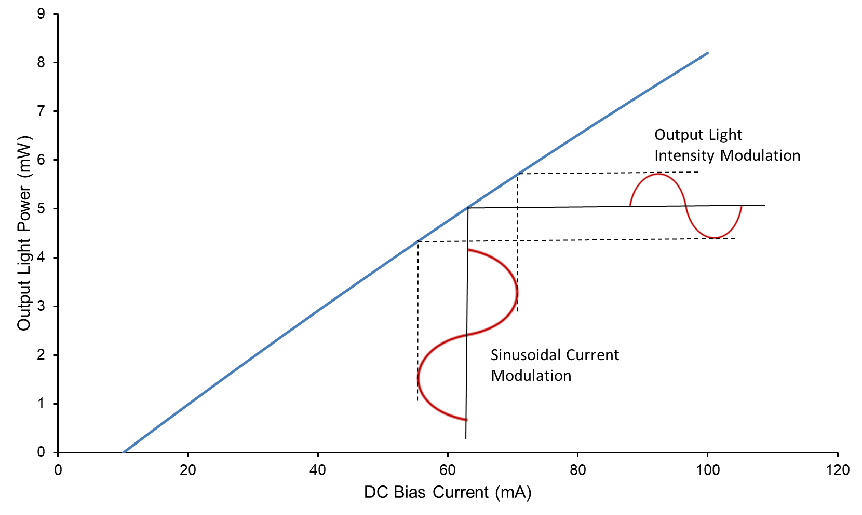
Light vs Intensity Curve of Laser Diode Current & Intensity Modulation
Slightly non-linear curve
i_{m}
I_{b}

Slide 6
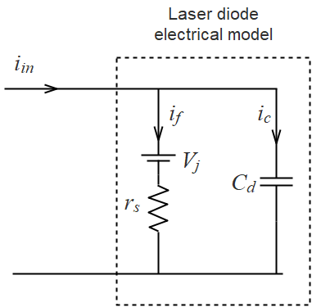
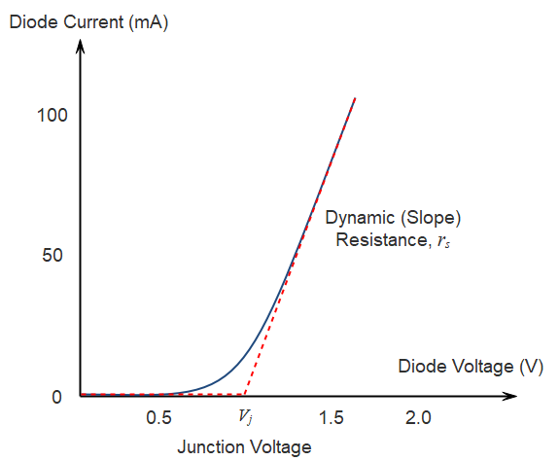
Electrical Characteristics of Laser Diode
For r_{s}~5Ω, C_{d} ~1nF, then φ <0.2⁰ for f <100kHz

Slide 7
Electrical Power Dissipated as Heat
Using
for the forward voltage, v_{f}
With the forward current i_{f} consisting of a bias current I_{b} and a modulation current i_{m}:

Slide 8
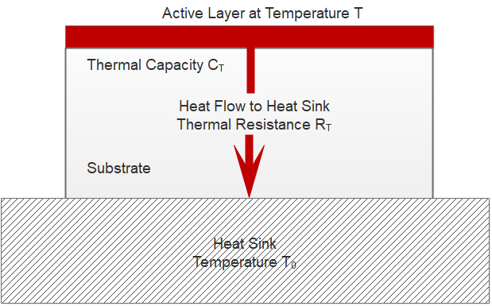
RC Model of Heat Flow in Laser Diode

Slide 9
Relationship of Temperature Change to Change in Output Wavelength
A change in the laser temperature changes the physical length of the laser cavity or the grating period and also changes the refractive index. As a result, the output wavelength is changed according to:
where α_{l} and α_{n} are the thermal linear expansion and refractive index coefficients.
Typically:

Slide 10
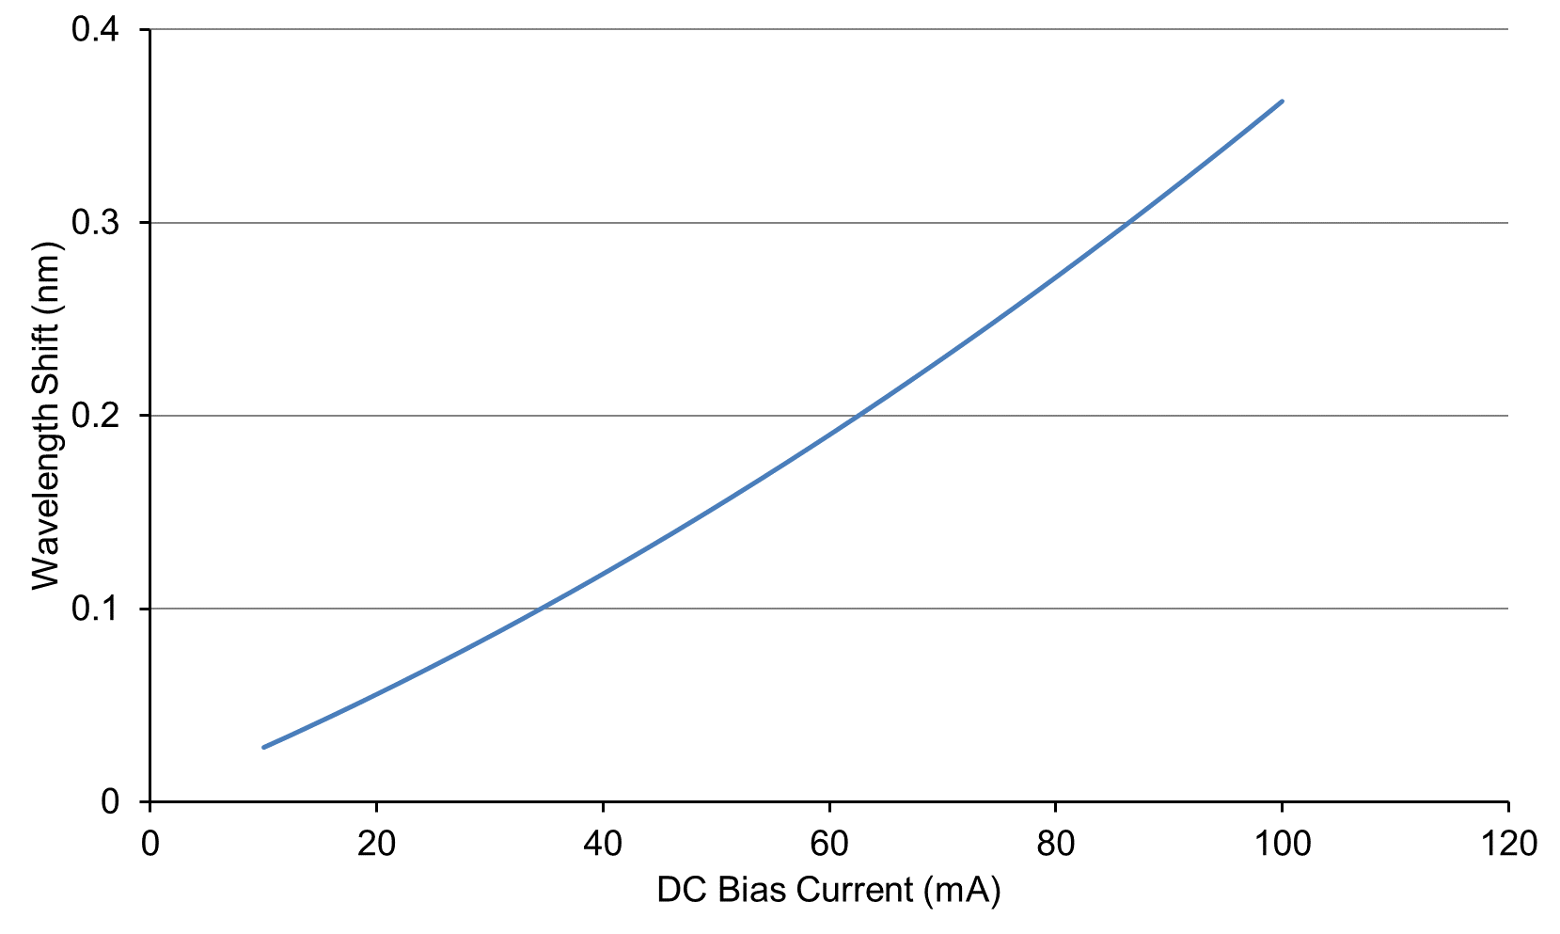
DC Thermal Tuning Characteristic

Slide 11
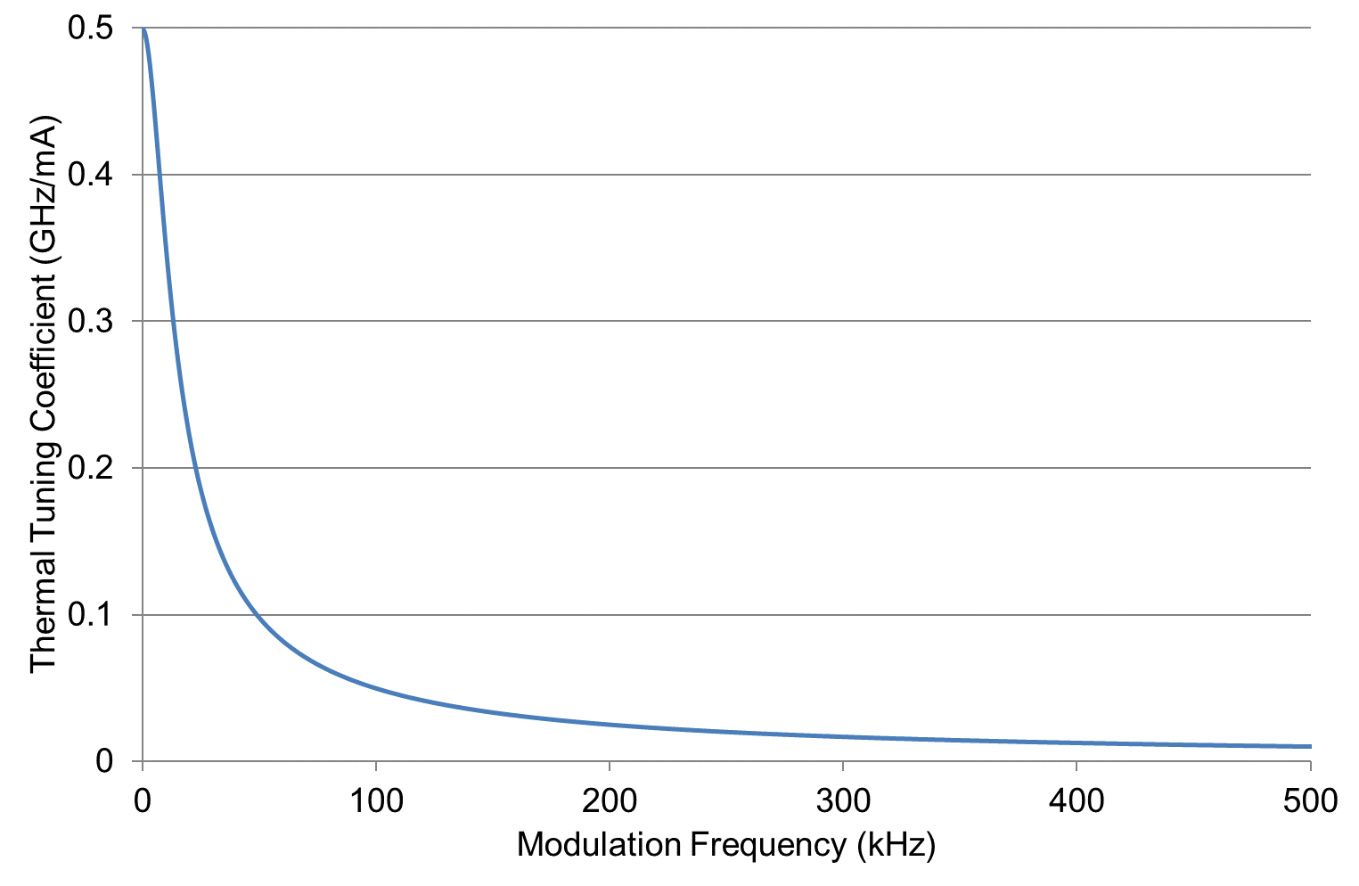
Thermal Tuning Coefficient (RC Model)

Slide 12
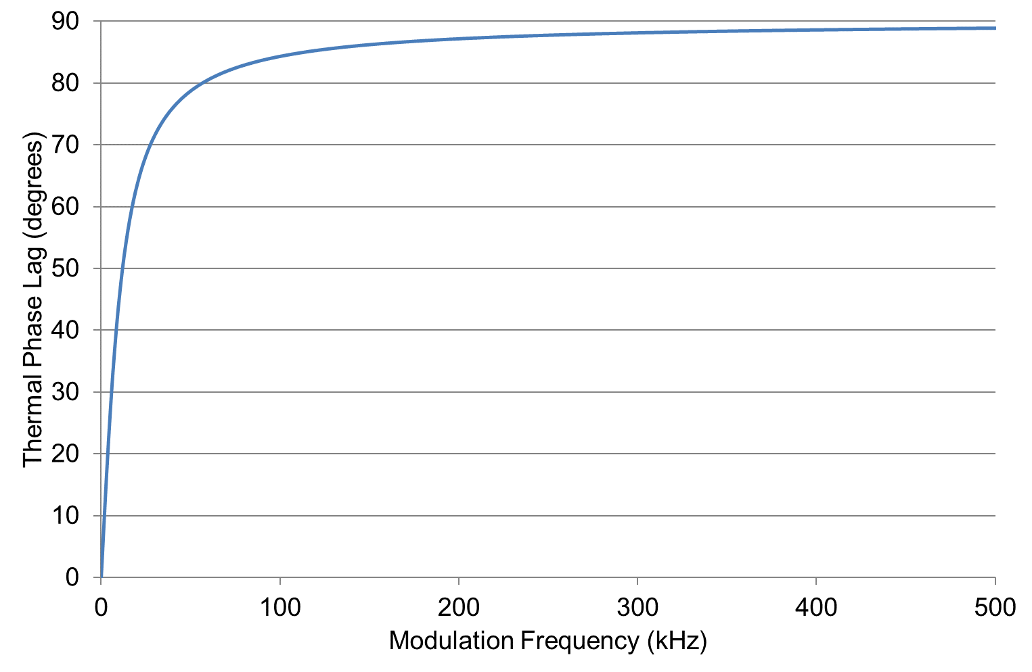
Thermal Phase Lag (RC Model)

Slide 13
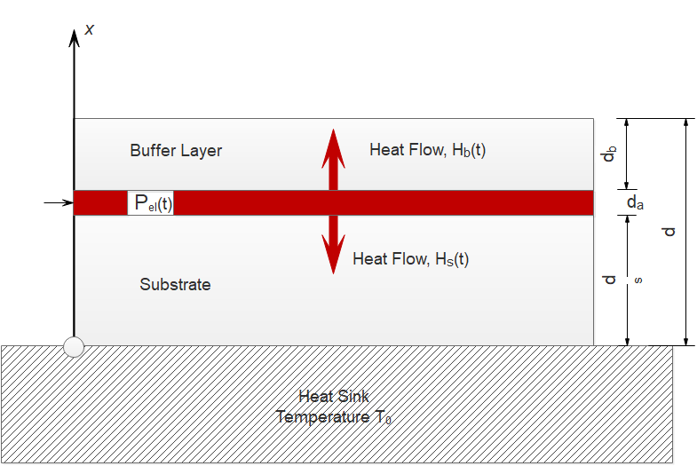
1-D Solution of the Heat Conduction Equation

Slide 14
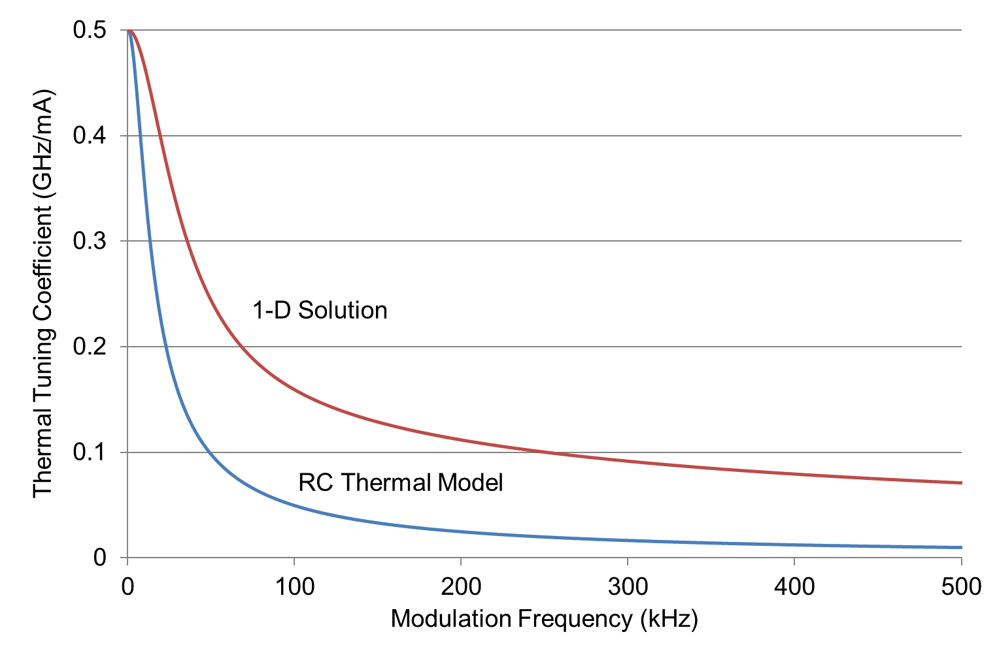
Comparison of RC Model with 1-D Solution of Heat Conduction Equation

Slide 15
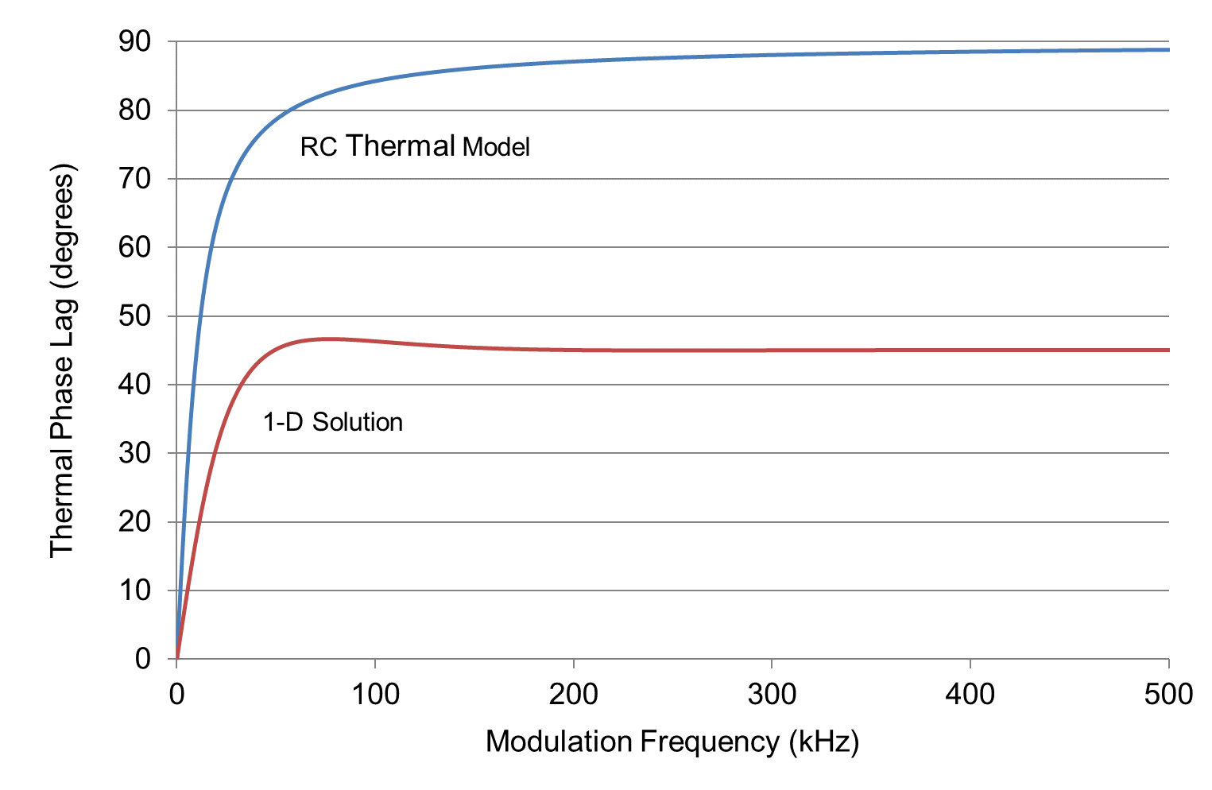
Comparison of RC Model with 1-D Solution of Heat Conduction Equation

Slide 16
Carrier Modulation & Tuning
When current modulation is applied to a laser diode, carrier density modulation results in modulation of the real part, n_{r}, of the refractive index of the active region which in turn causes modulation of the frequency of the output light.
There are two principal contributions to the carrier tuning coefficient:
Spectral hole-burning or gain compression: independent of the modulation frequency, typically ~10–100MHz/mA, in phase with the current modulation.
Spatial hole-burning: arises from the distribution of the carrier density along the laser cavity affecting the round-trip phase and the feedback losses of the cavity.
Fractional frequency shift
Perturbation in carrier density

Slide 17
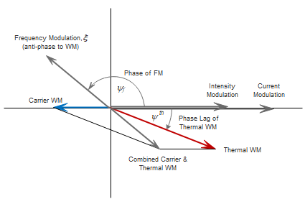
Relative Phase of the Various Modulations

Slide 18
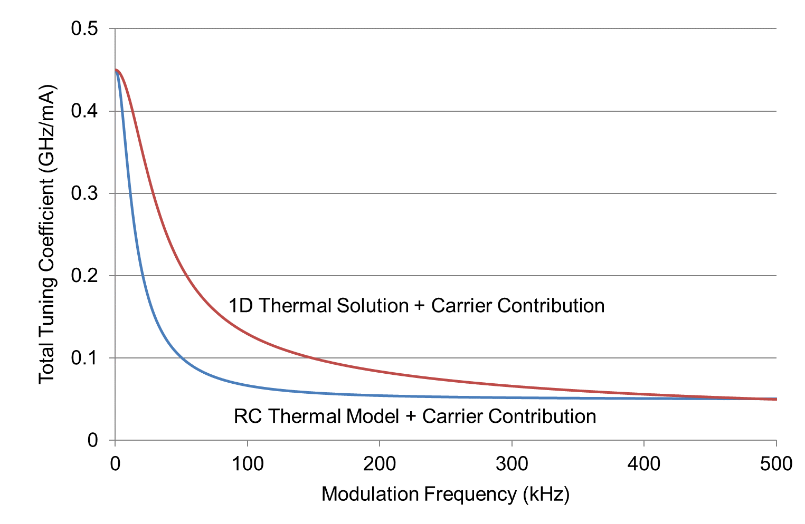
Total Tuning Coefficient (Thermal + Carrier Contributions)

Slide 19
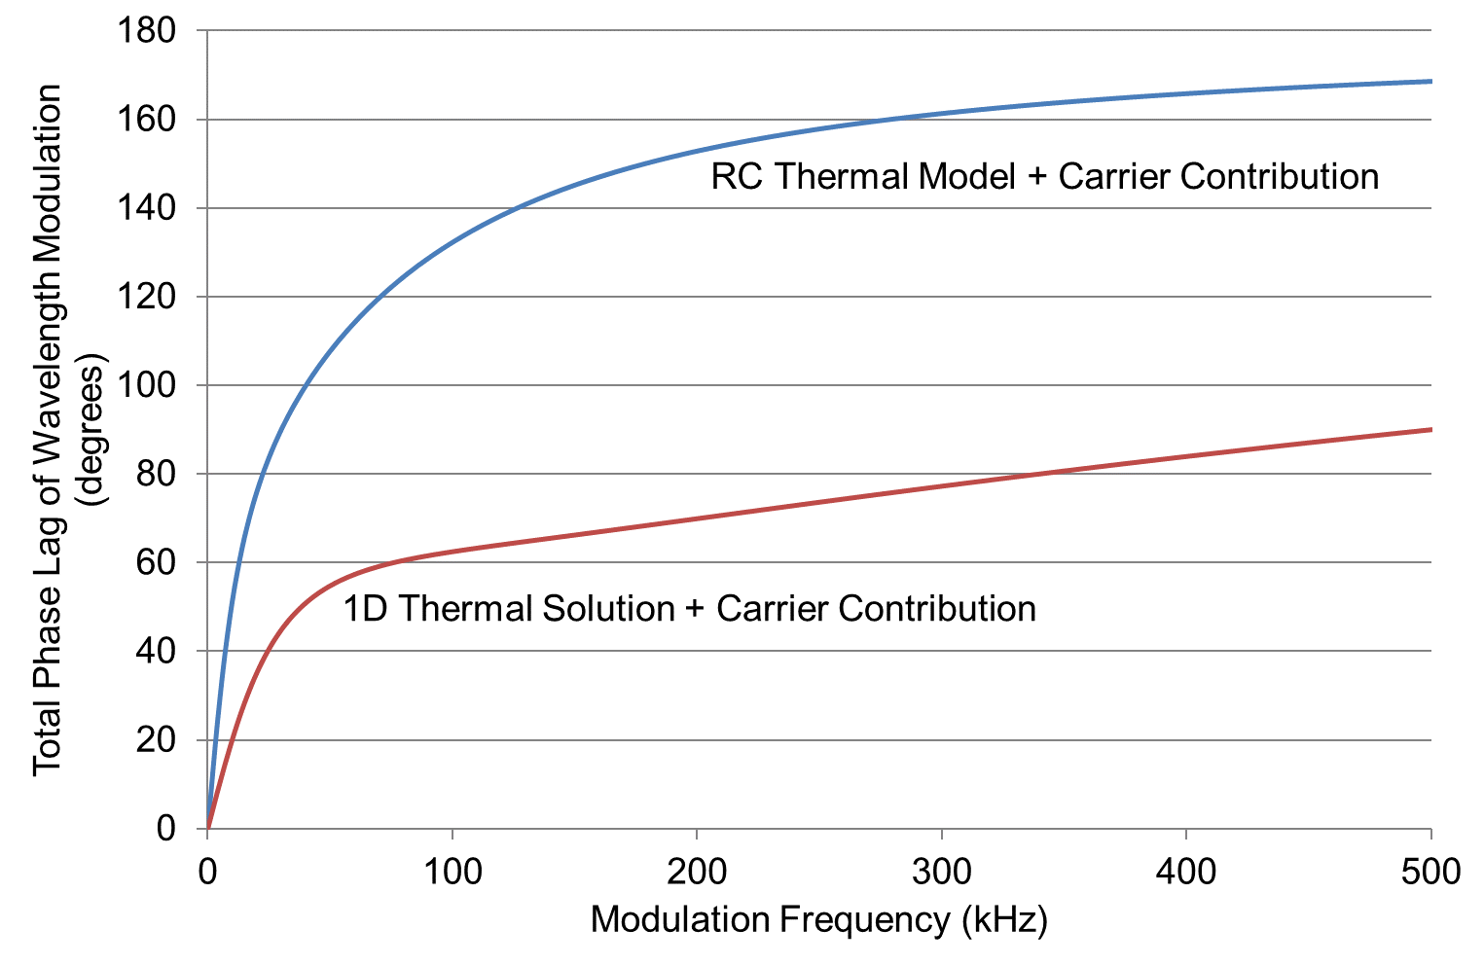
Total Phase Lag (Thermal + Carrier)

Slide 20
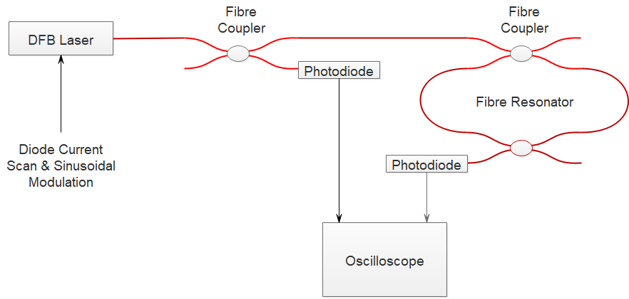
Fibre Ring Resonator for Measurement of Tuning Characteristics of DFB Lasers

Slide 21
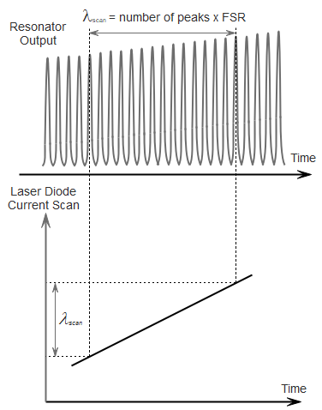
DC Wavelength Tuning from Linear Current Scan

Slide 22
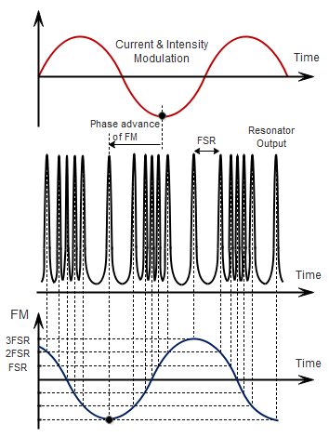
Measurement of the Magnitude and Phase of the Tuning Coefficient

Slide 23
Summary & Conclusions
Frequency modulation in DFB lasers arises from both thermal and carrier tuning effects.
There is a phase shift between the intensity and the frequency modulation due to the thermal lag, which is dependent on modulation frequency.
Knowledge of the magnitude and phase of the tuning coefficient is important in understanding the harmonic signals that are generated with WMS

