Slide 1
IMPORTANT – PLEASE NOTE:
These resources are provided free of charge by Cambridge University Press with permission of the authors of the corresponding work, but are subject to copyright. You are permitted to view, print and download these resources for your own personal use or for educational purposes, provided any copyright lines on the resources are not removed or altered in any way. Any other use, including but not limited to distribution of the resources in modified form, or via electronic or other media, is strictly prohibited unless you have prior permission from the authors of the corresponding work and the owners of the images displayed herein, and provided you give appropriate acknowledgement of the source.

Slide 2
NOTE TO USERS:
The simplified information included in this presentation is intended to compliment the accompanying CUP book on Glaciovolcanism by Smellie & Edwards. Please refer to the book for further details and information on references cited, etc

Slide 3
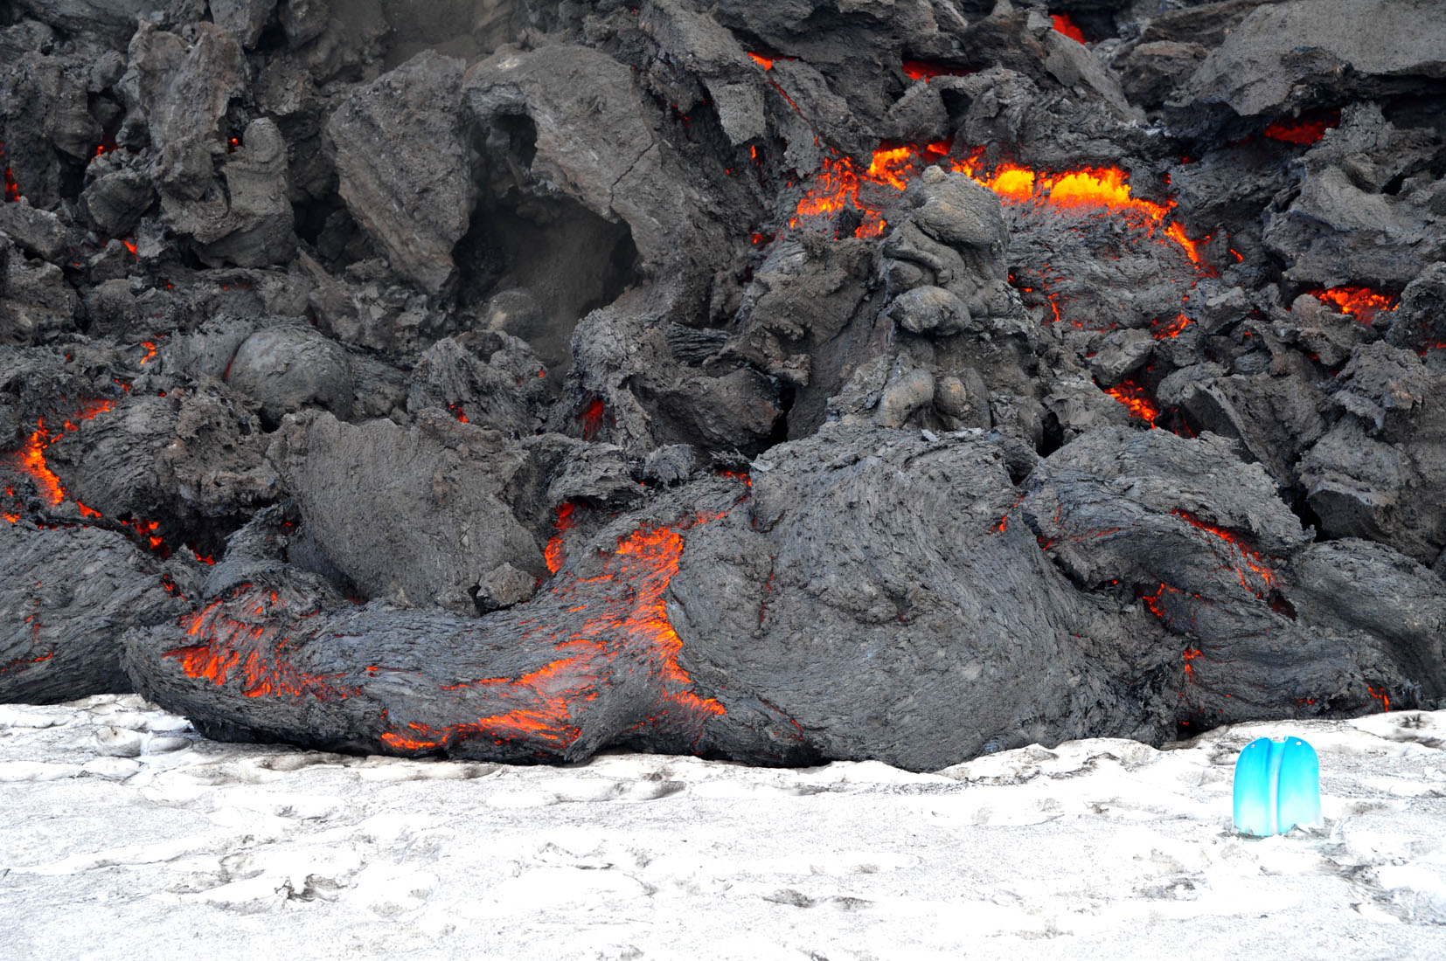
Constraints on interactions between lava flows and ice/snow
Shovel blade for scale
~15 cm wide
Image: Ben Edwards

Slide 4
TALK OUTLINE -
1. General constraints on lava-ice/snow interactions
2. Examples from recent eruptions
  Basaltic lava-snow interactions I (Fimmvorðuháls 2010)
  Basaltic lava-snow interactions II (Tolbachik 2013)
  Trachyandesite-ice interactions (Gigjökull 2010)
  Andesite-ice interactions (Veniaminof 2013)
3. Constraints from large-scale experiments
4. Influence of lava types versus extrusion rates

Slide 5
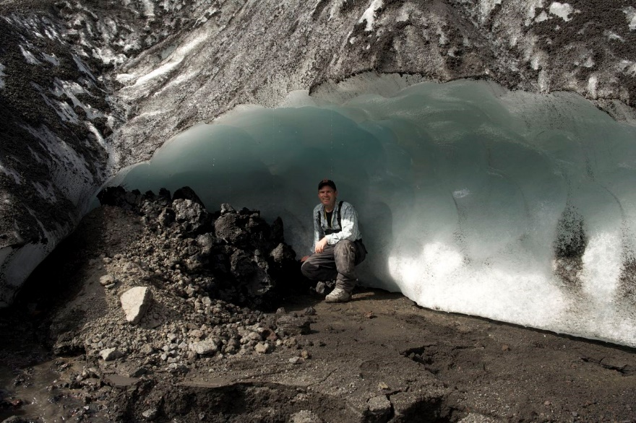
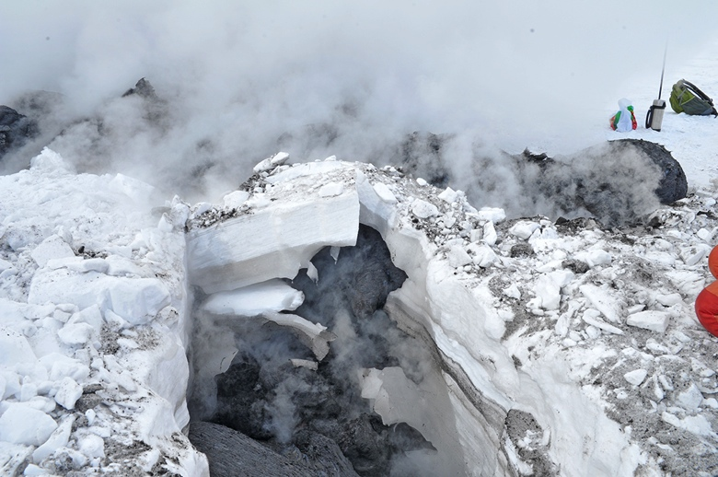
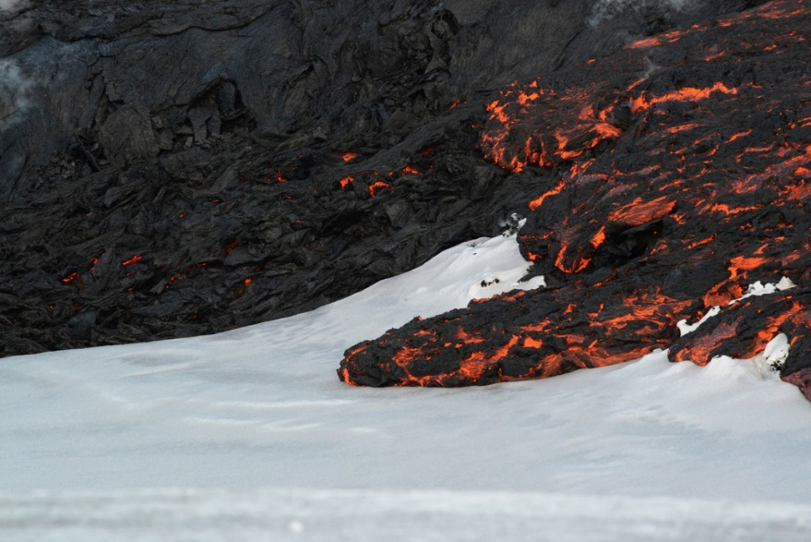
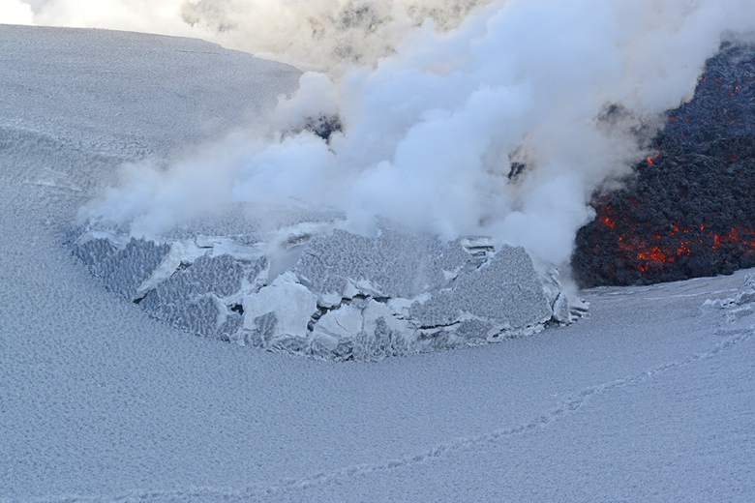
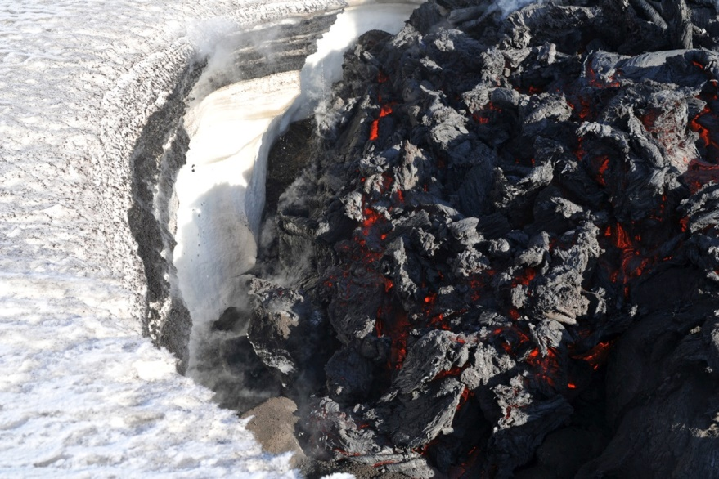
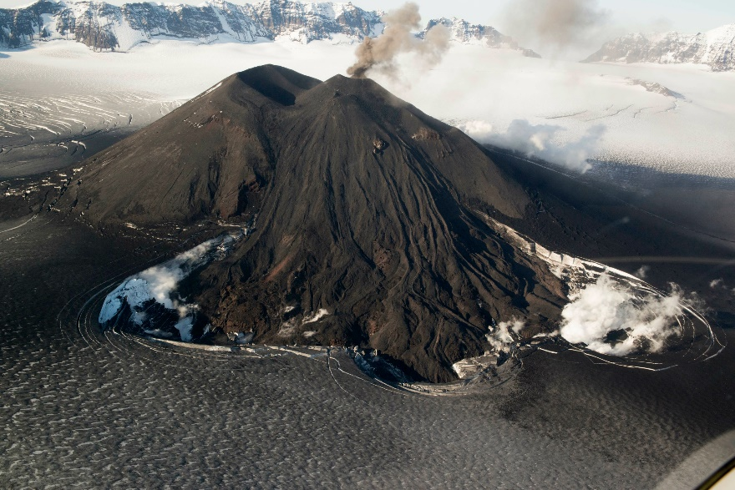
1. General constraints on lava—ice/snow interactions
Lava beneath ice/snow
Lava within ice/snow
Lava above ice/snow
Tolbachik 2013
Gigjökull 2010
Tolbachik 2013
Tolbachik 2013
Tolbachik 2013
Veniaminof 2013
Images: Ben Edwards

Slide 6
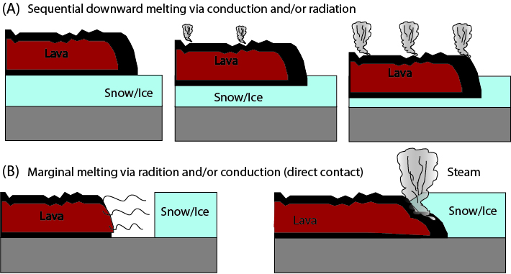
A. Potential processes of heat transfer between lava and ice/snow
Edwards et al. (2012)

Slide 7
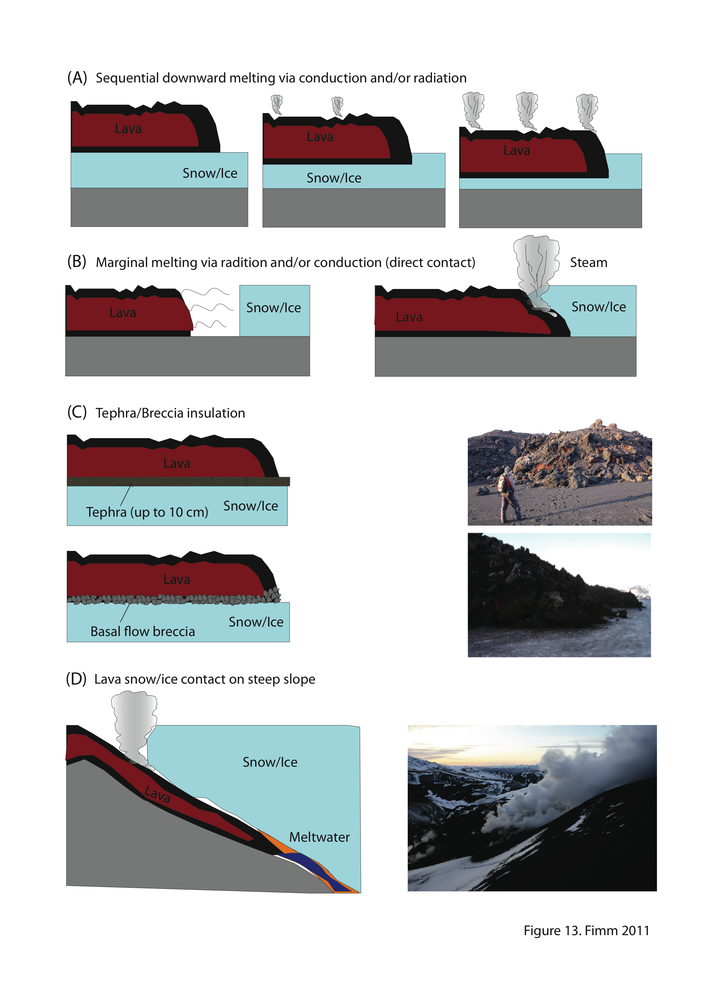
The presence of an insulating layer between lava and snow/ice significantly slows heat transfer from lava to frozen substrate.
Fimmvorðuháls 2010
Fimmvorðuháls 2010
Edwards et al. JGR (2012)
Edwards et al. (2012)
Images: Ben Edwards

Slide 8
On steep slopes lava can maintain direct contact between lava and snow/ice.
Fimmvorðuháls 2010
Image: Ben Edwards
Edwards et al. (2012)

Slide 9
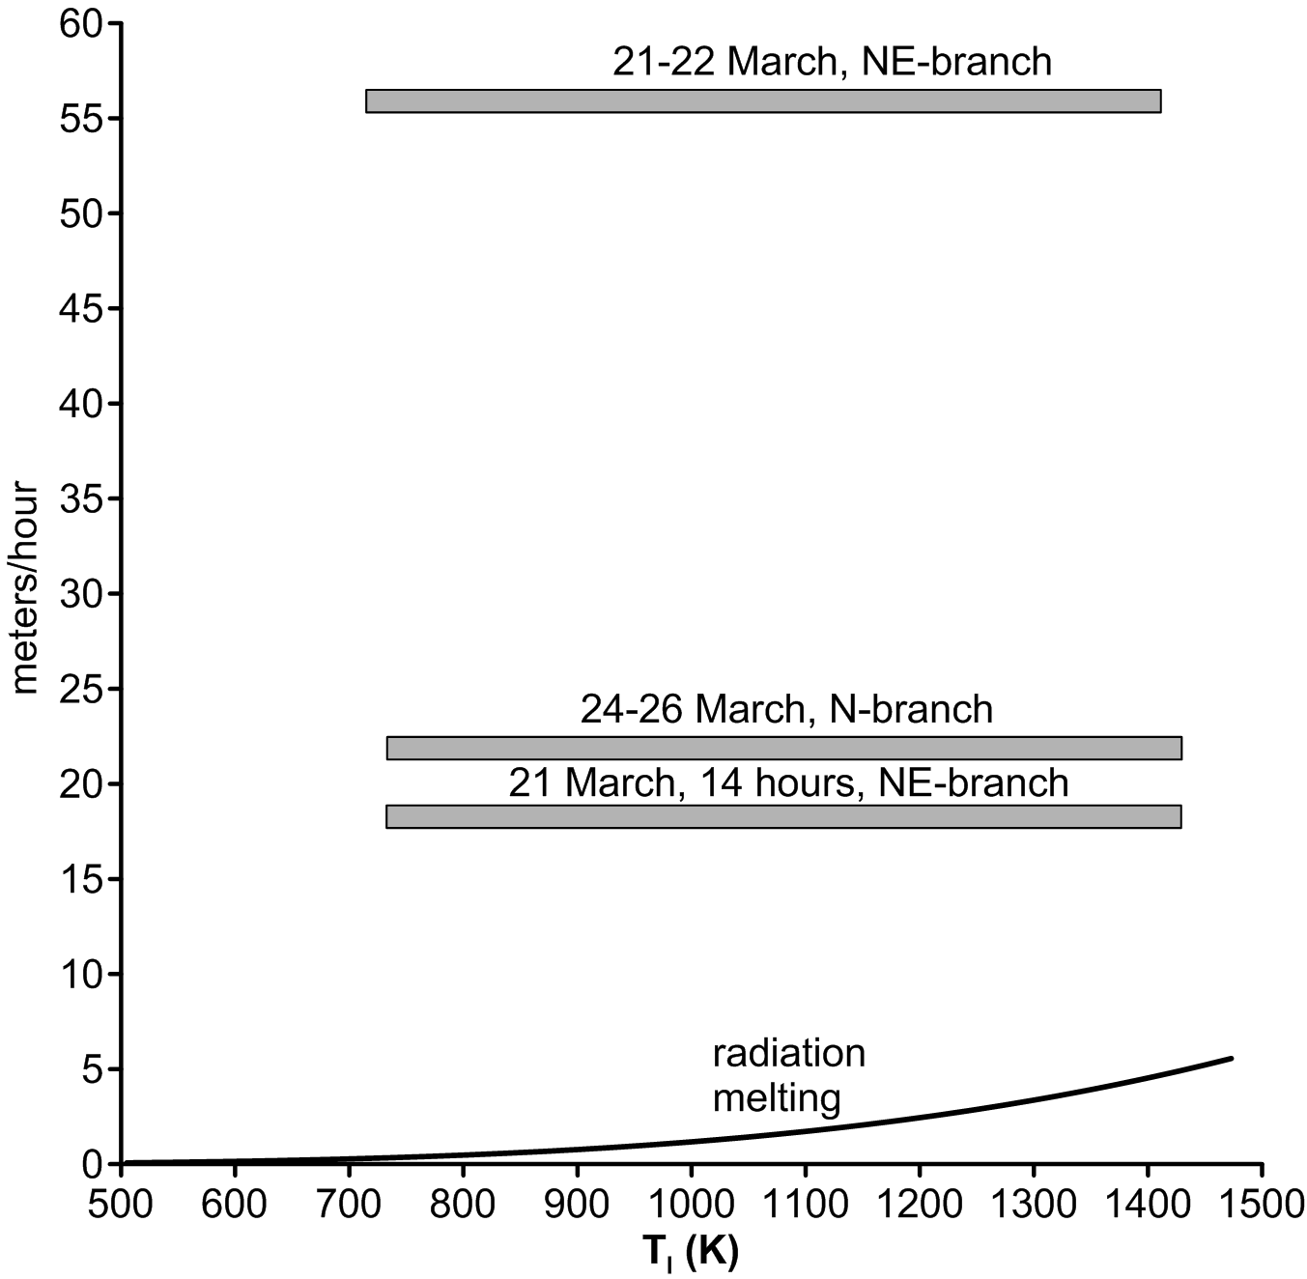

B. Heat transfer via radiation (fastest possible way to move heat at close distance)
Velocity of Lava
Advance
Lava cannot melt snow before contact
Lava melts snow in front before contact
e= emissivity
= Planck constant
T_{i} = lava temperature
T_{o} = ambient temperature
Edwards et al. (2012)

Slide 10
Given observed velocities of lava advance, most mafic flows will move too quickly to melt snow/ice ahead of lava, and so lavas will flow on top of snow (this is facilitated by tephra cover on snow). Slow moving pāhoehoe lobes may be an exception
(Edwards et al., 2015)
Velocity of Lava
Advance
Fimmvorðuháls lava flows (2010)
Tolbachik `a`ā flows (2013)
Fimmvorðuháls lava flows (2010)
Tolbachik pāhoehoe lava flows (2013)

Slide 11
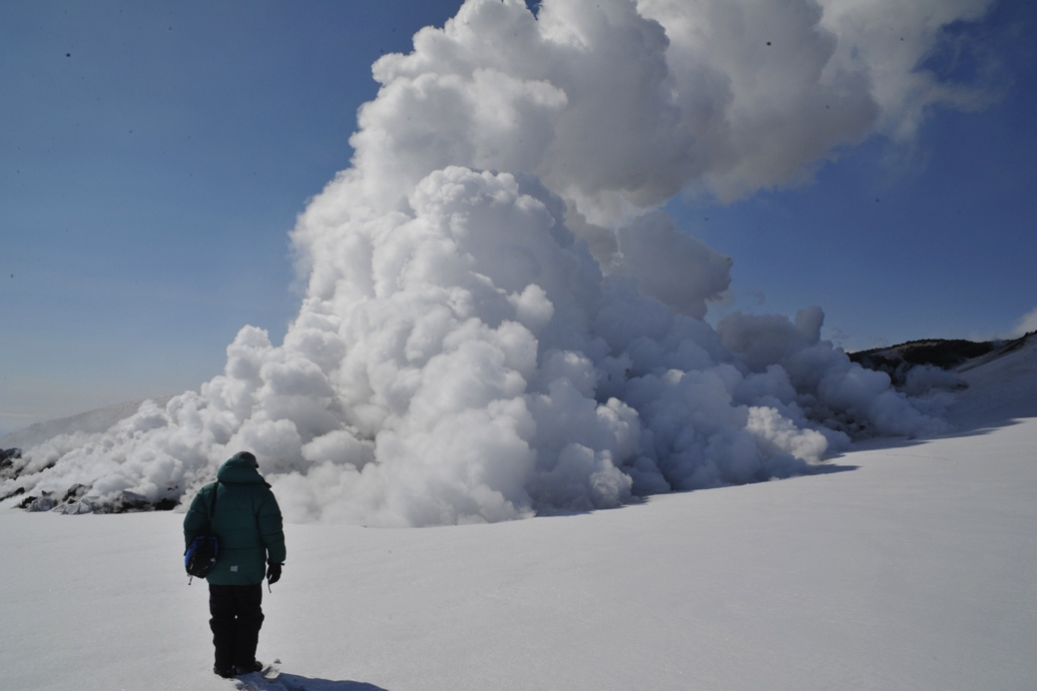
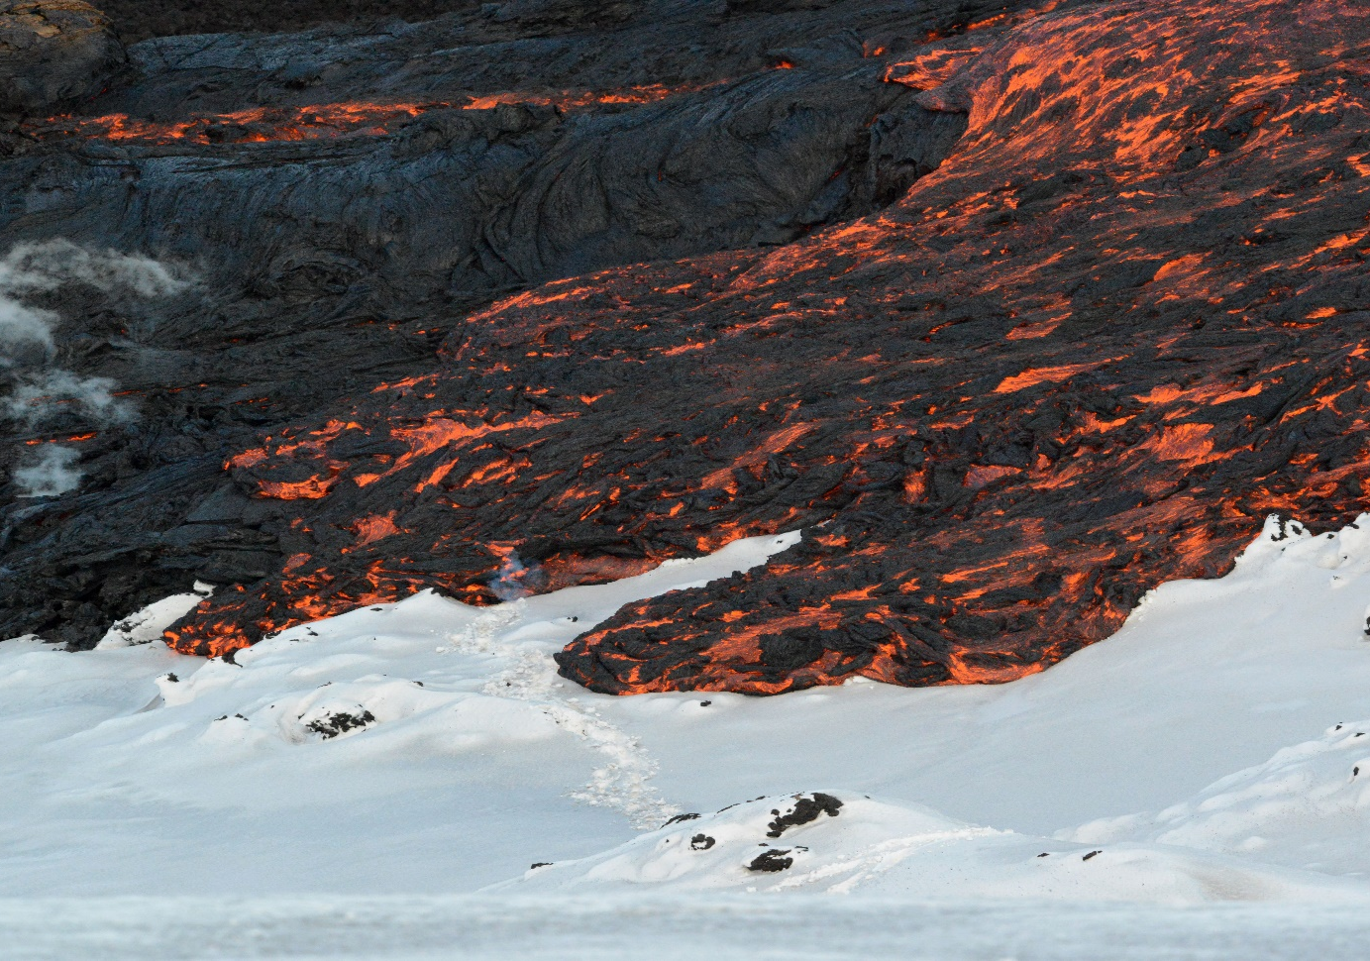
C. Voluminous steam production is frequently a signal that lavas are moving beneath ice/snow
Images: Ben Edwards
Tolbachik 2013
Tolbachik 2013
Voluminous steam: lava moving beneath snow
Little steam: lava moving on top of snow

Slide 12
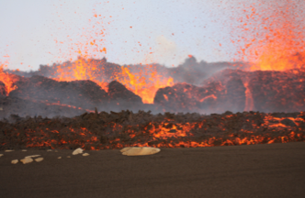
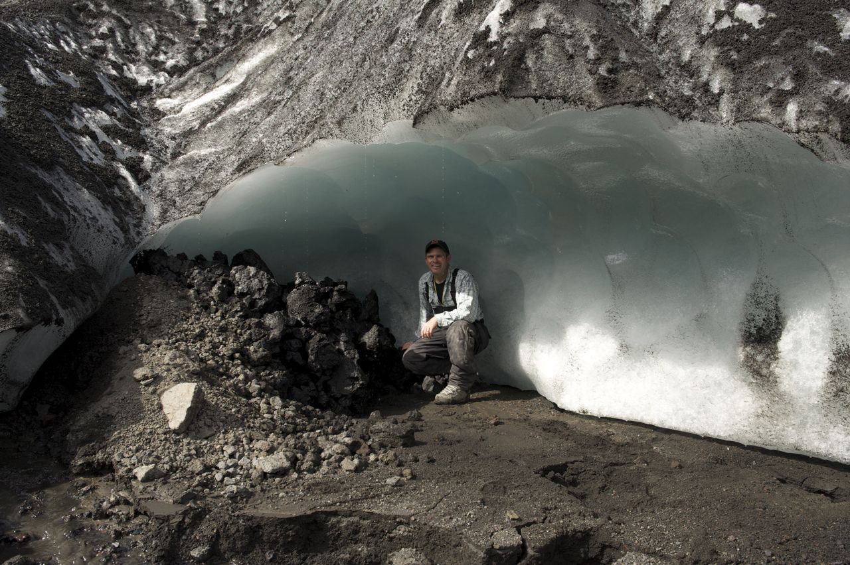
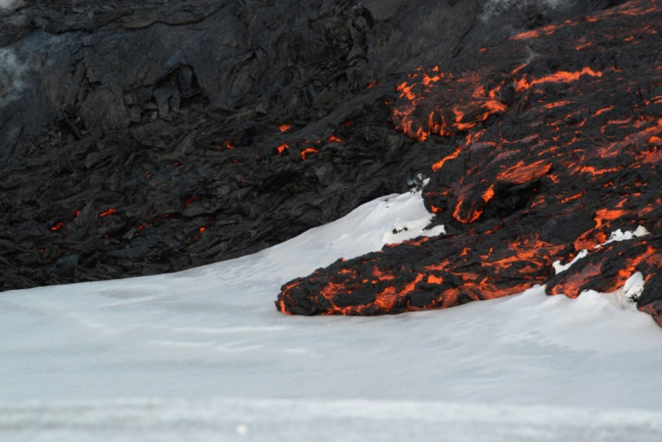

2. Insights from recent eruptions
Fimmvorðuháls (2010): basaltic eruption in Iceland; lavas flowed over snow up to 5 m thick (Edwards et al. 2012)
Gigjökull (2010): trachyandesite lava from Eyjafjallajokull summit flows beneath ice (>50 m thick) (Oddsson et al. 2016)
Tolbachik (2012-13): basaltic eruption in Russia; lavas flowed beneath, through and on top of snow up to 5 m thick (Edwards et al., 2015)
Veniaminof (2013): andesite lava from cone flowed onto ice surface within ice-filled caldera
Images: Ben Edwards
Notes:
Oddsson, B, Gudmundsson, MT, Edwards, BR, Thordarsson, T, Magnusson, E., Siggurdsson, G. 2016 (in press). Subglacial propagation and heat transfer in intermediate lava flow during the 2010 Eyjafjallajokull eruption. Bulletin of Volcanology.

Slide 13
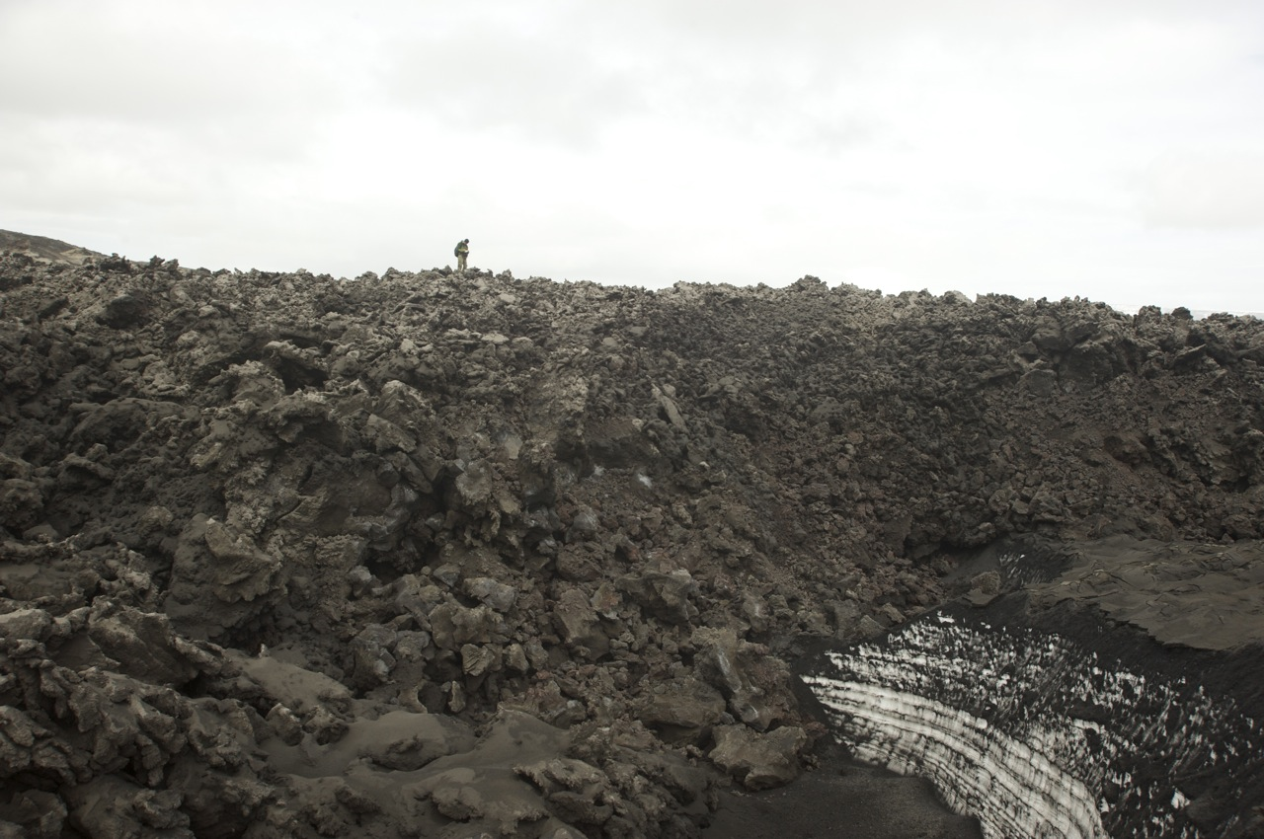
Fimmvorðuháls, Iceland 2010
Main lessons learned are that lavas easily travel on top of snow, and most evidence of snow presence during eruption is post-eruption modification of lavas
Edwards et al. (2012)
Image: Ben Edwards

Slide 14
Post-eruption modification due to melting of underlying snow
Edwards et al. (2012)
Images: Ben Edwards

Slide 15
Post-eruption modification due to melting of underlying snow
Edwards et al. (2012)
Images: Ben Edwards

Slide 16
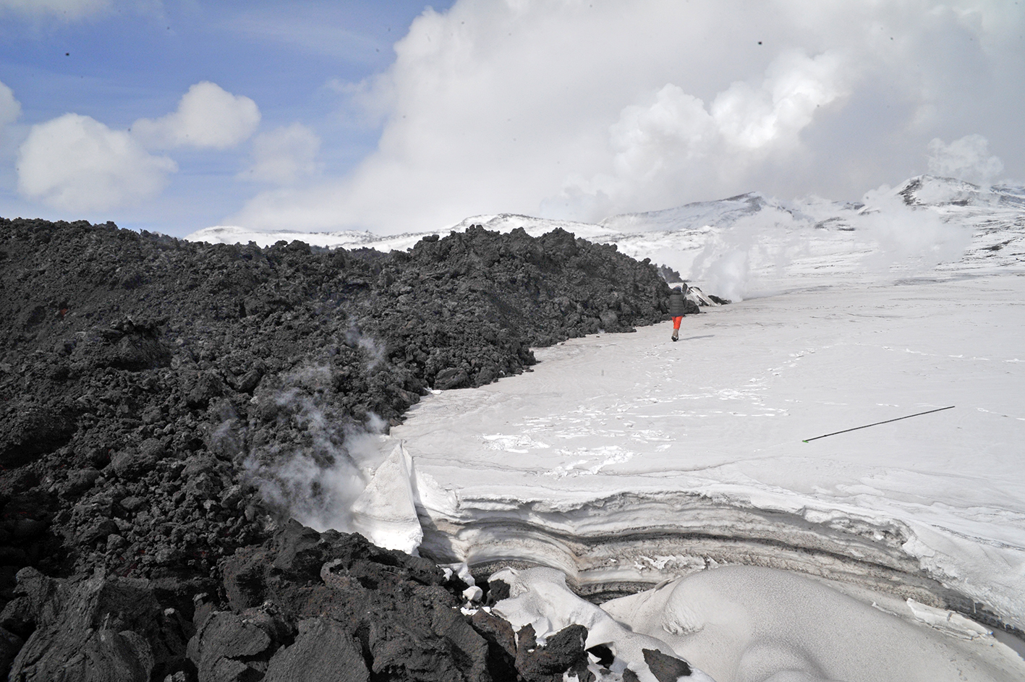
Tolbachik, Kamchatka, Russia 2012-13
Tolbachik, Kamchatka, Russia 2012-13
Main lesson learned is that lava emplacement style controls whether lavas travel above or through/beneath snow.
person for scale (~1.3 m tall)
Lava flows on top of snow: `a`ā lava
Edwards et al. (2015)
Image: Ben Edwards

Slide 17
`A`ā—snow interactions
Edwards et al. (2015)

Slide 18
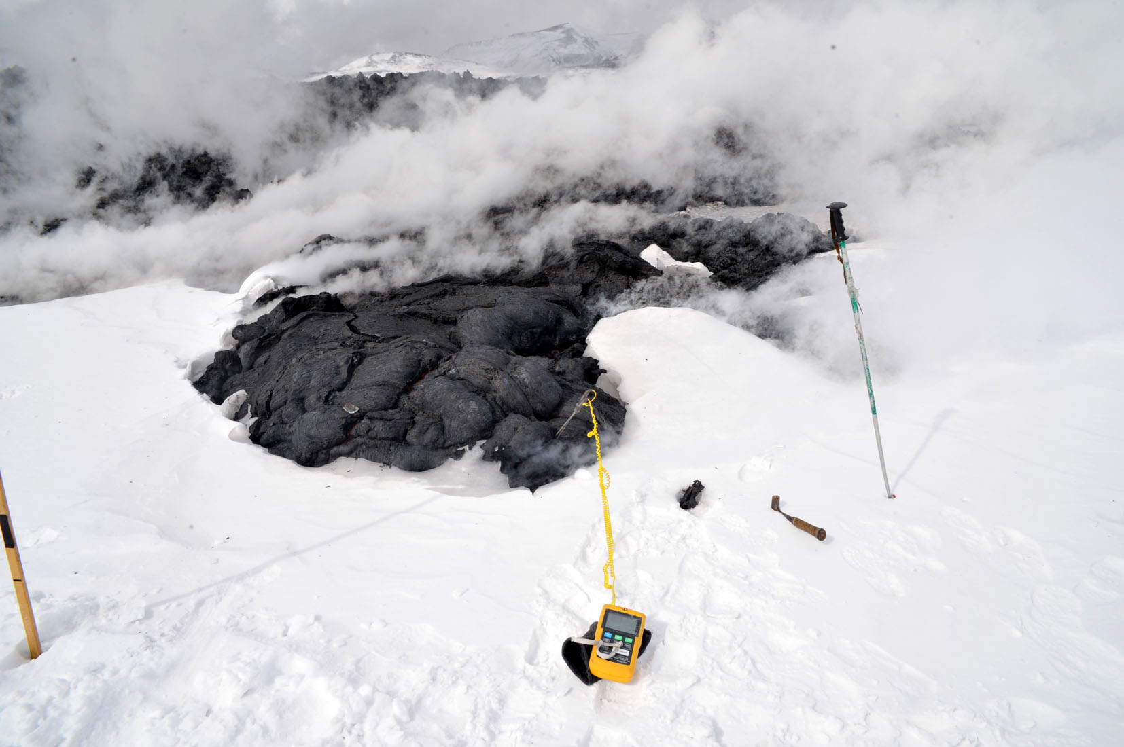
Pāhoehoe—snow interactions
Max lava T = 1080 deg C
Image: Ben Edwards

Slide 19
Pāhoehoe—snow interactions
Edwards et al. (2015)

Slide 20
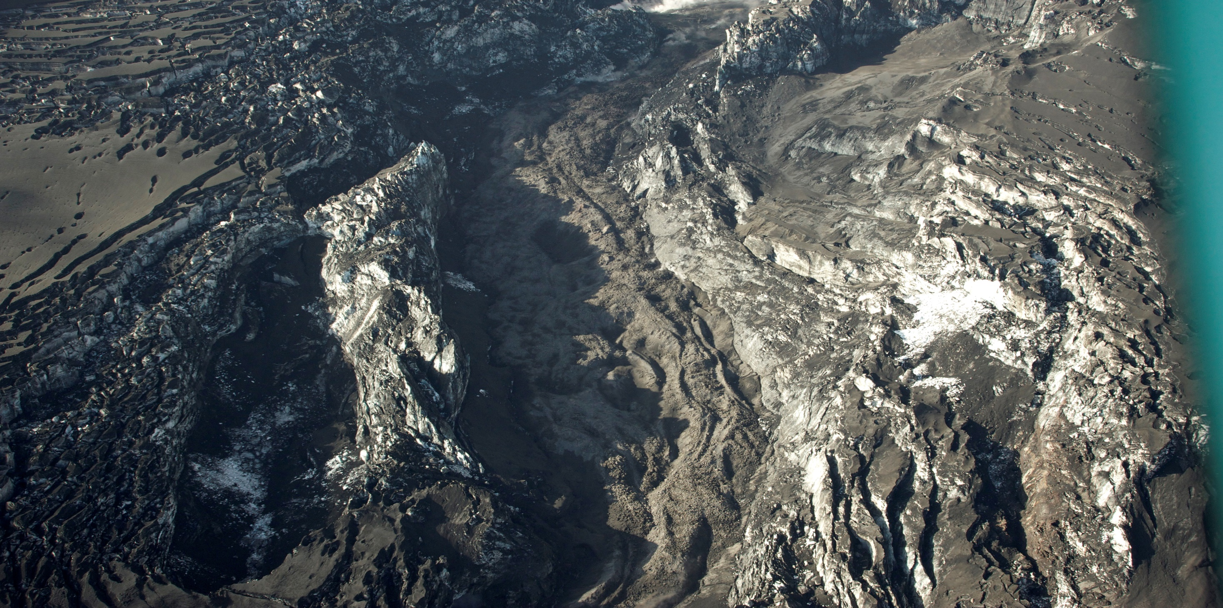
Gigjökull, Iceland 2010
Lava channel levees
July 2010
Main lesson learned is that lavas can exploit pre-existing structures below the lava to travel subglacially
Image: Ben Edwards

Slide 21
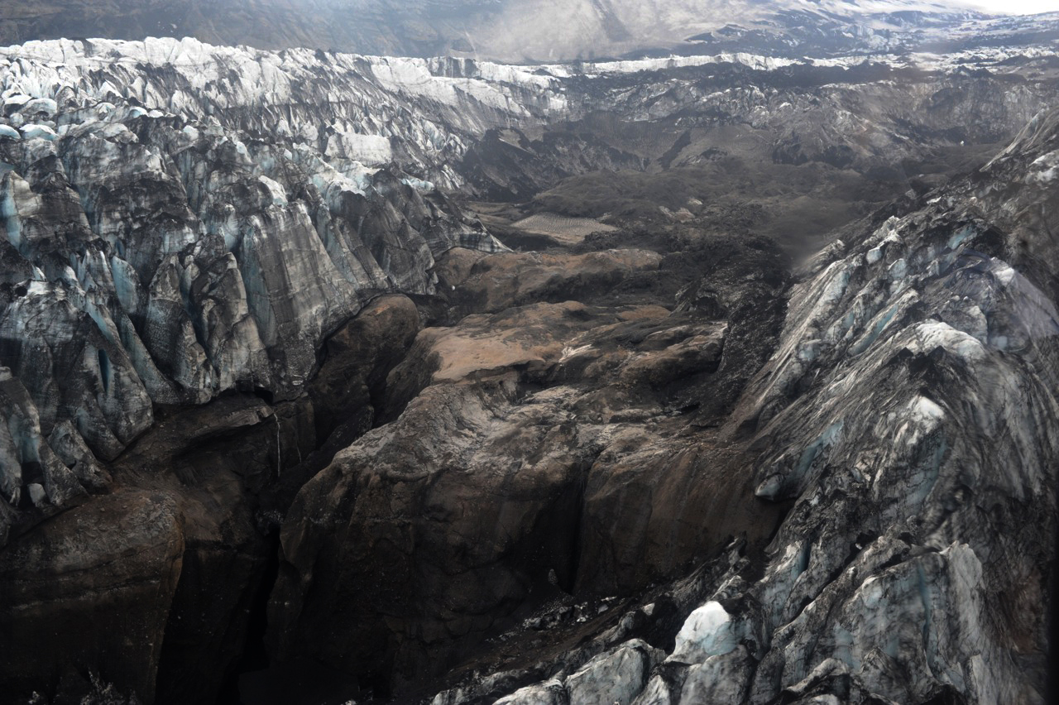
[Gigjökull, Iceland 2010]
South
Ponded water?
End of the lava flow
(R-channel)
N-channel
Aug 2011
North
Oddsson et al. (2016)
Image: Ben Edwards
Notes:
Oddsson, B, Gudmundsson, MT, Edwards, BR, Thordarsson, T, Magnusson, E., Siggurdsson, G. 2016 (in press). Subglacial propagation and heat transfer in intermediate lava flow during the 2010 Eyjafjallajokull eruption. Bulletin of Volcanology.

Slide 22
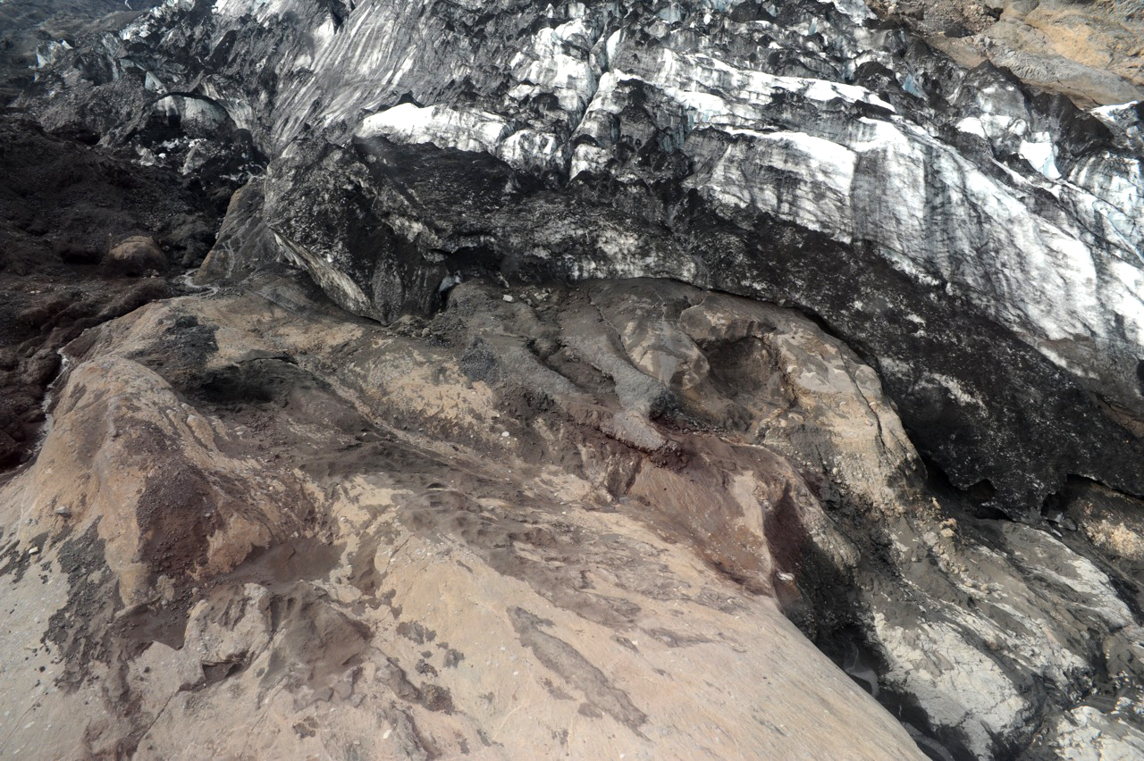
Ice-confined lava flows exposed after ice melt-back
[Gigjökull, Iceland 2010]
Oddsson et al. (2016)
Image: Ben Edwards
Notes:
Oddsson, B, Gudmundsson, MT, Edwards, BR, Thordarsson, T, Magnusson, E., Siggurdsson, G. 2016 (in press). Subglacial propagation and heat transfer in intermediate lava flow during the 2010 Eyjafjallajokull eruption. Bulletin of Volcanology.

Slide 23

Veniaminof, Alaska, USA 2013
Main lesson learned is that lavas emplaced above ice can melt downwards through ice via basal melting without producing significant morphological changes in the lava, to gain access to interior of ice
Image: Ben Edwards

Slide 24
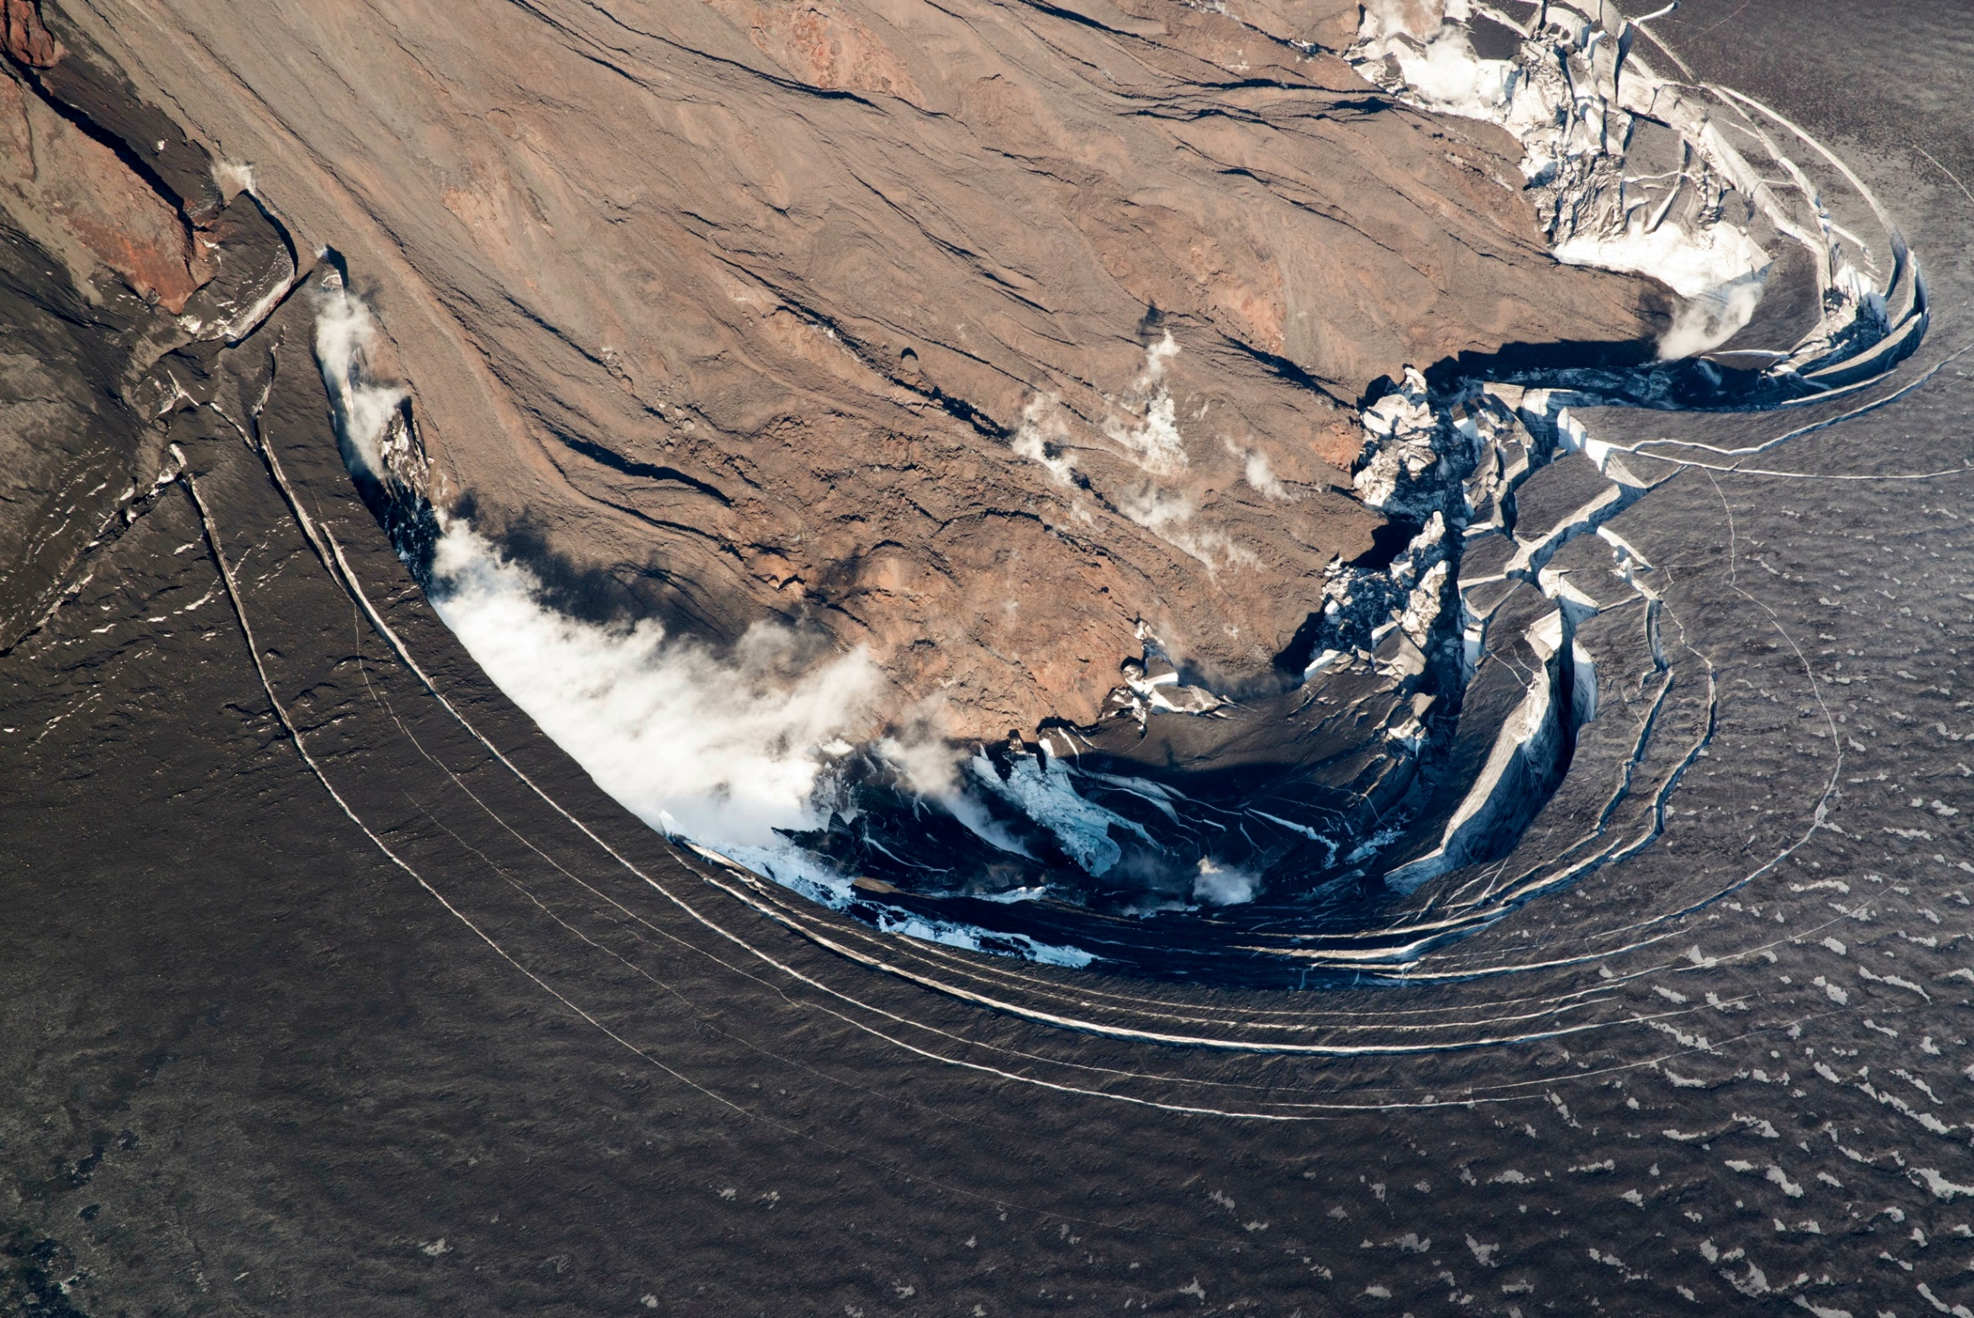
Veniaminof, Alaska, USA 2013
Image: Ben Edwards

Slide 25
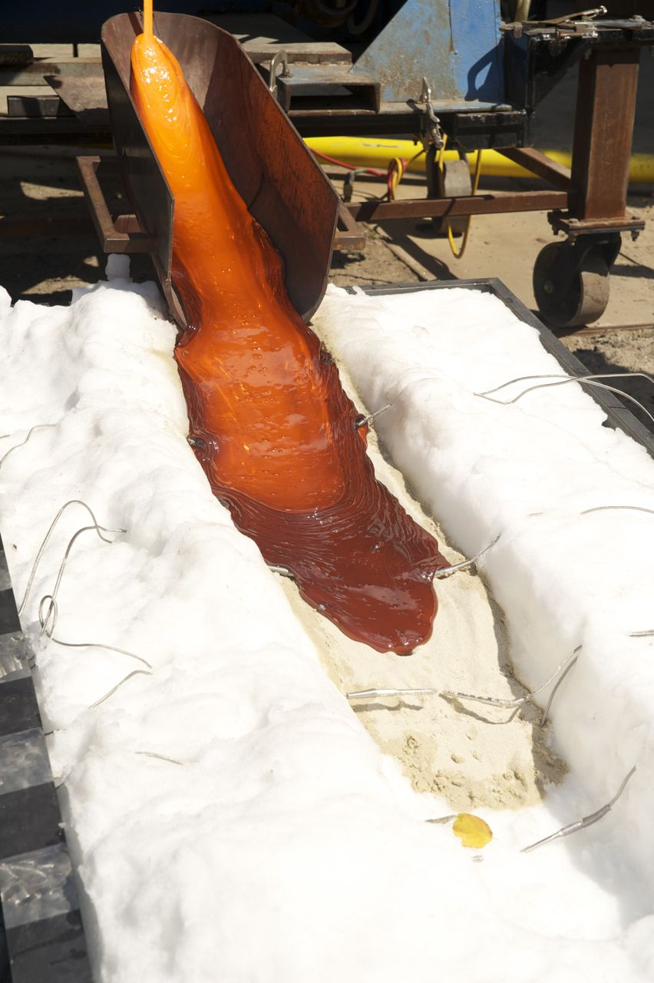
3. Constraints from large-scale experiments
(Edwards et al., 2013)
Syracuse Lava Lab furnace (up to ~400 kg melt; T_{max} ~1350 C)
Starting materials (basaltic gravel, ice)
Experimental ‘vessels’
Experimental variations: solid ice sheet, ice blocks, shaved ice; with and without sand layers
Experiments monitored with multiple thermal probes
Image: Ben Edwards

Slide 26
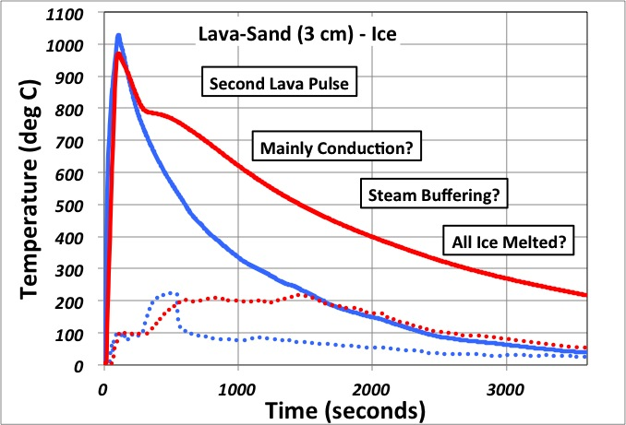
Experiment where melted basalt is poured on a layer of sand on top of shaved ice (representing snow); temperatures at the sand—ice interface remain at 100 ˚C until all ice is melted (dotted line).
[Blue: 1st lava pulse
Red: 2nd lava pulse]
Edwards et al., 2013

Slide 27
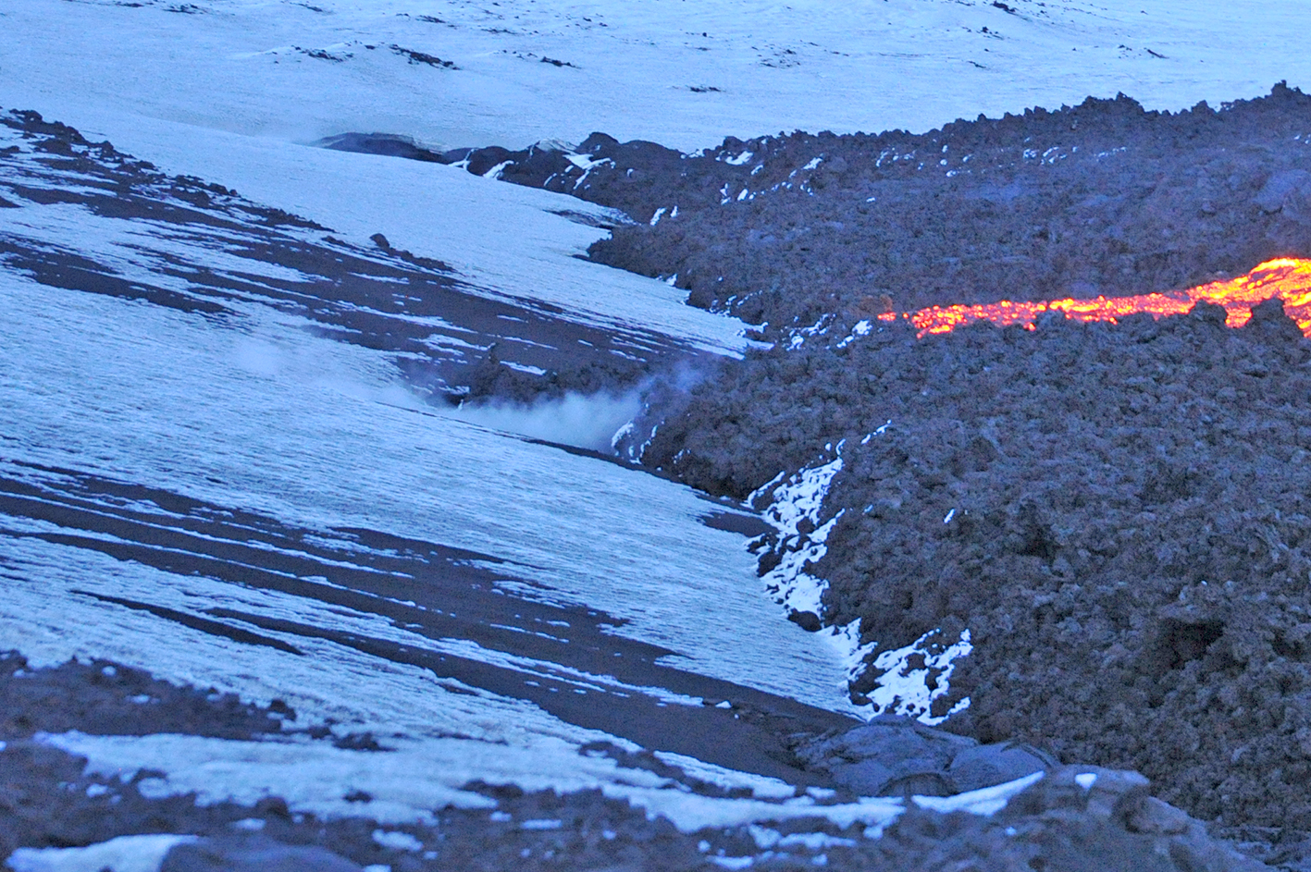
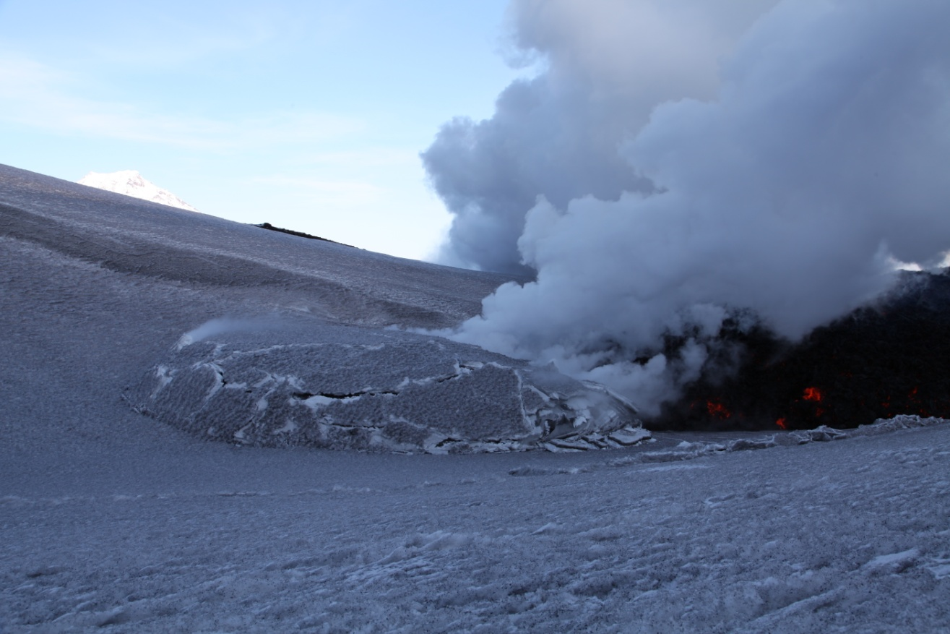
4. Controls on emplacement: lava type vs advance rate
A. Lava type: The conveyor-belt motion of `a`ā and sheet lava flows allows them to ‘climb’ snowpack; pāhoehoe lava lobes extrude individually and then inflate
Images: Ben Edwards
`a`ā lava flow ‘climbing’ on to top of snowpack
Snow doming caused by inflation

Slide 28

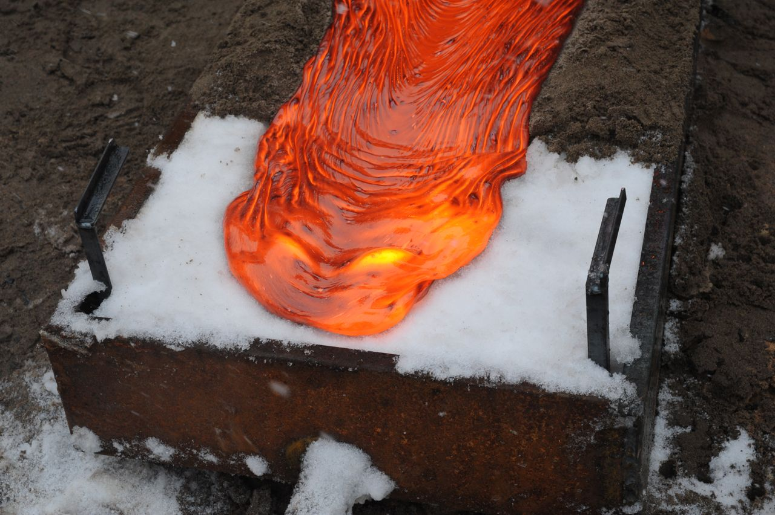
4. Controls on emplacement: lava type vs advance rate
B. Extrusion rate: `a`ā and sheet lava flows move at higher velocities (`a`ā ~0.5 m/m minimum; sheet lava flows > 0.1 m/s; pāhoehoe lava lobes advance ~0.1 m/m); evidence from Fimmvorduhals 2010, theory and experiments (Edwards et al., 2012, 2013)
Tolbachik sheet flows
(360 m/hr)
Tolbachik ‘a’a
Tolbachik lobate
Image: Ben Edwards
Time-scale of melting via radiation
(Edwards et al., 2012)
Experiments at Syracuse Lava Lab
(Edwards et al., 2013)

Slide 29
SUMMARY
Interactions between lava and ice/snow are important for understanding ancient deposits and potential hazards of future eruptions.
2. Presence of steam is strong indication that lava is moving within or beneath ice.
Because basaltic lavas can move faster than radiative heat transfer, they generally move initially on top of snow/ice.
On a timescale of days, lavas will melt into snow/ice, and they will exploit sub-ice drainage structures to move beneath ice.

