Slide 3
Measuring HRM

Slide 5
Approaches To HRM Evaluation

Slide 6
Evaluating HRM

Slide 7
Evaluating Human Resource Planning

Slide 8
Evaluating Staffing

Slide 9
Evaluating Learning and Development

Slide 10
Evaluating Performance Management

Slide 11
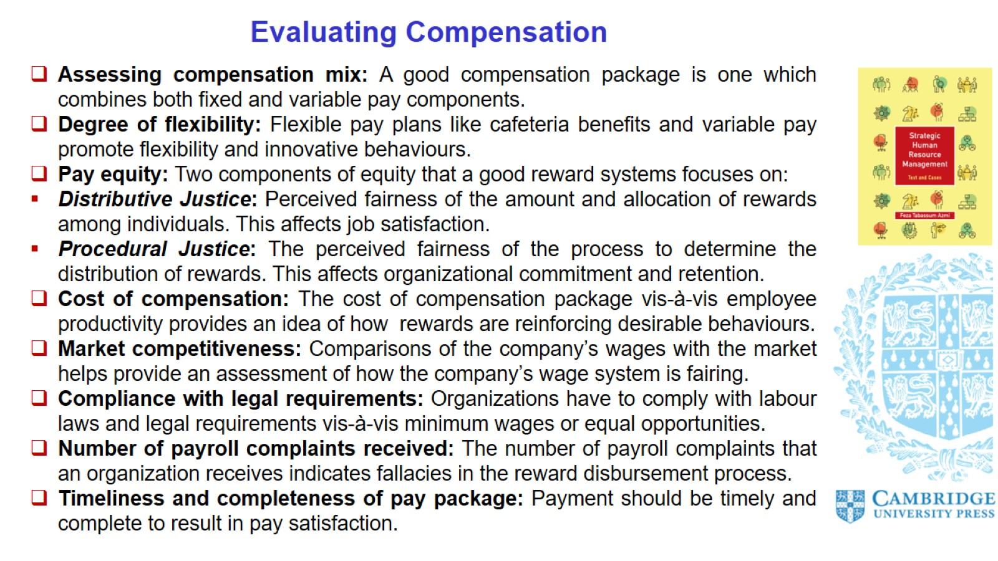
Evaluating Compensation

Slide 12
Evaluating Employee Relations

Slide 13
Evaluating the HR System

Slide 14
Strategic HR Evaluation: Challenges

Slide 15
HR Analytics

Slide 16
Domains of HR Analytics

