Slide 1
Chapter 3
Convex Programming and Applications

Slide 2
Outline
Concepts and key results in convex optimization
A case study
  Cross-layer optimization for multi-hop MIMO networks

Slide 3
Convex Set
Basic definitions
  Convex set: A set is convex if for any its two elements z1 and z2 and any 0 ≤ λ ≤ 1, λz1 +(1-λ)z2 is also its element
  Examples
λz1 +(1-λ)z2
z2
z2
λz1 +(1-λ)z2
z1
z1
Convex set
Non-convex set

Slide 4
Convex Function
Convex function: A function f(x) is a convex function if for any two x1 and x2 and any 0 ≤ λ ≤ 1, f(λx1 +(1- λ)x2) ≤ λf(x1)+(1-λ)f(x2)
  λf(x1)+(1-λ)f(x2)
x2
Convex
x1
f(λx1 +(1- λ)x2)

Slide 5
Concave Function
Concave function: A function f(x) is a concave function if for any two x1 and x2 and any 0 ≤ λ ≤ 1, f(λx1 +(1- λ)x2) ≥ λf(x1)+(1-λ)f(x2)
f(λx1 +(1- λ)x2)
Concave
x2
x1
  λf(x1)+(1-λ)f(x2)

Slide 6
Other Functions
Some functions are neither convex nor concave
  For example
Neither convex nor concave

Slide 7
Affine Function
Basic definitions
  Affine function: A function f(x) is an affine function if it is a linear function
  An affine function is both convex and concave
Affine functions

Slide 8
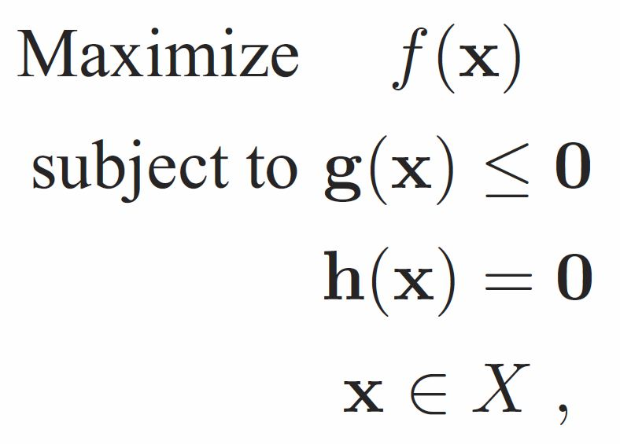
Convex Programming
  x is a vector of continuous variables
  f(x) is a concave objective function
  g(x) are convex functions
  h(x) are affine functions
  X is a convex set
Notes:
Example :
An LP (Chapter 2) is a convex problem
A mixed-integer linear program (MILP) is not

Slide 9
Key Results in Convex Optimization
A nice property:
  A local optimal solution is also globally optimal
    A convex optimization problem can be solved by finding a local optimum
  Efficient local optimization approaches: subgradient method, gradient projection method
    Improve the current solution and converge to an optimal solution
    Can terminate if the current solution is good enough

Slide 10
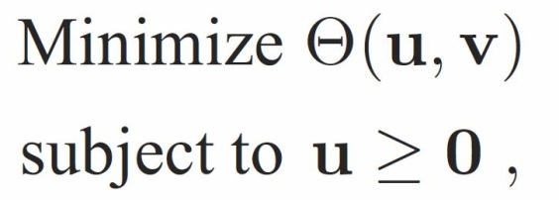
Key Results in Convex Optimization (2)
Lagrangian dual problem
  u is the Lagrangian multiplier to constraint g(x) ≤ 0
  v is the Lagrangian multiplier to constraint h(x) = 0
The original problem and its dual problem
  The same optimal objective value
  Once one problem is solved, the optimal solution to the other can be easily constructed
Notes:
A problem can be solved in its dual domain

Slide 11
Outline
Concepts and key results in convex optimization
A case study
  Cross-layer optimization for multi-hop MIMO networks

Slide 12

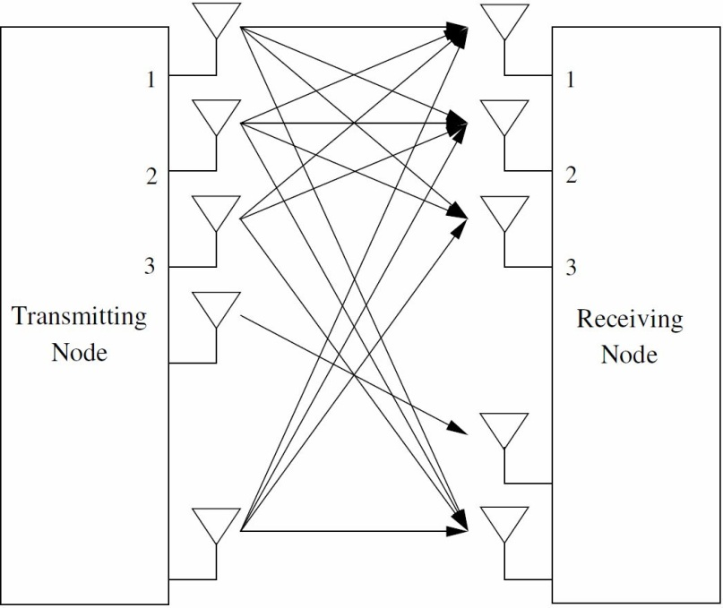
Multiple-Input Multiple–Output (MIMO)
Employs multiple antennas at transmitters and receivers
Capable of increasing channel capacity without the cost of additional spectrum and power
An enabling technology for high throughput wireless networks

Slide 13
Multi-hop MIMO Networks
Special single-hop networks have significant breakthrough in recent years.
  Uplinks and downlinks in cellular system
  The understandings of MIMO in multi-hop networks remain limited
Cross-layer design in multi-hop MIMO networks will be addressed

Slide 14
Problem To Be Solved
Throughput utility maximization for a multi-hop MIMO network
Throughput depends on the coordinated mechanisms at
  Physical layer
  Link layer
  Network layer
  Transport Layer
Joint optimization across multiple layers are desirable

Slide 15
Outline of Case Study
Network model and problem formulation
Approach
Numerical results

Slide 16


Network Configuration
A multi-hop MIMO network
  N MIMO nodes
  L possible MIMO links
  F end-to-end sessions
  Each node is assigned a non-overlapping band
  Each node is subject to a maximum power limit

Slide 17


Utility Function
Network utility function
  The well-known proportional fairness utility function is adopted
    : strictly concave, monotonically increase
  Other network utility functions can be treated in the same way
The goal:
Maximize the network utility of a multi-hop MIMO network
Notes:
r_f is the flow rate of session f

Slide 18
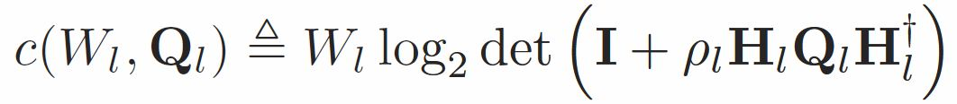


Link Capacity
MIMO link capacity expression
  where
  is bandwidth of link l
  is input covariance matrix of link l
Concave and monotonically
increasing for W_{l} ≥ 0 and Q_{l} ≥ 0

Slide 19

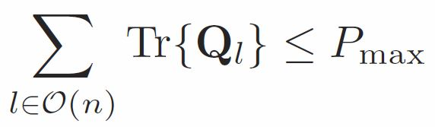



Link/Physical Layer Constraints
Physical layer constraints
  : input covariance matrix is PSD
  : subject to the max power at each node
Link layer constraints
  : bandwidth is non-negative
  and : subject to the allocated band at each node
Notes:
PSD: positive semi-definite

Slide 20


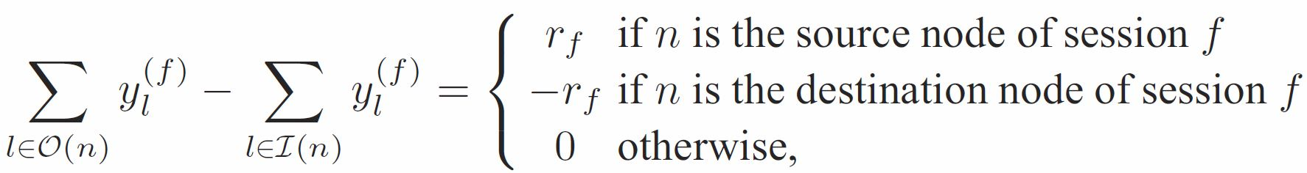
Transport Layer Constraints
Multi-commodity flow model
  : amount of flow in link
  : the flow rate of session

Slide 21

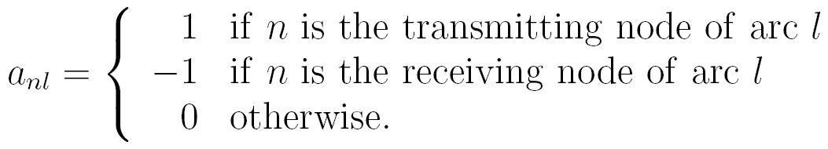




Network/Transport Layer Constraints (1)
Network topology
  Node-Link Incidence Matrix (NLIM) : , where
  and : the incoming and outgoing links of node n
  : source node of session
  : destination node of session

Slide 22





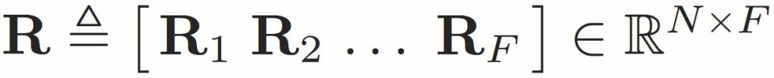
Network/Transport Layer Constraints (2)
Constraints for a session can be compactly written as
  Let
  : the right-hand-side of the constraints
    1 ,
The flow model can be compactly written as

Slide 23

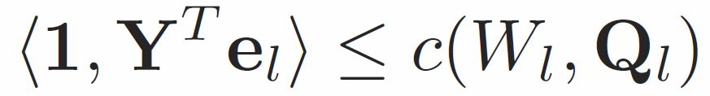
Coupling Constraints
Constraints related to network, link, and physical layers
  The sum of flows in link cannot exceed the link capacity
  Using matrix notation, it can be compactly written as
Notes:
e_l

Slide 24
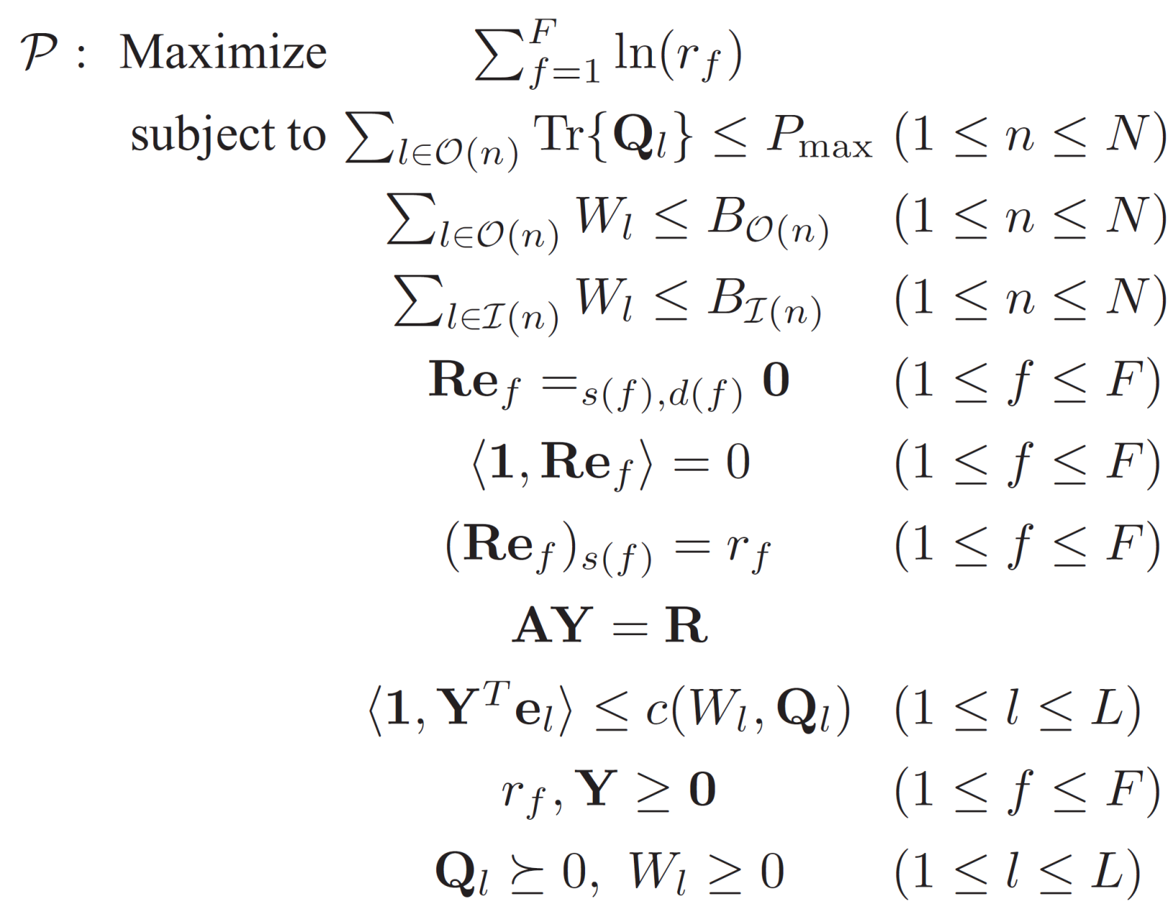
Problem Formulation
LINK-PHY Coupling
Constraints
Transport Layer
Constraints
TSPT-NET Coupling
Constraints
Link and Physical
Layer Constraints
Notes:
Constraints under consideration
1. Power allocation – physical layer
2. Bandwidth allocation – link layer
3. Flow routing– network layer
Joint optimization across three layers
Three layer variables are coupled only through one constraint

Slide 25
Problem Formulation
Convex programming problem
Special structure allows decomposing the original problem into two subproblems in its dual domain
Notes:
Constraints under consideration
1. Power allocation – physical layer
2. Bandwidth allocation – link layer
3. Flow routing– network layer
Joint optimization across three layers
Three layer variables are coupled only through one constraint

Slide 26
Outline of Case Study
Network model and problem formulation
Approach
Numerical results

Slide 27

Highlight of Approach
Problem is “large”
  Decompose into smaller subproblems
    one network layer problem
    one link-physical layer problem
  Solve each small subproblem separately
The approach
  Step 1: Lagrangian Dual Decomposition (LDD)
  Step 2: Cutting-plane method for solving Lagrangian dual
  Step 3: Recover the primal optimal solution

Slide 28
Step 1:
Lagrangian Dual Decomposition (1)
Dualize the LINK-PHY
coupling constraints

Slide 29
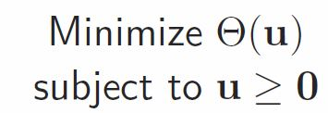
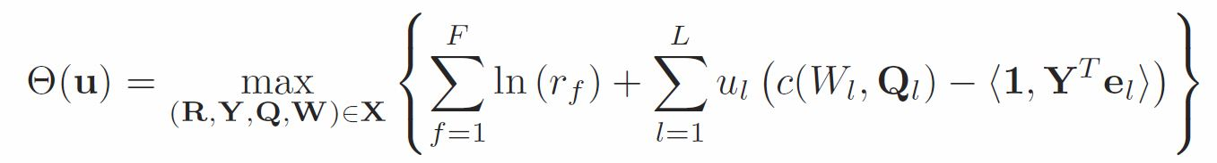
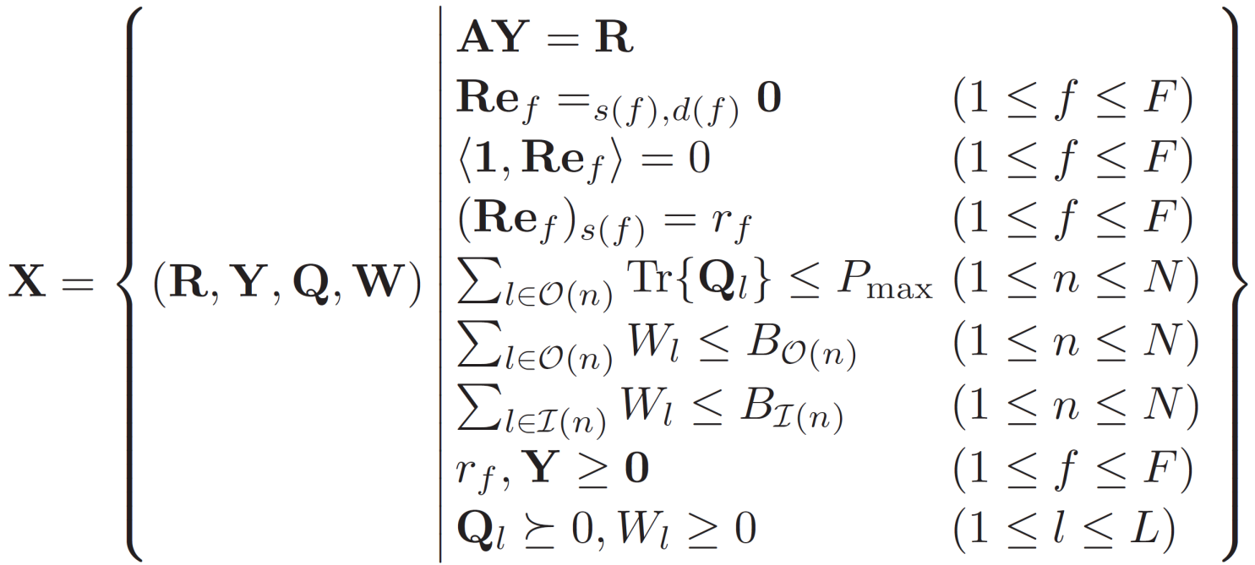
Step 1:
Lagrangian Dual Decomposition (2)
The resulting Lagrangian dual is
where

Slide 30
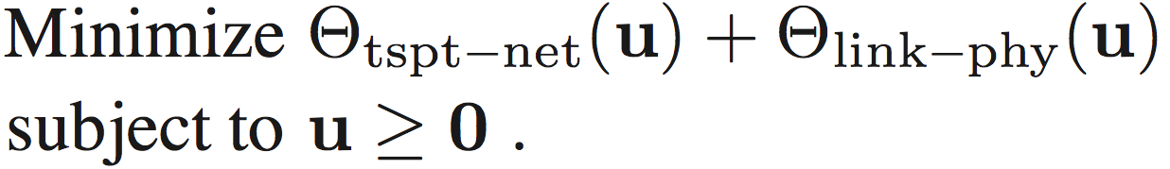
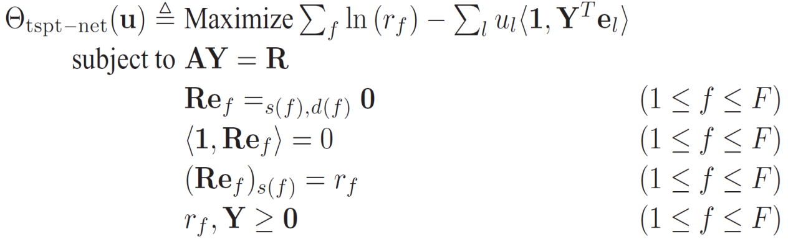
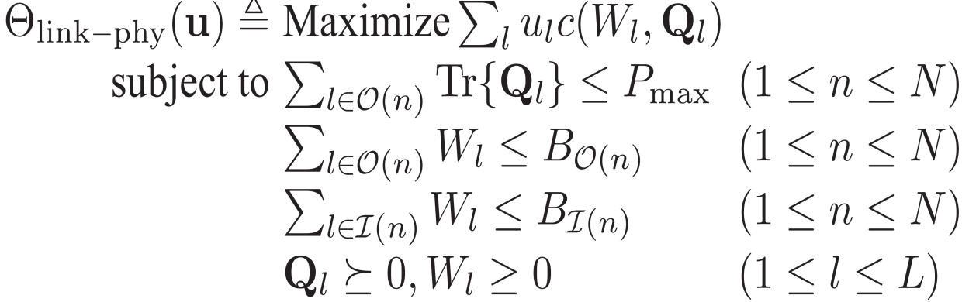
Step 1:
Lagrangian Dual Decomposition (3)
The Lagrangian dual problem can be written as
  Two subproblems are convex problems
  Solvable by many convex optimization methods

Slide 31
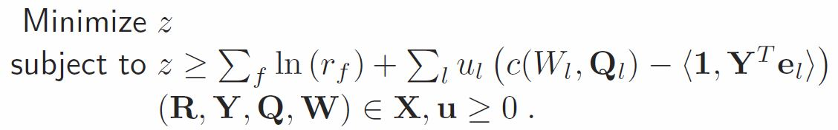

Step 2:
Cutting-Plane Method for Solving Dual (1)
Basic idea: Using cutting-planes to construct a relaxation of the original problem
Rewrite the Lagrangian dual as
  Each given point corresponds to a constraint
    Infinite number of points
  LP with infinite number of constraints

Slide 32

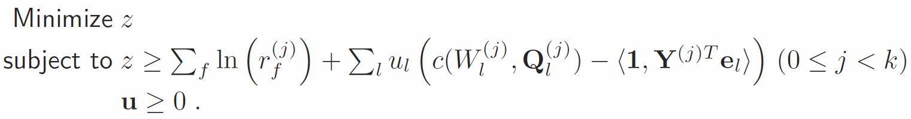


Step 2:
Cutting-Plane Method for Solving Dual (2)
A relaxed problem can be obtained by finite number of points
  is the optimal solution to the relaxed problem
  is a lower bound of the Lagrangian dual problem
  It is optimal if feasible!
j=0,….k-1

Slide 33
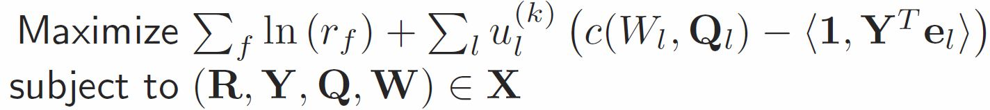


Step 2:
Cutting-Plane Method for Solving Dual (3)
Feasibility test
  Check
  Solve the following problem
Optimal solution
Optimal objective value
Notes:
Decompose the problem into two smaller subproblems and solve each of them efficiently

Slide 34


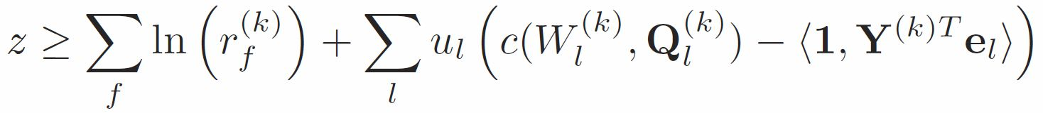
Step 2:
Cutting-Plane Method for Solving Dual (4)
Feasibility test (cont’d)
Y
is optimal, done
N
Add a new cutting-plane constraint (k=k+1):

Slide 35
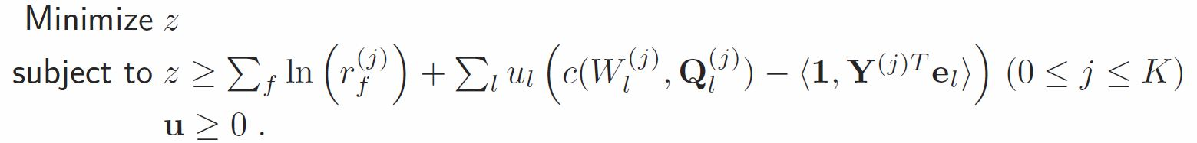
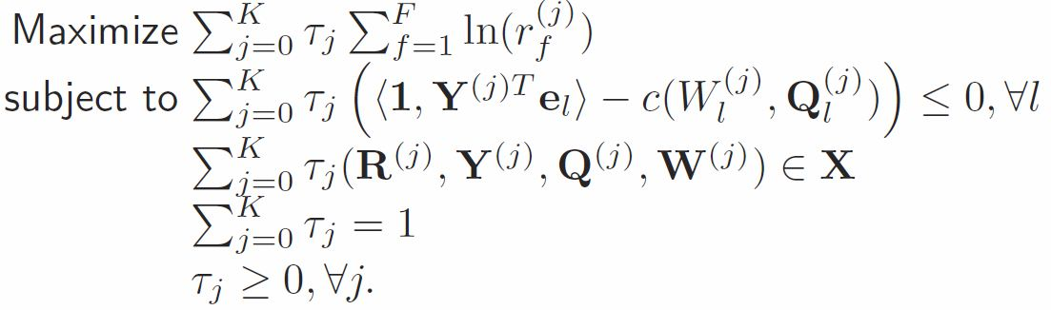
  Step 3:
  Recover the Primal Optimal Solution
Suppose that feasibility test succeeds at k=K
The last solved convex program
Dual problem

Slide 36

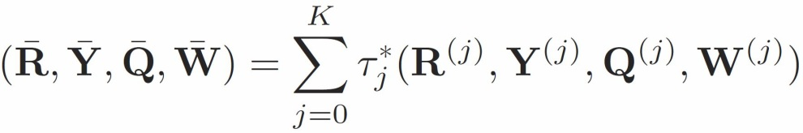

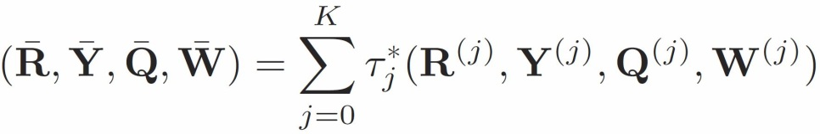
  Step 3:
  Recover the Primal Optimal Solution (2)
Properties of dual problem
  Immediately know the optimal value
  Note that
is a feasible solution to problem if the coupling constraints are satisfied
is proved to be a feasible and optimal solution to problem

Slide 37
Outline of Case Study
Network model and problem formulation
Approach
Numerical results

Slide 38
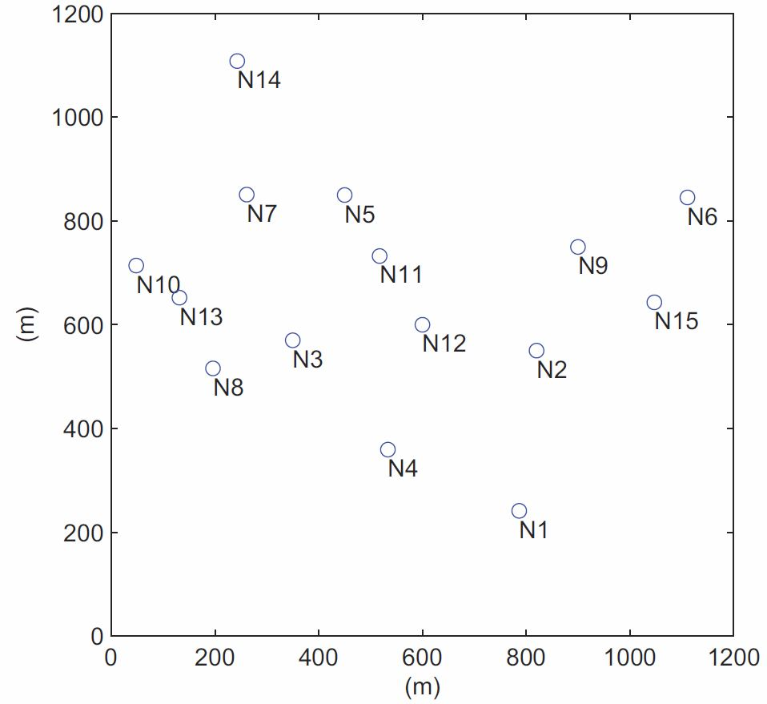
Simulation Setting
15 nodes
1200 m × 1200 m area
2 antennas at each node
20 dBm maximum transmit power
20 MHz bandwidth at each node
Three sessions
  Node 14 → 1
  Node 6 → 10
  Node 5 → 4
Network topology of a 15-node network

Slide 39
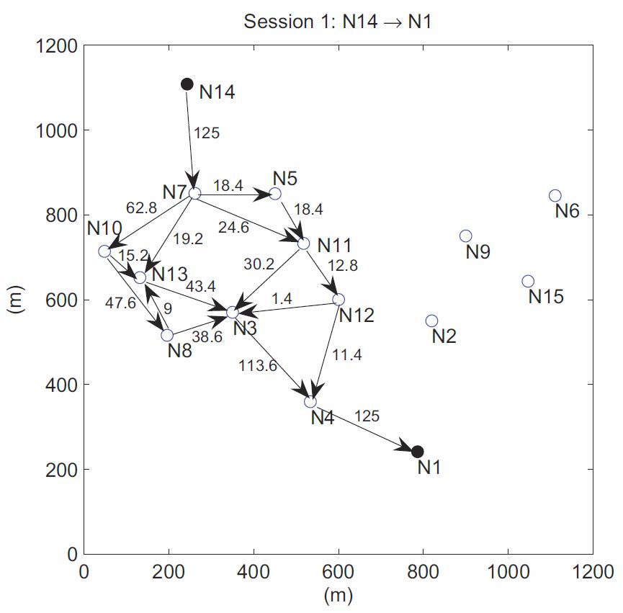
Routing Solution
Routing and flow rates of session 1 (in Mb/s)

Slide 40
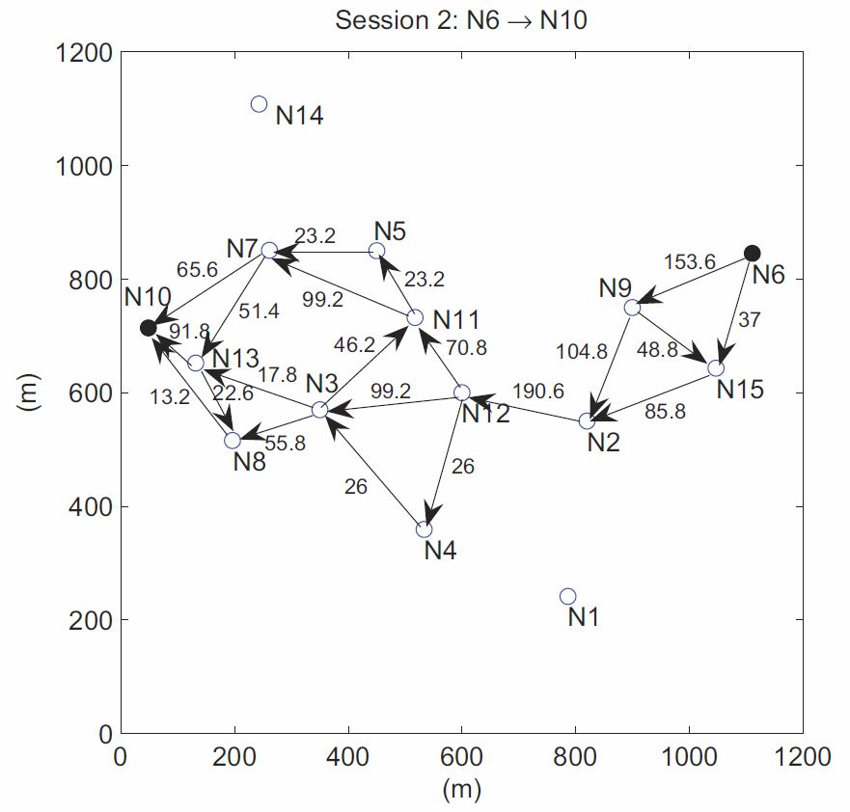
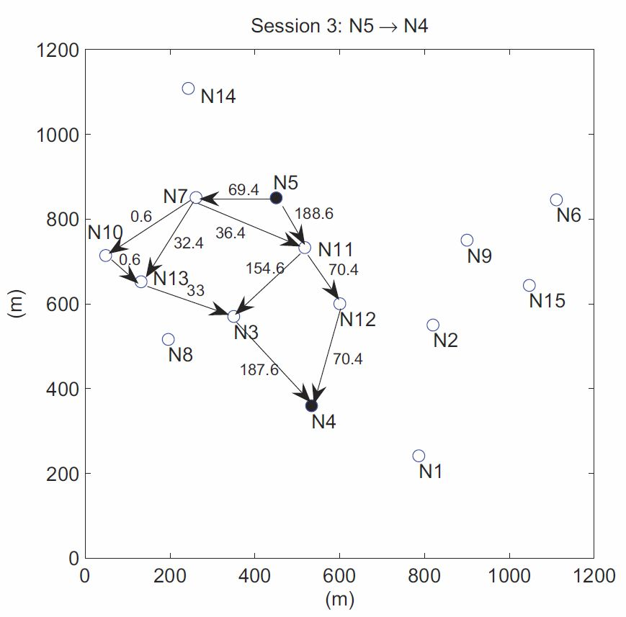
Routing Solution (2)
Routing and flow rates of session 2 (in Mb/s)
Routing and flow rates of session 3 (in Mb/s)

Slide 41
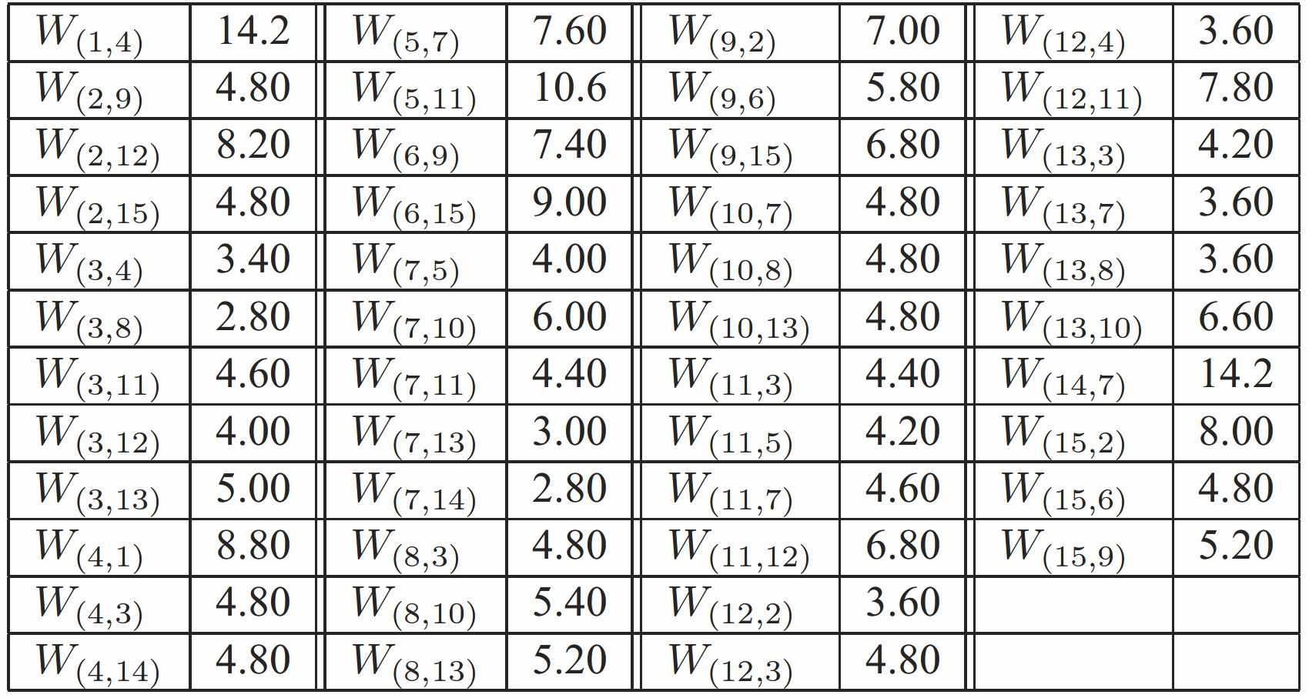
Bandwidth Allocation (in MHz)

Slide 42
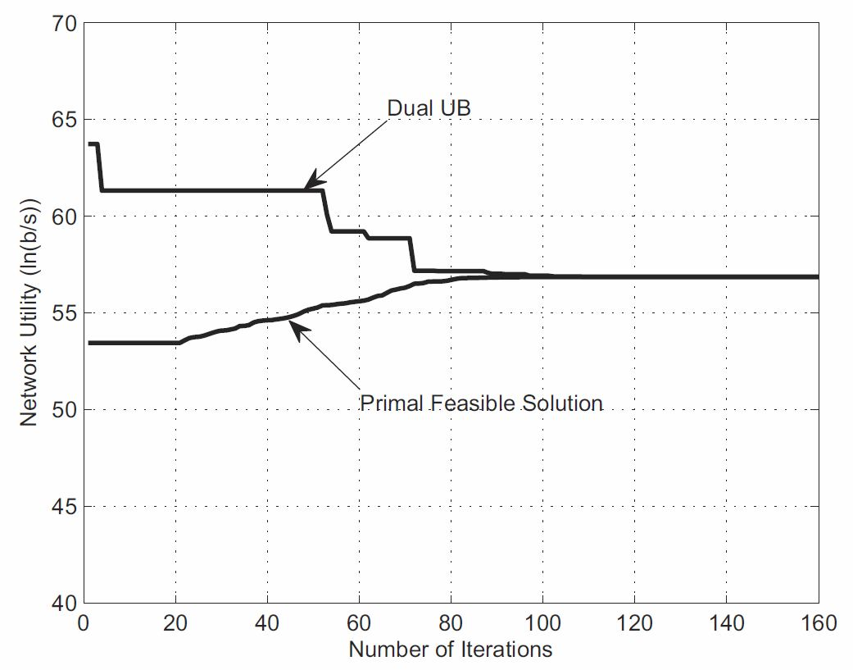
Convergence Behavior of Cutting-plane
Notes:
In this figure, “Dual UB” denotes the current objective value of the Lagrangian dual function, which can be thought of as an upper bound of the primal objective value.
“Primal Feasible Solution” denotes the current primal feasible solution recovered from the Lagrangian dual, which can be thought of as a lower bound of the optimal primal
objective value.
During each iteration, the cutting-plane method solves the Lagrangian dual problem.
The optimal objective value of the the Lagrangian dual problem (or the upper bound of the primal objective value) is non-increasingwith iterations.
Meanwhile, the primal feasible objective values keep increasing with iterations.

Slide 43
Summary
Concepts and key results in convex optimization
A case study
  Cross-layer optimization for multi-hop MIMO networks
Approach
  Lagrangian dual decomposition
  Cutting-plane algorithm for solving Lagrangian dual
The presented approach provides optimal solution to multi-hop MIMO networks

