Slide 1
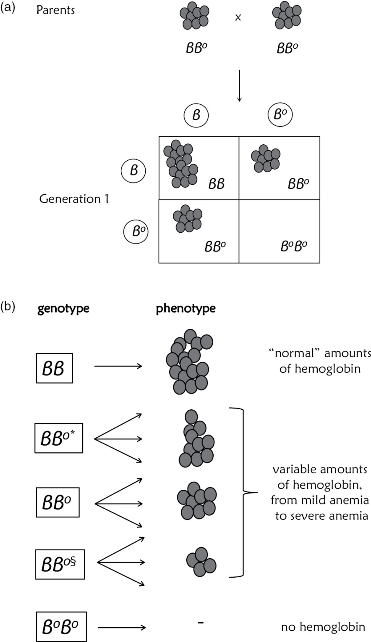
Figure 7.1

Slide 2
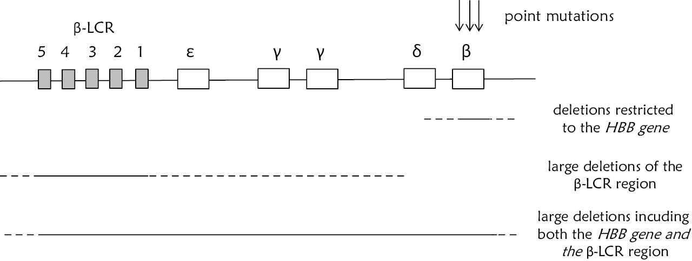
Figure 7.2

Slide 3
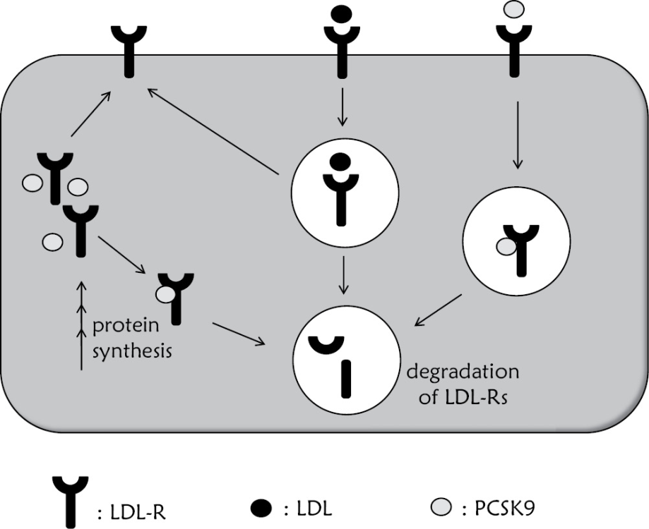
Figure 7.3

Slide 4
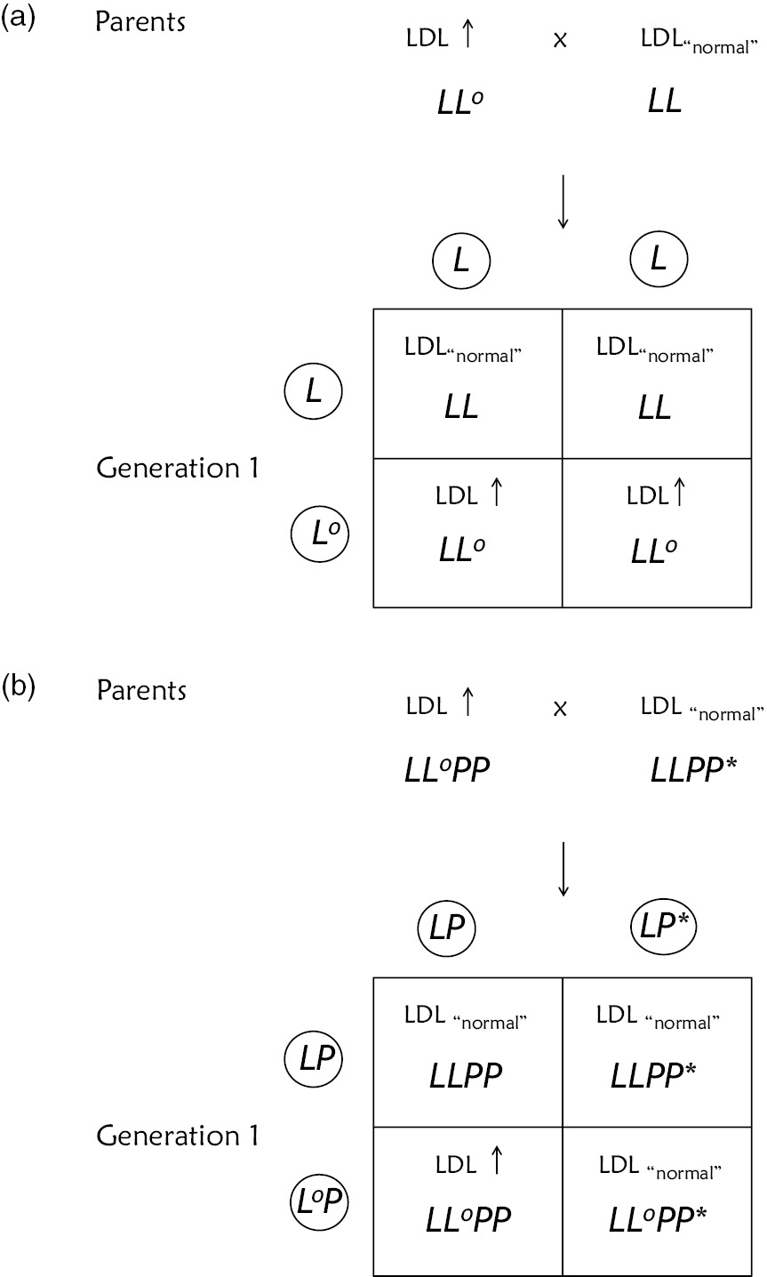
Figure 7.4

Slide 5
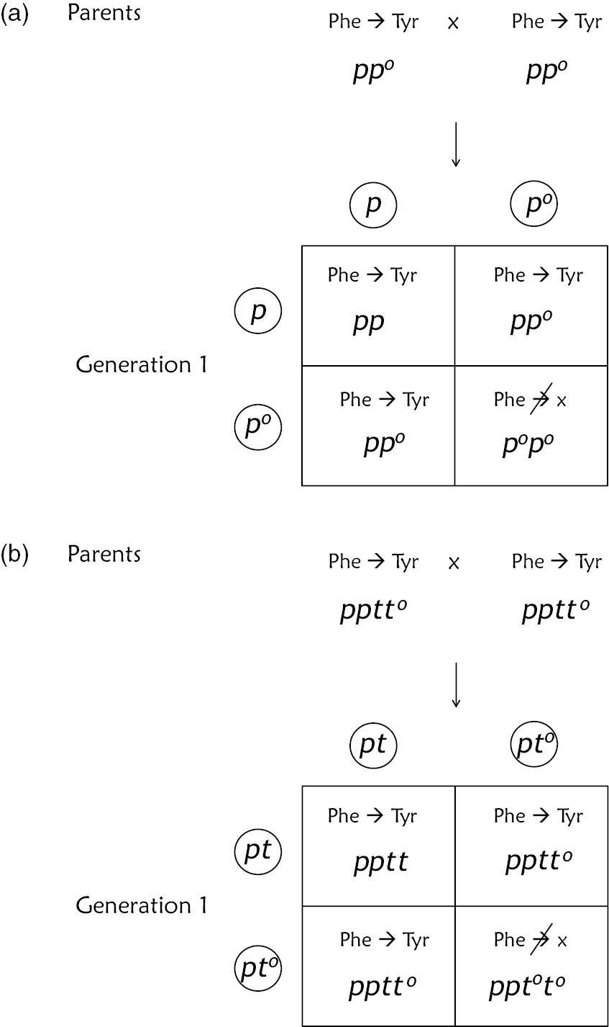
Figure 7.5

Slide 6
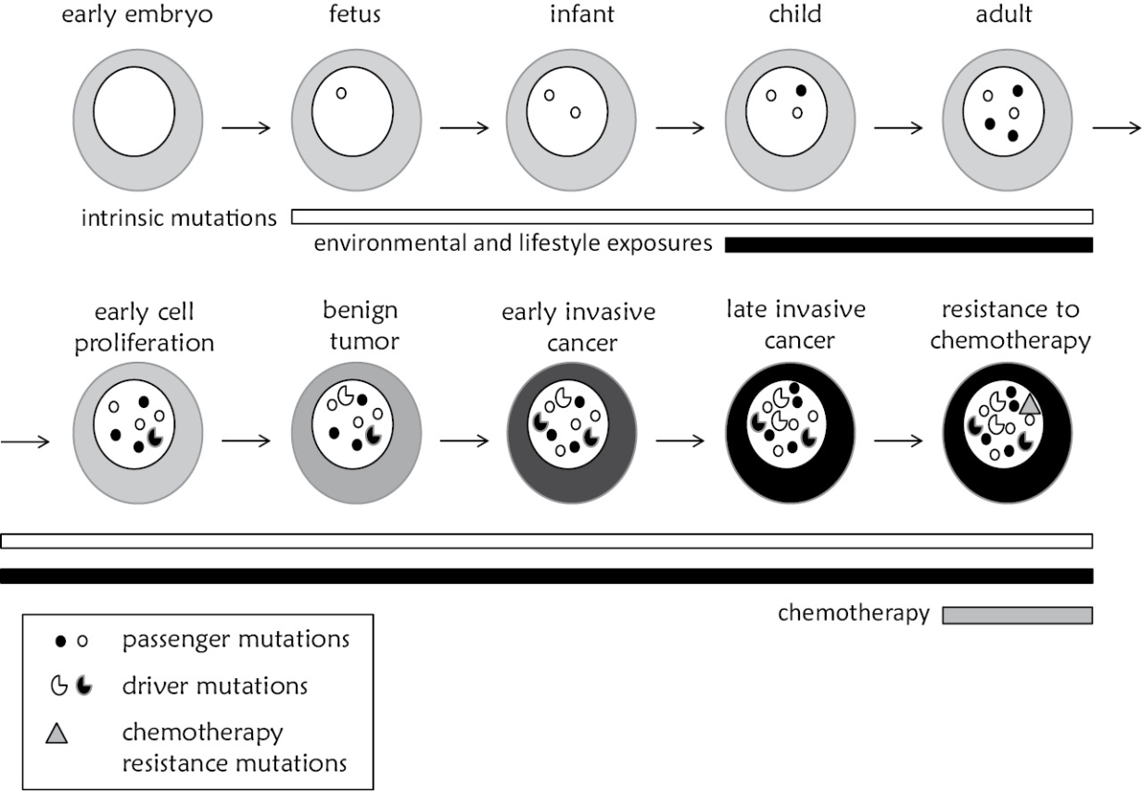
Figure 7.6

Slide 7
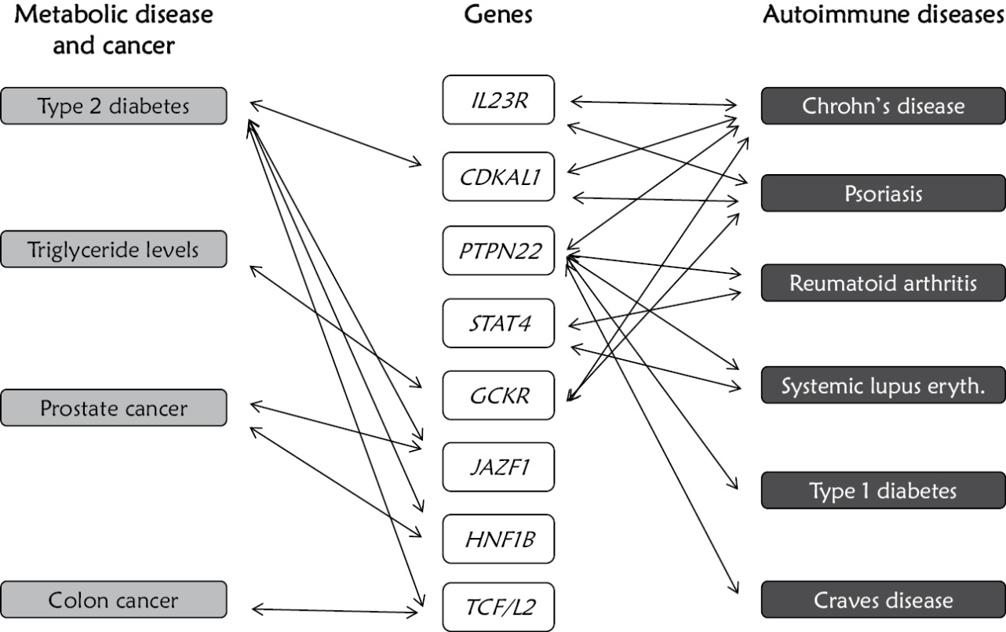
Figure 7.7

Slide 8
Figure 7.8
Due to copyright restrictions, this figure is not available online.

