Slide 3
Future of Work and Talent Management

Slide 4
Future of Work and Talent Management

Slide 5
Future of Work and Talent Management

Slide 6
Work Flow Analysis

Slide 7
Steps in Work Flow Analysis

Slide 8
Job Design, Job Redesign and Job Analysis

Slide 9
Job Analysis

Slide 11
Conducting a Job Analysis

Slide 12
Strategic Job Analysis

Slide 13
Strategic Job Analysis

Slide 15
Competency Profiling and Strategic Job Modeling

Slide 16
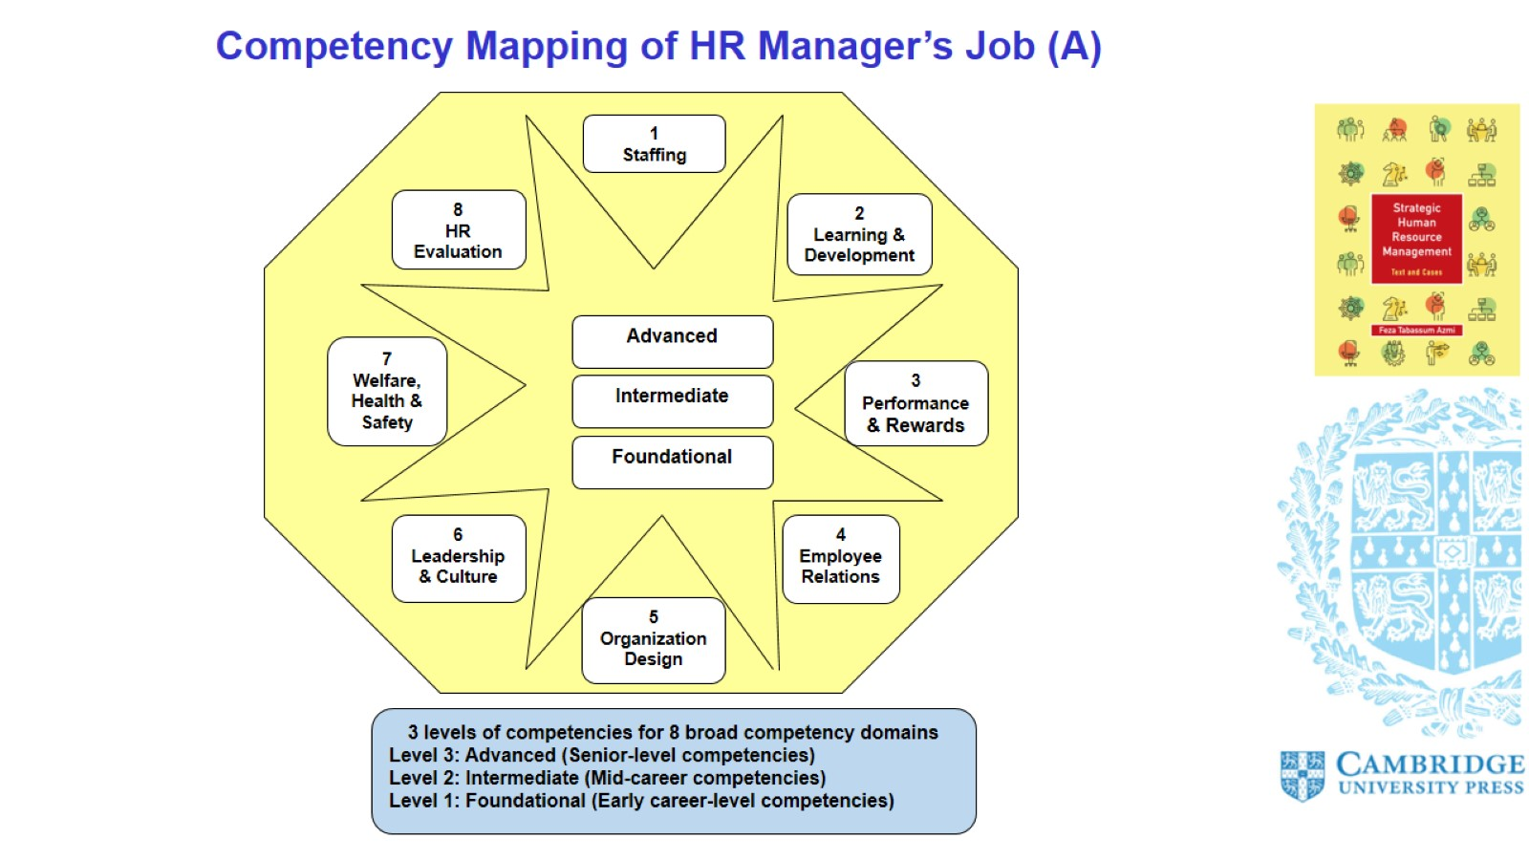
Competency Mapping of HR Manager’s Job (A)

Slide 17
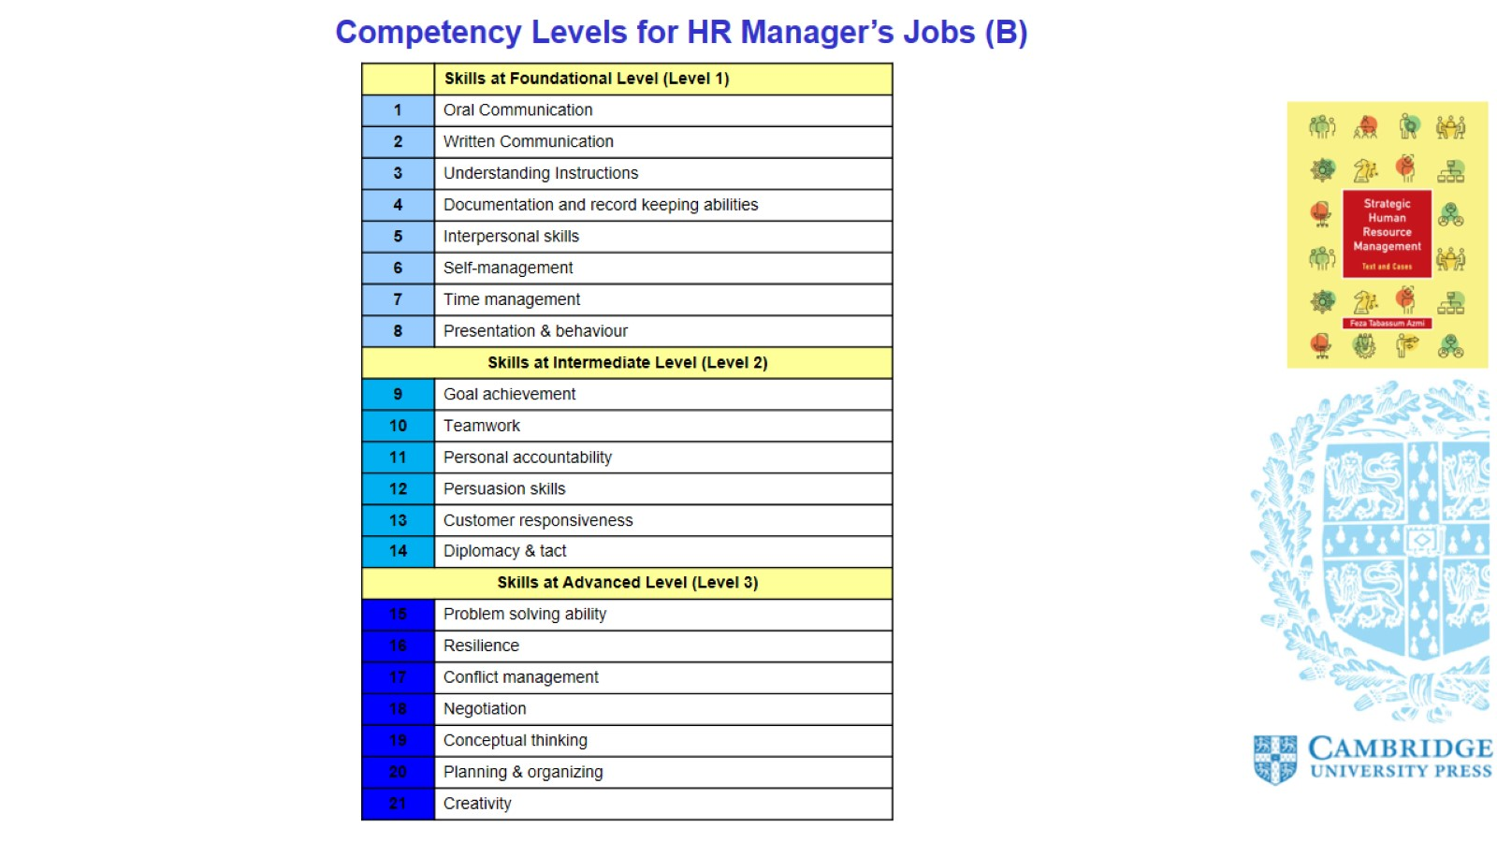
Competency Levels for HR Manager’s Jobs (B)

