Slide 1
Digital Design: A Systems Approach
Lecture 15: Interfaces, Interconnect, and Memory

Slide 2
Reading
L15: Chapters 22, 24, & 25
L16: Course Review

Slide 3
Today
Interface Timing
Interconnect
Memory

Slide 4
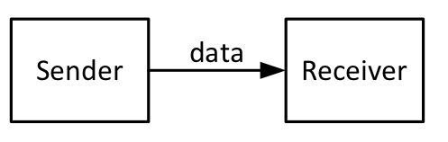
Interface Timing
How do you pass data from one module to another?
  Open loop
  Flow control
  Serialized

Slide 5
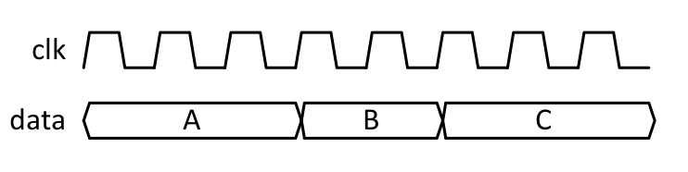
Always Valid Timing

Slide 6
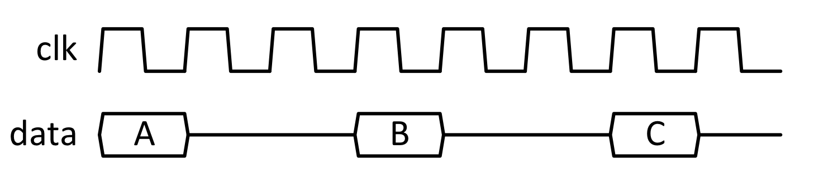
Periodically Valid Timing

Slide 7
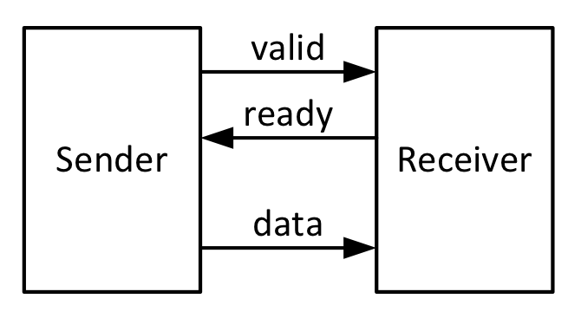
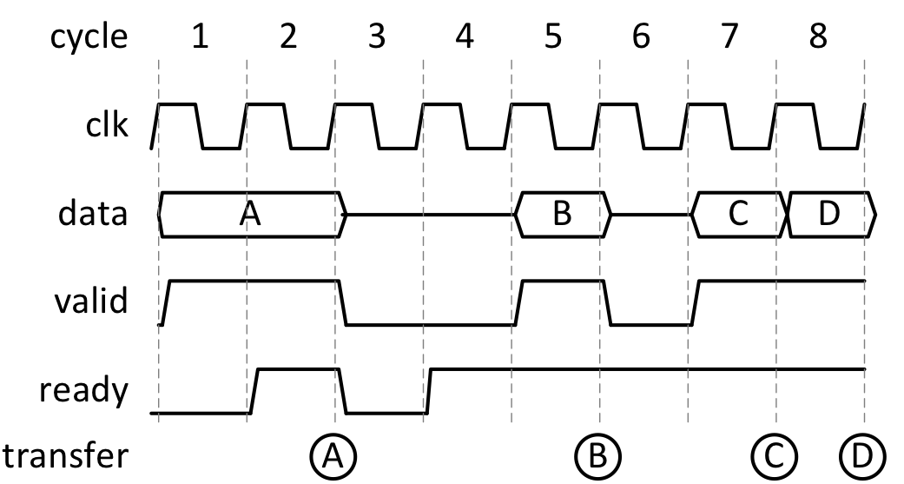
Flow Control

Slide 8
Flow-control
Valid – Tx has data available
Ready – Rx able to take data
Push flow control – assume Rx always Ready
Pull flow control – assume Tx always Valid

Slide 9
Serialization
Frame signals start of new serial frame (in this case 4 words)
Flow control can be at frame granularity or word granularity

Slide 10
Serialization with word granularity FC

Slide 11
Interconnect
Many clients need to communicate
Ad-hoc point-to-point wiring or shared interconnect
Like a telephone exchange

Slide 12
Bus

Slide 13
Verilog for a simple bus interface
// Combinational Bus Interface
// t (transmit) and r (receive) in signal names are from the perspective of the bus
module BusInt(cr_valid, cr_ready, cr_addr, cr_data, // bus rx - to the bus
ct_valid, ct_data, // bus tx - from the bus
br_addr, br_data, br_valid, // to the bus
bt_addr, bt_data, bt_valid, // from the bus
arb_req, arb_grant, // the arbiter
my_addr) ; // address of this interface
parameter aw = 2 ; // address width
parameter dw = 4 ; // data width
input cr_valid, arb_grant, bt_valid ;
output cr_ready, ct_valid, arb_req, br_valid ;
input [aw-1:0] cr_addr, bt_addr, my_addr ;
output [aw-1:0] br_addr ;
input [dw-1:0] cr_data , bt_data ;
output [dw-1:0] br_data, ct_data ;
// arbitration
wire arb_req = cr_valid ;
wire cr_ready = arb_grant ;
// bus drive
// assumes bus ORs these signals with those from other interfaces
wire br_valid = arb_grant ;
wire [aw-1:0] br_addr = arb_grant ? cr_addr : 0 ;
wire [dw-1:0] br_data = arb_grant ? cr_data : 0 ;
// bus receive
wire ct_valid = bt_valid & (bt_addr == my_addr) ;
wire [dw-1:0] ct_data = bt_data ;
endmodule

Slide 14
Crossbar Switch

Slide 15
Interconnection Networks

Slide 16
Interconnection Networks

Slide 17
What factors determine which interconnect solution you pick?

Slide 18
Memory
Address
Data
Capacity
Bandwidth
Latency
Granularity

Slide 19
SRAM Primitive

Slide 20
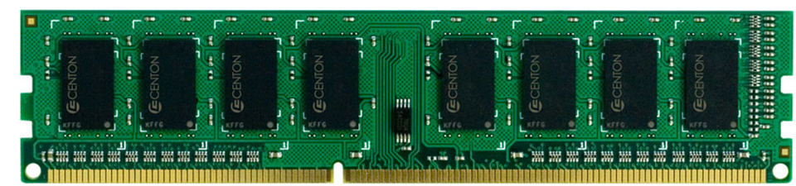
DRAM Primitive

Slide 21
DRAM Operation

Slide 22
What if you need more memory or more bandwidth than one primitive?

Slide 23
Bit-Slicing

Slide 24
Banking

Slide 25
Bit slicing & banking

Slide 26
Interleaving

Slide 27
Avoid head-of-line blocking

Slide 28
Hierarchy

Slide 29
Summary
Interface timing
  Convention about when data is transferred
    When valid, when accepted
    Open loop – always valid or periodic
    Ready-valid flow-control, both ways, push, or pull
  Serialization
Interconnect
  Allow any pair of clients to communicate
  Bus, Crossbar, Network
Memory
  Capacity, bandwidth, latency, and granularity
  SRAM and DRAM primitives
  Bit-slice bank, or interleave to combine primitives
  Hierarchy

