Slide 1
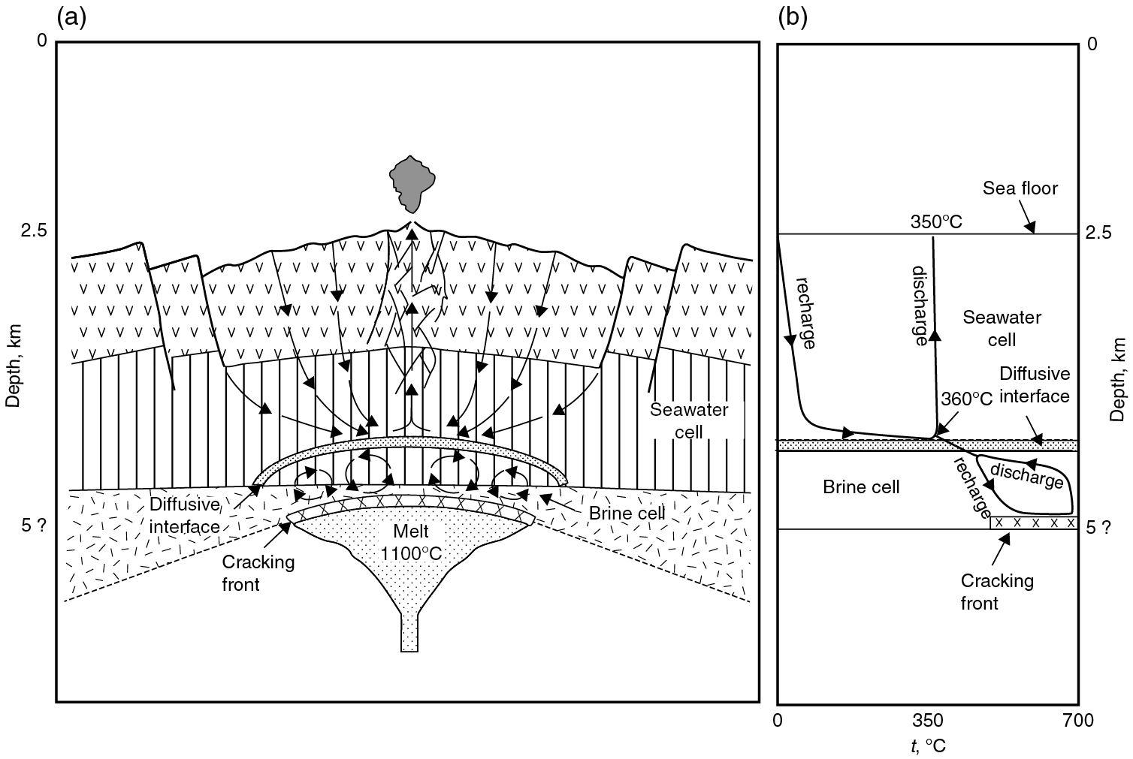
PILSON_Fig 13_01
© Cambridge University Press 2012

Slide 2
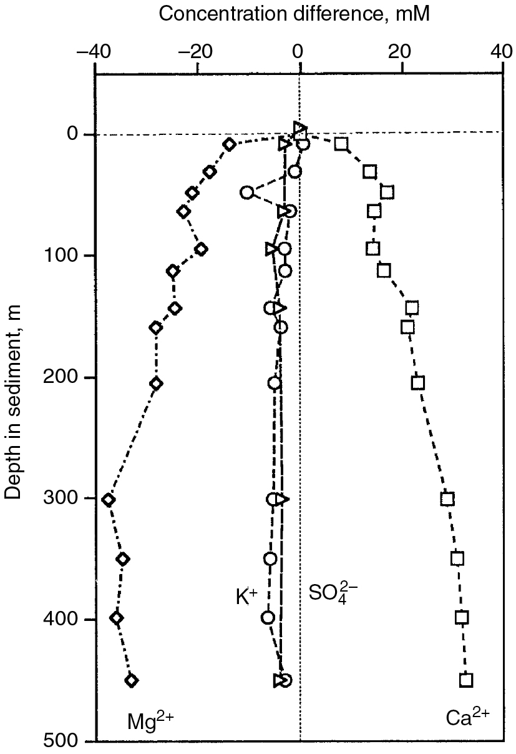
PILSON_Fig 13_02
© Cambridge University Press 2012

Slide 3
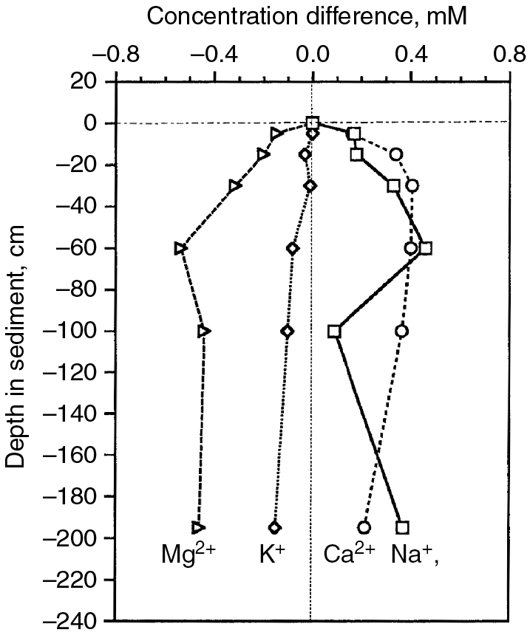
PILSON_Fig 13_03
© Cambridge University Press 2012

Slide 4
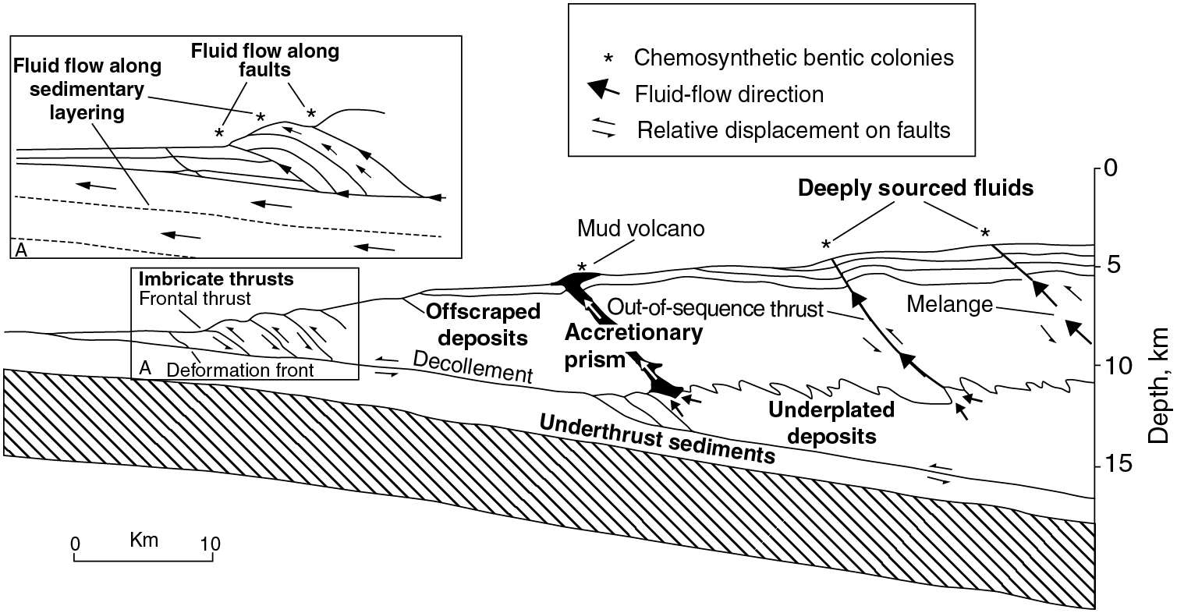
PILSON_Fig 13_04
© Cambridge University Press 2012

