Slide 1
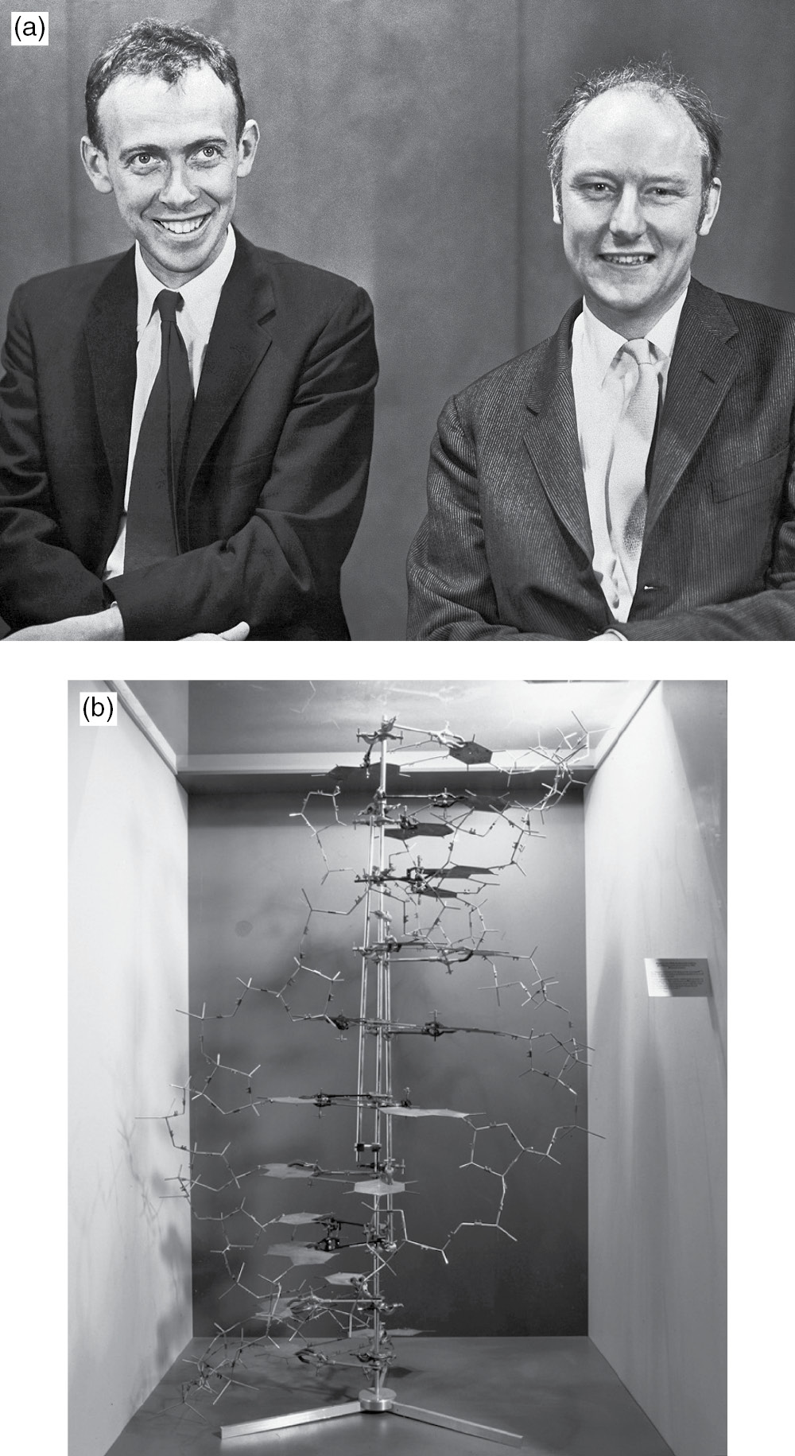
Figure 3.1

Slide 2
Figure 3.2
Due to copyright restrictions, this figure is not available online.

Slide 3
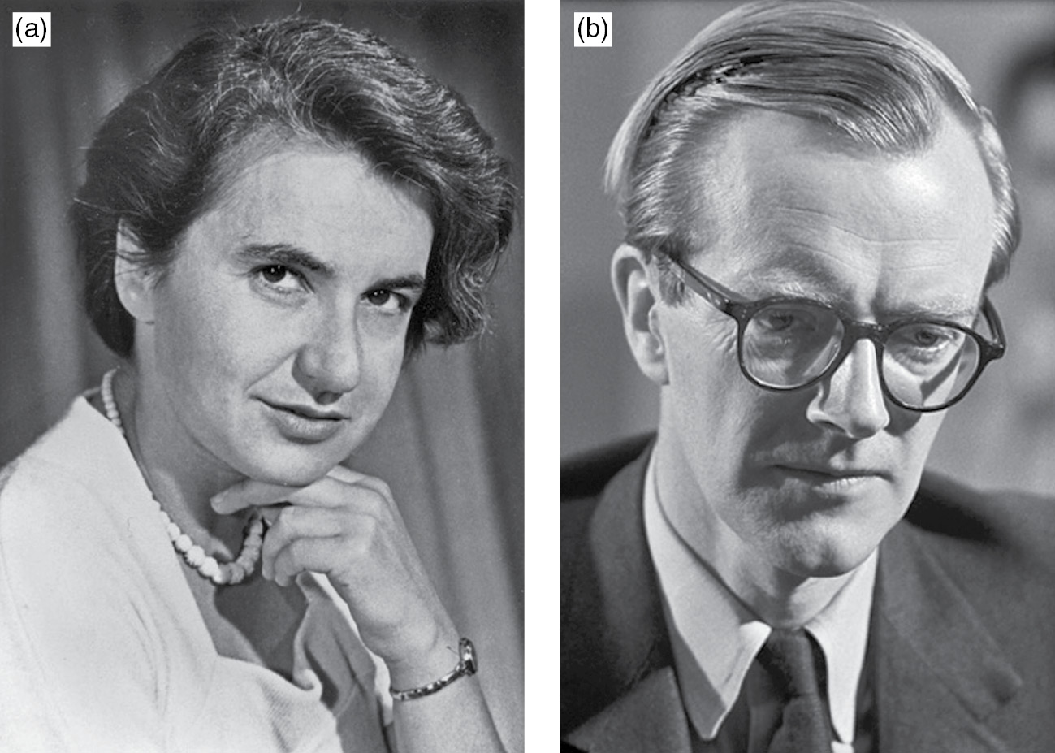
Figure 3.3

Slide 4
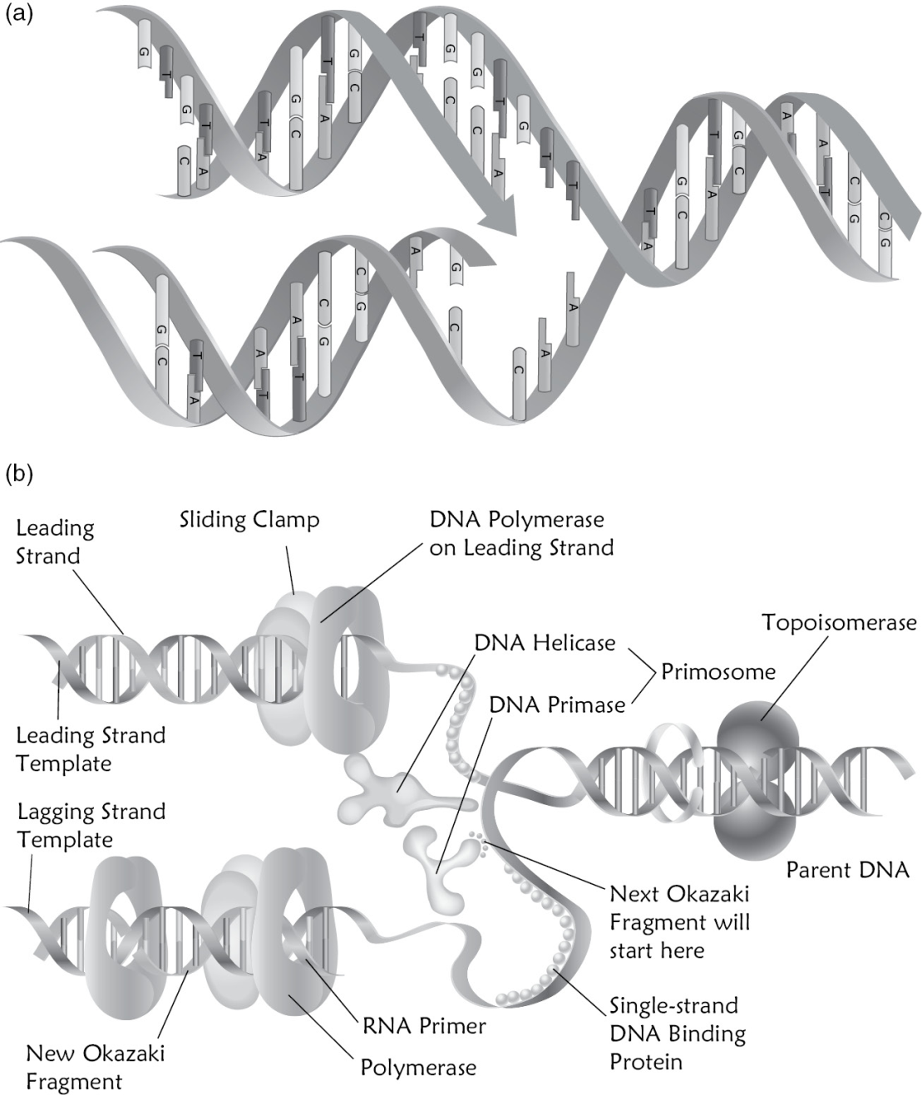
Figure 3.4

Slide 5
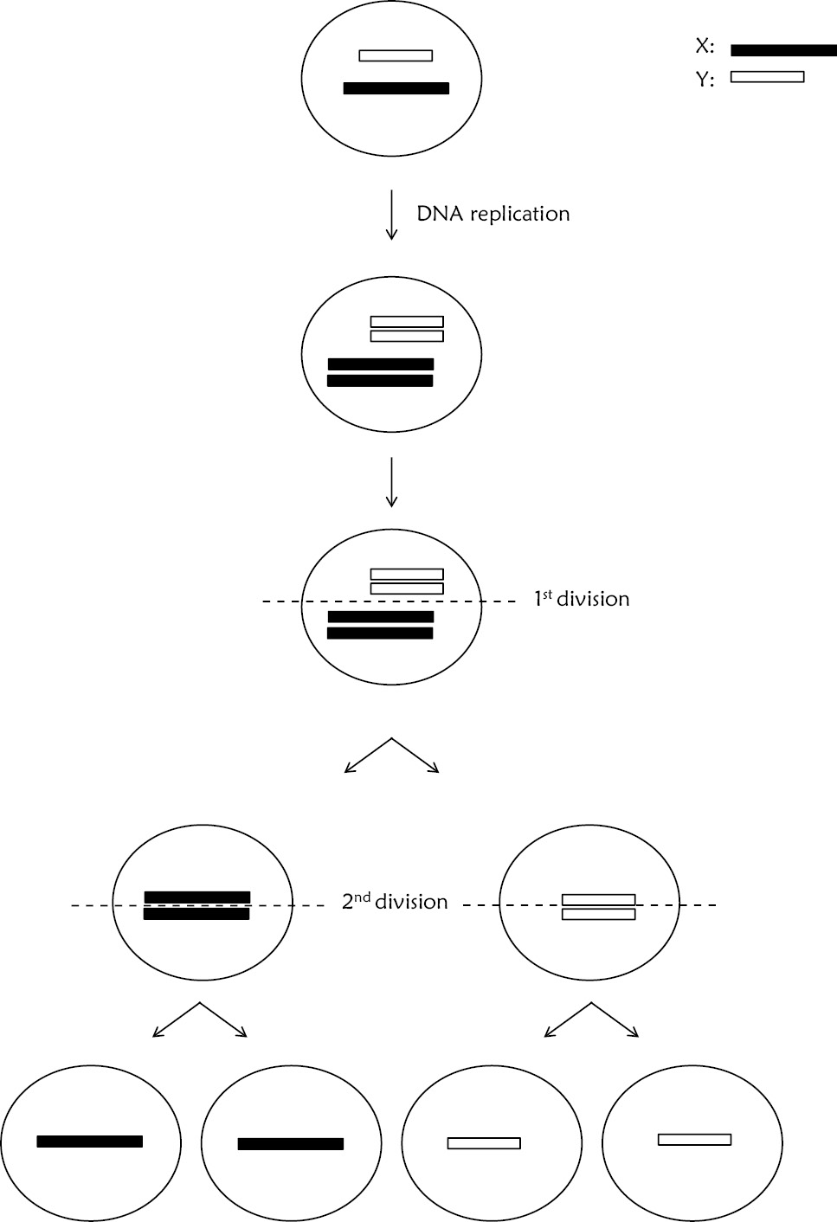
Figure 3.5

Slide 6
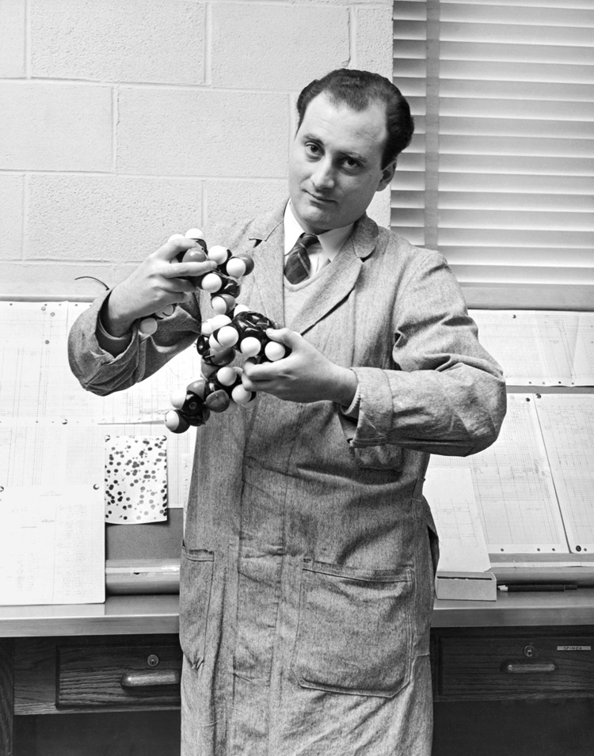
Figure 3.6

Slide 7
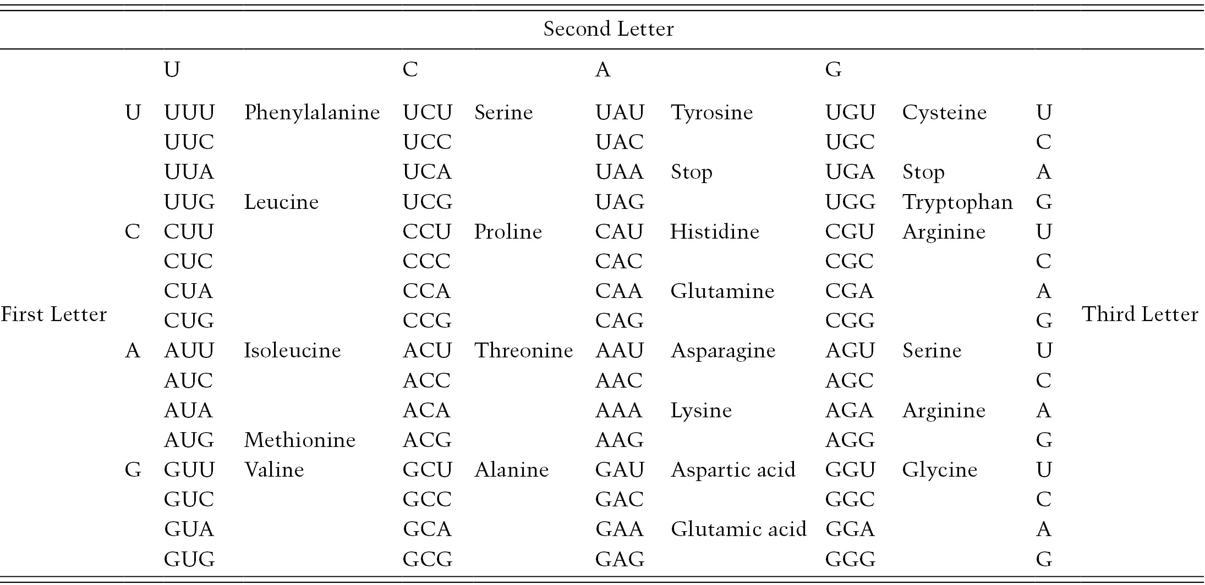
Table 3.1

Slide 8
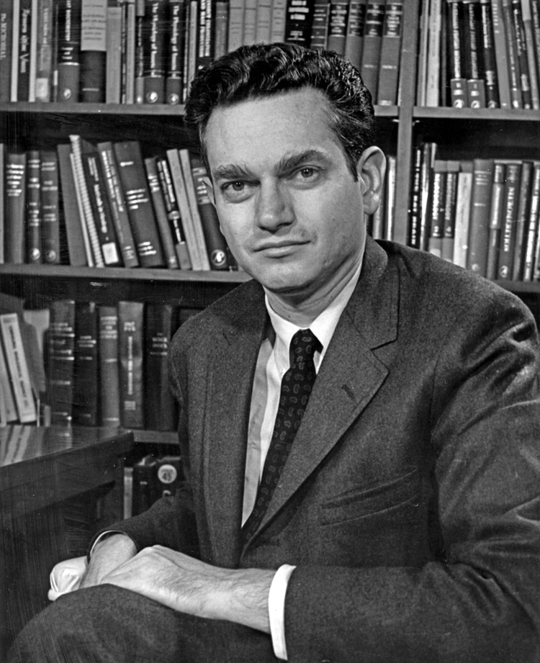
Figure 3.7

Slide 9
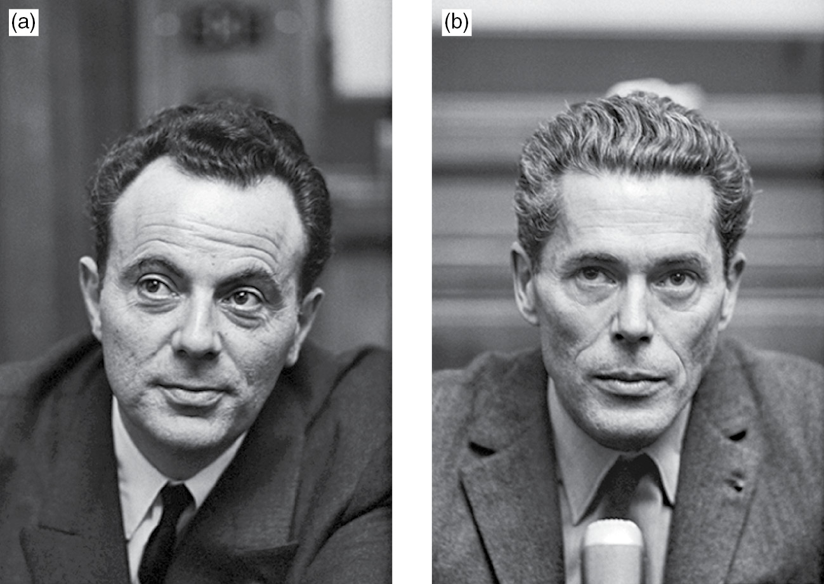
Figure 3.8

Slide 10
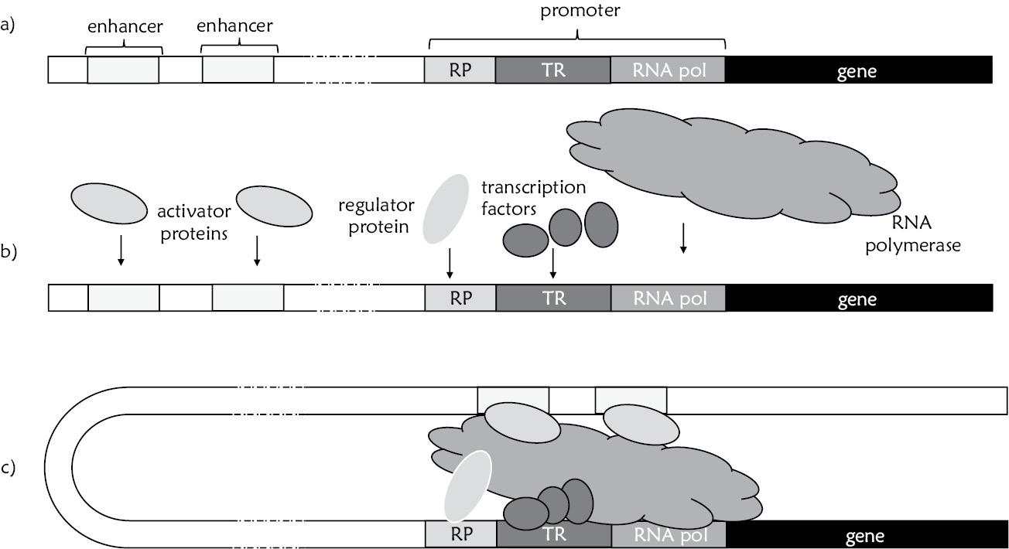
Figure 3.9

Slide 11
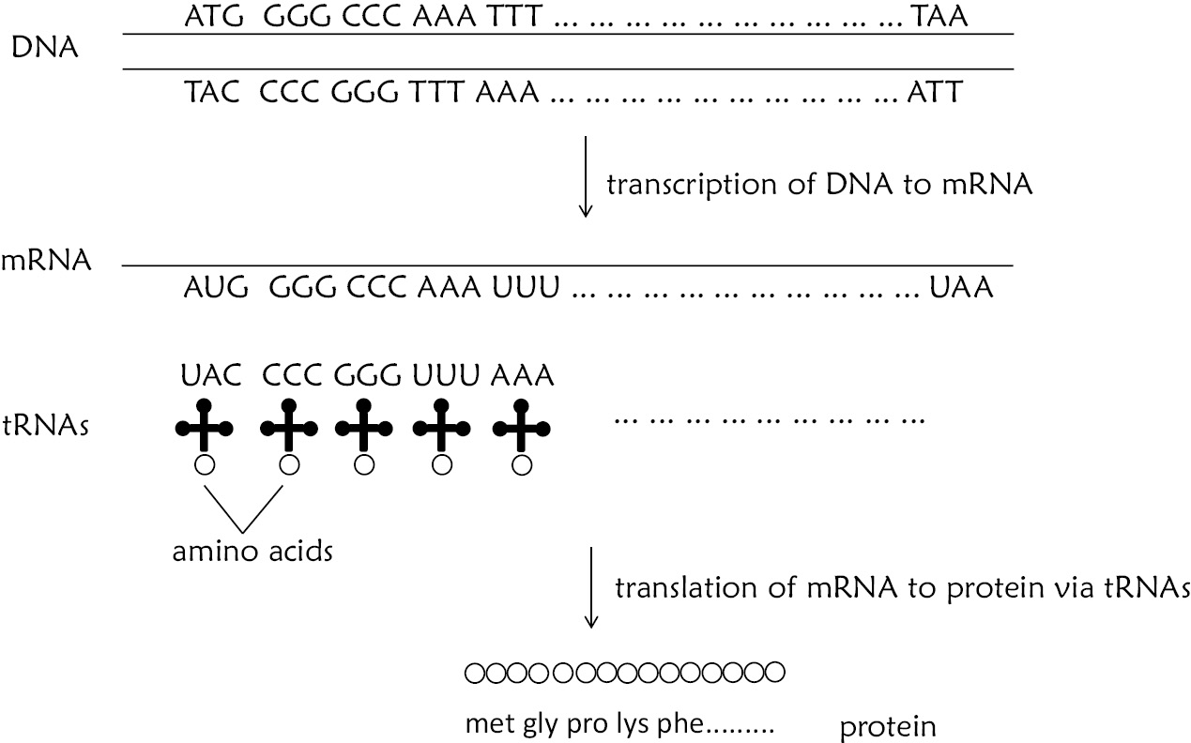
Figure 3.10

Slide 12
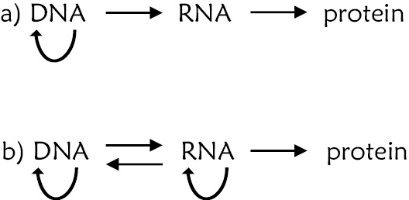
Figure 3.11

