Slide 1
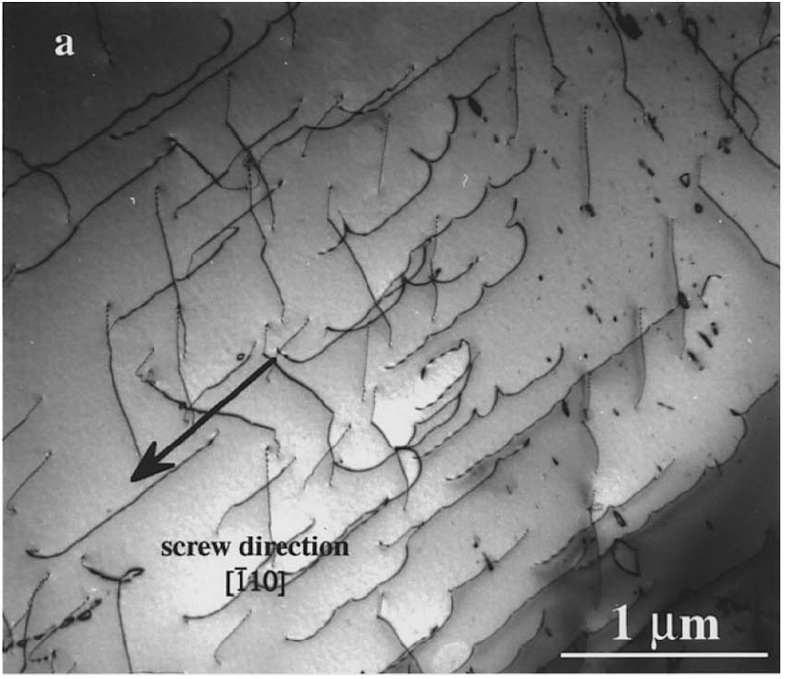
jog
bowing on
screw direction
[110]

Slide 2
A
xy
B
z
xz
y
x
b
xy
b
ξ
Notes:
3.19” x 4”, tiff.

Slide 3
z
y
x
v
vacancies
l
h
ξ
b
Notes:
3.81” x 4”, tiff.

Slide 4
B
A
a
l
Notes:
0.74” x 3”, tiff.

Slide 5
C, D
B
a*
A
C
a
(a)
D
l
W
B
E
E
C
D
A
(b)
reaction coordinate
Notes:
3.37” x 4”, tiff.

Slide 6
W
B
E
E
C
D
A
reaction coordinate
Notes:
2.54” x 4”, tiff.

Slide 7
δη(y)
A
B
y
Notes:
1.32” x 3”, tiff.

Slide 8
C
B
A
a*
l
Notes:
1.02” x 3”, tiff.

Slide 9
B
l
A
F
F
F
F
Notes:
1.28” x 3”, tiff.

Slide 10
C
B
A
δη
P
η
F_{η}
Notes:
3.18” x 3”, tiff.

Slide 11
v
interstitial
production
plateau
0
σ
σ_{crit}
Notes:
1.65” x 3”, tiff.

Slide 12
l
int.
vac.
int.
vac.
int.
Notes:
0.7” x 3”, tiff.

Slide 13
B
C
A
L
L'
Notes:
2.25” x 3”, tiff.

Slide 14
B
A
Notes:
0.92”x 3”, tiff.

Slide 15
(c)
(b)
B
B'
A'
A
v
b
(a)
ξ
Notes:
1.58” x 3”, tiff.

Slide 16
(4)
(3)
(2)
(1)
A,B
B
B
A
A
Notes:
2.79” x 3”, tiff.

Slide 17
B
B
B
A
A
A
Notes:
2.69” x 3”, tiff.

Slide 18
C
δB
Aδ
B
A
γδ
D
γB
δγ
Aγ
δB
Aδ
Notes:
1.93” x 3”, tiff.

Slide 19
(a)
αβ
δB
Aδ
C
D
Bα
αδ
βA
B
A
βδ
αA
Bβ
αδ
βδ
Bα
βA
(b)
(c)
Notes:
2.51” x 3”, tiff.

Slide 20
αA
Aβ
C
δA
δA
αA
δα
βδ
B
A
Bα
Bδ
Bα
βB
D
Bδ
(1)
(2)
δA
δA
δA
Cβ
δβ/AC
αβ/AC
Cβ
δβ/AC
Bδ
BA
Bδ
δα
Bβ/AC
Bα
Bδ
(3)
(4)
(5)
δA
δβ/AC
αδ/BA
δA
δA
αβ/AC
δα
Bα
αδ/BA
Bα
Cα
δC
Cα
δα
αC
Bδ
αA
Bδ
Bδ
Bα
Bα
(6)
(7)
(8)
Notes:
7” x 4.53”, tiff.

Slide 21
Bβ
δA
δA
βδ/AB
Cβ
βδ/AC
Bδ
Bβ
δA
βδ/AB
βA
βδ/AB
Bδ
BC
βA
(1)
βA
Bδ
(2)
(3)
Notes:
3.94” x 5”, tiff.

Slide 22
δA
αβ
βδ
C
δα
βA
Aδ
B
A
Bδ
Bα
αδ
δB
D
(1)
(4)
αβ
βδ
γA
αγ
δα
γδ
δA
δγ
δA
βγ
γA
αδ
Aδ
(2)
(3)
Notes:
2.95” x 5”, tiff.

Slide 23
z
x
y
(a)
(b)
Notes:
2.04” x 5”, tiff.

Slide 24
(a)
0.25 μm
(b)
Notes:
7” x 4.41”, tiff.

Slide 25
δA
Bδ
h
l
F
F
F
Notes:
1.22” x 3”, tiff.

