Slide 1
Digital Design: A Systems Approach Lecture 13: Metastability and Synchronization Failure (or When Good Flip-Flops go Bad)

Slide 2
Readings
L13: Chapters 27 & 28
L14: Sequential Logic Review

Slide 3
What happens when we violate setup and hold time constraints?

Slide 4
Look at structure of CMOS latch
Storage loop gets initialized with an ‘analog’ value
Latch is a “time-to-voltage” converter

Slide 5
Storage loop has a metastable state between 0 and 1

Slide 6
Dynamics of ΔV

Slide 7
Dynamics of ΔV

Slide 8
Metastability Demonstration Circuit

Slide 9
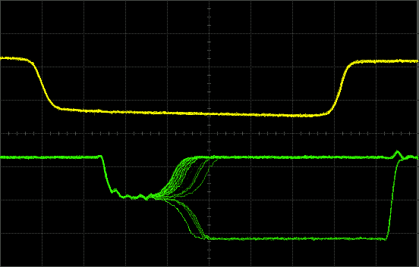
Metastable state of FF1 – 4007 Nand RS Latch

Slide 10
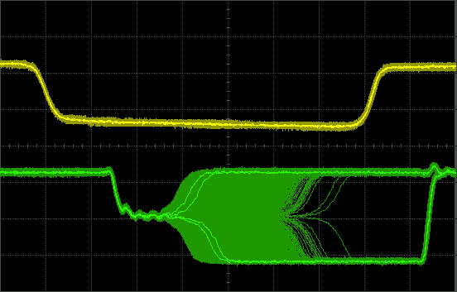
Over time the waveform fills in

Slide 11
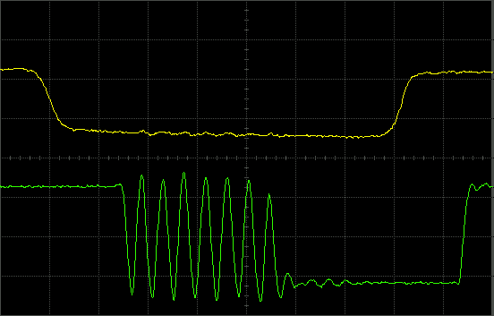
Metastable state of 4011 Nand RS Latch What’s going on here?

Slide 12
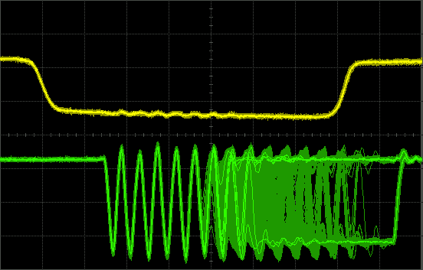
Over time this waveform fills in too

Slide 13
Actual circuit of 4011 Nand RS Latch

Slide 14
Initial state when both inputs are low

Slide 15
When both inputs go high, it becomes a 6-stage ring oscillator Oscillation is metastable

Slide 16
Oscillation is metastable

Slide 17
If delays are balanced, ring sequences through six states repeatedly

Slide 18
A Brute-Force Synchronizer

Slide 19
What if AW is still in a metastable state when FF2 is clocked?

Slide 20
Calculating Synchronization Failure (The Big Picture)
P(failure) = P(enter metastable state) x P(still in state after t_{w})

Slide 21
Probability of Entering a Metastable State
FF1 may enter the metastable state if the input signal transitions during the setup+hold window of the flip flop
Probability of a given transition being in the setup+hold window is the fraction of time that is setup+hold window

Slide 22
Probability of Staying in the Metastable State
Still in metastable state if initial voltage difference was too small to be exponentially amplified during wait time
Probability of starting with this voltage is proportion of total voltage range that is ‘too small’

Slide 23
Failure Probability and Error Rate
Each event can potentially fail.
Failure rate = event rate x failure probability

Slide 24
Example
t_{s} = t_{h} = t_{dCQ} = τ =100ps
t_{cy} = 2ns
must sample a f_{E} = 1MHz asynchronous signal
P_{E} = (.1+.1)/2 = 0.1
P_{S} = exp(-1.8/.1) = exp(-18) = 1.5 x 10⁻⁸
P_{F} = P_{S}P_{E} = 1.5 x 10⁻⁹
f_{F} = f_{E}P_{F} = 1.5 x 10⁻³
1 failure every 656 seconds ~ every 11 minutes
This is not adequate. How do we improve it?
How do we get failure rate to one every 10 years ~ 3 x 10⁸s (f_{F} < 3 x 10⁻⁹)

Slide 25
Synchronizing multi-bit signals
Consider a 4-bit counter running on clk1 you need the value of this counter sampled by clk2. Will the following circuit work? (assume t_{w} >> τ)
This happens, for example, in a FIFO where the head and tail pointers are in different clock domains.

Slide 26
Multi-bit signals (2)
When synchronizing a multi-bit signal, each changing bit is independently synchronized
Consider what happens on the 0111 to 1000 transition. All bits are changing. Each can independently fall either way.
How do you fix this?

Slide 27
Warning: The Surgeon General has determined that passing binary-coded and one-hot signals through a brute-force synchronizer can be hazardous to your circuits.

Slide 28
Solution:
Use a Gray code counter
For all but the MSB:
next_b[i] = (b[i-1] & !(|b[i-2:0])) ? !xor(b[n-1:i+1]) : b[i];
For the MSB:
next_b[i] = (|b[i-2:0]) ? b[i] : b[i-1] ;
Can we use this Gray code for the head and tail pointers of our FIFO?

Slide 29
module GrayCount4(clk, rst, out) ;
input clk, rst ;
output [3:0] out ;
wire [3:0] out, next ;
DFF #(4) count(clk, next, out) ;
assign next[0] = !rst & !(out[1]^out[2]^out[3]) ;
assign next[1] = !rst & (out[0] ? !(out[2]^out[3]) : out[1]) ;
assign next[2] = !rst & ((out[1] & !out[0]) ? !out[3] : out[2]) ;
assign next[3] = !rst & (!(|out[1:0]) ? out[2] : out[3]) ;
endmodule

Slide 30
# xxxx
# 0000
# 0001
# 0011
# 0010
# 0110
# 0111
# 0101
# 0100
# 1100
# 1101
# 1111
# 1110
# 1010
# 1011
# 1001
# 1000
# 0000
# 0001
# 0011
# 0010

Slide 31
Metastability and Synchronization Failure Summary
Clocking a flip-flop during the “keepout” interval may leave the storage node in an “illegal state”
Some “illegal states” are Metastable
Time to decay to a legal state depends on log of initial voltage
Probability of entering metastable state is probability of hitting “keepout” interval.
Probability of staying in metastable state after time T is probability that initial voltage was too small to decay in time T
Brute-force synchronizer – sample signal and wait for metastable states to decay.
Don’t use on multi-bit signals unless they are Gray coded

