Slide 1
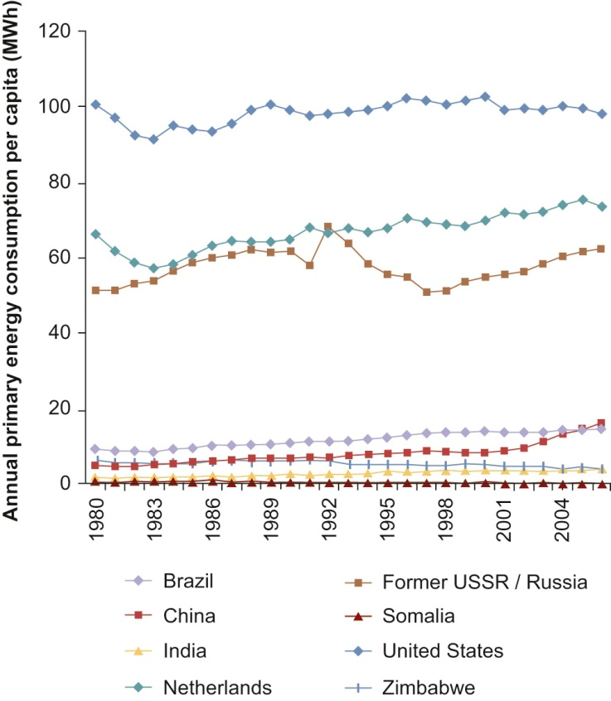
Fig 02_01
© Materials Research Society 2012

Slide 2
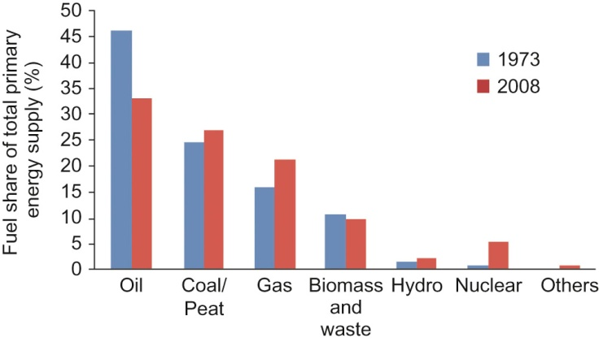
Fig 02_02
© Materials Research Society 2012

Slide 3
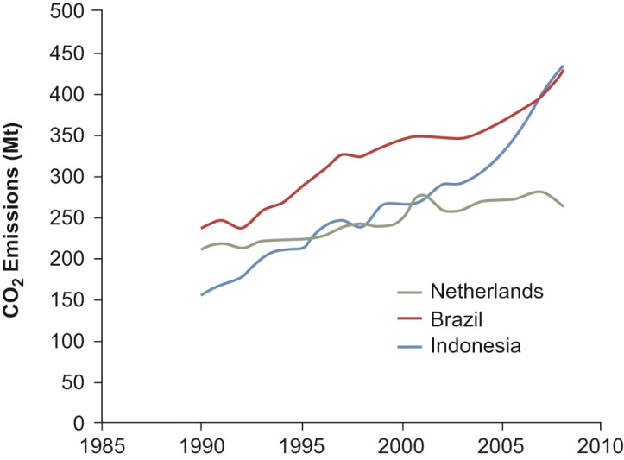
Fig 02_03
© Materials Research Society 2012

