Slide 1
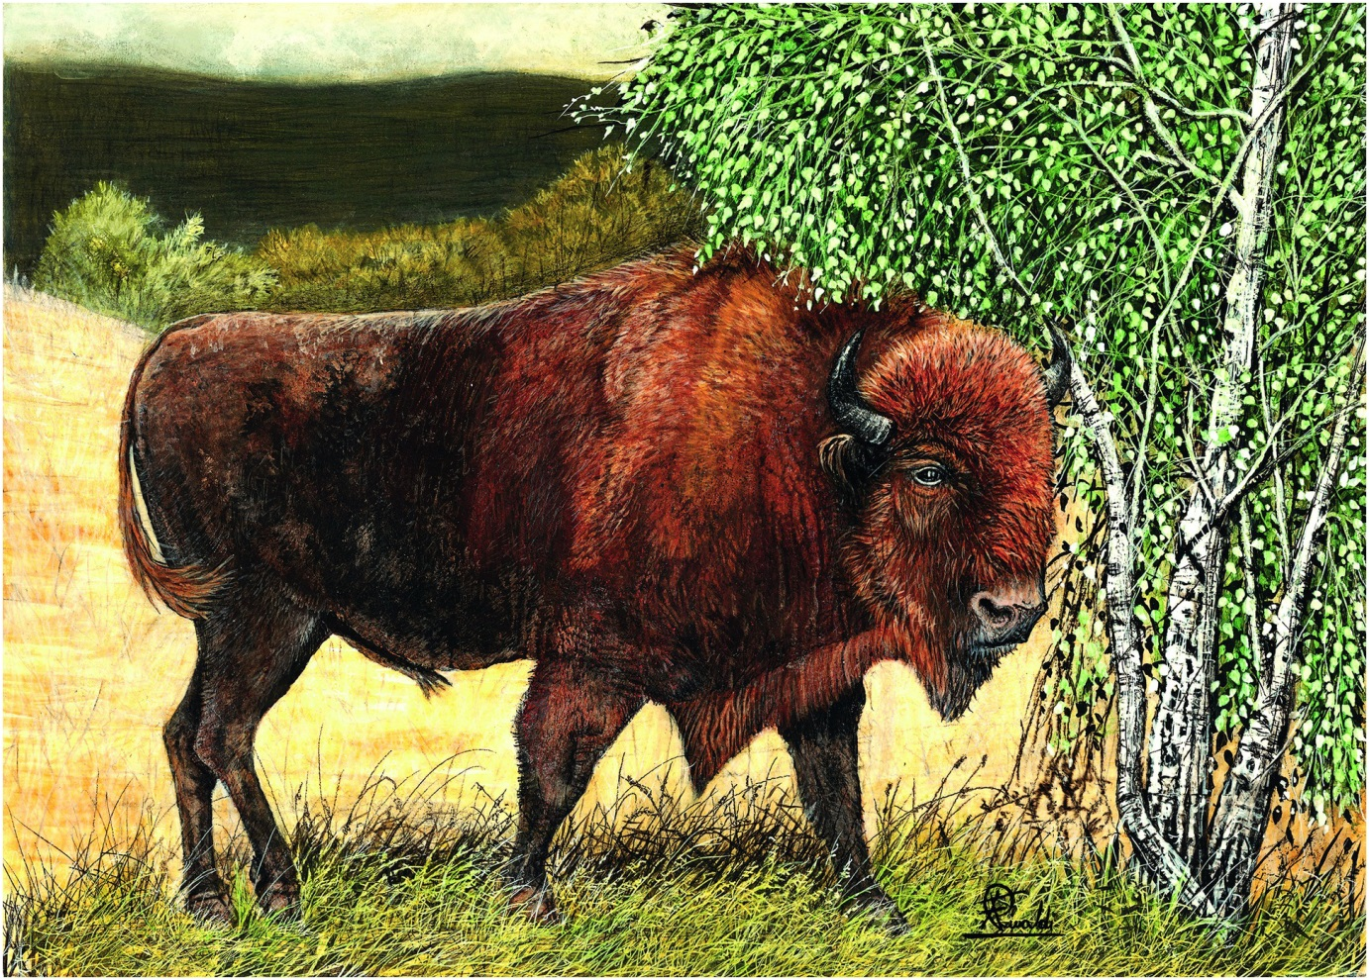
Plate 13
European bison (illustration by Francesco Rinaldi)

Slide 2
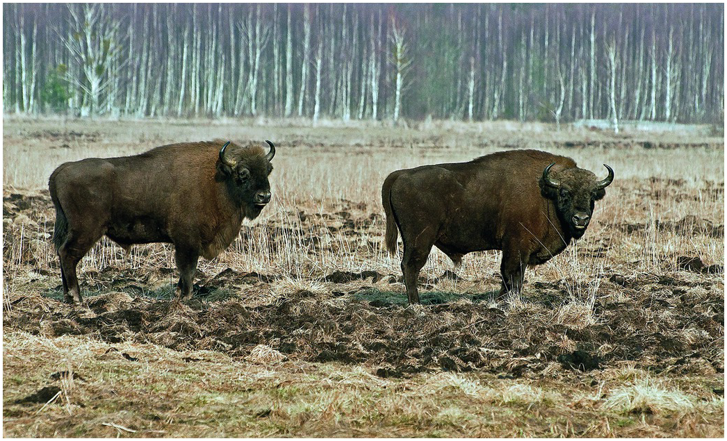
Figure 10.15
Adult bulls foraging on the meadow outside of Białowieża Forest, March 2011.
Photo by T. Kamiński.

Slide 3
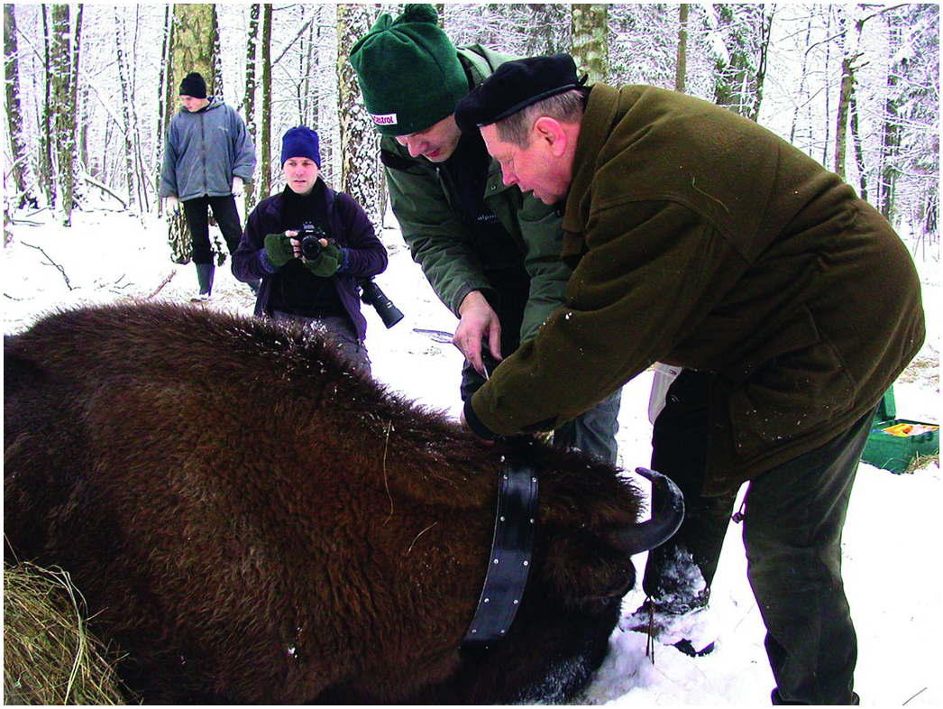
Figure 10.16
Dr R. Kowalczyk from Mammal Research Institute PAS and Dr Z.A. Krasiński from Białowieża National Park are fitting the radio-collar to bison cow, Białowieża Forest, winter 2005. Photo by T. Kamiński.

Slide 4
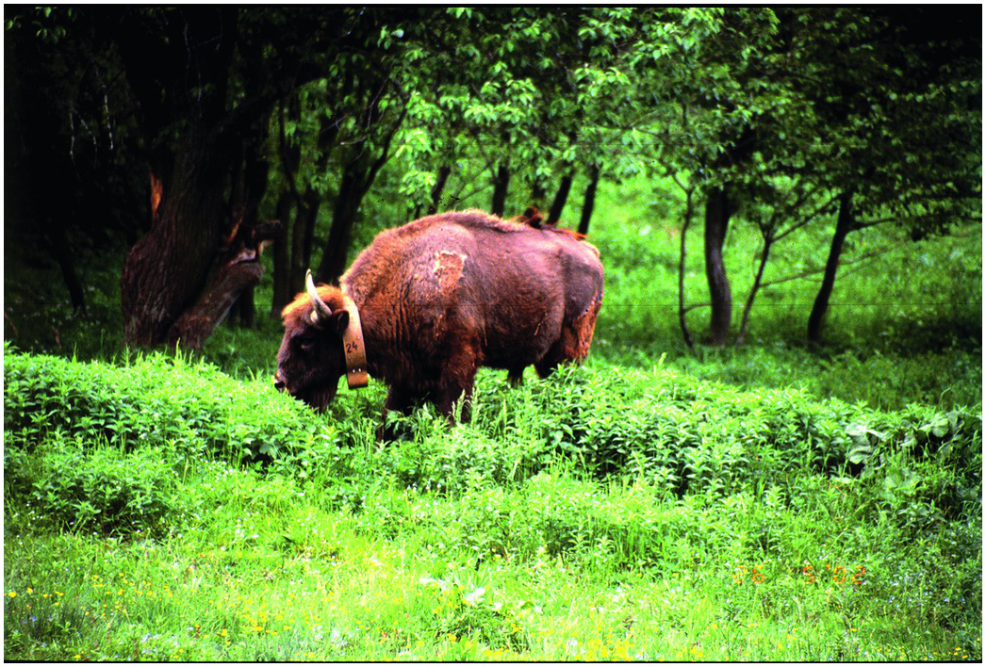
Figure 10.18
A Young bull imported from Sweden, fitted with radio-collar - after its release at Bieszczady Mts. Photo by K. Perzanowski

Slide 5
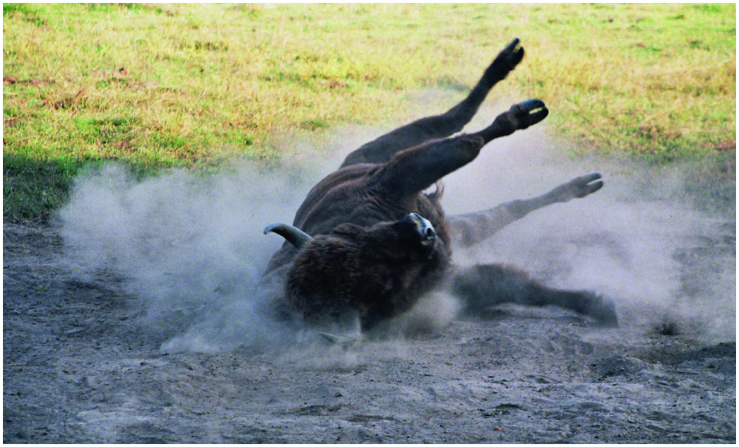
Figure 10.19
Wallowing is the most often observed behaviour among adult bulls in the breeding season. Photo by M. Hławiczka.

Slide 6
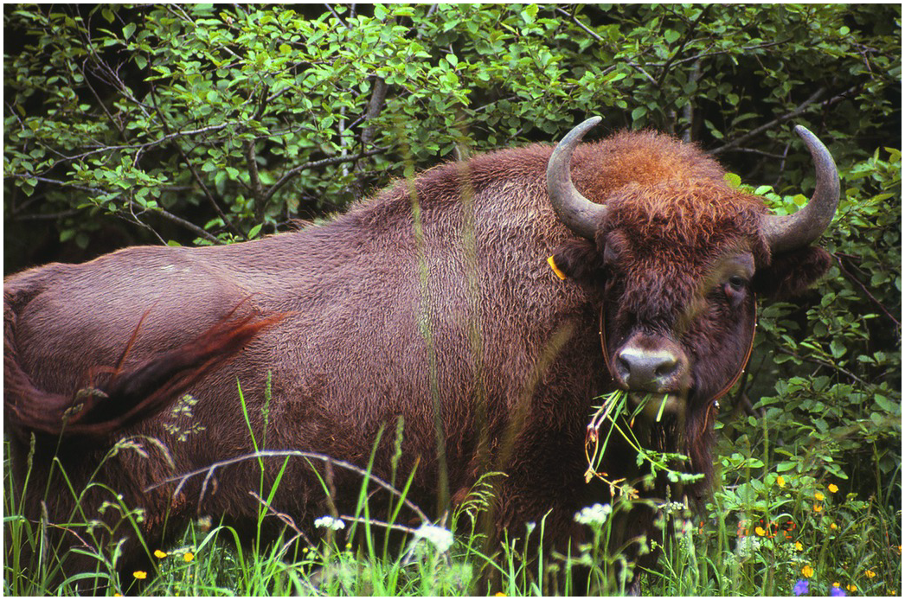
Figure 10.20
A young European bison feeds on natural forage after being released to the wild. Photo by K. Perzanowski.

Slide 7
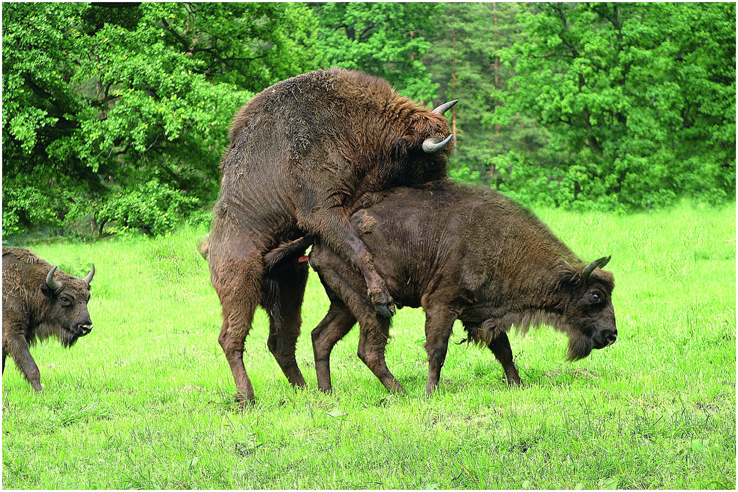
Figure 10.21
A bull mates a cow during the rutting season at European Bison Breeding Centre in Pszczyna (Poland). Photo by M. Hławiczka.

Slide 8
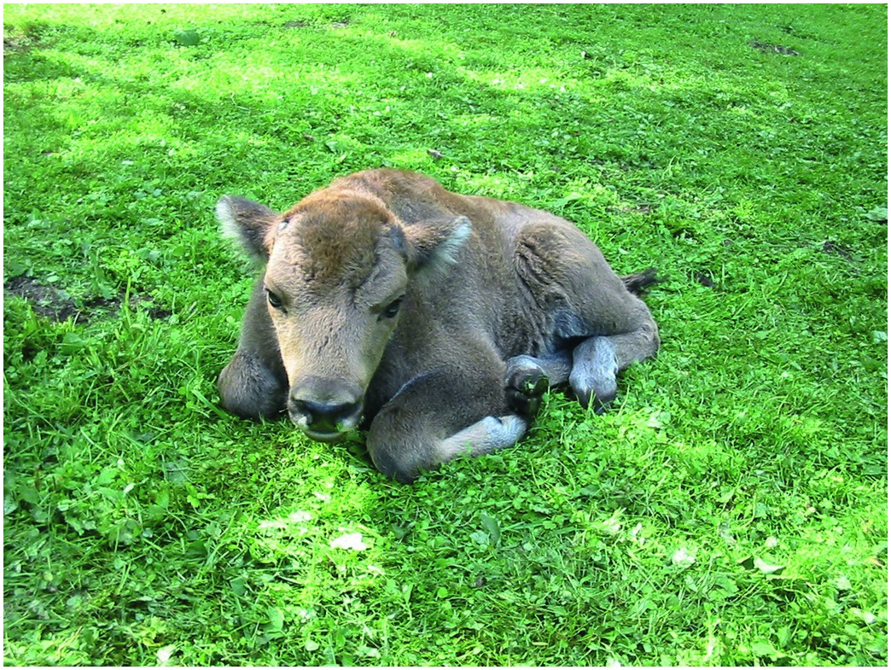
Figure 10.24
Several days old calf, rescued after a torrent at Bieszczady Mts.
Photo by K. Perzanowski.

Slide 9
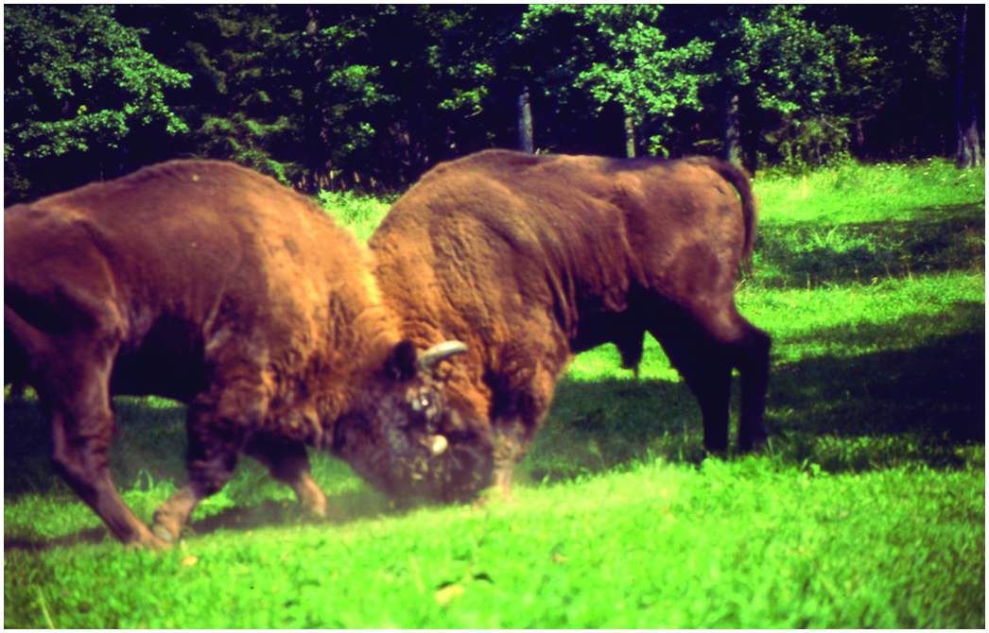
Figure 10.30
Beginning of the contest, bulls with low bowed heads are pushing at each other. Photo by Z. A. Krasiński.

Slide 10
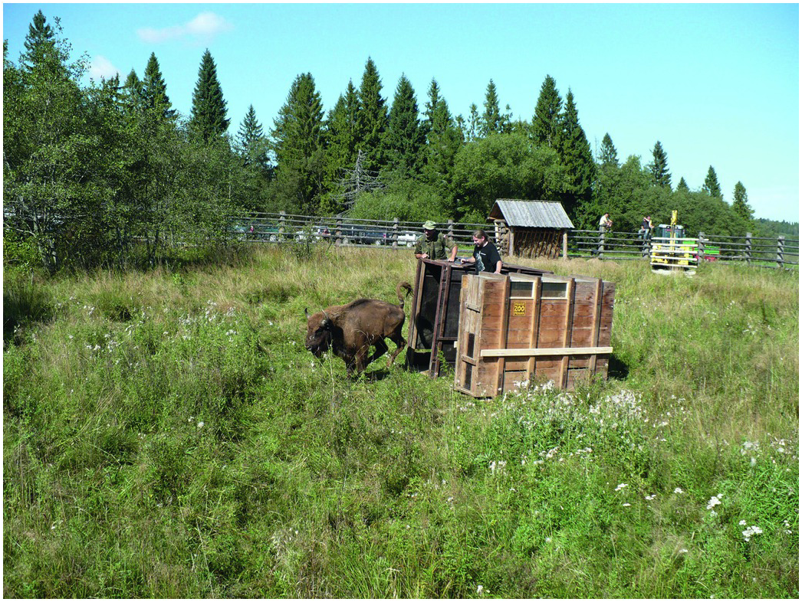
Figure 10.32
Young European bison released to acclimatisation enclosure at Bieszczady National Park.
Photo by K. Perzanowski.

Slide 11
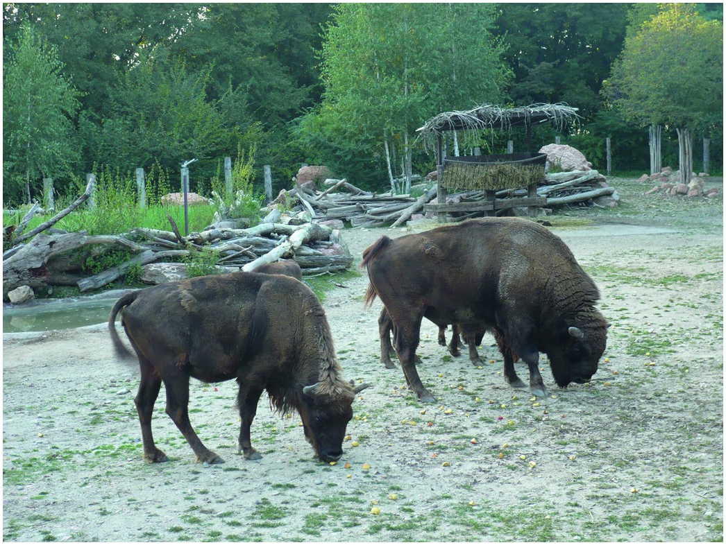
Figure 10.34
Animals in Busolengo Zoo (Italy).
Photo by W. Olech.

Slide 12
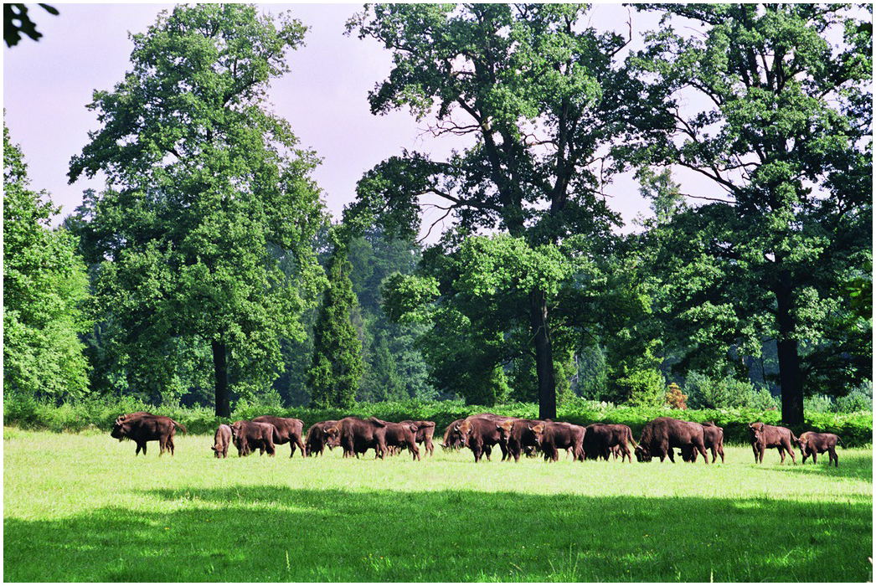
Figure 10.35
Herd in the European Bison Breeding Centre at Pszczyna (Poland).
Photo by M. Hławiczka.

Slide 13
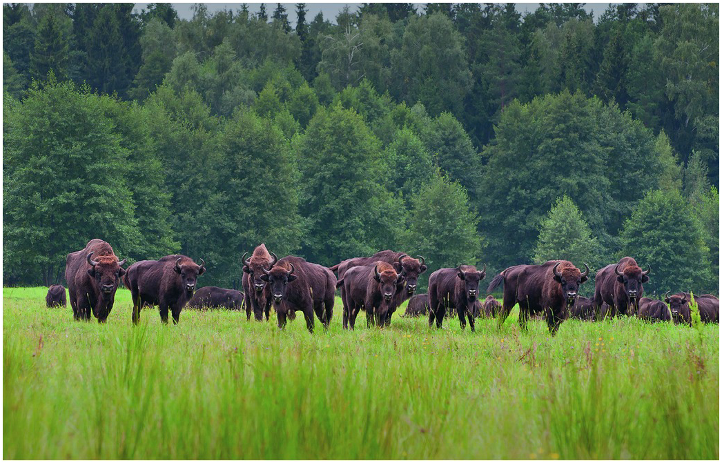
Figure 10.36
Group of European bison foraging at forest clearing during the rut period, on the left radio-collared bull, September 2011. Photo by T. Kamiński.

