Slide 1
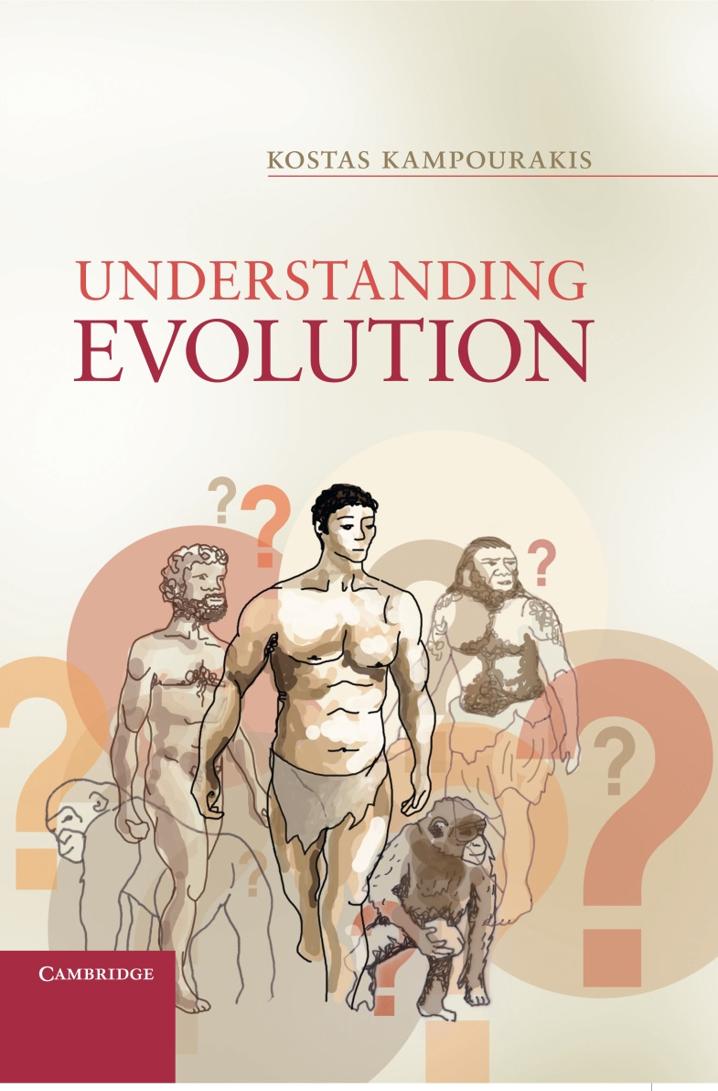
Chapter 3
Conceptual obstacles
to understanding evolution

Slide 2
Figure 3.1
Different perceptions of reality. In both cases, the Sun and the Earth move relatively to each other. According to the geocentric model the Earth is static and the Sun move\s around it (A), whereas according to the heliocentric model the Sun is static and the Earth moves (B). Although we intuitively think that A. is what is happening, B. can describe the relative movement as well. Based on this evidence only, one cannot conclude what is actually happening.

Slide 3
Figure 3.2
Relative movement: both a1 and a2 can explain the relative movement, so based on this observation only one cannot conclude what is actually happening. In order to understand which of the elements of a system is moving and which is not (persons X and Y), we must examine their movement relatively to a third element which we consider static (e.g. a house). In a similar but much more complicated manner, Copernicus did not only examine the motion of the Sun relatively to the Earth but carefully studied the system that included the other planets. He concluded that a heliocentric model provided a better explanation for the motions of planets compared to a Ptolemaic/geocentric model.

Slide 4
Figure 3.3
Comparison of the Ptolemaic/geocentric and the heliocentric model (adapted from Goldstein 2002, p.227). In order to explain the relative movement of Venus and Earth, one had to assume that the Venus epicycle as well as the Sun orbited the Earth. The heliocentric model was free of such assumptions and the Venus epicycle was transformed to the orbit of Venus around the Sun. In this case, the Earth also orbited the Sun, like Venus and any other planet. It should be noted that 3.3.a only shows Prolemy’s epicycle on deferent model (this does not include the eccentric and the equant models)

Slide 5
Figure 3.4
The anticipated phases of Venus are different between the Ptolemaic and the heliocentric models (adapted from Heilbron 2010, p.168). In 1610 Galileo observed phase 5 in b. which was not a phase consistent with Prolemy’s model.

Slide 6
Figure 3.5
The relative sizes and body length/wing length ratio for an eagle (left) and an ostrich (right) in airplane form (with a high degree of approximation); or how eagles and ostriches would look if they were airplanes. Could you imagine the plane on the right being designed for flying and yet be unable to fly?

Slide 7
Figure 3.6
An imaginary depiction of several artifacts sharing common ancestry. This depiction is of course incorrect as these artifacts have independent origins. They were designed and made independently for different uses. However, do you realize that organisms as diverse in appearance as these artifacts all share a common ancestry and various fundamental common characters?

Slide 8
Figure 3.7
A representation of stimuli used in Keil’s transformation studies. Children thought that a horse would be a horse despite changes in external appearance that made it look like a zebra. It is important to note that this picture does not portray evolutionary change. It just presents changes in an individual, but this is not how evolution proceeds. Even if one imagined that this figure portrays changes across a lineage, it still is deficient as it neglects the other lineages evolving at the same time. So children’s essentialist bias is actually a denial that individual essences undergo change. This is consistent with evolutionary theory which suggests that evolutionary changes take place across generations and within lineages, not during individual lives.

Slide 9
Figure 3.8
Dolphins and sharks have similar hydrodynamic shapes not because they were designed in order to be able to swim fast underwater but because they have independently evolved similar shapes which have advantageous consequences for underwater life.

