Slide 1
S
S
S
T
D
2 μm

Slide 2
(a)
(b)
(c)
(d)
(e)
y
x
z
(f)
(g)
Notes:
5” wide, tiff.

Slide 3
W
(a)
x
σ
(b)
x
Notes:
2.14” x 3”, jpg.

Slide 4
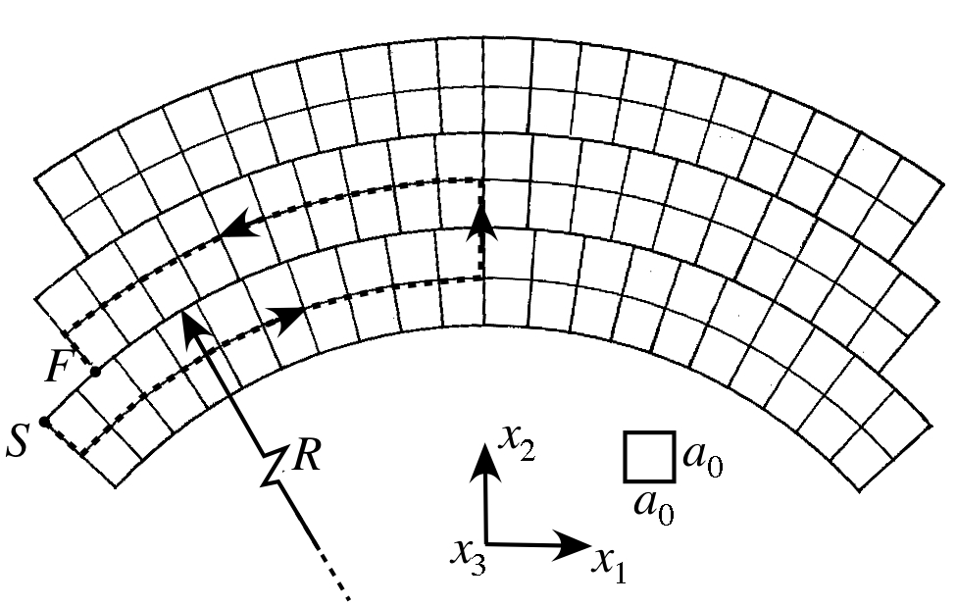
F
S
Notes:
2.22” x 3.5”, jpg.
Match arrows to old style.

Slide 5
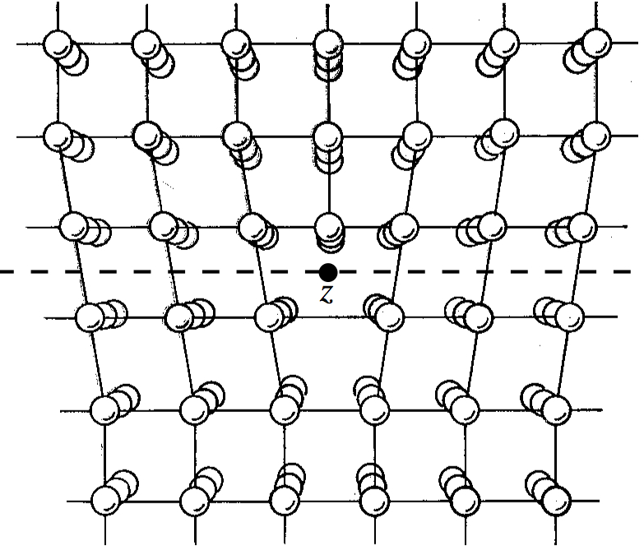
y
slip plane
z
x
Notes:
2.01” x 2.75”, jpg.

Slide 6
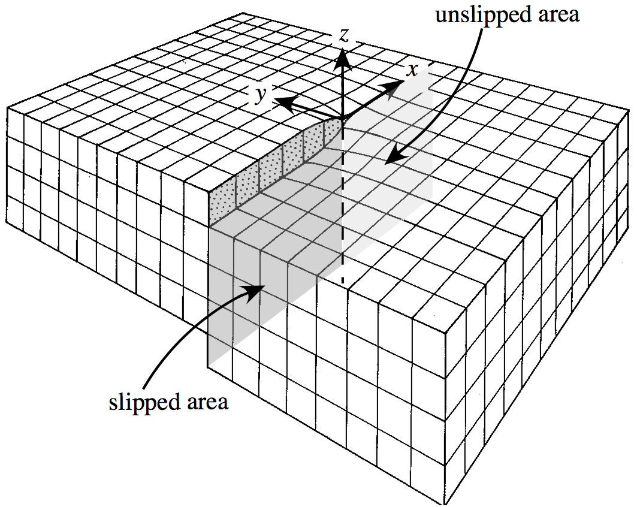
z
unslipped area
y
x
slipped area
Notes:
2.78” x 3.5”, jpg.
Match arrows to old style.

Slide 7
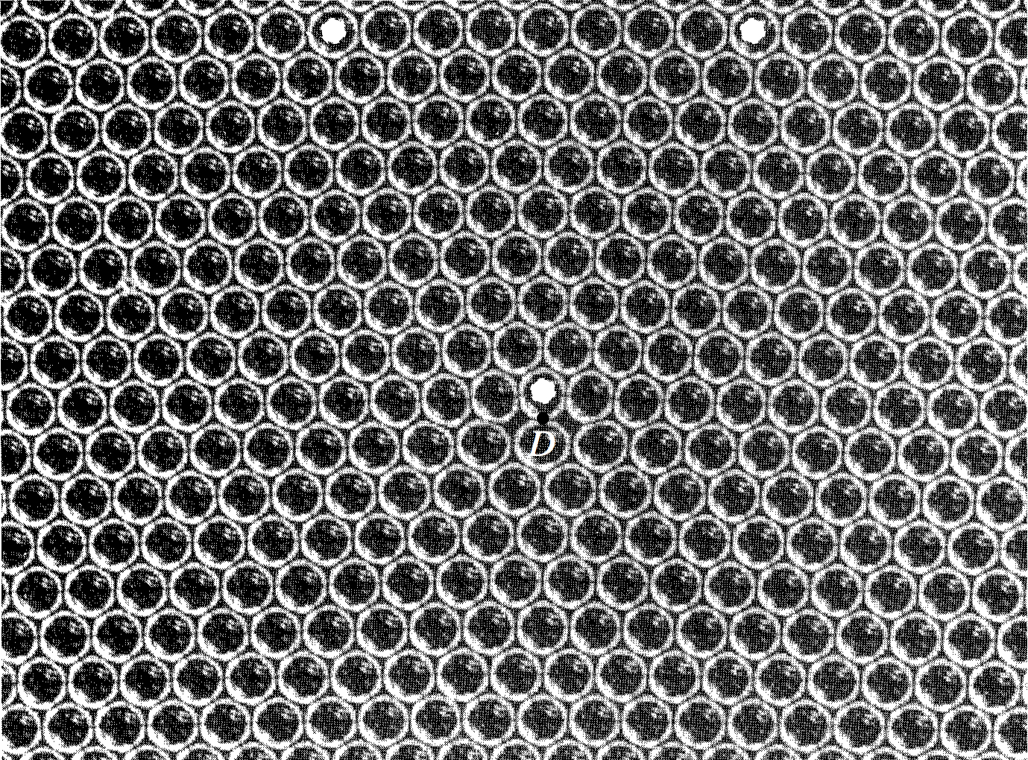
A
B
O
C
D
C'
Notes:
3.55” x 5”, jpg.

Slide 8
1 μm
Notes:
3.78” x 5”, tiff.

Slide 9
10 μm
Notes:
3.1” x 3”, tiff.

Slide 10
100 μm
Notes:
5.46” x 5”, tiff.

Slide 11
10 μm
Notes:
4.62” x 3”, tiff.

Slide 12
10 μm
Notes:
2.66” x 5”, tiff.

Slide 13
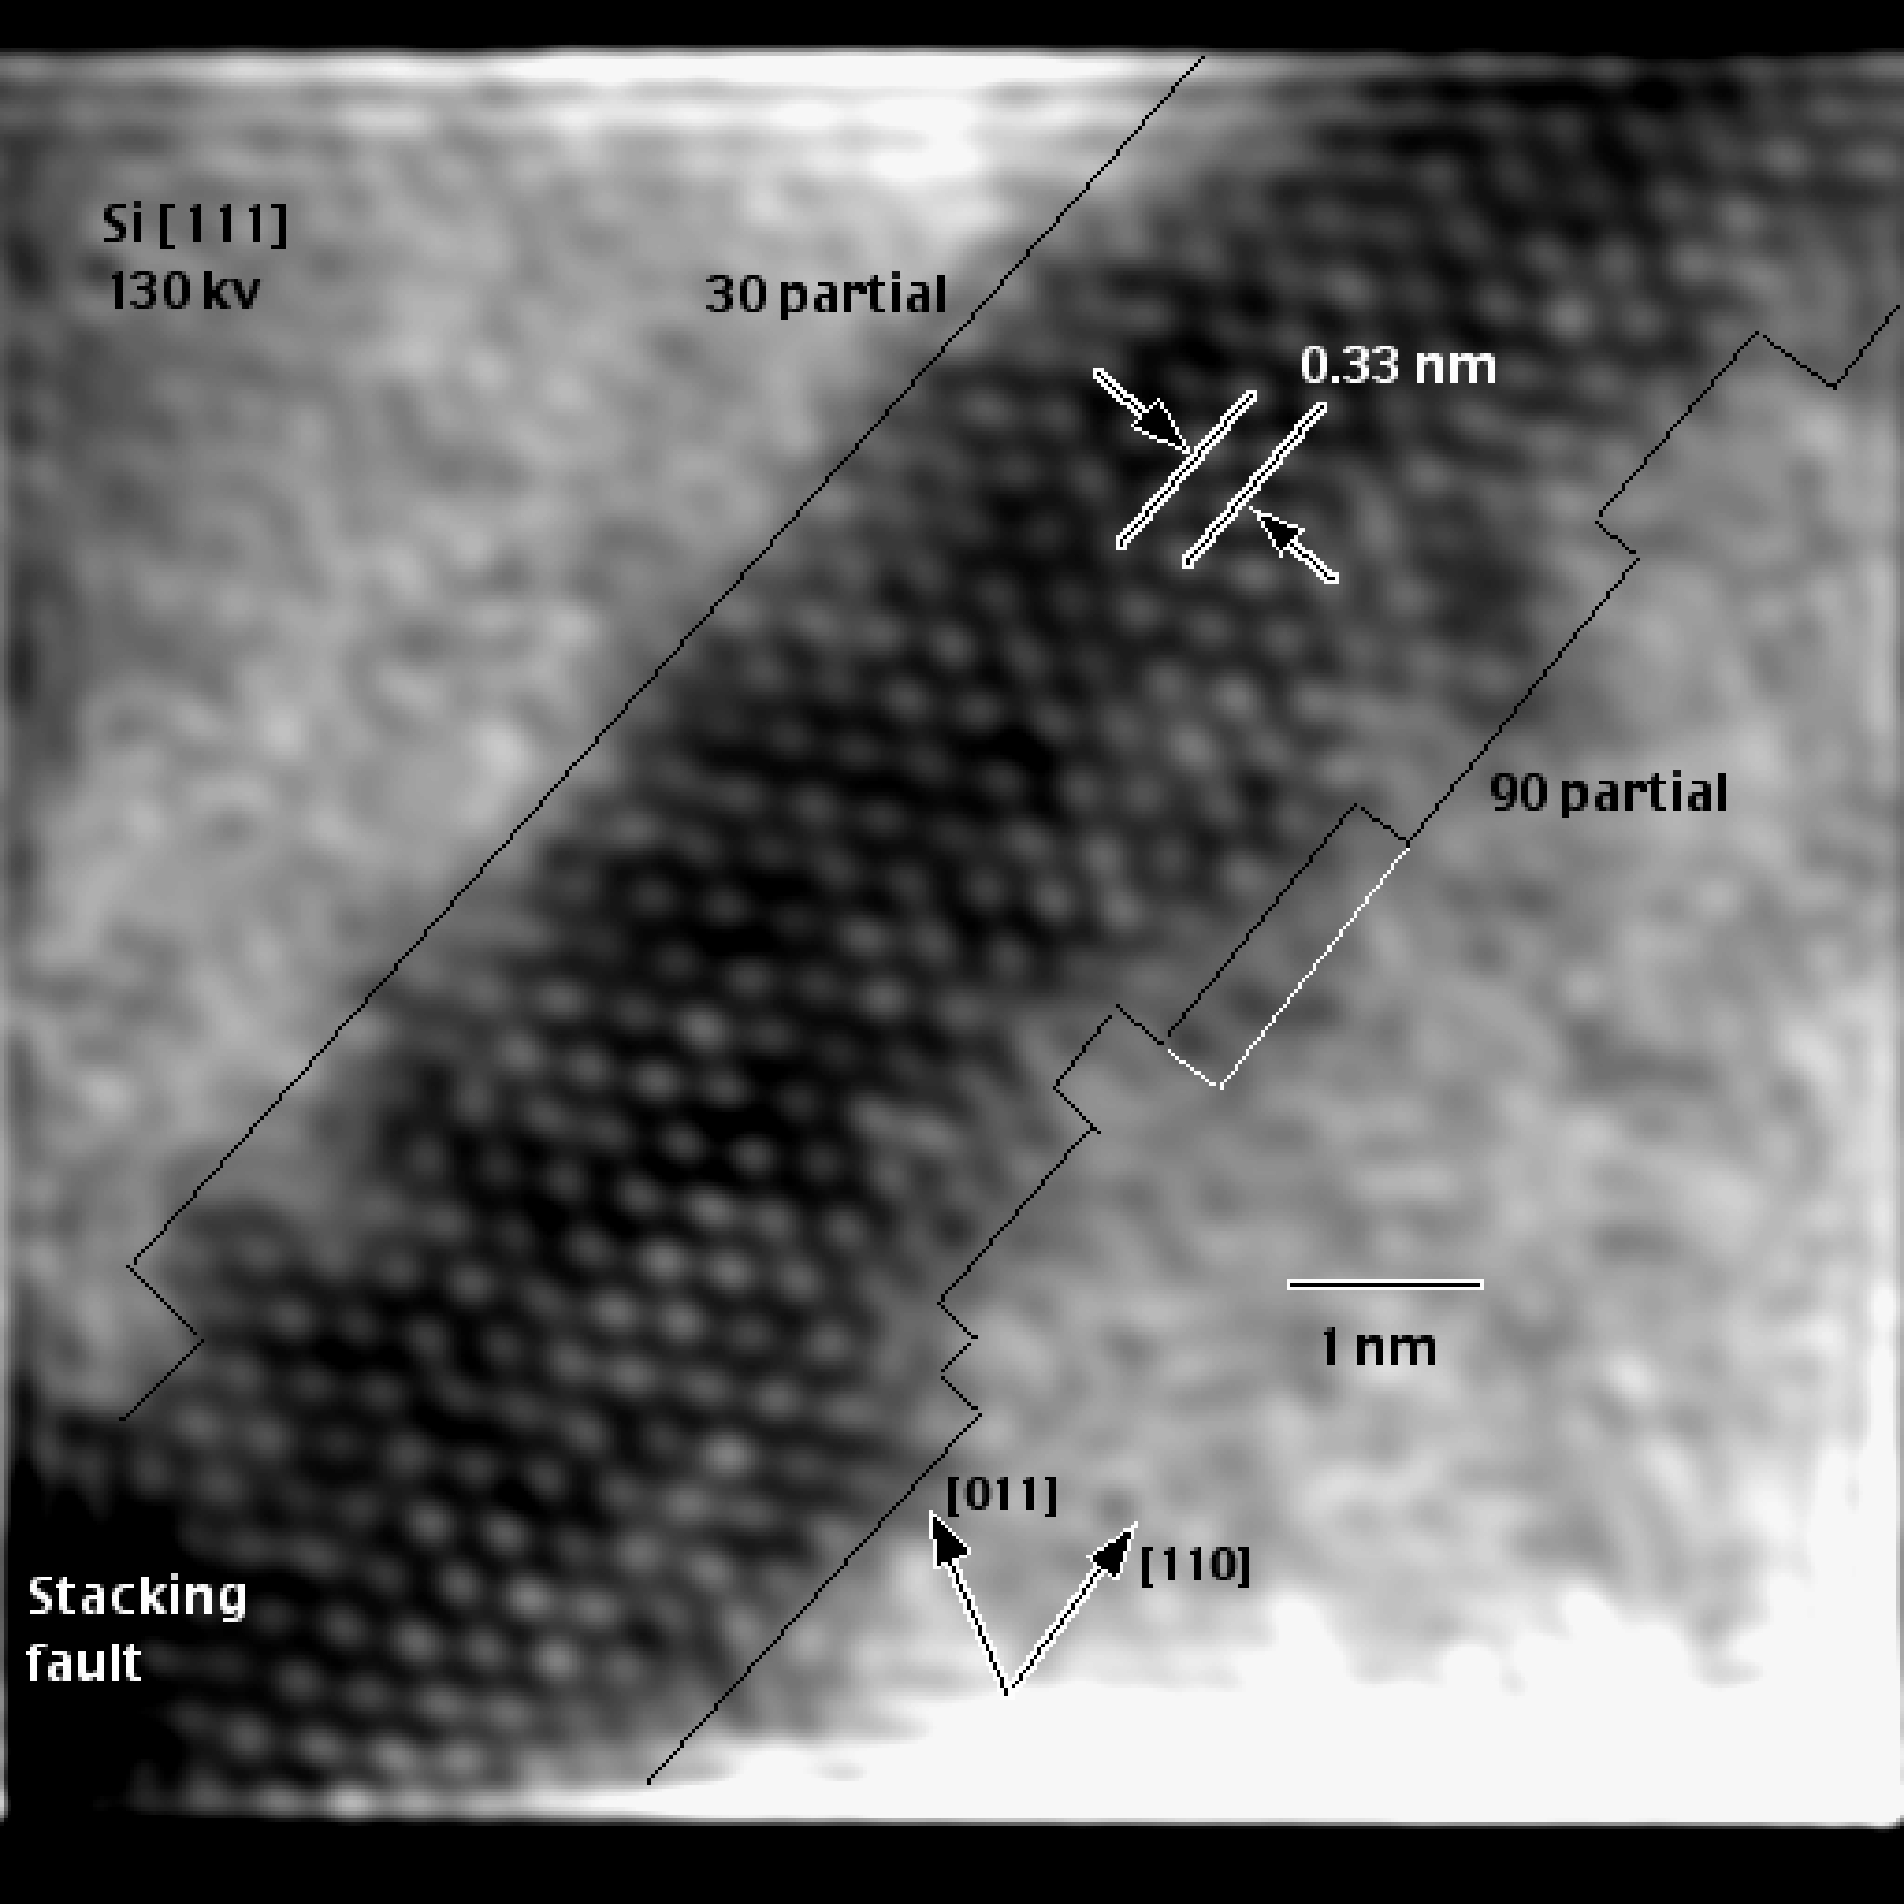
Si[111]
130 kV
30° partial
0.33 nm
90° partial
1 nm
[011]
[110]
stacking fault
Notes:
5” x 5”, jpg.

Slide 14
100 μm
(1)
(2)
(3)
Notes:
3.67” x 5”, tiff.

Slide 15
500 μm
Notes:
6.66” x 5”, tiff.

Slide 16
1 μm
Notes:
4.59” x 5”, tiff.

Slide 17
1 μm
Notes:
7.15” x 5”, tiff.

Slide 18
10 nm
Notes:
6.25” x 5”, tiff.

Slide 19
1 nm
Notes:
6.21” x 5”, tiff.

Slide 20
z
σ
b
A
v
A
x
σ
(a)
y
(b)
A
v
A
n
b
(c)
(d)
σ
σ
(e)
(f)
Notes:
5.67” x 5”, jpg.

Slide 21
1
2
O
S
F
3
(a)
1
2
S
t₂
F
3
(b)
b
t₁
Notes:
6.39” x 5”, tiff.

Slide 22
1
2
S
F
3
(a)
1
2
O
F
S
3
(b)
b
Notes:
6.8” x 5”, tiff.

Slide 23
dl
ξ
Notes:
2” x 2.64”, tiff.

Slide 24
z
σ
x
no slip
ξ
A
ξ
B
slip
b
x
σ
C
y
(a)
y
(b)
b
b_{s}
b_{e}
ξ
(c)
Notes:
3.96” x 5”, tiff.

Slide 25
C
B
ξ₂
D
b₂
ξ₃
b₃
O
A
ξ₁
b₁
Notes:
3.37” x 5”, tiff.

Slide 26
C
B'
A
B
C'
(a)
A'
b
b
slip plane normal n
m × n
slip plane normal m
(b)
Notes:
2.59” x 2.5”, tiff.

Slide 27
x₃
C
D
E
n
O
B
x₂
A
F
x₁
Area A

Slide 28
x₃
A
S
F
O
x₂
x₁
B

Slide 29
ξ
C
A
b
B
D

Slide 30
A
B

