Slide 1

University of California, Berkeley
X-rays and Extreme Ultraviolet Radiation
AST210/EECS213
Fall 2019

Slide 2
Physics of Hot, Dense Plasmas
David Attwood
University of California, Berkeley

Slide 3
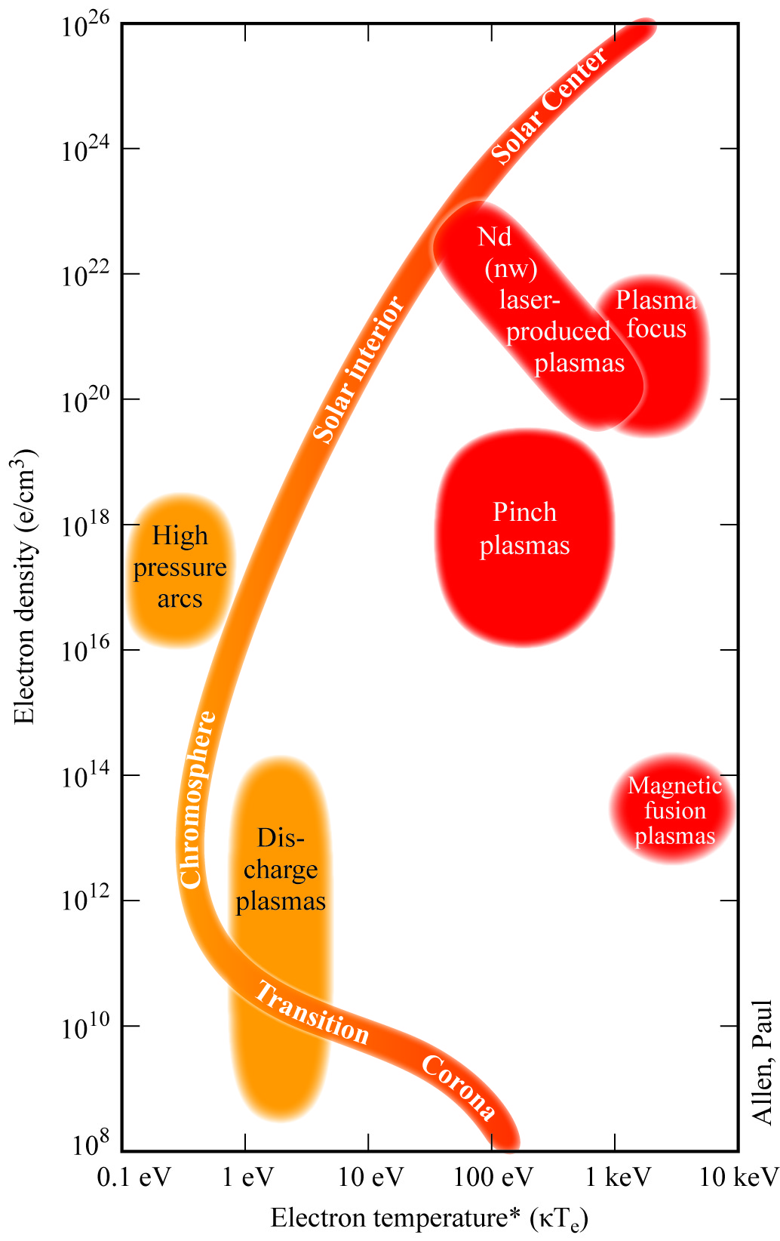
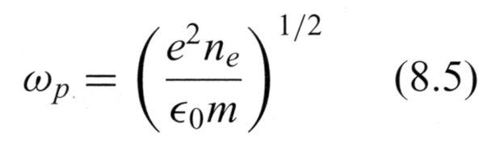
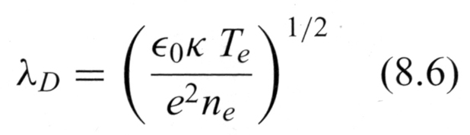
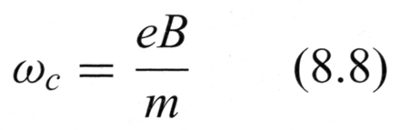
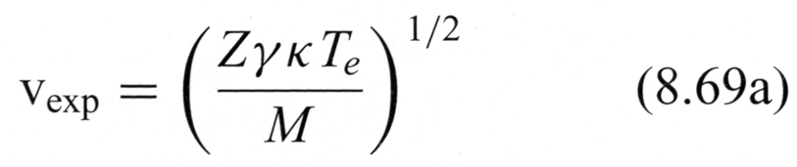
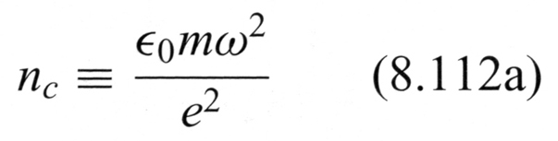
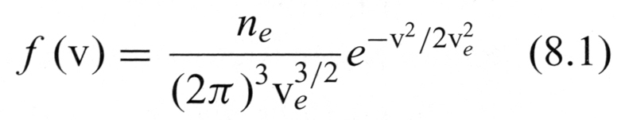



Hot-dense plasmas radiate in the EUV/x-ray range
e²n_{e}
T_{e}

Slide 4
Processes in a plasma
Particle-particle interactions (short-range “collisions”)
Kinetic theory (velocity distribution function)
Collective motion (electron and ion waves)
Wave-particle interactions (collisionless damping and growth)
Wave-wave interactions (linear and non-linear)
Continuum emission
Atomic physics of ionized species (multiple charge states)
Density and temperature
Spatial profiles
Time dependence

Slide 5
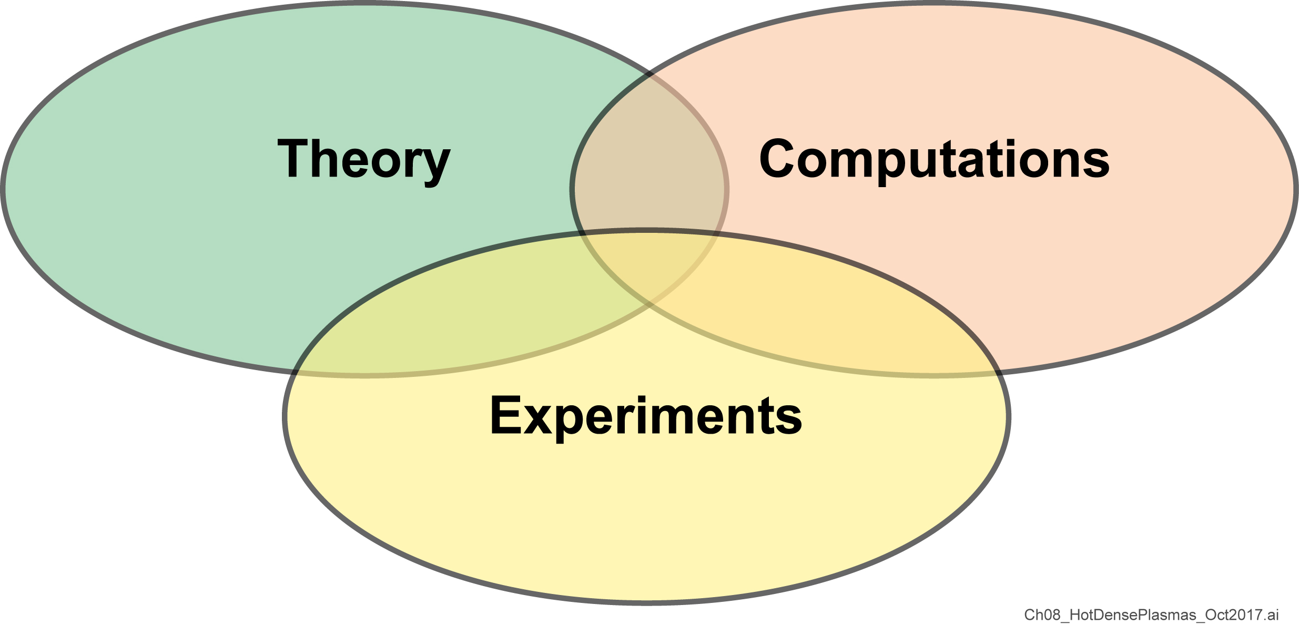
Understanding hot-dense plasmas requires theory, computations and experiments

Slide 6
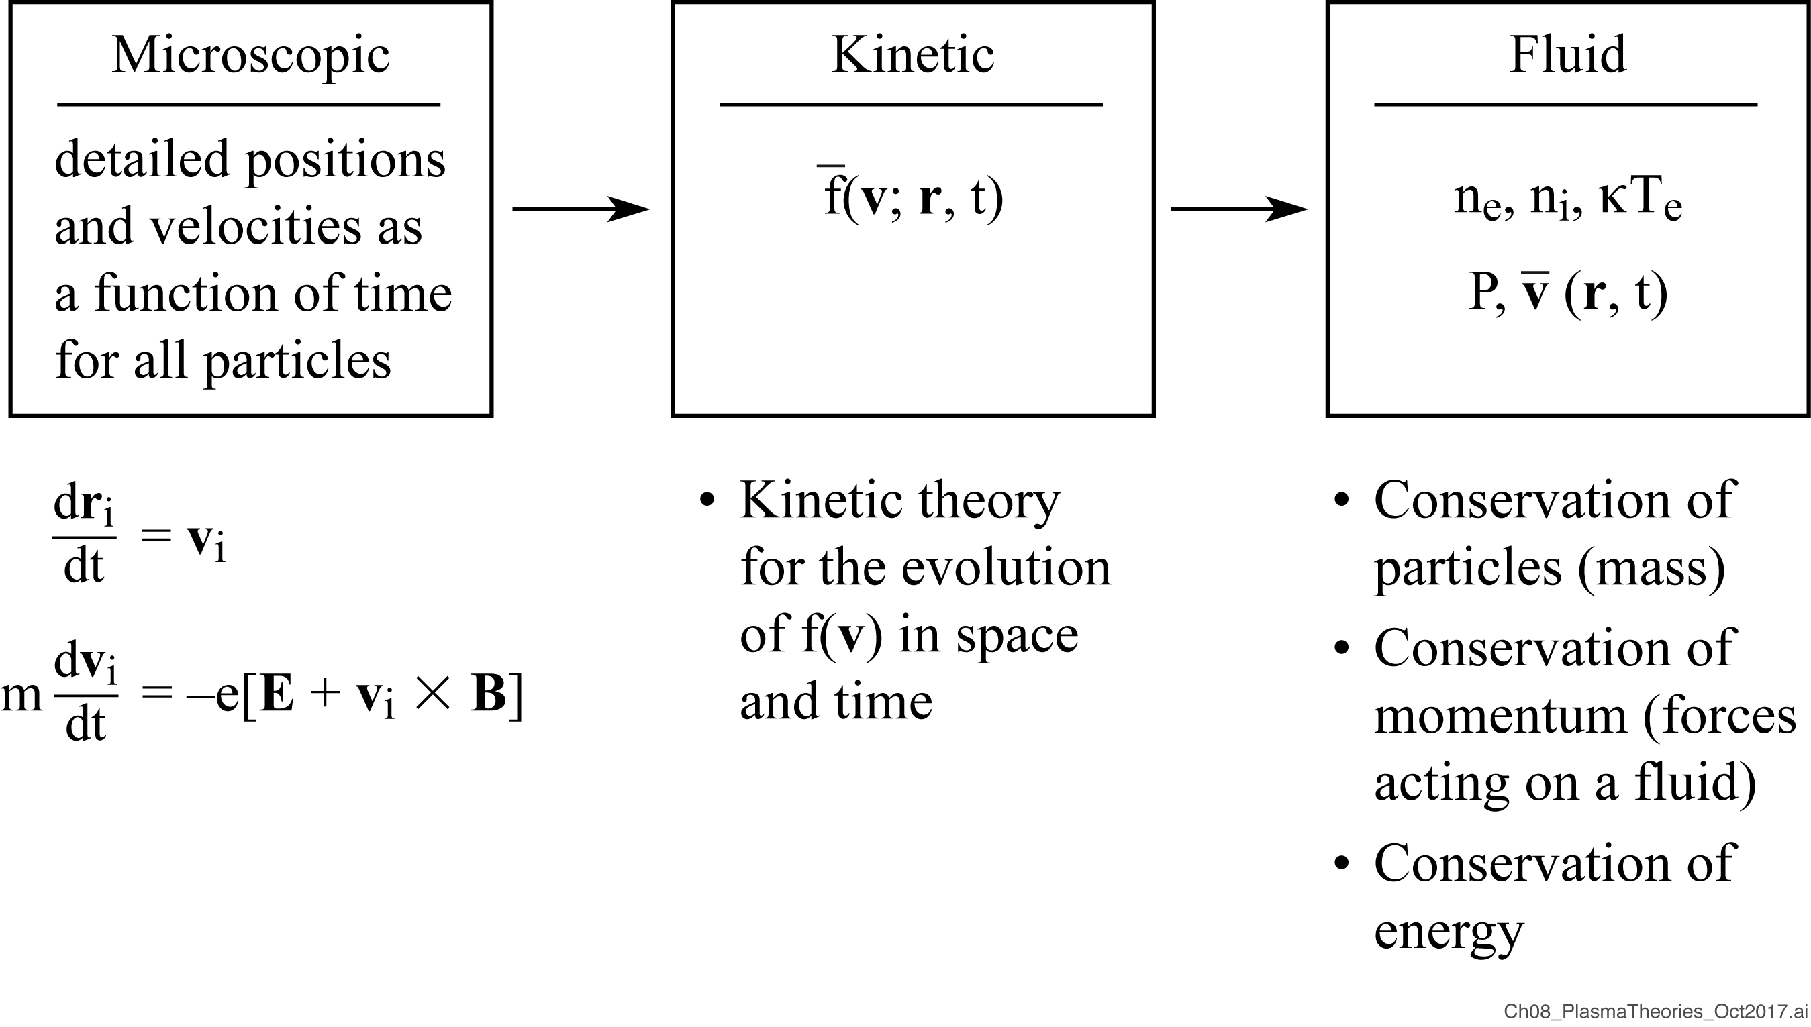
Plasma theories address physical phenomena at various levels of “particle detail”

Slide 7
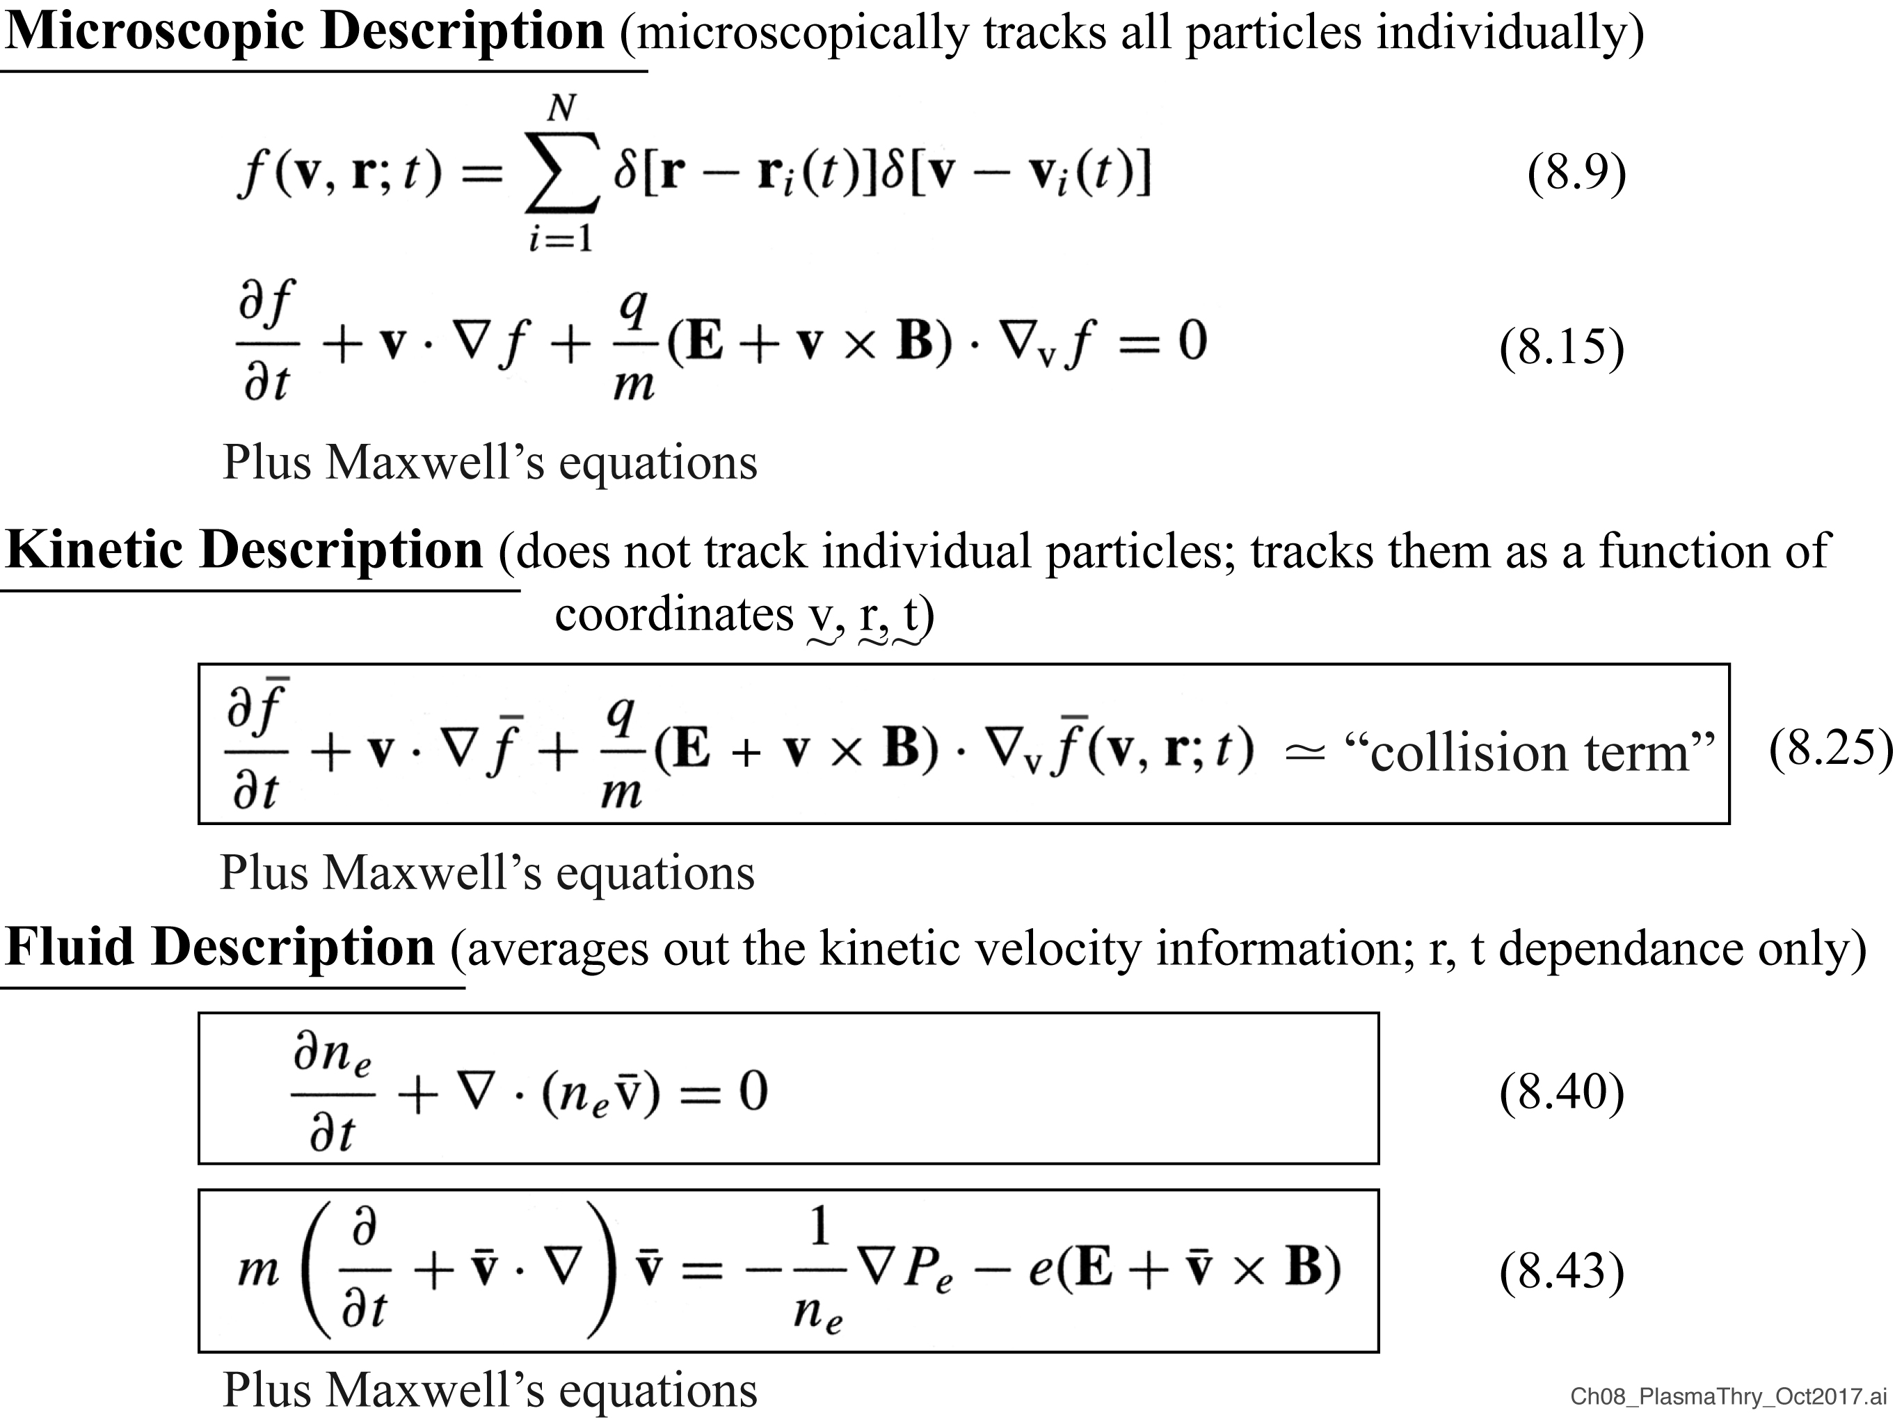
Plasma theory

Slide 8
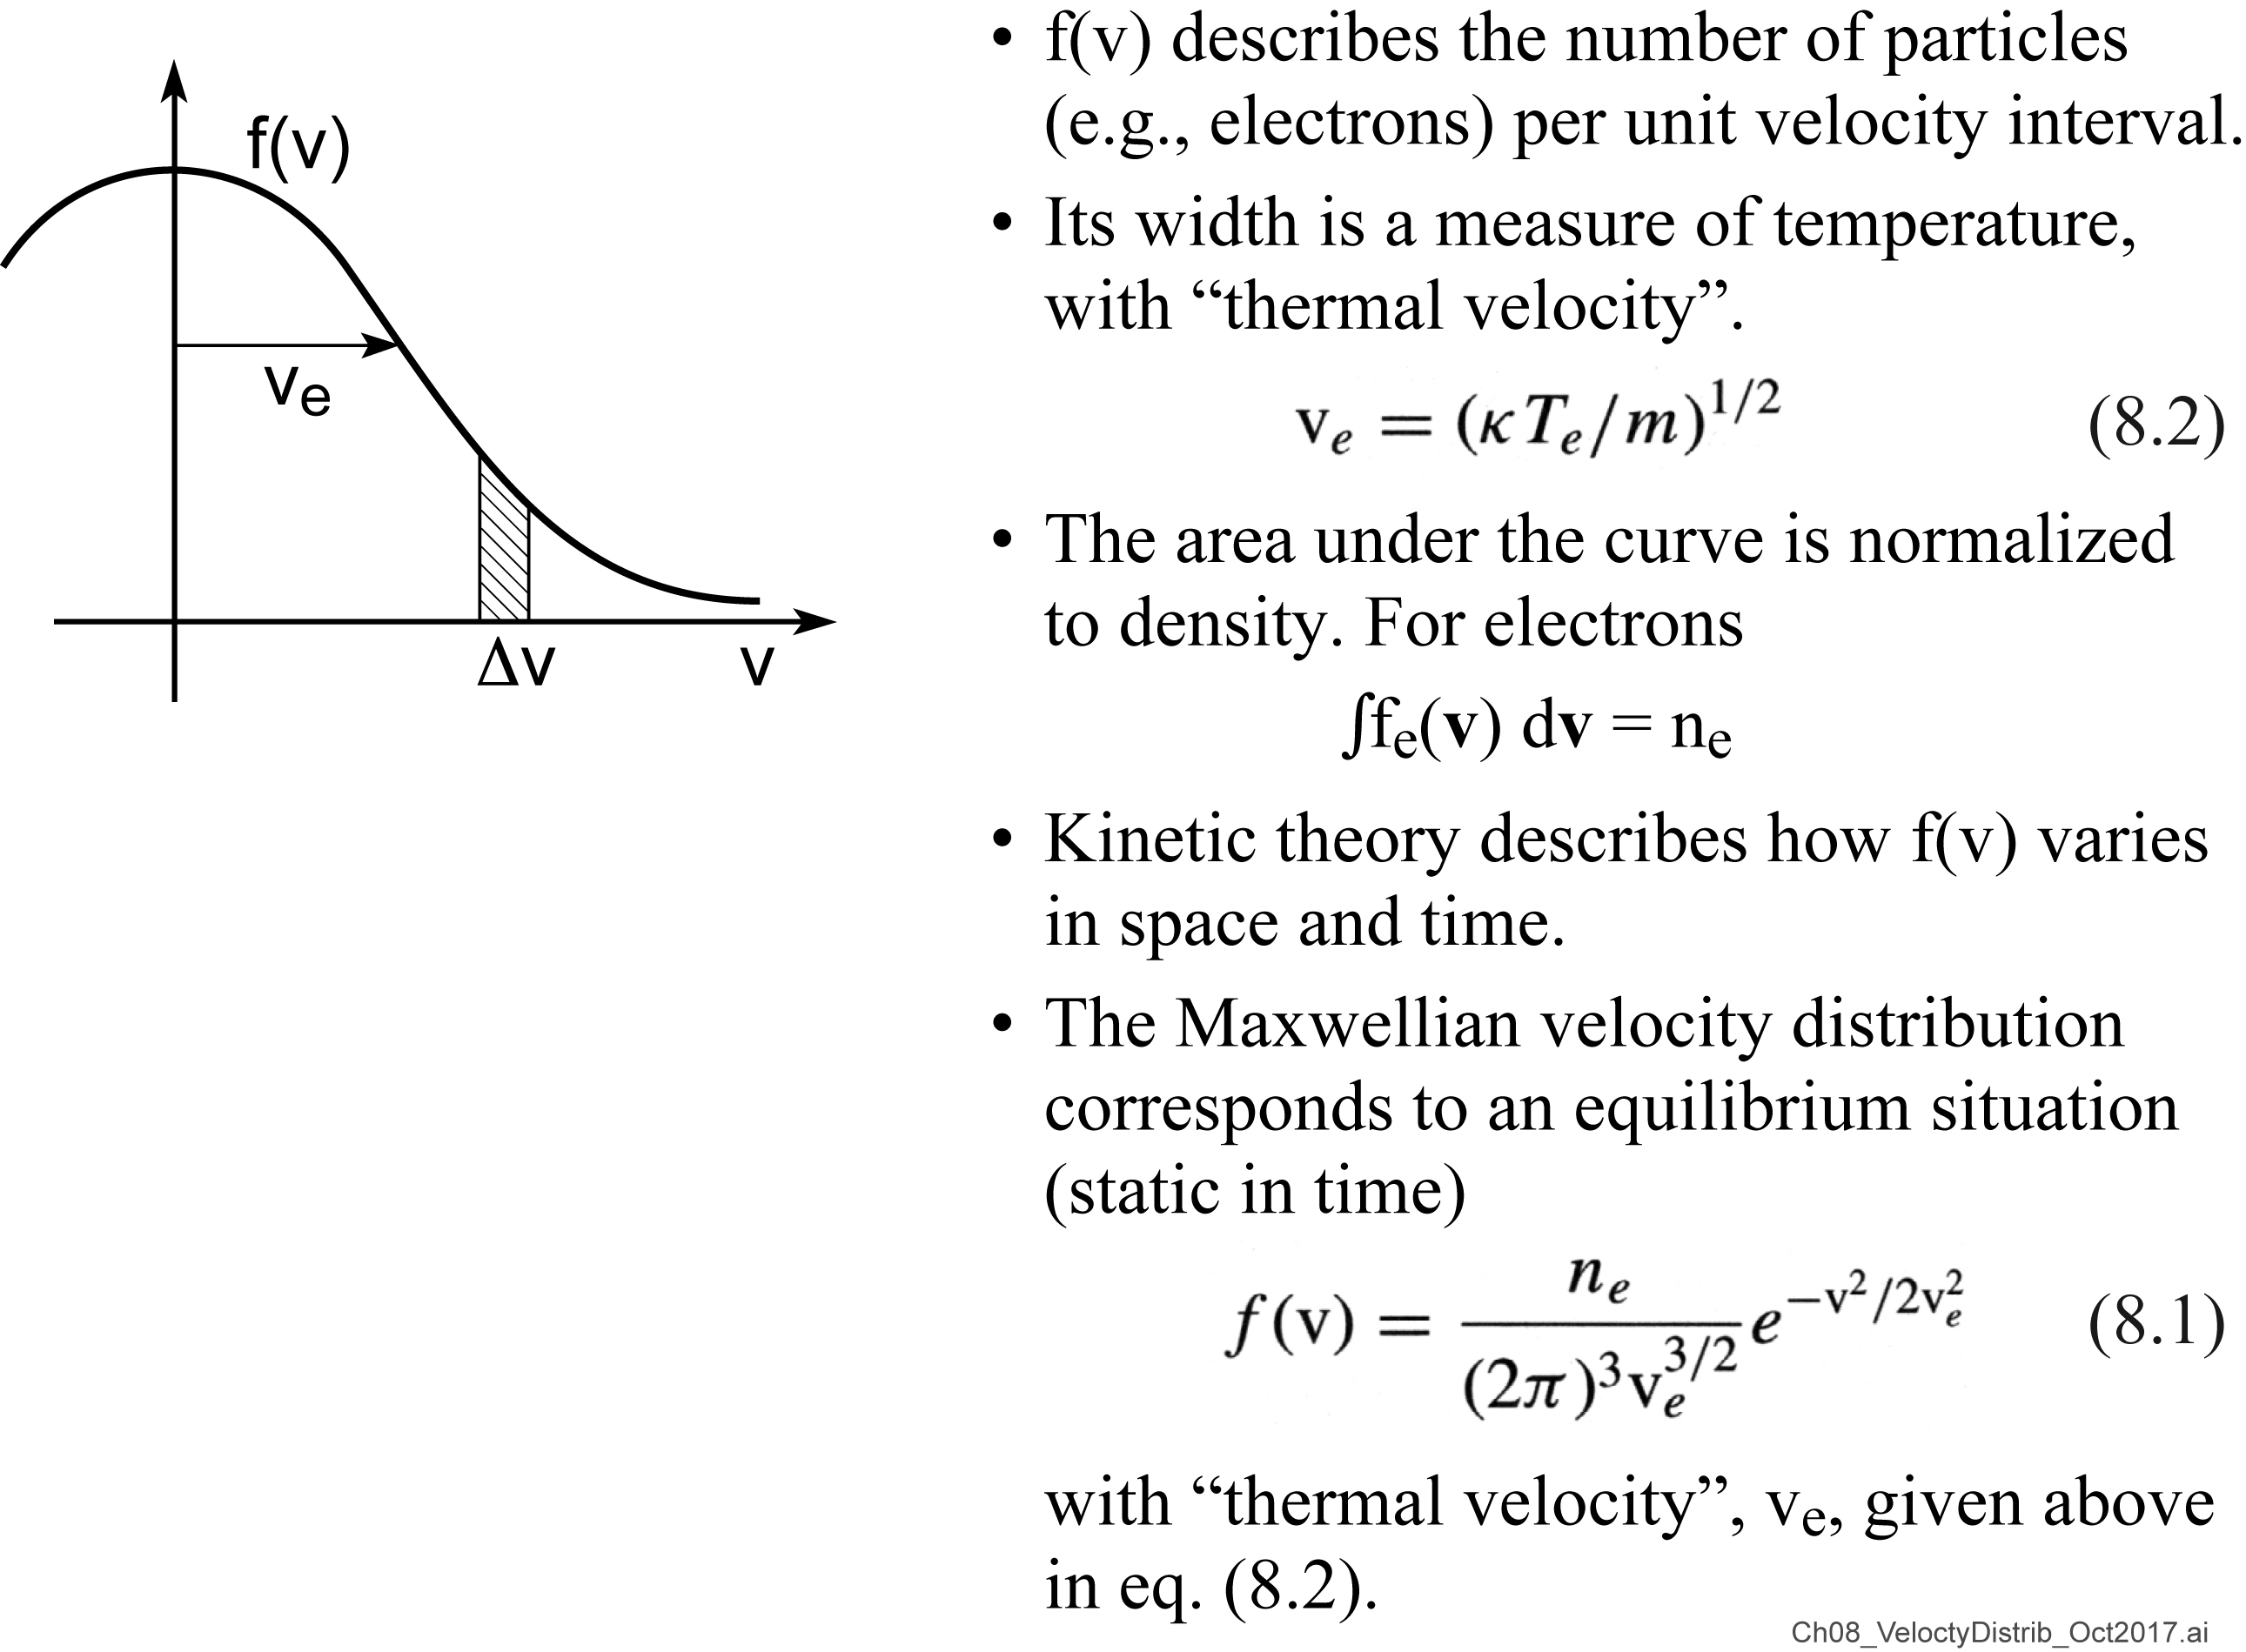
The velocity distribution function, f(v)

Slide 9
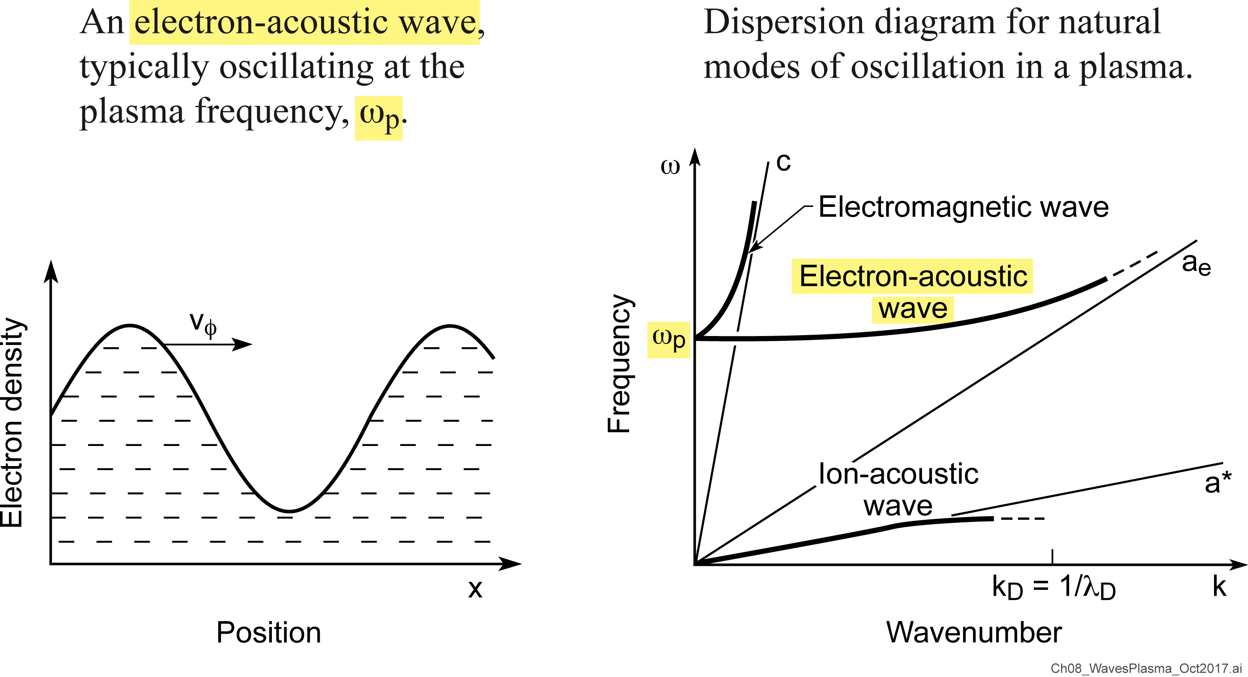
Waves in a plasma

Slide 10
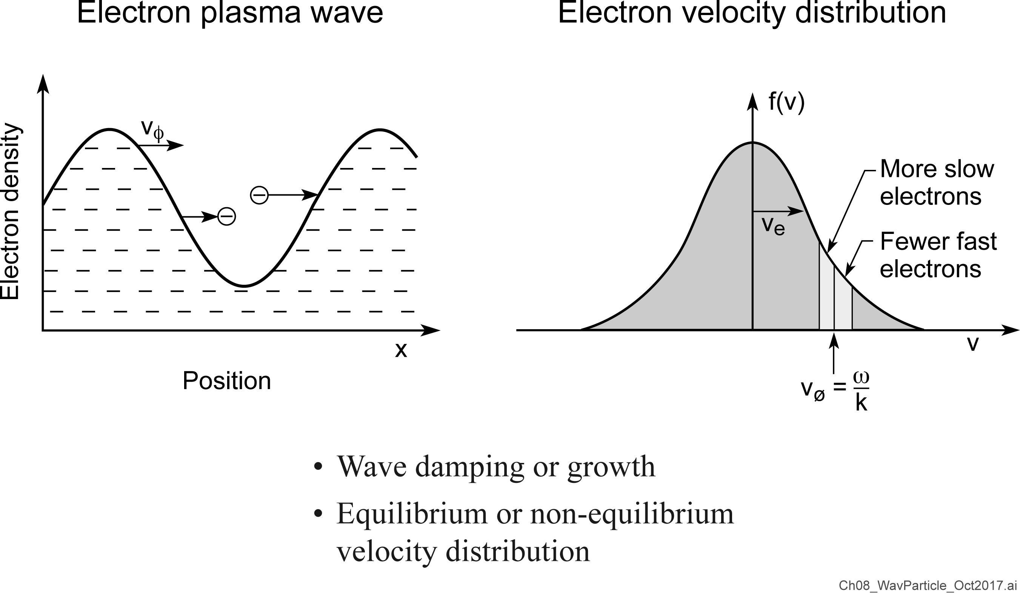
Wave-particle interactions

Slide 11
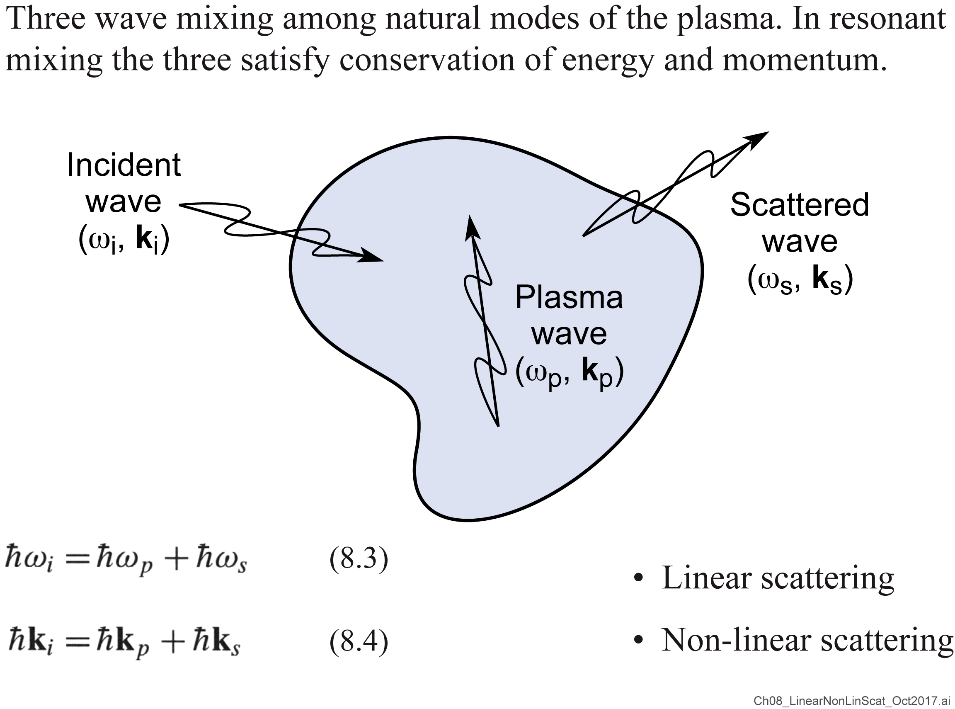
Linear and non-linear processes: scattering as an example

Slide 12
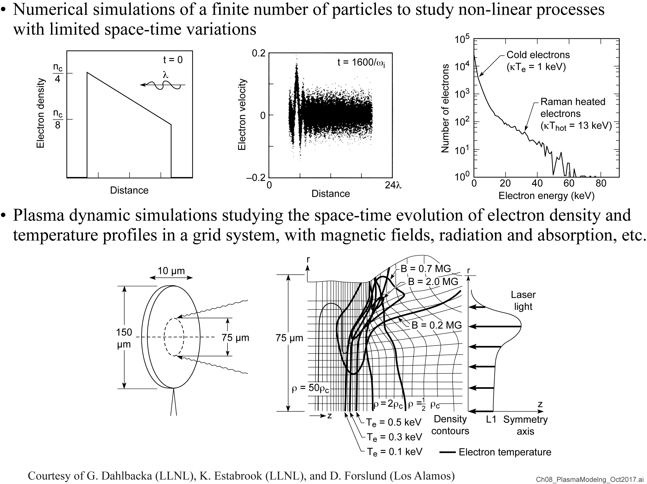
Plasma modeling

Slide 13
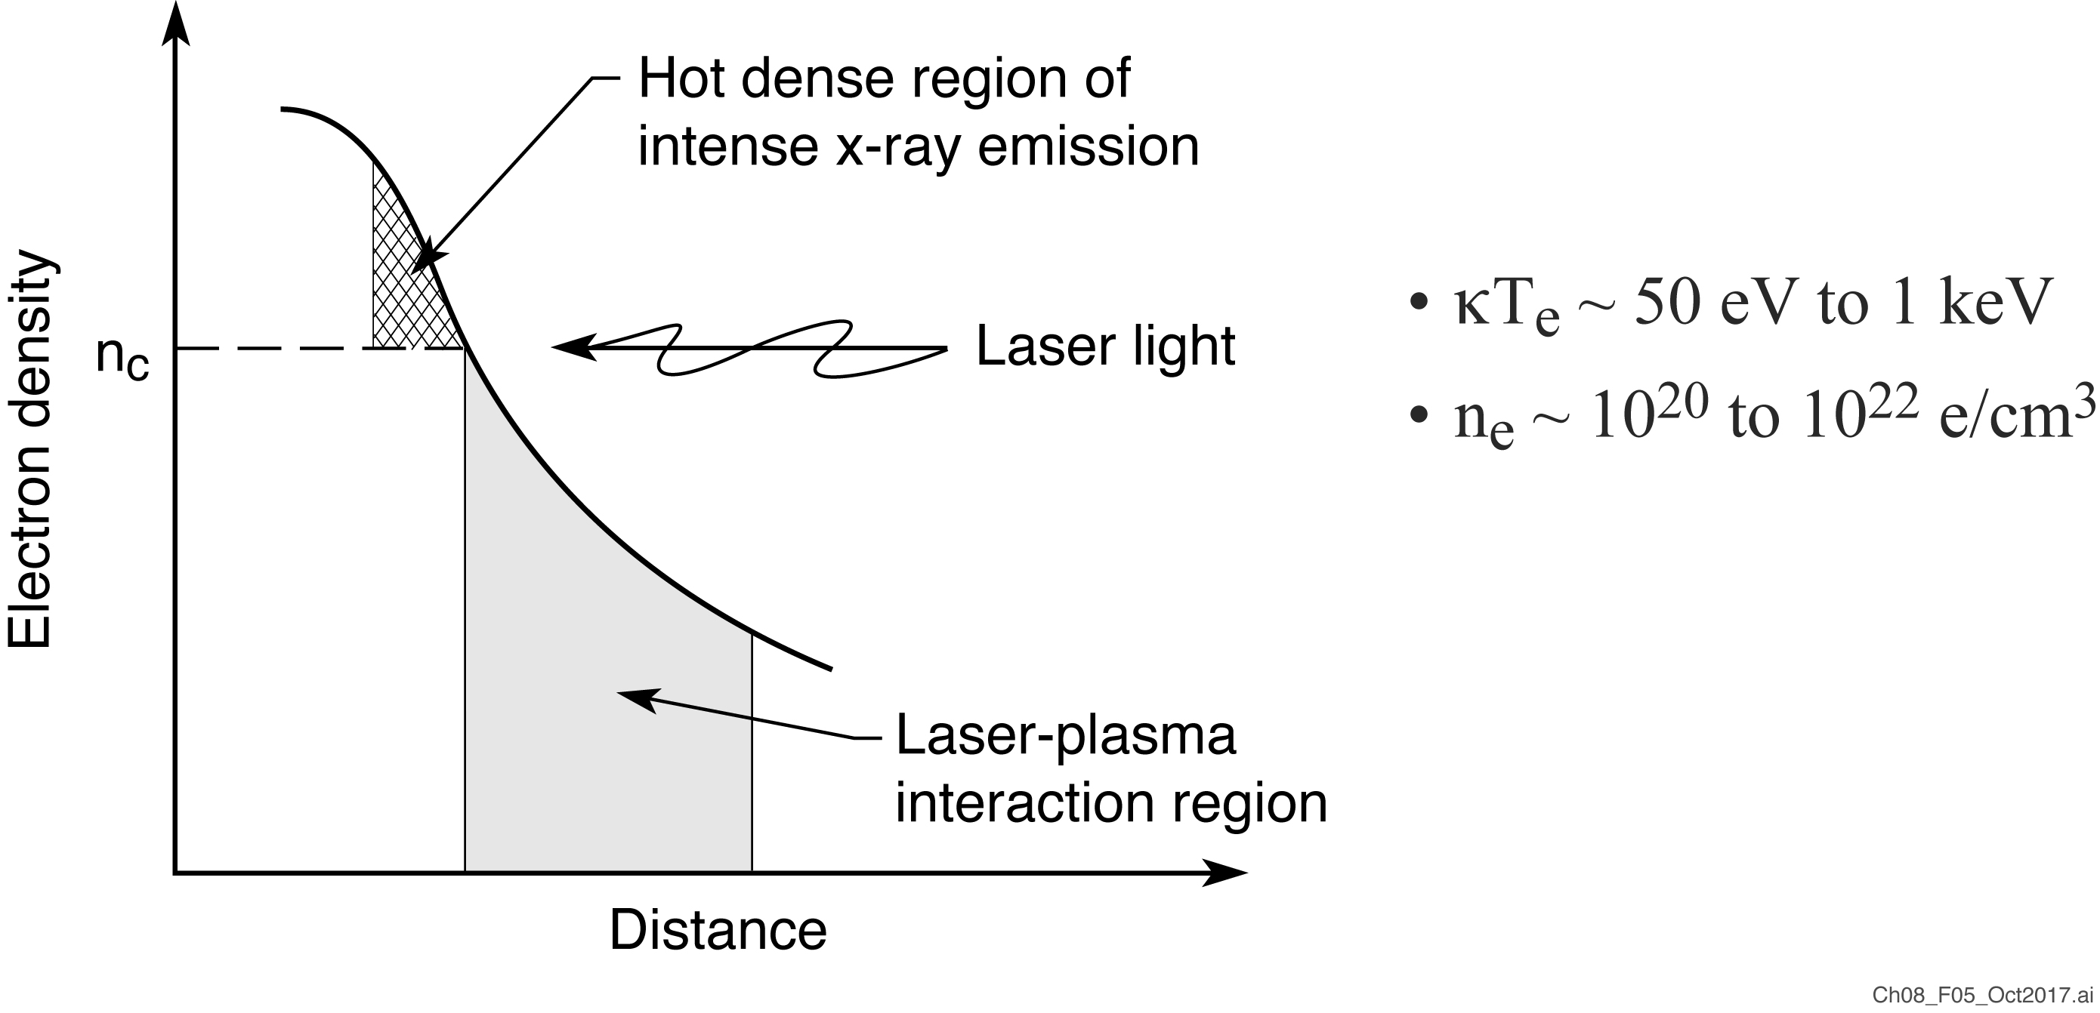
X-ray and EUV emission from a hot-dense plasma
The role of a low intensity prepulse: To provide a gentle gradient
plasma profile for enhanced laser light absorption by thermal processes

Slide 14
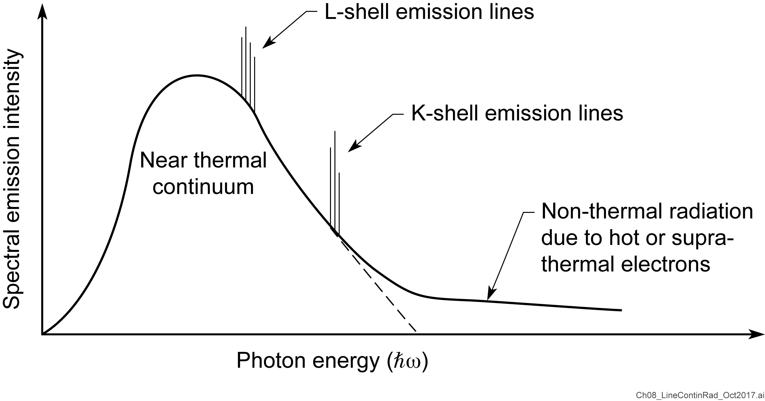
Line and continuum radiation from a hot-dense plasma

Slide 15
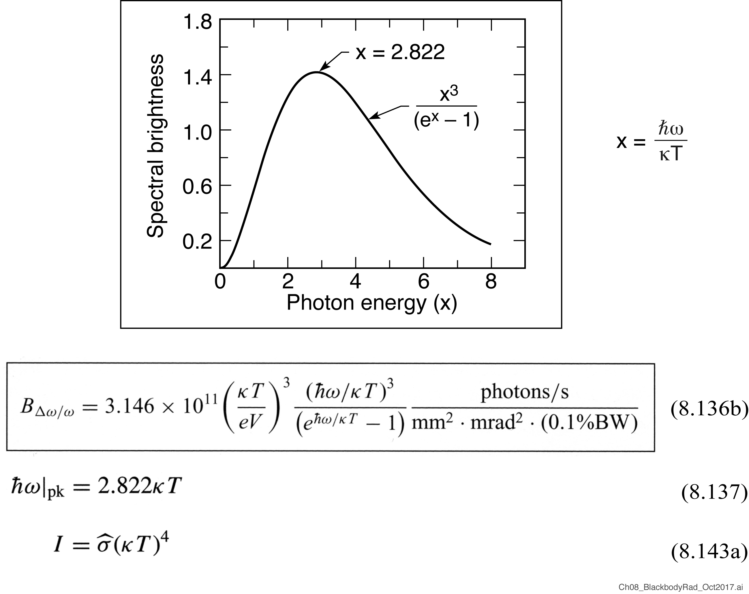
Blackbody radiation: the equilibrium limit

Slide 16
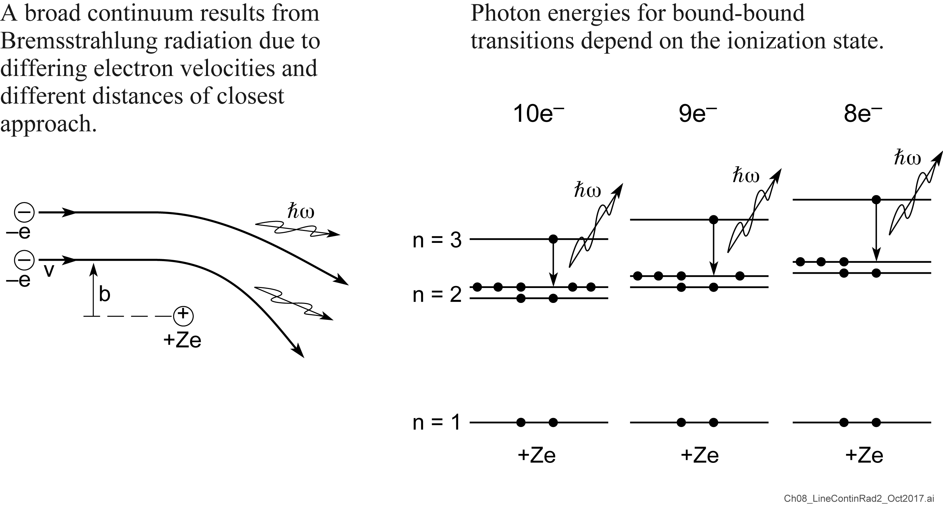
Line and continuum radiation
Importance for EUV atomic lasers

Slide 17
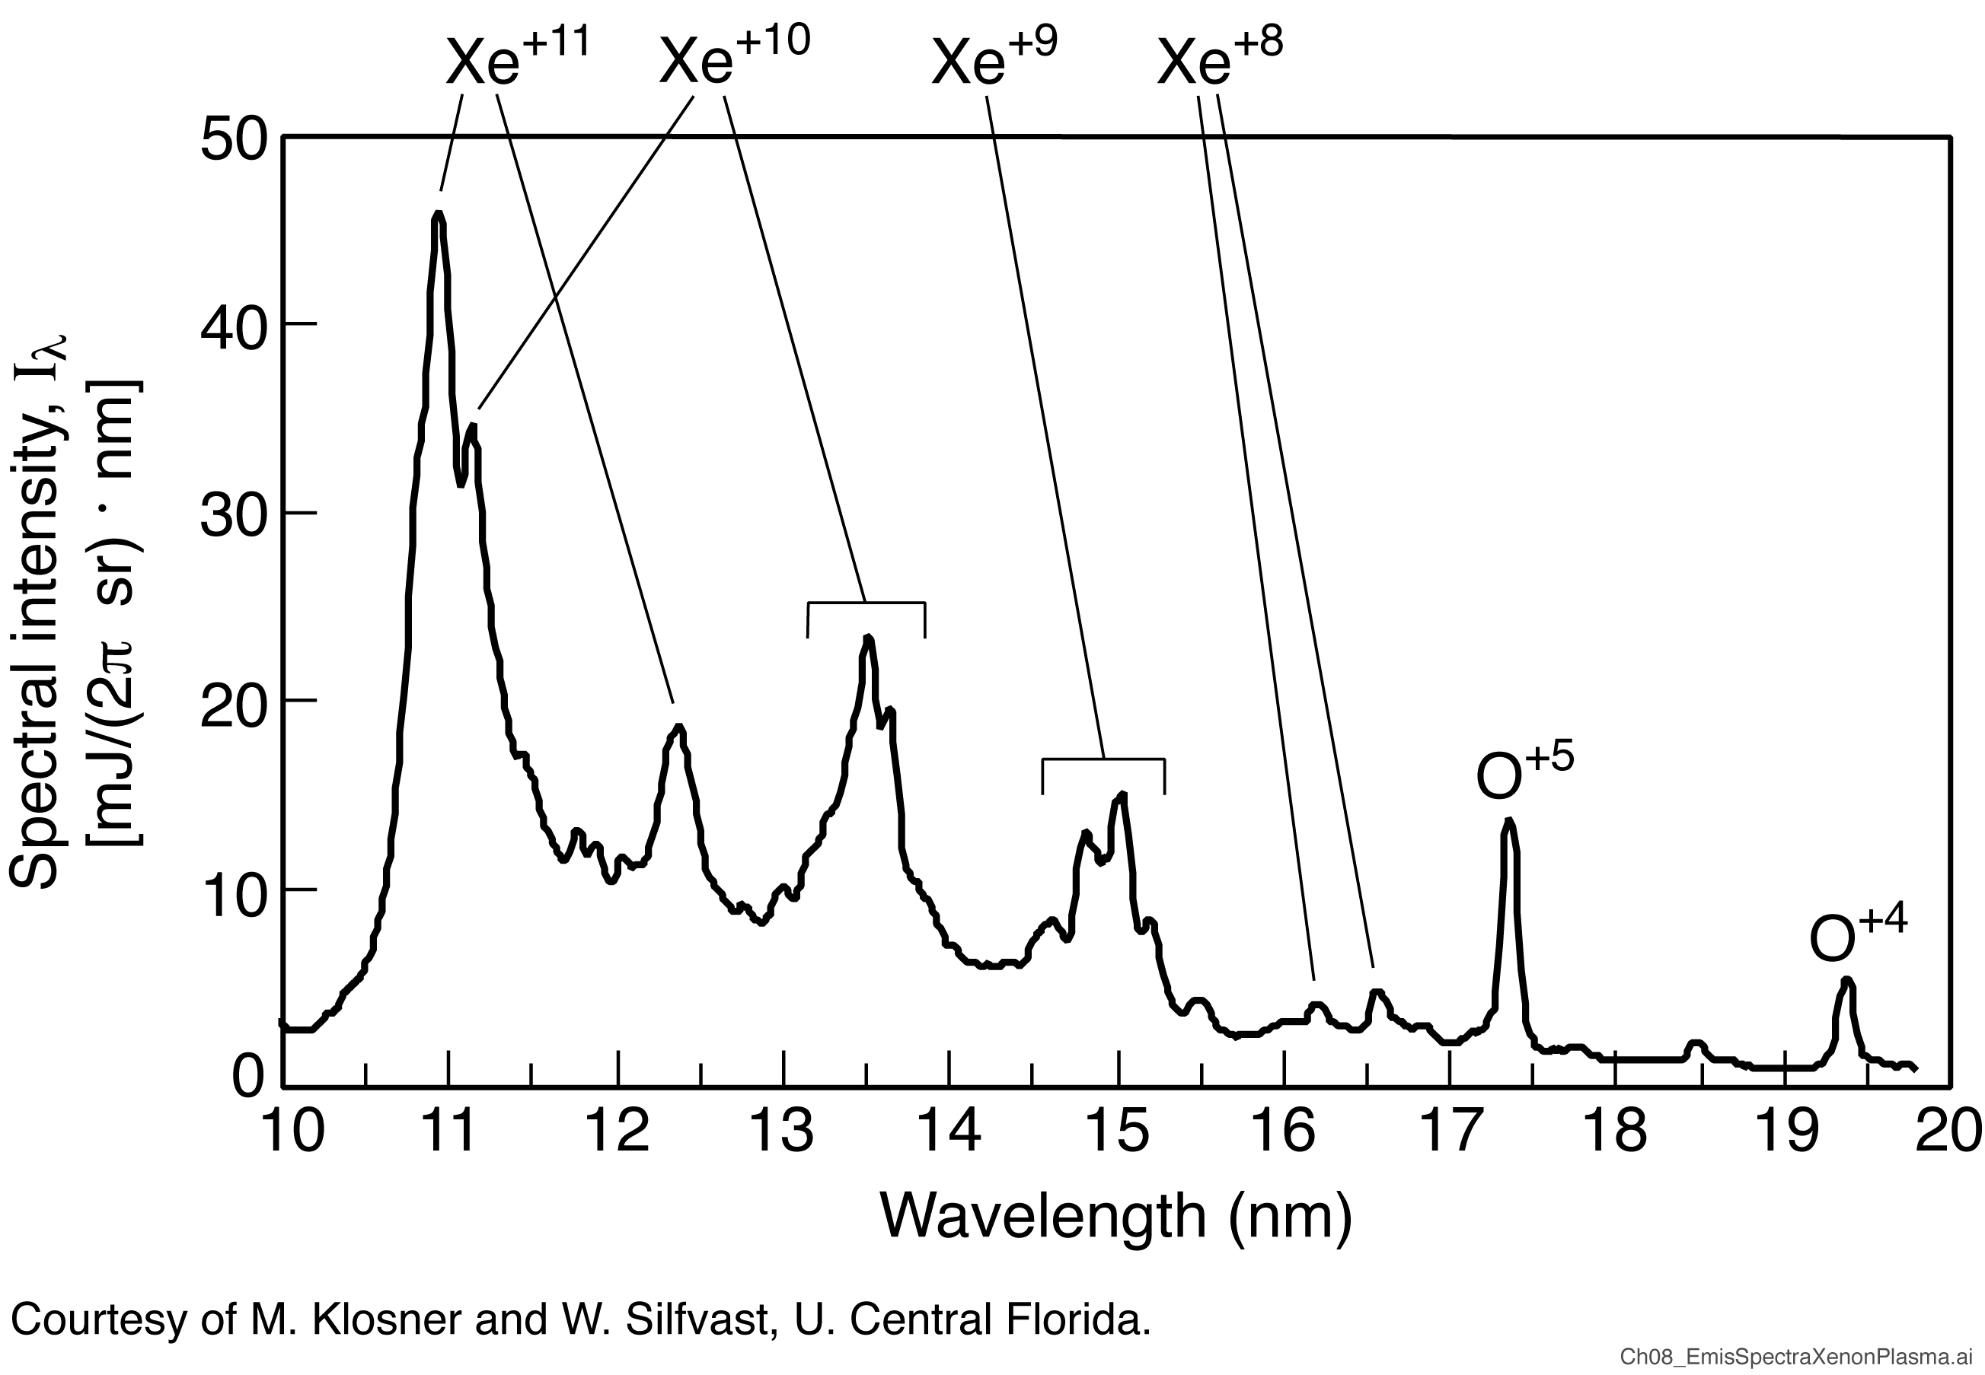
Emission spectra from a xenon plasma

Slide 18
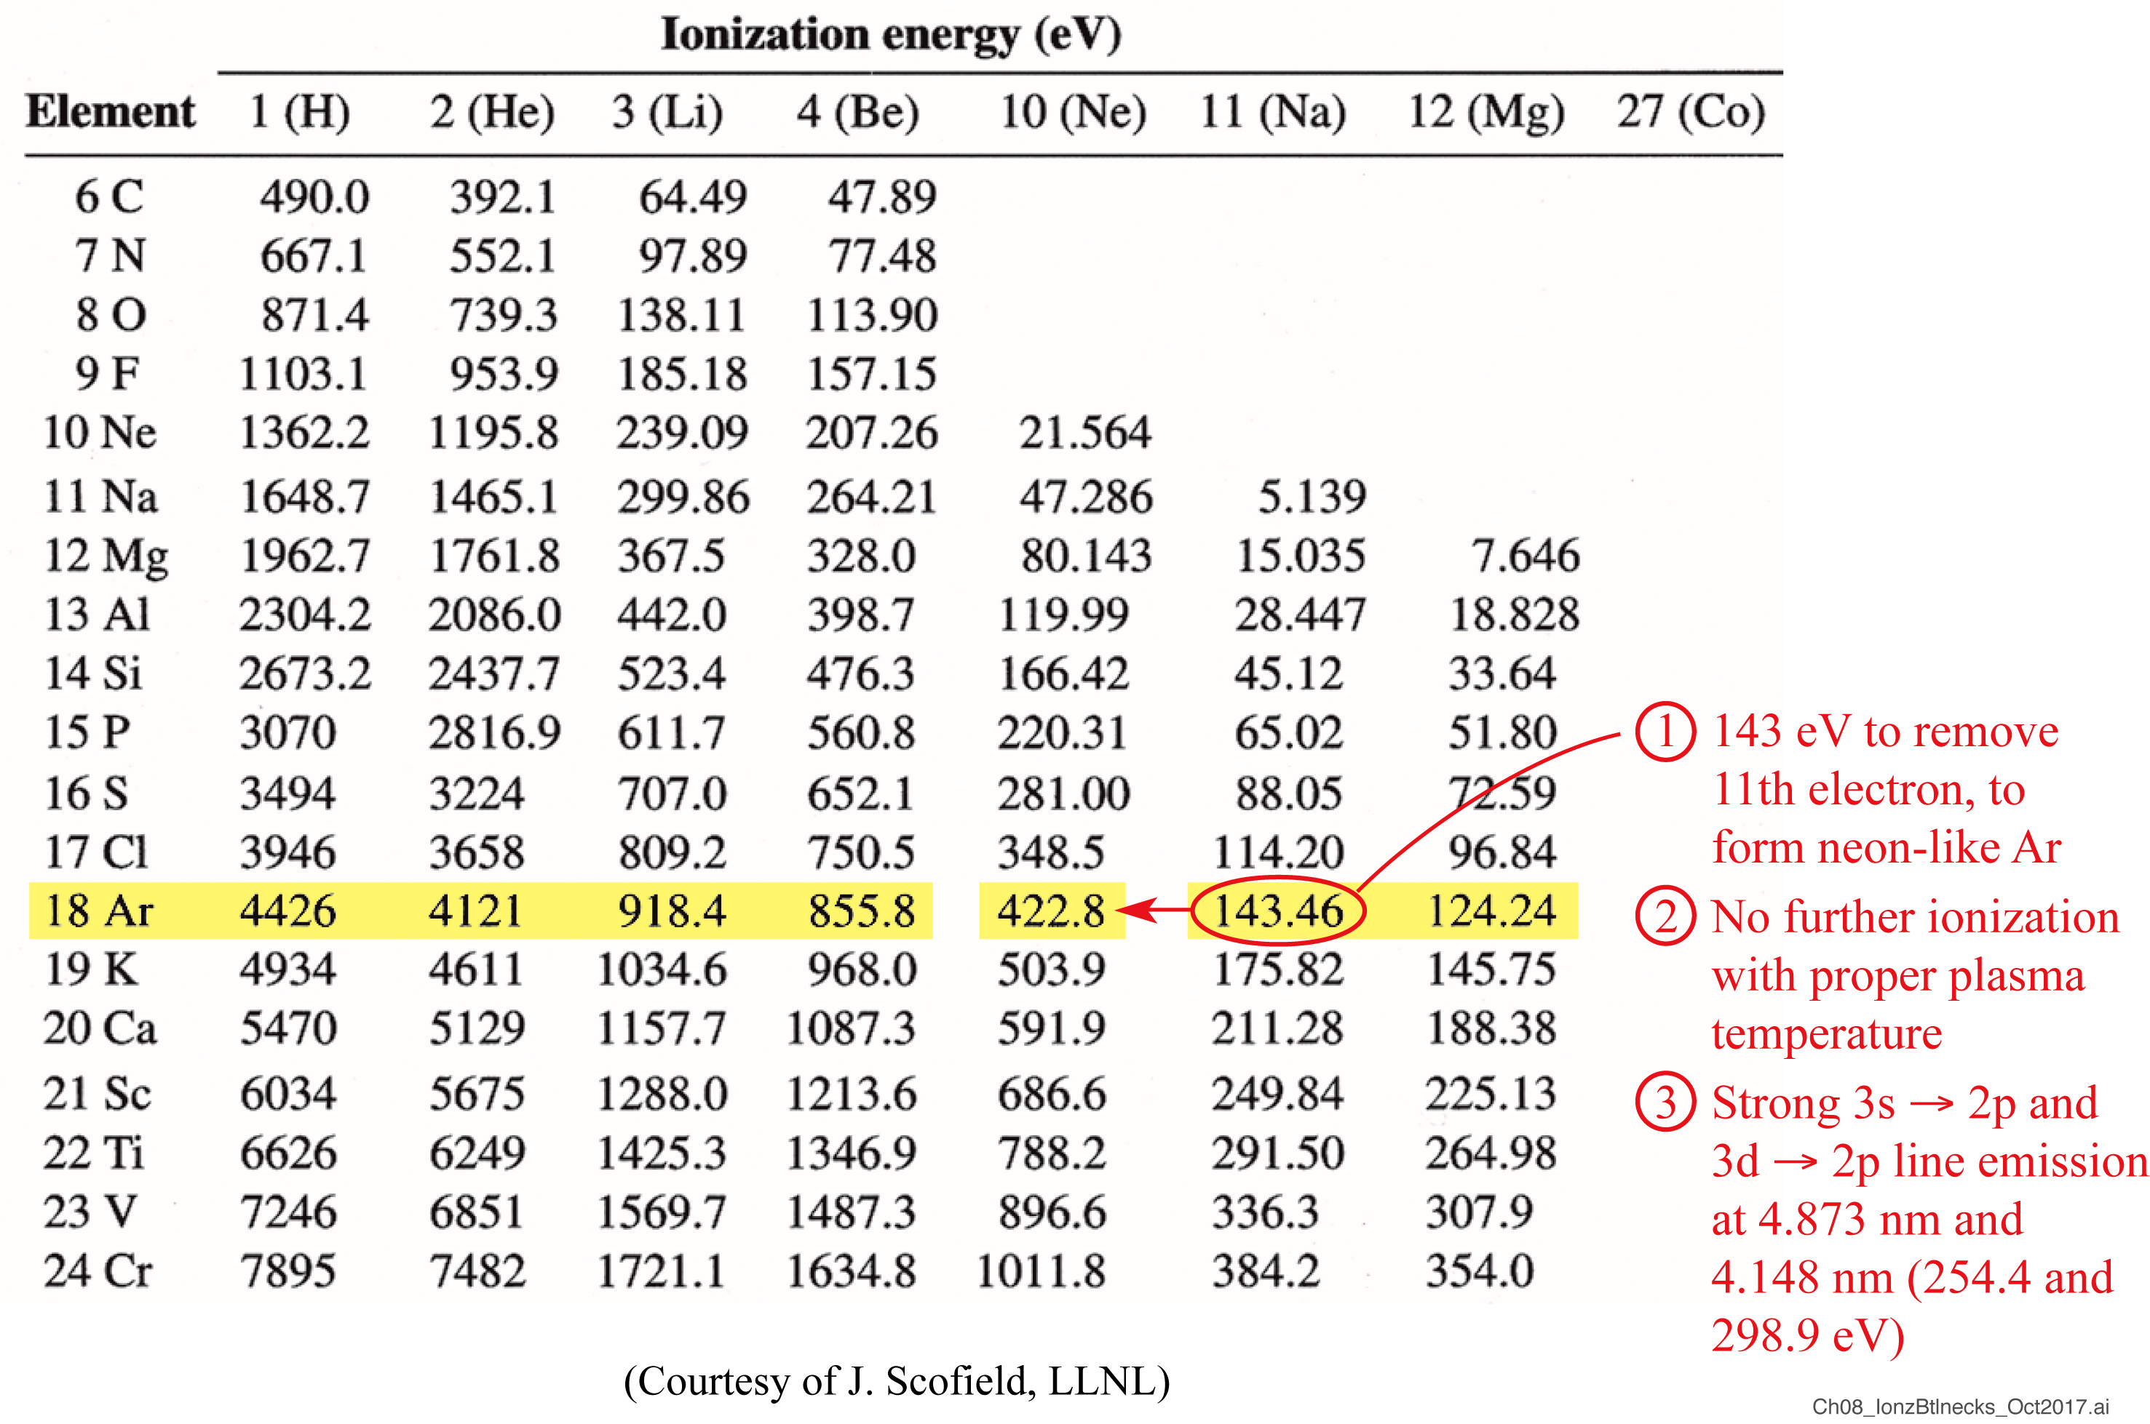
Ionization “bottlenecks” limit the number of ionization states present in a plasma
Courtesy of J. Scofield, LLNL

Slide 19

Plasma theories address physical phenomena at various levels of “particle detail”

Slide 20
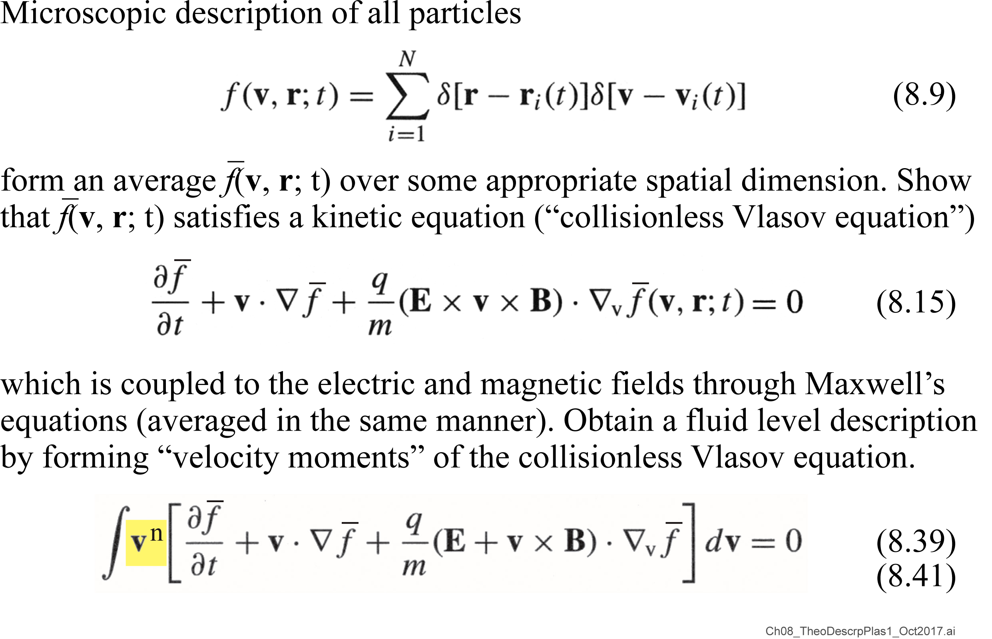
Various levels for description of a plasma

Slide 21
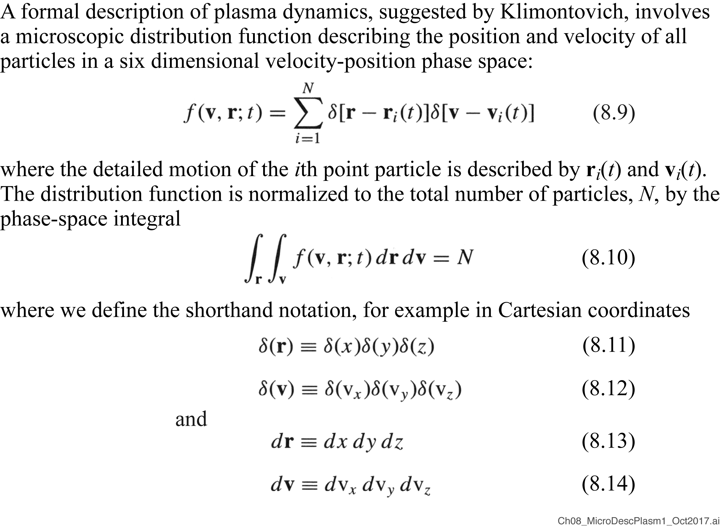
Microscopic description of a plasma

Slide 22
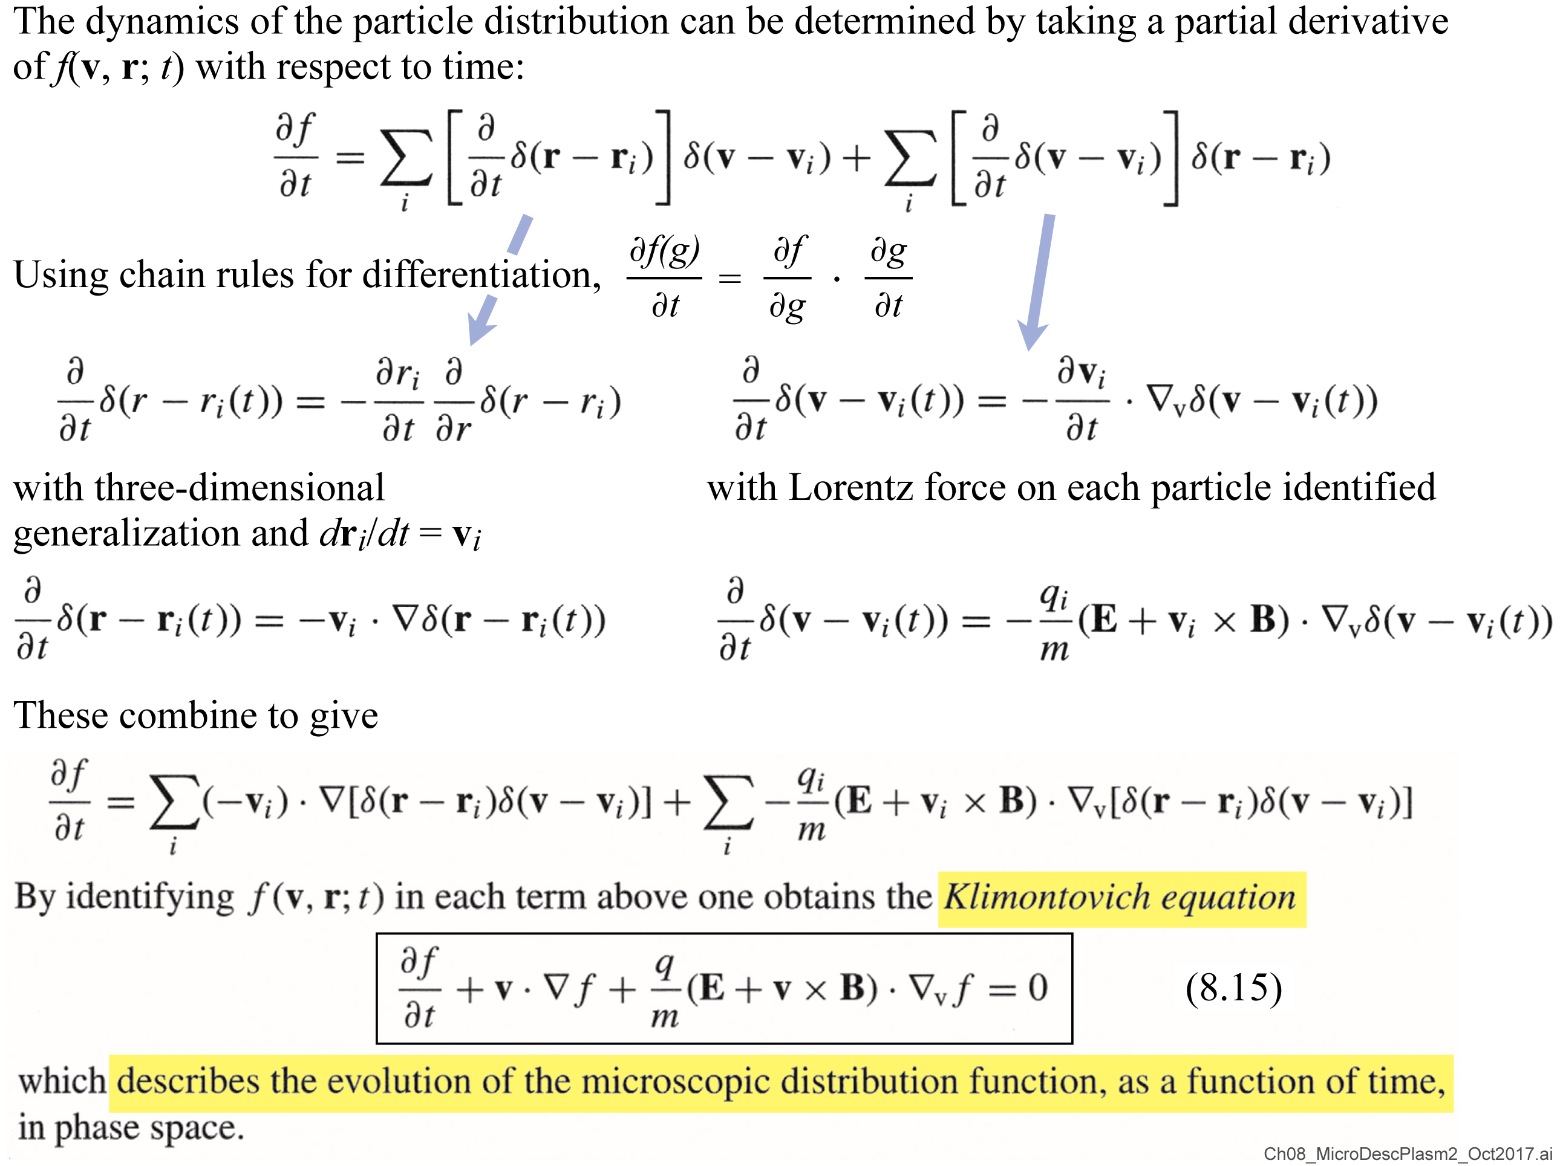
Microscopic description of a plasma (continued)

Slide 23
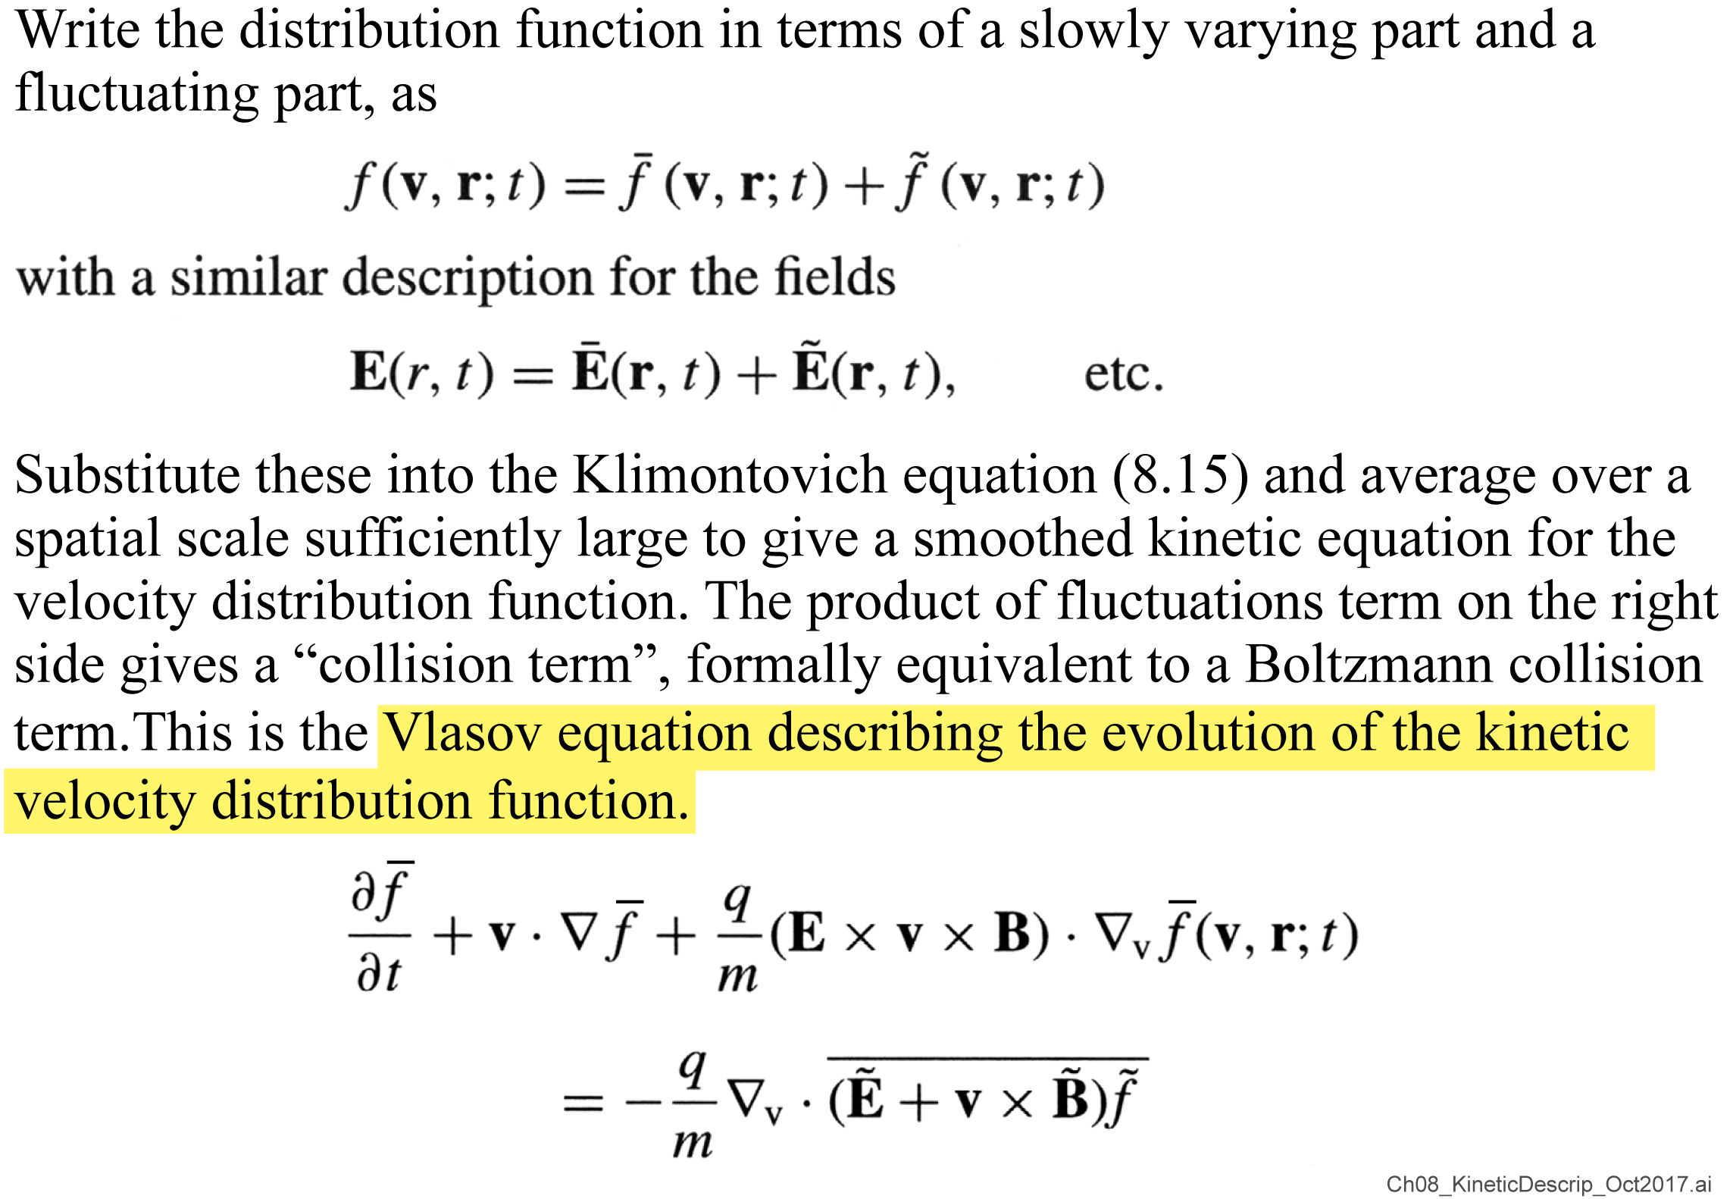
The kinetic description of a plasma

Slide 24
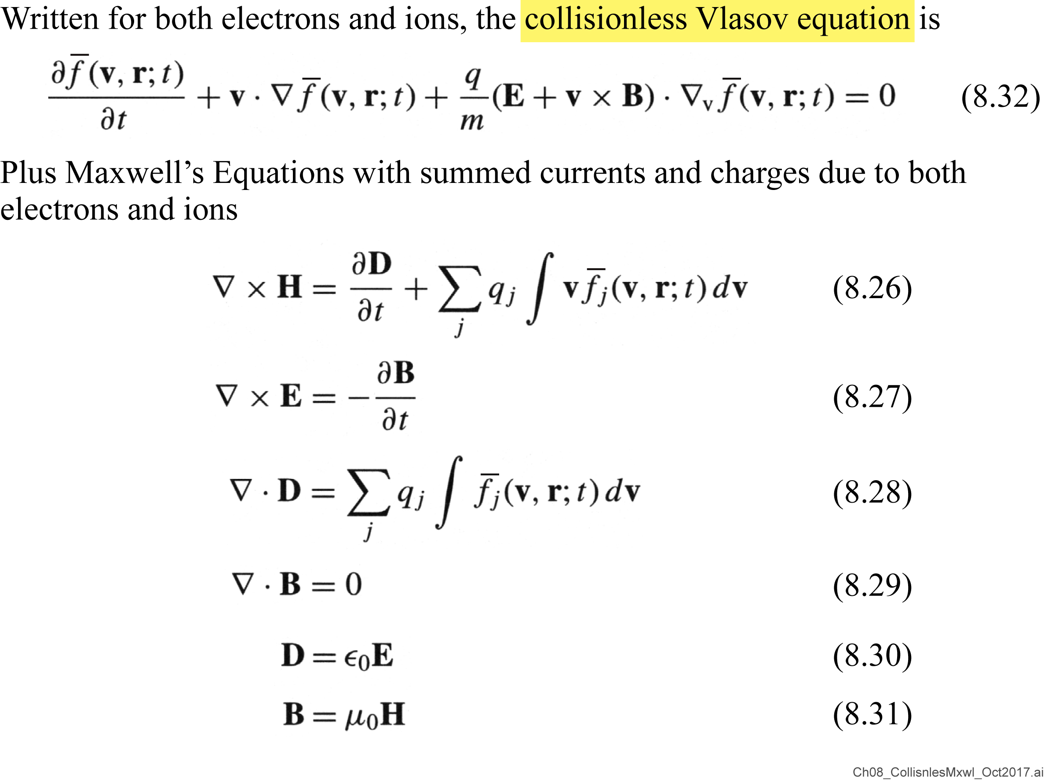
The collisionless Maxwell-Vlasov equations

Slide 25
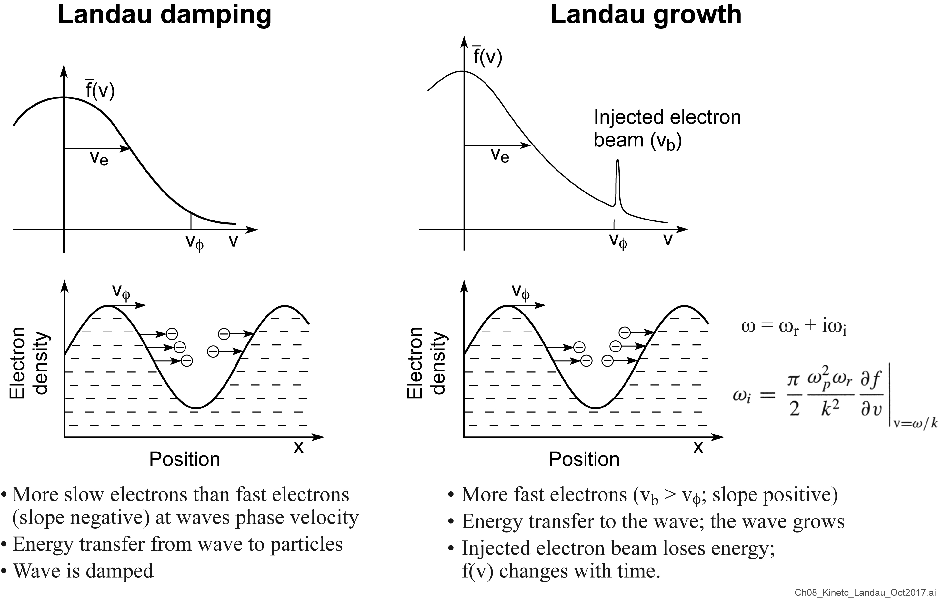
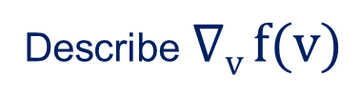
A kinetic effect: Landau damping or Landau growth
Describe $∇v f(v)$
Lev Landau 1945

Slide 26
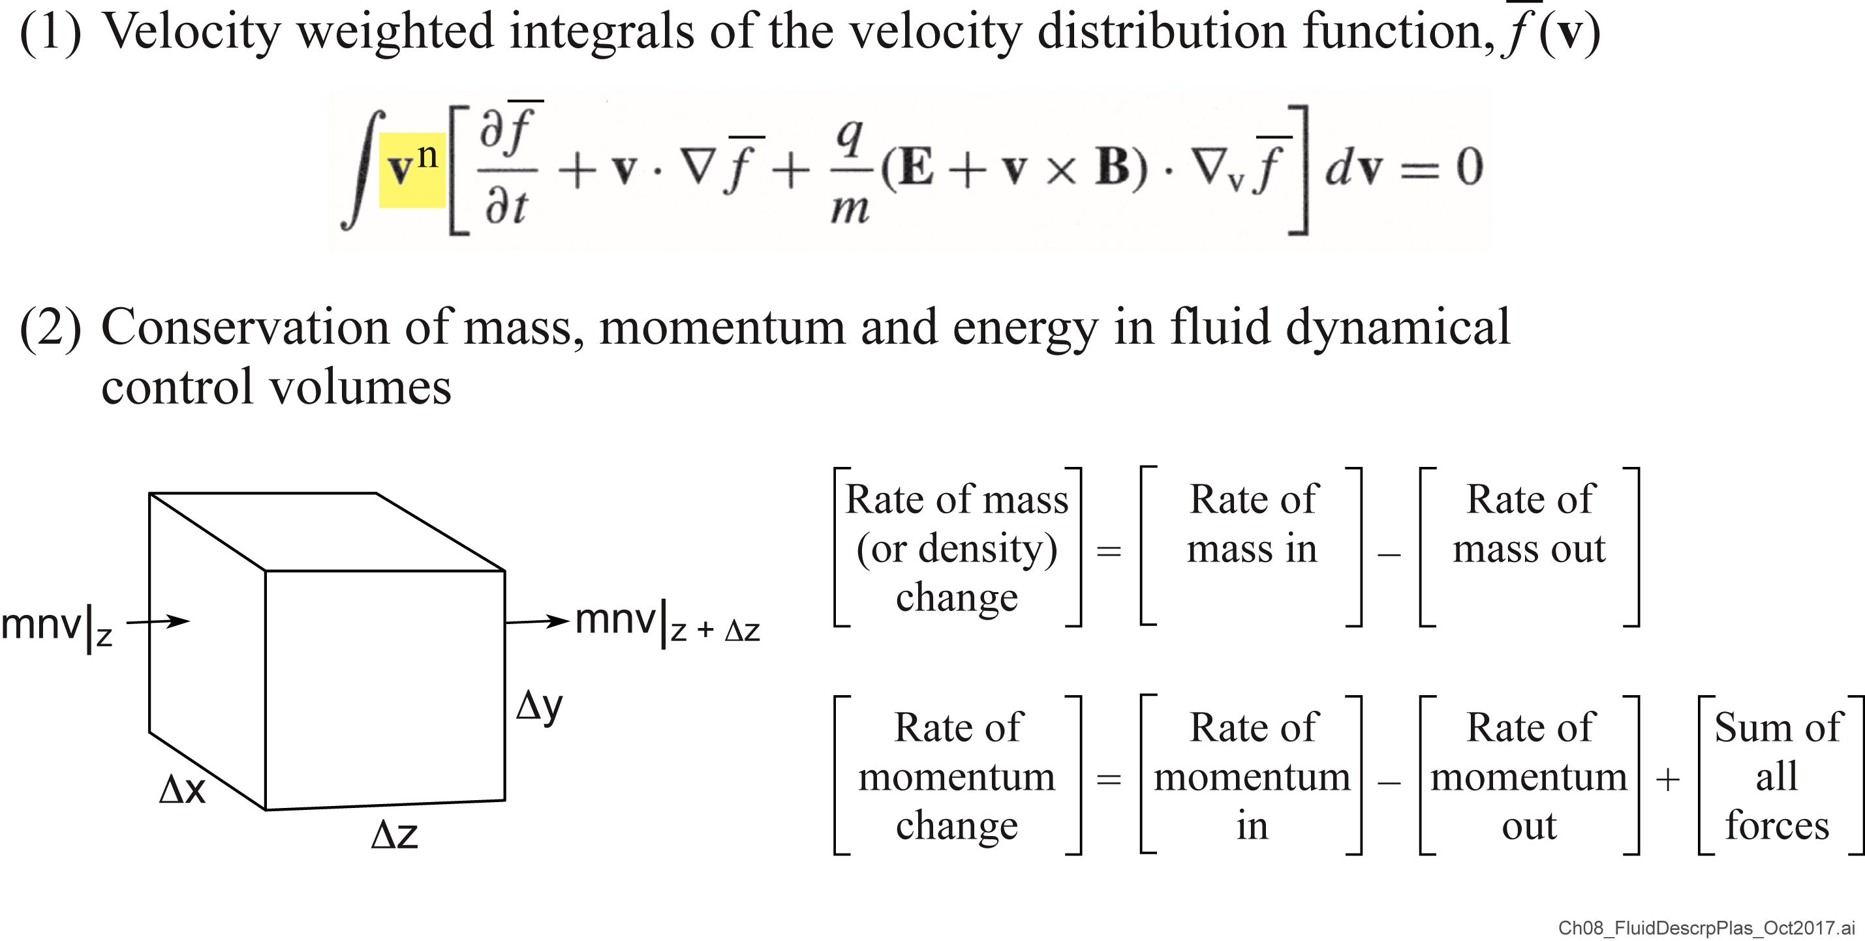
Fluid description of a plasma – two approaches
“moment equations”

Slide 27
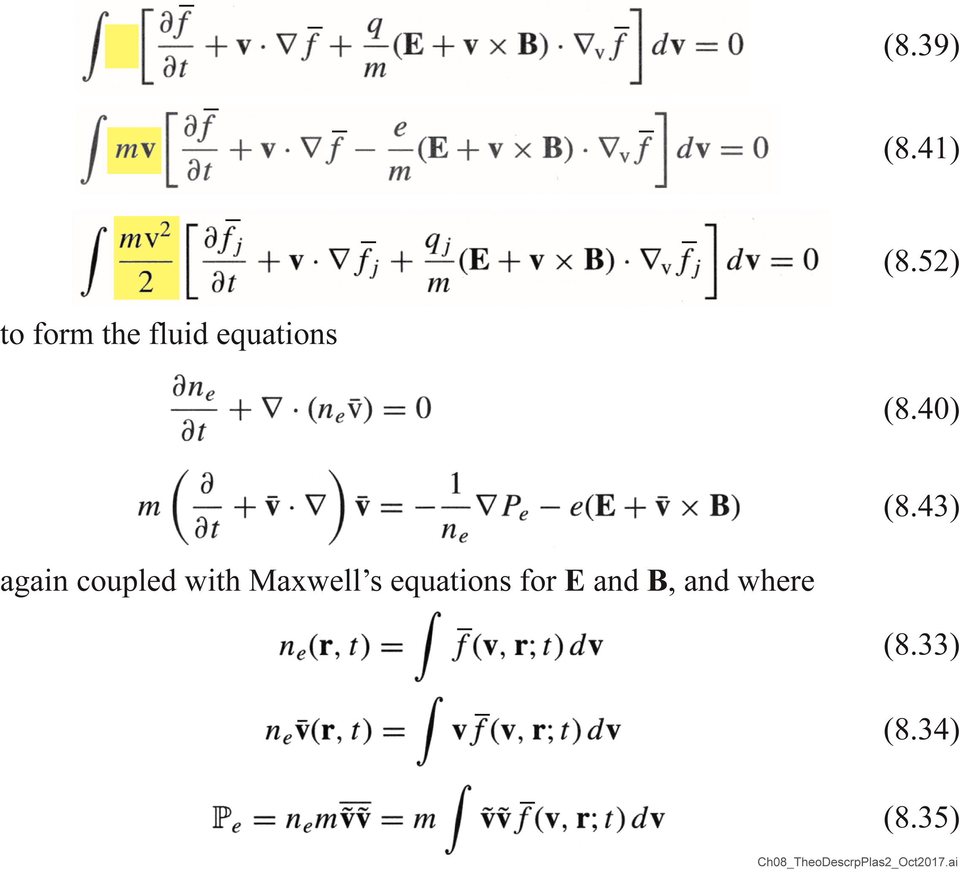
Theoretical description of a plasma (continued)

Slide 28
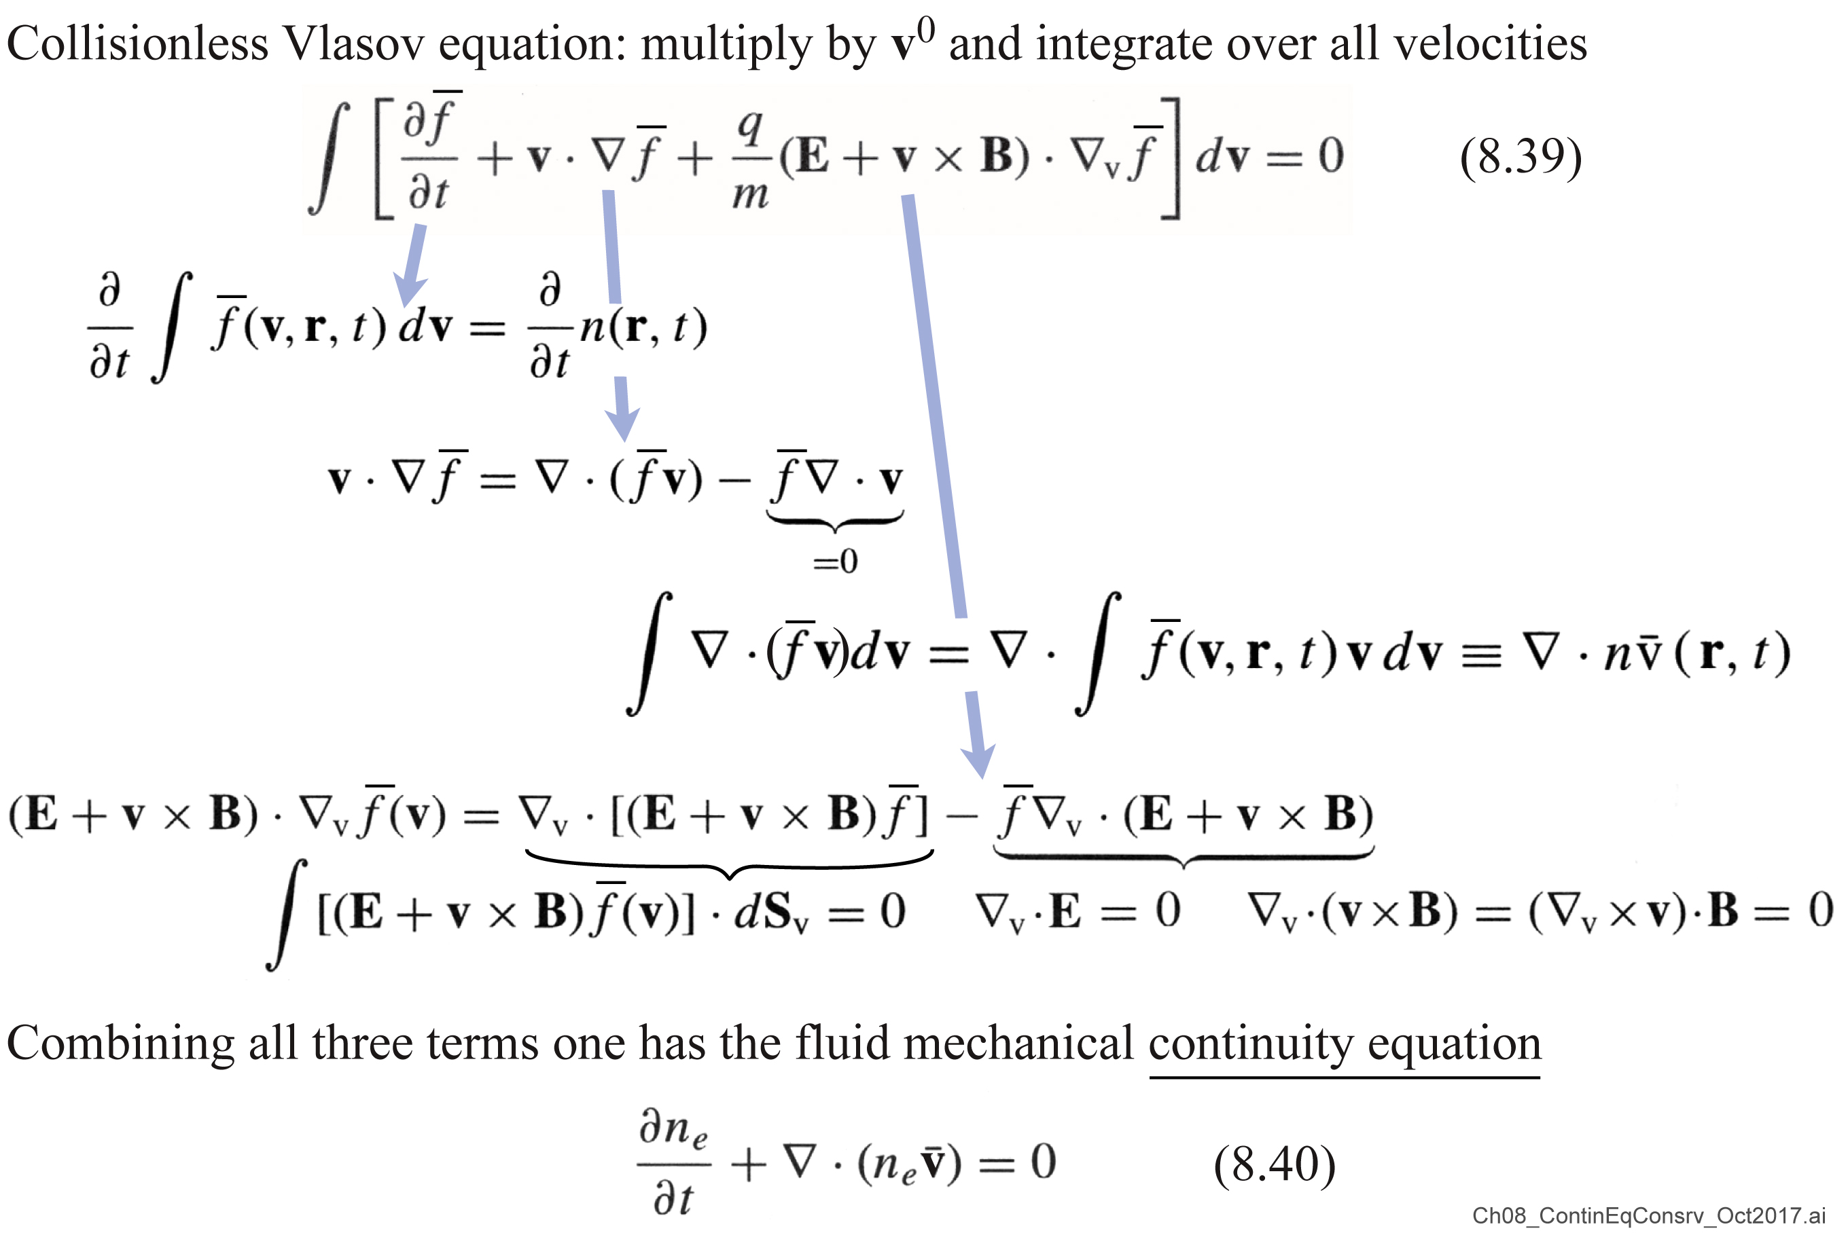
First moment equation:The continuity equation for conservation of mass or conservation of particles

Slide 29
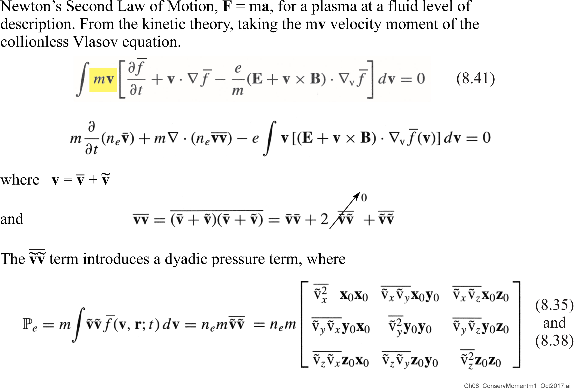
Conservation of momentum: A force equation for a fluid plasma

Slide 30
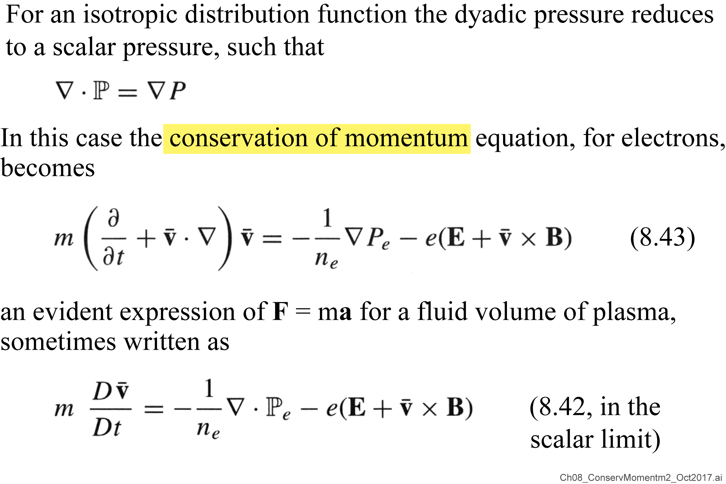
Conservation of momentum: A force equation for a fluid plasma (continued)

Slide 31
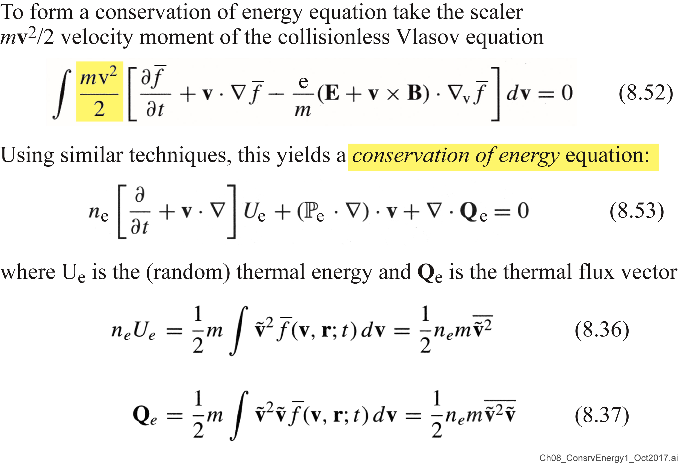
The conservation of energy for a plasma fluid

Slide 32
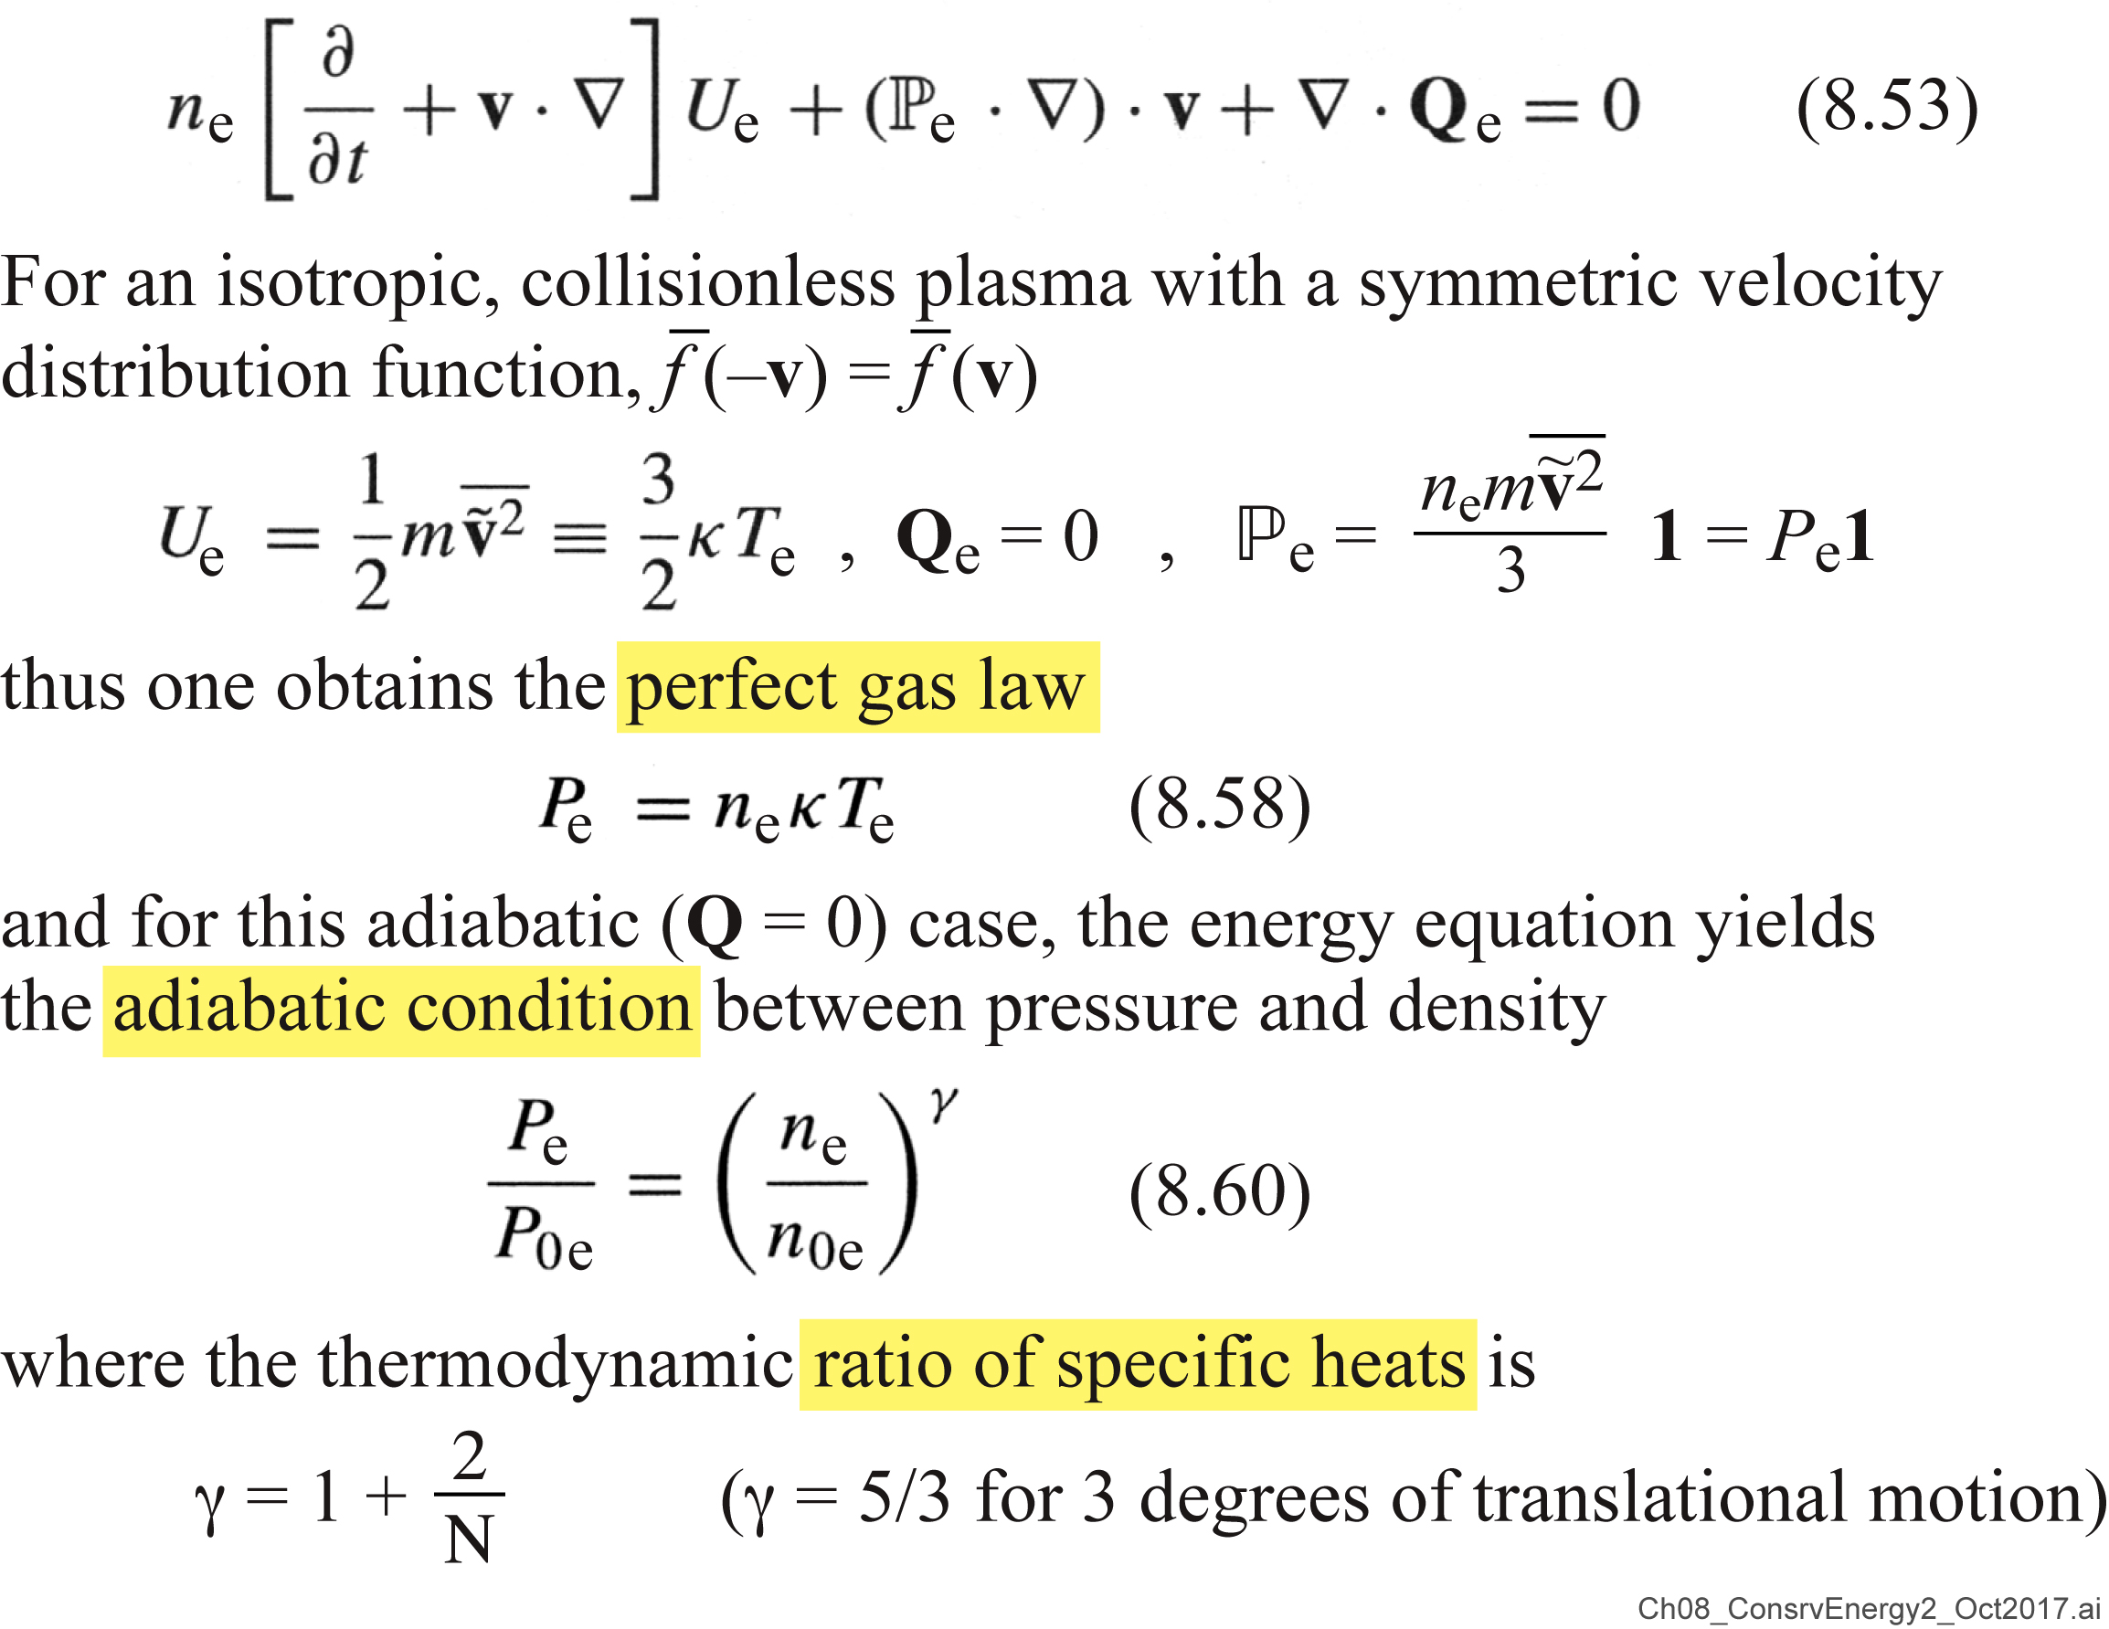
The conservation of energy for a plasma fluid (continued)

Slide 33
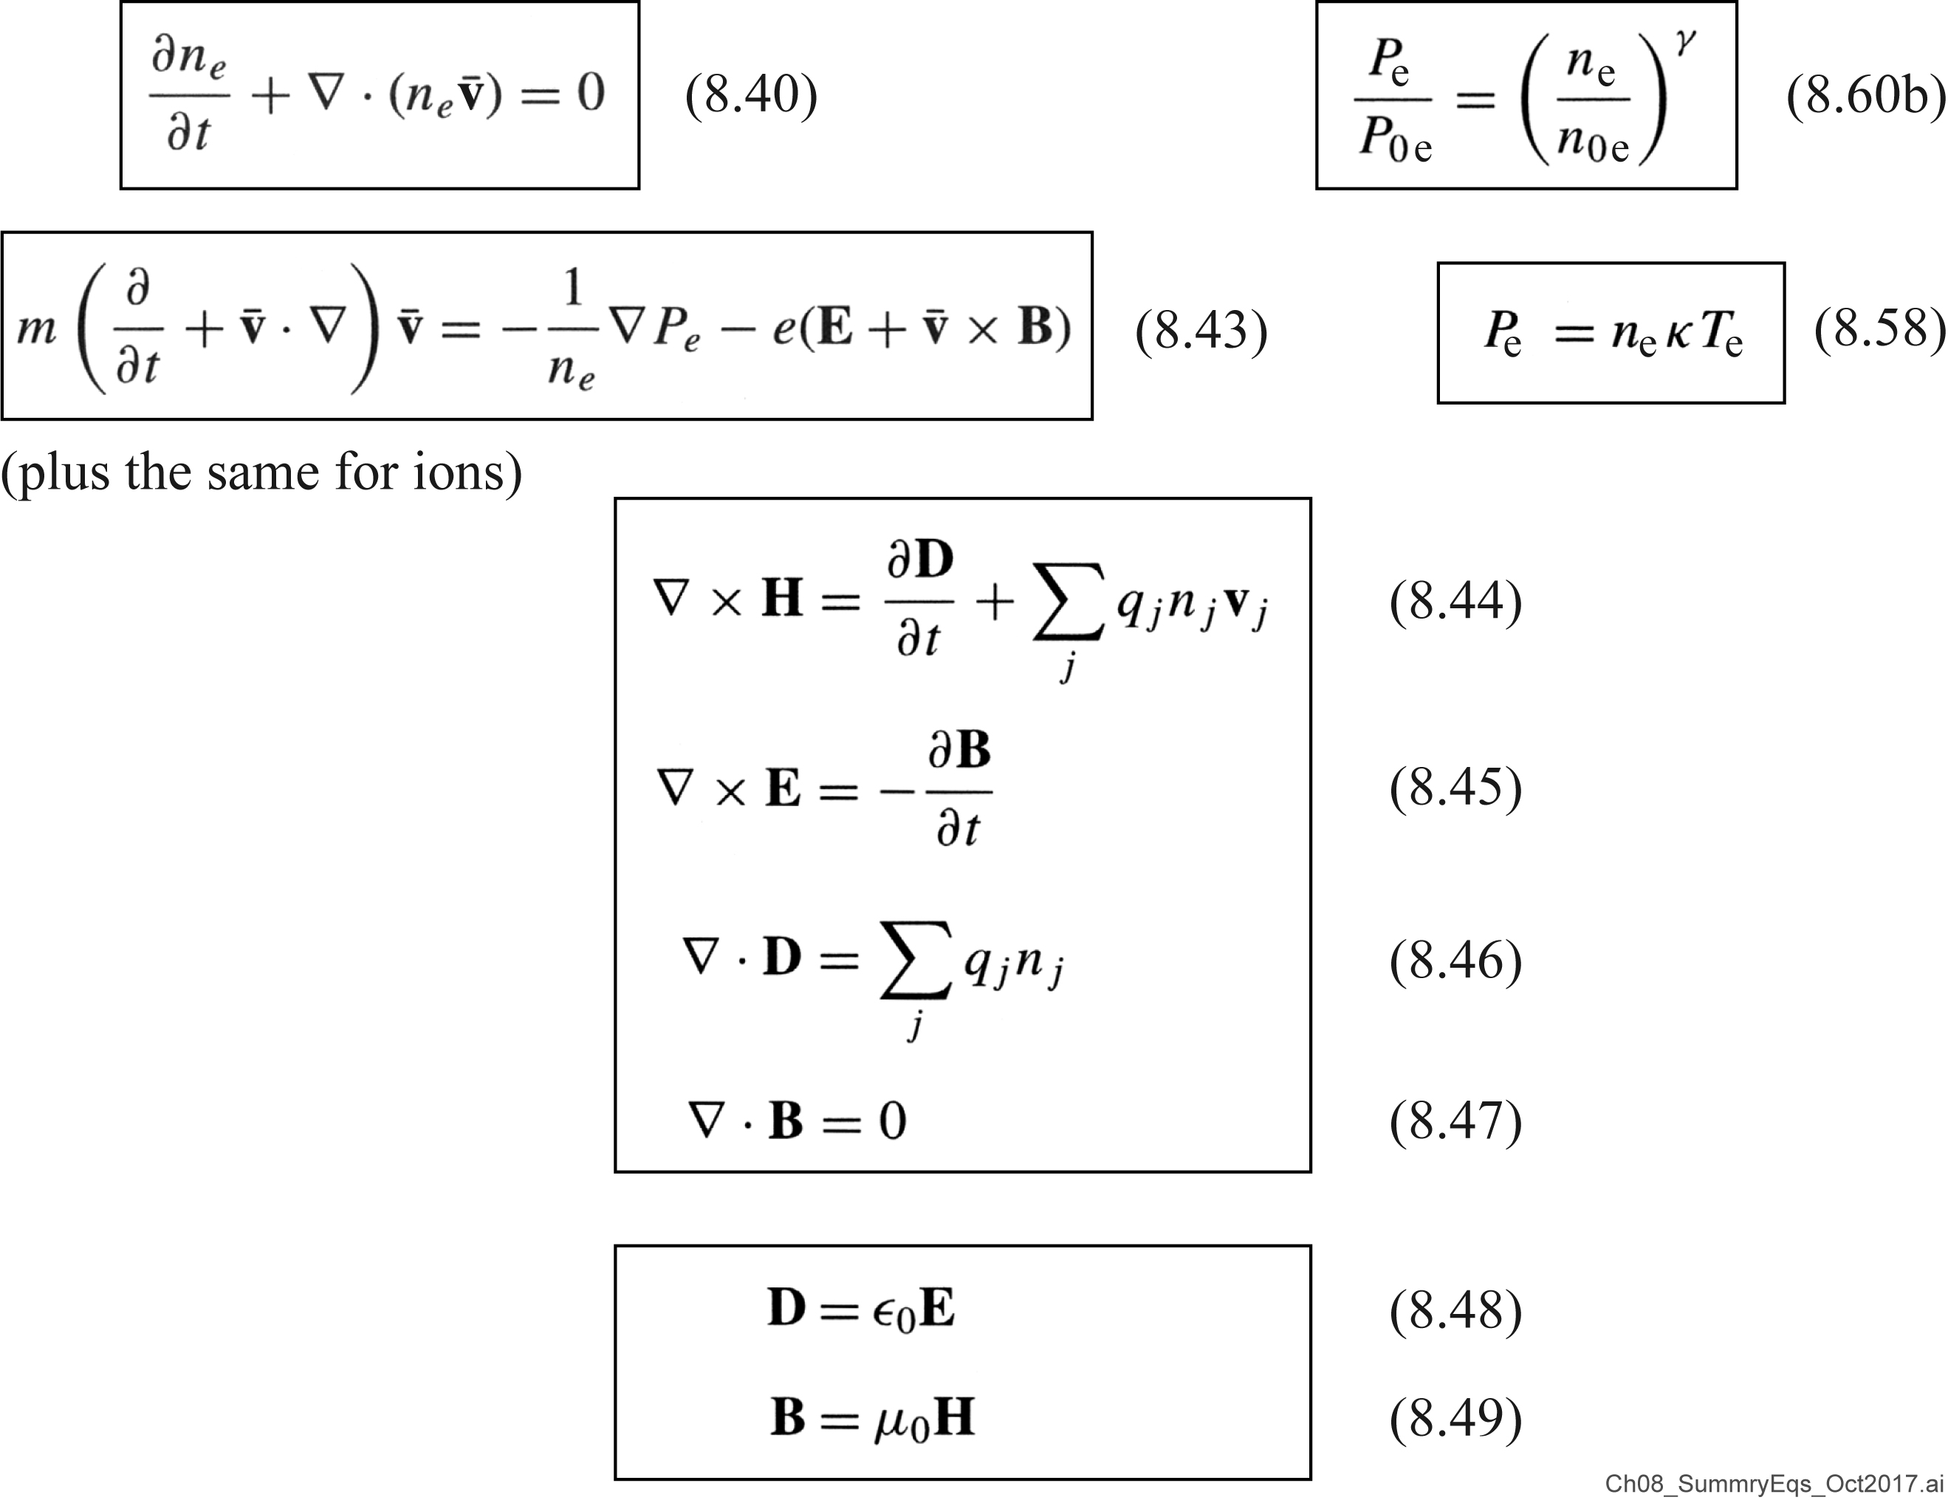
Summary of fluid equations for an isotropic, collisionless plasma

Slide 34
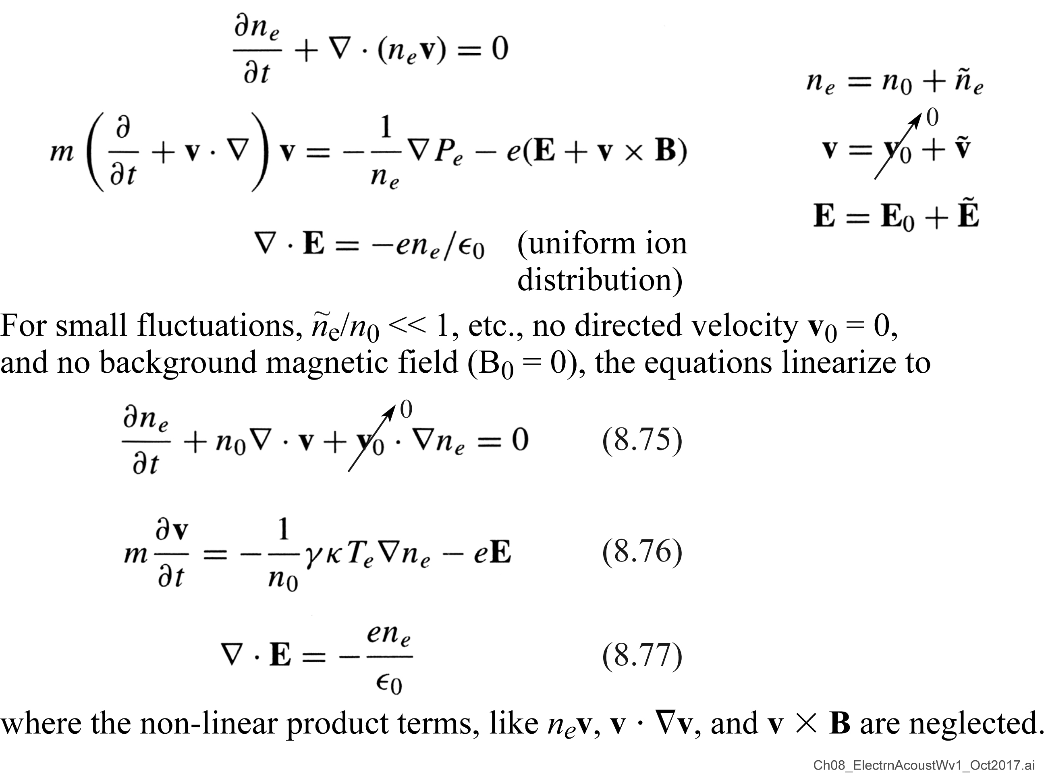
Electron-acoustic wave in a plasma

Slide 35
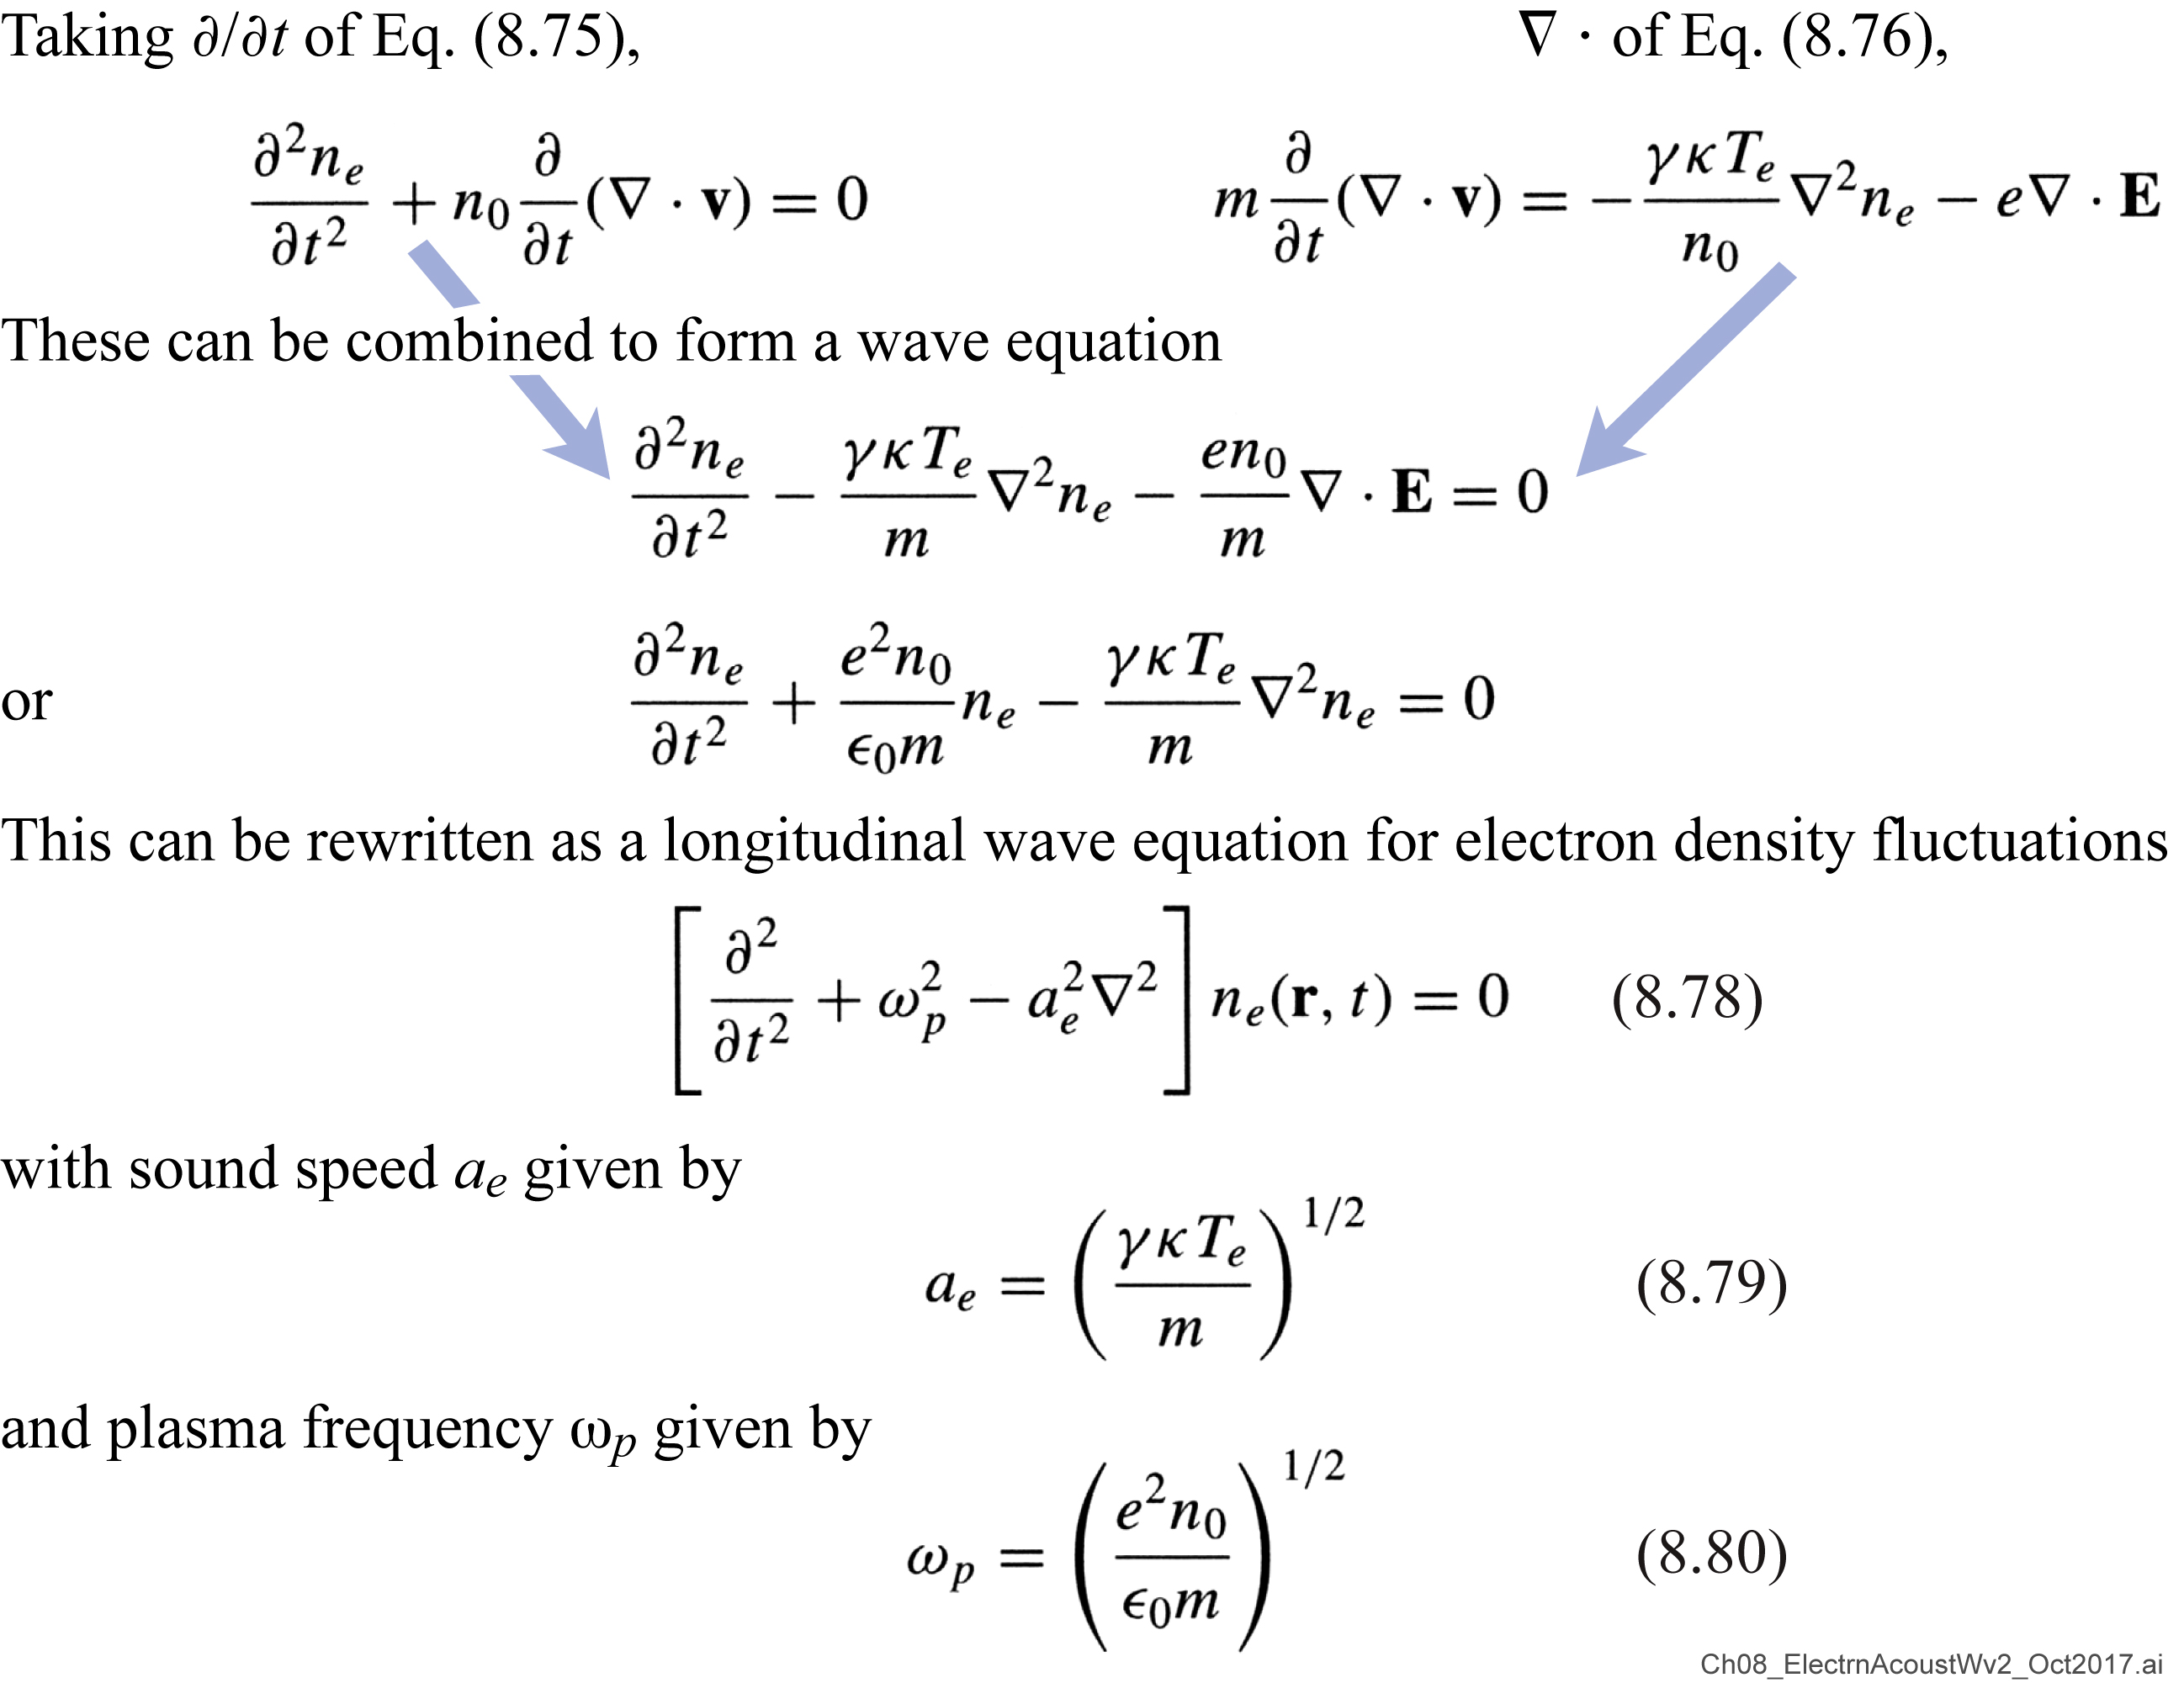
Electron-acoustic wave in a plasma (continued)

Slide 36
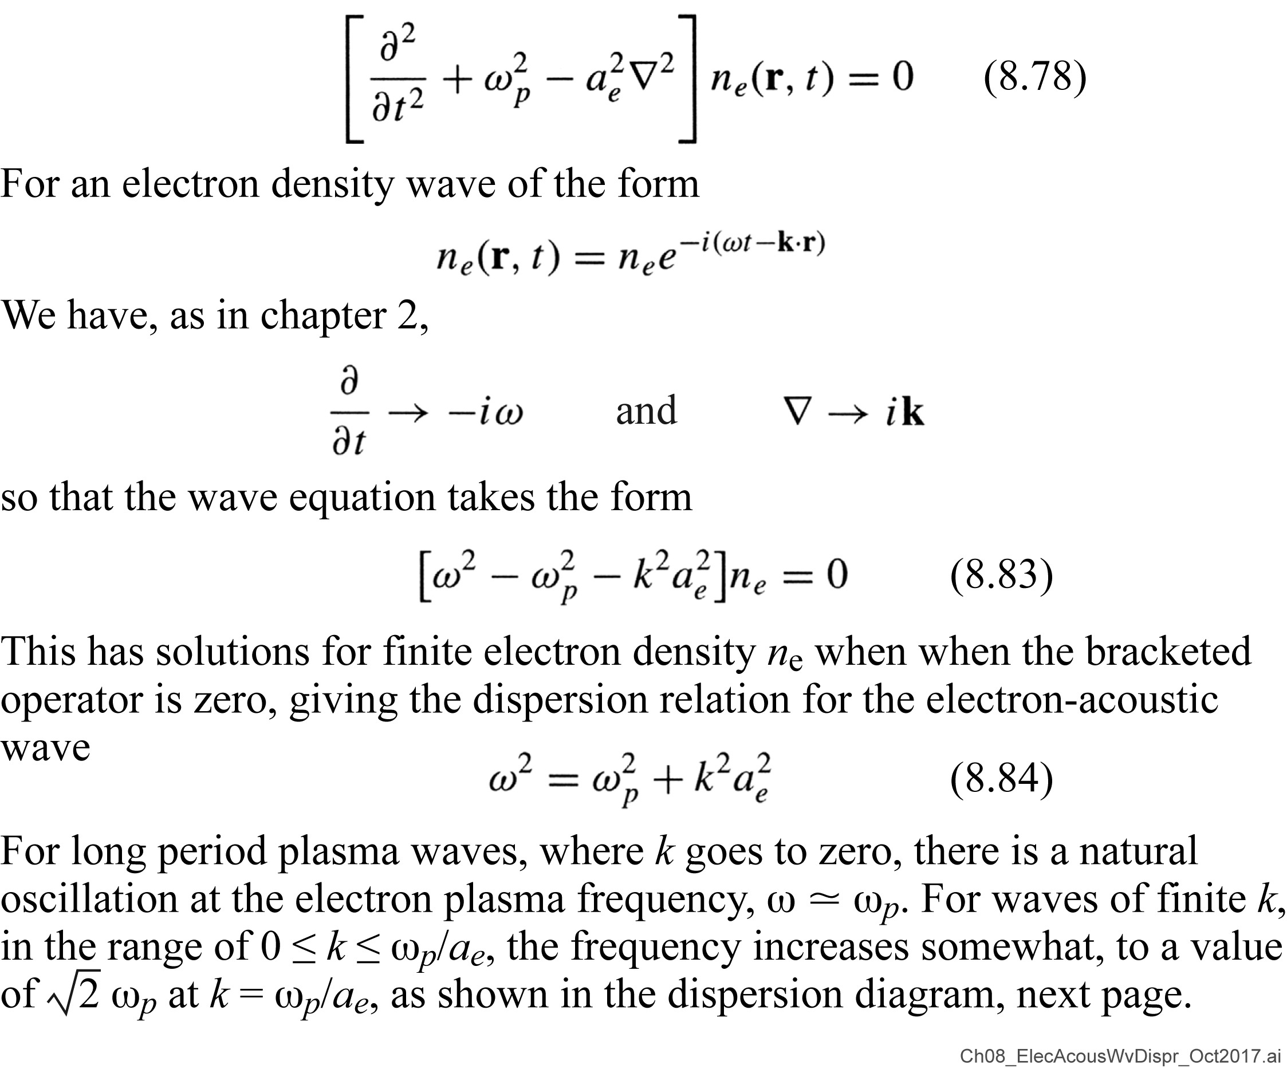
Electron-acoustic wave: dispersion relation

Slide 37
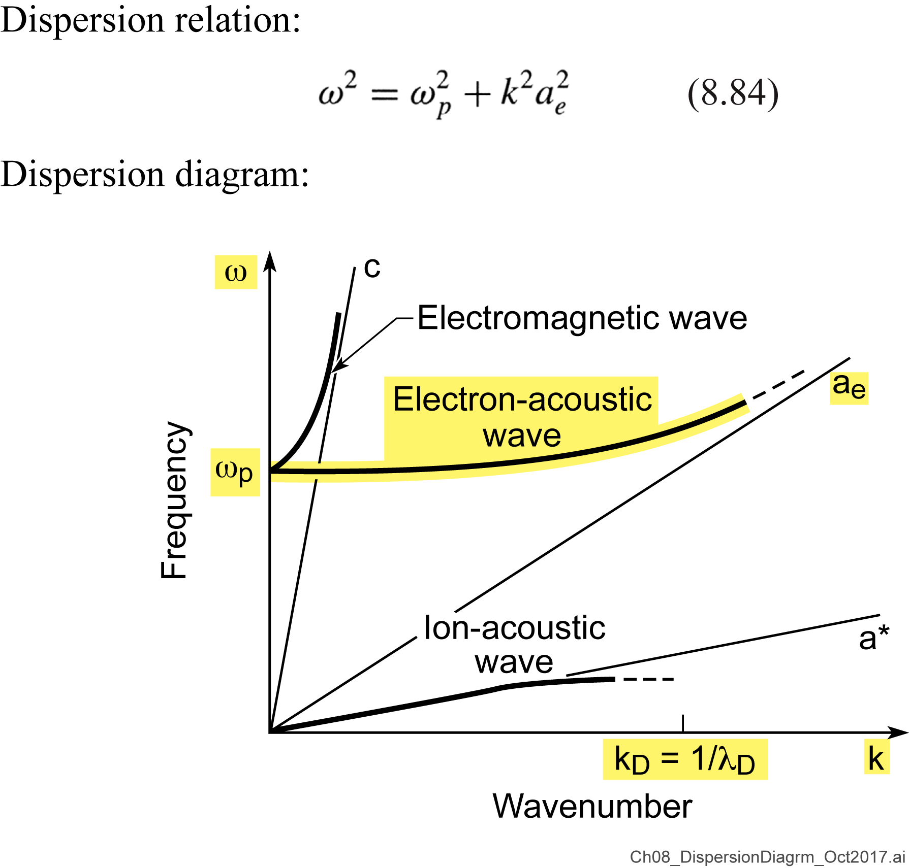
Electron-acoustic wave: dispersion diagram

Slide 38
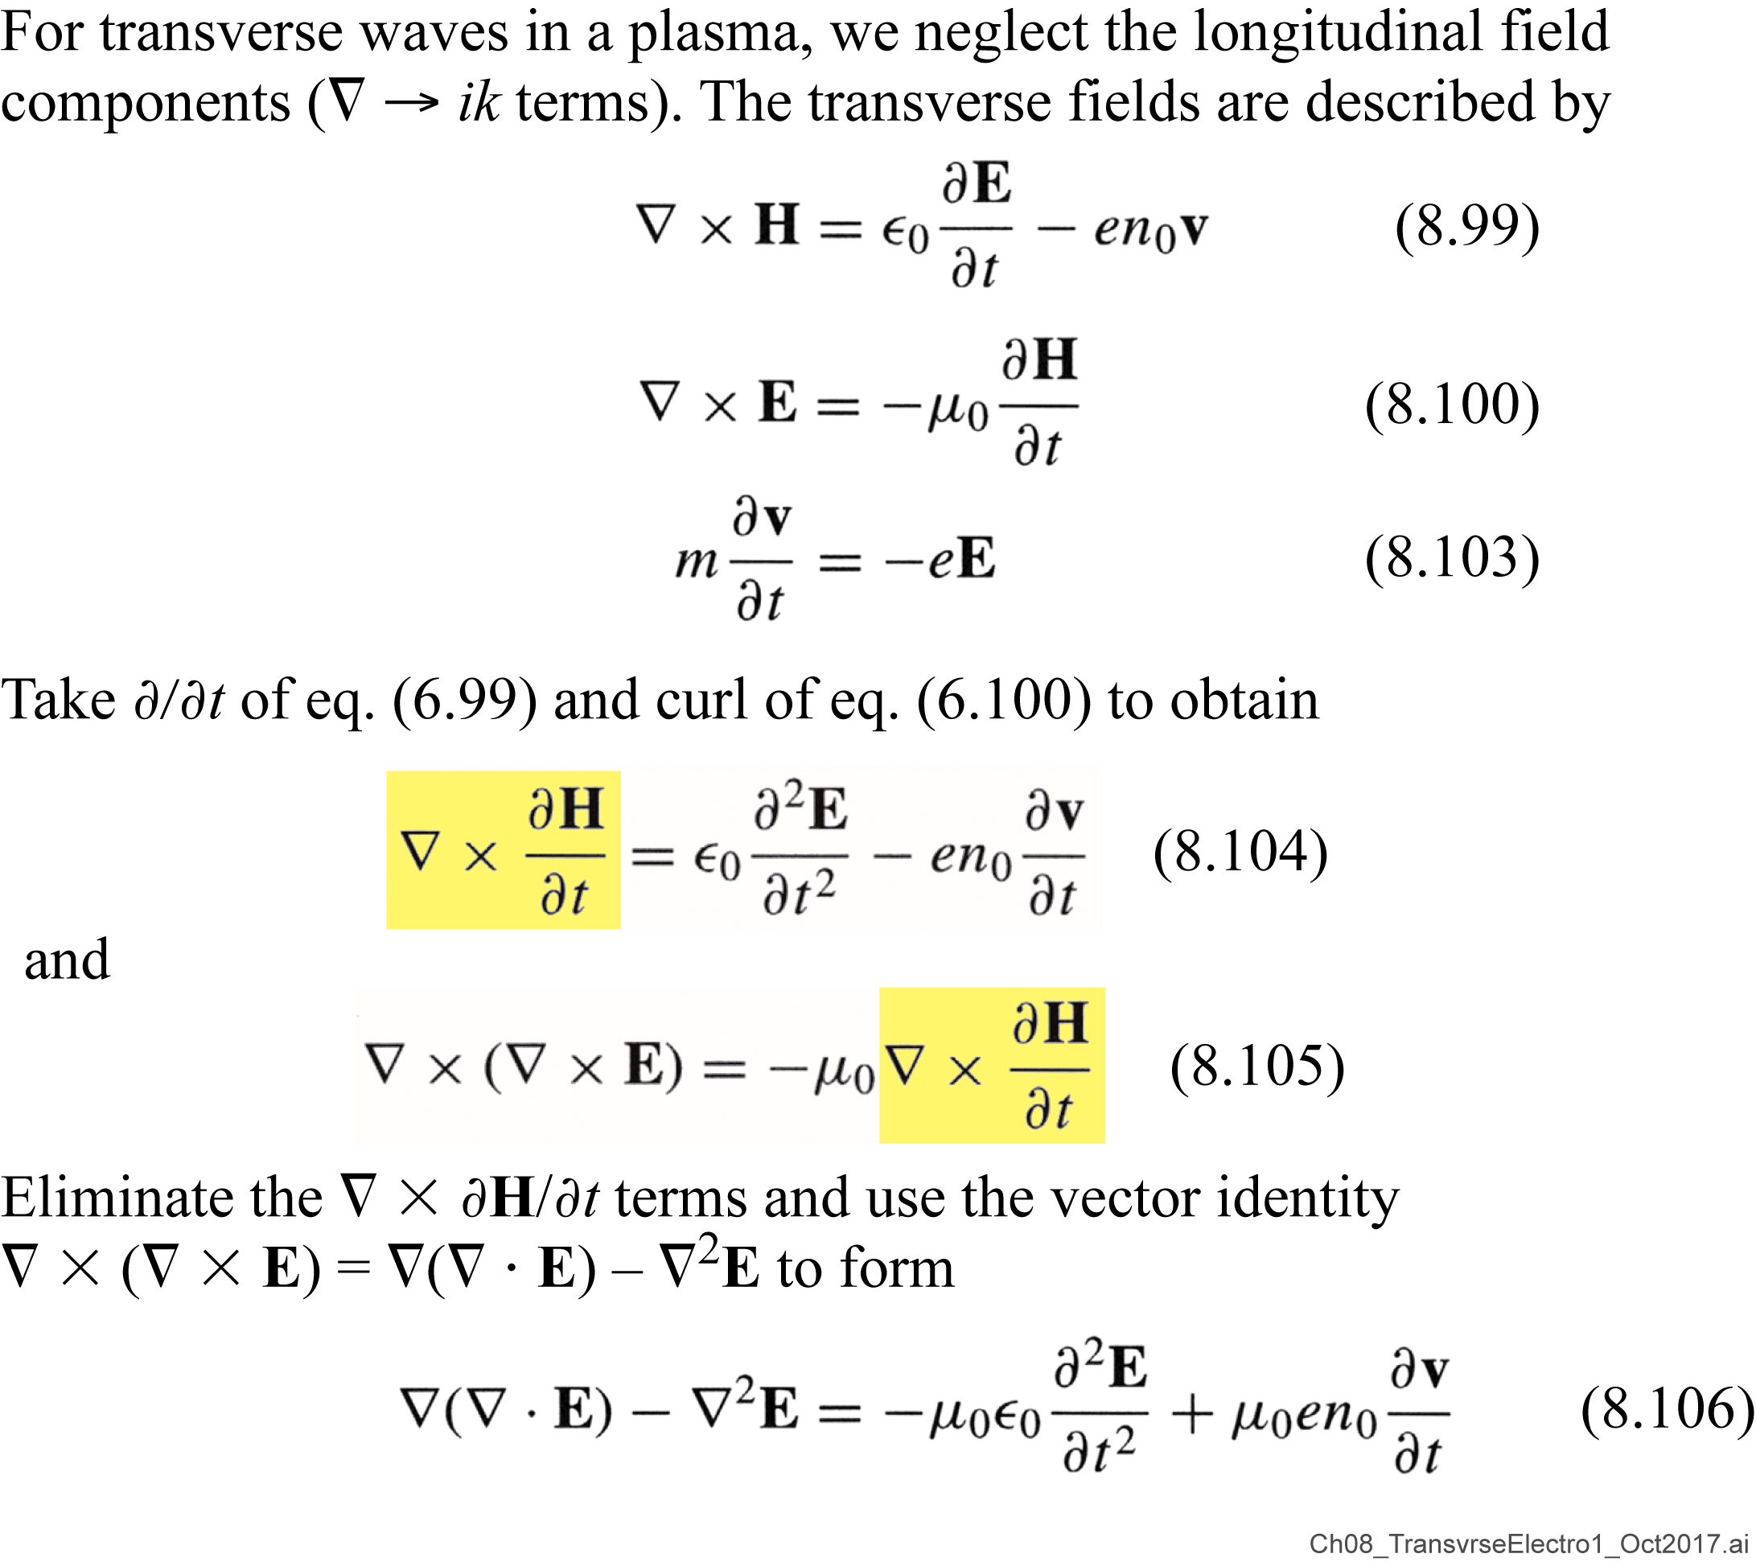
Transverse electromagnetic waves in a plasma

Slide 39
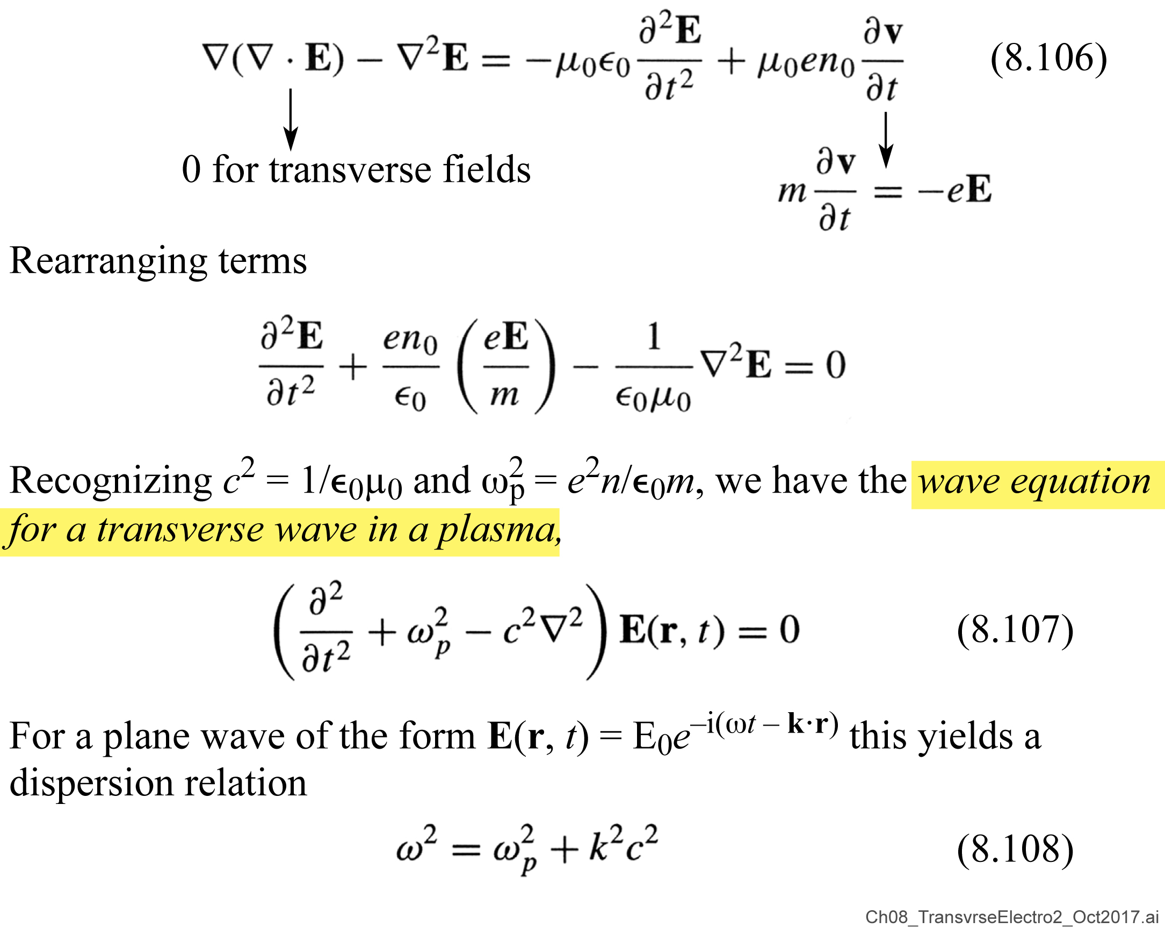
Transverse electromagnetic waves in a plasma (continued)

Slide 40
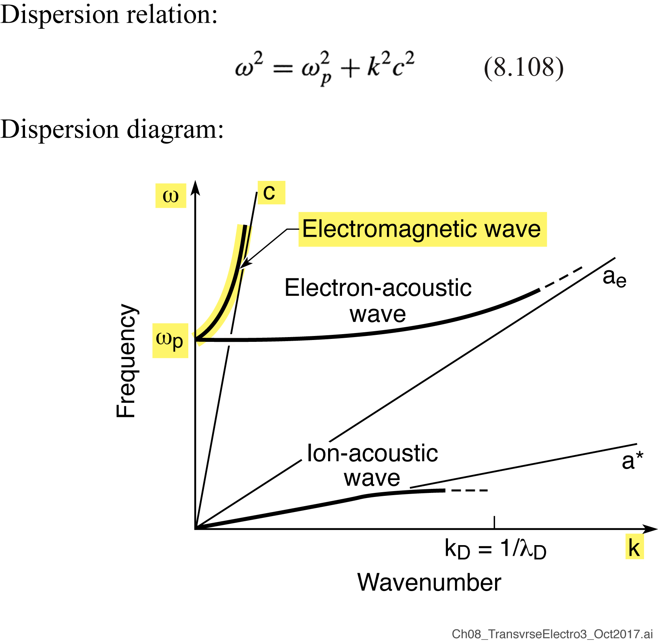
Transverse electromagnetic waves in a plasma (continued)

Slide 41
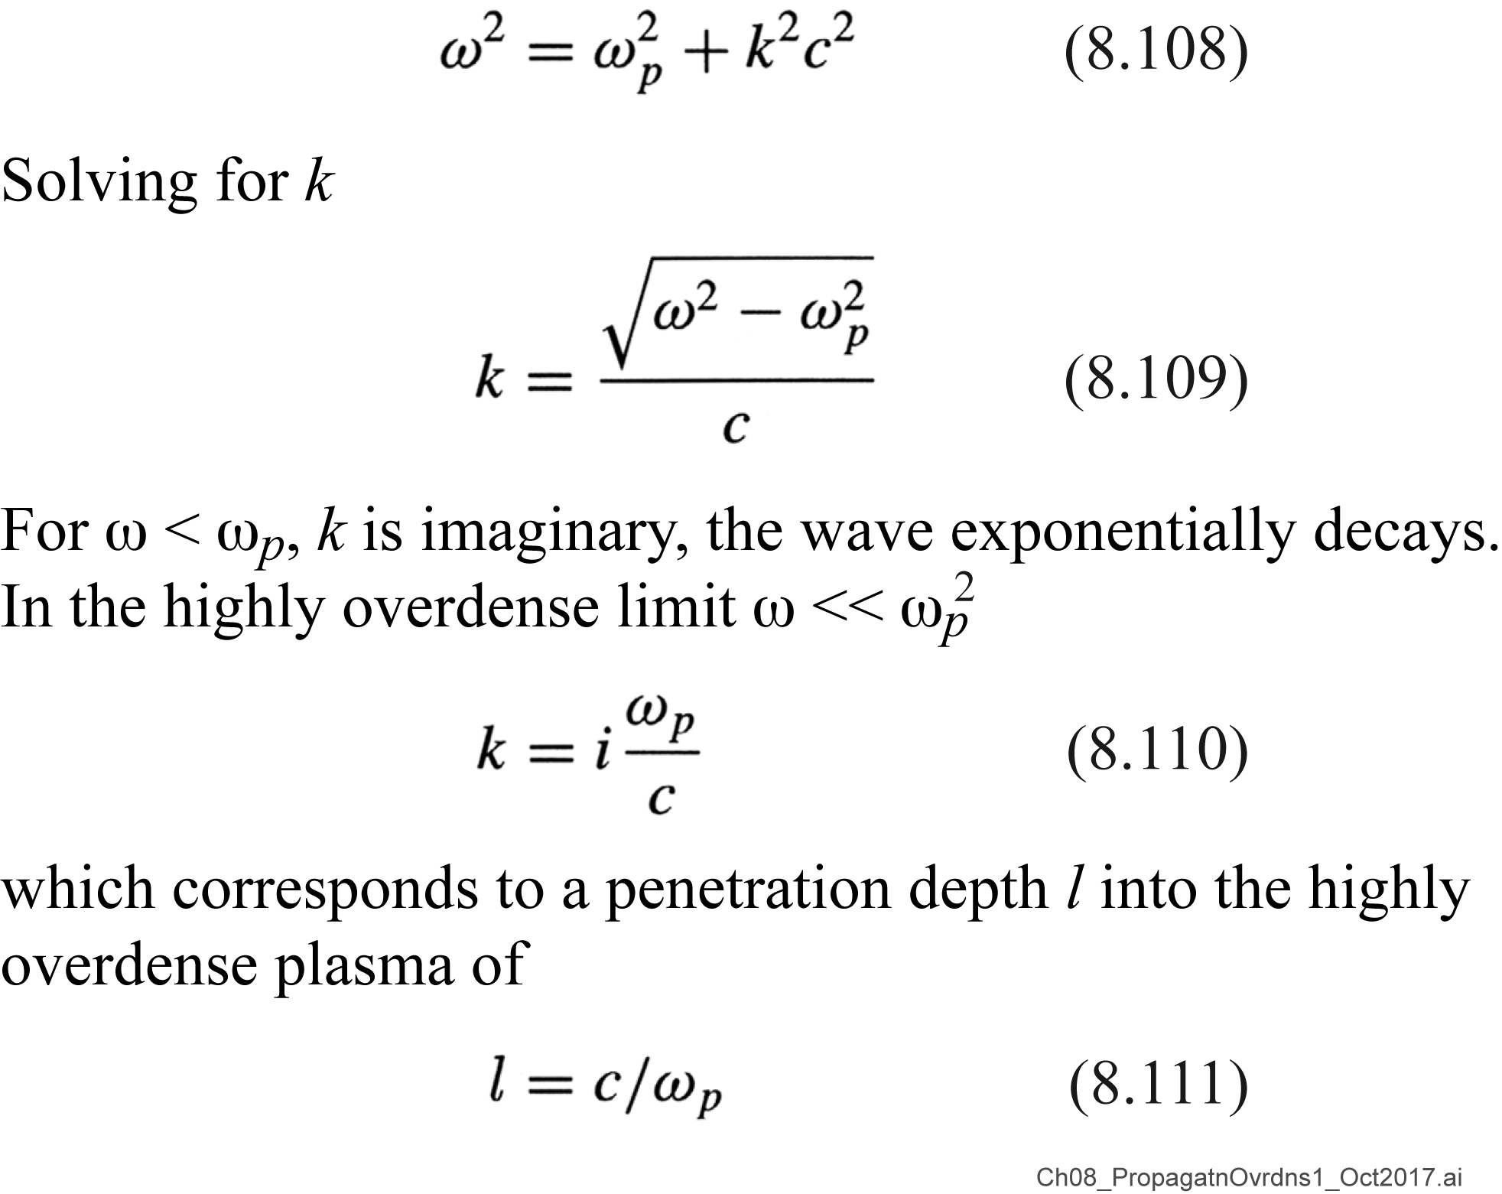
Propagation in an overdense plasma

Slide 42
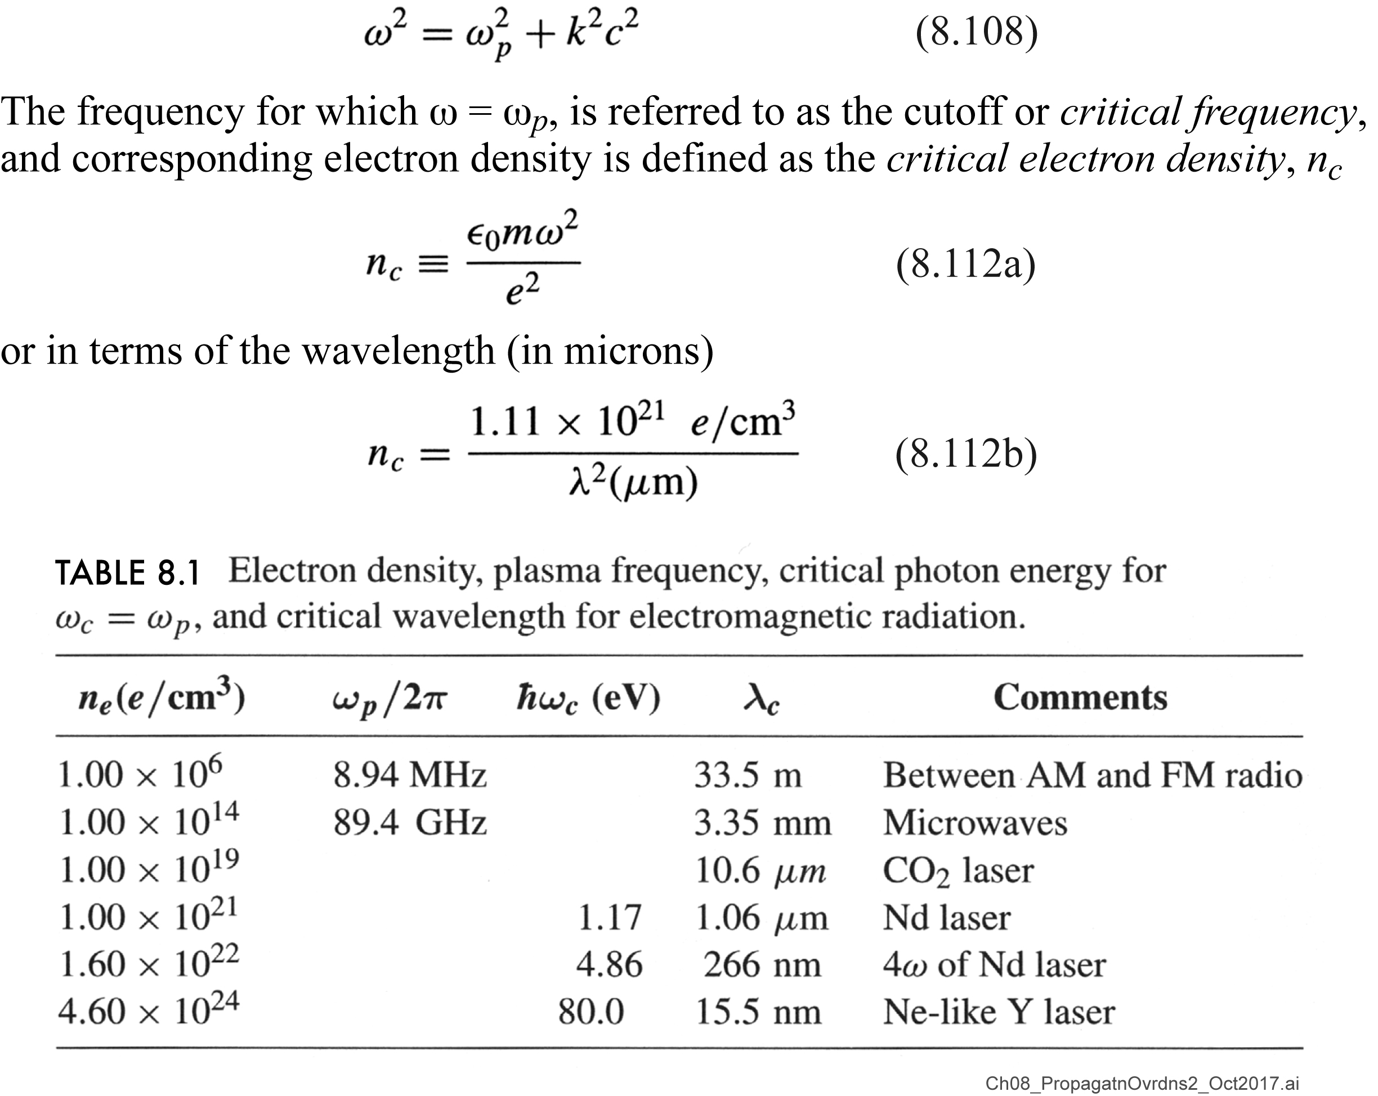
Transverse wave at the “critical electron density”, n_{c}
ω_{p}² = e²n/ε₀m
[µm]
Comment on re-entry vehicles

Slide 43
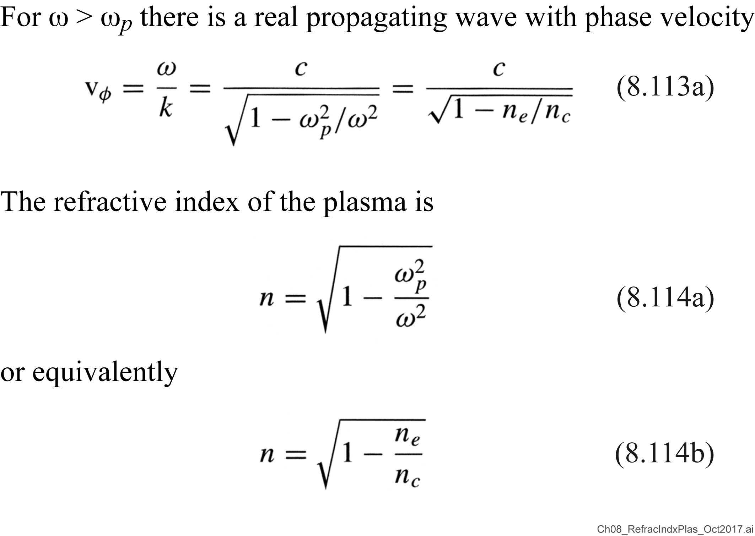
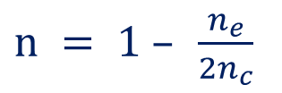
Refractive index of an electromagnetic wave in a plasma
n = c/v_{φ}
$n = 1 – \frac{n_{e}}{2n_{c}}$
for n_{e}/n_{c} «1, where n_{c} = 1.11 x 10²¹e/cm³ / λ²[µm]

Slide 44
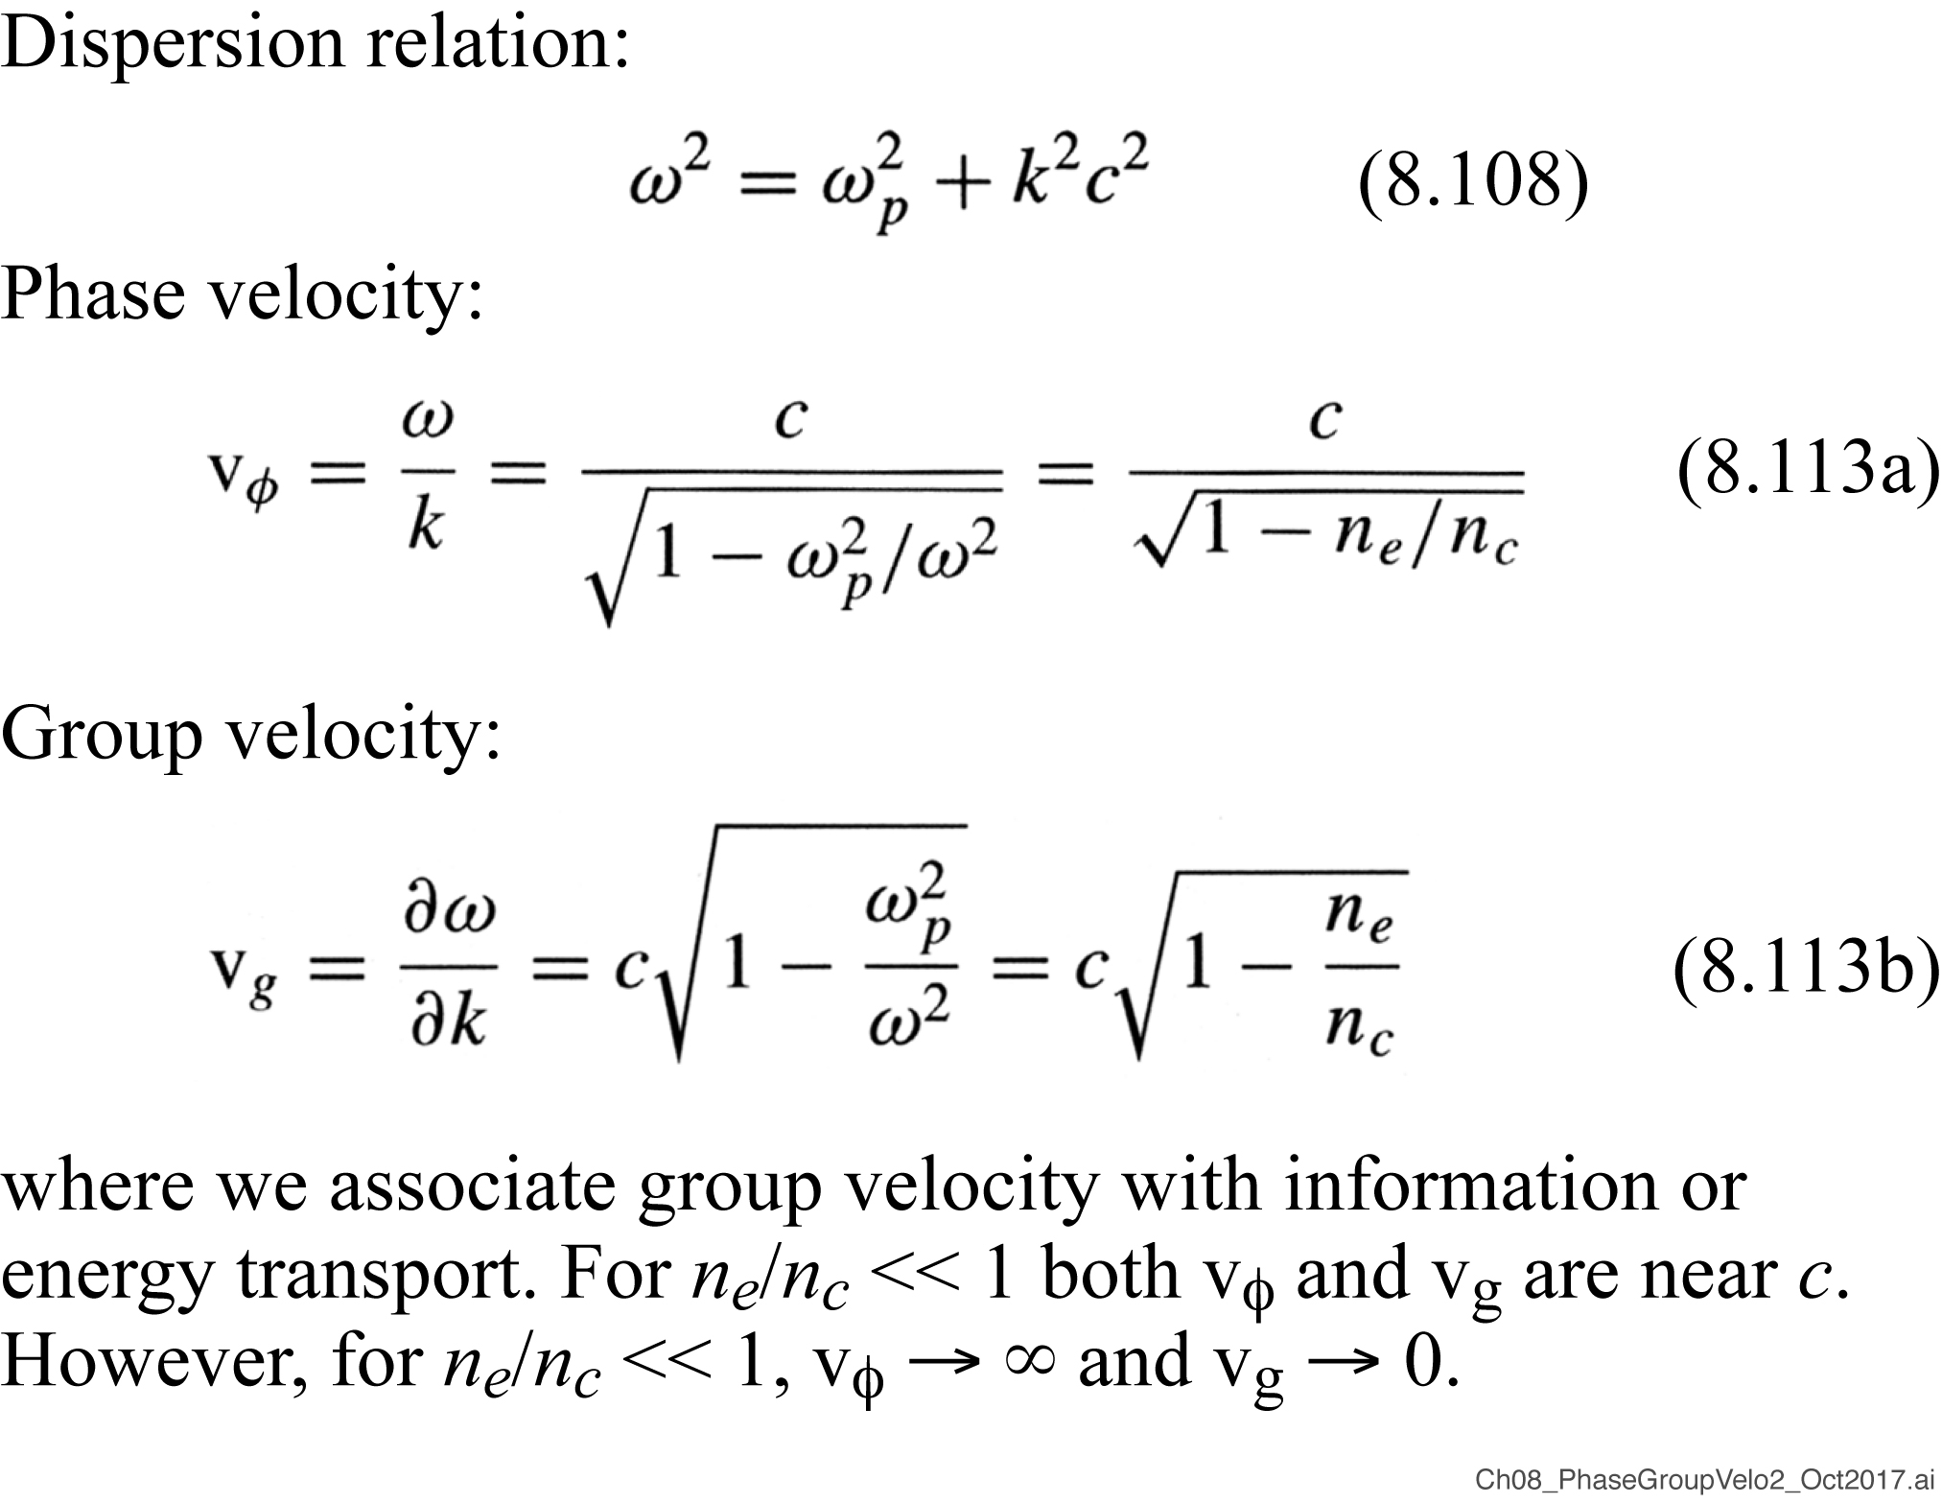

Phase velocity and group velocity (continued)
$$→$$

Slide 45
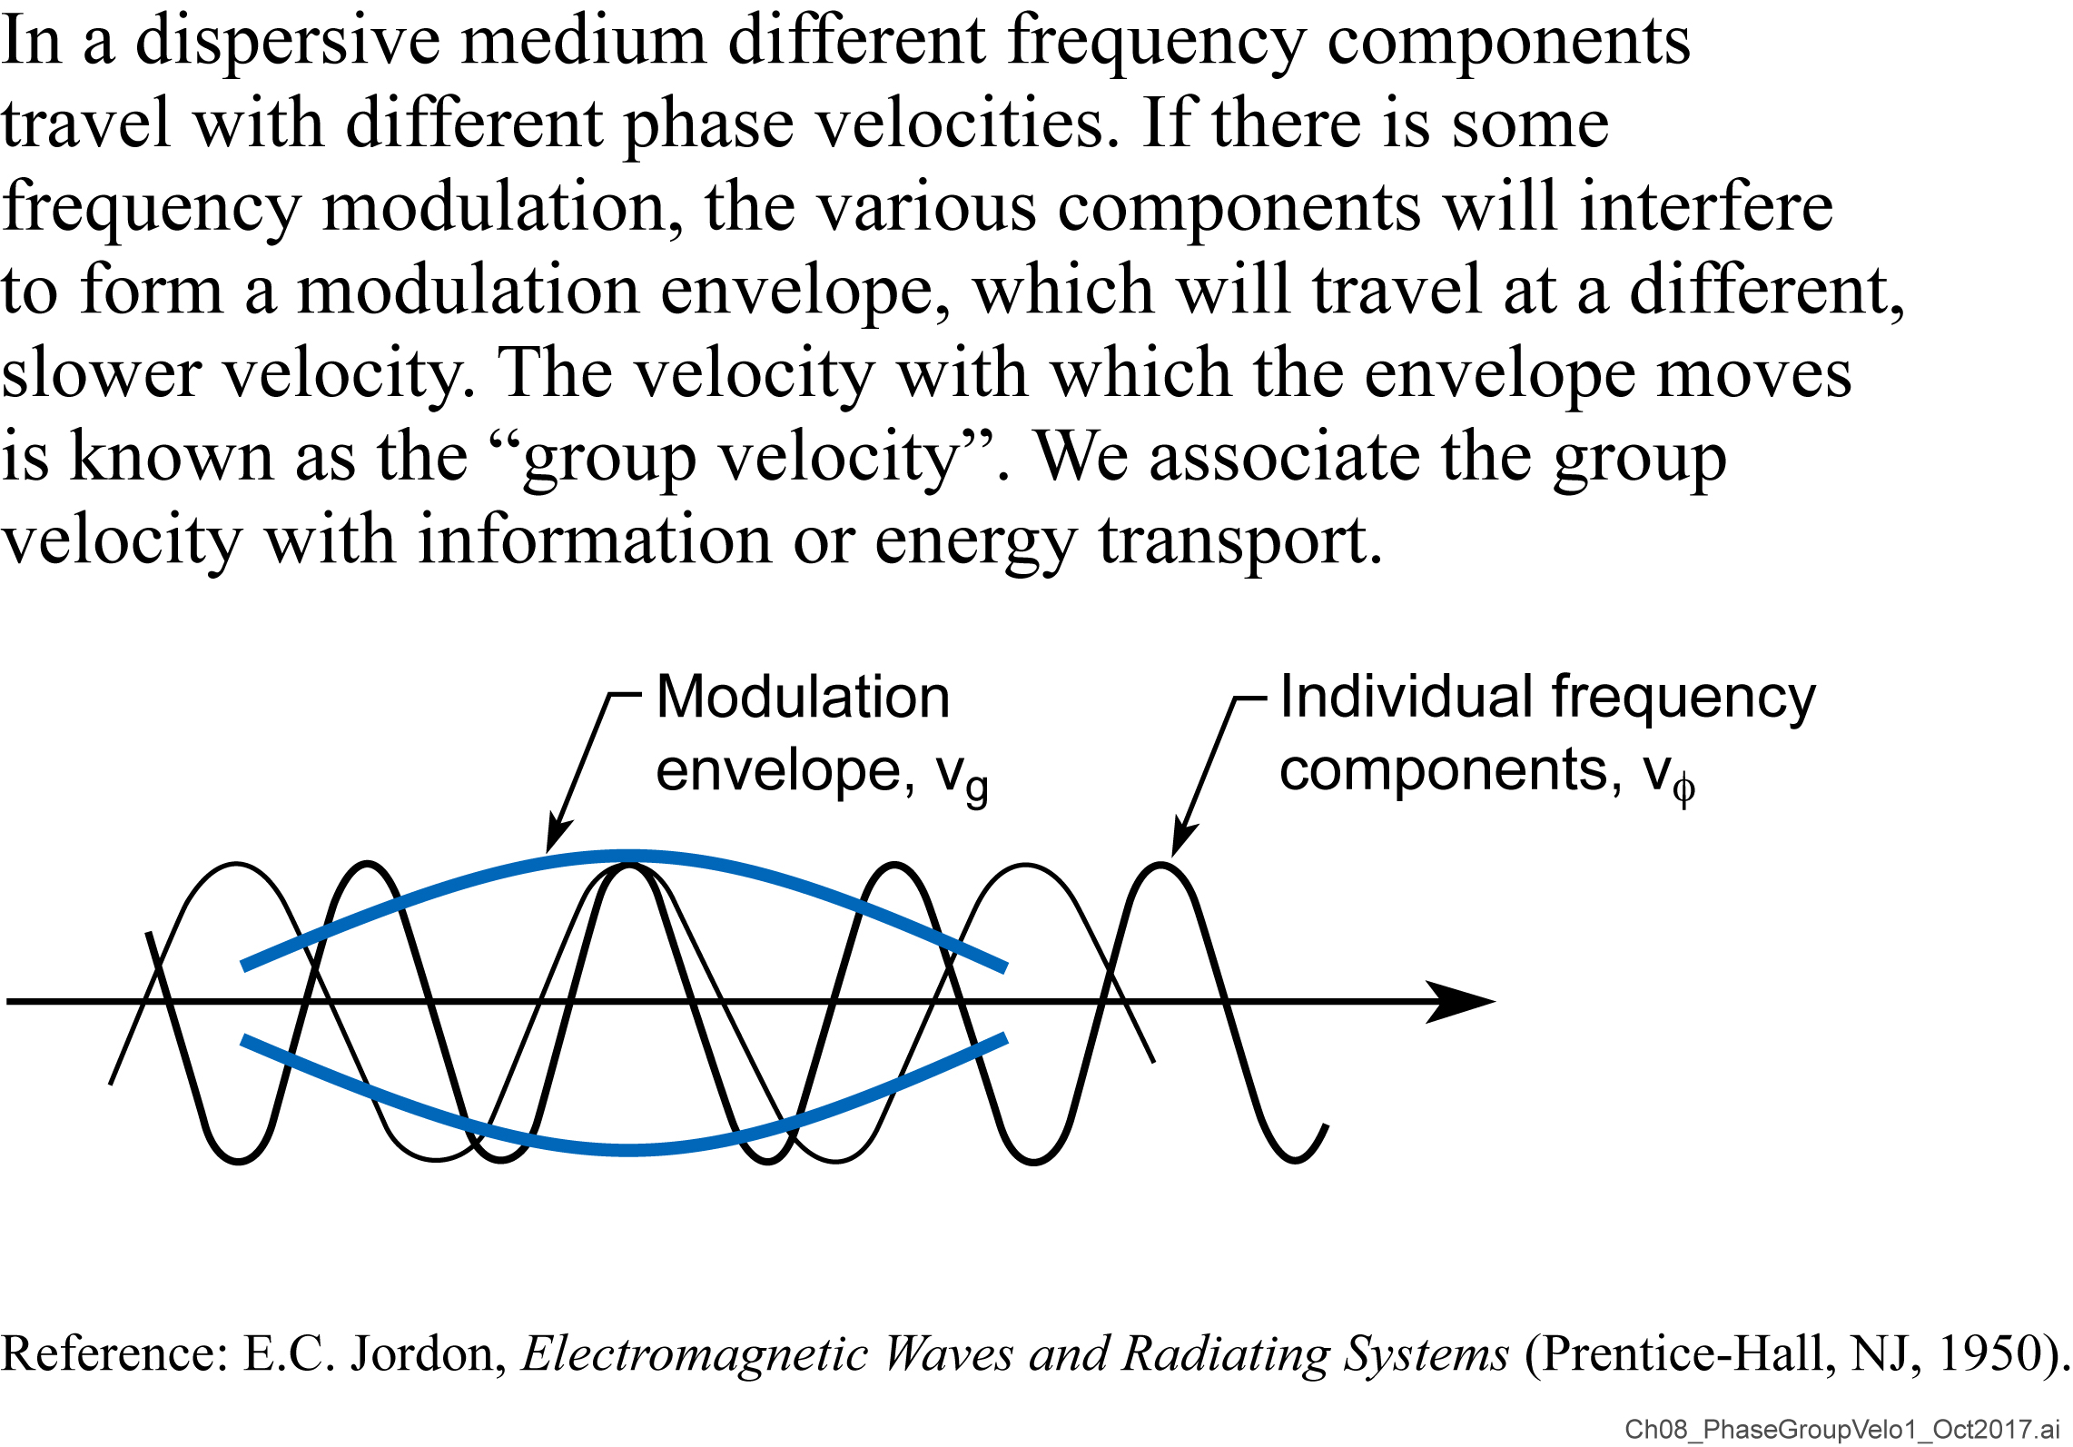
Phase velocity and group velocity

Slide 46
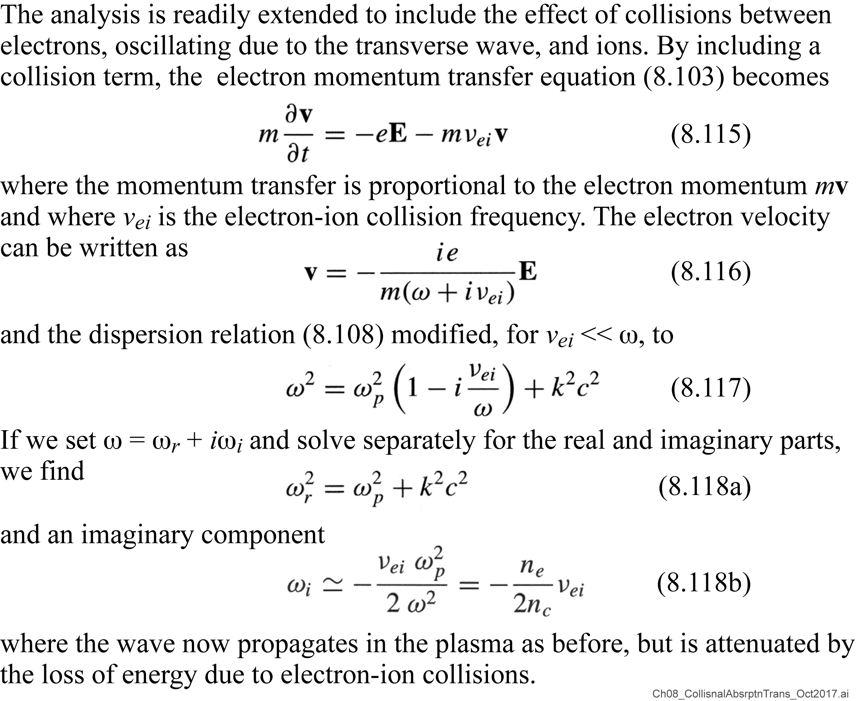
Collisional absorption of a transverse wave in a plasma

Slide 47

Waves in a magnetized plasma

Slide 48
University of California, Berkeley
X-rays and Extreme Ultraviolet Radiation
AST210/EECS213
Fall 2019

Slide 49
Examples of longitudinal waves
Acoustical (sound) waves
Electron or ion acoustical waves
Water waves (e.g.,‘shallow water waves’)

Slide 50
Oberved x-ray spectra from laser irradiated targets
Blackbody radiation as a model for plasma temperature
Soft x-rays. Time resolved in broad spectral channels
Soft x-ray line spectra; ionization “bottlenecks’
Several keV line spectra; very efficient at 4.7 keV
Comments on nonlinear processes and the generation of suprathemal electrons in plasmas
Hard x-ray continuum spectra driven by intense wave-wave interactions
Suprathermal electrons generate 100⁺ keV x-rays
Next class: EUV radiation for lithography

Slide 51

Continuum radiation and blackbody spectra

Slide 52

Blackbody radiation
EUVL is based on MLs at 13.5 nm (92 eV). Estimate the req’d plasma temperature

Slide 53

Blackbody radiation across a surface
Blackbody radiated
Intensity scales as (κT)⁴

Slide 54

Measuring soft x-ray continuum emission from a hot dense plasma on a picosecond time scale

Slide 55

The Notch Filter, useful for broad spectral sampling

Slide 56

Determining an equivalent blackbody temperature

Slide 57

Measuring energy transport into a laser produced plasma by observing specific spectral bands with multilayer mirrors

Slide 58
X-ray line emission in a plasma

Slide 59

Multiple ionization states result in many emission lines

Slide 60

Example of soft x-ray emission spectra from a laser produced, neon-like chromium plasma

Slide 61


Ionization “bottlenecks” can limit the number of ionization states present in a plasma: Cr example
Recall peak blackbody
is 2.82 $≅$ 560 eV
κT

Slide 62

R. Kelley: atomic and ionic spectral lines

Slide 63


Slide 64
He-like and H-like ions
TABLE 8.3. Transition energies⁵⁵ for transitions from the n = 2 state to the n = 1 ground state of H- and He-like ions.
 | Transition energy (eV)
 | Hydrogen-like |  | Helium-like
Element | 2p_{1/2} | 2p_{3/2} | 2p ³P₁ | 2p ¹P_{l}
5 B | 255.17 | 255.20 | 202.78 | 205.4
6 C | 367.5 | 367.5 | 304.3 | 307.8
7 N | 500.3 | 500.4 | 426.3 | 430.7
8 O | 653.5 | 653.7 | 568.7 | 574.0
9 F | 827.3 | 827.6 | 731.5 | 737.8
10 Ne | 1021.5 | 1022.0 | 914.9 | 922.1
11 Na | 1236.3 | 1237.0 | 1118.8 | 1126.9
12 Mg | 1471.7 | 1472.7 | 1343.2 | 1352.3
13 Al | 1727.7 | 1729.0 | 1588.3 | 1598.4
14 Si | 2004.3 | 2006.1 | 1853.9 | 1865.1
15 P | 2301.7 | 2304.0 | 2140.3 | 2152.6
16 S | 2619.7 | 2622.7 | 2447.3 | 2460.8
17 Cl | 2958.5 | 2962.4 | 2775.1 | 2789.8
18 Ar | 3318 | 3323 | 3124 | 3140
19 K | 3699 | 3705 | 3493 | 3511
20 Ca | 4100 | 4108 | 3883 | 3903
21 Sc | 4523 | 4532 | 4295 | 4316
22 Ti | 4966 | 4977 | 4727 | 4750
23 V | 5431 | 5444 | 5180 | 5205
24 Cr | 5917 | 5932 | 5655 | 5682
Courtesy of J.Scofield, Lawrence Livermore National Laboratory.

Slide 65



He-like and H-like silicon emission lines from a laser irradiated glass (Si$O_{2}$) disk
From Table 8.3 for Si doublets:
H-like lines are at 2004 & 2006 eV.
He-like are at 1853 & 1865 eV.
Courtesy of R. Kauffman, LLNL

Slide 66

A laser irradiated titanium disk can strongly radiate H-like and He-like lines
2 joules of
helium-like
emission at
4.7 keV, from a 3 kJ, 600 psec irradiation
From Table 8.3:
He-like doublet at
4727 & 4750 eV.
Courtesy of D. Matthews, LLNL

Slide 67
Nonlinear plasma waves drive suprathermal electrons

Slide 68

Non-linear processes in a plasma

Slide 69

Linear and non-linear processes: scattering as an example

Slide 70
Threshold for non-linear processes

Slide 71

Stimulated Brillouin and Raman scattering of intense laser light

Slide 72

Stimulated Raman backscattering at n_{e} ≅ n_{c}/4 can generate high phase velocity electron acoustic waves

Slide 73

100 keV⁺ x-rays are generated at high laser intensity
Lawrence Livermore National Laboratory

Slide 74

100 keV⁺ x-rays are generated at high laser intensity; decrease with shorter wavelength
Lawrence Livermore National Laboratory

Slide 75

Suprathermal x-rays at three laser wavelengths
40-50 keV x-rays
Lawrence Livermore National Laboratory
Plasma wave acceleration is not good for laser fusion,
but opens new opportunities for compact electron accelerators

Slide 76
EUV lithography
EUV lithography uses a 10.6 μm CO₂ laser, irradiating small Sn droplets, to form a 13.5 nm EUV plasma source

Slide 77

Exteme Ultraviolet (EUV) Lithography
Step and scan system,
Mo/Si coated optics at
13.5 nm wavelength,
CO2 laser irradiated
30 μm Sn microspheres
Anticipated market entry for
high volume manufacturing
at the “7 nm node”, in 2019.
Courtesy of V. Banine (ASML)
and W. Kaiser (Zeiss).

Slide 78


Liquid Sn droplets for EUV lithography
EUV optical inefficiency, R^{N},
puts great pressure on source
power requirements, ~ 1kW.
28 μm diameter Sn droplets
10 mJ,10 psec Nd prepulse
60 mJ, 20 nsec ${CO}_{2}$ heating
pulse in an 80 μm focal spot
Courtesy of M. Nakano, Gigaphoton, Japan

Slide 79

Comparison of Nd and${ CO}_{2}$ laser produced plasmas
For EUV lithography the desired photon energy is ~ 92 eV (13.5 nm wavelength). Our black body model indicates that a 100 eV plasma radiates at 1 x 10¹³ W/cm². With a κT⁴ scaling this indicates that 1 x 10¹¹ W/cm² should generate a 30 eV plasma. With a peak at 2.8 κT such a plasma should radiate at ~90 eV.
Simulations: 35 μm^{D} Sn doped sphere, 1 x 10¹¹ W/cm², 10 nsec pulse
Courtesy of M. Richardson, U. Central Florida

Slide 80


Searching for a plasma source for EUV lithography: The comparative spectra of Xe and Sn

Slide 81

Calculated ionization fractions for Sn
Note the high ionization fractions for Sn+9, Sn+10 and Sn+11
For electron temperatures of 30 eV to 40 eV
Courtesy of G. O’Sullivan, University College Dublin

Slide 82
Exteme Ultraviolet (EUV) Lithography
Step and scan system,
Mo/Si coated optics at
13.5 nm wavelength,
CO2 laser irradiated
30 μm Sn microspheres
Anticipated market entry for
high volume manufacturing
at the “7 nm node”,
likely in 2019.
Courtesy of V. Banine (ASML)
and W. Kaiser (Zeiss).

Slide 83

EUV lithography will use a
step and scan ring field system

Slide 84

Multilayer coatings provide a modest band pass, and have achieved 70% normal incidence EUV reflectivity .
mλ = 2d sinθ
Courtesy of S. Bajt, LLNL, presently DESY, Hamburg

Slide 85


Reflective Mask for EUV Lithography
Attribute TaN Cr Comments
CD control ✓ TaN has smaller RIE CD bias
Cleaning Both resistant to standard cleans
Emissivity ✓
Inspection contrast ✓ TaN has higher contrast
Repair selectivity Both need small improvement
Aspect ratio ✓ TaN can be 8 nm thinner than Cr
Cr (30nm)
SiON
(100nm)
Mo/S ML

Slide 86



Mask blank defects can be on the substrate
or within the stack
Amplitude Defect
Phase Defect

Slide 87

Earliest study of mask defect printability
Multilayer EUVL mask with both an underlying ‘defect’ pattern and a top-side lines and spaces pattern.
Substrate defects affect printing of top-side pattern
Experiments performed at the NTT beamline, Photon Factory; K.B. Nguyen et al. J.Vac.Sci.Techn. B 12, 3833 (1994); PhD thesis, EECS/UCB (1994).
Courtesy of Khanh Nguyen (UCB/EECS, now Google), Tsuneyuki Haga (NTT/Atsugi), and Hiroo Kinoshita (NTT Atsugi, now Hyogo U.)

Slide 88
Extreme Ultraviolet (EUV) Lithography in 2019
Courtesy of http://techno.jp/NE

Slide 89

EUV lithography: High volume manufacturing (HVM) of computer chips and smart phone chips in 2019
TSMC’s second-generation 7 nm manufacturing technology will use extreme ultraviolet lithography.
9 October 2018
After 7 nm comes TSMC’s 5 nm process, which will use EUV on up to 14 layers. TSMC’s 5 nm technology will enable customers to shrink the area of designs by ~45% (transistor density ~1.8x higher), increase frequency by 15% ,or reduce power by 20%.TSMC will be ready to start risk production of chips using its N5 tech in April, 2019.
VB VentureBeat 18 October 2018
Samsung begins making 7LPP chips, commercializing 7nm EUV lithography
7nm EUV lithography In a significant milestone for the semiconductor industry, Samsung today announced that it is now manufacturing 7LPP chips: processors based on extreme ultraviolet lithography (EUV) and a 7-nanometer manufacturing process. Beyond this specific accomplishment, the company notes that it is providing customers a clear path to future 3-nanometer chips.

Slide 90

ASML to ship 30 EUV scanners in 2019

Slide 91

TSMC supplying 7nm node chipsets to Qualcom, Apple and Huawei
Powerful chipsets like the Qualcomm Snapdragon 855, Apple A13 Bionic and Huawei's HiSilicon Kirin 990 all have something in common. While designed by Qualcomm, Apple, and Huawei respectively, all three chips are actually manufactured by Taiwan Semiconductor Manufacturing Company (TSMC), the largest independent foundry in the world. And all three are produced using some variation of TSMC's 7nm process. … The number of transistors inside the …the Kirin 990 that features an embedded embedded 5G modem carries 10.3 billion transistors. over 10.3 billion transistors.

Slide 92

Samsung’s new EUV Fab for the 7nm node, Hwaseong

Slide 93
Apple's New A13 Bionic CPU to Power iPhone 11 with Longer Battery Life, Higher Speeds
Tom’sHARDWARE Nathaniel Mott September 10, 2019
Apple today announced the iPhone 11 and iPhone 11 Pro. The devices boast many new features, but perhaps the most interesting revelation was the A13 Bionic system-on-a-chip, which led the company to claim the new iPhones have the fastest CPU and GPU of any smartphone. Much of the new chip's design was focused on reducing its power draw. The A13 Bionic's CPU features two high-performance cores with 20% faster performance and 30% lower power requirements than previous generations. Four high-efficiency cores, meanwhile, are 20% faster and require 40% less power. Apple said these cores are capable of performing more than 1 trillion operations per second.
Similar changes were made to the A13 Bionic's GPU: Apple said it was optimized for the Metal framework, boasts four cores, offers 20% faster performance and requires 40% less power than its predecessor. Both the CPU and GPU are complemented by a new Neural Engine made specifically for machine learning; Apple said this part of the chip boasts eight cores, is 20% faster and needs 15% less power.
These optimizations could be partly attributed to Apple reportedly having TSMC make the A13 Bionic with its second-generation 7nm process, which is its first to use extreme ultraviolet (EUV) lithography. That switch to a new process resulted in a greater transistor count, and the increased density would lead to higher performance, as well as changes to the chip's power requirements.
Those changes are said to add one hour of battery life to the iPhone 11 compared to the iPhone XR; the iPhone 11 Pro is rated to last four hours more than the iPhone XS. (Other changes would affect battery life, too, but Apple attributed much of these improvements to the A13 Bionic.) They also enable many of the new features in the latest-generation iPhones, including advanced photo and video editing tools. We wouldn't be surprised if the A13 Bionic reaches new iPad models in the coming months. The A12 Bionic had a similar release path--it debuted in the iPhone XS last year before reaching the updated iPad mini and iPad Air earlier this year. Apple released the A12X Bionic with the iPad Pro in 2018, too, so it's possible that a variant of the A13 Bionic is set to debut when the company refreshes that lineup.

Slide 94
Huawei’s Kirin 990 system-on-chip will power their Mate 30 Pro, using TSMC’s 7nm node EUV technology

Slide 95
https://www.youtube.com/watch?v=f0gMdGrVteI
Hey guys -- thought I should share this very cool introductory video on ASML's EUV lithography and the 13.5 nm breakthrough.
Joseph Natal
AST210/EE213 Fall2019

Slide 96
Issues likely to be discussed at the SPIE Advanced Lithography Conference, San Jose CA, 25 Feb 2020
Further source power increases
Resist resolution, sensitivity, line-edge roughness
Defect inspection, defect free masks & mask blanks
Debris mitigation for optics and mask
Also: A special “EUV Retrospective” session at
SPIE’s Advanced Lithography Conference
San Jose, CA, Tuesday, 4-6 pm, 25 February, 2020

