Slide 1
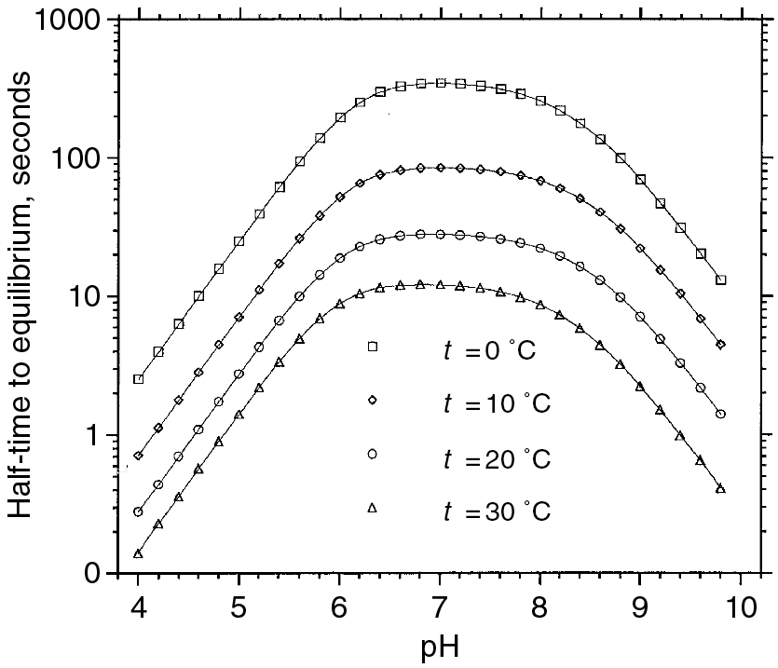
PILSON_Fig 07_01
© Cambridge University Press 2012

Slide 2
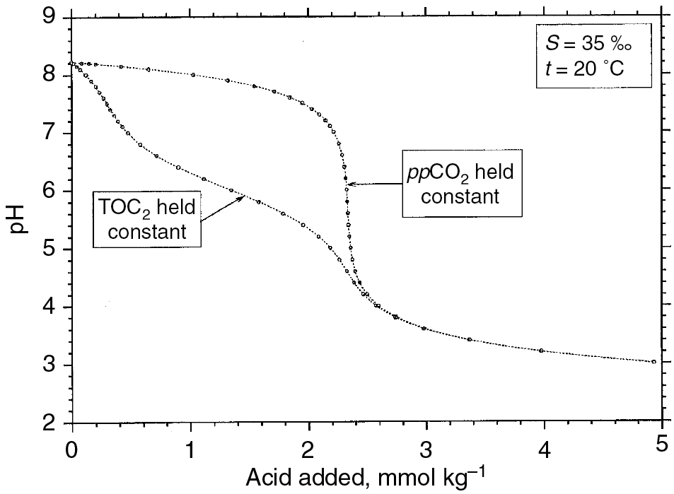
PILSON_Fig 07_02
© Cambridge University Press 2012

Slide 3
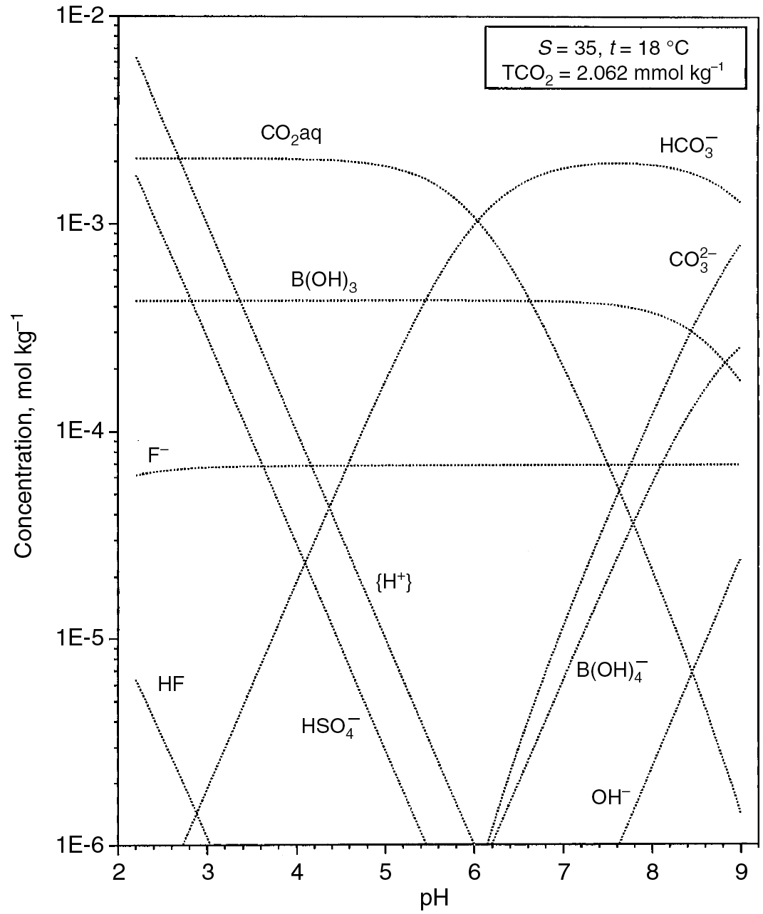
PILSON_Fig 07_03
© Cambridge University Press 2012

Slide 4
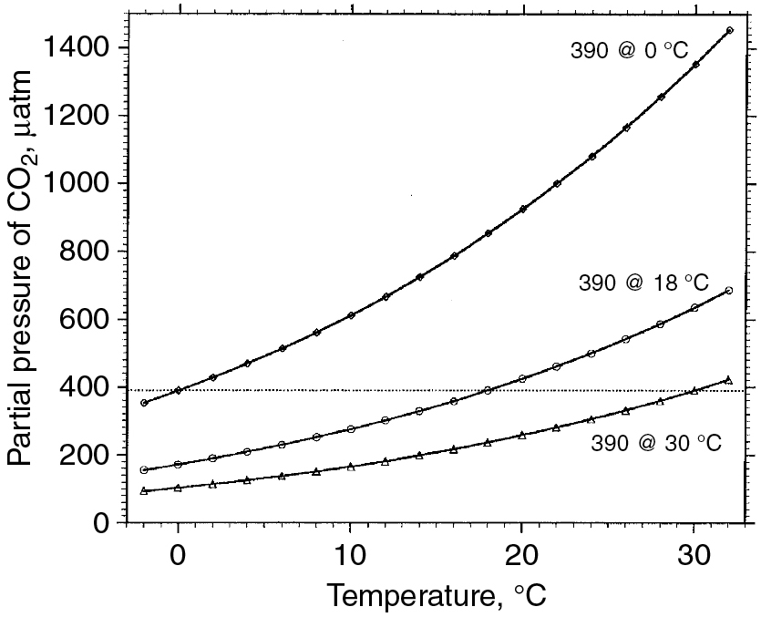
PILSON_Fig 07_04
© Cambridge University Press 2012

Slide 5
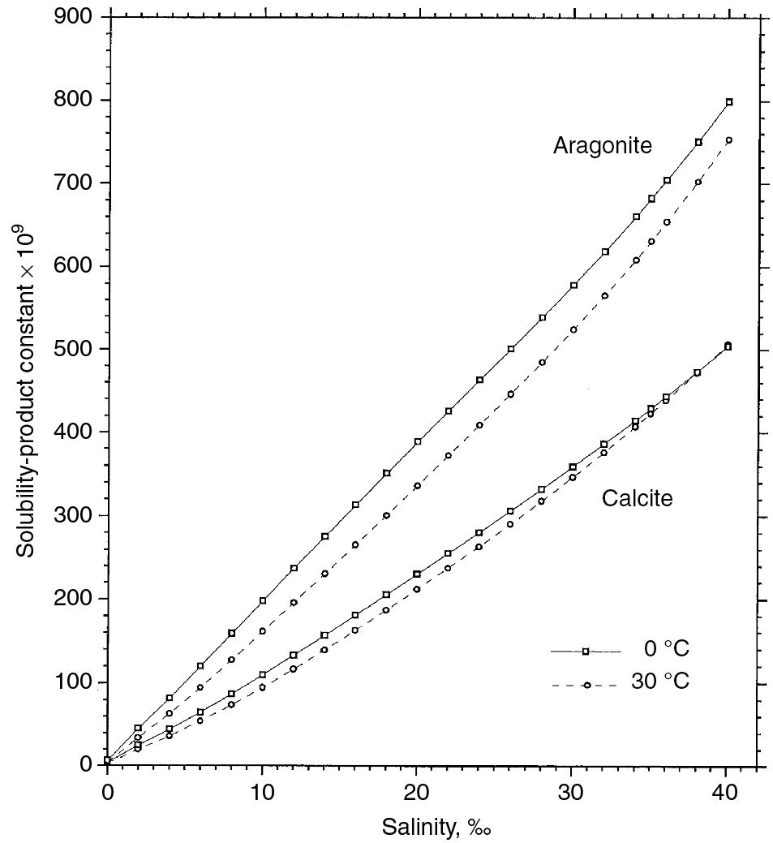
PILSON_Fig 07_05
© Cambridge University Press 2012

Slide 6
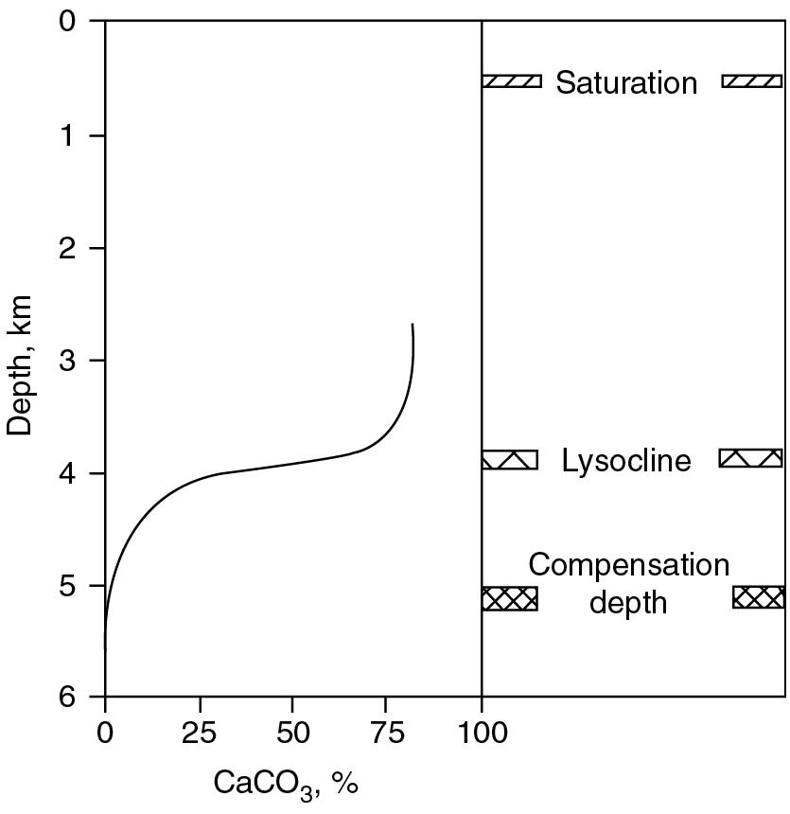
PILSON_Fig 07_06
© Cambridge University Press 2012

Slide 7
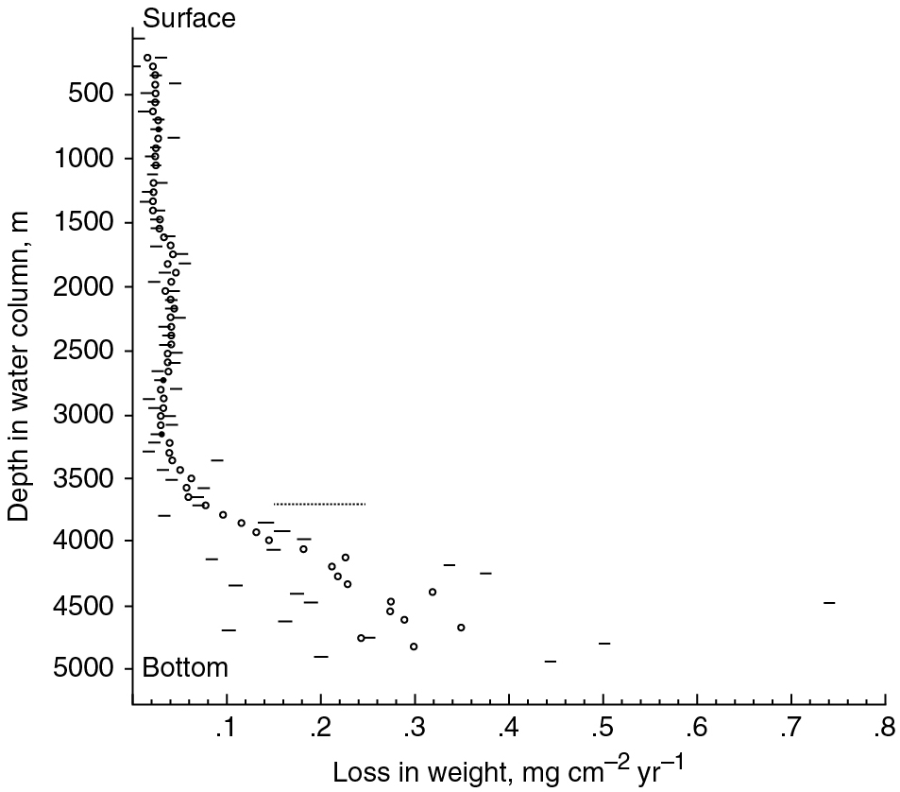
PILSON_Fig 07_07
© Cambridge University Press 2012

Slide 8
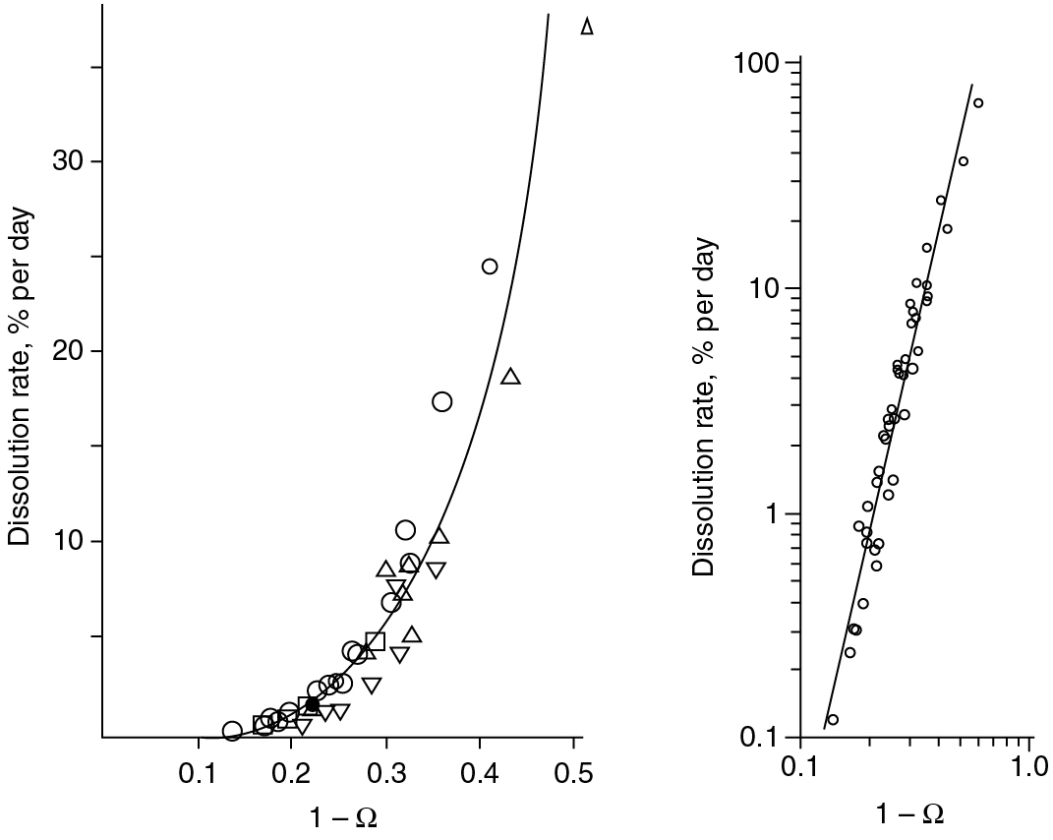
PILSON_Fig 07_08
© Cambridge University Press 2012

Slide 9
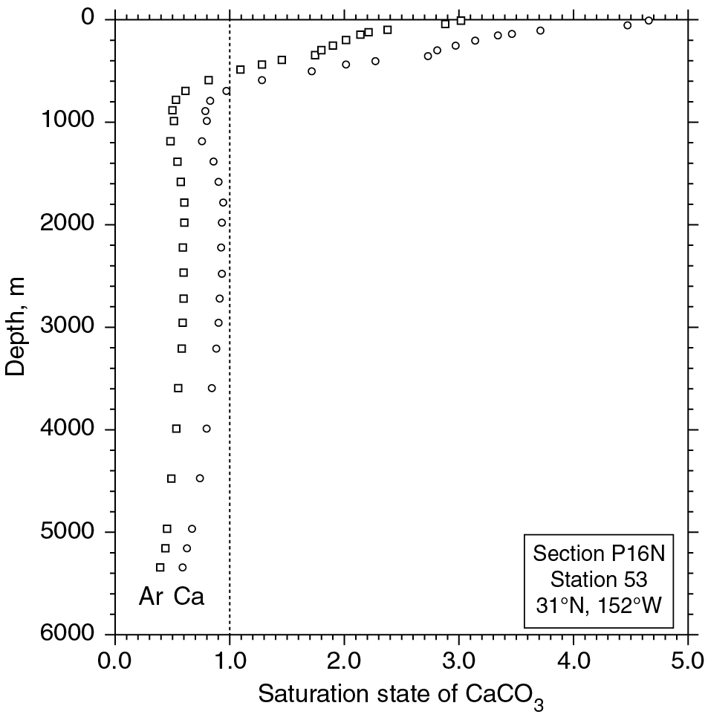
PILSON_Fig 07_09
© Cambridge University Press 2012

Slide 10
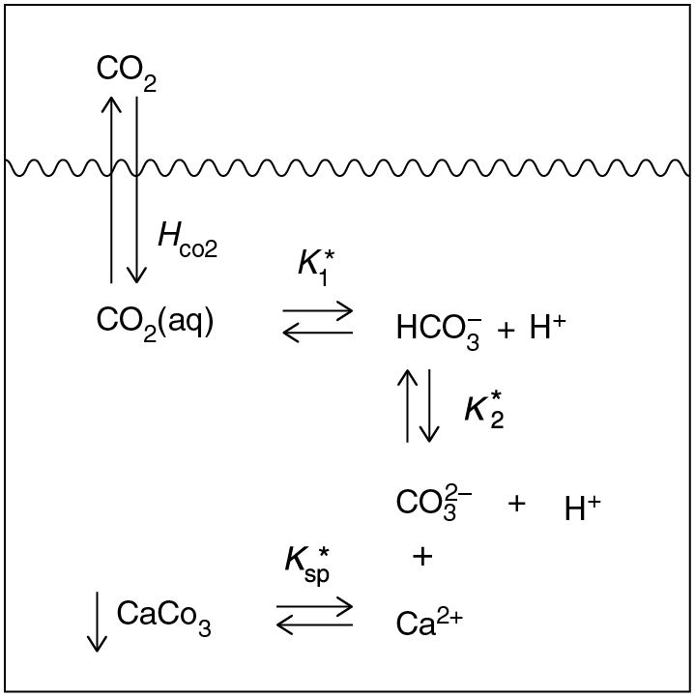
PILSON_Fig 07_10
© Cambridge University Press 2012

Slide 11
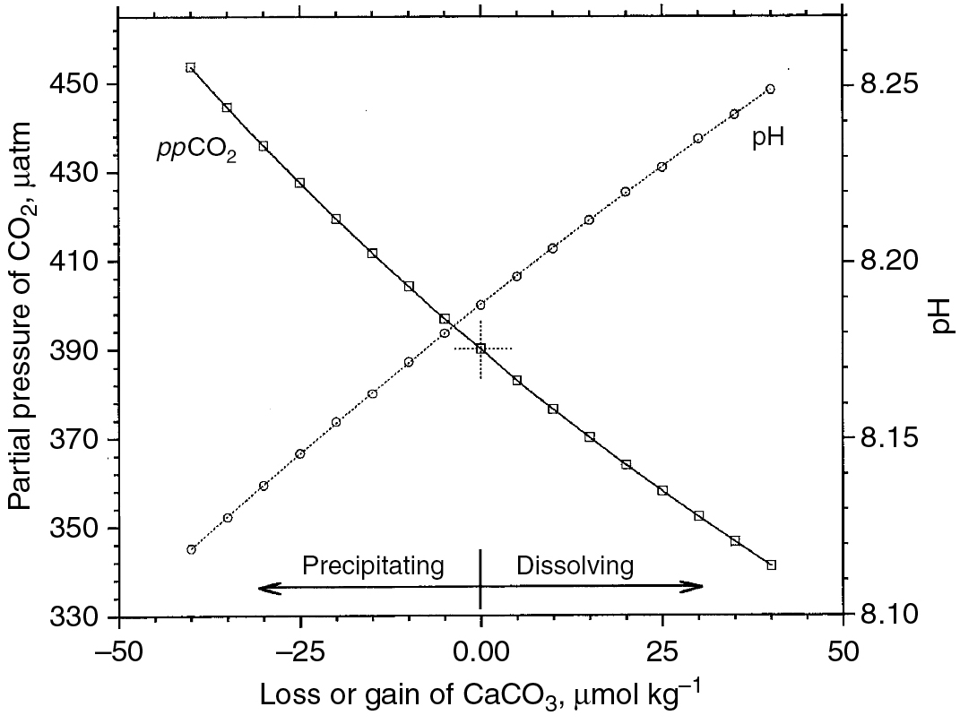
PILSON_Fig 07_11
© Cambridge University Press 2012

Slide 12
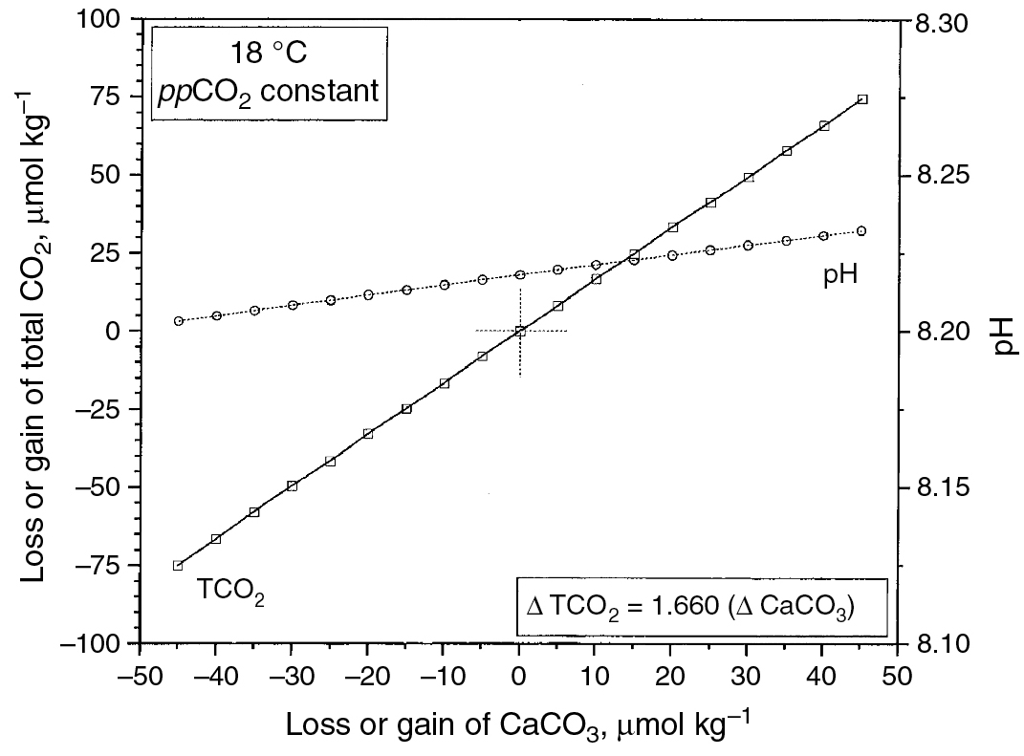
PILSON_Fig 07_12
© Cambridge University Press 2012

Slide 13
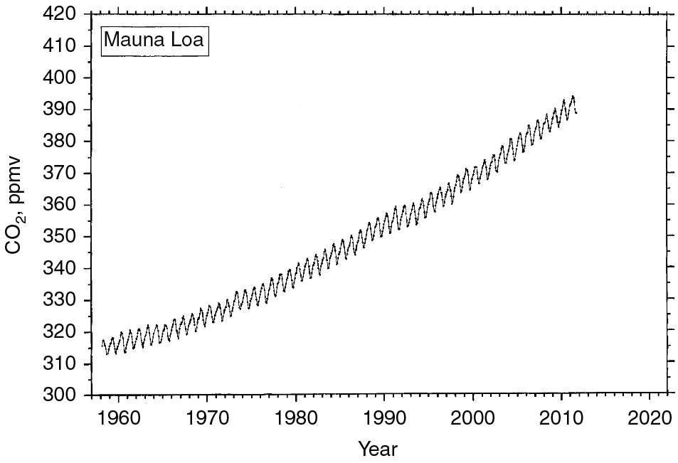
PILSON_Fig 07_13
© Cambridge University Press 2012

Slide 14
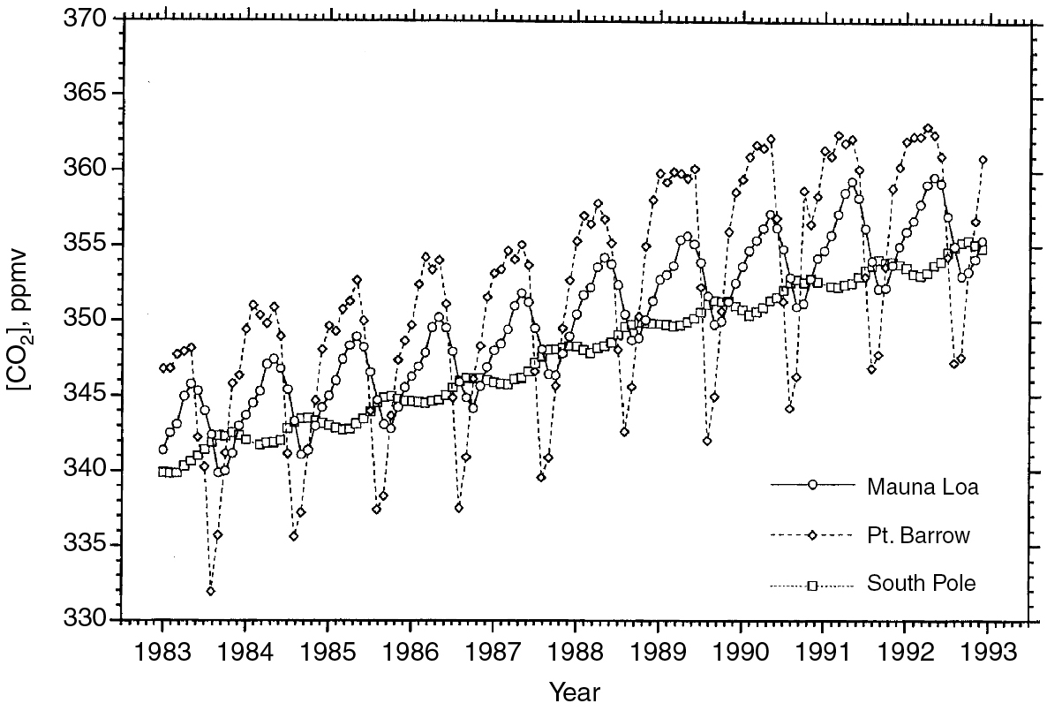
PILSON_Fig 07_14
© Cambridge University Press 2012

Slide 15
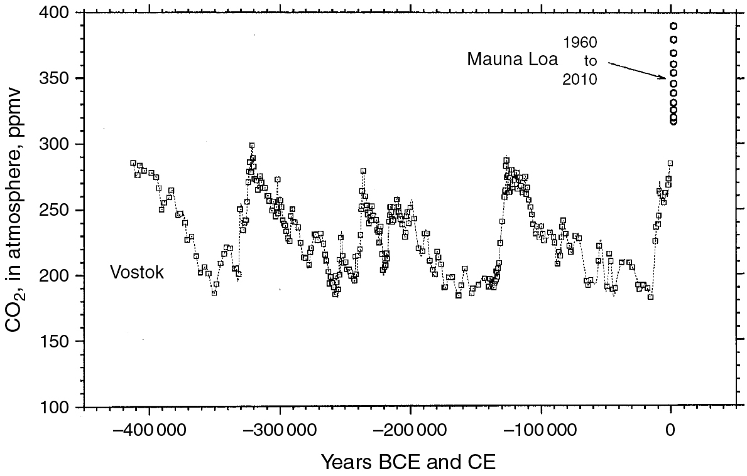
PILSON_Fig 07_15
© Cambridge University Press 2012

Slide 16
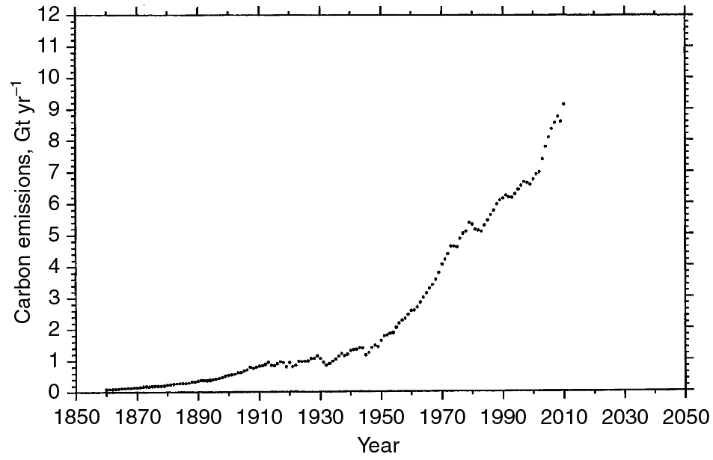
PILSON_Fig 07_16
© Cambridge University Press 2012

Slide 17
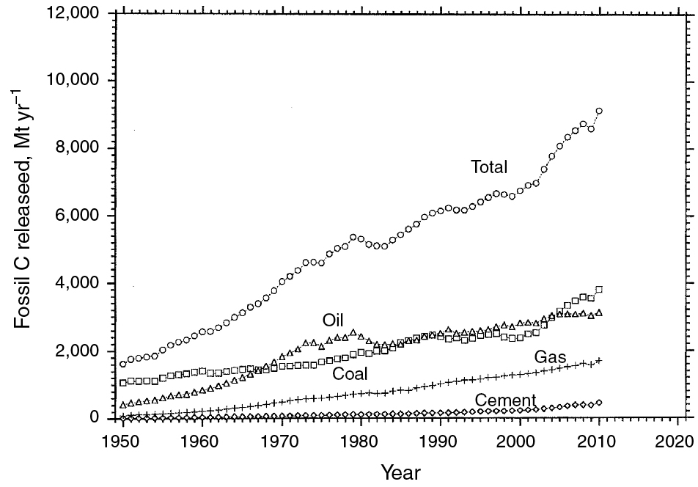
PILSON_Fig 07_17
© Cambridge University Press 2012

Slide 18
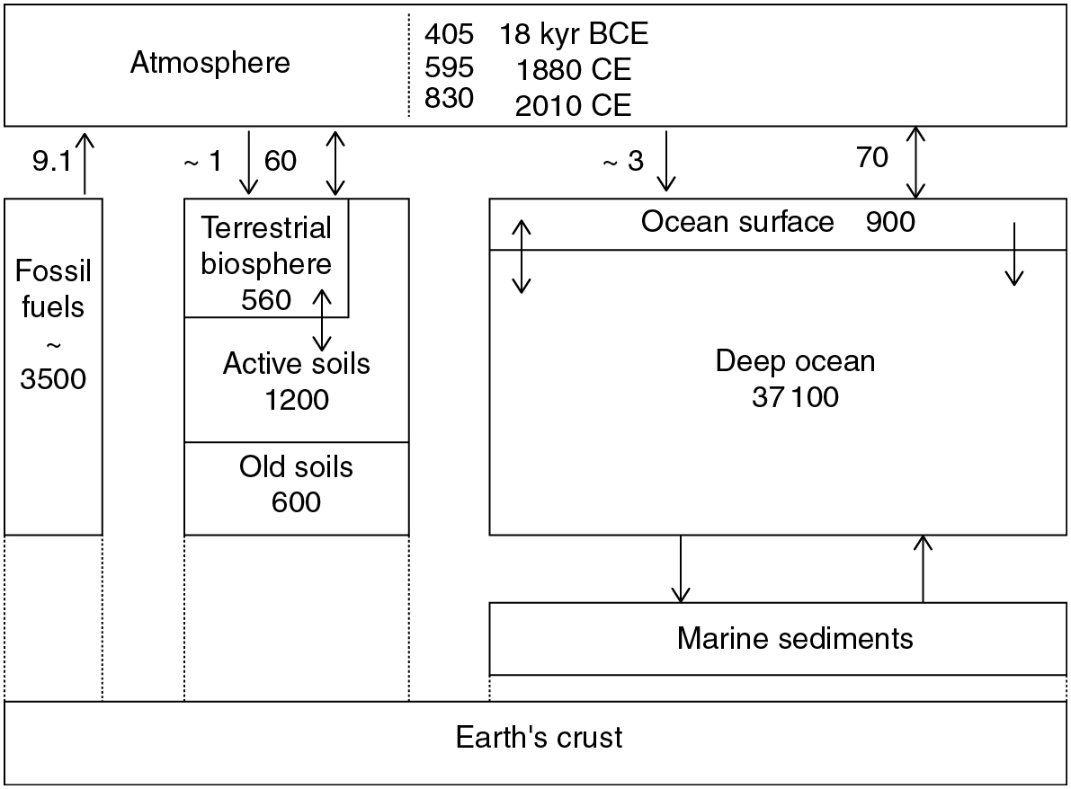
PILSON_Fig 07_18
© Cambridge University Press 2012

Slide 19
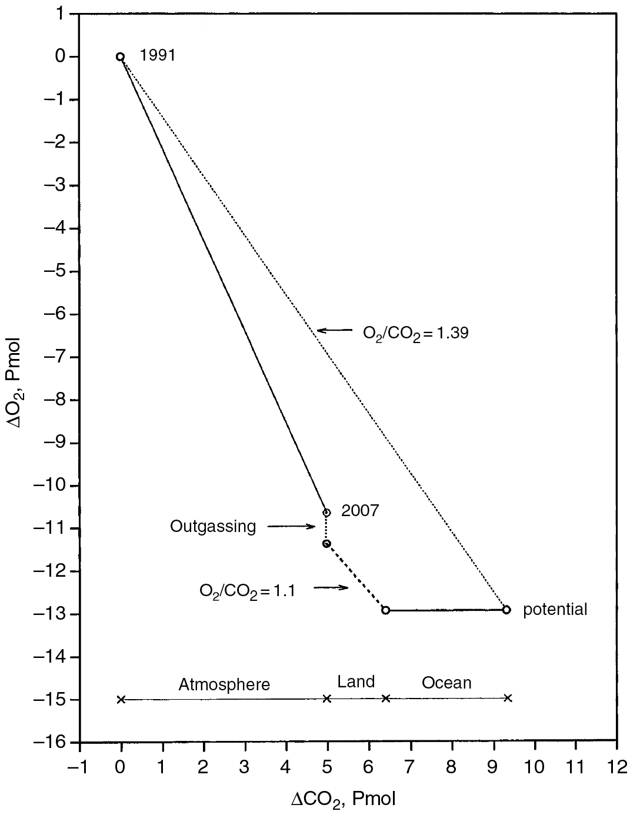
PILSON_Fig 07_19
© Cambridge University Press 2012

Slide 20
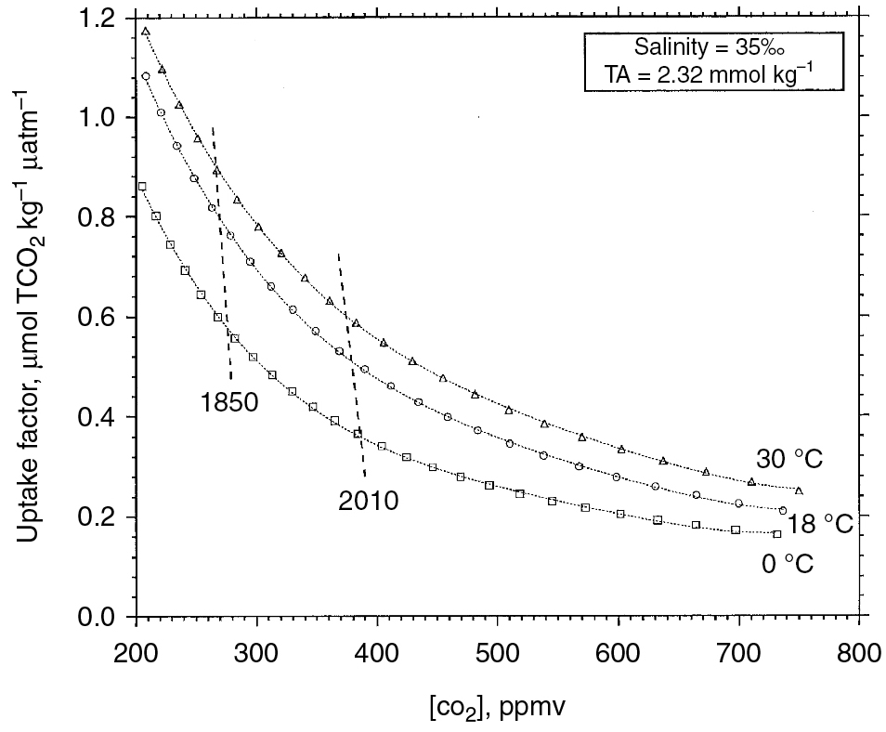
PILSON_Fig 07_20
© Cambridge University Press 2012

Slide 21
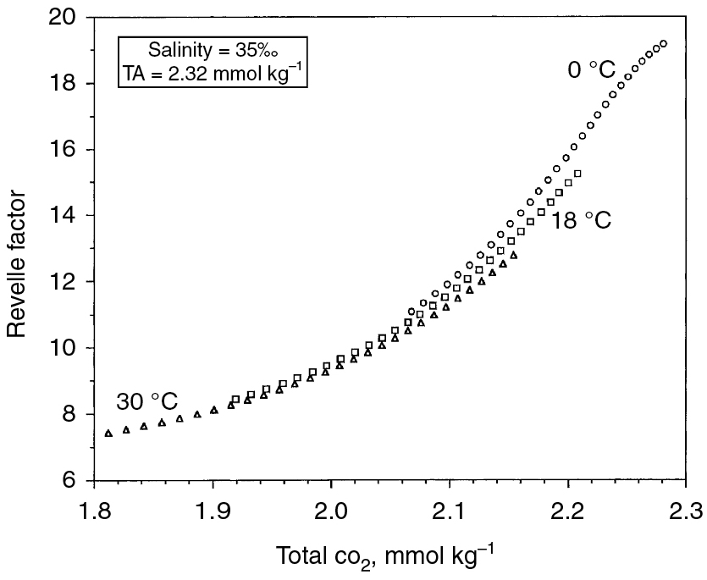
PILSON_Fig 07_21
© Cambridge University Press 2012

Slide 22
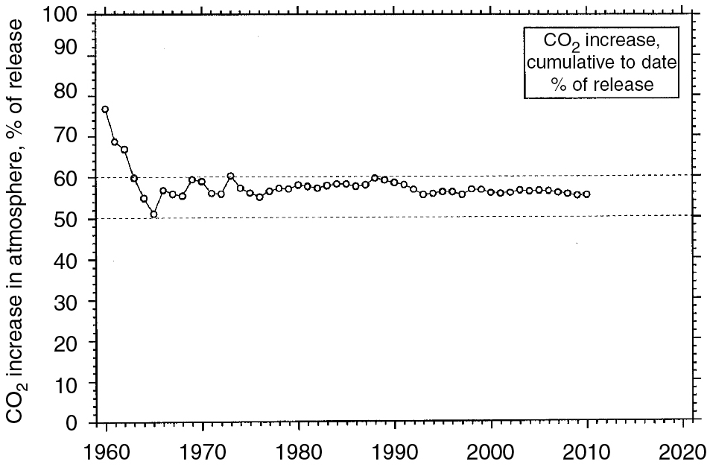
PILSON_Fig 07_22
© Cambridge University Press 2012

Slide 23
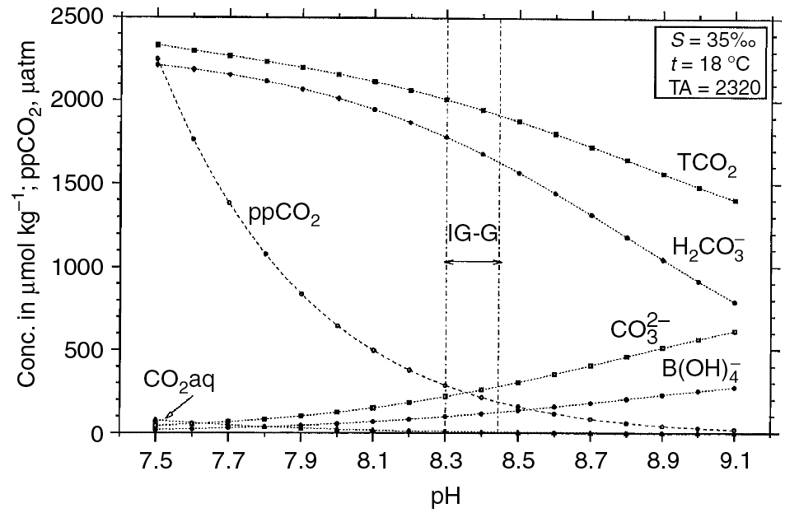
PILSON_Fig 07_23
© Cambridge University Press 2012

Slide 24
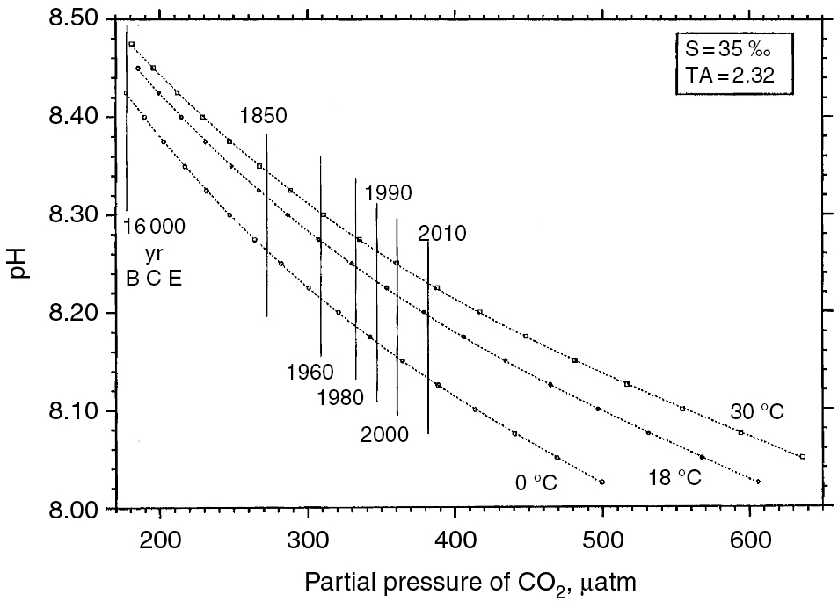
PILSON_Fig 07_24
© Cambridge University Press 2012

Slide 25
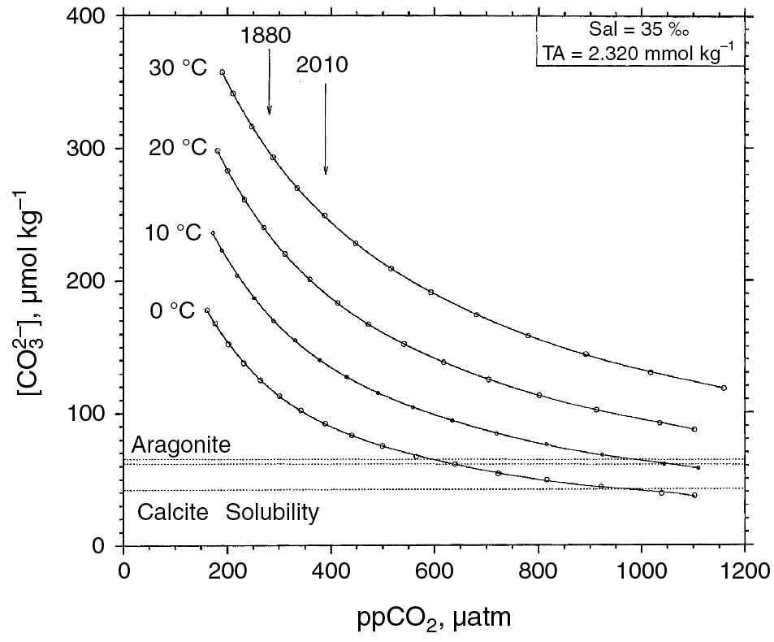
PILSON_Fig 07_25
© Cambridge University Press 2012

