Slide 1
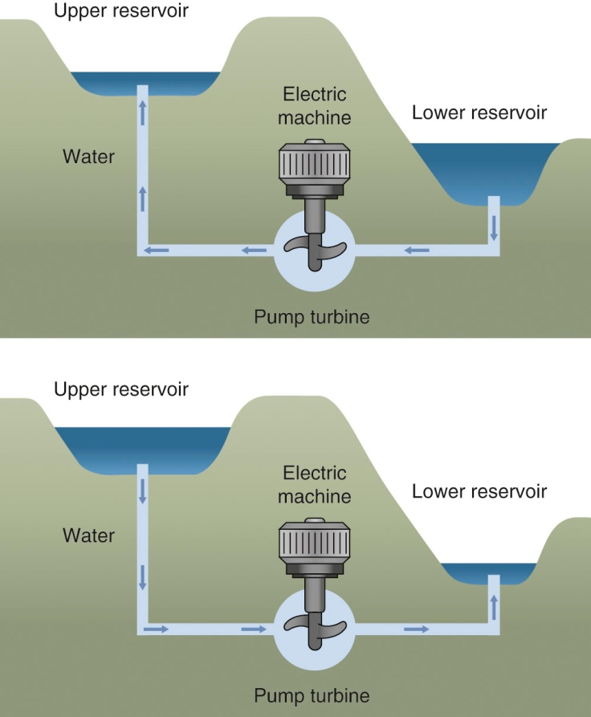
Fig45_01

Slide 2

Fig45_02

Slide 3
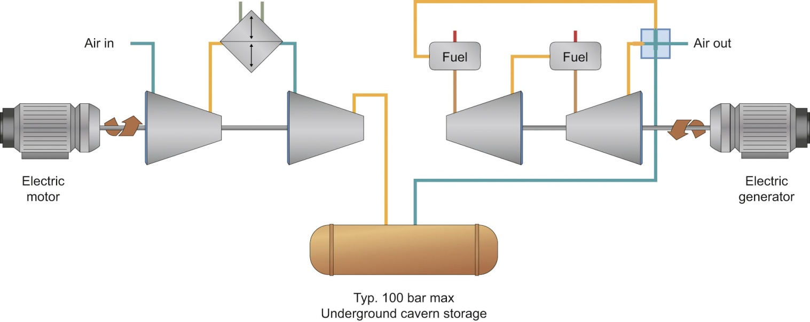
Fig45_03

Slide 4
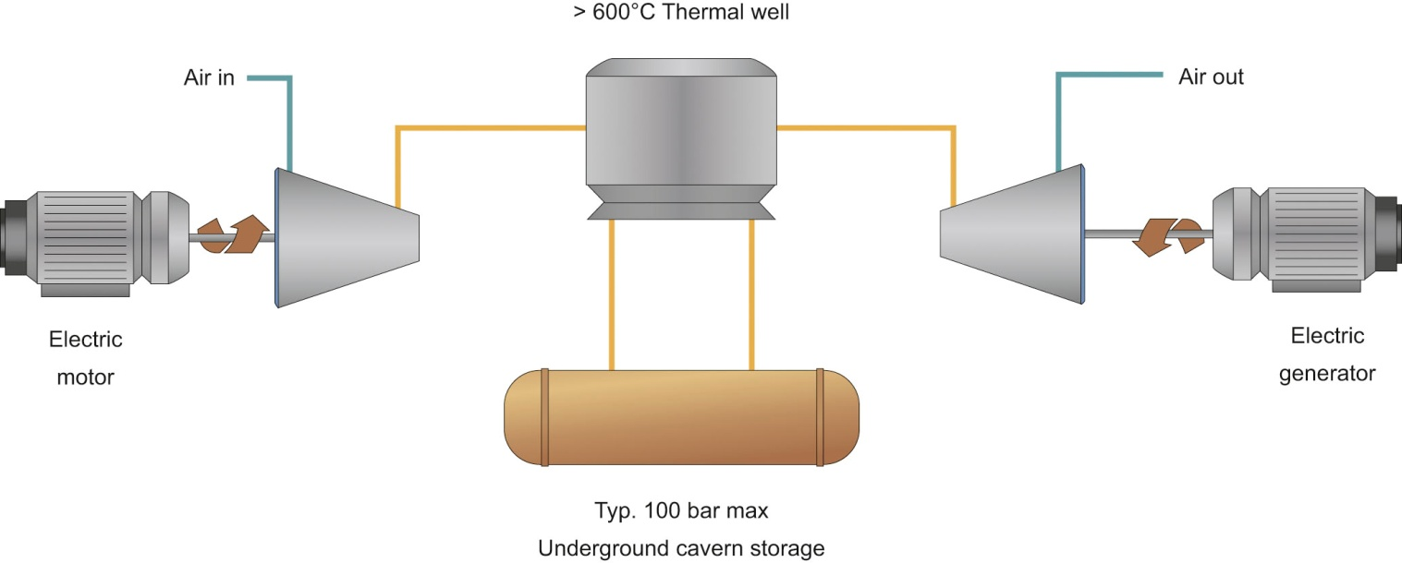
Fig45_04
© SustainX, Inc.

Slide 5
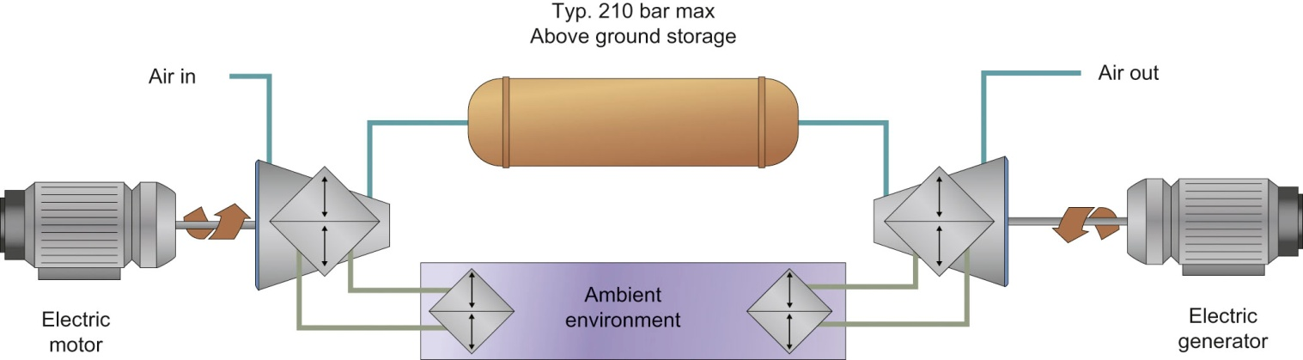
Fig45_05
© SustainX, Inc.

Slide 6
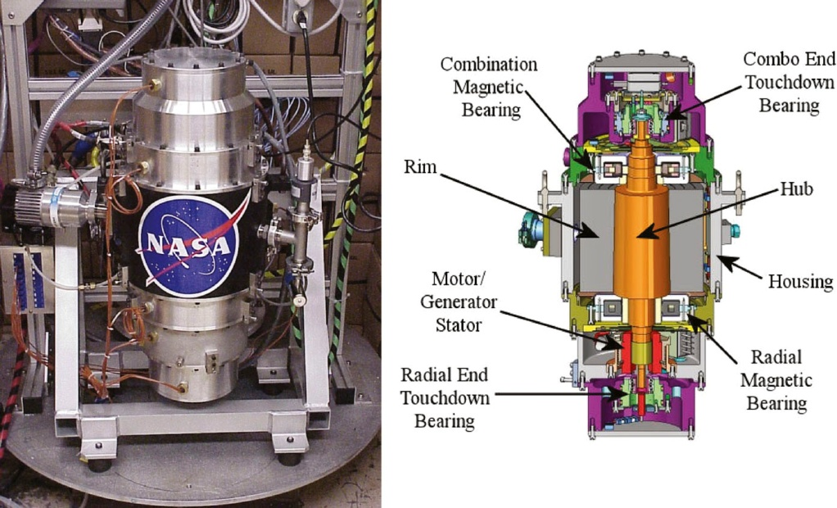
Fig45_06

