Slide 1
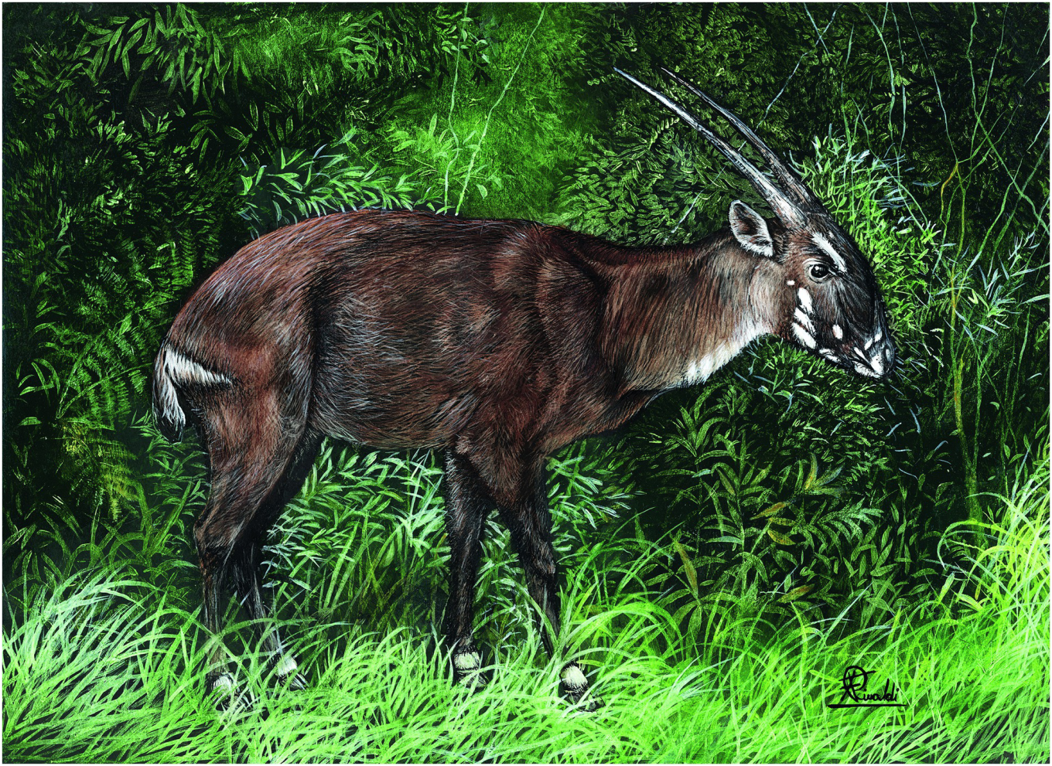
Plate 22
Saola (illustration by Francesco Rinaldi)

Slide 2
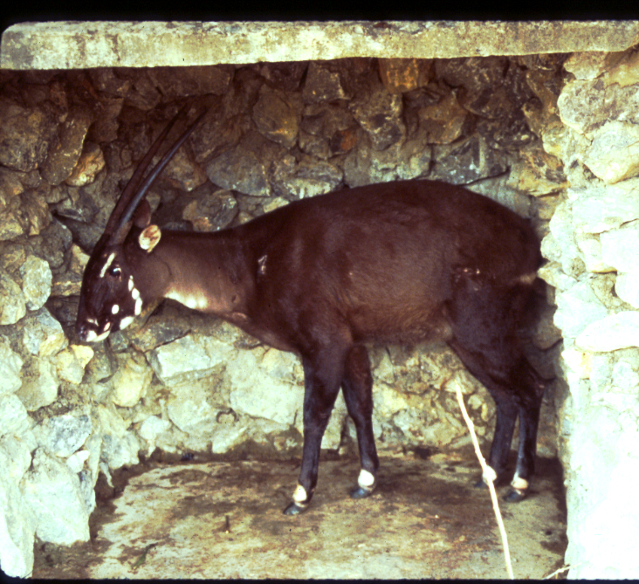
Figure 19.1
Female Saola captured by villagers in Bolikhamxay Province, Lao PDR in August, 2010, and photographed shortly before she died (Photo by William Robichaud).

Slide 3
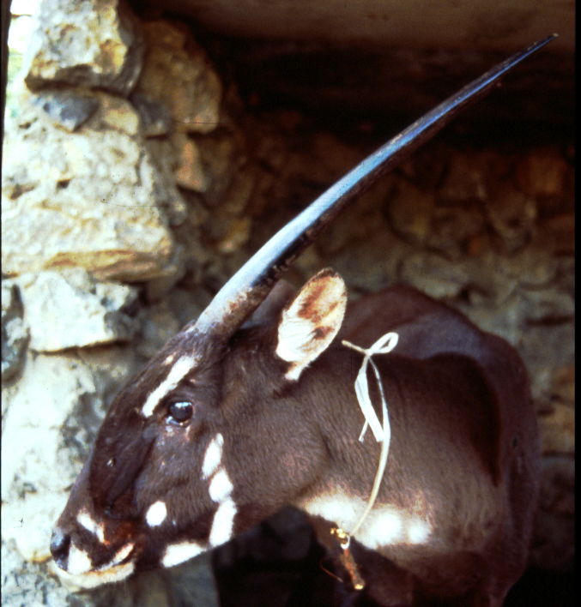
Figure 19.2
Female Saola in captivity. Bolikhamxay Province, Lao PDR (Photo by William Robichaud).

Slide 4
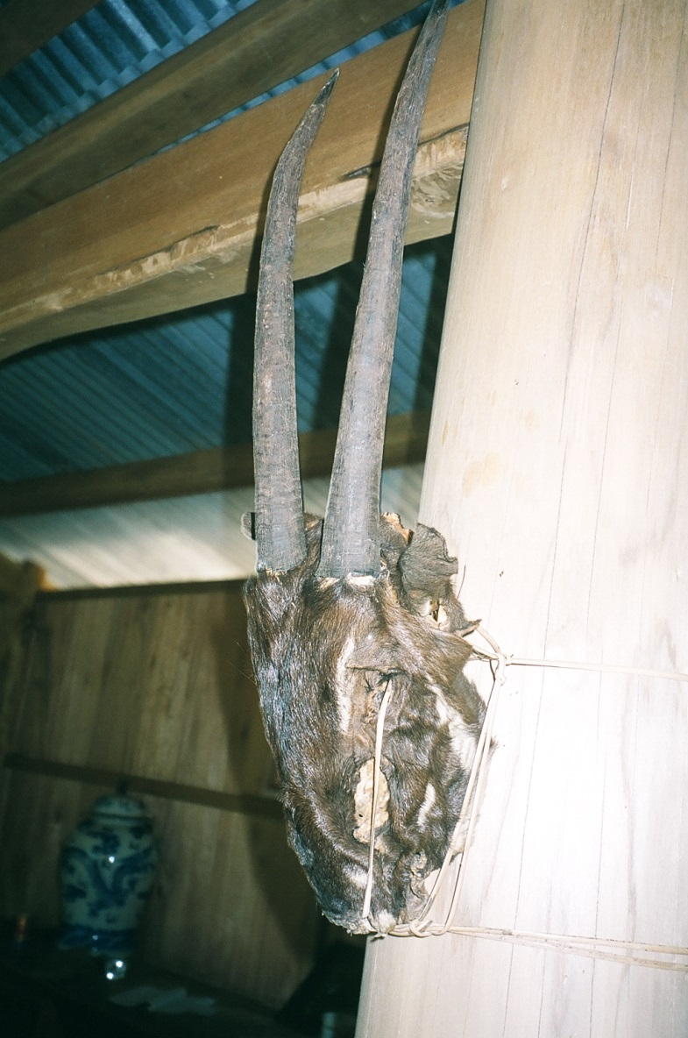
Figure 19.3
Saola hunting trophy in a Ka Tu house, Quang Nam, Vietnam
(Source WWF Vietnam / Minh Hoang).

Slide 5
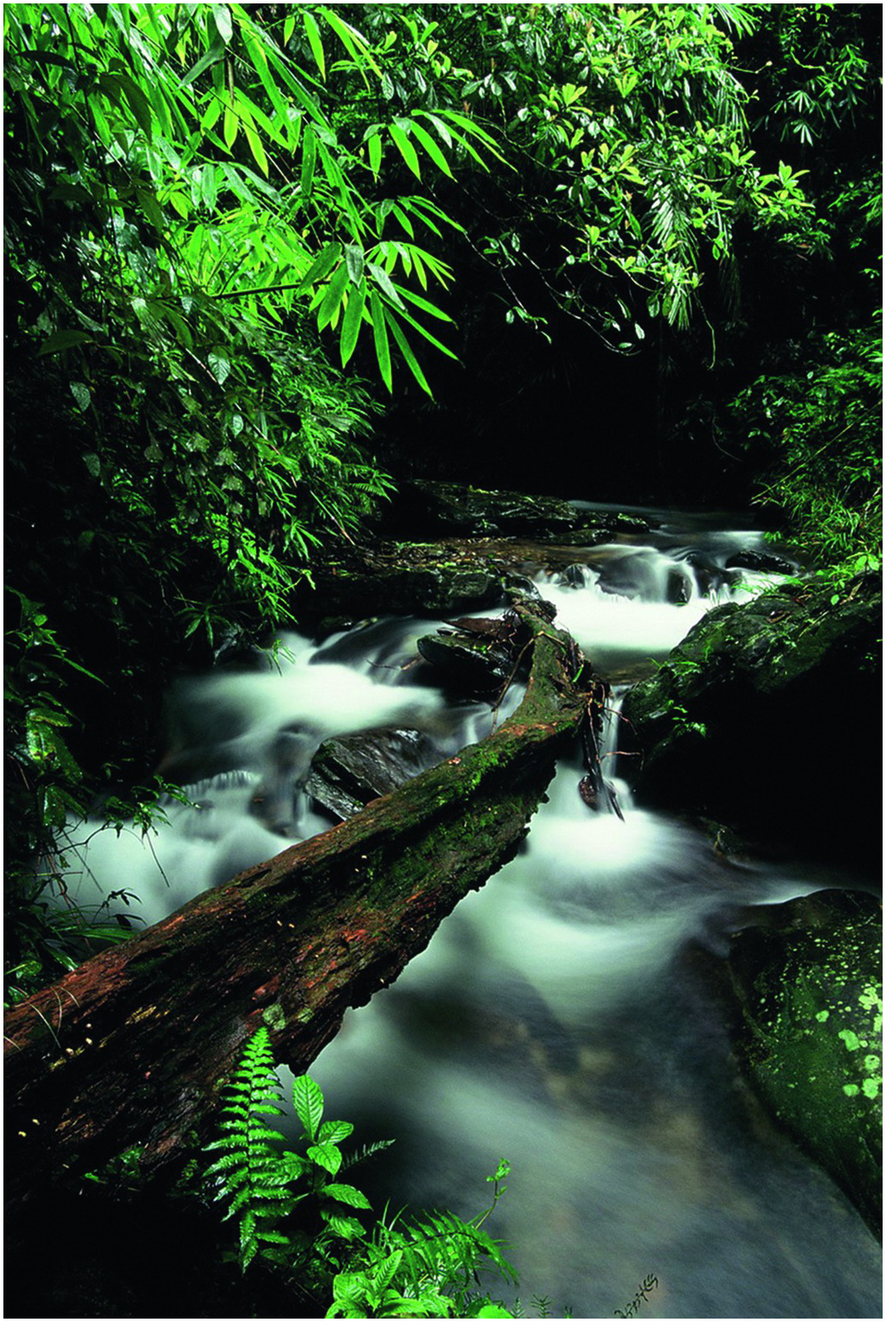
Figure 19.4
Forest stream Au Rong: Saola habitat, Quang Nam, Vietnam.
Source Jeremy Holden/WWF.

Slide 6
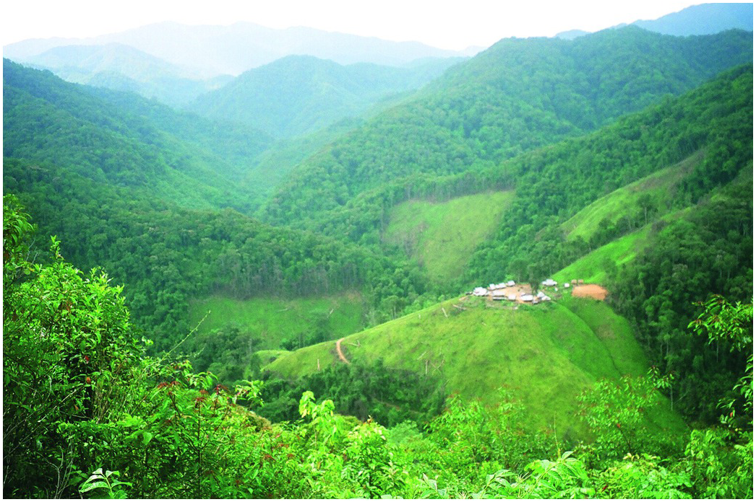
Figure 19.5
Tu village in the heart of saola range, Quang Nam, Vietnam.
Source Minh Hoang/WWF.

Slide 7
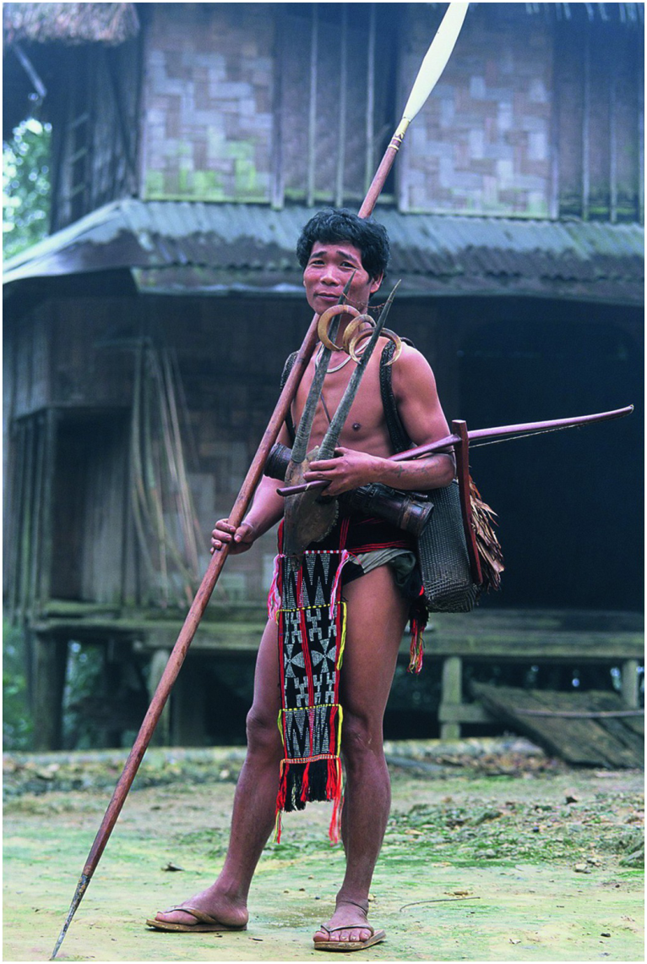
Figure 19.6
Ka Tu hunter with Saola skull.
Source Jeremy holden/WWF.

Slide 8
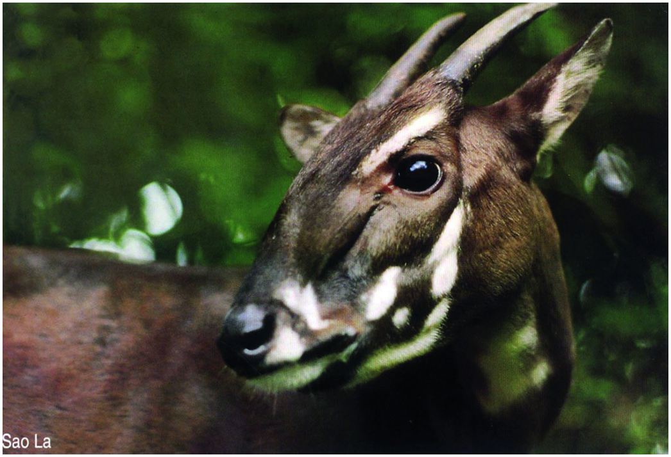
Figure 19.7
Captive saola in Vietnam.
Source Toon Fey/WWF.

