Slide 1
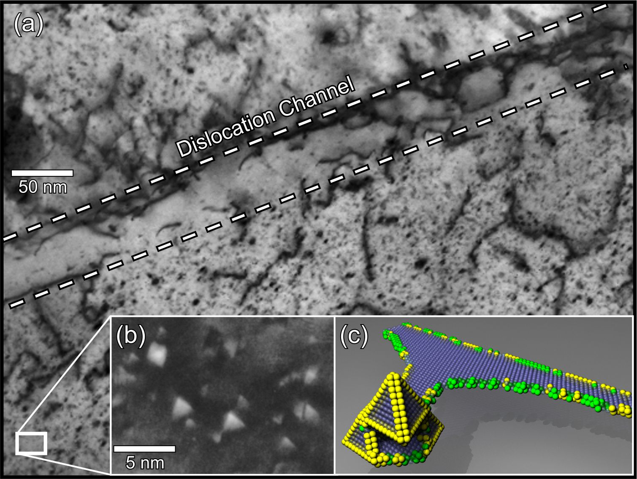

Slide 2
0.5 μm
Notes:
3.84” x 5”, tiff.

Slide 3
ΔG
(a) elastic + surface terms
+
0
ΔG*
i
i*
(c) total
−
(b) vacancy annihilation term
Notes:
2.3” x 3”, tiff.

Slide 4
b_{e}
v
ξ
c
c⁰
Notes:
2.51” x 3”, tiff.

Slide 5
A
(b)
(a)
L
B
Notes:
2.08” x 3”, tiff.

Slide 6
(b)
(a)
A
C
B
D
Notes:
2.97” x 3”, tiff.

Slide 7
v
r
ω
θ
4πρ₀
Notes:
3.8” x 4”, tiff.

Slide 8
25 μm
Notes:
3.18” x 5”, tiff.

Slide 9
ξ
b
b
b
(a)
ξ
(b)
ξ
Notes:
2.18” x 5”, tiff.

Slide 10
y
z
x
A
v
B
C
v
D
ξ
(a)
v
v
b
A
b_{e}
C
(b)
b_{e}
b
ξ
B
D
b
(c)
ξ
Notes:
3.32” x 3”, tiff.

Slide 11
y
z
x
ξ
b
Notes:
2.52” x 3”, tiff.

Slide 12
A
y
z
ξ
x
y
b
A
B
(a)
B
(b)
z
y
B
A
(c)
Notes:
4.37” x 5”, tiff.

Slide 13
A
B
Notes:
1.86” x 4”, tiff.

Slide 14
L
r
λ
Notes:
2.23” x 3”, tiff.

Slide 15
F
L
δL
Notes:
1.07” x 3”, tiff.

Slide 16
F₁
F₂
r₁
r₂
λ₁
λ₂
Notes:
1.05” x 3”, tiff.

Slide 17
500 μm
Notes:
3.45” x 5”, tiff.

Slide 18
Notes:
1.08” x 3”, tiff.

Slide 19
ξ
b
Notes:
1.2” x 3”, tiff.

Slide 20
A
B
D
C
Notes:
2.56” x 3”, tiff.

Slide 21
B
δγ
extrinsic
fault
D
βγ
δβ
δγ
γβ
Cδ
δC
A
βC
βδ
βδ
C
extrinsic fault
Notes:
2.4” x 3”, tiff.

