Slide 1
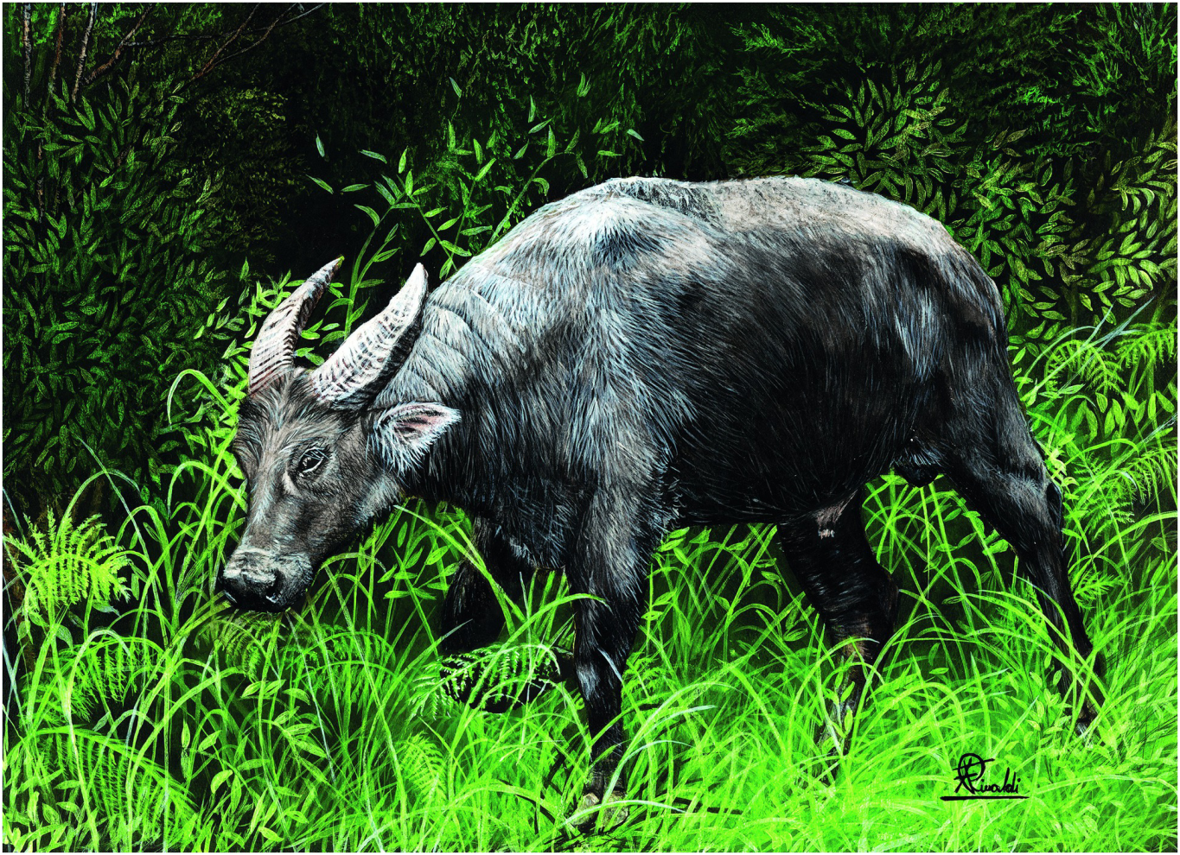
Plate 21
Tamaraw (illustration by Francesco Rinaldi)

Slide 2
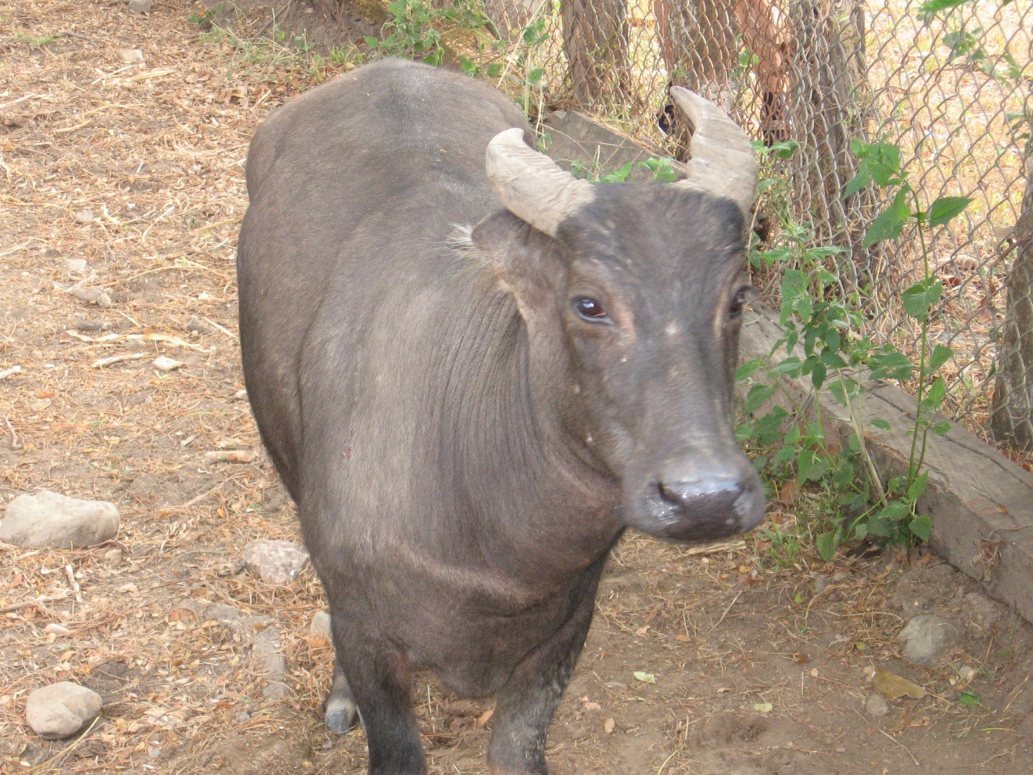
Figure 18.1
A captive cow in 2007 from Occidental Mindoro (Photo by M. R. Cebrian).

Slide 3
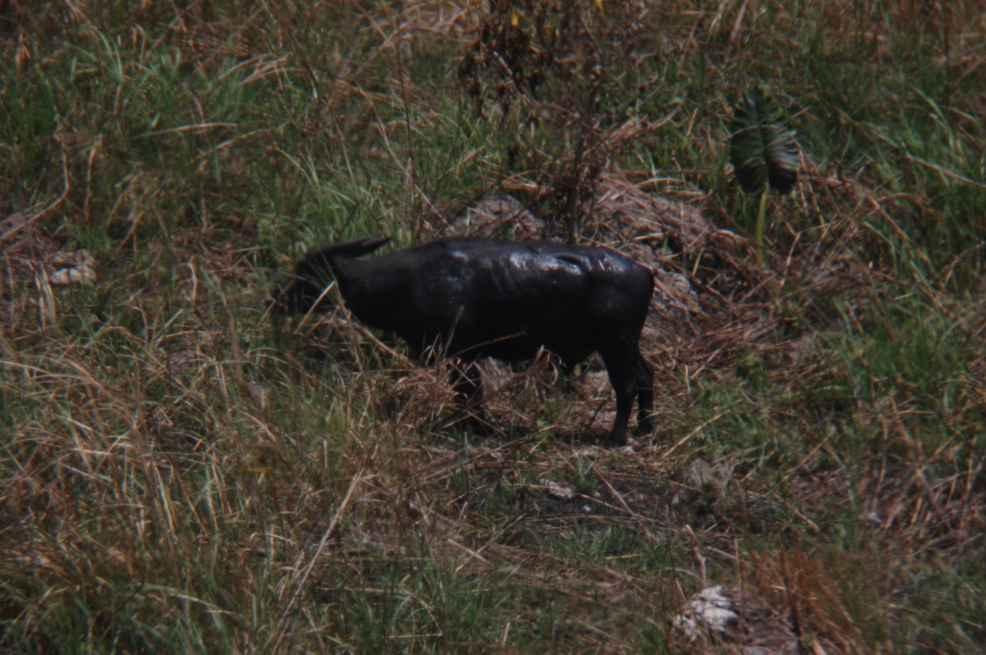
Figure 18.2
A wild bull in 2010 (Photo by M. R. Cebrian).

Slide 4
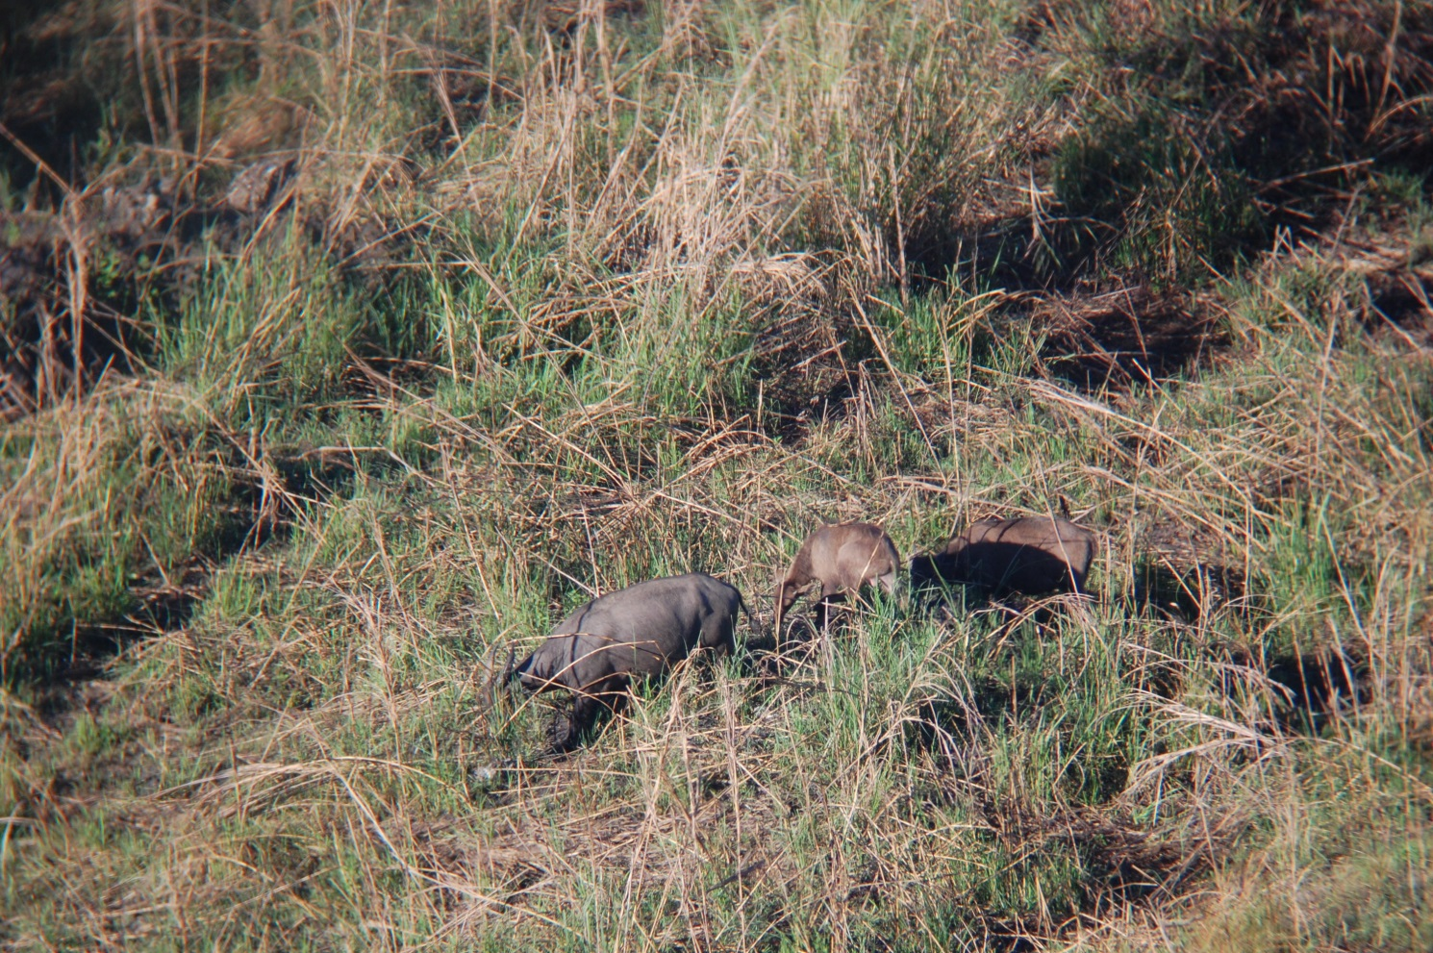
Figure 18.3
A family group in 2010 consisting of a cow, a yearling, and a juvenile. (Photo by M.R. Cebrian).

Slide 5
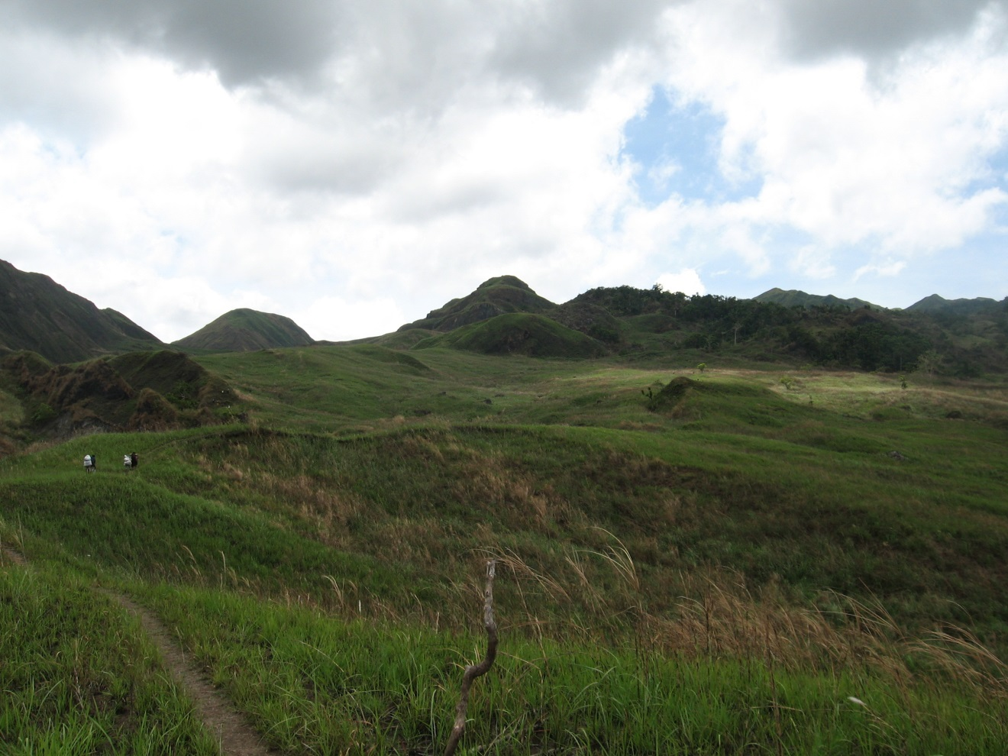
Figure 18.4
A typical tamaraw habitat in Mts. Iglit-Baco National Park, Occidental Mindoro, Philippines in 2010. The park at elevation is dominated by grasslands interspersed with secondary forests along riparian corridors.
(Photo by M. R. Cebrian)

Slide 6
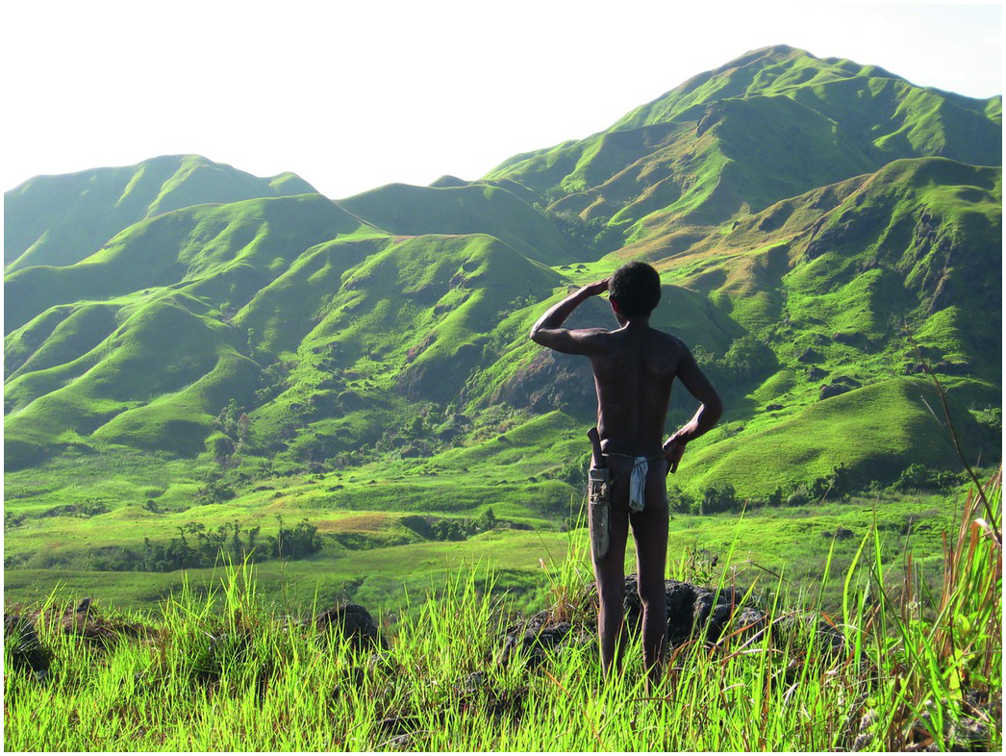
Figure 18.5
An indigenous Mangyan at Mts. Iglit-Baco National Park, Occidental Mindoro, Philippines in 2007. Tamaraw regularly traverse steep terrain as evidenced by hoof marks and droppings on trails in the mountains. (Photo by M. R. Cebrian)

