Slide 1
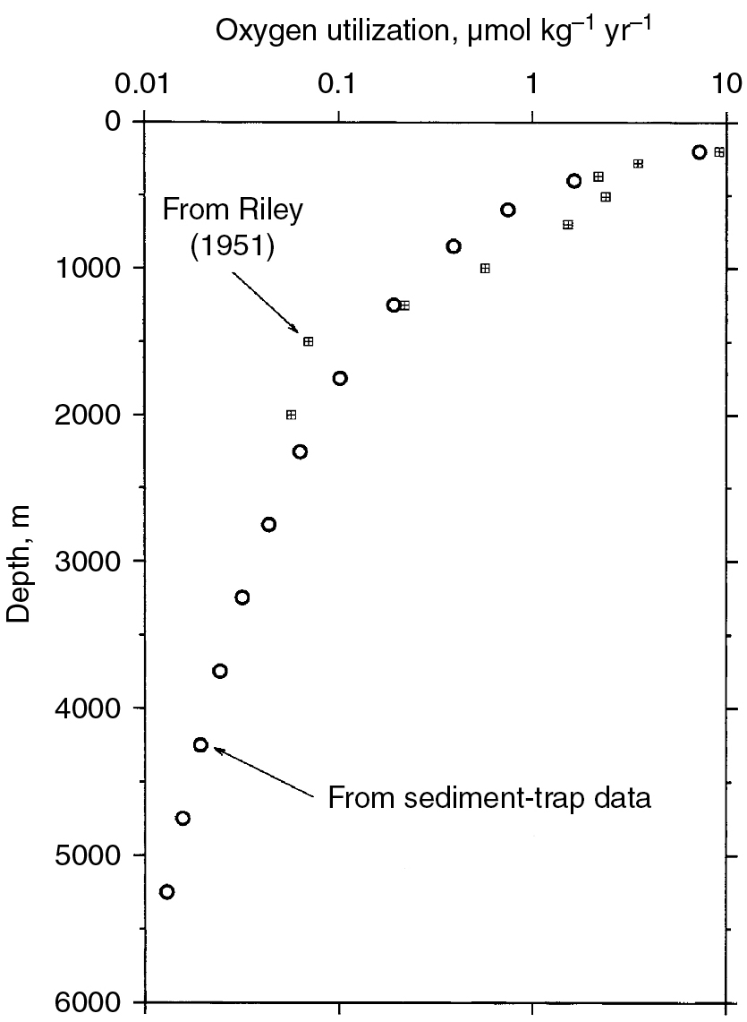
PILSON_Ch12_fig01
© Cambridge University Press 2012

Slide 2
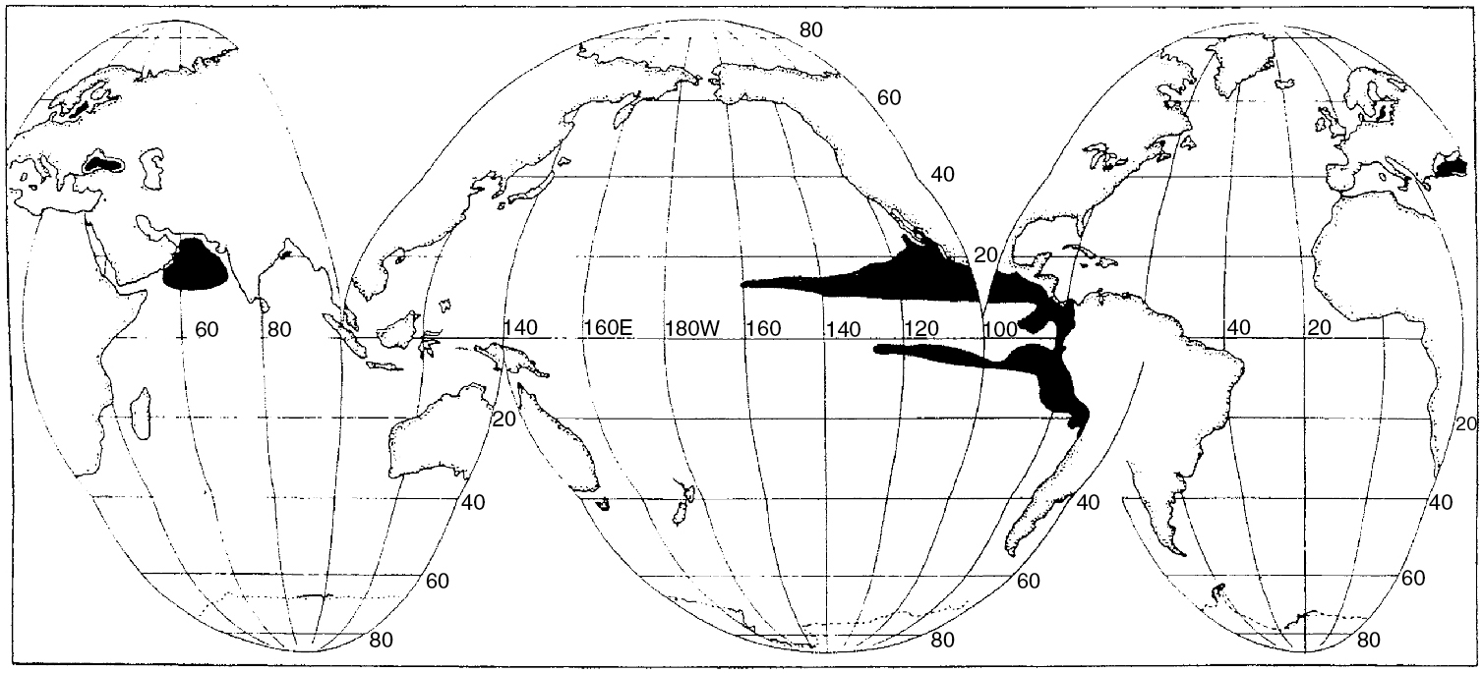
PILSON_Ch12_fig02
© Cambridge University Press 2012

Slide 3
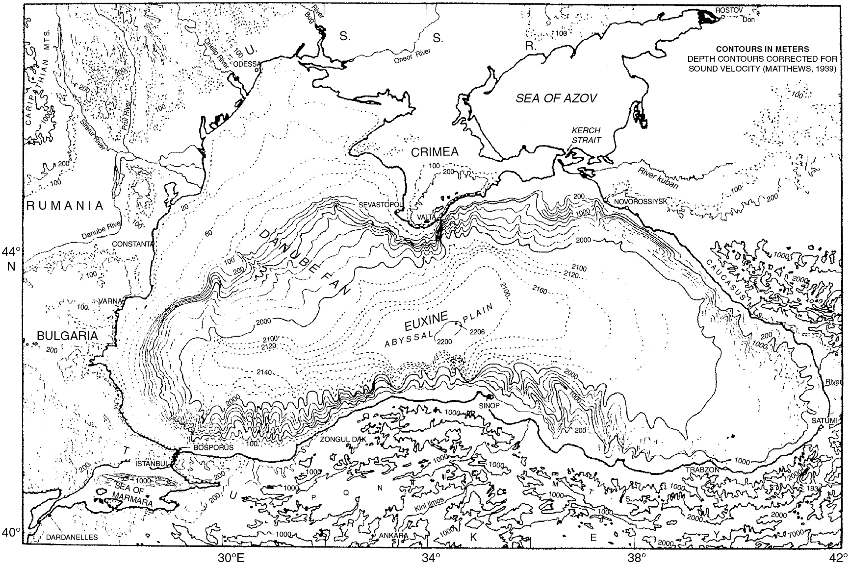
PILSON_Ch12_fig03
© Cambridge University Press 2012

Slide 4
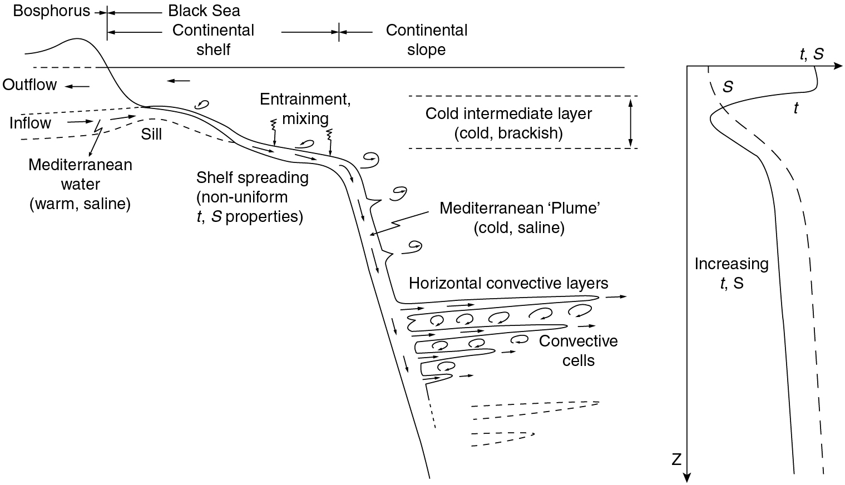
PILSON_Ch12_fig04
© Cambridge University Press 2012

Slide 5
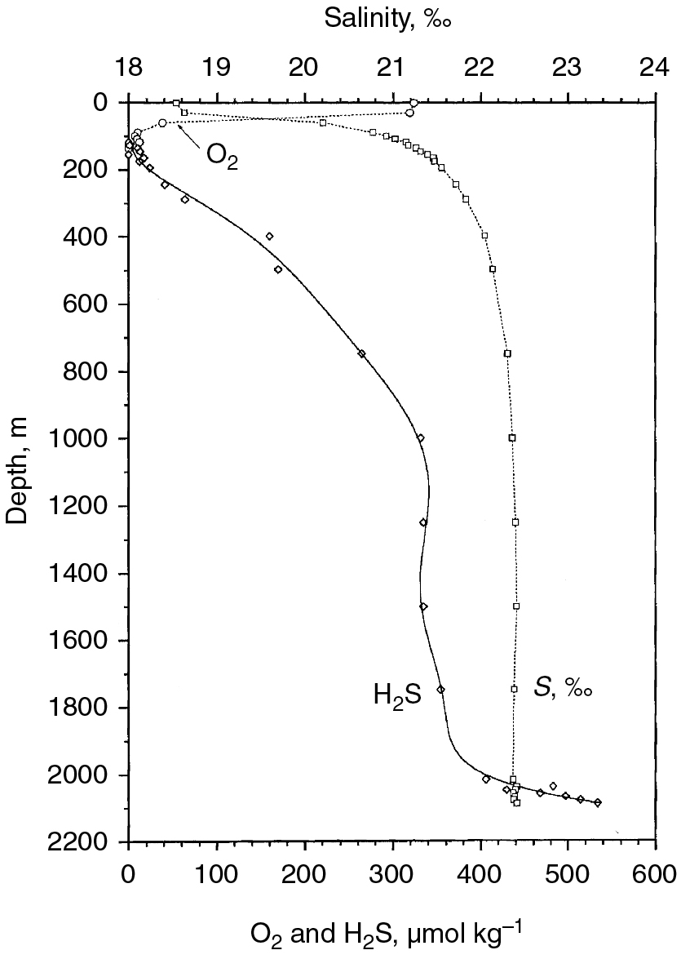
PILSON_Ch12_fig05
© Cambridge University Press 2012

Slide 6
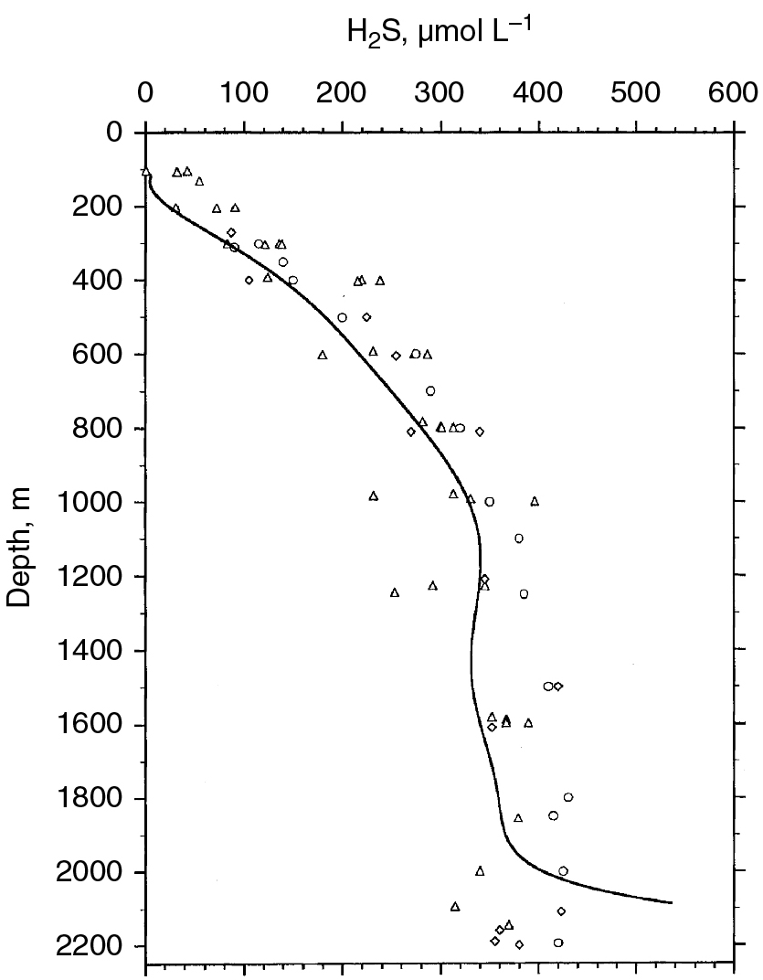
PILSON_Ch12_fig06
© Cambridge University Press 2012

Slide 7
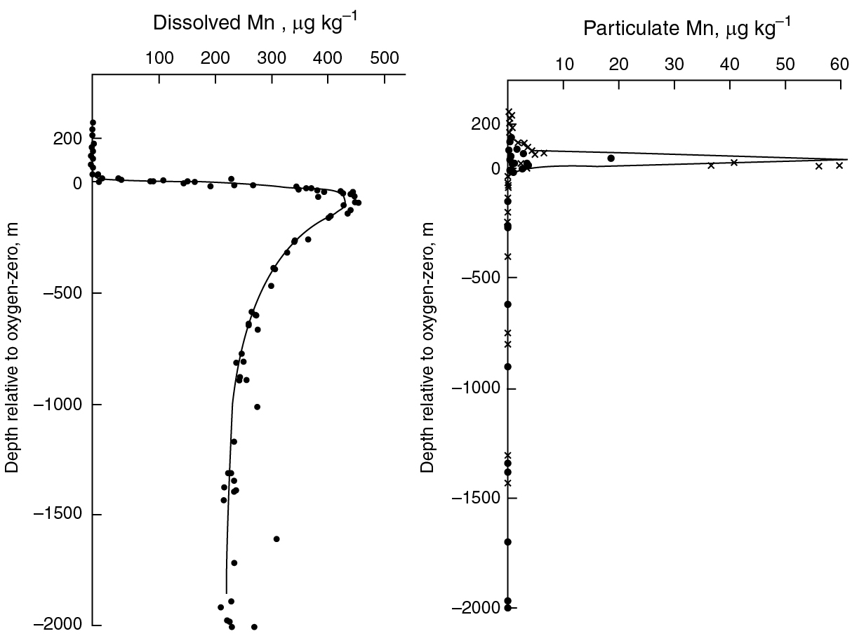
PILSON_Ch12_fig07
© Cambridge University Press 2012

Slide 8
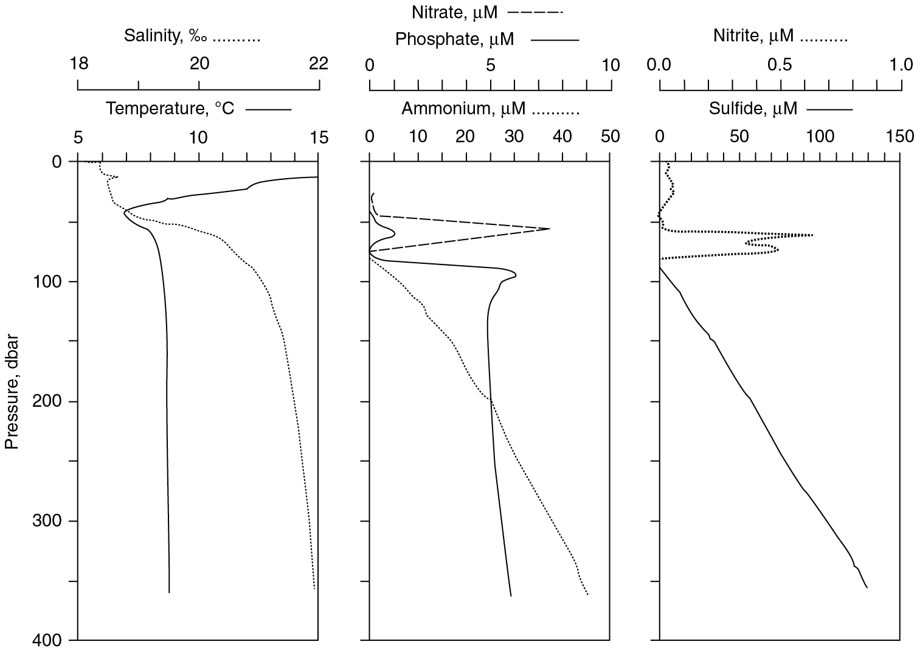
PILSON_Ch12_fig08
© Cambridge University Press 2012

