Slide 1
Plate 23
African buffalo (illustration by Francesco Rinaldi)

Slide 2
Figure 20.1 a
Distribution of the four African buffalo subspecies in relation to human population density. Source IUCN, 2008. Red List of Threatened Species.

Slide 3
Figure 20.1 b
Distribution of the four African buffalo subspecies in relation to average rainfall. Source IUCN, 2008. Red List of Threatened Species.

Slide 4
Figure 20.1 c
Distribution of the four African buffalo subspecies in relation to protected areas. Source IUCN, 2008. Red List of Threatened Species.

Slide 5
Figure 20.2 Differences in body size, horns shape and size of the four African buffalo subspecies
Cape buffalo male. Photo by Mario Melletti

Slide 6
Figure 20.2 Differences in body size, horns shape and size of the four African buffalo subspecies
Forest buffalo male. Photo by A. Turkalo.

Slide 7
Figure 20.2 Differences in body size, horns shape and size of the four African buffalo subspecies
West African savanna buffalo male. Photo by D. Cornèlis.

Slide 8
Figure 20.2 Differences in body size, horns shape and size of the four African buffalo subspecies
African savanna buffalo male. Photo by Central D. Cornèlis.

Slide 9
Figure 20.2 Differences in body size, horns shape and size of the four African buffalo subspecies
Forest buffalo female. Photo by A. Turkalo.

Slide 10
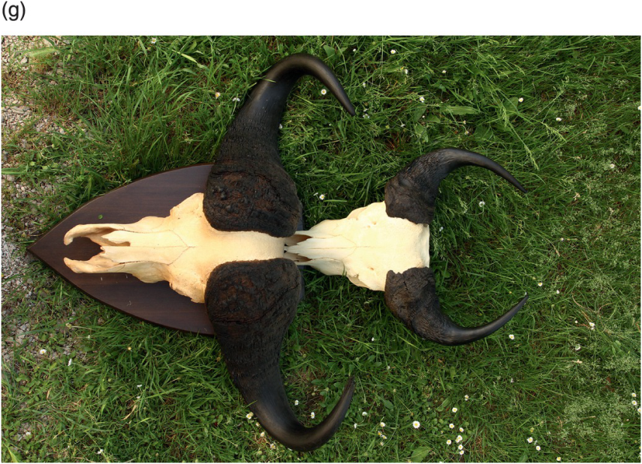
Figure 20.2 Differences in body size, horns shape and size of the four African buffalo subspecies
f) male horns of transitional "buffalo" from North Angola compared with g) horns of West African savanna and Cape buffalo males (right and left respectively). (f) Photo by C. Chiarelli and (g) photo by M. Melletti.

Slide 11
Figure 20.3 a&b
grassy glades and watercourses areas in rainforest (Photo by M. Melletti)
forest muddy areas (Photo by A. Turkalo)

Slide 12
Figure 20.3 c
Forest buffalo are forest-dwellers, inhabiting different habitats with:
c) costal and equatorial savannas (Photo by Mathieu Bourgarel, Cirad).

