Slide 1
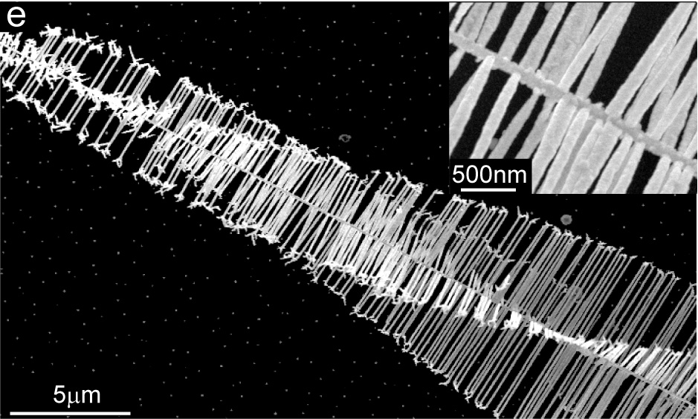

Slide 2
y
r
e_{r}
e_{θ}
ξ
θ
S
−
R
F
b
-0.061
(a)
z
x
-0.184
-0.31
-0.31
0.31
−
+
0.184
0.31
y
-0.184
0.184
+
-0.061
0.061
0.061
b
x
(b) σ_{yz}
(c) σ_{xz}
b
Notes:
4.11” x 5”, jpg.

Slide 3
dA
r
dF = σ_{θz} dA
dM_{z} = r dF
Notes:
1.73” x 2.5”, tiff.

Slide 4
R
Screw
r₀
Notes:
1.91” x 2”, tiff.

Slide 5
y
δx
δx
II
σ_{yz}
δx
z
x
h
a
I
x
b
L
Notes:
2.58” x 5”, tiff.

Slide 6
y
σ_{yz}(x,0)
x
y
x
Δu
Notes:
5.23” x 5”, tiff.

Slide 7
y
Free surface
l
l
Screw
Image screw
x
Notes:
2.17” x 3”, tiff.

Slide 8
y
R
ρ
r
r'
r'
θ'
ϕ
θ
O
λ
x
O
λ
R²/λ
Notes:
2.4” x 5”, tiff.

Slide 9
y
Cut
z
Surface Forces
x
Notes:
2.1” x 3”, tiff.

Slide 10
R
r₀
Notes:
2.05” x 2”, tiff.

Slide 11
y
r
ξ
θ
u_{y}
S
z
u_{x}
b
F
x
Notes:
2.54” x 3”, jpg.

Slide 12
(a)
(b)
Notes:
3.43” x 3.5”, tiff.

Slide 13
0.053
-0.053
-0.053
-0.159
0.159
0.053
-0.69
0.69
(a) σ_{xy}
0.053
-0.053
-0.059
-0.053
y
-0.178
-0.159
-0.297
-0.69
b
0.053
x
b
-0.053
0.297
0.178
0.159
0.69
(b) σ_{xx}
(c) σ_{yy}
0.059
0.053
Notes:
5.02” x 5”, jpg.

Slide 14
y
x
Notes:
1.19” x 3”, tiff.

Slide 15
y
x = −w−b/2
δv=b δy
x = w + b/2
Region I
δy
y_{I}
σ_{xx}
b
δy
x
σ_{xx}
y_{II}
Region II
δy
x = −w
x = w
Notes:
2.02” x 3”, tiff.

Slide 16
A'
A
B
B'
δv'/L
δv'/L
δy
h'
h
A'
A
B
B'
Notes:
2.35” x 3”, tiff.

Slide 17
y
y
(a)
(b)
F_{x} /L
image
F_{x} /L = σ_{xy} (−l, 0)b
x
(l,0)
x
(−l,0)
free surface
(−l,0)
edge
b = b e_{x}
ξ = e_{z}
edge
b = b e_{x}
ξ = e_{z}
image
b = −b e_{x}
ξ = e_{z}
Notes:
2.21” x 2.5”, tiff.

Slide 18
z
z
image
x
y
b_{s}
free surface
ξ
η'
η
y
β
b
ξ'
δr
b_{e}
α
b_{s}
b_{e}
ξ
(a)
(b)
dislocation line
Notes:
2.44” x 2”, tiff.

Slide 19
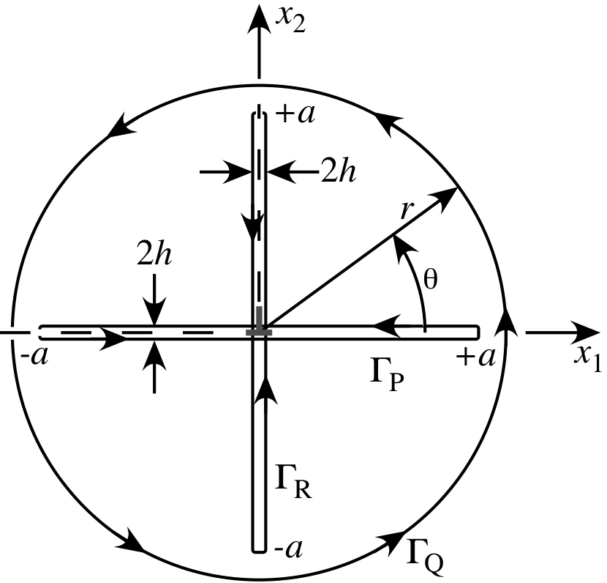
x₂
x₁
Notes:
2.4” x 2.5”, jpg.

Slide 20
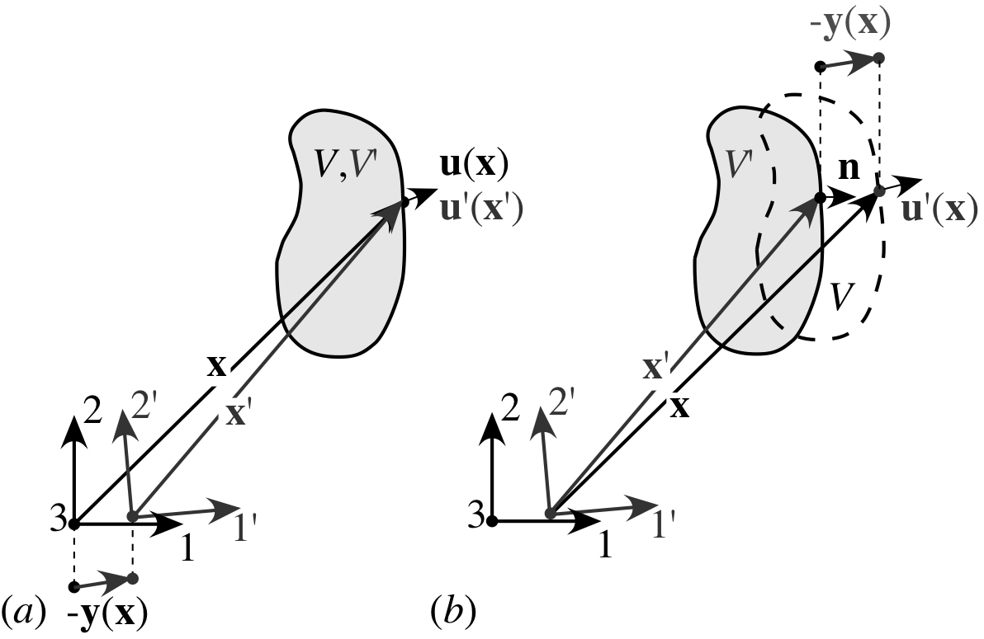
−y(x)
u(x)
u'(x)
u'(x')
(a)
(b)
Notes:
1.63” x 2.5”, jpg.

Slide 21
y
y₁
B
A
x
x₁

Slide 22
y
c
B
A
O
a
x

Slide 23
y
Surface 2
Surface 1
E
C
A
B
D
F
x
l
l
d
Notes:
1.51” x 2.5”, tiff.

