Slide 1
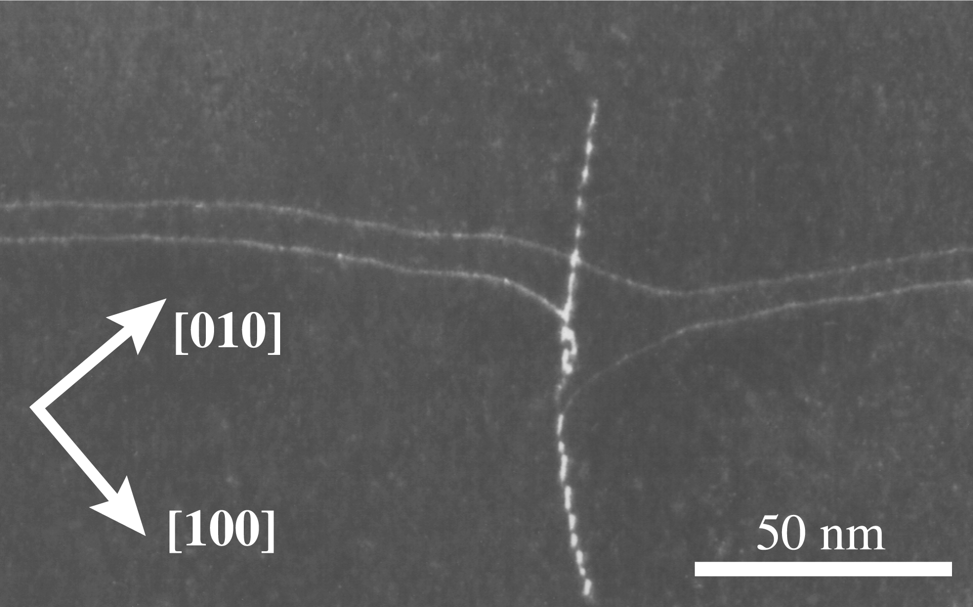
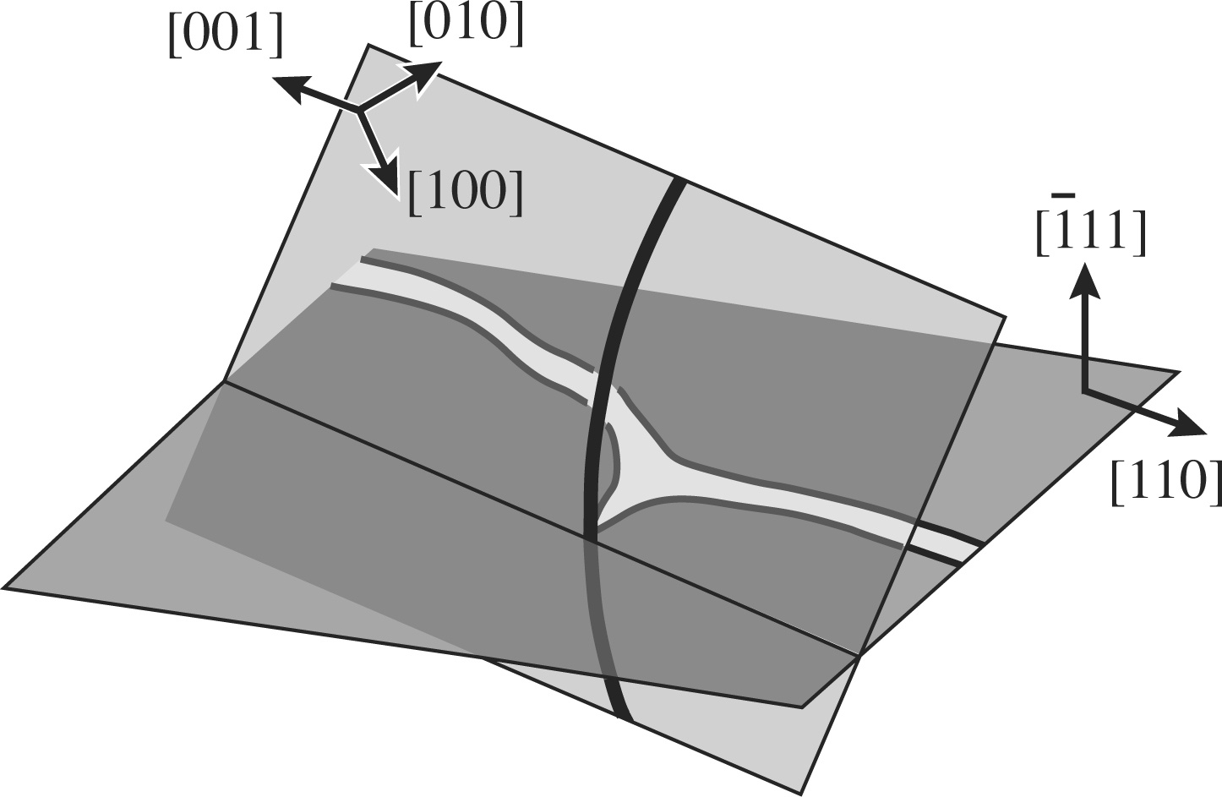
B
A
B
A

Slide 2
y
b
(a)
d
x
y
B
-u_{x}(x)
A
A
(b)
x
d
u_{x}(x)
A'
B'
A'
Notes:
3.3” x 5”, jpg.

Slide 3
ϕ_{x}, u_{x}
b/2
b/4
ϕ_{x}(x)
u_{x}(x)
O
(a)
x
ϕ_{x}(x)
u_{x}(x)
−b/4
−b/2
S
F
S
(b)
F
x
2
1
db_{x}
SF⁽²⁾ = 2u_{x}(x+dx)
SF⁽¹⁾ = 2u_{x}(x)
Notes:
4.67” x 5”, jpg.

Slide 4
y
ϕ⁰
b
(a)
z
x
y
ξ
b
(b)
x
z
u_{z}
u_{z}
u_{z}
u_{z}
Notes:
3.56” x 5”, tiff.

Slide 5
range of force law
(a)
6
(b)
5
4
Dislocation energy W/L (eV/Å)
3
R
2
I
|
II
1
III
0
1
10
100
R (Å)
Notes:
3.72” x 4”, tiff.

Slide 6
y
B
C
2ρ'₂
2ρ'₁
A
x
Notes:
2.97” x 3”, tiff.

Slide 7
(a)
y
(b)
z
x
(c)
Notes:
6.55” x 3”, tiff.

Slide 8
b
b
(a)
x
(b)
x
z
z
Notes:
1.61” x 5”, tiff.

Slide 9
W(α)
σ(α)
W_{p}
W₀
σ_{p}
O
α
O
α
(a)
(b)
Notes:
1.43” x 5”, tiff.

Slide 10
W(α)
W(α)
O
1
α
O
0.5
1
α
(a)
(b)
Notes:
1.62” x 5”, tiff.

Slide 11
C
D
E
α
A
B
Notes:
1.1” x 4”, jpg.

Slide 12
ξ
C
b
A
D
a
C'
E
B
M
L
M
Notes:
0.74” x 3”, tiff.

Slide 13
ξ
b
L
Notes:
0.76” x 3”, tiff.

Slide 14
w
w
L
Notes:
1.19” x 3”, tiff.

Slide 15
A'
B
A
A''
Notes:
2.32” x 4”, tiff.

Slide 16
vacuum
crystal
l
z
a
image
kink
x
Notes:
2.45” x 3”, tiff.

Slide 17
y
b_{x}
b
l
b_{z}
O
external
surface
forces
O'
x
z
superposed
forces
plane z = 0
(a)
(b)
y
δA_{y}
y
δA_{y}
b
u_{z}
P
u_{x}
ξ
b
ξ
O
x
u_{x}
x
z
u_{z}
z
(c)
(d)
Notes:
4.16” x 5”, jpg.

Slide 18
D
E
ξ
F
b
a
A
B
ψ
C
M
w
M
Notes:
1.39” x 4”, tiff.

Slide 19
y
b
Q
ξ
P
Δy
Δx
ψ_{m}
w
x
Notes:
1.22” x 4”, tiff.

Slide 20
b
β
ξ
Notes:
1.06” x 3”, tiff.

Slide 21
w
x
(a)
a
(b)
Notes:
1.1” x 4”, jpg.

Slide 22
y
b
l
ξ
a
x₋₃
x₋₂
x₋₁
x₀
x₁
x₂
x
Notes:
1.4” x 3”, tiff.

Slide 23
D
d
C
A
B
Notes:
1.54” x 4”, tiff.

Slide 24
y
x
z
Notes:
2.22” x 4”, tiff.

Slide 25
ξ
y
y
b
z
z
x
(a)
(b)
Notes:
1.86” x 5”, jpg.

Slide 26
y
a
b
z
d
x
L
ξ
Notes:
0.73” x 4”, tiff.

