Slide 1
DFB Lasers and Fibre Networks for Near-IR Gas Spectroscopy
Design and Applications

Slide 2
Enhancement of Sensitivity
For the relatively weak near-IR absorption lines, it may be desirable in some cases to enhance the effective length of the gas cell. This may be done by use of:
Multi-Pass cells (White cell or Herriott cell)
Ring-Down Spectroscopy
Cavity-Enhanced Absorption Spectroscopy (CEAS)
Off-Axis CEAS
Optical-Feedback CEAS
Noise-Immune Cavity-Enhanced Optical Heterodyne Molecular Spectroscopy (NICE-OHMS)

Slide 3
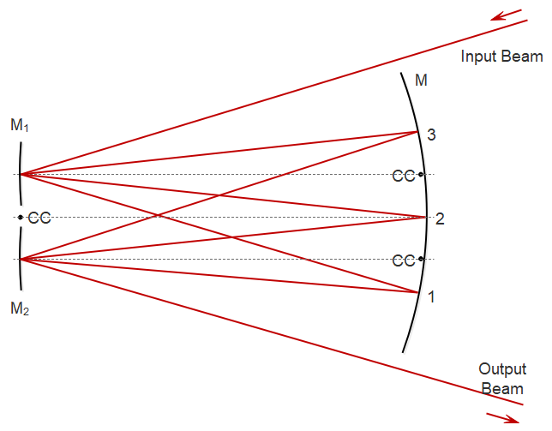
White Cell (8-pass)
cc=centre of curvature

Slide 4
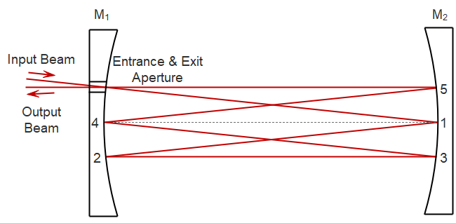
Herriott Cell (6-pass)

Slide 5
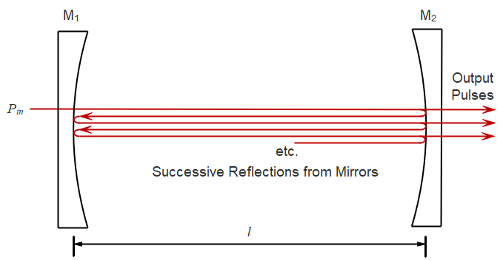
Principles of Ring-Down Spectroscopy
Gas absorbance, αCl
Input Pulse
Round-trip time τ
Reflectance R₁
Reflectance R₂

Slide 6
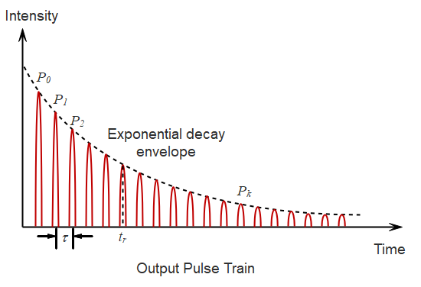
Output Pulse Train from Ring-Down Cavity
Cell length enhancement factor:
Ring-down time

Slide 7
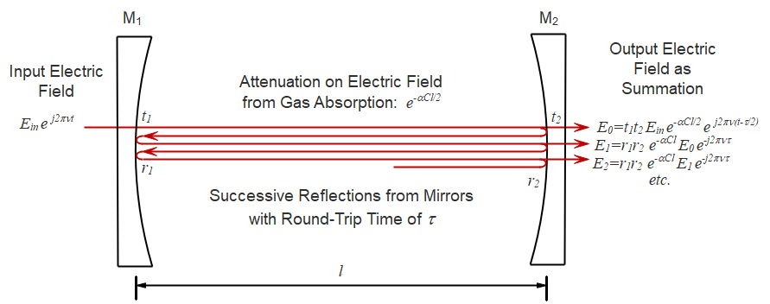
Cavity-Enhanced Spectroscopy
Coefficient of finesse for cavity:
Transmission function:
Enhancement factor
(on transmission peaks)
for R close to unity

Slide 8
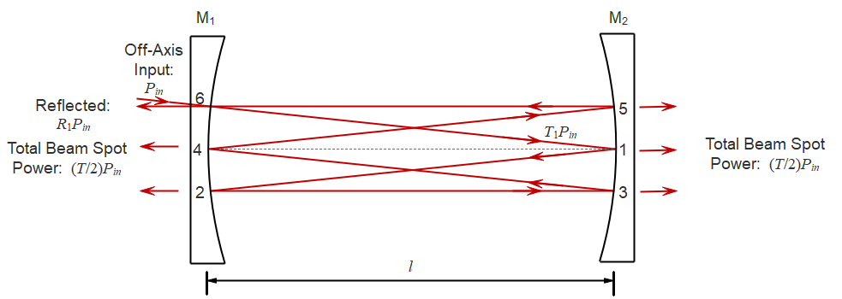
Off-Axis Cavity-Enhanced Spectroscopy
Dense mode spectrum with virtually uniform optical frequency response
Low power output
(with no absorbance)
For R₁=R₂ close to unity
and small absorbance
Enhancement factor
Avoids the need to lock the laser frequency to a cavity mode

Slide 9
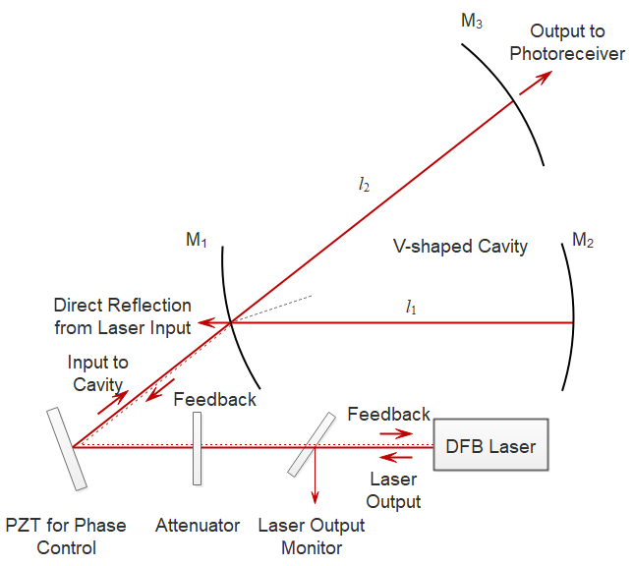
V-Shaped Cavity for Optical Feedback Cavity-Enhanced Spectroscopy
The laser frequency is self-locked to a cavity mode by optical feedback from the cavity

Slide 10
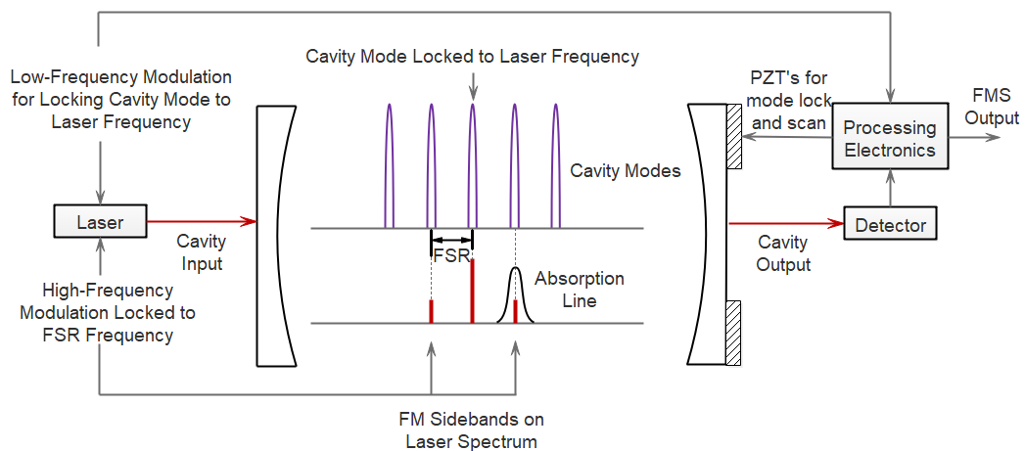
Noise-Immune Cavity-Enhanced Optical Heterodyne Molecular Spectroscopy
Frequency modulation spectroscopy (FMS) is employed with the modulation frequency matched to the FSR of the cavity

Slide 11
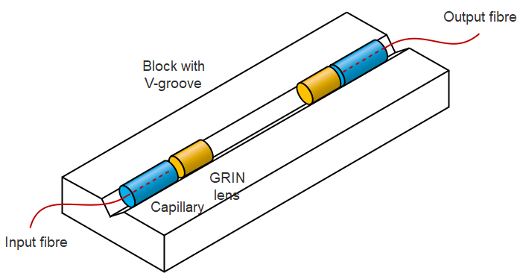
Fibre-Coupled Micro-Optic Cell

Slide 12
Surface Reflections in a Micro-Optic Gas Cell & Etalon Fringes
Etalon fringe output power distribution as a function of optical frequency, ν,
where is the etalon fringe spacing (FSR of the cell), η² is the transmission loss of the cell (typically ~1dB) and r² is the reflectance.

Slide 13
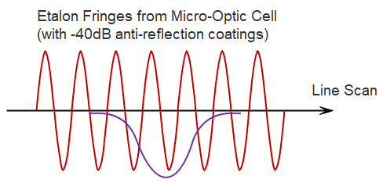
Etalon Fringes Compared With a Gas Absorption Line (-40dB AR Coatings)
Absorption line with line centre absorbance of 10⁻⁴

Slide 14
Reduction of Etalon Fringes
1) Focusing Cell Design
Reflected light is divergent
2) Use of high-quality anti-reflections coatings of -60dB.
3) With WMS, the second harmonic generated from the etalon fringes is:
The Bessel functions are zero at certain values of so the fringe magnitude can be reduced (but not eliminated) by choice of the modulation amplitude, δν.
4) Data processing algorithms and adaptive filtering to remove residual ripples.

Slide 15
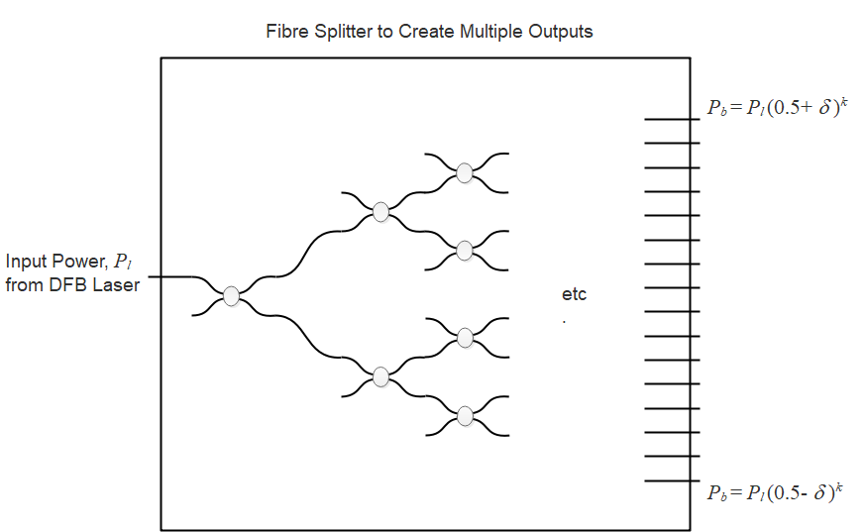
Spatial Division Multiplexing (SDM) 2x2 Fibre Couplers Forming Branched Network
All couplers have the same split ratio of
where δ is the deviation from the ideal 50:50 coupler
Slight power variation over the 2^{k} outputs

Slide 16
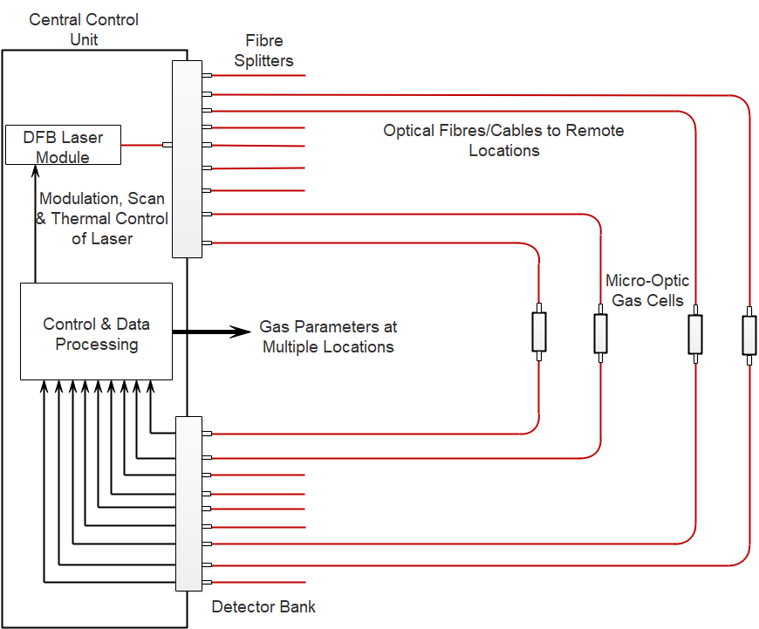
Spatial Division Multiplexing (SDM) for Multi-Point Methane Detection

Slide 17
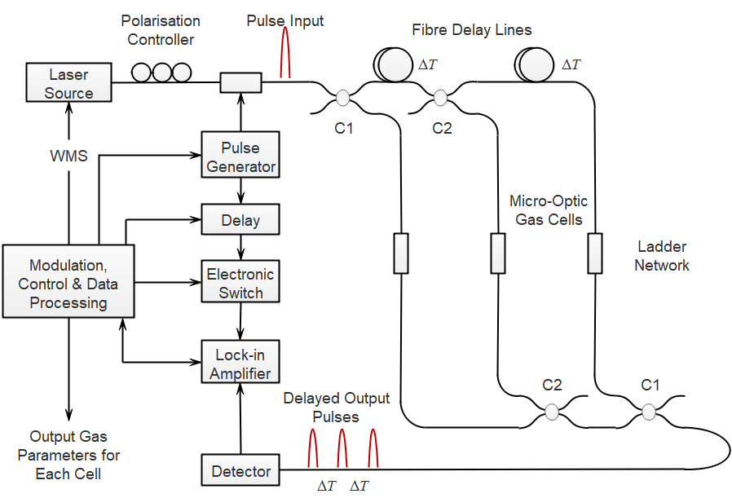
Time Division Multiplexing (TDM) For Multi-Point System

Slide 18
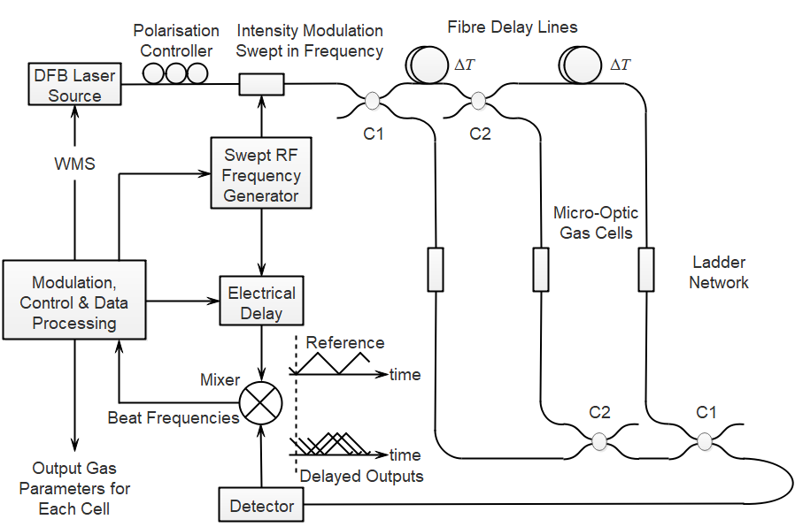
RF Frequency-Modulated Continuous Wave (RF-FMCW) Multiplexing

Slide 19
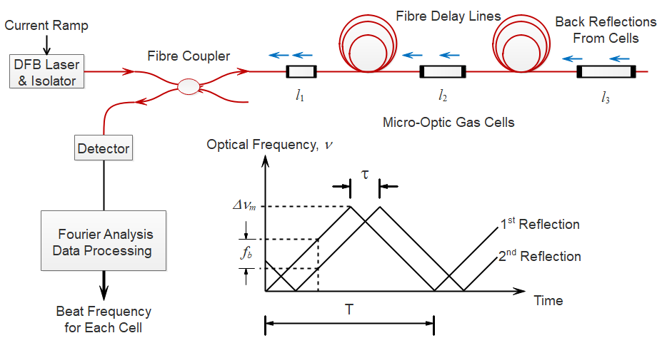
Optical Frequency-Modulated Continuous Wave (Optical-FMCW) Multiplexing

Slide 20
The Evanescent Field for Interaction with a Gas Absorber
Instead of using an open path gas cell, the evanescent field at the surface of an optical waveguide or fibre may in principle be used to interact with a gas absorber.
However the power fraction in the evanescent field is small so the relative sensitivity compared with a standard gas cell is low.
Examples of fibres or waveguides for evanescent field interaction are:
Polished or D-shaped fibres
Tapered or bare fibres to expose the core
Planar or ridge waveguides
Silicon photonic waveguides

Slide 21
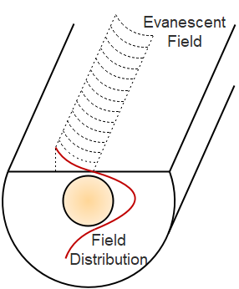
The Evanescent Field at The Surface of a D-Fibre

Slide 22
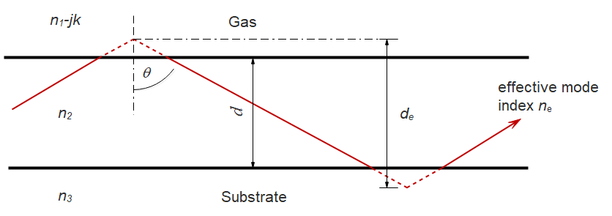
Asymmetric Planar Waveguide With a Gas Absorber on One Side
Relative sensitivity of evanescent wave interaction for TE modes as compared with a standard gas cell of the same length:

Slide 23
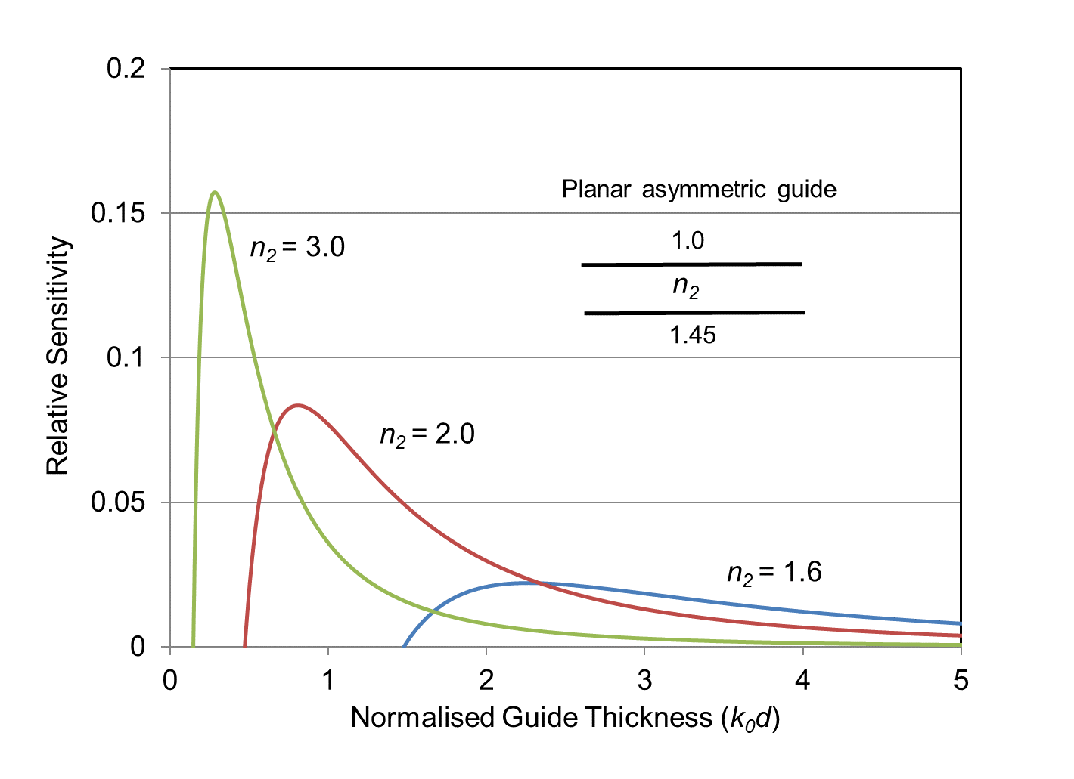
Relative Sensitivity of a Planar Asymmetric Guide (TE₀ mode) for Various Guide Indices

Slide 24
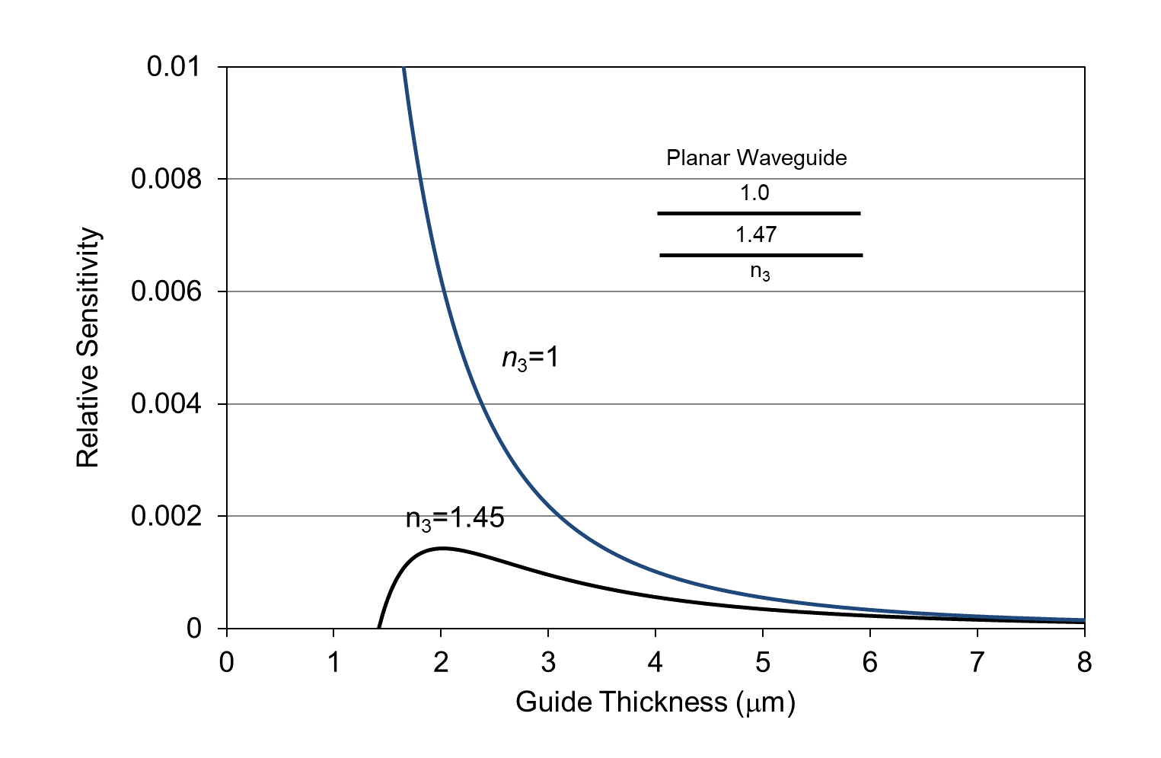
Relative Sensitivity of D-fibre and Unclad Fibre (Estimate from Planar Waveguide Model)
Bare fibre
D-fibre

Slide 25
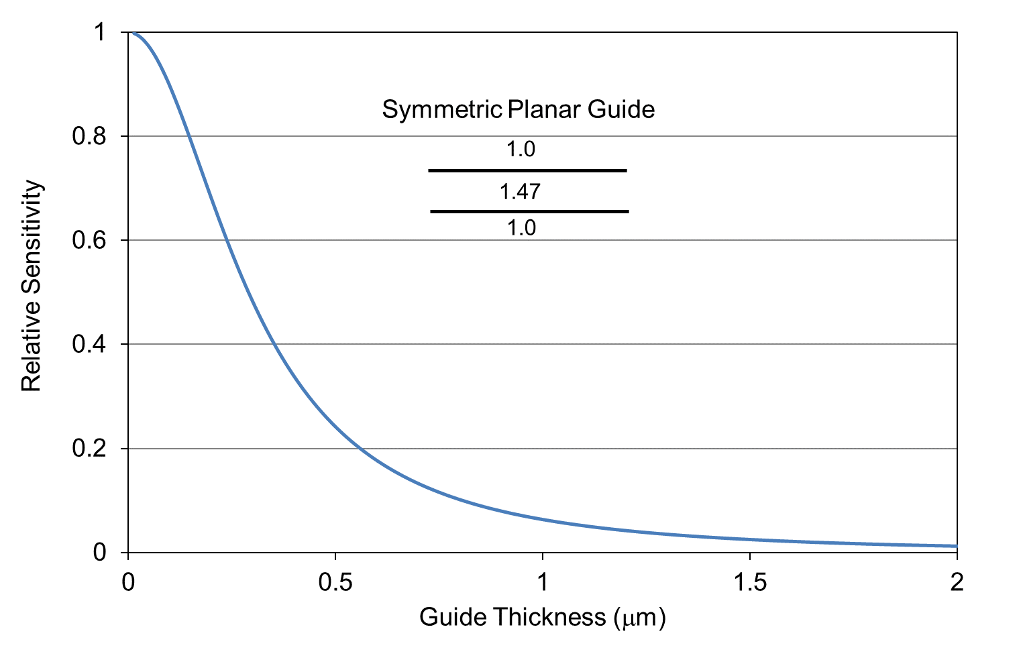
Relative Sensitivity of Thin Unclad/Tapered Fibre (Estimate from Symmetric Planar Waveguide Model)

Slide 26
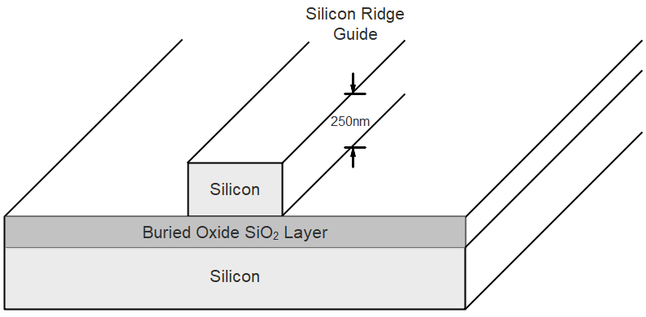
Silicon Ridge Waveguide for Evanescent Field Interaction with a Gas Absorber

Slide 27
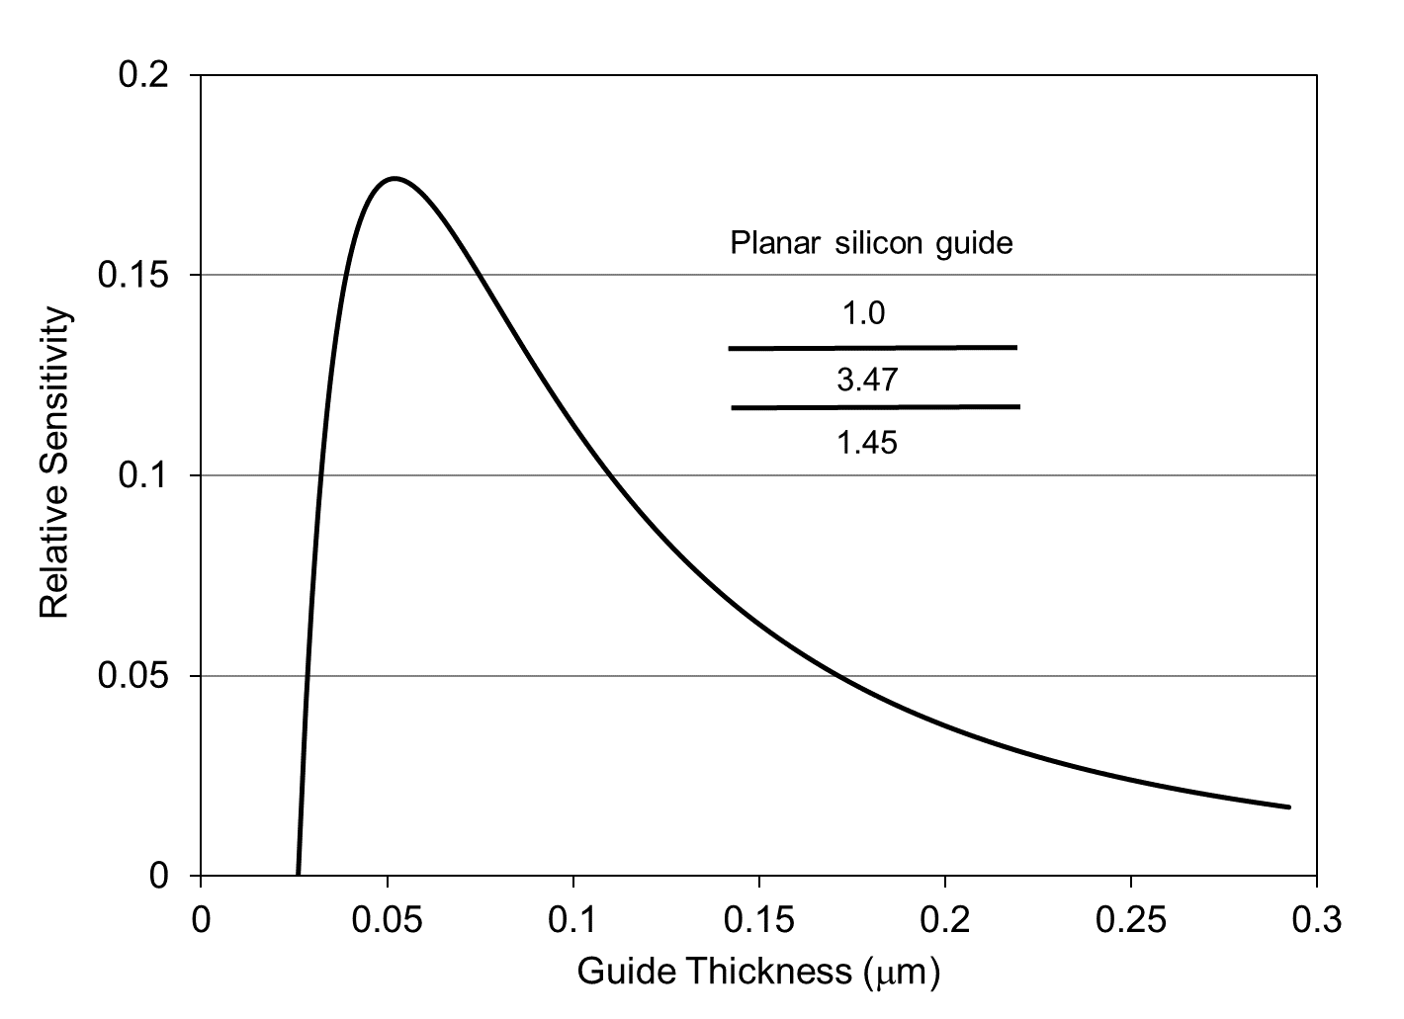
Relative Sensitivity of Silicon Ridge Waveguide (Estimate from Planar Waveguide Model)

Slide 28
Applications of Near-IR DFB Laser Systems
Commercial near-IR systems are available for gases such as CH₄, C₂H₂ and H₂O where the near-IR lines are relatively strong. Application areas include:
Environmental monitoring
Atmospheric sensing and monitoring
Detection and imaging of gas leaks
Combustion analysis
Emissions monitoring
Tomographic imaging of emissions

Slide 29
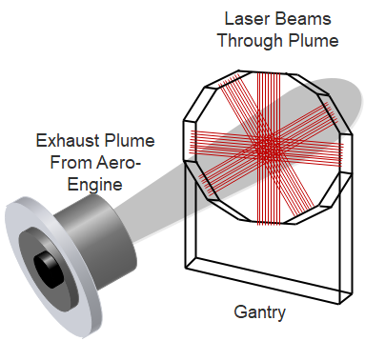
System for Creating Tomographic Images of CO₂ Emissions from Aero-Engines
The measured integrated absorption along each ~1metre path-length through the plume is processed to generate real-time 2-d tomographic images of the CO₂ concentration during engine operation.
The output of a single DFB laser at 1997.2nm (with WMS) is amplified by a thulium-doped fibre amplifier and coupled to 126 paths through the exhaust plume.

Slide 30
Summary & Conclusions
A number of methods can be used in the design of low-cost near-IR spectroscopy systems with DFB lasers to give a high degree of flexibility or enhanced sensitivity.
multi-pass cells
ring-down and cavity-enhanced spectroscopy
evanescent-wave cells in silicon photonics
open-path systems
multiplexing of micro-optic cells for wide-area fibre networks
Important application areas include the monitoring of emissions and combustion processes, atmospheric and greenhouse gas monitoring, safety and environmental monitoring.

