Slide 1
Colonialism and the Indian Economy
Chapter 1

Slide 2
Main questions addressed in this chapter
What was the structure of the Indian economy before Britain colonized India?
Why did Britain colonize India?
How did colonial policies transform the agricultural and industrial sector in India?
How were the anti-colonial movements in India shaped by British occupation and global events?
What was the state of the Indian economy on the eve of independence?

Slide 3
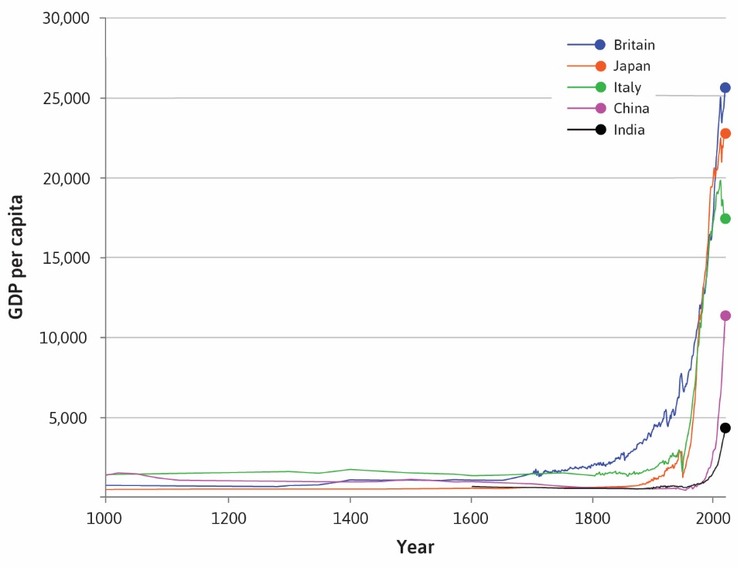
THE GREAT DIVERGENCE

Slide 4
The Great Divergence
Britain grew at a faster rate than any other country in the globe in the 17th century. This phenomenon is called the Great Divergence.
The expansion of GDP in Britain was fueled by the industrial revolution – cheap production of textile through steam-powered technology.
Britain captured the global market for textiles over a century through its colonial policies.

Slide 5
Indian Economy before British colonial rule
Asia was the most prosperous nation with well-established trade links between the Middle East, China, and India.
Indian ports from Lahore to Bengal were embedded within trade networks and generated substantial money and employment.
The subcontinent dominated the production of textile and garments in the global economy. They also exported cotton, pepper, grains, pulses, and vegetable oil.

Slide 6
Indian Economy before British colonial rule
Indian mainland was very diverse as it was broken into multiple princely states; some were well administered like Travancore and Mysore but most were not oriented towards production and trade.
Most regions produced self-subsistent agriculture and traded through local markets.
There were no national markets or centralized economic policies.

Slide 7
Why India was important to Britain?
The East India Company landed in the subcontinent in the 17th century.
By the 19th century they gained monopoly on trade within India and did not allow other countries access to Indian production.
They converted India into a trading post for other Asian economies.
They created a triangular trade relationship with China, where Indian goods exported to China and Chinese goods were imported to Britain through India.
Britain made India into a market for British-produced commodities.

Slide 8
How EIC created the Indian economy?
The Indian economy did not exist before the 19th century – no national market, no centralized laws around money, trade, contracts.
After 1857 Uprising, British administration took over India and created a homogenous administrative structure for the whole country – power vested in governor general, states, and district had a mix of colonial administrators and Indian bureaucrats.
British administration created institutions such as common laws implemented through courts, police, army, bureaucrats, and infrastructure such as railways, education, health, roads, ports, monetary system to administer the country.

Slide 9
How colonial policy shaped the agriculture sector?
Indian agriculture was locally self-subsistent, production was based around the village economy, markets served the needs of a region. Social relations between landowners and tenants shaped the arrangement of sharing of produce.
British encouraged commercial farming and connected prosperous agricultural regions to the global market for commodities.
Indian traders, merchants, moneylenders made great profits by selling cash crops such as opium, cotton, jute, tea, and wheat to traders in Indian ports.

Slide 10
They would provide loans to Indian peasants to grow cash crops and purchase the produce at a lower price. Peasants did not have direct access to global markets.
This changed the nature of agriculture as production was not done for local needs/demands.
Peasants would be caught in debt traps if they had one or two bad agricultural seasons.

Slide 11
How colonial policies shaped Indian industries?
India had a substantial handicraft industry which dominated global trade.
British created a discriminatory tariff structure which made it difficult to import goods from other countries.
Cheap British-manufactured goods, especially textiles flooded the Indian market and outcompeted Indian goods.
Infant factory production emerged in west India in the late 19th century. Indian merchant classes built textile mills in Ahmedabad and Mumbai.

Slide 12
Roots to colonial resistance
Two British policies provided the basis of critique of colonial policies by Indians.
The first was the discriminatory tariff policies which favored British goods over Indian goods.
The second was the substantial home charges that were transferred from Indian tax revenue to Britain. The home charges included payment for British capital used to fund infrastructure in India, charges for services of British troops in India and payment of wages and salaries for British administrative staff.
This was framed as the drain theory by Indian nationalist like Dadabhai Naroji and Rajaramohan Roy.

Slide 13
World War 1 and its impact on the economy
Britain faced a huge physical and financial cost in WW1 and had to borrow from USA to fund the war. They lost their position as political and financial leaders of the world after the war.
Global trade stagnated during and after the WW1.
This benefitted Indian infant industries such as steel, railway equipment which got contracts from colonial governments in India.

Slide 14
The Great Depression and its impact on the freedom movement
The Great Depression of 1929 in USA affected all the western colonial economies and led to a stagnation of global trade.
Britain leveraged the Indian economy to assist in its economy – by charging higher tax revenue and not making any policies to insulate the Indian economy from the effects of depression.
The fall in global agricultural prices affected Indian peasants and farmers who were caught in debt cycles as they did not earn enough to sustain production without taking more debt.
Indian textile industries also got adversely impacted as there were no supportive colonial policies.

Slide 15
Gandhi launched the Satyagraha movement and demanded removal of discriminatory colonial economic policies.
Through these demands he mobilized antagonistic classes in India onto a common plank of economic independence.
While the Satyagraha movement was a failure, the popularity of the movement allowed Congress to gain majority in the 1935 elections, allowing it to influence colonial policies.

Slide 16
WW2 and its impact on the independence movement
India had to bear a huge cost in terms of money, troops, and commodities to support Britain in WW2. This was used as leverage to gain independence from Britain.
India faced several famines in this time which forced a re-thinking in agricultural policy which would impact future policies.
The Bombay Plan was released by Indian industrialists supporting the Congress government and requesting the creation of a mixed economy. This would shape industrial policy in the future.

Slide 17
India on the eve of independence
Political uncertainty and Partition
Majority population in underdeveloped agricultural sector
High poverty and economic inequality with no policies for re-distribution
Infant manufacturing sector which did not contribute much to output or employment
Financial and economic dependence on British goods and capital
Regional inequality: Some prosperous regions but most of India severely underdeveloped

