Slide 1
Chapter 6
Reformulation-Linearization Technique and Applications

Slide 2
Outline
An introduction to the Reformulation-Linearization Technique (RLT)
Case study
  Capacity maximization for multi-hop cognitive radio networks under the physical model

Slide 3
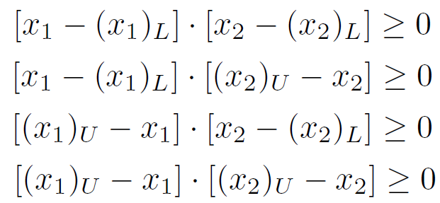
Basic Idea
RLT
  A systematic approach for deriving tight linear relaxations for any monomial
A simple example – RLT for nonlinear term x₁x₂
  Define a new variable X_{{1,2}} to represent x₁x₂
  Add linear constraints based on bounds for x₁ and x₂
    Suppose (x₁)_{L}≤x₁≤(x₁)_{U}, (x₂)_{L}≤x₂≤(x₂)_{U}. We have

Slide 4
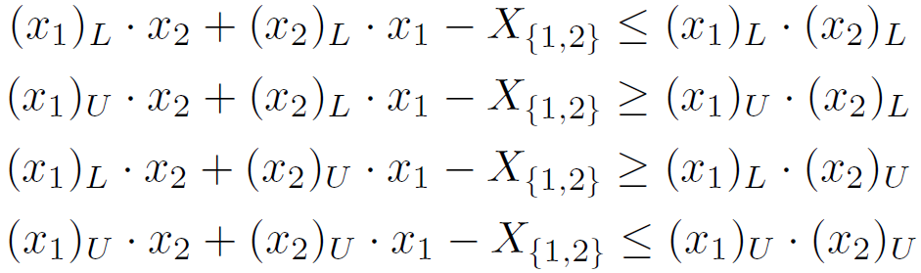
Basic Idea (cont’d)
  Substituting X_{{1,2}} for x₁x₂, we have

Slide 5

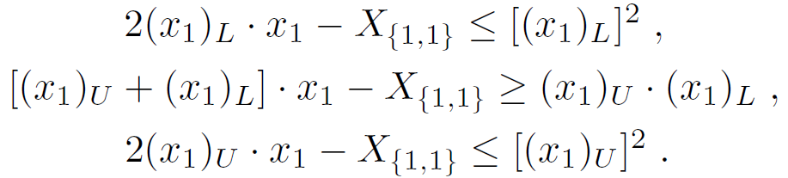
Basic Idea (cont’d)
Another example – RLT for nonlinear term
  Define a new variable X_{{1,1}} to represent
  Suppose (x₁)_{L}≤x₁≤(x₁)_{U}. We have

Slide 6

Sequential Quadrification Process for RLT
Many processes to define new RLT variables for a general monomial
A simple approach – Sequential quadrification process
  New variable to represent quadratic terms
  New variable to represent a produce of two variables
  Add RLT constraints for each new variable

Slide 7

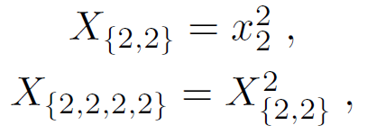
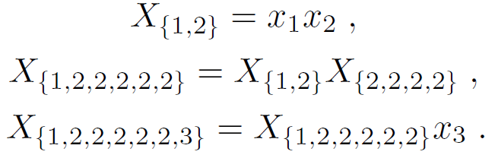
Sequential Quadrification Process
An Example
Given a monomial
New variable to represent quadratic terms
New variable to represent a produce of two variables

Slide 8
Outline
Review of reformulation-linearization technique (RLT)
Case study
  Capacity maximization for multi-hop cognitive radio networks under the physical model

Slide 9
Problem Statement
Problem setting
  A multi-hop CR network
  Available frequency bands at each node may be different
  A set of communication sessions with minimum rate requirements
Objective: Maximize capacity for a multi-hop CR network
  Consider SINR interference model
  Optimize power control, scheduling, and routing
9

Slide 10
Outline of Case Study
Mathematical Modeling and Problem Reformulation
A Solution Procedure
Numerical Results

Slide 11

Power Control
Power control can be done on Q levels
  The transmission power can be
Denote the power level at link (i, j) on band m

Slide 12

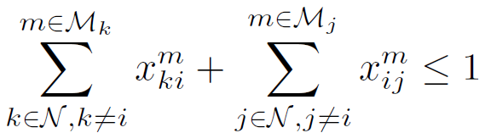
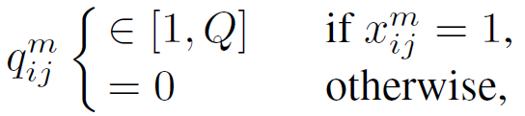
Scheduling
Scheduling is performed on bands
Denote
On the same band, a node can transmit to or receive from only one node
The cross-layer relationship between the scheduling variable x and the power control variable q is

Slide 13
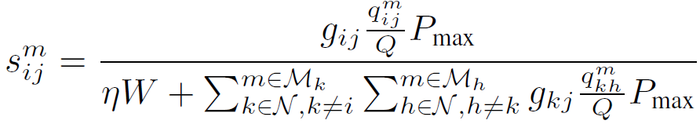


SINR Interference Model
A transmission is successful if and only if SINR exceeds a certain threshold
The relationship between s and x is

Slide 14
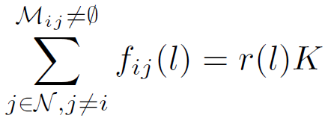
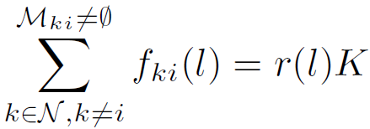
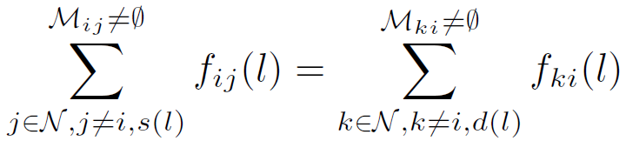
Routing
For maximum flexibility (and optimality), we allow flow splitting (multi-path routing)
Flow balance constraints for a session l
  If node i is the source node, then
  If node i is the destination node, then
  For all other cases, we have

Slide 15
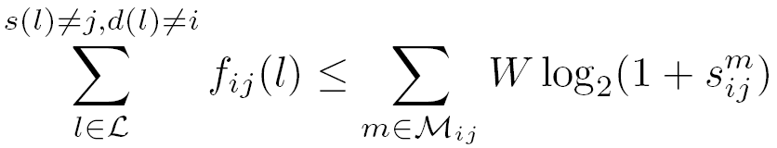
Link Capacity Constraint
The cross-layer relationship between routing variable f and lower layer variable s
  Aggregate flow on link (i, j) cannot exceed link capacity

Slide 16



Problem Formulation
Maximize K
Subject to
Not suitable for
mathematical
programming
Fraction is not
easy to handle
Redundancy?
Notes:
We have a formulation by considering all previous constraints.
But such a raw formulation is not the best formulation we can have.

Slide 17


Reformulation
It is easy to verify that
=>
=>
Notes:
These two new constraints are suitable for mathematical programming

Slide 18
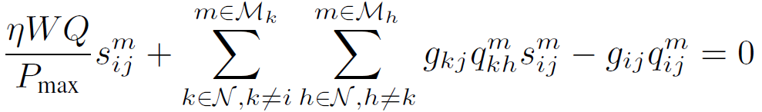
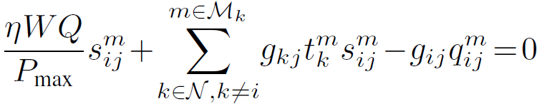
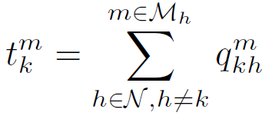
Reformulation (cont’d)
→
→
where
Notes:
The benefit of introducing t_k^m is that the double sum can be reduced as a single sum.

Slide 19
Reformulation (cont’d)
Three routing constraints:
Redundant
Notes:
We should remove any redundant constraint

Slide 20
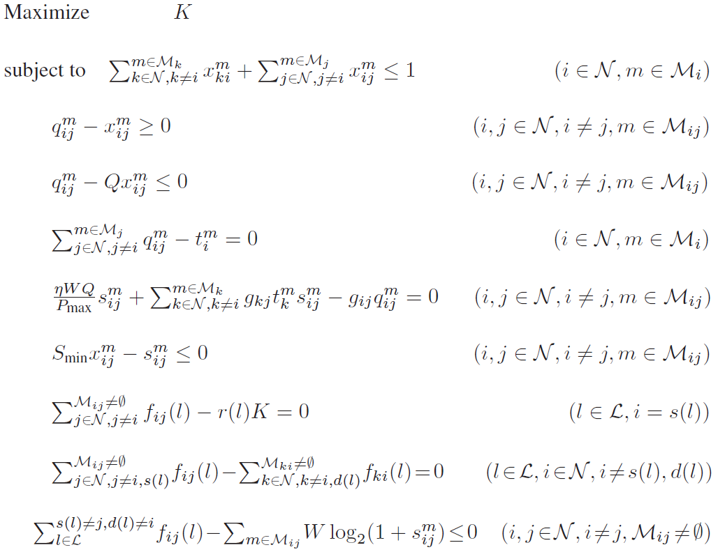
Reformulated Problem – MINLP
Integer
variables
Nonlinear
constraints
Notes:
This problem is in the form of mixed-integer nonlinear program

Slide 21
Outline of Case Study
Mathematical Modeling and Problem Reformulation
A Solution Procedure
Numerical Results

Slide 22
Branch-and-bound Framework
A form of the divide-and-conquer technique
  Divide the original problem into sub-problems
  Find upper and lower bounds for each sub-problem
    Upper bound obtained via Reformulation-Linearization Technique (RLT)
    Lower bound obtained via a local search algorithm
  We then have the upper and lower bounds for the original problem
    Once these two bounds are close to each other, we are done
    Otherwise, we further divide and obtain more sub-problems
The obtained solution is near-optimal
Notes:
We have applied branch-and-bound in the last chapter. In this chapter, we will focus on its new components, e.g., RLT.

Slide 23


Core Variables and
Core Optimization Space
The MINLP has many variables:
  These variables yield a very large optimization space
Core variables:
  Other variables can be derived by these core variables
  Yield a much smaller core optimization space

Slide 24

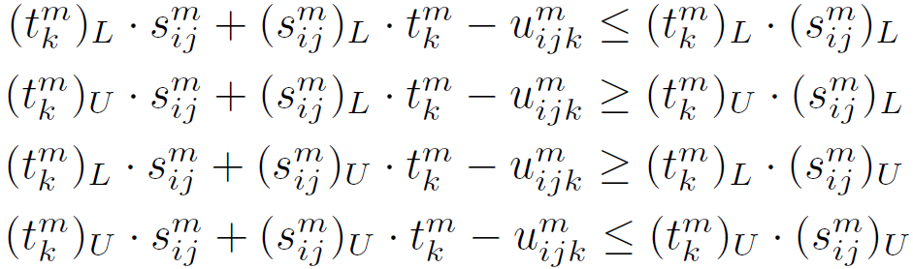
Determining Upper Bounds
---RLT
For the monomial , we have
where

Slide 25
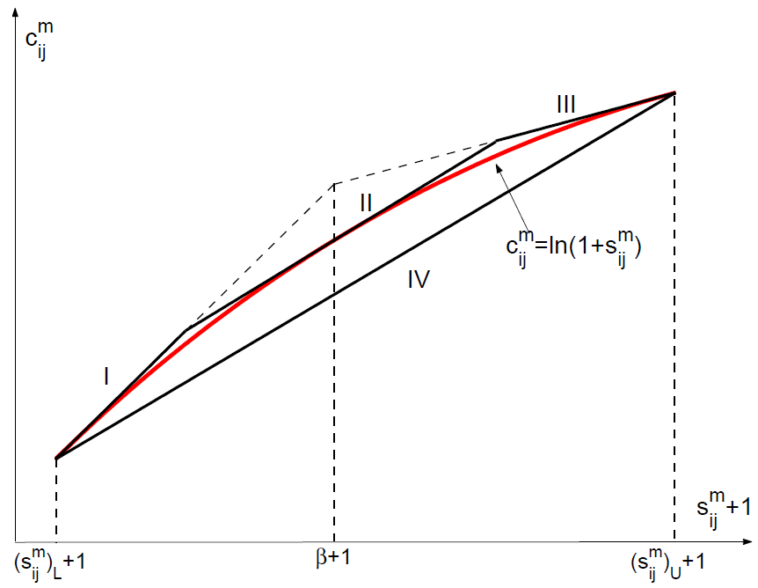
Determining Upper Bounds
---Linear Relaxation for log Terms
Notes:
Instead of considering the exact nonlinear curve, we consider a convex hull that can be described by a set of linear constraints.

Slide 26
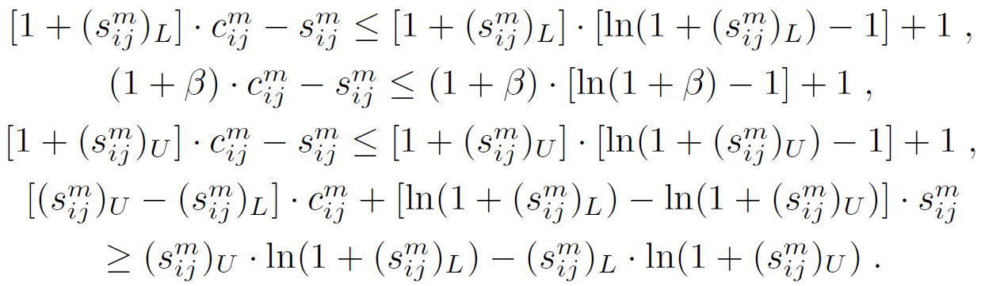
Determining Upper Bounds
---Linear Relaxation for log Terms (cont’d)
We have
where

Slide 27
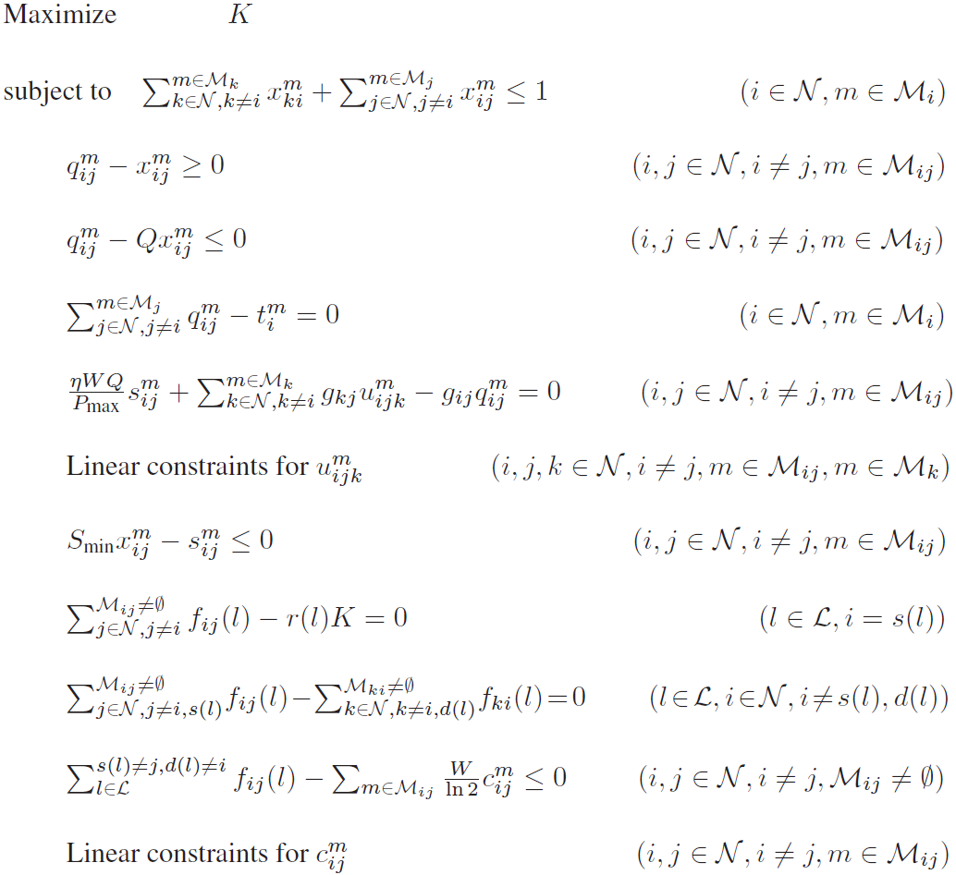
Determining Upper Bounds
---Relaxed Problem Formulation (LP)

Slide 28
Determining Lower Bounds
---Search for A Feasible Solution
In the solution to the upper bound, both the x and q variables may not be integers
  Infeasible to the original problem
A local search algorithm to find a feasible solution
  First determine the x and q values based on the solution to the upper bound
  Then compute the best routing via an LP
This feasible solution provides a lower bound

Slide 29
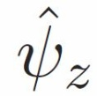
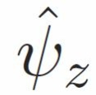

Determining Lower Bounds
--- Local Search Algorithm: Details
Denote the relaxation solution as
  may not be feasible to the original problem
Construct a feasible solution based on
  should satisfy all constraints in the original problem
  We only need to determine core variables’ value and verify their constraints

Slide 30



Determining Lower Bounds
--- Initial Feasible Solution
Set and
We can verify that all constraints on x and q hold
  Otherwise the problem z does not have a feasible solution – should be removed
Other variables can be derived to obtain a complete solution

Slide 31
Determining Lower Bounds
--- Improve The Current Feasible Solution
Identify the bottleneck link
Try to increase transmission power on this link
  We need to verify that constraints on x and q still hold
If a better solution is found, go to Step 1; otherwise, local search terminates

Slide 32
Selection of Partitioning Variables
What if the gap between the lower and upper bound is large?
  Generate two new sub-problems to narrow down the gap
Identification of a partition variable
  Based on its relaxation error
  Consider x variables first
  After all x variables are determined, consider q variables
Notes:
This process is the same as what we did in the last chapter

Slide 33
Outline of Case Study
Mathematical Modeling and Problem Reformulation
A Solution Procedure
Numerical Results

Slide 34
Simulation Setting
  20-, 30-, and 50-node CRNs in a 50 x 50 area
  5—10 communication sessions with minimum rate requirement in [1, 10]
  10—30 bands with the same bandwidth of 50
  A subset of these bands is available at each node
10 power levels
  Aim to find 90% optimal solution

Slide 35
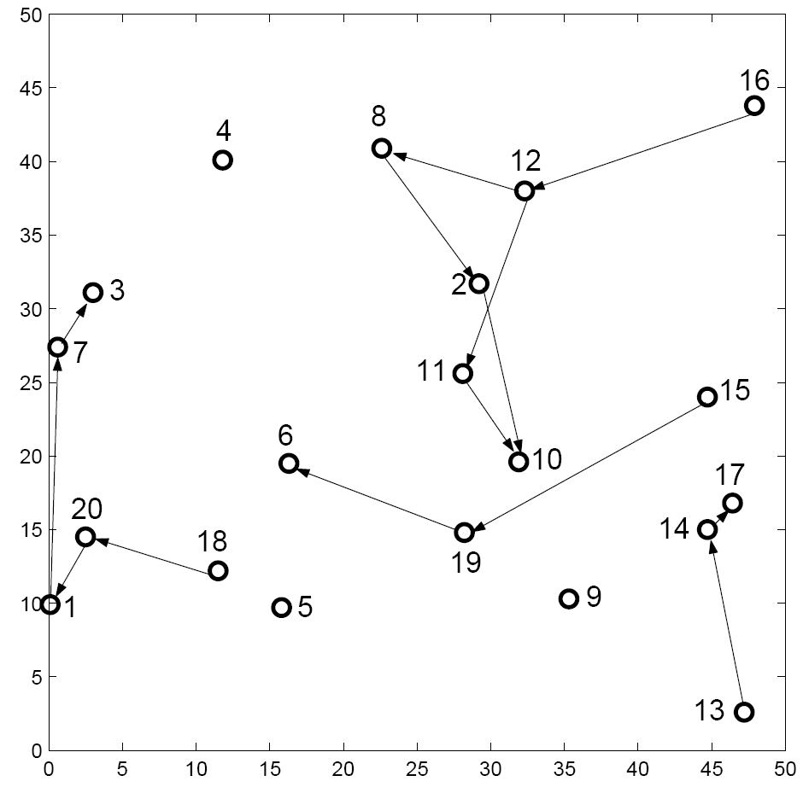
20-Node Network
Multi-Hop Multi-Path Routing
Multi-path routing is used to transmit from 16 to 10.
90% optimal K=13.24

Slide 36
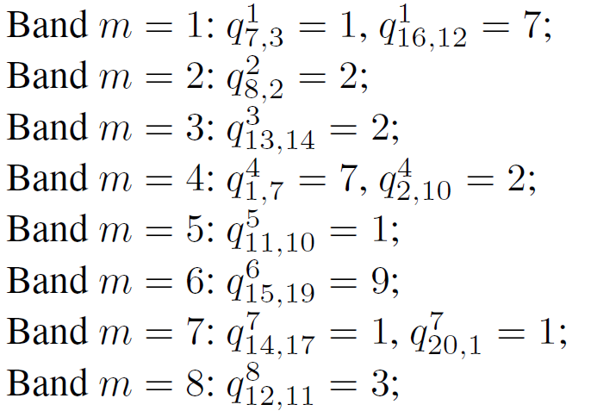
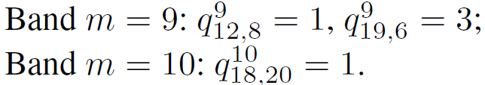
20-Node Network
Power Control
Power control is necessary due to multiple links active in the same band
Scheduling is determined by

Slide 37
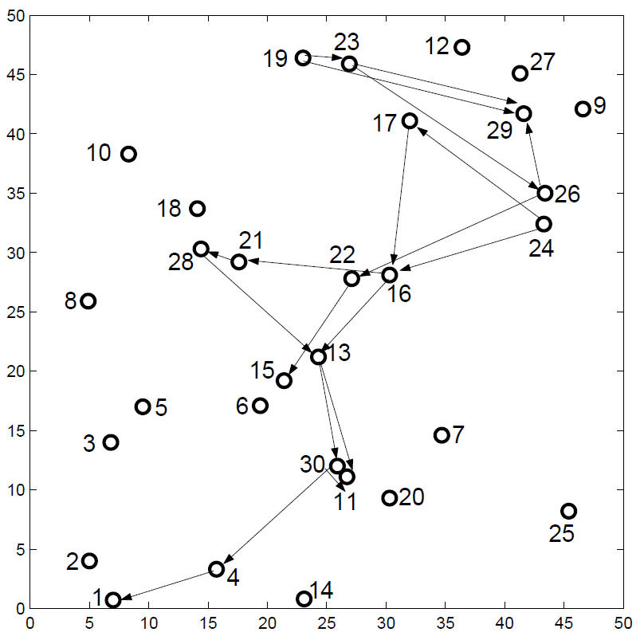
30-Node Network
Multi-Hop Multi-Path Routing
Multi-path routing is used to transmit from 24 to 11 and from 19 to 29.
90% optimal K=31.18

Slide 38
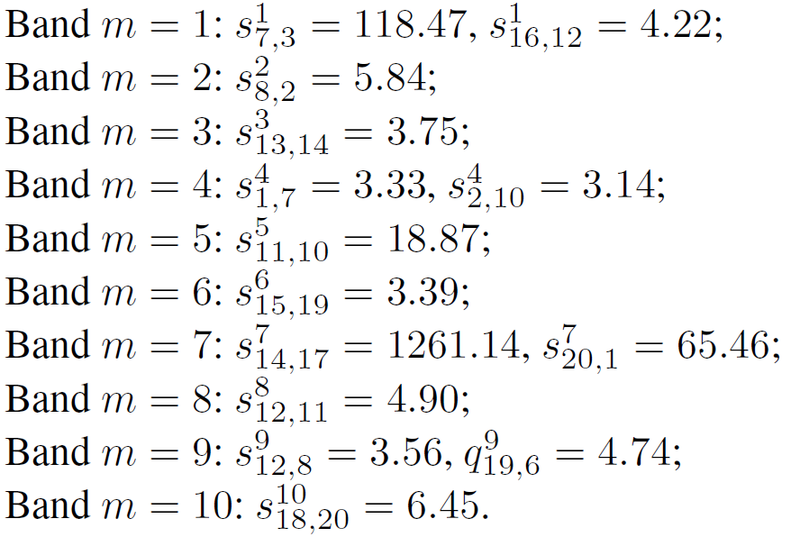
30-Node Network
Power Control
Notes:
Results for 50-node network are similar and omitted.

Slide 39
Summary
Review of reformulation-linearization technique
A case study
  Investigated the throughput maximization problem for multi-hop CR networks
  Formulated a cross-layer optimization problem
    Including physical, link, and network layers
    Employed generalized physical interference model
    The optimization problem is MINLP
  Developed a near-optimal solution based on branch-and-bound and RLT
39

