Slide 1
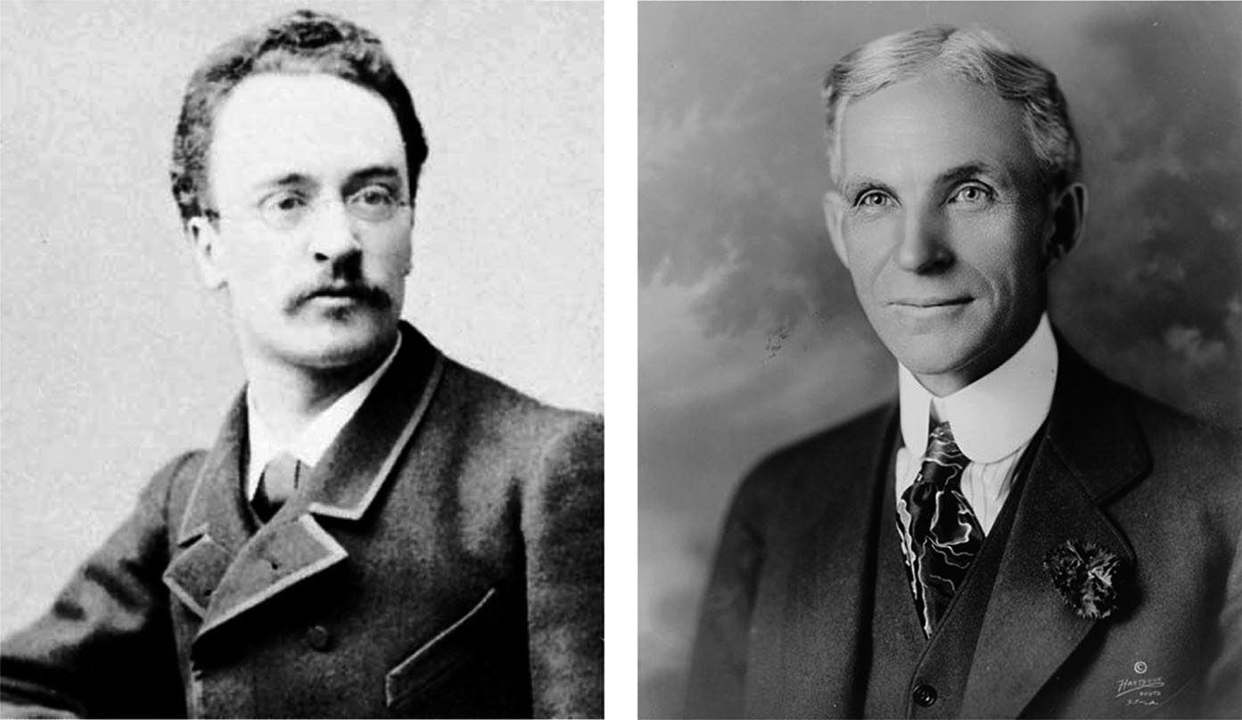
Fig25_01

Slide 2
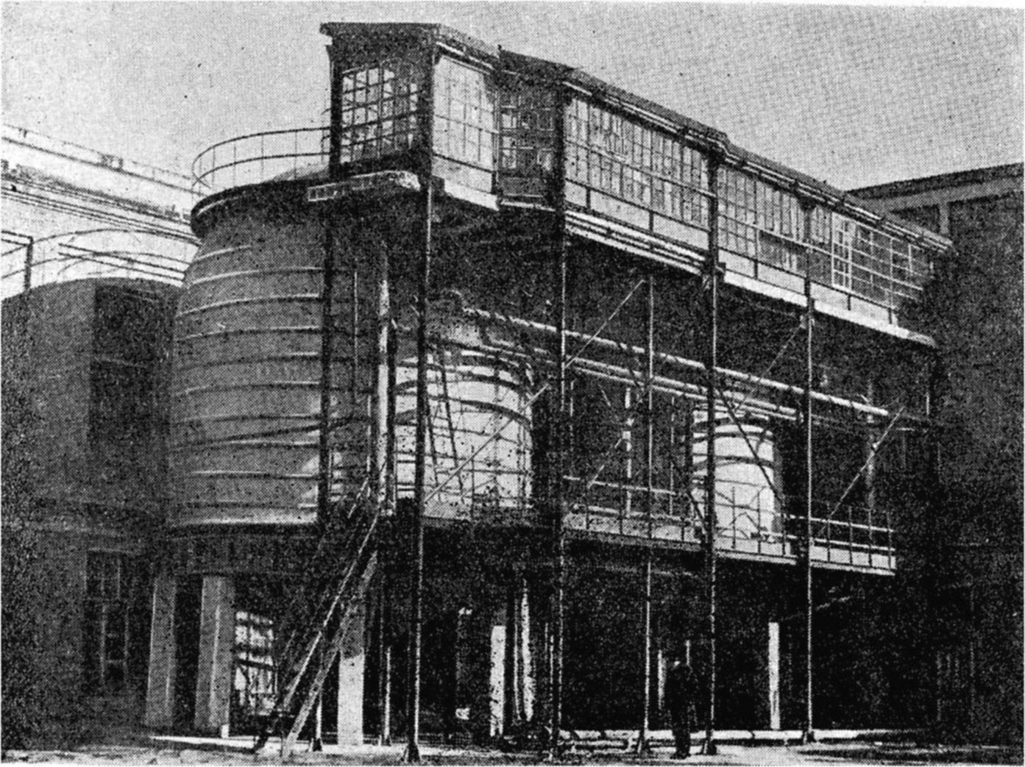
Fig25_02

Slide 3
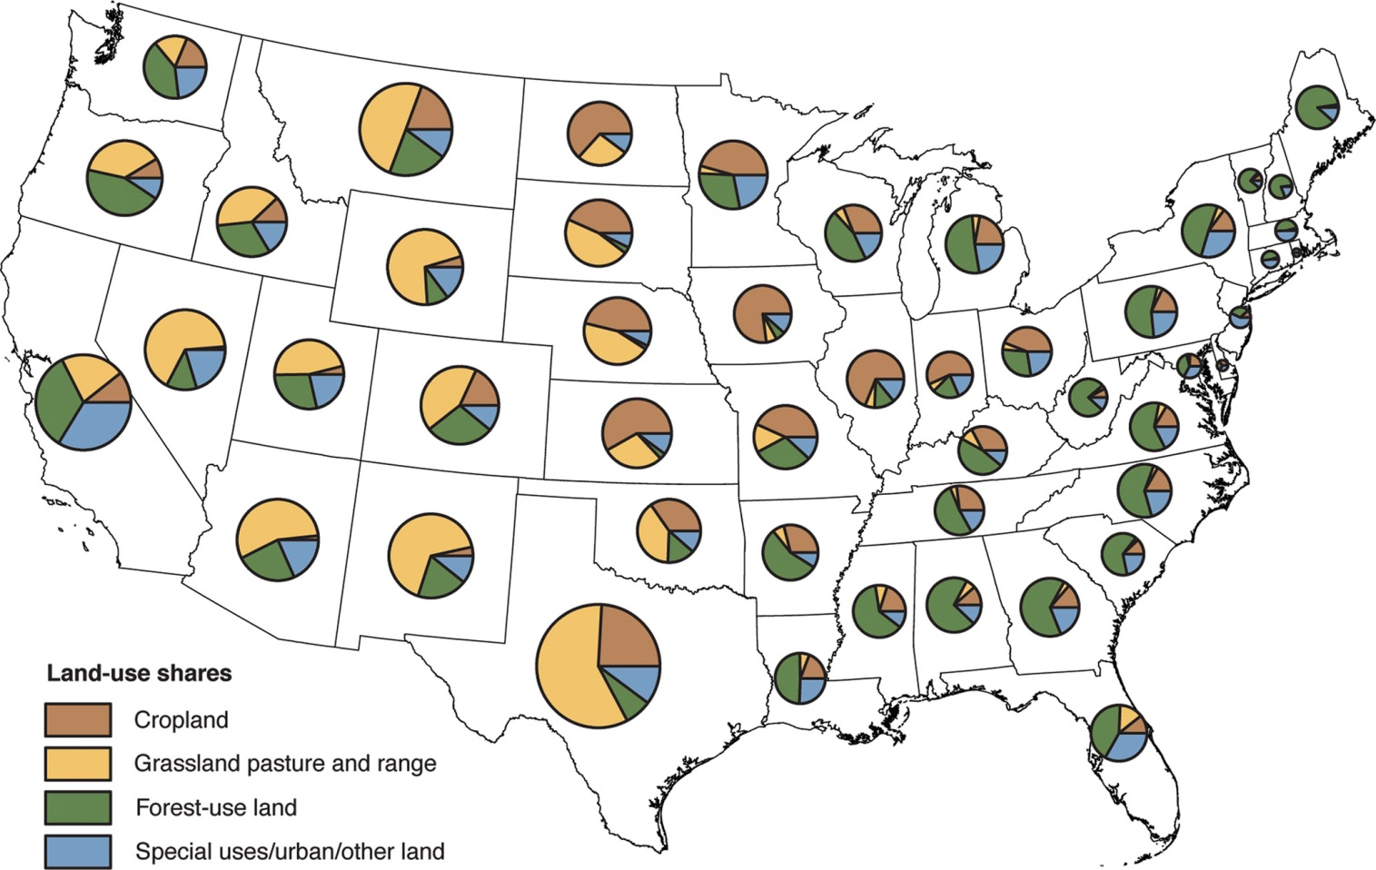
Fig25_03

Slide 4
Fig25_04

Slide 5
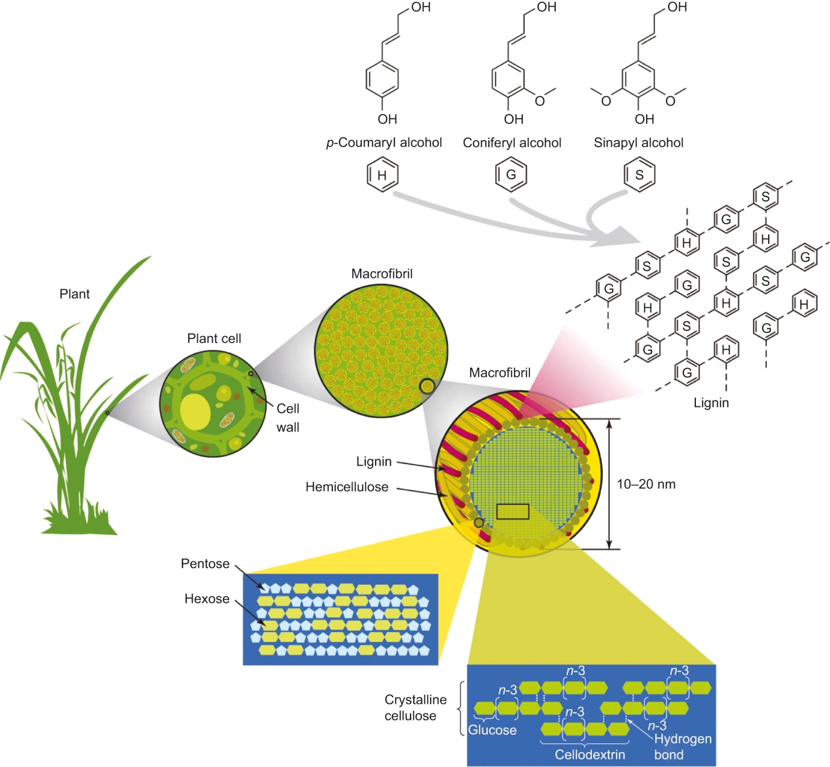
Fig25_05

Slide 6
Fig25_06

Slide 7
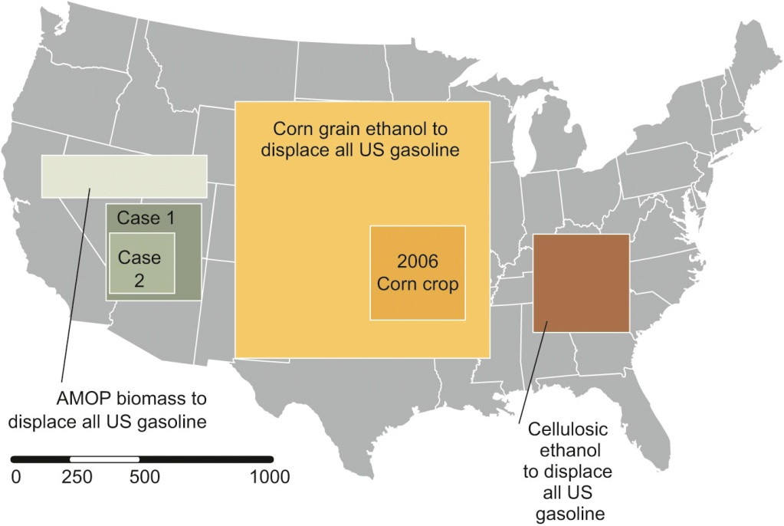
Fig25_07

Slide 8
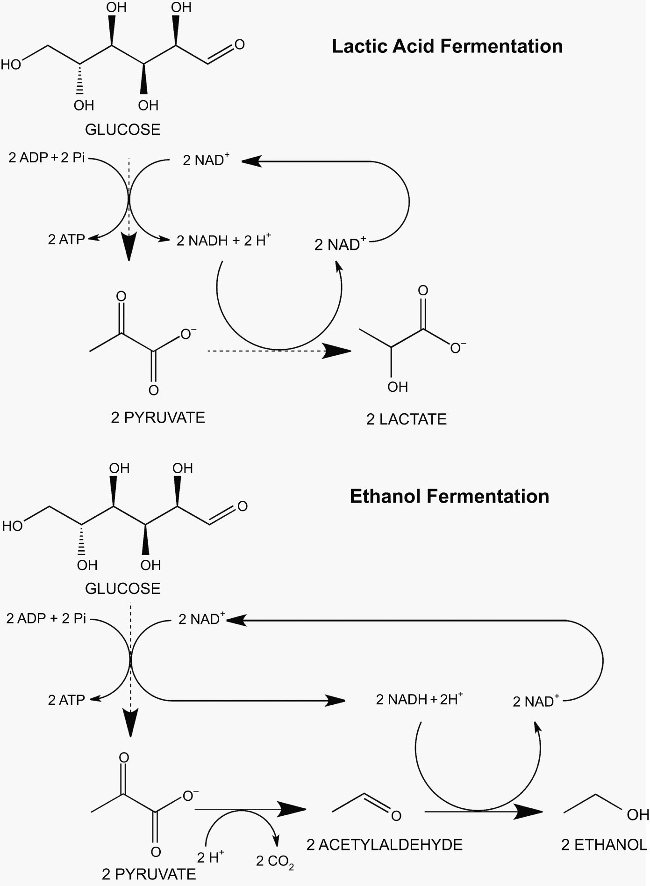
Fig25_08

Slide 9
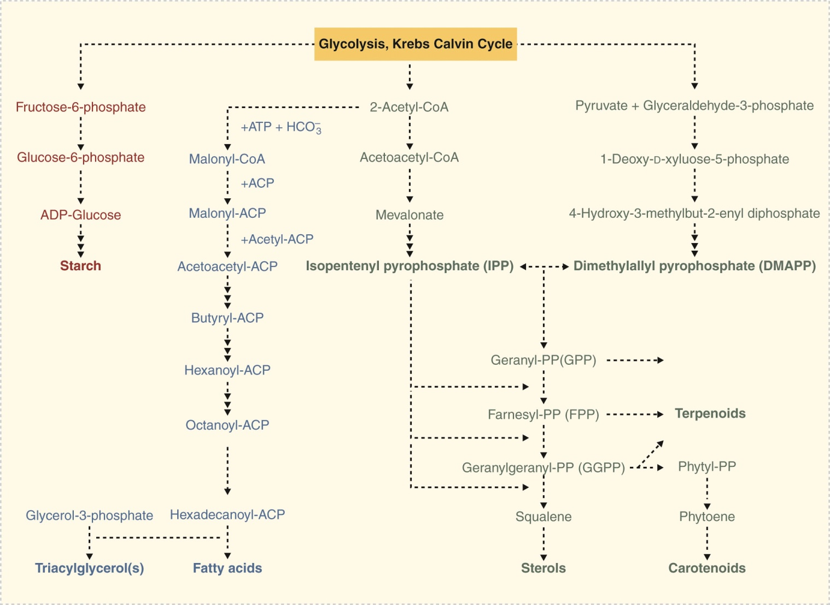
Fig25_09

Slide 10
Fig25_10

Slide 11
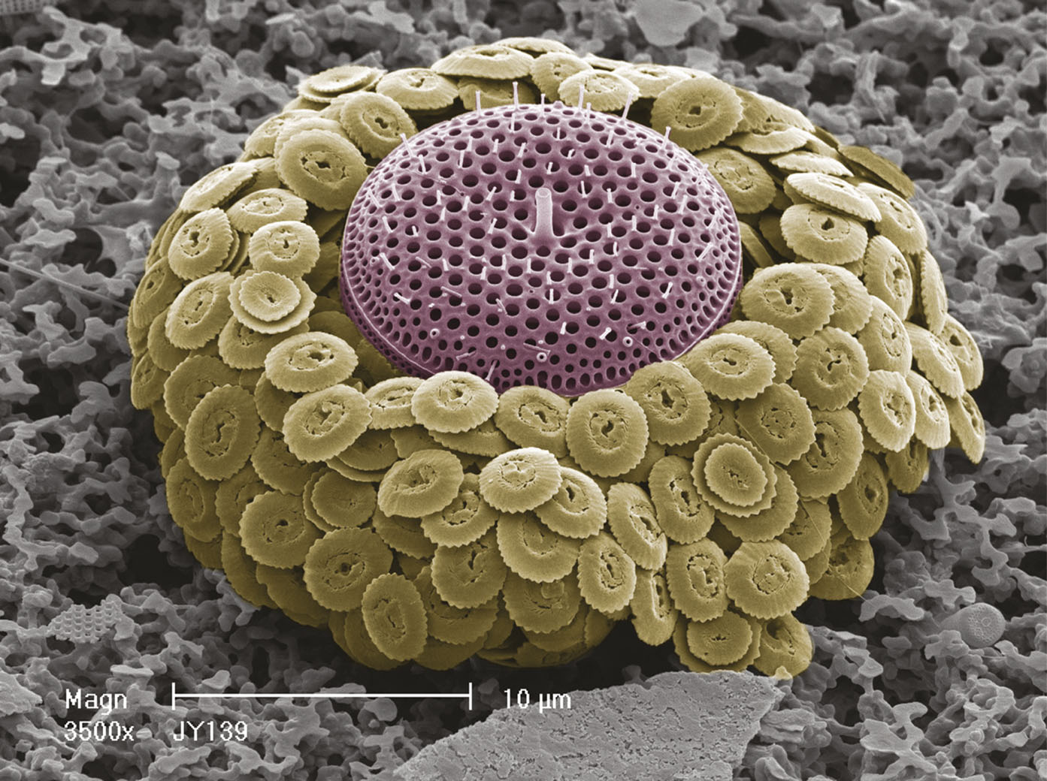
Fig25_11

Slide 12
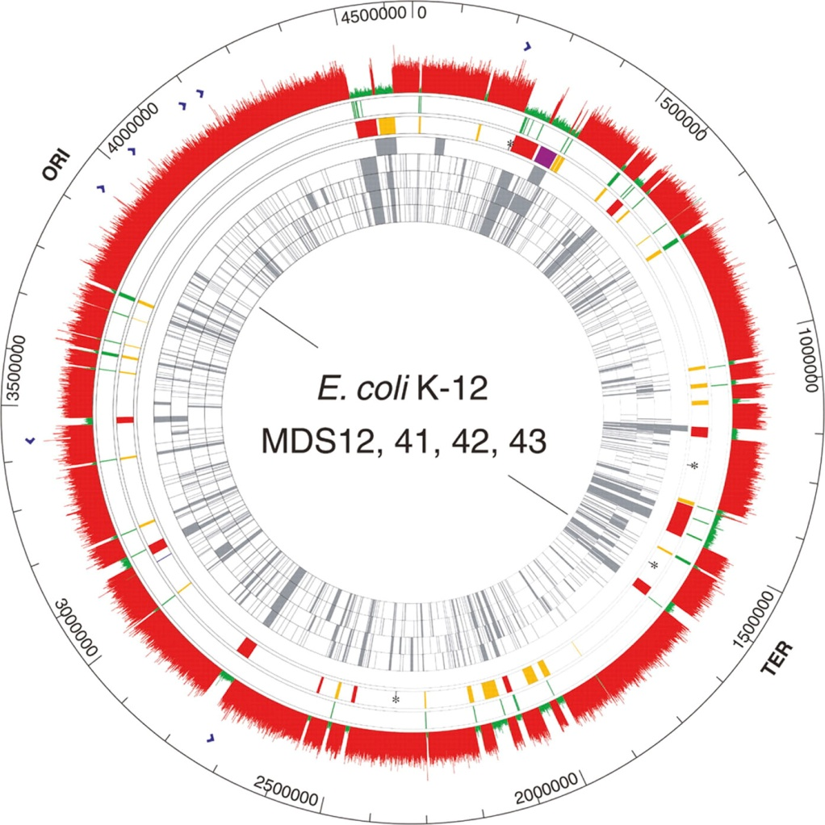
Fig25_12

Slide 13
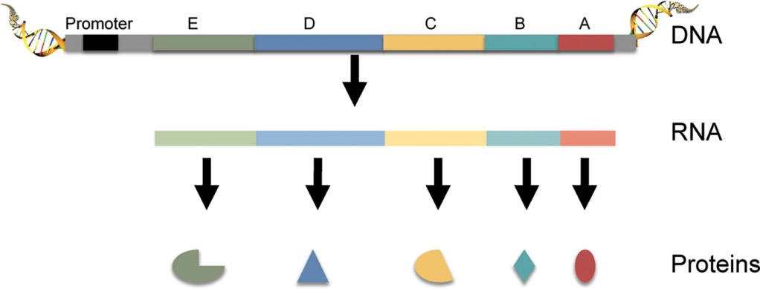
Fig25_13

Slide 14
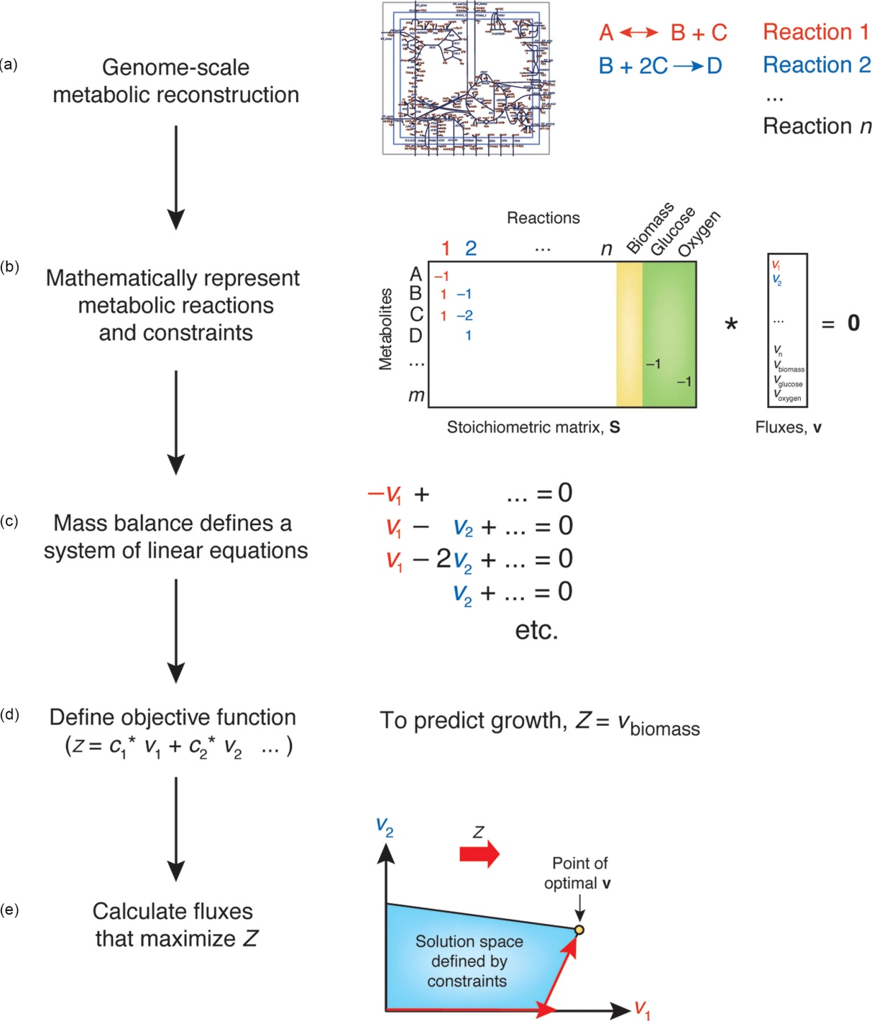
Fig25_14

Slide 15
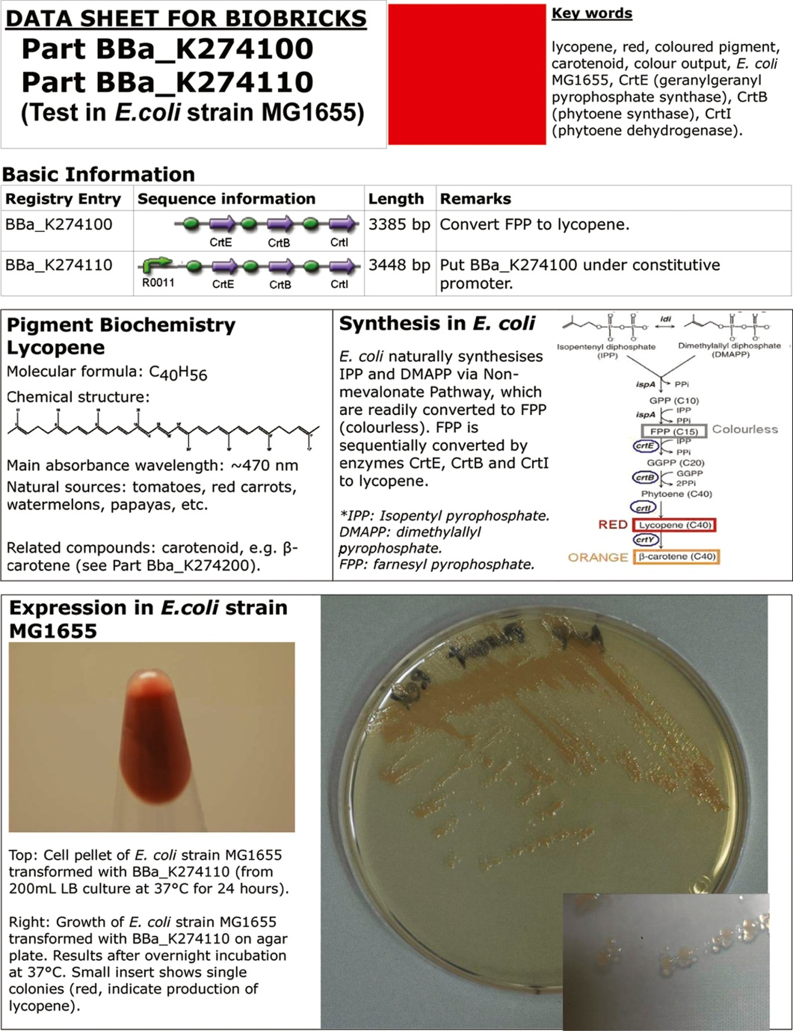
Fig25_15

Slide 16
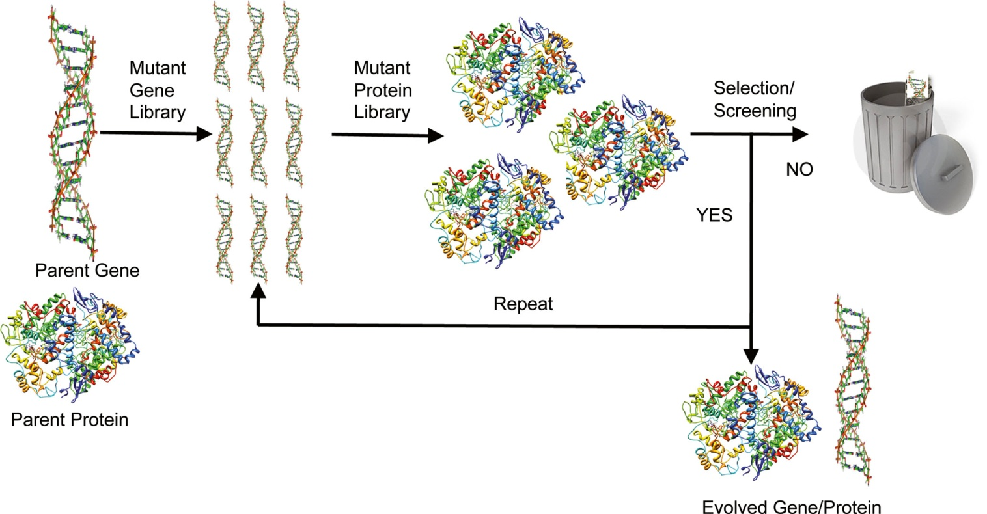
Fig25_16

Slide 17
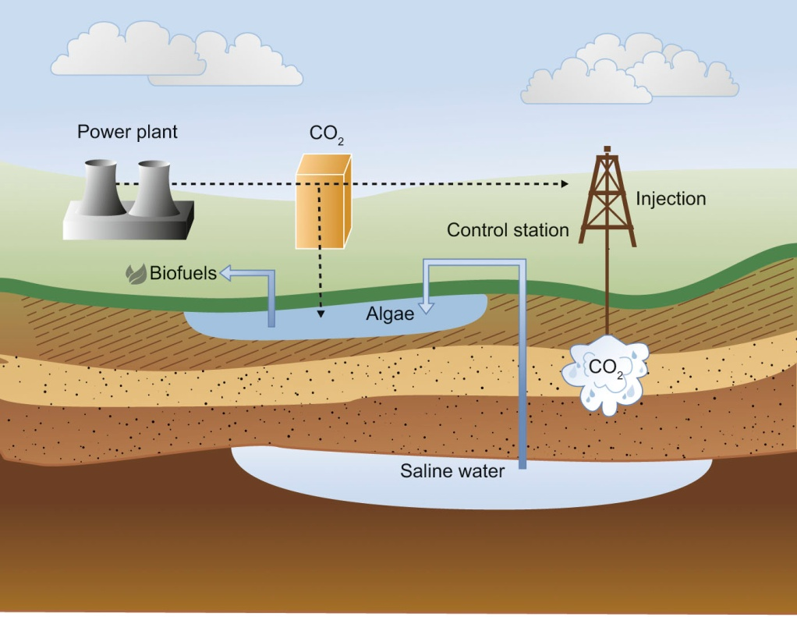
Fig25_17

