Slide 1
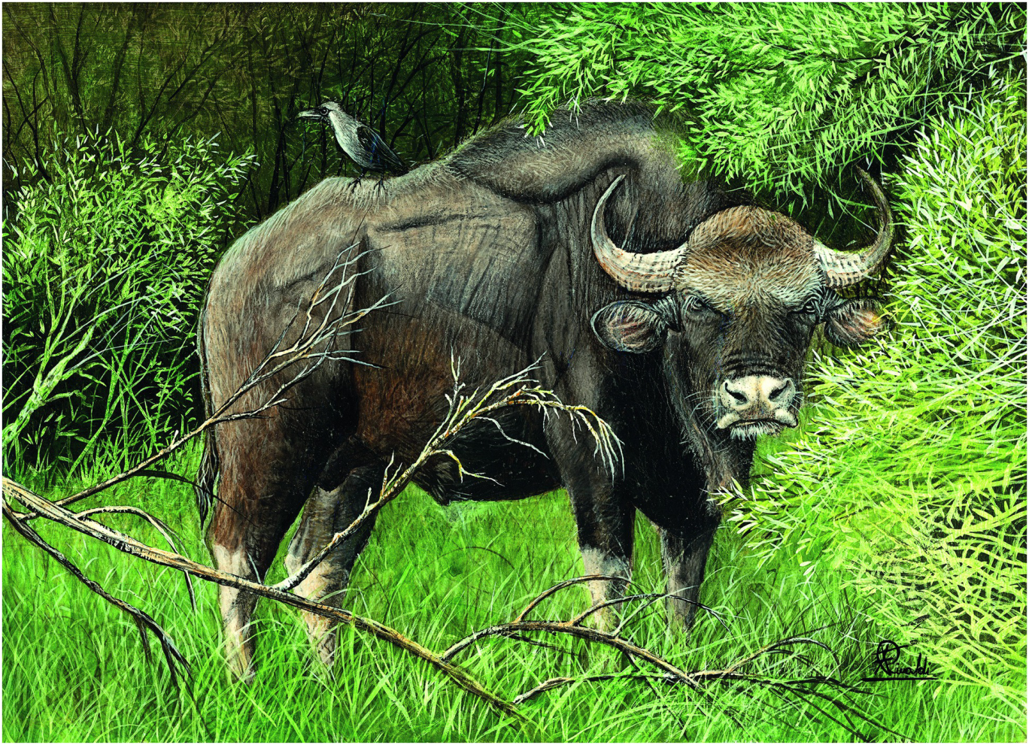
Plate 14
Gaur (illustration by Francesco Rinaldi)

Slide 2
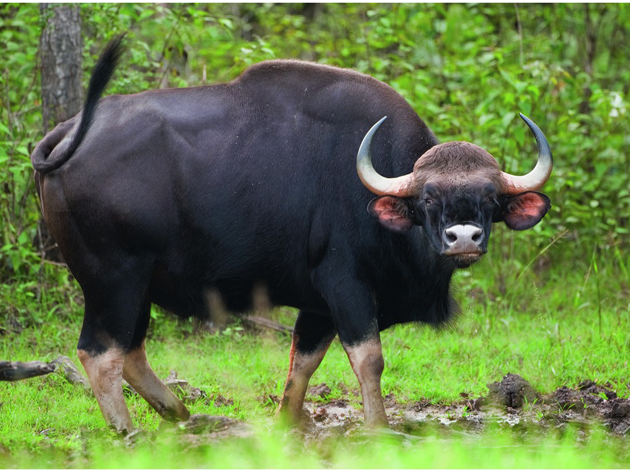
Figure 11.1
Adult male gaur.
Photo by Ramki Sreenivasan, Location: Nagarahole, India

Slide 3
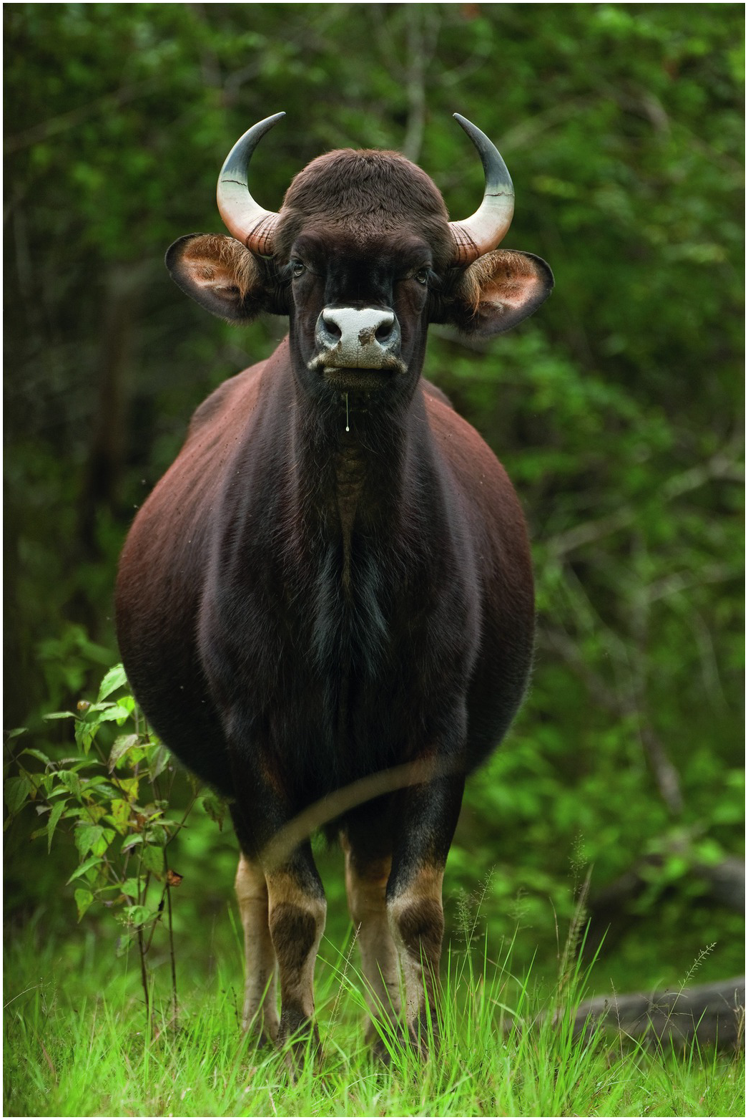
Figure 11.2
Adult female gaur.
Photo by Ramki Sreenivasan,
Location: Nagarahole, India

Slide 4
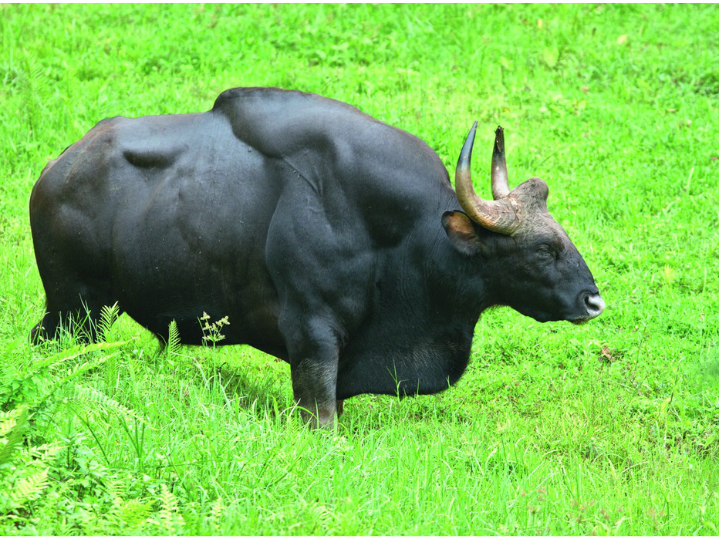
Figure 11.3
Adult male gaur with conspicuous dorsal ridge and dewlap - features that distinguish males from females.
Photo by Ramki Sreenivasan, Location: Valparai, India

Slide 5
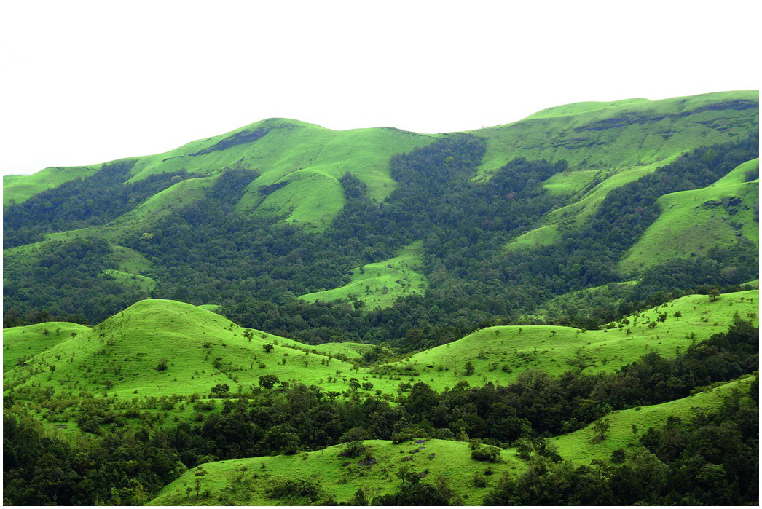
Figure 11.4
Montane evergreen grassland-shola habitat.
Photo by: Rohit Rao, Location: Kudremukh National Park, India

Slide 6
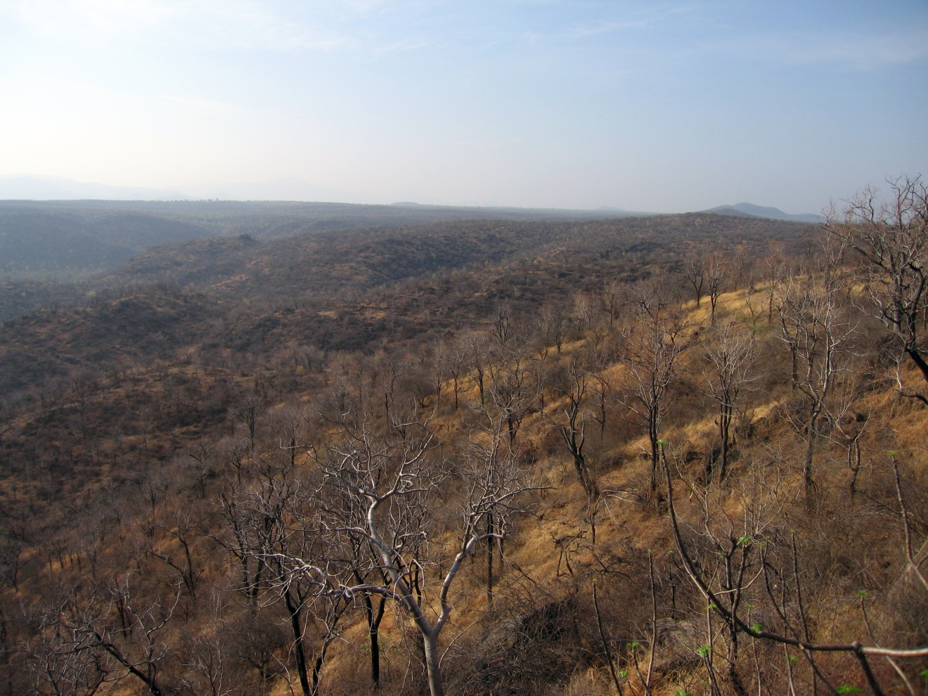
Figure 11.5
Dry deciduous forest. (Photo by Killivalavan R, Location: Cauvery Wildlife Sanctuary, India).

Slide 7
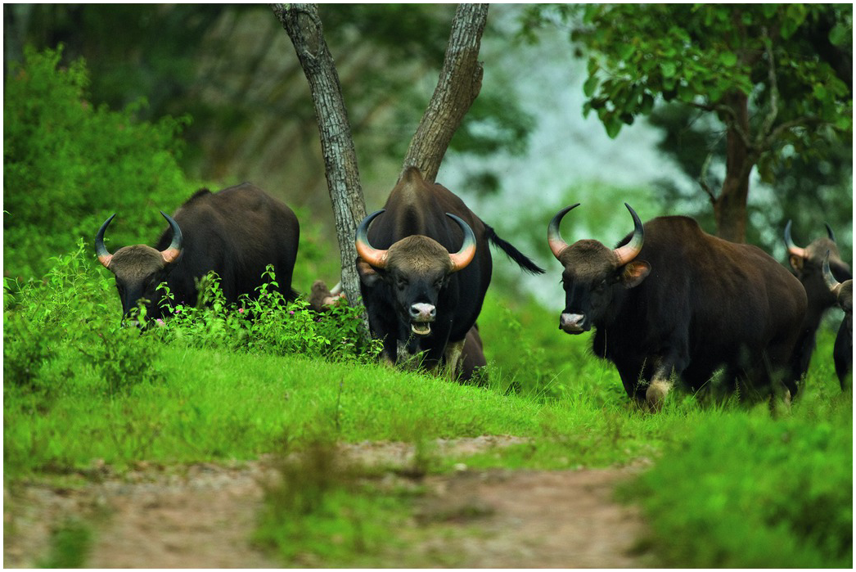
Figure 11.9
Adult females in a gaur herd
Photo by Ramki Sreenivasan, Location: Bandipur, India

Slide 8
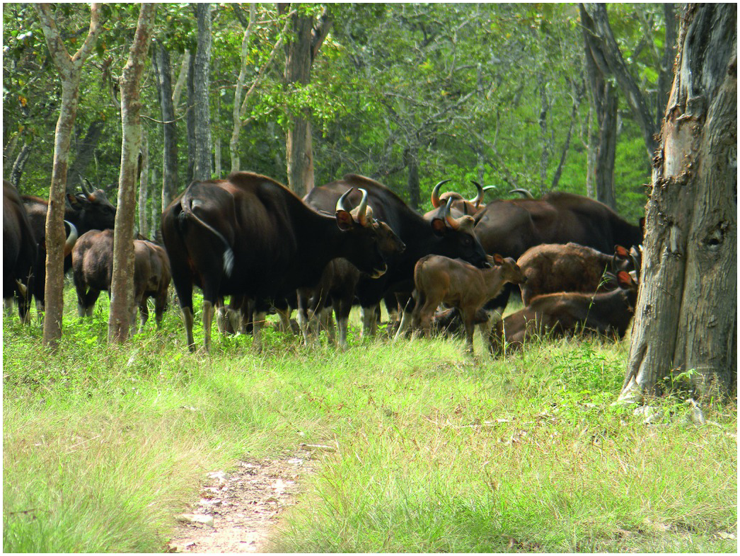
Figure 11.10
Gaur herd with adult females and calves.
Photo by Naveen M N, Location: Bandipur, India

