Slide 1
Chapter 2
Linear Programming and Its Applications

Slide 2
Outline
Key results in linear programming
A case study
  Lexicographic max-min rate allocation and node lifetime problems

Slide 3
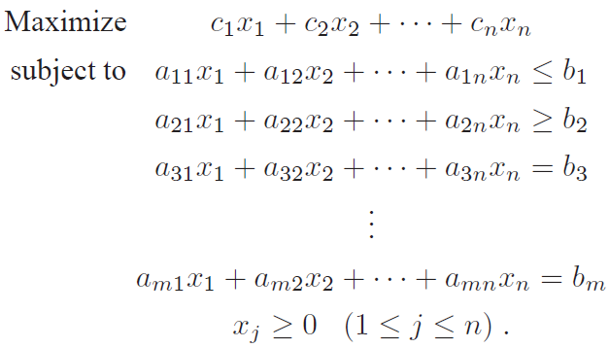
Linear Programming
Linear programming (LP)
  Maximizing or minimizing a linear objective function
  Subject to a set of linear constraints on real variables
A general form

Slide 4

Key Results in LP
An LP can be solved optimally in a complexity of
  is the number of variables
Solvable by open-source solvers and commercial solvers

Slide 5
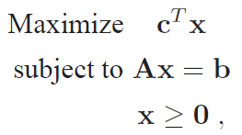
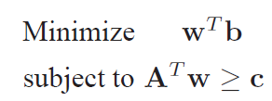
Dual Problem
An important dual relationship
Good properties
  Two problems can be solved simultaneously
  Two optimal objective values are equal
The dual problem
The original problem

Slide 6

Case study – Wireless Sensor Networks
Apply LP techniques for wireless sensor networks
Sensor nodes
  Sensing multi-media (video, audio etc.) and scalar data (temperature, pressure, light etc. )
  Battery-powered
  Challenge: limited energy source
A wireless sensor network

Slide 7
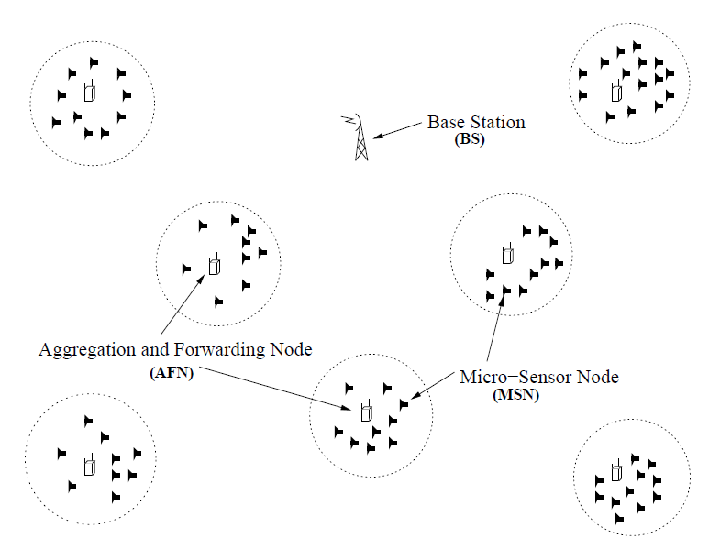
Reference Network Model
  Micro-Sensor Node (MSN)
  Aggregation and Forwarding Node (AFN)
  Base Station (BS)
A Two-tiered Wireless Sensor Network

Slide 8
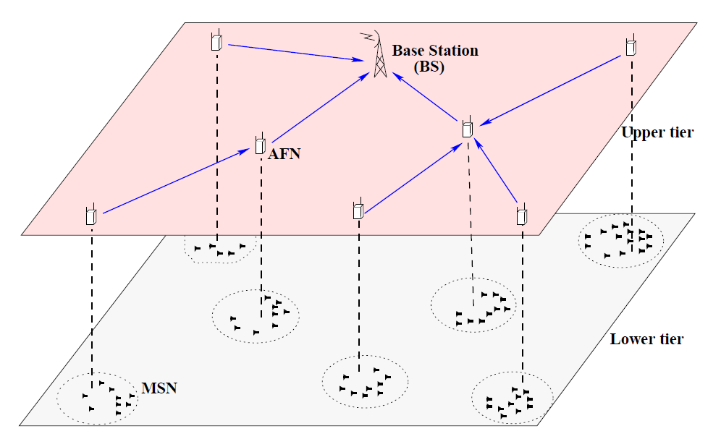
A Hierarchical View

Slide 9
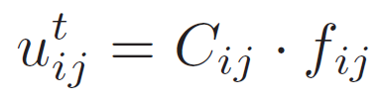
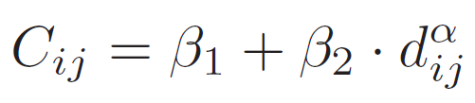
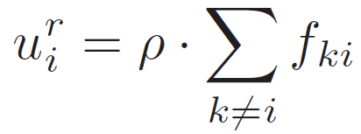
Energy Consumption Modeling
For upper-tier AFNs, communication power is the dominant source of energy consumption
  AFN relays data streams over large distances
Transmission power modeling
where
Reception power modeling

Slide 10
Performance Limits Due to Energy Constraint
Network capacity
  Maximize the total data rates from all AFNs
Network lifetime
  Maximize the time until any AFN runs out of energy
Problem under consideration
  Under a common lifetime requirement for all AFNs, how to maximize the network capacity?
  Under a common rate requirement for all AFNs, how to maximize the network lifetime?
Notes:
We first study the capacity problem.
Need to understand power consumption behavior

Slide 11
Outline of Case Study
Fairness issue
  Advocate lexicographic max-min (LMM) rate allocation
Difficulties for solving LMM rate allocation
Approach
  SLP-PA algorithm: Exploiting parametric analysis (PA) technique in LP
  SLP-PA is strictly polynomial and very efficient
Extension to LMM node lifetime problem
Numerical results
Notes:
1. Given network lifetime requirement, maximizing information collection (i.e. capacity) could lead to severe fairness problem in rate allocation
2. But LMM rate allocation couples routing and rate allocation – A very difficulty problem
Introduce two incorrect approaches.

Slide 12
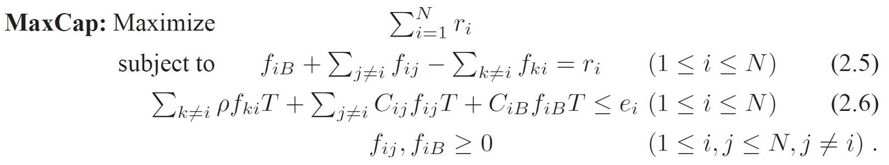
Maximize Capacity
Maximize the total data rates from all nodes under a given network lifetime requirement T
MaxCap is an LP
12

Slide 13
Fairness Issue
The objective is to maximize the total data rates (or capacity)
Rate allocation favors nodes that consume less power on their data paths toward the base-station
The surveillance quality at different nodes are extremely uneven
  Poor sensing quality for certain area
Advocate the use of LMM rate allocation
13
Notes:
Nodes that consume less power on their data paths toward the base-station are allocated with much larger rates
Nodes that consume larger power on their data path toward the base-station are allocated with smaller rates

Slide 14



LMM Rate Allocation
Definition
Under a network lifetime requirement T, a sorted rate vector g=[g1,g2,….,gN], g1≤g2≤…≤gN, is LMM-optimal iff for any other sorted rate allocation vector there exists a k,1≤k≤N, such that gi= for 1≤i≤k-1 and gk > .
Similar to max-min
But there is a fundamental difference
  LMM rate allocation couples routing with rate allocation
A much more difficult problem than max-min
14

Slide 15
Outline of Case Study
Fairness issue
  Advocate lexicographic max-min (LMM) rate allocation
Difficulties for solving LMM rate allocation
Approach
  SLP-PA algorithm: Exploiting parametric analysis (PA) technique in LP
  SLP-PA is strictly polynomial and very efficient
Extension to LMM node lifetime problem
Numerical results
Notes:
1. Given network lifetime requirement, maximizing information collection (i.e. capacity) could lead to severe fairness problem in rate allocation
2. But LMM rate allocation couples routing and rate allocation – A very difficulty problem
Introduce two incorrect approaches.

Slide 16
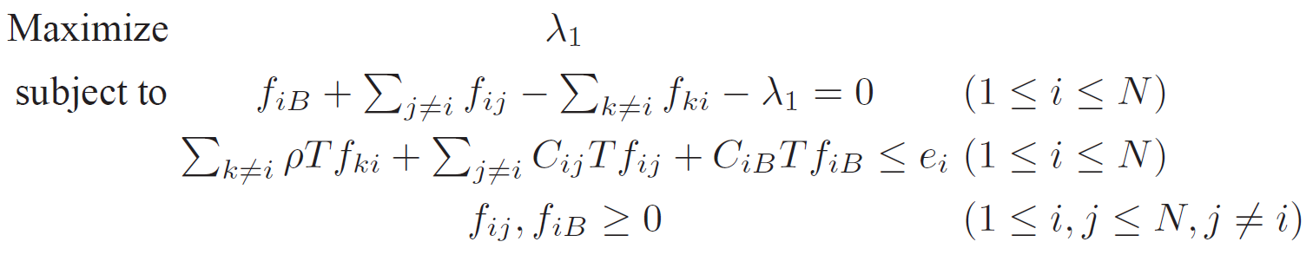

Incorrect Iterative Approaches - 1
Serial LP with Energy Reservation (SLP-ER)
  Calculate the first level optimal rate
  Once is found, record the flow routing solution and the remaining energy at each node

Slide 17


Incorrect Iterative Approaches - 1
  Build an LP for the rest of network
    For nodes with positive remaining energy, increase their data rate from to with the maximum
  The process continues until all nodes use up their energy

Slide 18

Incorrect Iterative Approaches - 2
Serial LP with Rate Reservation (SLP-RR)
  Only determine the rate and the set of nodes that use up their energy at each level
    Do not fix flow routing at each iteration
  Continue the process until all are determined
  The flow routing is solved in the last iteration

Slide 19
Why Incorrect?
At each iteration, there exists non-unique flow routing solutions
  They all correspond to the same rate level
Each flow routing could yield different available energy on the remaining nodes
  Leading to a different rate allocation for future iterations
Any iterative rate allocation approach that requires
energy reservation at each iteration is incorrect!
19

Slide 20
Outline of Case Study
Fairness issue
  Advocate lexicographic max-min (LMM) rate allocation
Difficulties for solving LMM rate allocation
Approach
  SLP-PA algorithm: Exploiting parametric analysis (PA) technique in LP
  SLP-PA is strictly polynomial and very efficient
Extension to LMM node lifetime problem
Numerical results
Notes:
1. Given network lifetime requirement, maximizing information collection (i.e. capacity) could lead to severe fairness problem in rate allocation
2. But LMM rate allocation couples routing and rate allocation – A very difficulty problem
Introduce two incorrect approaches.

Slide 21
SLP-PA Algorithm: Basic Idea
An iterative algorithm
  Only rates for certain nodes are determined
  But without energy reservation at each iteration
At the first iteration
  Step 1: maximize the rate for all nodes
    Same as SLP-ER
    Can be solved via LP
  Step 2: minimize the number of nodes at the first level of rate allocation
    Minimum node set determination
    Exploit PA technique
21

Slide 22
SLP-PA Algorithm: Basic Idea
At each subsequent iteration
  Step 1: maximize the rate for the remaining nodes
  Step 2: minimize the number of nodes at this level of rate allocation
Algorithm terminates when all nodes are allocated with their optimal rates

Slide 23
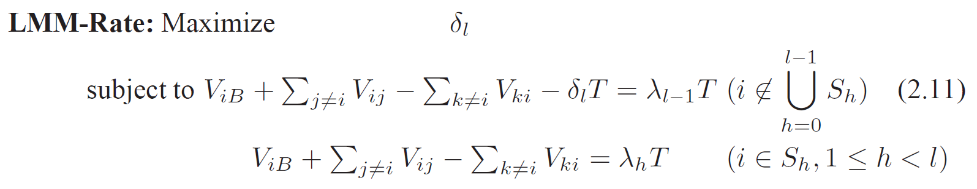

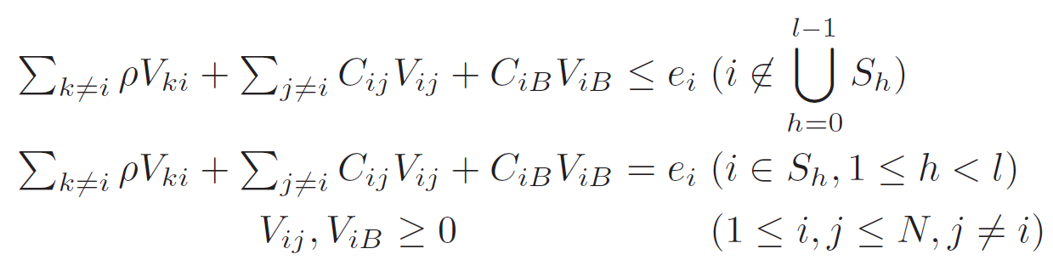
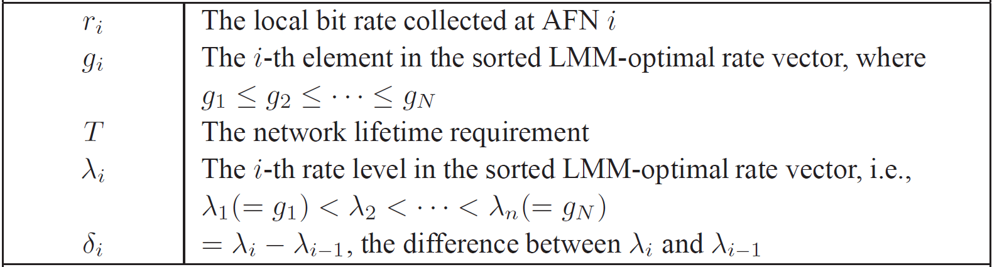
Step 1: Maximize Rate at Iteration l

Slide 24
Step 2: Determine Minimum Node Set
Parametric Analysis (PA)
  For each node under examination, analyze the impact of increasing its current rate with a small amount
If objective value decreases, then this node belongs to the minimum node set
Otherwise (i.e., no change in objective value), this node does not belong to the minimum node set (i.e., rate can be further increased)
24
Notes:
Under Case 2, although MSV is similar to Brown’s approach, the computational complexity is polynomial since our problem formulation is per link based instead of per sub-flow based, which is exponential.

Slide 25
Some Properties
Minimum node set at each iteration is unique
LMM rate allocation is unique
SLP-PA complexity is strictly polynomial
25

Slide 26
Outline of Case Study
Fairness issue
  Advocate lexicographic max-min (LMM) rate allocation
Difficulties for solving LMM rate allocation
Approach
  SLP-PA algorithm: Exploiting parametric analysis (PA) technique in LP
  SLP-PA is strictly polynomial and very efficient
Extension to LMM node lifetime problem
Numerical results
Notes:
1. Given network lifetime requirement, maximizing information collection (i.e. capacity) could lead to severe fairness problem in rate allocation
2. But LMM rate allocation couples routing and rate allocation – A very difficulty problem
Introduce two incorrect approaches.

Slide 27
Extension to LMM Node Lifetime Problem
LMM node lifetime problem [Brown et al, MobiHoc’01]
  Given fixed bit rate at each node, how to maximize the lifetime for all nodes in the network
Problem can be cast into the same mathematical form as LMM rate allocation
  Can also be solved by SLP-PA
Why LMM rate allocation and LMM node lifetime problems are so similar?
27
Notes:
SLP-PA is much more efficient than the technique by Brown et al.

Slide 28
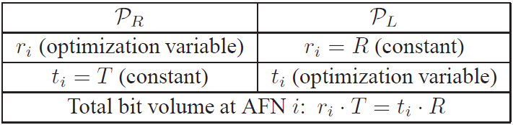
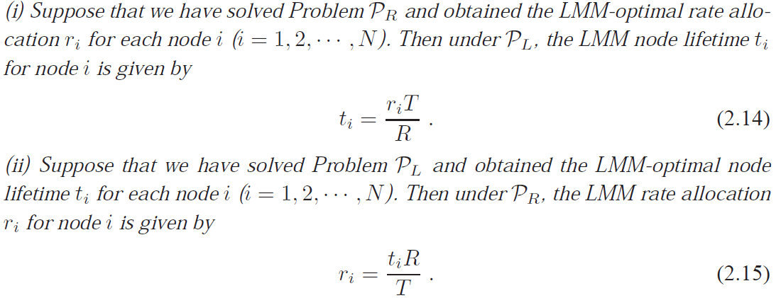
Mirror Relationship
28
Notes:
Solution to one problem can be used to construct a solution to the other problem

Slide 29
Outline of Case Study
Fairness issue
  Advocate lexicographic max-min (LMM) rate allocation
Difficulties for solving LMM rate allocation
Approach
  SLP-PA algorithm: Exploiting parametric analysis (PA) technique in LP
  SLP-PA is strictly polynomial and very efficient
Extension to LMM node lifetime problem
Numerical results
Notes:
1. Given network lifetime requirement, maximizing information collection (i.e. capacity) could lead to severe fairness problem in rate allocation
2. But LMM rate allocation couples routing and rate allocation – A very difficulty problem
Introduce two incorrect approaches.

Slide 30
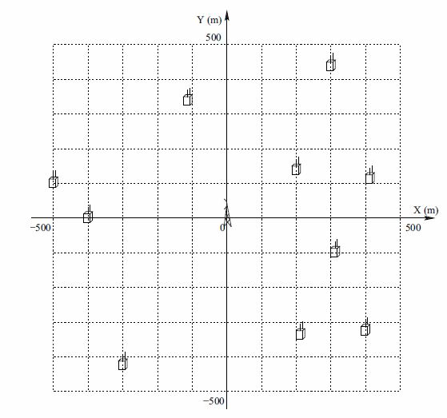
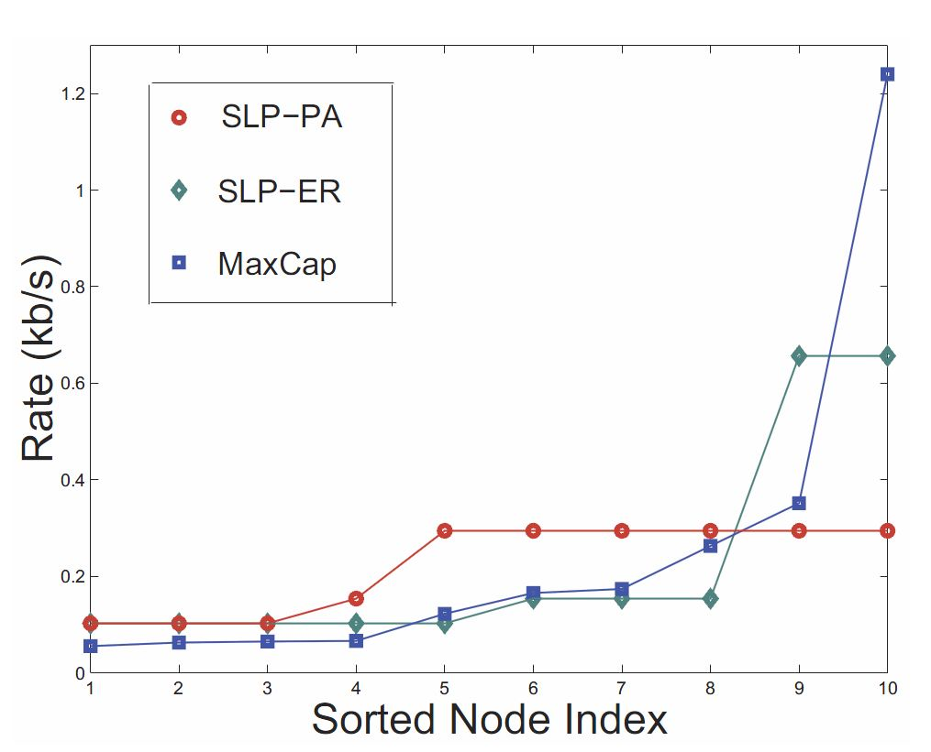
10-AFN Network
Network Topology
Rate allocation comparison
30
Notes:
We observe, as expected, a severe bias in the rate allocation under the MaxCap approach.
Rate allocation for sorted node index 20 is 1.2398 (extremely unfair).
SLP-PA is most fair in rate allocation.
Clearly, among the three rate allocation approaches, only the rate allocation under SLP-PA meets the LMM-optimal rate allocation definition.
In other words, the rate allocation vector under the SLP-PA algorithm has the smallest rate difference between the smallest rate (r1) and
the largest rate (r10) among the three approaches.

Slide 31
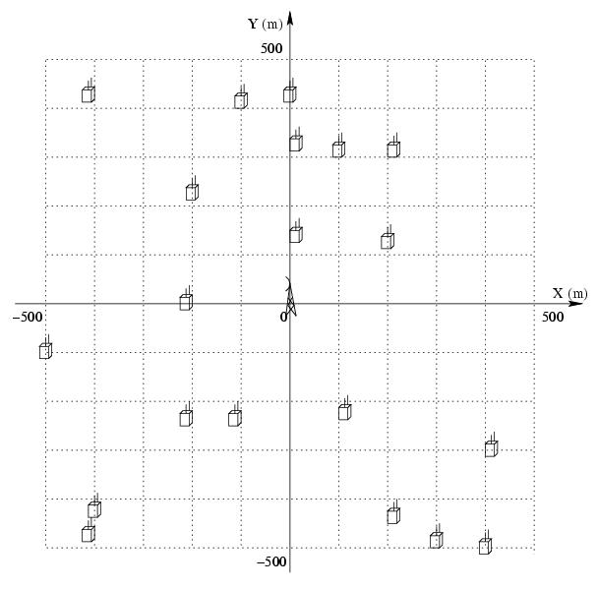
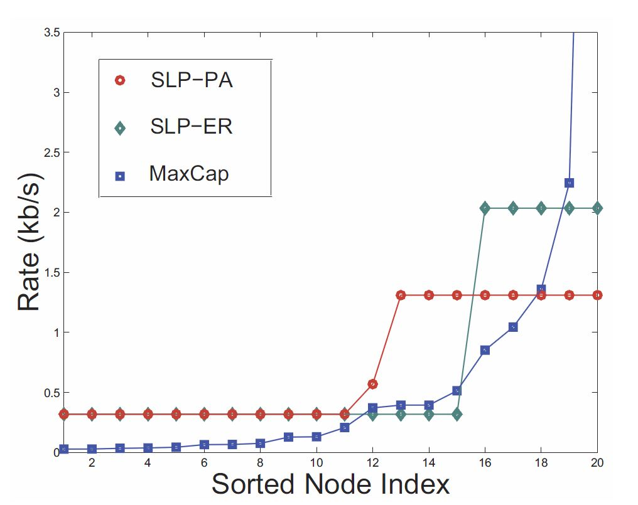
20-AFN Network
Network Topology
Rate allocation comparison
31
Notes:
Rate allocation for sorted node index 20 is 10.4362 (extremely unfair).
SLP-PA is most fair in rate allocation.
SLP-PA correctly solves the LMM rate allocation problem.

Slide 32
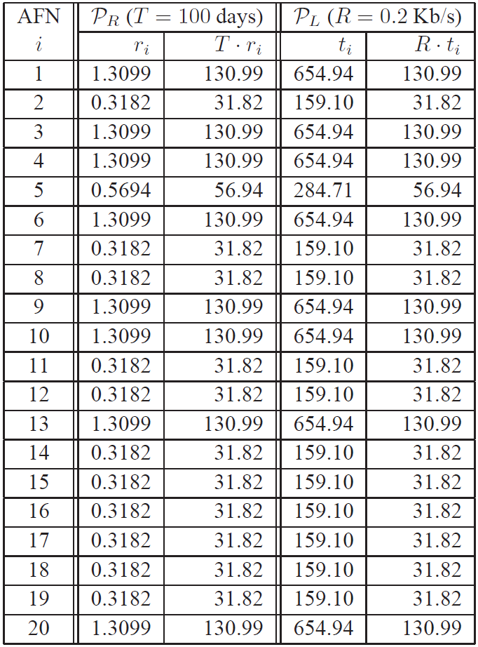


Verification of Mirror Relationship
Solve LMM rate allocation and LMM node lifetime problems independently
Compare and to see if equal.
They are exactly equal for all AFNs
32

Slide 33
Chapter 2 Summary
Review of key results in linear programming
Case study
  LMM Rate Allocation and Node Lifetime Problems
LMM rate allocation achieves both fairness and efficiency
  Couples routing and rate allocation
  Key step: Determining minimum node set at each rate level
  Approach: Exploit PA technique to determine minimum node set
  Developed a strictly polynomial solution SLP-PA
Discover a mirror relationship between LMM rate allocation and LMM node lifetime problems
33
Notes:
LP can be solved in polynomial time
Dual relationship

