Slide 1
IMPORTANT – PLEASE NOTE:
These resources are provided free of charge by Cambridge University Press with permission of the authors of the corresponding work, but are subject to copyright. You are permitted to view, print and download these resources for your own personal use or for educational purposes, provided any copyright lines on the resources are not removed or altered in any way. Any other use, including but not limited to distribution of the resources in modified form, or via electronic or other media, is strictly prohibited unless you have prior permission from the authors of the corresponding work and the owners of the images displayed herein, and provided you give appropriate acknowledgement of the source.

Slide 2
NOTE TO USERS:
The simplified information included in this presentation is intended to compliment the accompanying CUP book on Glaciovolcanism by Smellie & Edwards. Please refer to the book for further details and information on references cited, etc

Slide 3
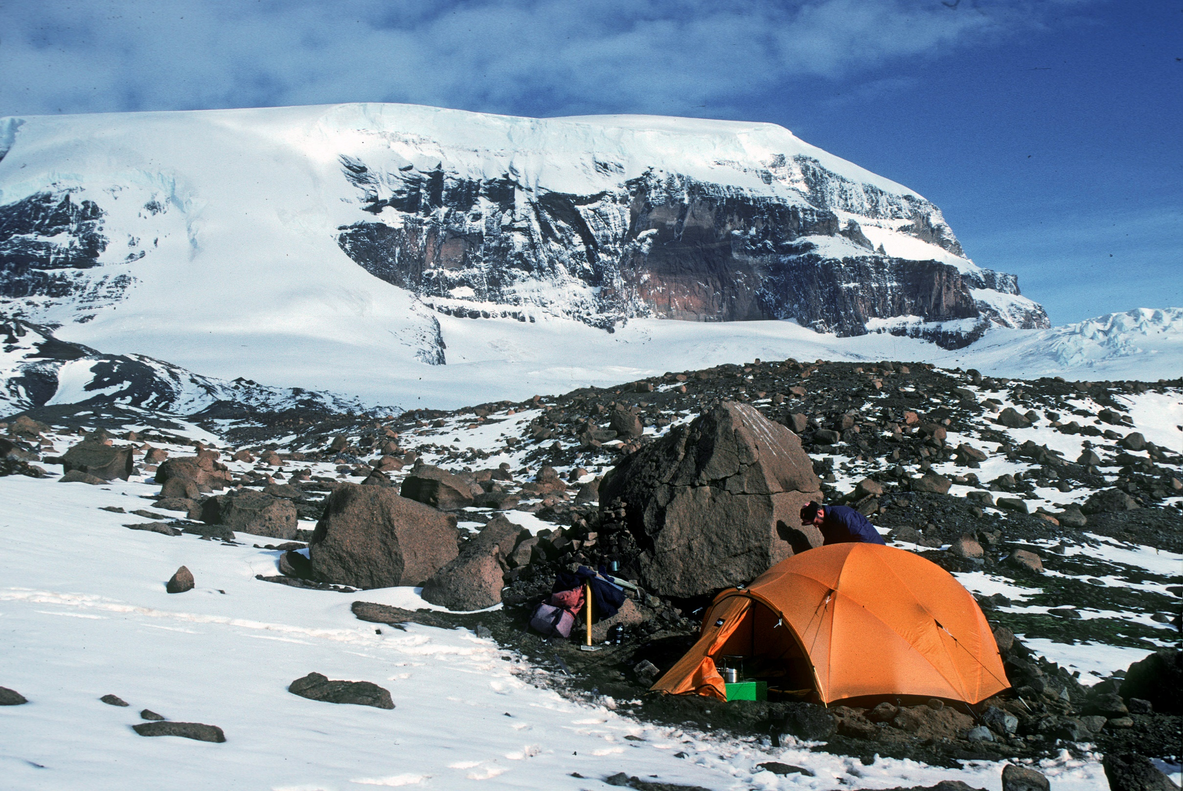
Distribution of glaciovolcanism on Earth
James Ross Island, Antarctica
Image: John Smellie

Slide 4
TALK OUTLINE -
Distribution of glaciovolcanism
1. Iceland
2. Canada (British Columbia)
3. Antarctica
4. Others - Russia

Slide 5
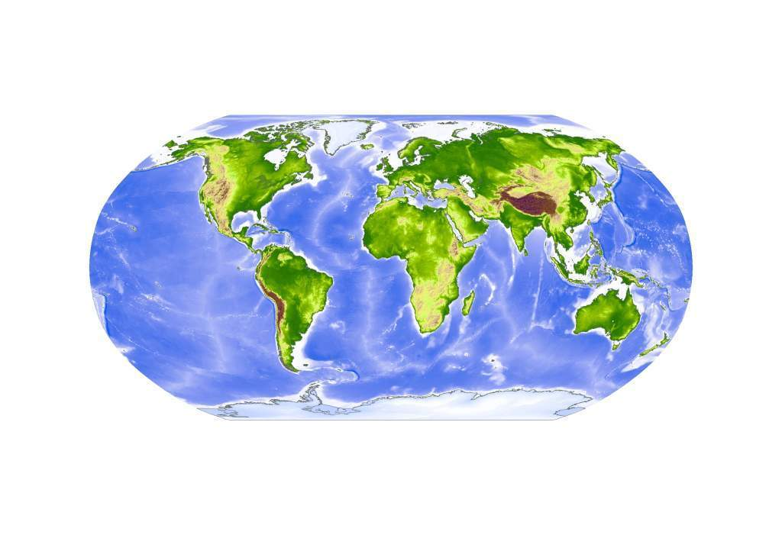

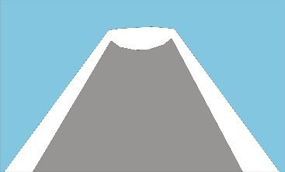
Distribution of terrestrial glaciovolcanic centres
Ice-capped
Ice-covered

Slide 6
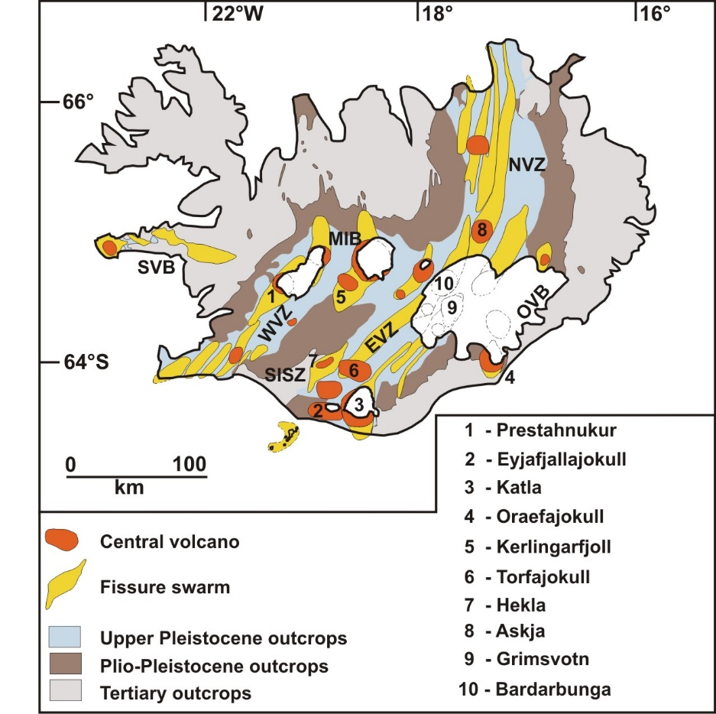
Iceland – distribution of glaciovolcanic landforms
Glaciovolcanic
outcrops
Smellie & Edwards (2016)

Slide 7
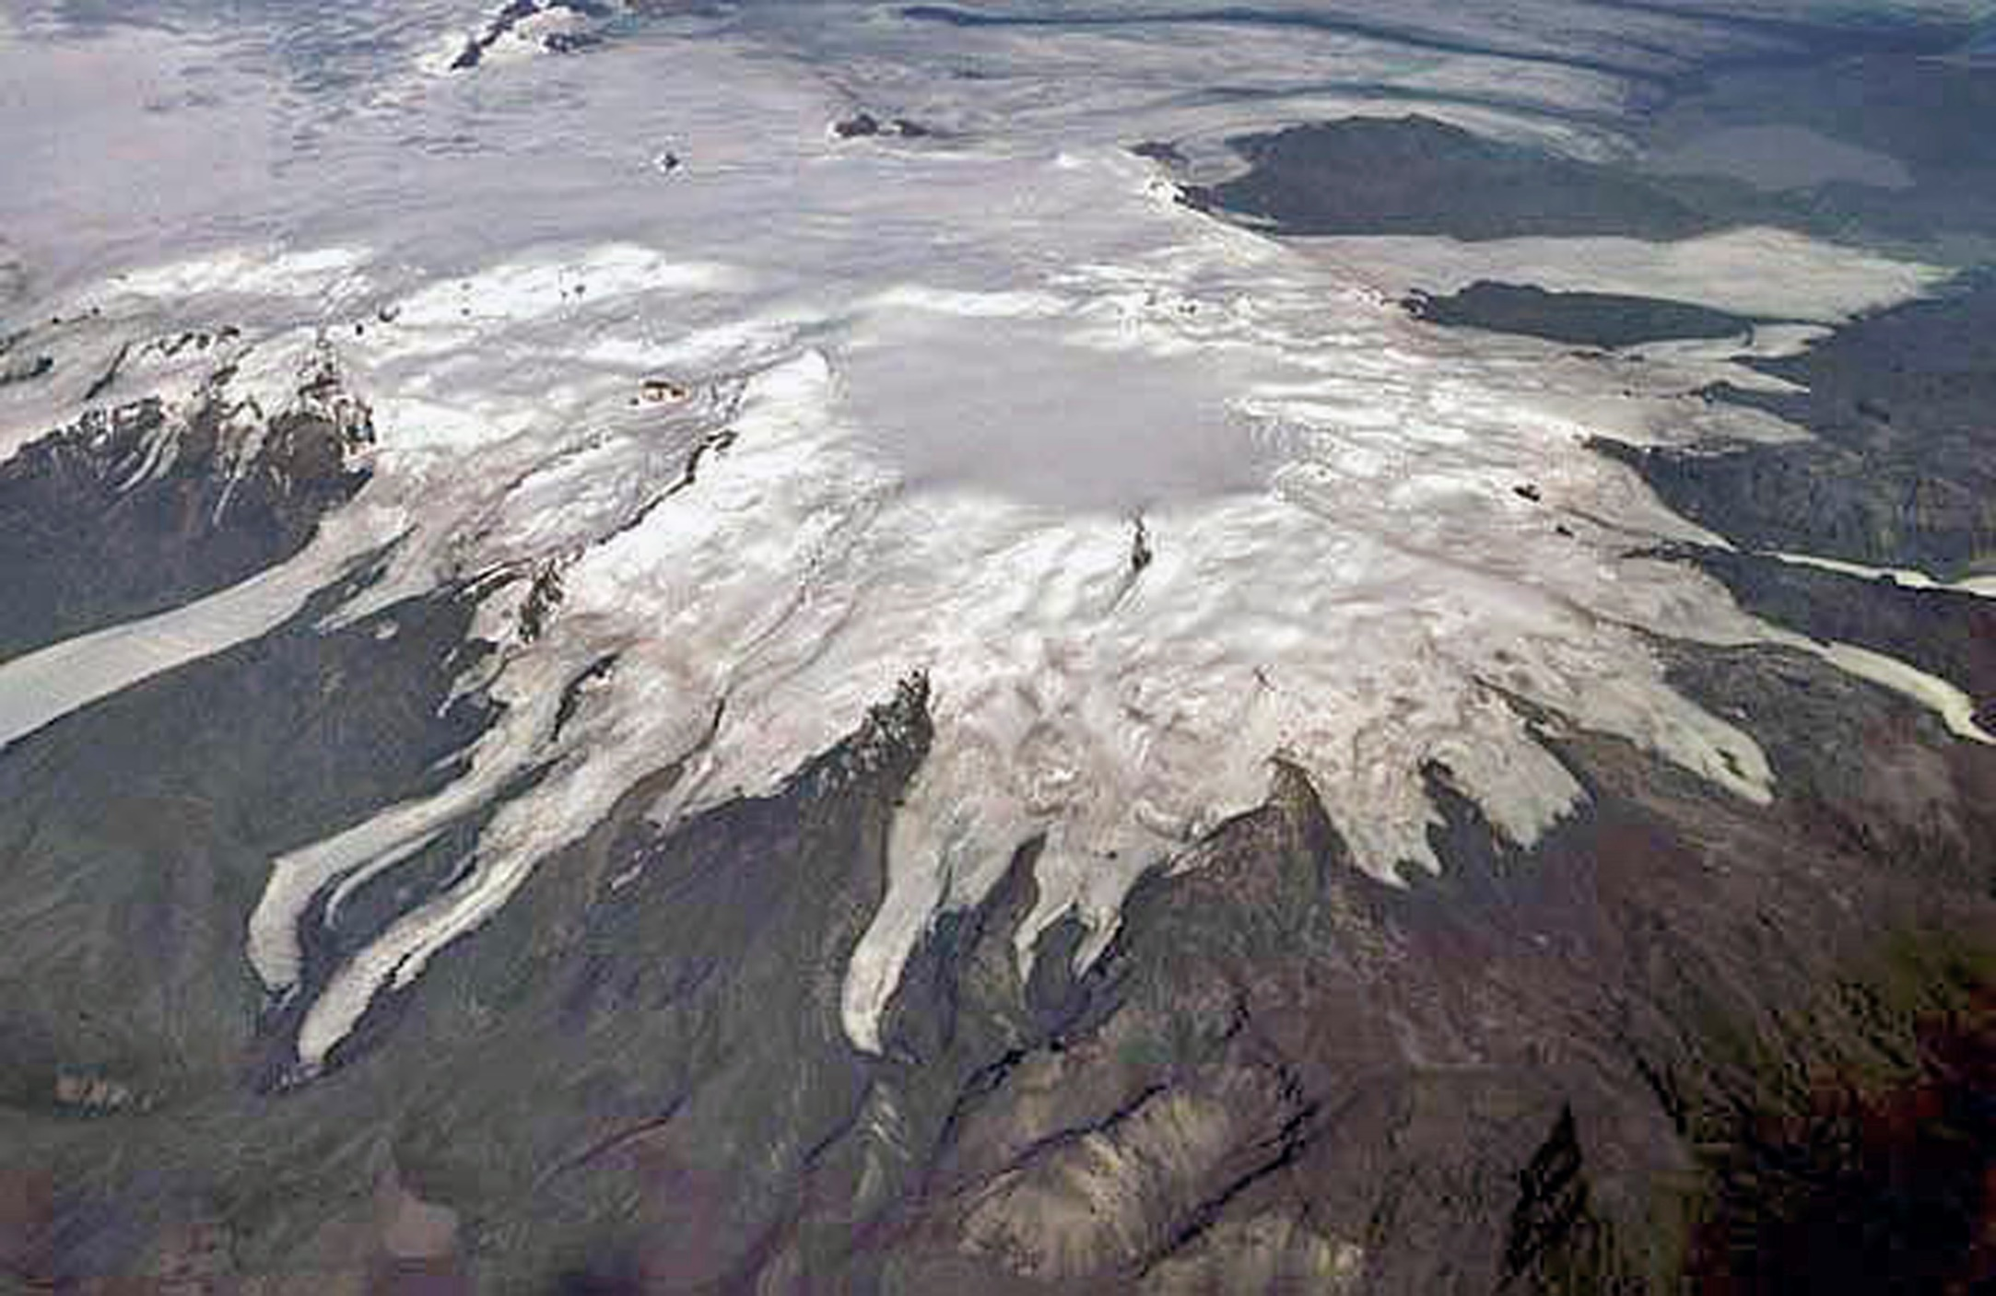
Iceland
Image: Tom Pfieffer
Glaciovolcanic stratovolcano
Oraefajokull
Notes:
Oraefajokull is the largest active volcano in Iceland. It rises to 2110 m and has an ice-filled caldera 4-5 km in diameter. Much of the volcano formed during glaciovolcanic eruptions, both basaltic and rhyolitic

Slide 8
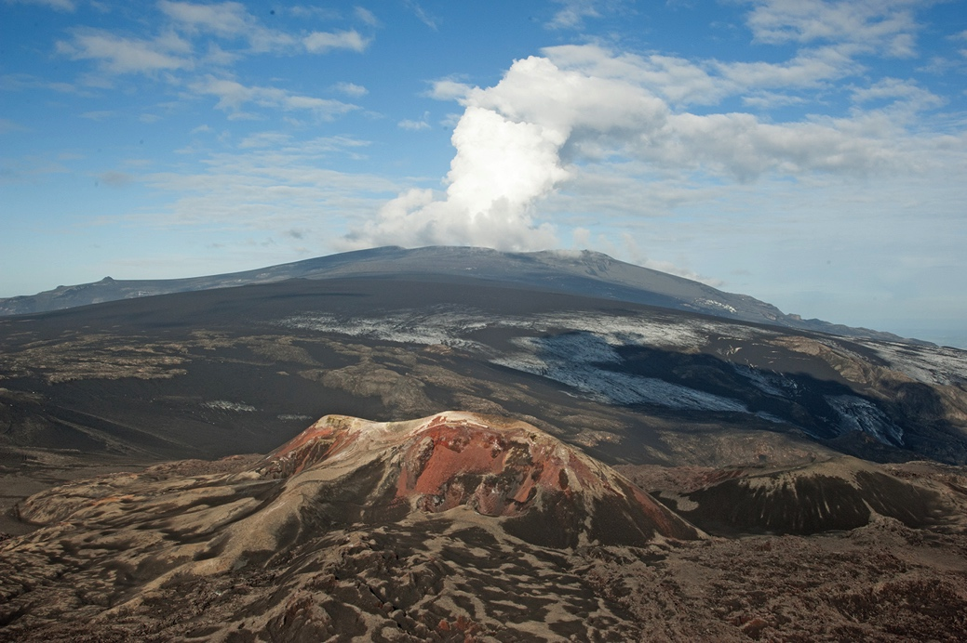
Iceland
Image: Ben Edwards
Glaciovolcanic stratovolcano
Eyjafjallajökull
Notes:
Eyjafjallajokull has a small ice cap, which is the source of the steam plume seen in the image (within a small summit caldera). Much of the ice cap is covered by light grey ash erupted in 2010. The red hill in foreground comprises tephra cones formed during the earliest phase of the eruption at Fimmvorduhals. Image taken in June 2010.

Slide 9
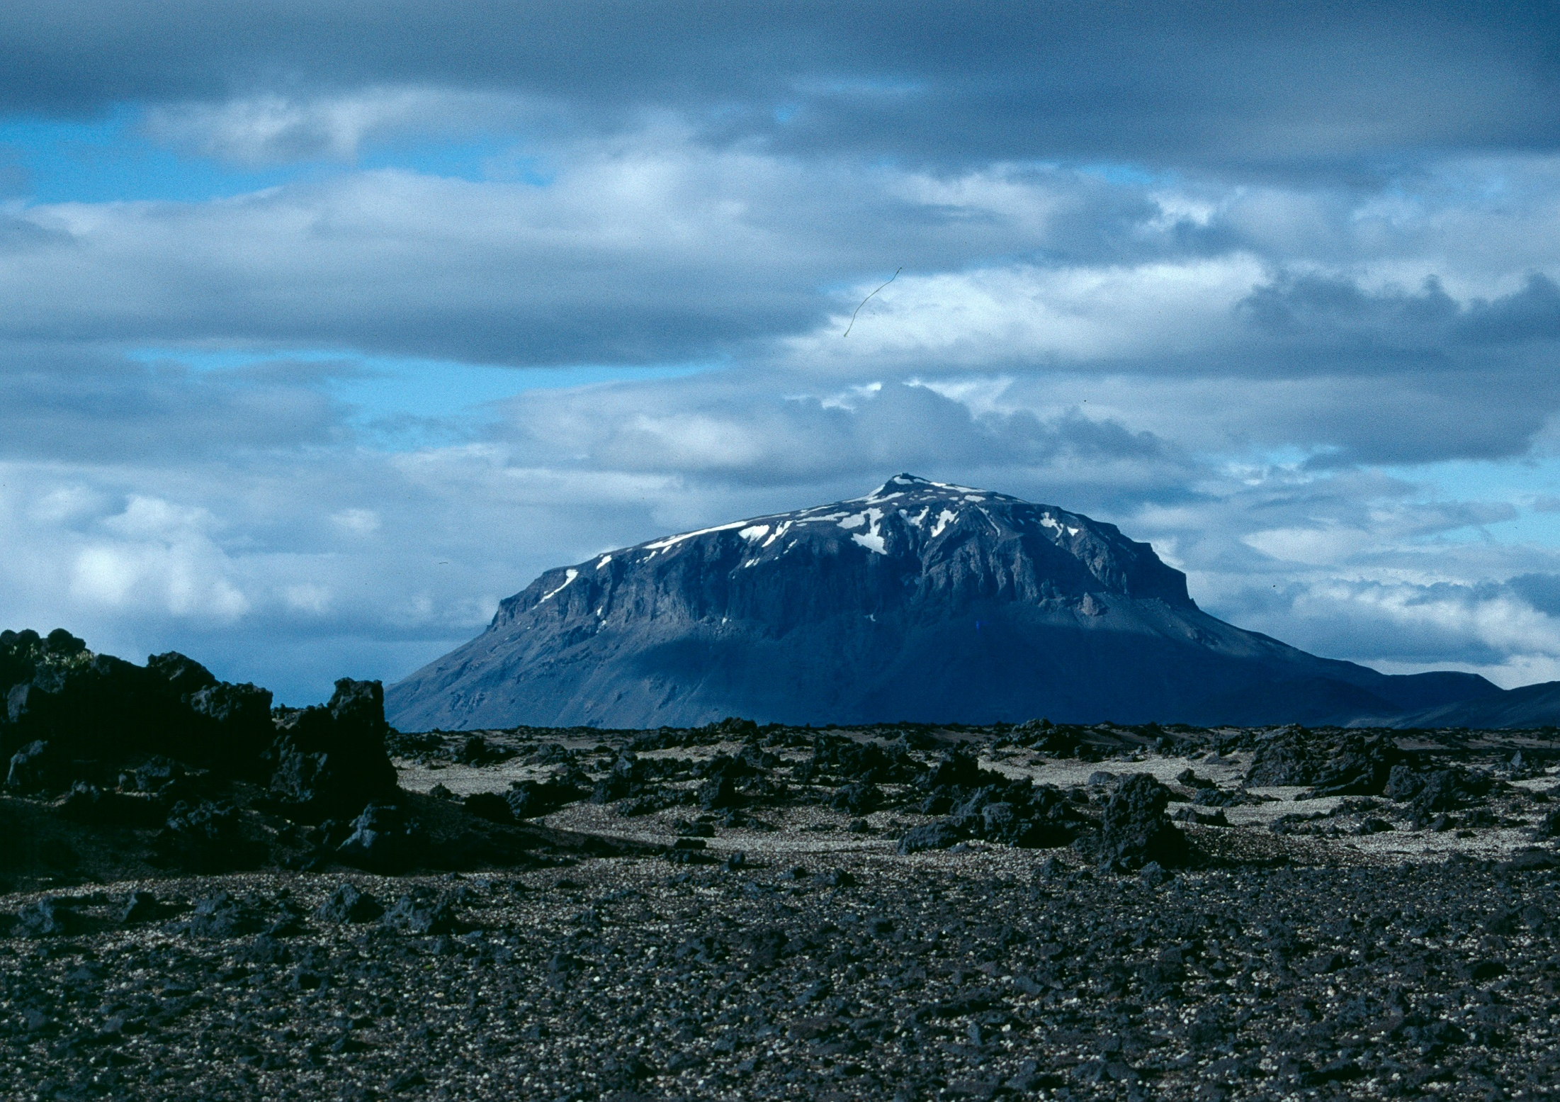
Iceland
Image: John Smellie
Mafic tuya
Herdubreid
Notes:
A classic mafic tuya. Note the domical shape to the summit caused by the source cone which issued the capping subaerial lavas that fed encircling lava-fed deltas

Slide 10
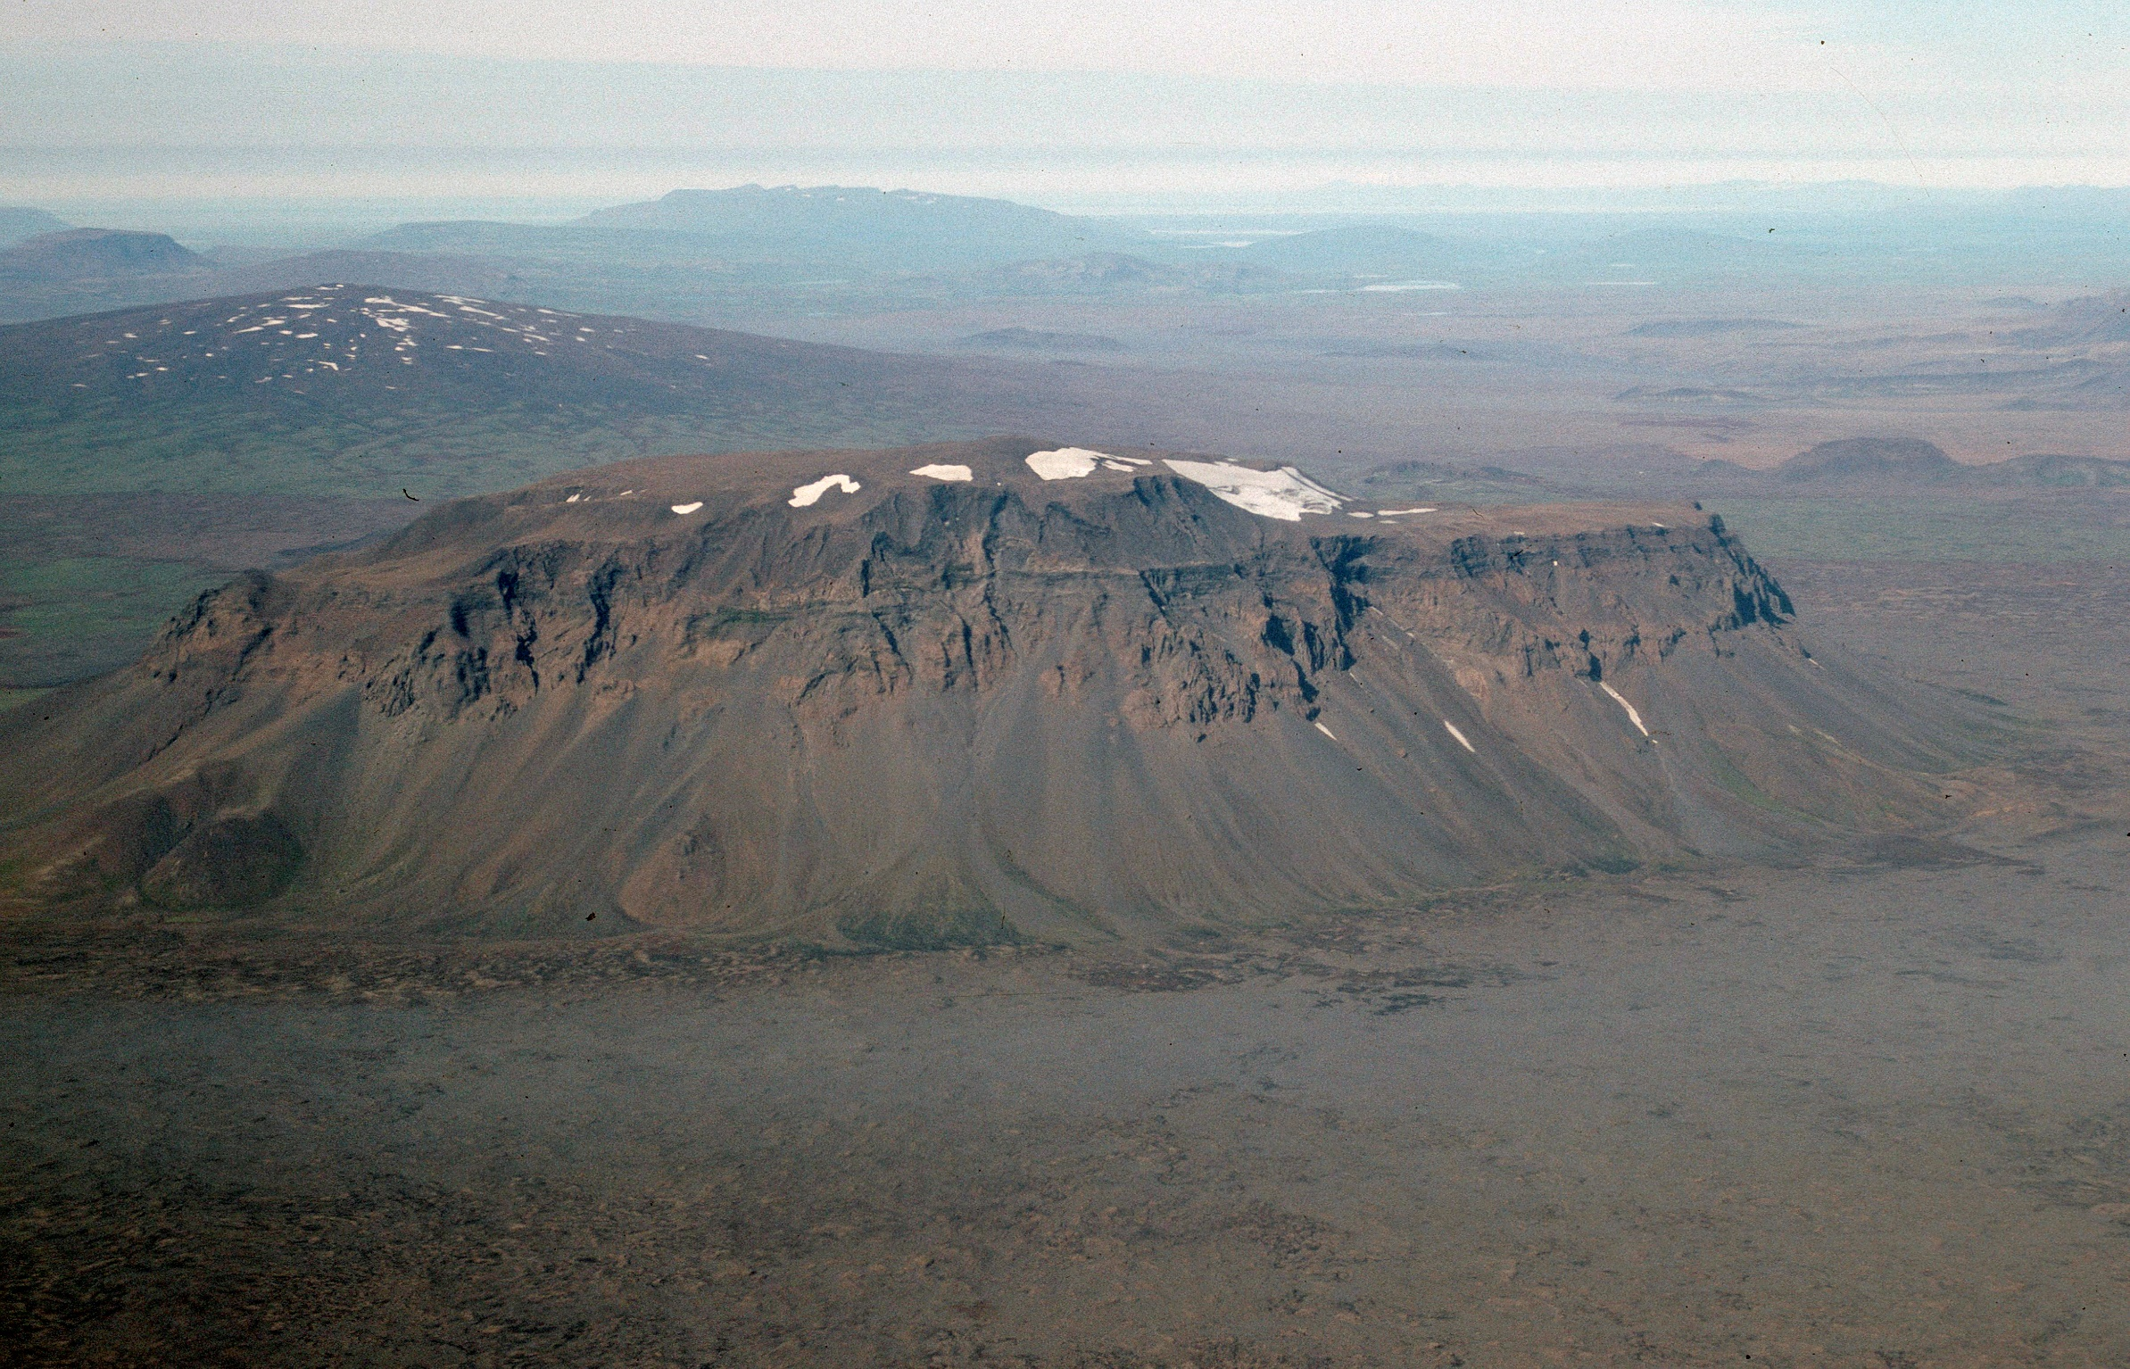
Iceland
Image: John Smellie
[Skjaldbreidur]
Mafic tuya
Hlodufell
Notes:
Note the contrast in morphology between Hlodufell, with its flat top and steep flanks, and Skjaldbreidur subaerial shield in the background, with its gentle slopes and conical shape

Slide 11
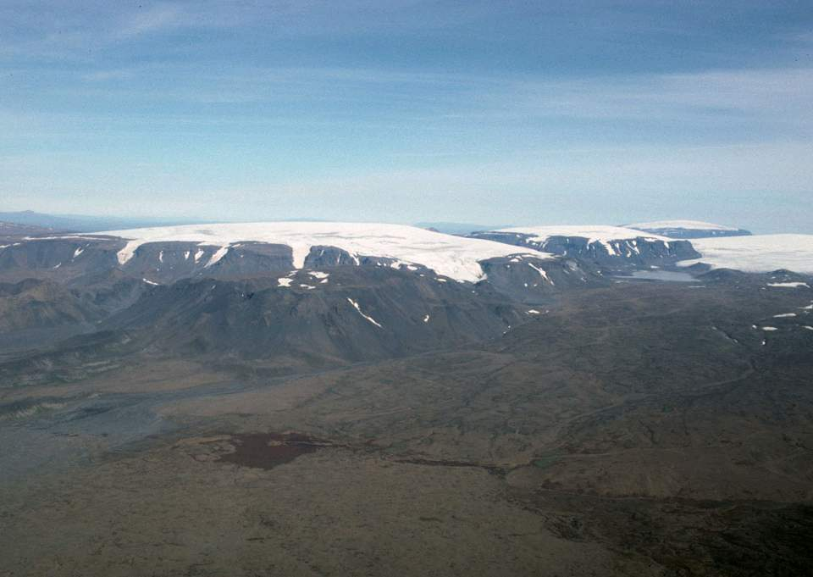
Iceland
Image: John Smellie
Mafic tuyas
Langjokull tuyas
Notes:
Three of the largest tuyas in Iceland

Slide 12
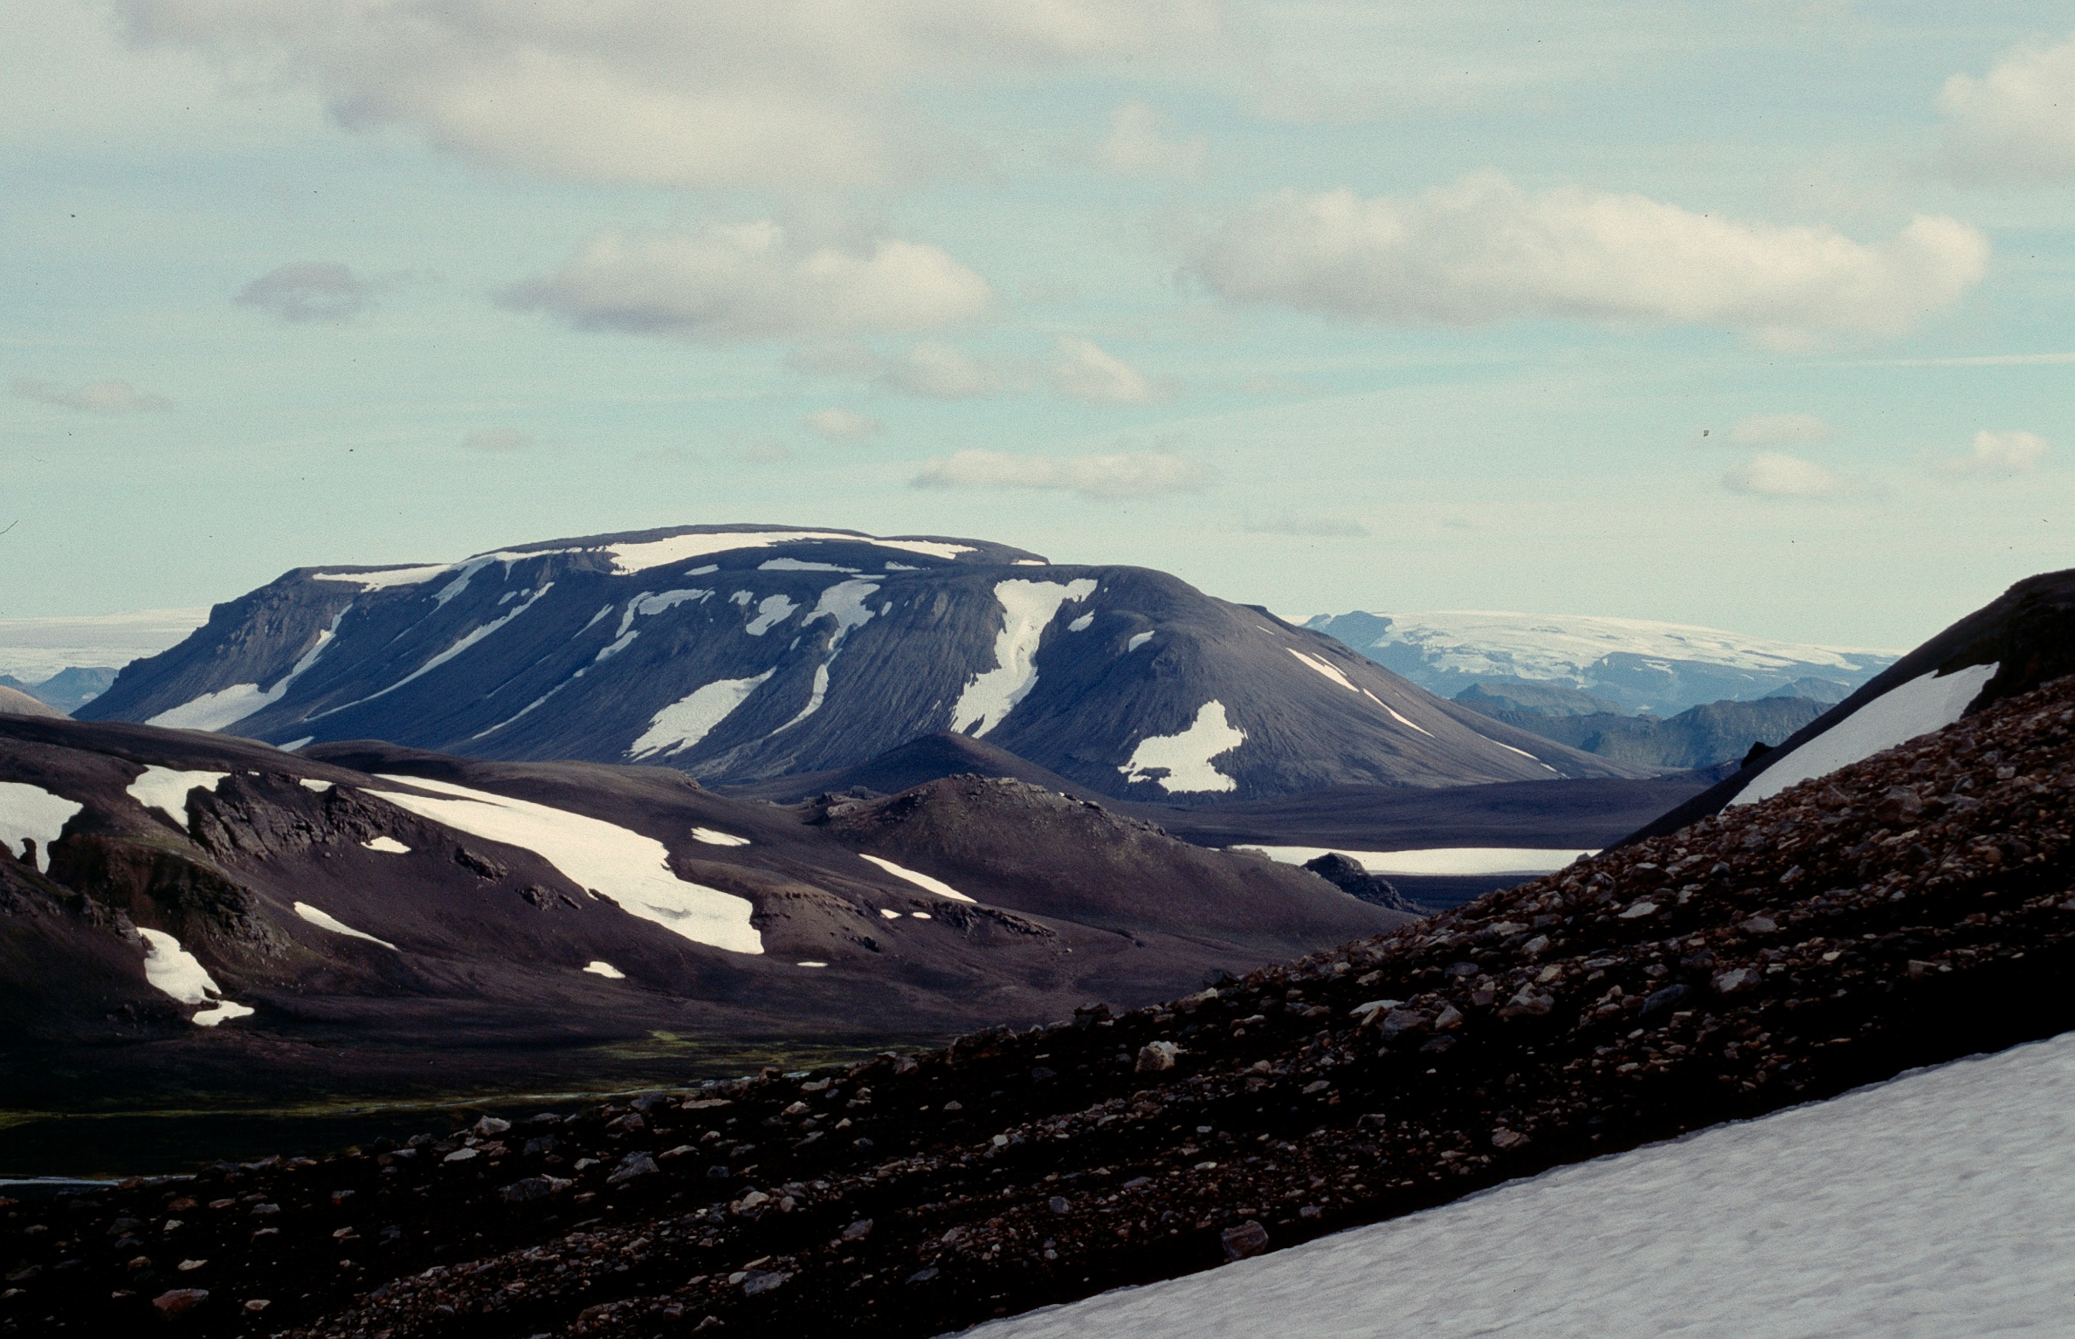
Iceland
Image: John Smellie
Felsic tuya
Laufafell, Torfajokull
Notes:
A prominent flat-topped tephra-dominated felsic tuya

Slide 13
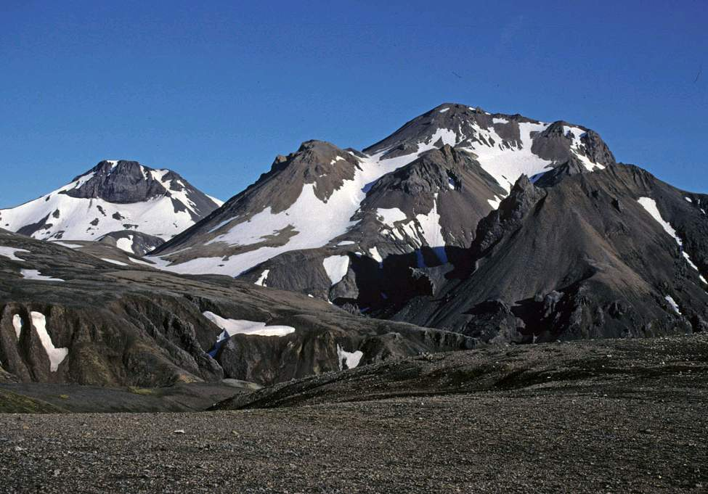
Iceland
Image: John Smellie
Felsic tuyas
Kerlingarfjoll
Notes:
Two tephra-dominated felsic tuyas are shown, each with relatively thin rhyolite capping lavas. The foreground is formed of mafic glaciovolcanic sequences

Slide 14
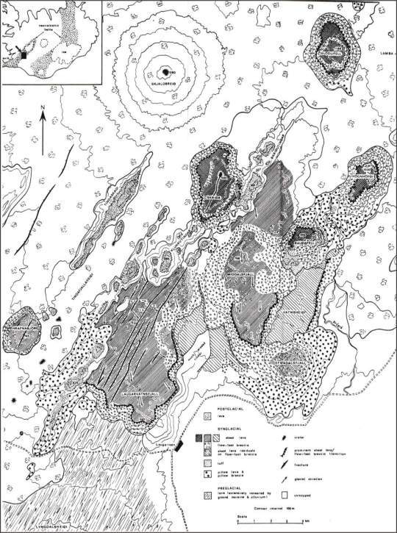
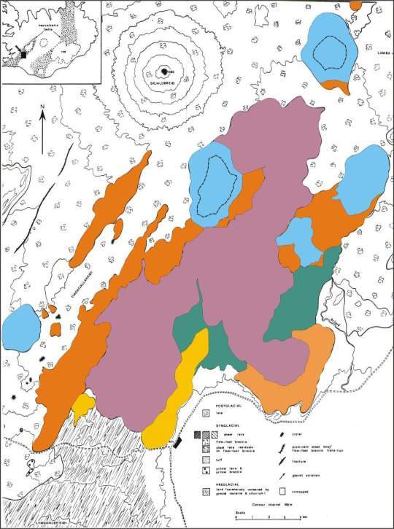
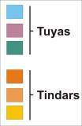
Iceland
Mafic tindar & tuya complex
Laugarvatn
Jones, 1969
Notes:
These tindars & tuyas at Laugarvatn form the classic area of glaciovolcanism described by Jones (1969, 1970) and have been widely used as the basis for a ‘standard model’ for tuya construction

Slide 15
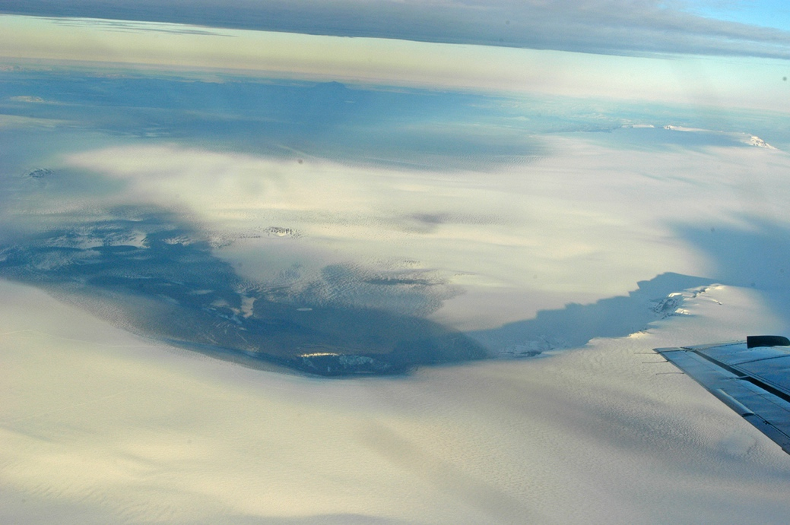
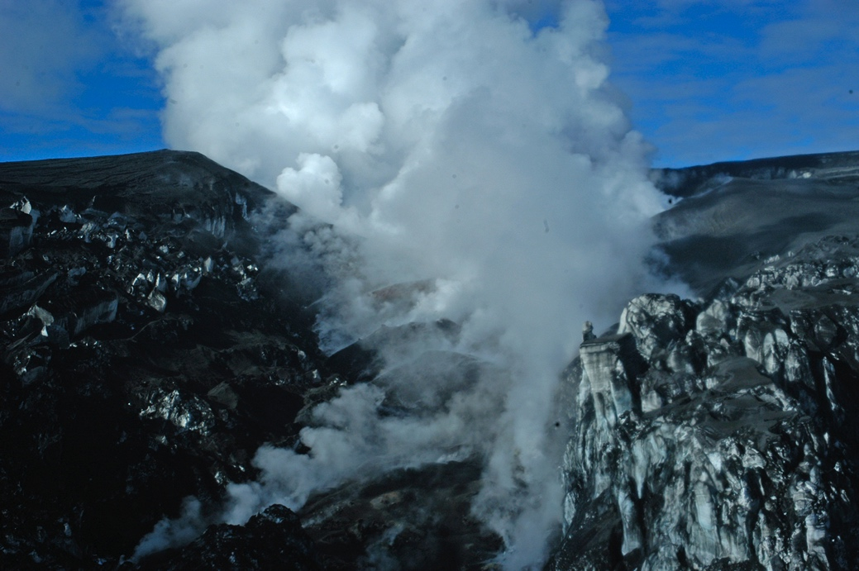
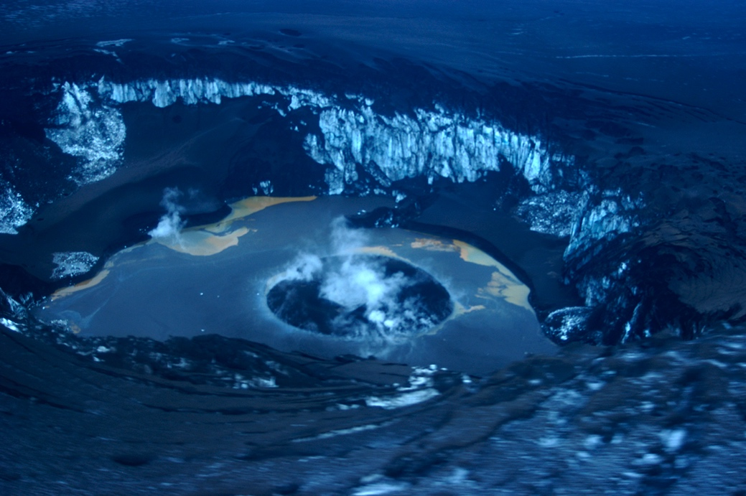
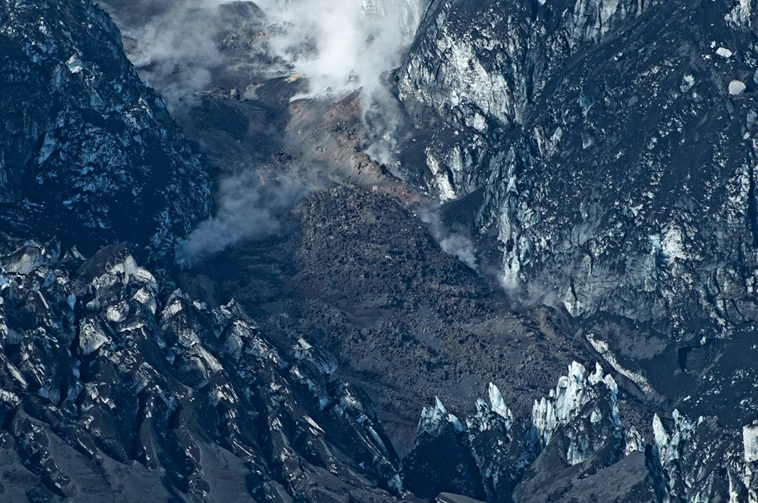
Iceland
Grimsvotn, 2004
Eyjfjallajokull, 2010
The most active
glaciovolcanic
Province today
Summit crater & lava entering ice canyon
Images: Ben Edwards (on left), James Haklar (on right)
Lava flow in ice canyon
Notes:
At left: two views of the cauldron formed in the ice in Grimsvotn caldera during the November 2004 eruption. Upper image shows two different tephra lobes deposited on the surface of the ice
At right: views of the summit of Eyjafjallajokull (top). The lower image shows the lava flow emplaced into an ice canyon (partly formed by ice melting by the lava) within Gigjokull, which is a valley glacier that flows down the north flank of Eyjafjallajokull

Slide 16
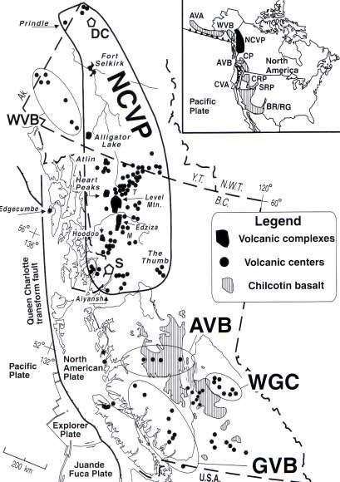
British Columbia, Canada – distribution of
glaciovolcanism
Wrangell
northern Cordilleran
Anaheim
Wells-Gray-Clearwater
Edwards & Russell, 2000
Garibaldi

Slide 17
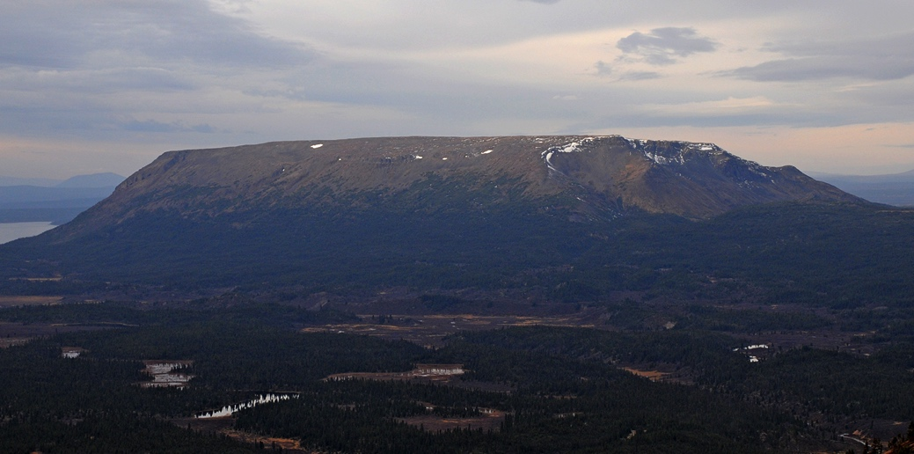
British Columbia
British Columbia
Image: Ben Edwards
Tuya Butte
Mafic tuya
Notes:
Tuya Butte is the volcano after which all tuyas are named. The mountain mainly comprises palagonitzed tuff breccia overlain by flat-lying subaerial basaltic lava flows

Slide 18
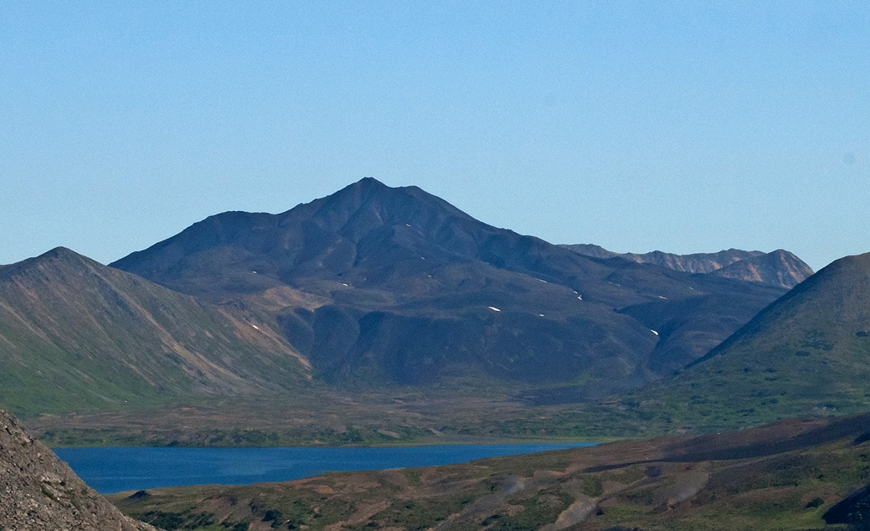
British Columbia
Image: Ben Edwards
Ash Mountain
Mafic tuya
Notes:
Ash Mountain is located immediately north of Tuya Butte. The bench in the middle ground comprises mainly basaltic pillow lava, and the upper, conical edifice comprises tuff breccia and intrusions

Slide 19
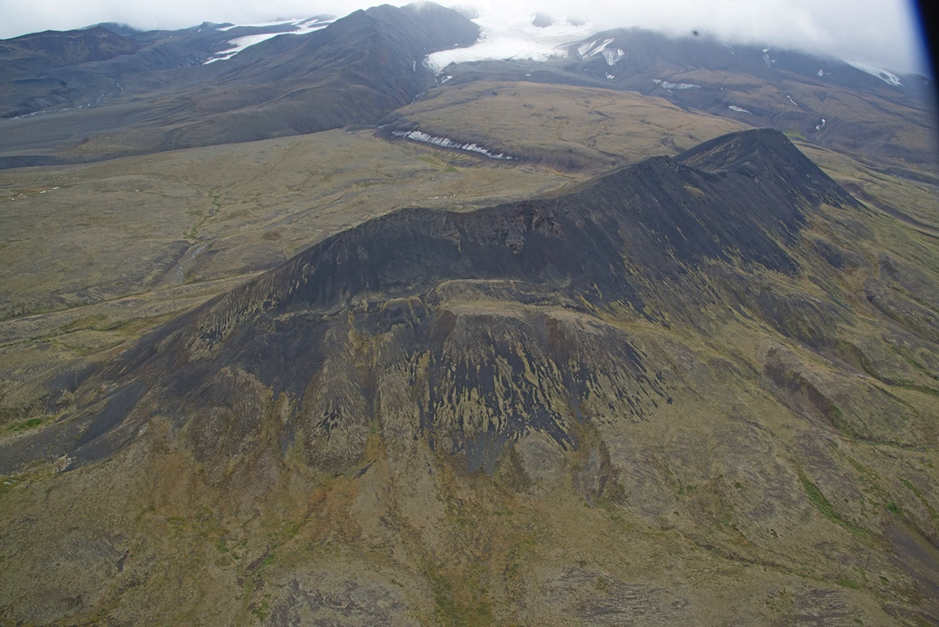
British Columbia
Image: Ben Edwards
Tsekone Ridge, Edziza
Mafic pillow ridge
Notes:
Tsekone Ridge is situated on the northwestern flank of the Edziza volcanic complex. Mainly composed of pillow lava with subordinate tuff breccia and intrusions

Slide 20
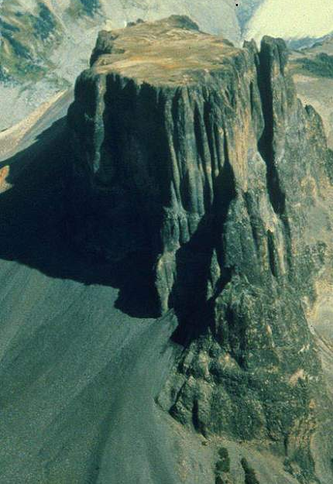
British Columbia
Image: Cathie Hickson
TheTable
Felsic, lava flow-dominated tuya
Notes:
The prominent & distinctive flat top and sheer sides are characteristic of lava-dominated felsic tuyas

Slide 21
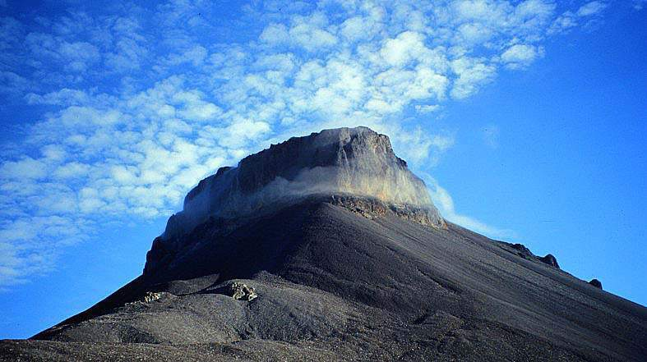
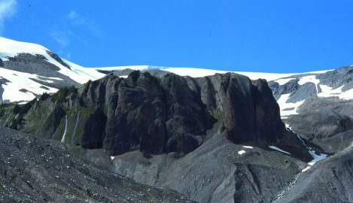
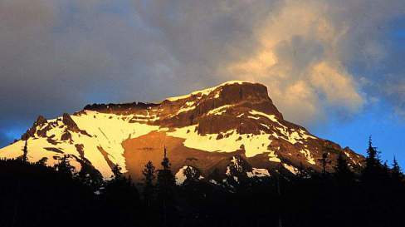
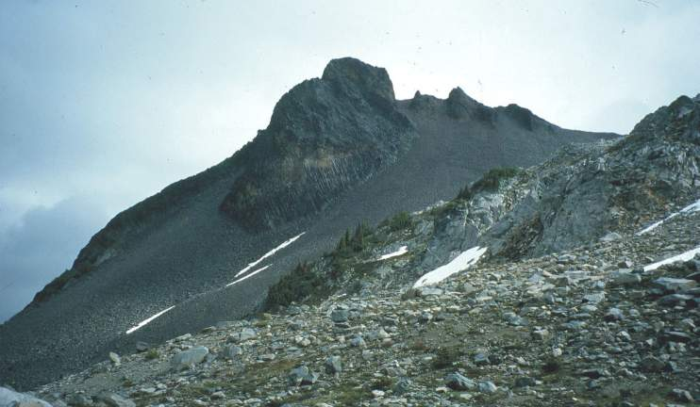
British Columbia
Felsic tuyas & domes
Images: Melanie Kelman
Little Ring Mountain
Pali Dome
Ring Mountain
Ember Ridge
Notes:
Little Ring Mountain & Ring Mountain are lava-dominated andesite tuyas. Pali Dome & Ember Ridge are andesite glaciovolcanic domes

Slide 22
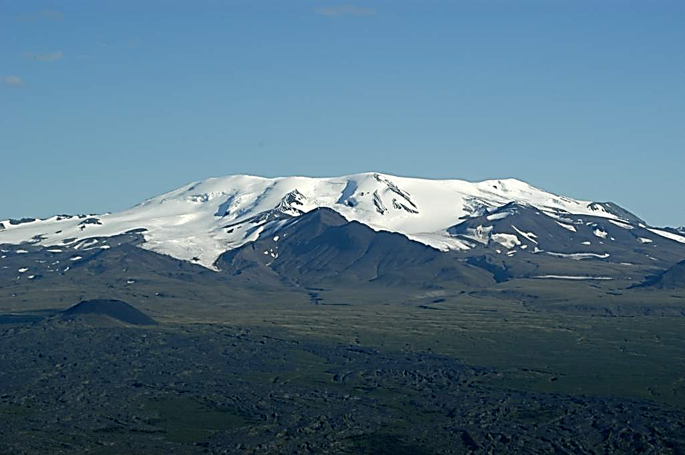
British Columbia
Image: Ben Edwards
Mt Edziza
Polygenetic glaciovolcanic edifice
Notes:
Edziza volcanic complex. The summit caldera is ice-filled, and the ridge in the centre of the image is Pillow Ridge (glaciovolcanic). The foreground is a post-glacial subaerial lava field and scoria cone

Slide 23
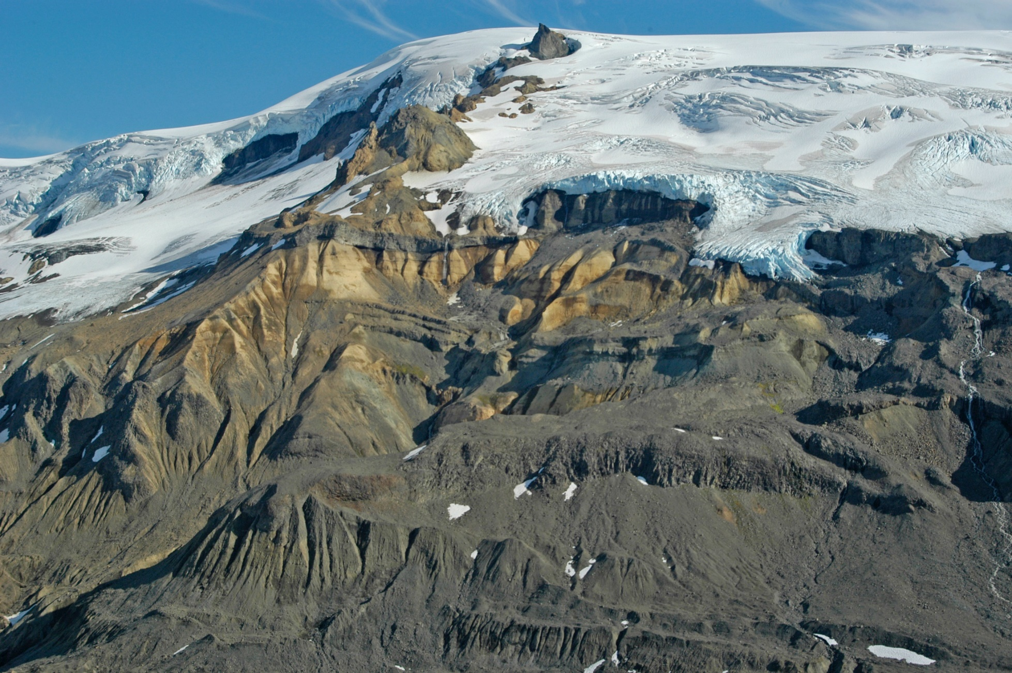
British Columbia
Image: Ben Edwards
Hoodoo Mtn
Polygenetic glaciovolcanic edifice
Notes:
Lowest grey units are ice-dammed lava flows, overlain by altered pyroclastic deposits (yellow, middle) and glaciovolcanic domes and lavas (upper nunatak)

Slide 24
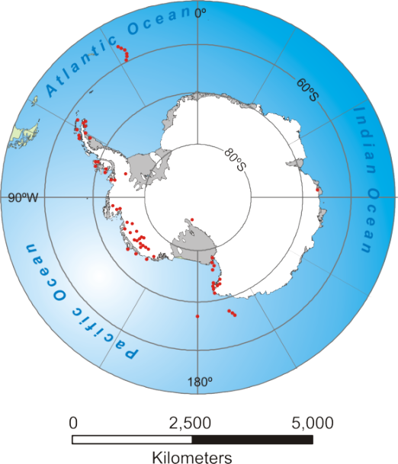
Antarctica – distribution of volcanic centres
Mainly large polygenetic centres
volcanoes
Notes:
Antarctica is the largest & longest-lived glaciovolcanic province on Earth, with a history of eruptions extending back to 28 Ma, at least

Slide 25
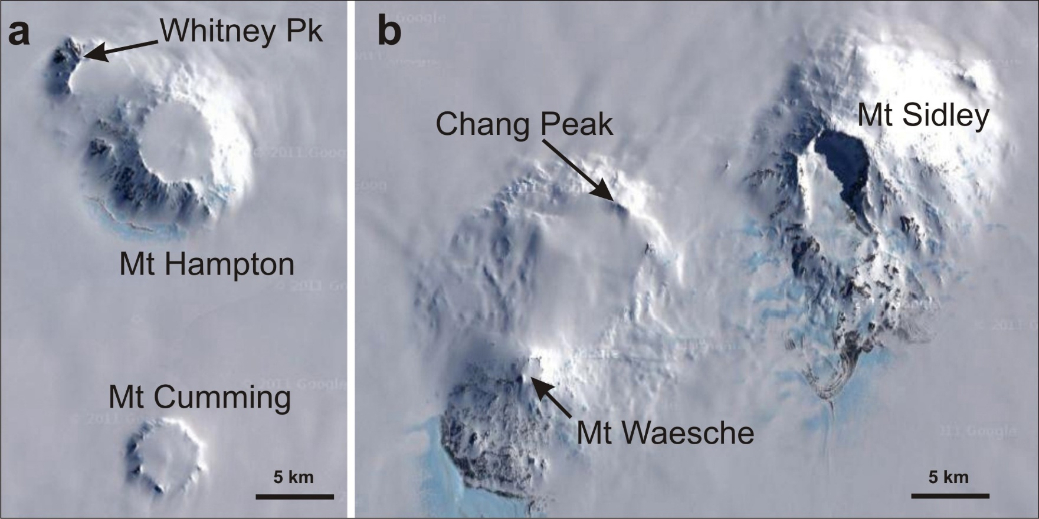
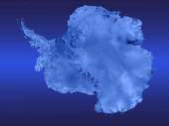
Antarctica
Images: GoogleEarth
Glaciovolcanic stratovolcanoes
Notes:
Large polygenetic volcanoes are common in West Antarctica, largely submerged by the West Antarctic Ice Sheet. Although very well preserved, the volcanoes shown range in age from 14 Ma (Whitney Peak) to < 170 ka (Mt Waeshe, probably active). Mt Sidley (4-5 Ma) is the highest volcano in Antarctica

Slide 26
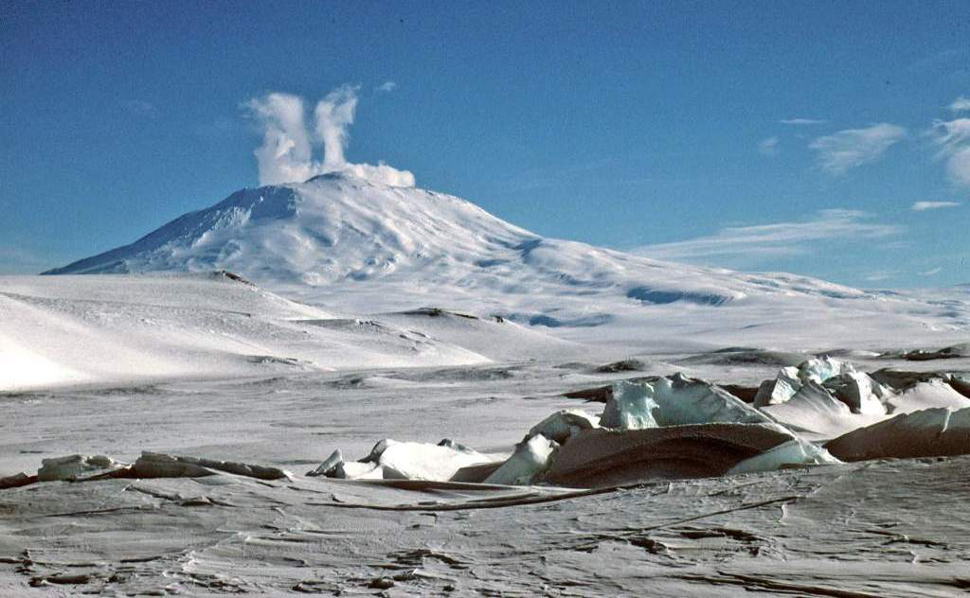
Antarctica
Image: John Smellie
Mount Erebus
Glaciovolcanic stratovolcano
Notes:
Mt Erebus is the most active volcano in Antarctica. It has a permanent convecting phonolite lava lake in the summit crater, the source of the steam plume seen in the image

Slide 27
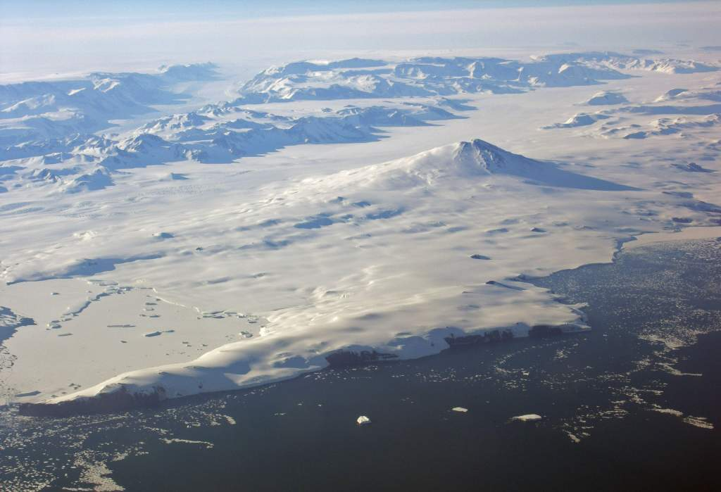
Antarctica
Image: Sergio Rocchi
Mount Melbourne
Glaciovolcanic stratovolcano
Photo by Sergio Rocchi
Notes:
Mt Melbourne is another active volcano in Antarctica

Slide 28
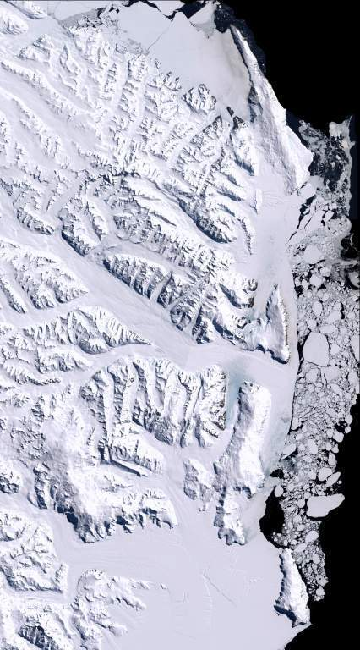
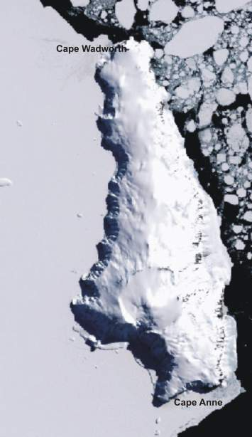
Source:
Antarctica
Glaciovolcanic shield volcanoes
North Victoria Land
Smellie et al. (2011a)
Notes:
The large polygenetic shield volcanoes in northern Victoria Land are ringed in yellow & red, each formed of multiple overlapping volcanic constructs probably erupted from fissures. The volcanoes are formed mainly of multiple successive aa lava-fed deltas erupted in late Miocene and Pliocene time

Slide 29
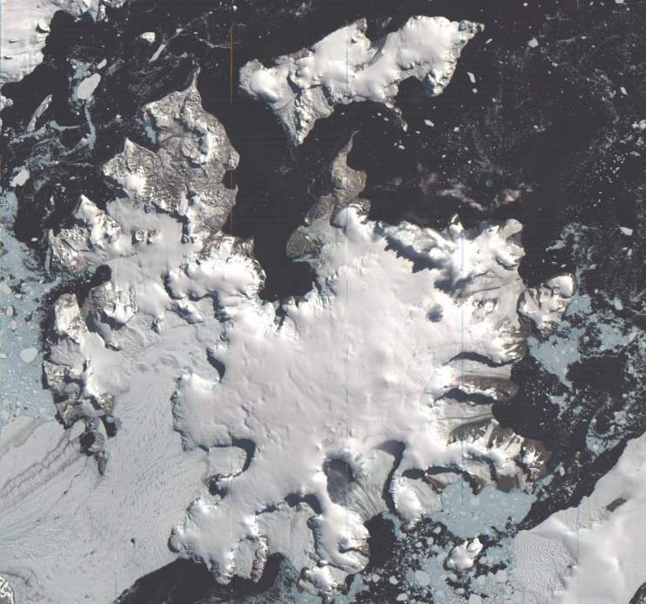
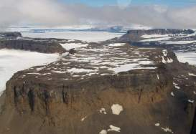
Antarctica
Images: John Smellie
Earth’s largest glaciovolcanic
shield volcano
James Ross Island
Notes:
The largest glaciovolcanic edifice on Earth, 60 km in diameter, is mainly formed of multiple large-volume pahoehoe lava-fed deltas

Slide 30
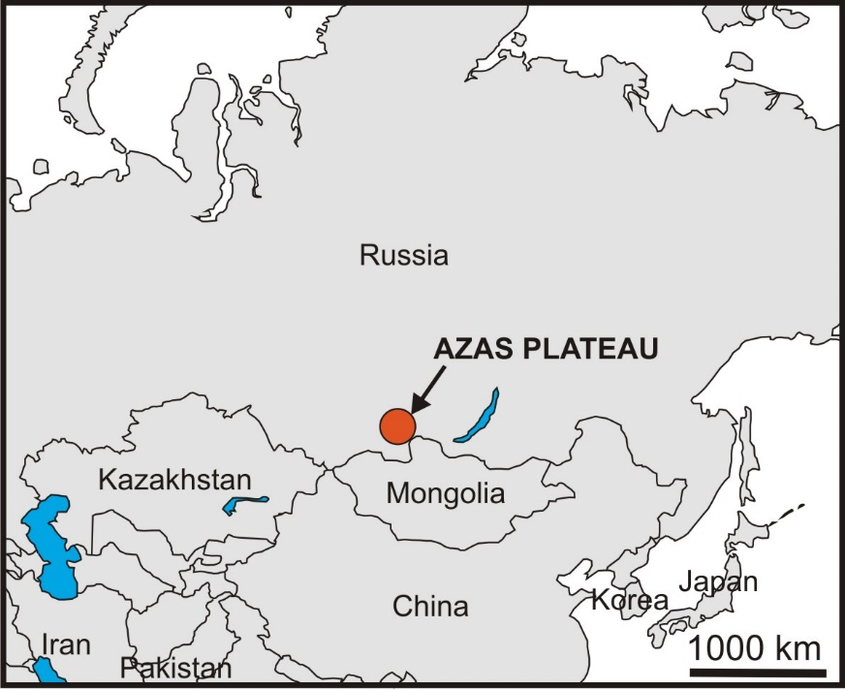
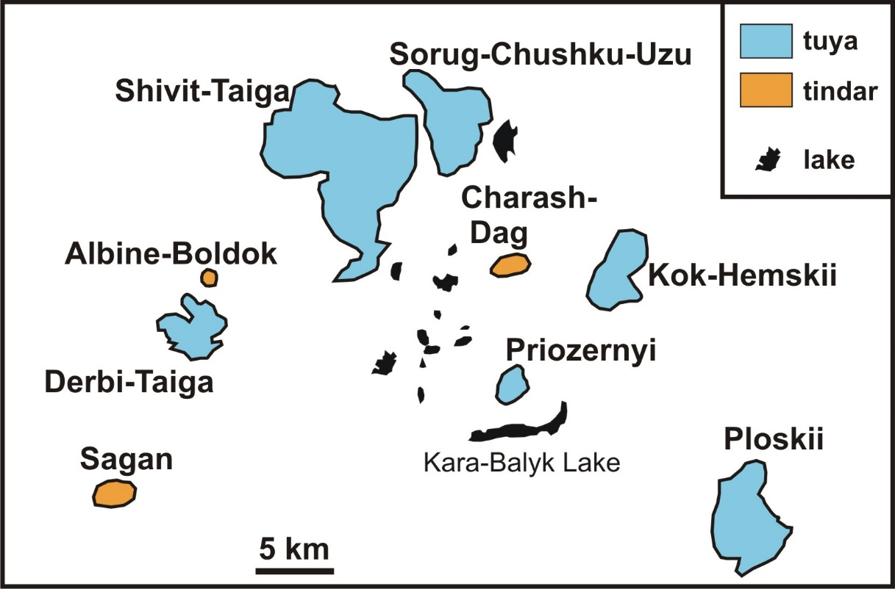
Azas Plateau, Russia – distribution of volcanic centres
[modified after Komatsu et al., 2007]

Slide 31
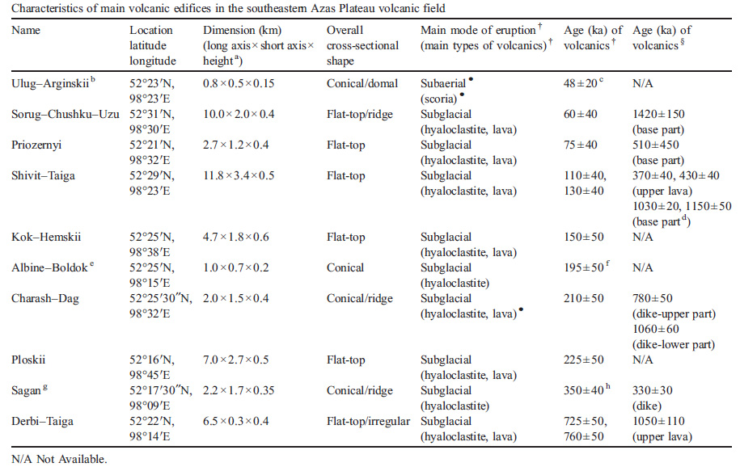
Azas Plateau
List of volcanic landforms
Komatsu et al., 2007
Tuya
Tindar

Slide 32
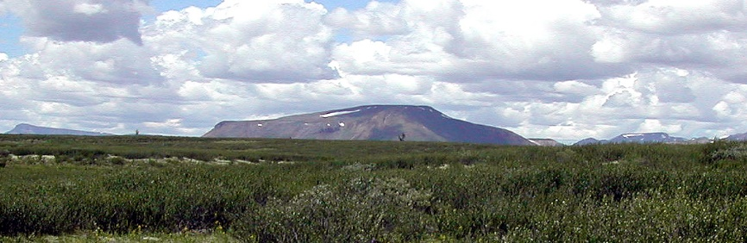
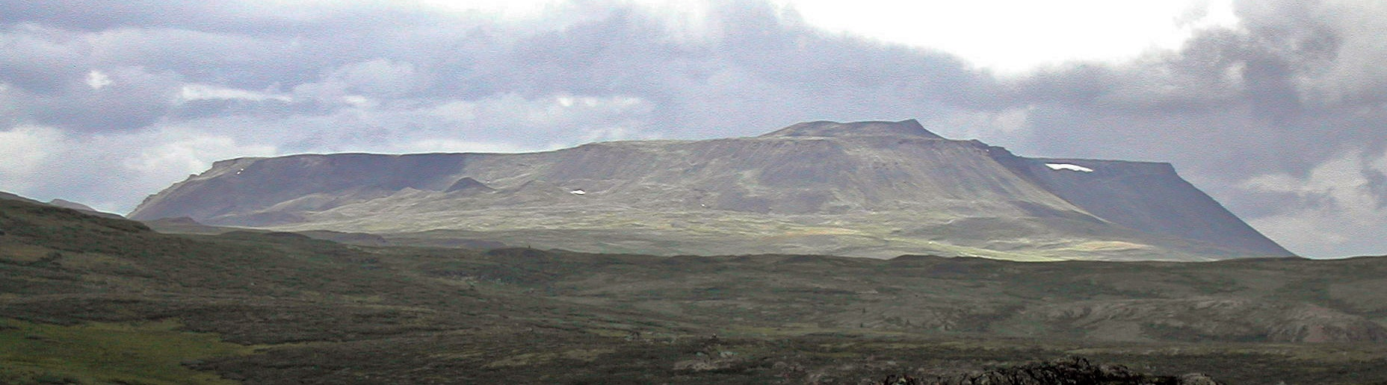
Azas Plateau
Tuyas
Images: Goro Komatsu
Priozernyi
Derbi-Taiga
Shivit-Taiga
Sorug-Chushku-Uzu
Komatsu et al., 2007

Slide 33
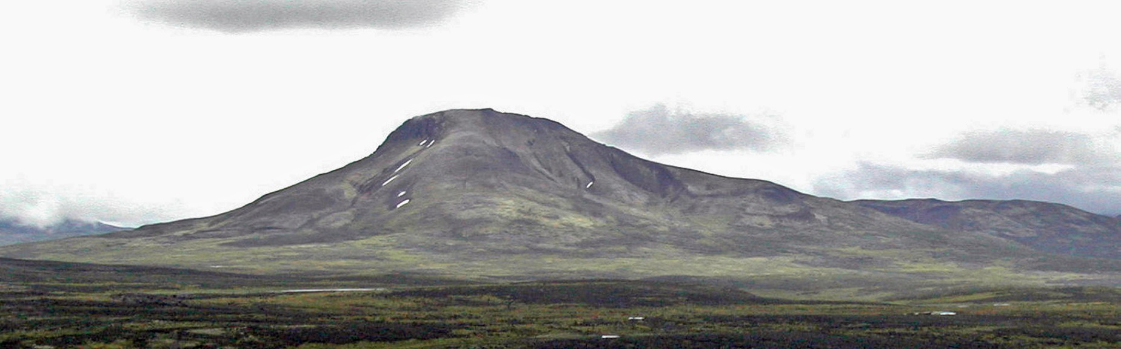
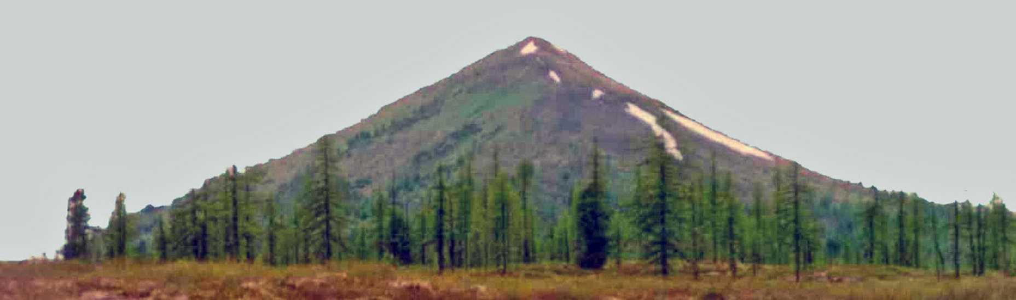
Azas Plateau
Tindars
Images: Goro Komatsu
Charash-Dag
Sagan
Komatsu et al., 2007

Slide 34
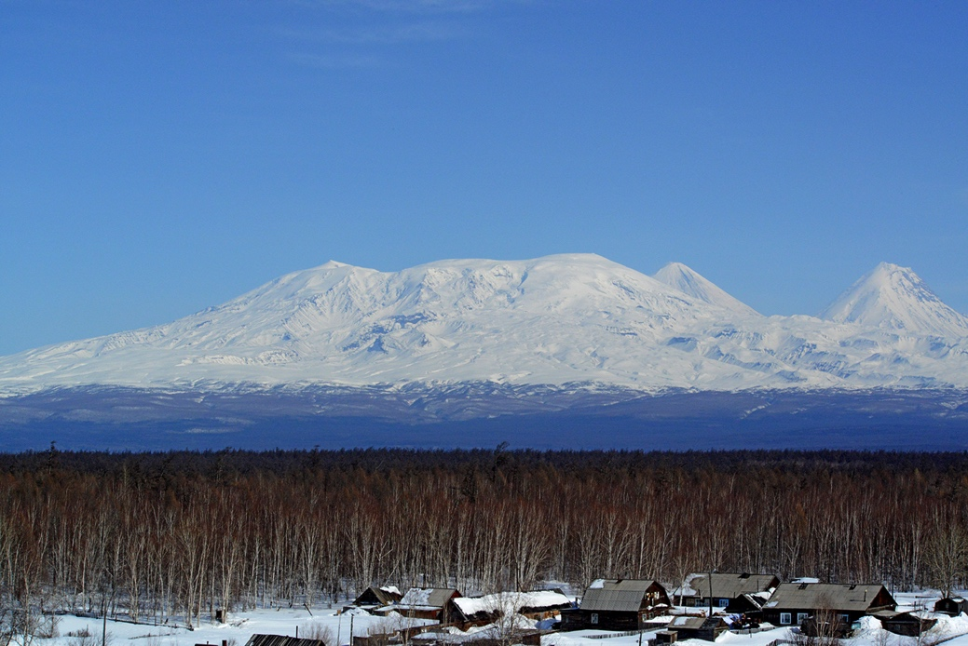
Ice-capped volcanoes
Image: Ben Edwards
Ushkovsky, Kamchatka, Russia
Notes:
Ushkovsky volcano has an ice-filled caldera but has not been studied in detail

Slide 35
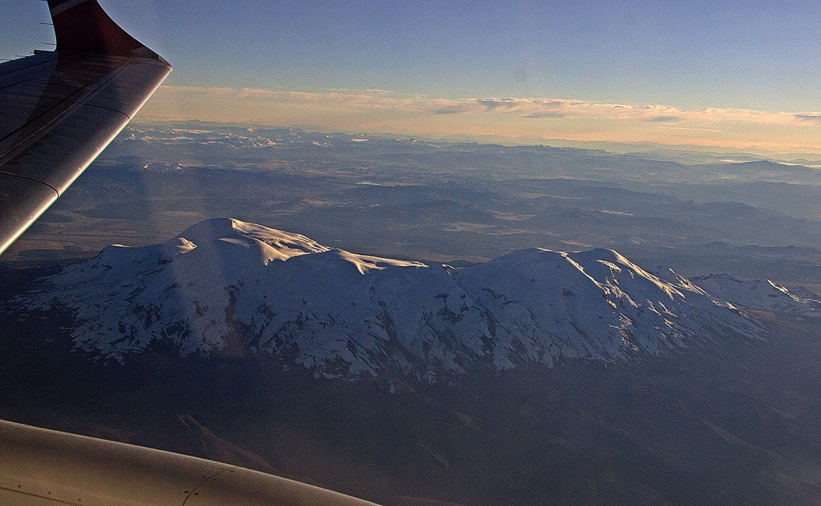
Ice-capped volcanoes
Image: Ben Edwards
Coropuna, Peru
Notes:
The Coropuna volcanic complex is presently being remapped and several ice-contact deposits have been identified (by BE) in addition to Holocene subaerial lava flows

Slide 36
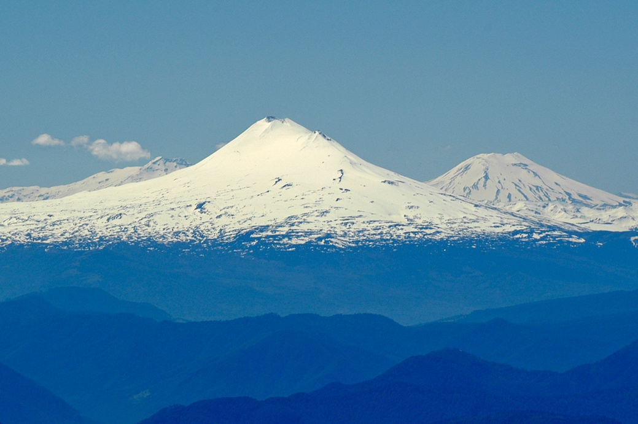
Ice-capped volcanoes
Image: Ben Edwards
Llaima, Chile
Notes:
Llaima volcano is covered by glaciers even though it is historically active. Lonquimay volcano is also seen at RHS

Slide 37
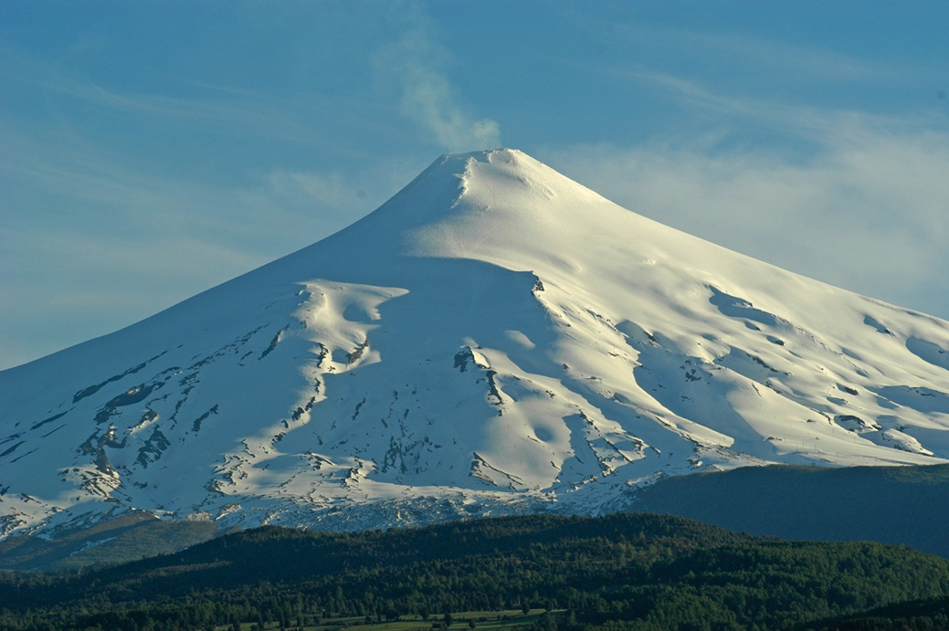
Ice-capped volcanoes
Image: Ben Edwards
Villarrica, Chile
Notes:
The summit cone on Villarrica volcano contains an active lava lake that undergoes frequent eruptions. Small glaciers surround the summit starting at 200-300 m below the crater rim

Slide 38
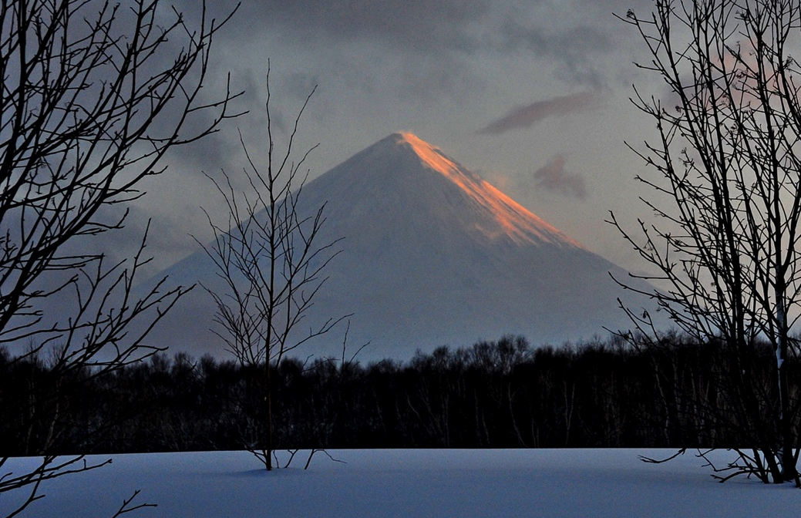
Snow-clad volcanoes
Image: Ben Edwards
Klyuchevskoy, Russia
Notes:
Klyuchevskoy volcano is over 4000 m high. It is snow covered and does not support summit ice because it is highly active

Slide 39

Snow-clad volcanoes
Image: Ben Edwards
Sabancaya, Peru
Notes:
Sabancaya volcano is snow covered much of the year and is historically active (gas plume coming from summit in June 2015)

Slide 40

Snow-clad volcanoes
Image: Ben Edwards
Tolbachik cones, Russia
Notes:
View of new tephra cones formed during the 2012-13 eruption on the south flank of Tolbachik volcano, Kamchatka. This eruption was below the limit of ice on the upper part of the volcano but produced extensive lava-snow interactions

Slide 41
SUMMARY
1. Snow- & ice-clad volcanoes, past and present, are scattered across the world.
2. Active glaciovolcanoes are common and are a volcanic hazard.
3. Most glaciovolcanoes are in polar or sub-polar localities; several snow- &
ice-capped volcanoes occur at lower latitudes.
4. They are important for assessing Earth’s water inventory, now and in the past.

