Slide 1
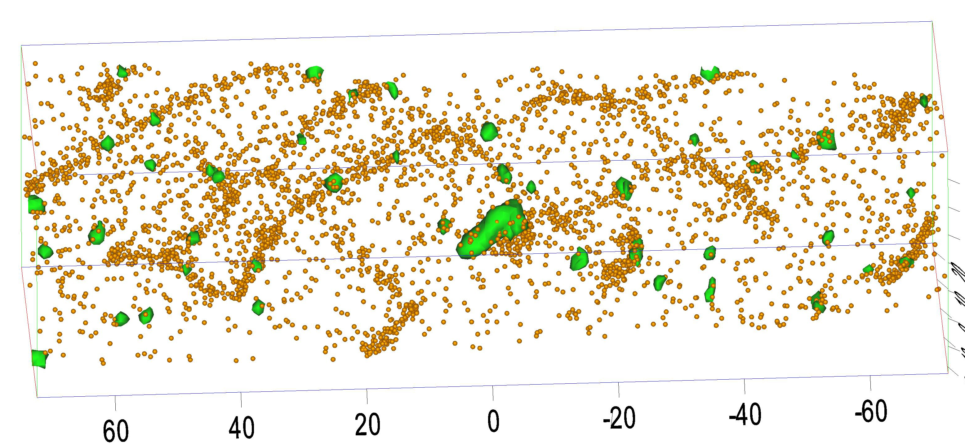

Slide 2
y
x
positive kink
negative kink
potential ridges
Notes:
1.71” x 3”, jpg.

Slide 3
a
Notes:
0.67” x 5”, tiff.

Slide 4
d
θ
Notes:
0.55” x 3, tiff.

Slide 5
dislocation
bowed out
dislocation
Notes:
1.43” x 4”, tiff.

Slide 6
P
A
Q
Notes:
1.07” x 3”, tiff.

Slide 7
bowed out dislocation
Q
P
Notes:
1.02” x 3”, tiff.

Slide 8
y
z
x
b_{e}
Q
ξ
b
P
a
glide planes
Notes:
3.09” x 4”, tiff.

Slide 9
A
C
Notes:
1.84” x 3”, tiff.

Slide 10
crystal A
crystal B
δV
Notes:
3.39” x 3”, tiff.

Slide 11
P
v_{a}
A
P
δV
Notes:
3.27” x 3”, tiff.

Slide 12
Notes:
3.79” x 3”, tiff.

Slide 13
(a)
(b)
Notes:
2.24” x 5”, tiff.

Slide 14
R
r₀
Notes:
2.85” x 3”, tiff.

Slide 15
B
A
Notes:
2.14” x 3”, tiff.

Slide 16
z
R
Q
y
P
x
Notes:
4.15” x 5”, tiff.

Slide 17
inserted plane
A
B
Notes:
1.59” x 3”, tiff.

