Slide 1
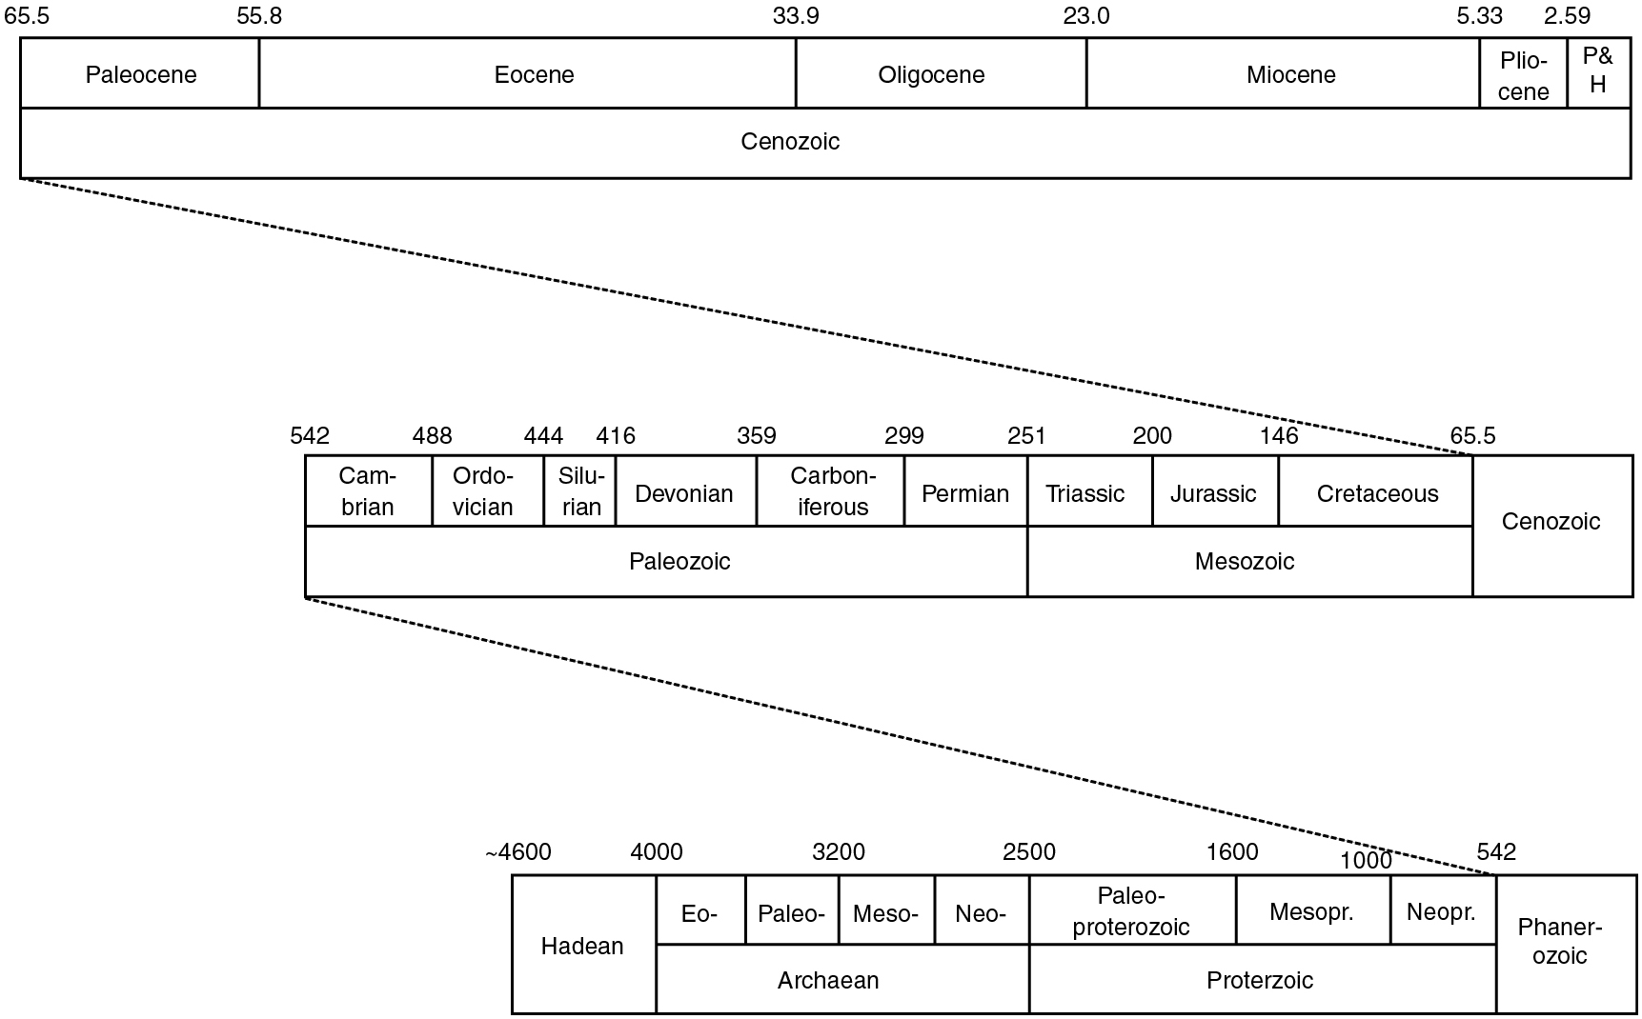
PILSON_Fig 15_01
© Cambridge University Press 2012

Slide 2
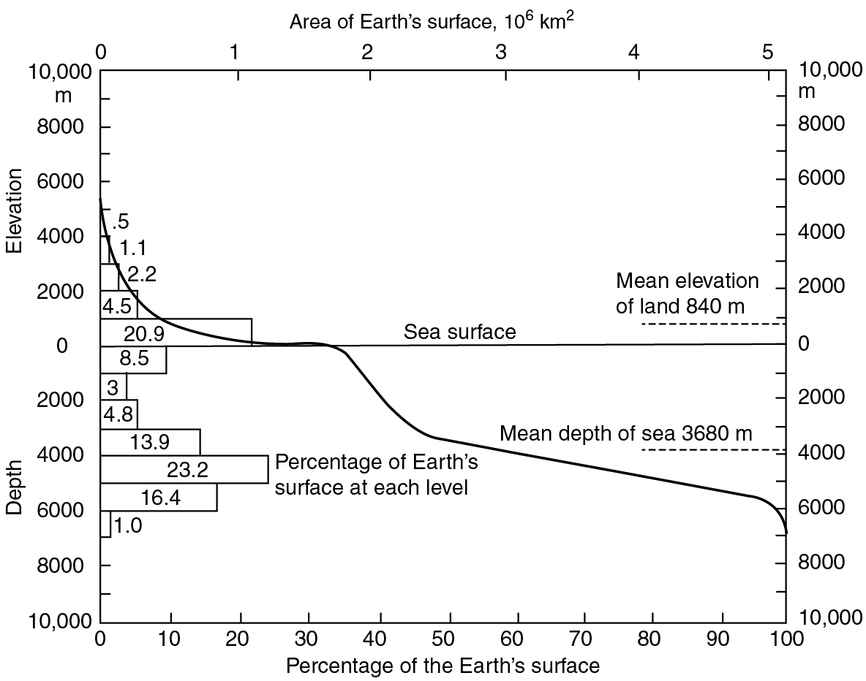
PILSON_Fig 15_02
© Cambridge University Press 2012

Slide 3
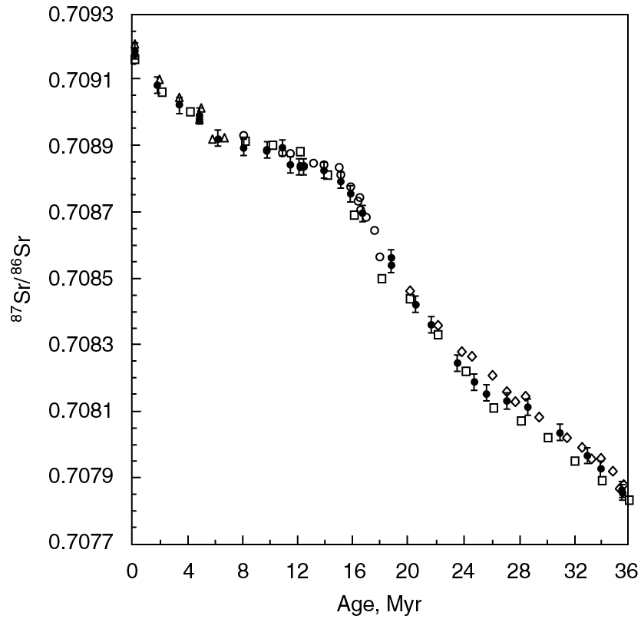
PILSON_Fig 15_03
© Cambridge University Press 2012

Slide 4
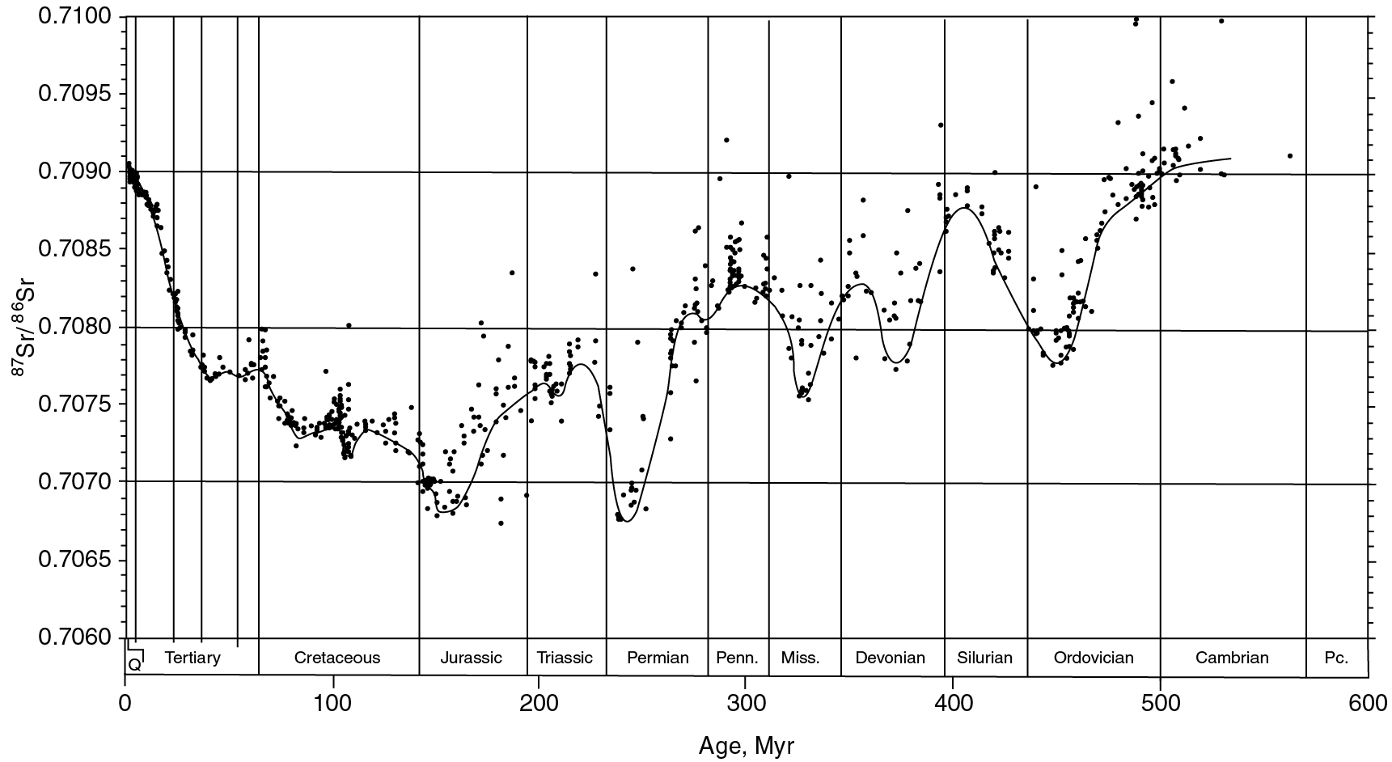
PILSON_Fig 15_04
© Cambridge University Press 2012

Slide 5
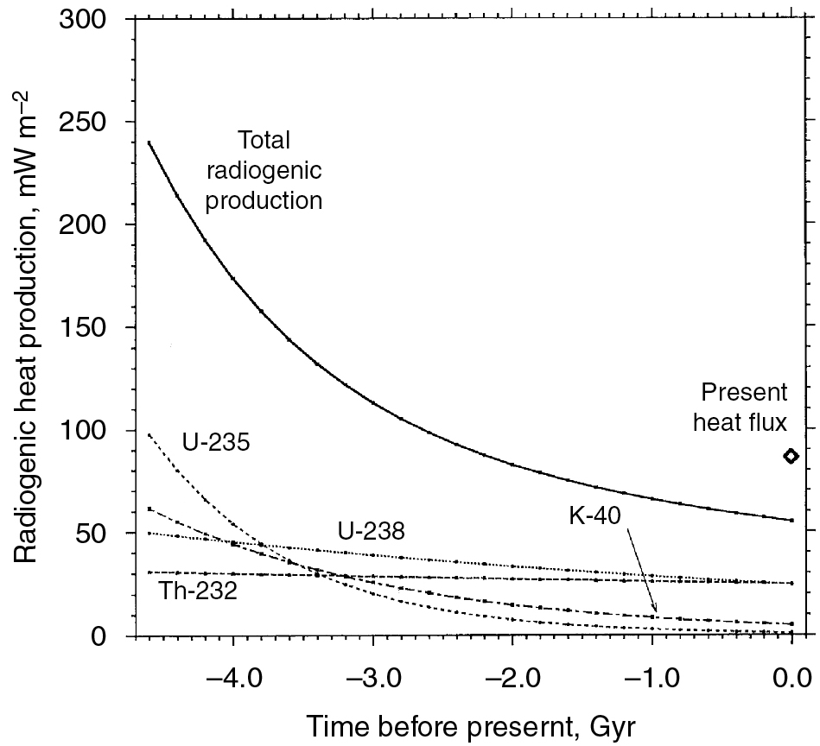
PILSON_Fig 15_05
© Cambridge University Press 2012

