Slide 1
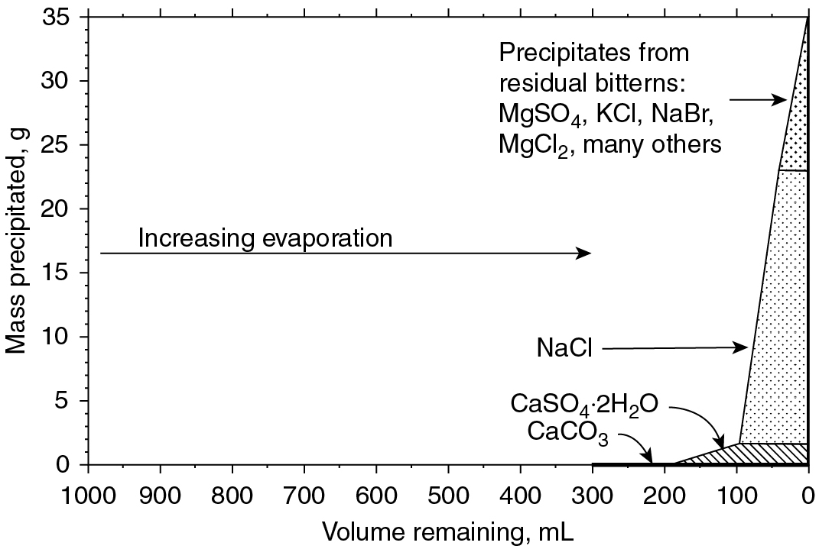
PILSON_Fig 14_01
© Cambridge University Press 2012

Slide 2
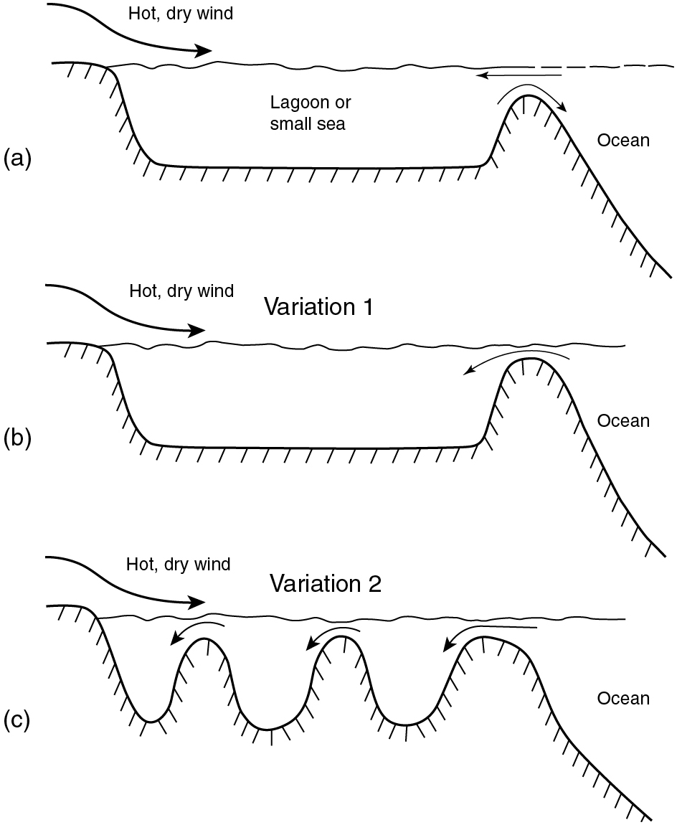
PILSON_Fig 14_02
© Cambridge University Press 2012

Slide 3
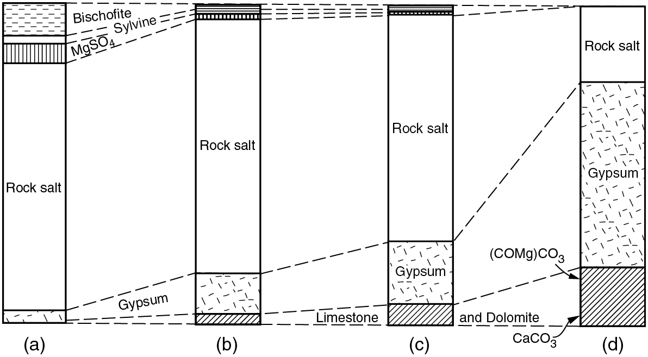
PILSON_Fig 14_03
© Cambridge University Press 2012

