Slide 1
Digital Design: A Systems Approach Lecture 9: Microcode

Slide 2
Readings
L9: Chapter 18
L10: Chapters 21, 22, & 20

Slide 3
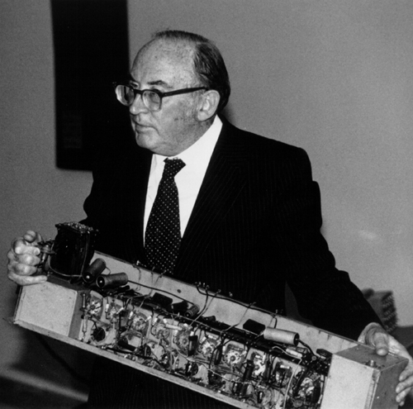
Sir Maurice Wilkes with a piece of EDSAC

Slide 4
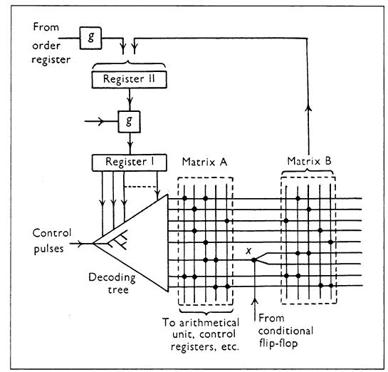
Figure from Wilkes 1953 paper on Microcode

Slide 5
Microcode – an FSM realized with a memory array
Original concept by Wilkes (1951)
Put state table in a memory (ROM or RAM)
Address with current state and input
Output is next state and output

Slide 6
Microcode – the picture
Memory size: 2^{s+i} s+o bit words

Slide 7
Example: Simple Light-Traffic Controller
carew
gns
carew
yns
gew
yew
100 001
010 001
001 100
001 010
state
output
gyr gyr
ns ew

Slide 8
Re-writing State Table Of Example
State
carew
address
data
gns
00
0
000
00100001
00
1
001
01100001
yns
01
0
010
11010001
01
1
011
11010001
gew
11
0
110
10001100
11
1
111
10001100
yew
10
0
100
00001010
10
1
101
00001010

Slide 9
Microcode Of Light-Traffic Controller
00100001
state
01100001
next
2
D
Q
2
11010001
11010001
3
10001100
8
carew
10001100
n_out
lights
00001010
D
Q
00001010
6
6
clk

Slide 10
Microcoded Traffic Light Controller – in Verilog
module ucodeTLC(clk,rst,in,out) ;
parameter n = 1 ; // input width
parameter m = 6 ; // output width
parameter k = 2 ; // bits of state
input clk, rst ;
input [n-1:0] in ;
output [m-1:0] out ;
wire [k-1:0] next, state ;
wire [k+m-1:0] uinst ;
DFF #(k) state_reg(clk, next, state) ; // state register
DFF #(m) out_reg(clk, uinst[m-1:0], out) ; // output register
ROM #(n+k,m+k) uc({state, in}, uinst) ; // microcode store
assign next = rst ? {k{1'b0}} : uinst[m+k-1:m] ; // reset state
endmodule

Slide 11
Waveforms Of Light-Traffic Controller Microcode
00100001
01100001
10010001
10010001
11001100
11001100
00001010
00001010

Slide 12
A New-and-Improved Light-Traffic Controller
Additional functions to original Light-Traffic Controller:
Light stays green in eat-west direction as long as car_ew is true.
Light stays green in north-south direction for a minimum of 3 states (GNS1, GNS2, and GNS3).
After a yellow light, lights should go red in both directions for 1 cycle before turning new light green.

Slide 13
Light-Traffic Control State Diagram
car_ew
car_ew
GNS1
GNS2
GNS3
YNS
100 001
100 001
100 001
010 001
car_ew
car_ew
REW
YEW
GEW
RNS
001 001
001 010
001 100
001 001

Slide 14
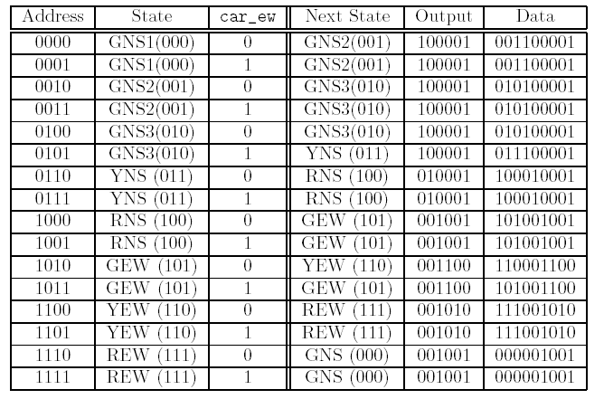
Light-Traffic Controller State Microcode

Slide 15
Waveforms Of Light-Traffic Controller Microcode
001100001
001100001
010100001
010100001
010100001
011100001
100010001
100010001
101001001
101001001
110001100
101001100
111001010
111001010
000001001
000001001

Slide 16
Instruction Sequencing
With lot of inputs, size of memory increases rapidly (exponentially).
Can reduce memory size by observing:
Most of the time we move to the next state.
We usually only need to branch to one other state based one (or a few) inputs.
Add a microprogram counter (μPC) register to simplify state sequencing.

Slide 17
Instruction Sequencing – the picture
branch_target
+1
0
Mux3
s
s
1
nuPC
D
Q
uPC
a
Memory
d
s
s
s
s+o+b
0
2
s
n_out
out
3
o
D
Q
o
inputs
i
Branch
clk
Logic
branch_instruction
b

Slide 18
Branching Logic
Branch logic selects between μPC+1 and branch_target, depending on input and branch_instruction.
Instructions are of the form branch if f(inputs)
For example branch if car_ew or branch if not car_ew.

Slide 19
Branch Microinstructions
Opcode | Encoding | Description
NOP | 000 | No branch – always go to next instruction
br | 100 | Always branch
brlt | 001 | Branch when left-turn car is detected
brnlt | 101 | Branch if no left-turn car is detected
brew | 010 | Branch when east-west car is detected
brnew | 110 | Branch if no east-west car is dected

Slide 20
Microcode Of Traffic-Light Controller With Branches
State
Addr
Inst
Target
Output
nsg1
0000
brlt
lt1
100001001
green ns
nsg2
0001
brnew
nsg1
100001001
green ns
ew1
0010
nop
010001001
yellow ns
ew2
0011
brew
ew2
001001100
green ew
ew3
0100
br
nsg1
001001010
yellow ew
lt1
0101
nop
010001001
yellow ns
lt2
0110
brlt
lt2
001100001
green lt
lt3
0111
br
nsg1
001001010
yellow lt

Slide 21
Microinstruction Format
For our example:
b = 3
s = 4
o = 9

Slide 22
Implementing Microcode Of Light-Traffic Controller With Branches Using Verilog
module ucodeIS(clk,rst,in,out) ;
parameter n = 2 ; // input width
parameter m = 9 ; // output width
parameter k = 4 ; // bits of state
parameter j = 3 ; // bits of instruction
input clk, rst ;
input [n-1:0] in ;
output [m-1:0] out ;
wire [k-1:0] nupc, upc ; // microprogram counter
wire [j+k+m-1:0] uinst ; // microinstruction word
// split off fields of microinstruction
wire [m-1:0] nxt_out ; // = uinst[m-1:0] ;
wire [k-1:0] br_upc ; // = uinst[m+k-1:m] ;
wire [j-1:0] brinst ; // = uinst[m+j+k-1:m+k] ;
assign {brinst, br_upc, nxt_out} = uinst ;
DFF #(k) upc_reg(clk, nupc, upc) ; // microprogram counter
DFF #(m) out_reg(clk, nxt_out, out) ; // output register
ROM #(k,m+k+j) uc(upc, uinst) ; // microcode store
// branch instruction decode
wire branch = (brinst[0] & in[0] | brinst[1] & in[1]) ^ brinst[2] ;
// sequencer
assign nupc = rst ? {k{1'b0}} : branch ? br_upc : upc + 1'b1 ;
endmodule

Slide 23
Microcode Of Light-Traffic Controller With Left Turn

Slide 24
Waveforms Of Light-Traffic Controller With Left Turn Microcode
0010101100001001
1100000100001001
0000000010001001
0100011001001100
1000000001001010
0000000010001001
0010110001100001
1000000001010001

Slide 25
Alternate Microcode For Light-Traffic Controller With Left Turn
Previous microcode has:
2 states with GNS light (NS1 & NS2)
2 states with YNS light (EW1 & LT1)
By adding a new branch instruction – BNA (branch on “not any”)
1 state with GNS light (NS1)
1 state with YNS light (NS2)

Slide 26
Waveforms Of Alternate Microcode
1110000100001001
0010100010001001
0100010001001100
1000000001001010
0010100001100001
1000000001010001

Slide 27
Multiple Instruction Types
For some FSMs the micro-instruction word can start getting a bit long.
To shorten it, we observe:
Not every state needs a branch
Not every output changes on every state
Define instruction that does just a branch or a load of one register:
brx – 1yyyvvvv - branch to value vvvv on condition yyy
ldx - 0yyyvvvv - load register yyy with value vvvv

Slide 28
Instruction Format Of Microcode With 2 Instruction Types
Branch Instruction
Store Instruction
1
condition
branch target
0
destination
value
1
3
4
1
3
4
Branch Instructions:
Operates branch mux as before
No write to output registers
Load Instructions:
Sets branch mux to +1
Update selected output register:
Can include other datapath components – e.g., timer in place of an output register

Slide 29
One step on the path to a processor
State table → Branch Inst → Branch and Load Insts → Full Instruction Set

Slide 30
Block Diagram Of Microcode With Output Instructions

Slide 31
Microcode For Traffic-Light Controller With brx & ldx Instructions
Registers to load: ldns – load north/south light with value ldlt – load left-turn light with value ldew – load east/west light with value ltim1 – load timer 1 with value – starts timer

Slide 32
Microcode For Traffic-Light Controller With brx & ldx Instructions (Cont)
EW to
Red
NS
Green
Back to NS
Until input
Wait for NS Red,
make LT
Green
NS
Yellow
to Red
EW or LT?
Wait for NS Red,
make EW
Green
LT to
Red
Back to NS

Slide 33
Implementing Traffic-Light Controller Microcode With brx & ldx Instructions In Verilog
//----------------------------------------------------------------------
module ucodeMI(clk,rst,in,out) ;
parameter n = 2 ; // input width
parameter m = 9 ; // output width
parameter o = 3 ; // output sub-width
parameter k = 5 ; // bits of state
parameter j = 4 ; // bits of instruction
input clk, rst ;
input [n-1:0] in ;
output [m-1:0] out ;
wire [k-1:0] nupc, upc ; // microprogram counter
wire [j+k-1:0] uinst ; // microinstruction word
wire done ; // timer done signal
// split off fields of microinstruction
wire opcode ; // opcode bit
wire [j-2:0] inst ; // condition for branch, dest for store
wire [k-1:0] value ; // target for branch, value for store
assign {opcode, inst, value} = uinst ;
To be continued on next page…

Slide 34
Implementing Traffic-Light Controller Microcode With brx & ldx Instructions In Verilog (Cont)
DFF #(k) upc_reg(clk, nupc, upc) ; // microprogram counter
ROM #(k,k+j) uc(upc, uinst) ; // microcode store
// output registers and timer
DFFE #(o) or0(clk, e[0], value[o-1:0], out[o-1:0]) ; // NS
DFFE #(o) or1(clk, e[1], value[o-1:0], out[2*o-1:o]) ; // EW
DFFE #(o) or2(clk, e[2], value[o-1:0], out[3*o-1:2*o]) ; // LT
Timer #(k) tim(clk, rst, e[3], value, done) ; // timer
// enable for output registers and timer
wire [3:0] e = opcode ? 4'b0 : 1<<inst ;
// branch instruction decode
wire branch = opcode ? (inst[2] ^ (((inst[1:0] == 0) & in[0]) | // BLT
((inst[1:0] == 1) & in[1]) | // BEW
((inst[1:0] == 2) & (in[0]|in[1])) | //BLE
((inst[1:0] == 3) & done))) // BTD
: 1'b0 ; // for a store opcode
// microprogram counter
assign nupc = rst ? {k{1'b0}} : branch ? value : upc + 1'b1 ;
endmodule

Slide 35
Extending this to a processor
Add three new instructions
ADD
R2 <- R1+R0
LOAD
R2 <- M[R1+R0]
STORE
M[R1+R0] <- R2
And add registers R0, R1, R2 – can also target these with LDR
Opcode 000 – Branch, 001 – LDR, 010 – ADD, 011 LOAD, 100 STORE
Branch and LDR take condition/register and value fields
ADD, LOAD, STORE ignore these fields
Can tweak the instruction set to make this more efficient.

Slide 36
Summary
Microcode is just FSM implemented with a ROM or RAM
One address for each state x input combination
Address contains next state and output
Adding a sequencer reduces size of ROM/RAM
One entry per state rather than 2^{i}
uPC, incrementer, branch address, and branch control
Adding instruction types reduces width of ROM/RAM
Branch or output in each instruction – rather than both
Type field specifies which one
One step away from a full processor
Just add more instructions

