Slide 1
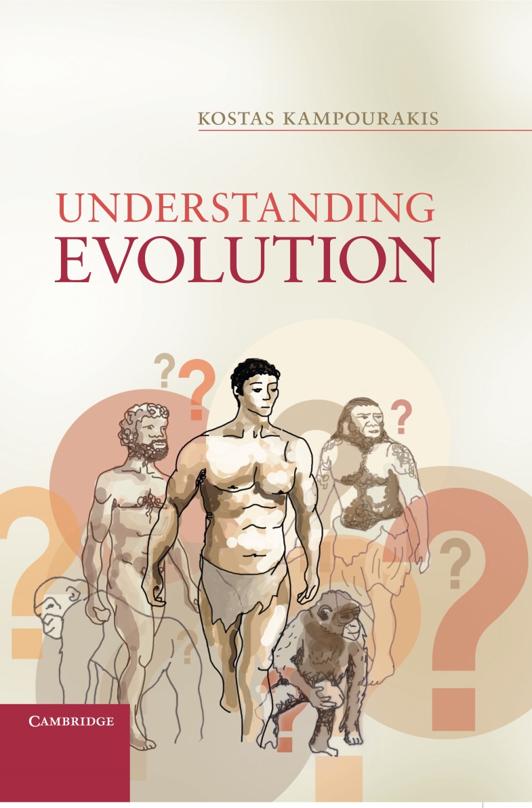
Chapter 6
Evolutionary change

Slide 2
Figure 6.1
Historical and ahistorical definitions of adaptation. According to the historical definition of adaptation, the brown color of beetles is an adaptation only if a) has taken place, independently of whether b) or d) are currently taking place. According to the ahistorical definition of adaptation the brown color of beetles is an adaptation only if d) is currently taking place, independently of whether a) or c) took place in the past (in all cases proportions, not actual numbers of the various types of individuals, are depicted).

Slide 3
Figure 6.2
Adaptation and exaptation (t1-t4 are used to temporally divide processes P1 and P2). In P1, brown color in beetles is an adaptation because it was selected (from time t1 to time t4) for conferring an advantage (concealment) to its bearers in the dark environment. In P2, brown color became prevalent in the population of beetles up to time t2 without conferring an advantage, as the environment had a light color and so there was no advantage for beetles with brown color. Reasons other than selection for (e.g. more brown beetles happened to reproduce compared to green beetles) increased the frequency of brown beetles in the population. However, after an environmental change that made the environment darker, brown beetles had a concealment advantage. From t3 to t4 they were selected for this advantage and increased in frequency. In this case, brown color was “co-opted” and so it is an exaptation (in all cases proportions, not actual numbers of the various types of individuals, are depicted).

Slide 4
Figure 6.3
Selection for size and selection of color (based on Sober 1993, p.99). White balls are also the larger ones and do not pass through the holes. Light gray balls are smaller and pass to the next layer. Dark gray balls are even smaller and pass to the next layer. However, only black balls pass to the bottom layer because they are the smallest. In this case, there is selection size (small balls pass to the bottom layer; large balls do not) and selection of color (black balls pass to the bottom layer because they are also small; white balls do not because they are also large).

Slide 5
Figure 6.4
Selection against and selection for. In both cases dark green and dark brown beetles initially live in a dark brown environment. In the first case, only the dark brown beetles survive while the dark green ones are quickly eliminated; there is selection against the latter. In the second case, there is a gradual selection for brown color over many generations with a gradual accumulation of useful variations: not only dark brown beetles but also light brown ones can be well adapted (in all cases proportions, not actual numbers of the various types of individuals, are depicted).

Slide 6
Figure 6.5
Drift due to indiscriminate parent sampling. Only those individuals that happened to survive produced offspring; because more brown rather than green beetles survived, the frequencies of the different varieties in the population changed (in all cases proportions, not actual numbers of the various types of individuals, are depicted).

Slide 7
Figure 6.6
Genetic draft: there is selection for brown color, but also of black or white wing blades in beetles depending on which of the alleles are linked. Whether black or white wing blades will become the prevalent character in the population is a matter of chance, depending on which of the two alleles is linked to the allele that affects the character which is being selected for (brown color) (in all cases proportions, not actual numbers of the various types of individuals, are depicted).

Slide 8
Figure 6.7
Contingency in evolution. Which of the two evolutionary paths will be taken is unpredictable. Once a path is taken there is a causal dependence of the outcome on the antecedent conditions (in all cases proportions, not actual numbers of the various types of individuals, are depicted).

Slide 9
Figure 6.8
The continuum between allopatry and sympatry. At one extreme the two populations are completely separated because of a geographic barrier (e.g. a river) they cannot cross (allopatry). At the other extreme, the two populations live together (pure sympatry). Between these two extremes, the two populations might interact slightly (parapatry) or quite extensively at specific locations (mosaic sympatry) (adapted from Mallet 2008; Mallet et al., 2009) (in all cases proportions, not actual numbers of the various types of individuals, are depicted).

Slide 10
Figure 6.9
An illustration of the so-called ring species. Populations A and Y initially evolved from a common ancestral population. Individuals from populations living close to each other can interbreed successfully (B with A; A with Y; Y with Z), whereas those living further away cannot. Although populations B and Z live close to each other, they cannot interbreed successfully because they have diverged and currently are reproductively isolated. In this case, B and Z can be considered as distinct species. This could also be the case for A and Z, as well as for B and Y (in all cases proportions, not actual numbers of the various types of individuals, are depicted).

Slide 11
Figure 6.10
The continuum of speciation. Species may split to more lineages, and evolve by diverging, remaining the same or going extinct (adapted from Ptacek and Hankinson, 2009, p.178). One problem is not so much the incompleteness of the fossil record, but the fact that one cannot deal with 'species' in the same way when dealing with extant and extinct organisms. In particular, in the case of lineages where considerable anagenesis but no cladogenesis, occurs, specimens samples, e.g. at 10 million year intervals can be so different as to invite recognition of separate species. However, these are not comparable to extant, distinct species derived from repeated cladogenesis from a common ancestor.

Slide 12
Figure 6.11
Tempo and mode in evolution (adapted from Jablonski 2007, p.91

Slide 13
Figure 6.12
The importance of antecedent conditions in evolution 1) natural selection, 2) drift, 3) no change (in all cases proportions, not actual numbers of the various types of individuals, are depicted).

Slide 14
Table 6.1
Some major events in evolution in actual time and in a 24 hour equivalent, compared to some widely (dates from Benton 2009; Knoll and Hewitt 2011). Note that the period during which dinosaurs lived on Earth, that might seem to be a long time ago, is actually quite recent.

Slide 15
Table 6.2
The geologic time scale (based on Macdougall 2008, p.240; a complete version can be found in Ogg, Ogg and Gradstein, 2008 or at www.stratigraphy.org; mya: million years ago; bya: billion years ago).

Slide 16
Table 6.3
The major transitions in evolution (based on Maynard Smith and Szathmáry 2000, pp.16-19)

Slide 17
Table 6.4
Conditions in order for a character to be considered as an adaptation according to the historical and ahistorical definitions

Slide 18
Table 6.5
Barriers causing reproductive isolation (adapted from Coyne and Orr 2004, pp.28-29)

Slide 19
Table 6.6
Proposed species-level and organismal-level traits which are hypothesized to have impact on rates of speciation and extinction.

