Slide 1
Fig23_01

Slide 2
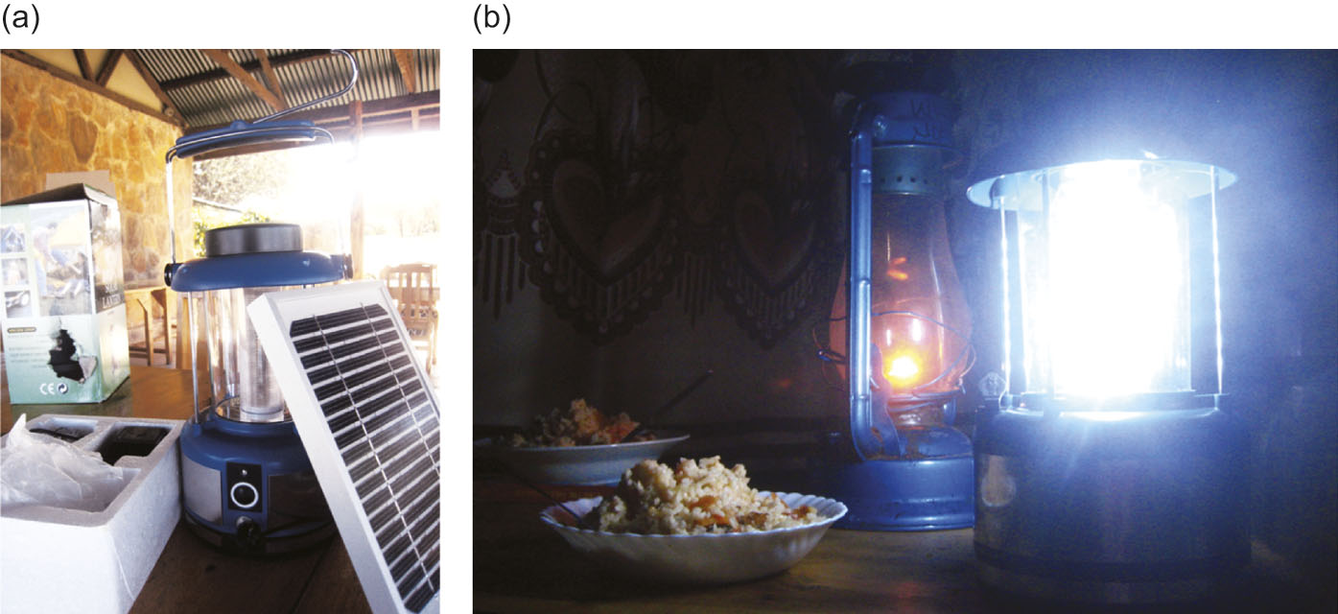
Fig23_02

Slide 3
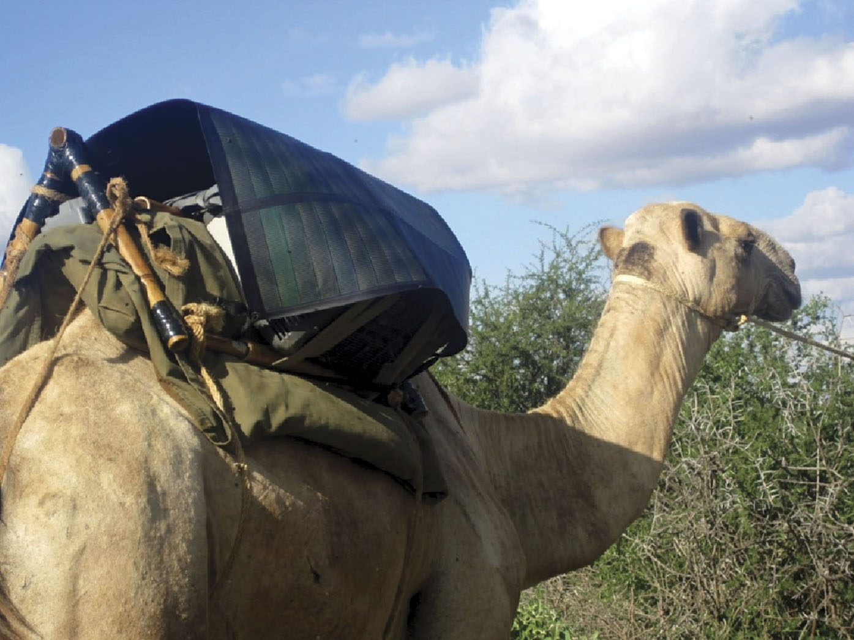
Fig23_03

Slide 4
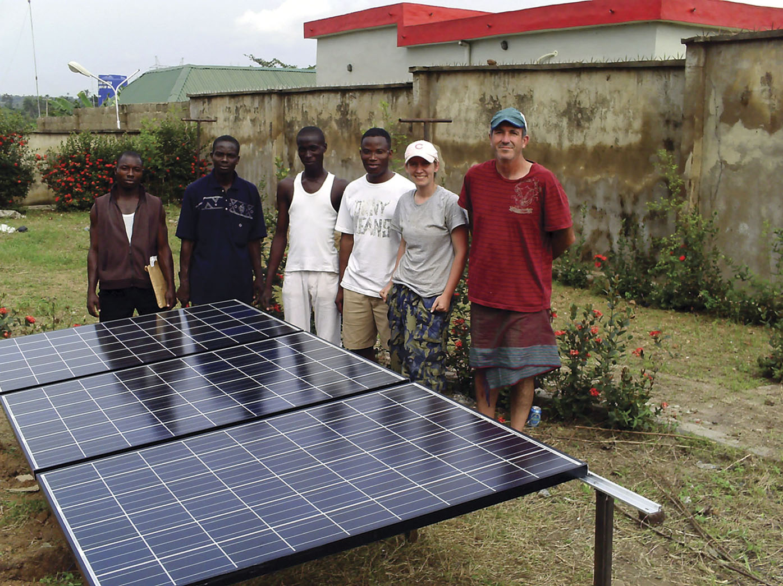
Fig23_04

