Slide 1
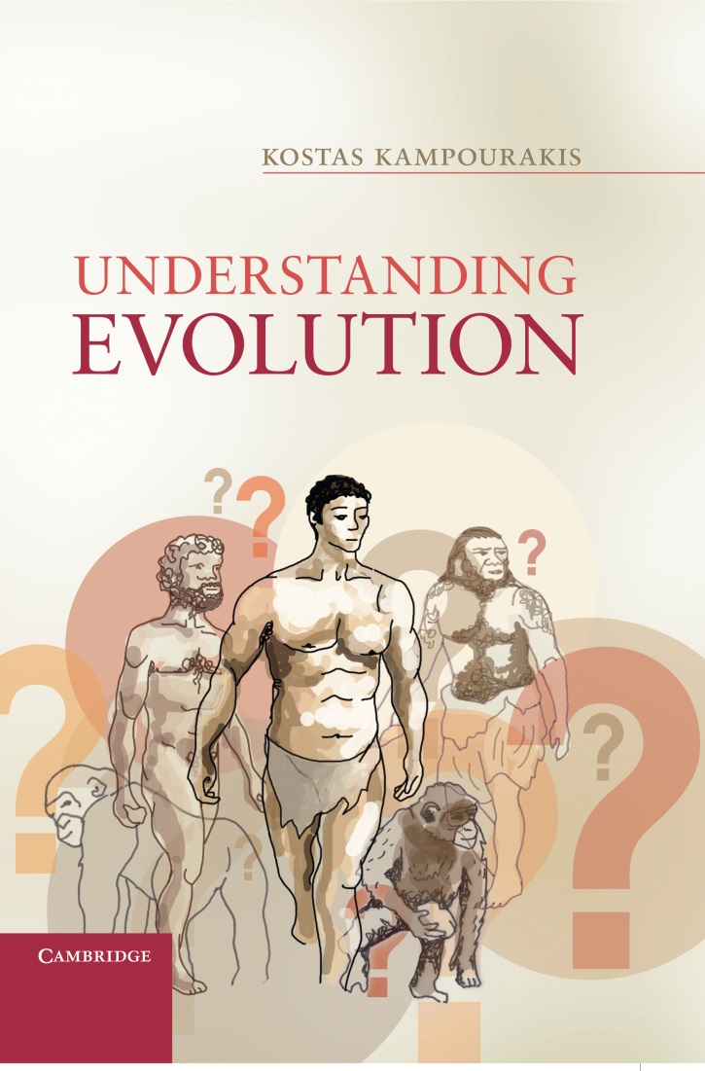
Chapter 2
Religious resistance to
accepting evolution

Slide 2
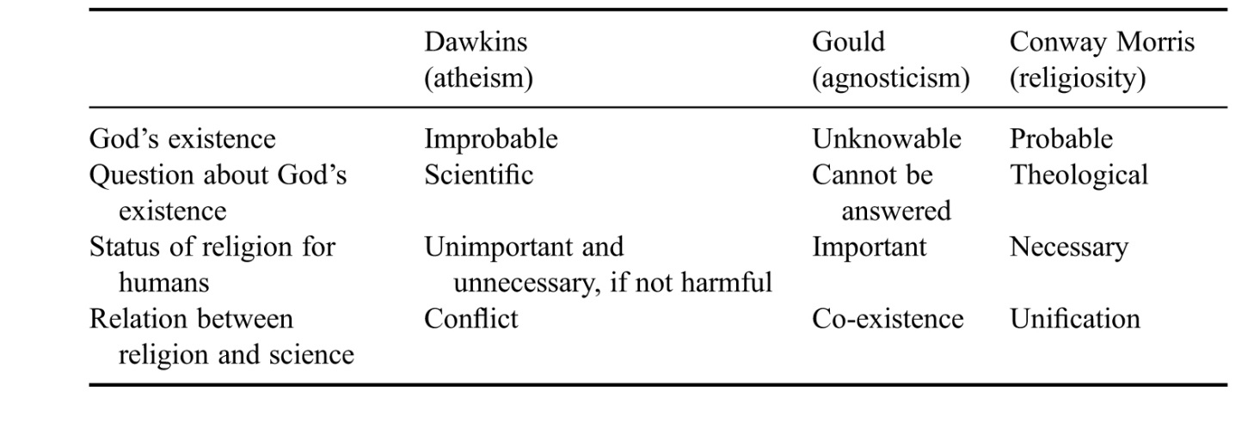
Table 2.1
An overview of the views of Dawkins, Gould and Conway Morris

Slide 3
Table 2.2
Grounding of beliefs and related questions

