Slide 1
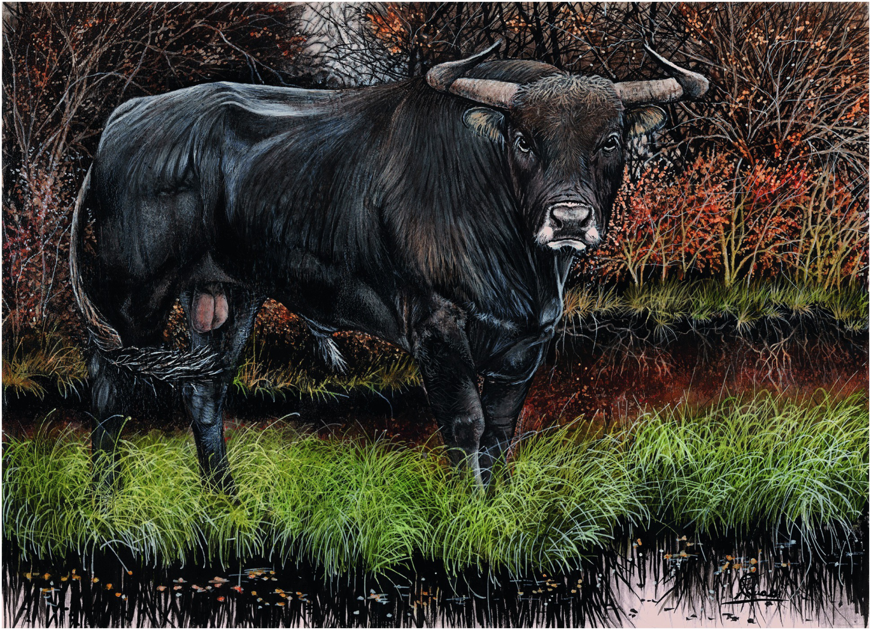
Plate 18
Aurochs (illustration by Francesco Rinaldi)

Slide 2
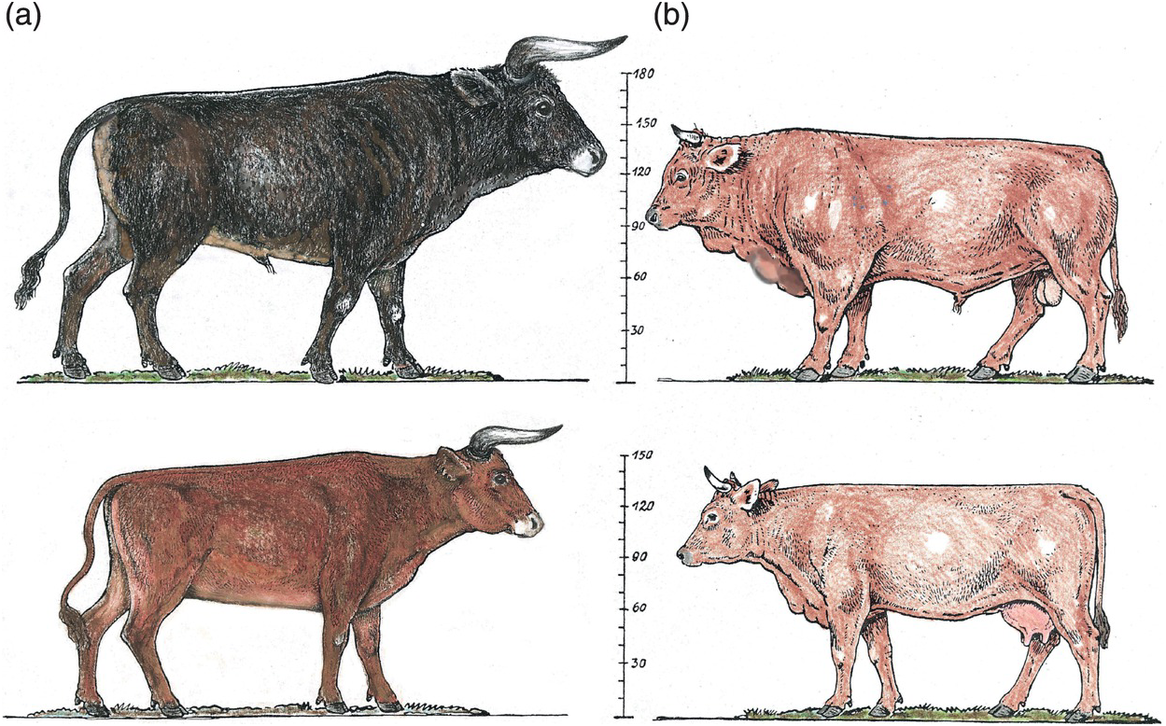
Figure 15.2
Comparison of bulls and cows of the aurochs and modern cattle (after Boessneck 1957, modified and coloured). The differences in body size, udder size, body proportions and horns are clear.

Slide 3
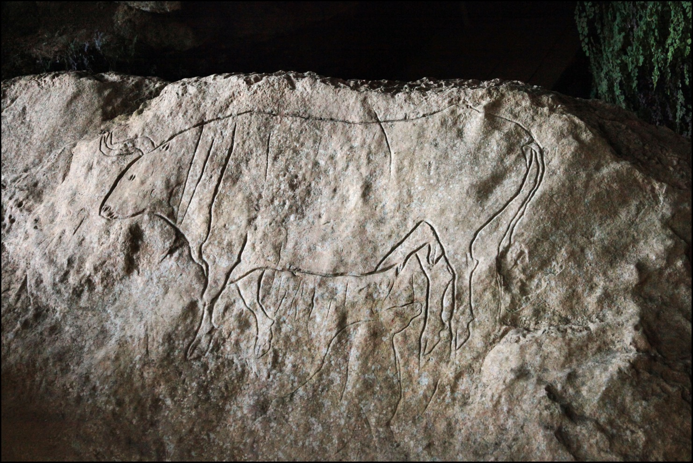
Figure 15.3
Rock engraving of an aurochs bull dated 14,000-10,000 years BC (Romito Cave, South Italy). Photo by Luca Policastri.

Slide 4
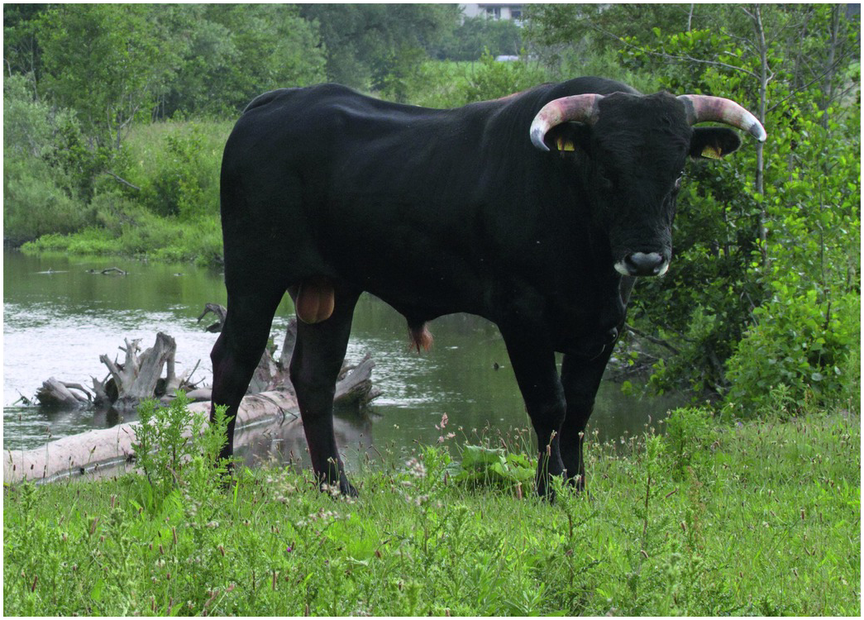
Figure 15.7
One of the crossings of the back-breeding experiment in the Lippe area (Germany). This bull is ½ Sayaguesa - ½ Heck. Photo by M. Bunzel-Drüke.

Slide 5
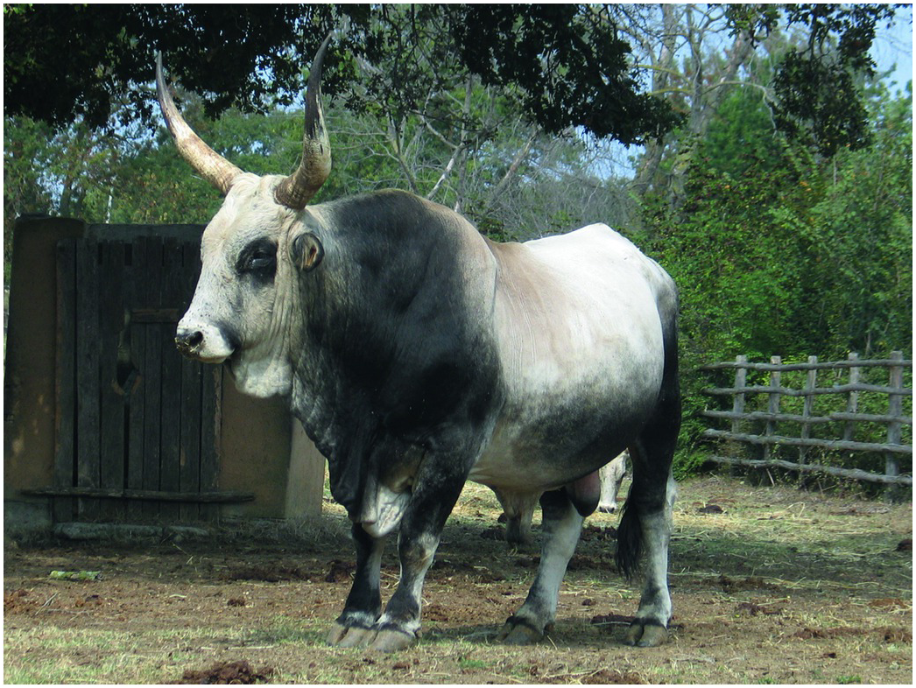
Figure 15.8
Marammana bull. One of the cattle breeds used for the back-breeding experiment in the ‘TaurOs Project’. Photo by Marco Di Luca.

