Slide 2
[hkl]
θ
[hkl]
Notes:
Why do orthogonal directions have the same [hkl] designation?

Slide 3
A
C
Twin
B
C
Matrix
A
Notes:
What is the purpose of the lower boundary "A"?

Slide 4
A
D
t₁
γ₁
θ₁
γ₄
ϕ₃
δx
ϕ₂
O'
δy
O''
θ₃
t₂
θ₂
ϕ₁
t₃
B
γ₂
γ₃
C
Notes:
3.68” x 3”, tiff.

Slide 5
Notes:
2.85” x 3”, tiff.

Slide 6
Notes:
2.97” x 3”, tiff.

Slide 7
5
7
Notes:
4.52” x 4”, tiff.

Slide 8
0.5 μm
Notes:
3.37” x 5”, tiff.

Slide 9
(a)
(b)
Notes:
1.23” x 5”, tiff.

Slide 10
A
B
ω
Notes:
2.22” x 3”, tiff.

Slide 11
A
B
ω
Notes:
2.34” x 3”, tiff.

Slide 12
grain A
grain B
2b_{g}
(a)
(b)
Notes:
2.38” x 3”, tiff.

Slide 13
grain A
grain B
b_{A}
b_{g}
b_{B}
(a)
(b)
(c)
Notes:
2.49” x 3”, tiff.

Slide 14
θ/2
θ/2
B
(100)
(100)
A
C
h
[100]
[100]
(010)
(010)
O
[001]
Notes:
2.31” x 3”, tiff.

Slide 15
ψ + θ/2
(100)
B
θ
b₂
F
A
[100]
b₁
[100]
(010)
(010)
D₁
E
h
D₂
(100)
F
ψ - θ/2
E
(a)
(b)
Notes:
2.25” x 5”, tiff.

Slide 16
θ/2
θ/2
z < 0
z > 0
z < 0
z > 0
y
ξ₂
b_{1g}
ξ₁
b_{1g}
z
x
ξ₁
b_{2g}
D₁
D₂
(a)
(b)
Notes:
3.35” x 3”, tiff.

Slide 17
D₁
B(−θ/2)
A(+h)
O(0)
ξ₁
O(0)
B(−h)
y_{B}
_{A}
_{B}
A(+θ/2)
D₂
_{B}
_{B}
ξ₂
b₂
y₀
y₀
_{A}
O
_{A}
y_{A}
b₁
D₁
_{A}
_{B}
B(−θ/2)
x_{A}
x₀
A
x₀
x_{B}
O
O(0)
(a)
(b)
B
ξ_{1g}
A(+θ/2)
z
z
D₂
ξ_{2g}
b_{2g}
y₀
O
z = +h
A
z = +h
A
b_{1g}
x_{A}
y_{A}
x₀
(c)
z = 0
O
z = 0
O
x₀
y₀
x₀
y₀
z = −h
B
y_{B}
z = −h
B
x_{B}
Notes:
3.26” x 3”, tiff.

Slide 18
S
F
S
F
F
B
S
−V
V
V_{B}
V
V_{A}
A
B
J
J
(a)
(b)
(c)
Notes:
4.1” x 3”, tiff.

Slide 19
S
F
ref
θ_{A}
θ_{B}
B
B
V
[100]
V
A
B
V_{B}
V_{A}
b₁
V_{B}
0
V_{A}
V
θ_{B}
θ_{A}
b₂
0
θ/2
θ/2
[010]
θ/2
θ/2
J
(a)
(b)
(c)
Notes:
4.38” x 5”, tiff.

Slide 20
N
b
b
b
N''
N'
(a)
(b)
Notes:
4.72” x 5”, tiff.

Slide 21
D₁
ϕ
D₂
N₂
L₂
ξ₂
O
L₁
N₁
ξ₁
b₂
b₁
Notes:
2.11” x 3”, tiff.

Slide 22
b
ξ
Notes:
4.57” x 5”, tiff.

Slide 23
C
b₁
A
ϕ
B
b₂
D
Notes:
1.73” x 3”, tiff.

Slide 24
b₁
ϕ_{e}
b₃
b₂
Notes:
2.97” x 3”, tiff.

Slide 25
(a)
(b)
Notes:
1.49” x 5”, tiff.

Slide 26
N₁
N₂
b₃ = ξ₃ = [001]
Notes:
2.56” x 3”, tiff.

Slide 27
b₁
b₃
b₄
b₂
b₅
Notes:
1.97” x 3”, tiff.

Slide 28
A
B
Notes:
3.62” x 2”, tiff.

Slide 29
A
B
A
B
D
A
C
C
B
(a)
C
(c)
δ
C
B
δ
δ
C
B
δ
δ
B
δ
A
Q
B
δ
A
δ
A
δ
C
δ
C
B
B
δ
C
A
δ
δ
A
B
T
δ
A
δ
C
δ
δ
(b)
C
A
δ
Notes:
6.12” x 5”, tiff.

Slide 30
A
C
B
δ
(a)
B
C
δ
B
A
A
C
δ
C
A
B
B
A
(b)
D
A
C
B
C
Notes:
2.75” x 3”, tiff.

Slide 31
B
B
B
P_{S}
A
B
A
C
A
C
A
C
D
B
B
K_{S}
C
C
A
(a)
(b)
Notes:
1.49” x 3”, tiff.

Slide 32
C
A
C
A
B
B
B
B
P_{U}
A
B
A
C
D
A
C
K_{U}
B
C
(a)
(b)
Notes:
1” x 3”, tiff.

Slide 33
K_{S}
K_{U}
B
A
B
B
B
A
D
A
C
C
A
A
C
C
(a)
(b)
Notes:
1.01” x 3”, tiff.

Slide 34
P_{S}
K_{S}
A
B
C
Notes:
3.54” x 4”, tiff.

Slide 35
~D
D
(a)
(b)
(c)
Notes:
4.28” x 4”, tiff.

Slide 36
∞
∞
∞
y
y
y
x
x
x
−∞
−∞
−∞
(a)
(b)
(c)
Notes:
4.03” x 4”, tiff.

Slide 37
(a)
(b)
(c)
Notes:
Needs more extensive figure caption

Slide 38
II
III
I
II
I
(a)
(110)
(b)
Notes:
2.31” x 5”, tiff.

Slide 39
π
Notes:
3.02” x 3”, tiff.

Slide 40
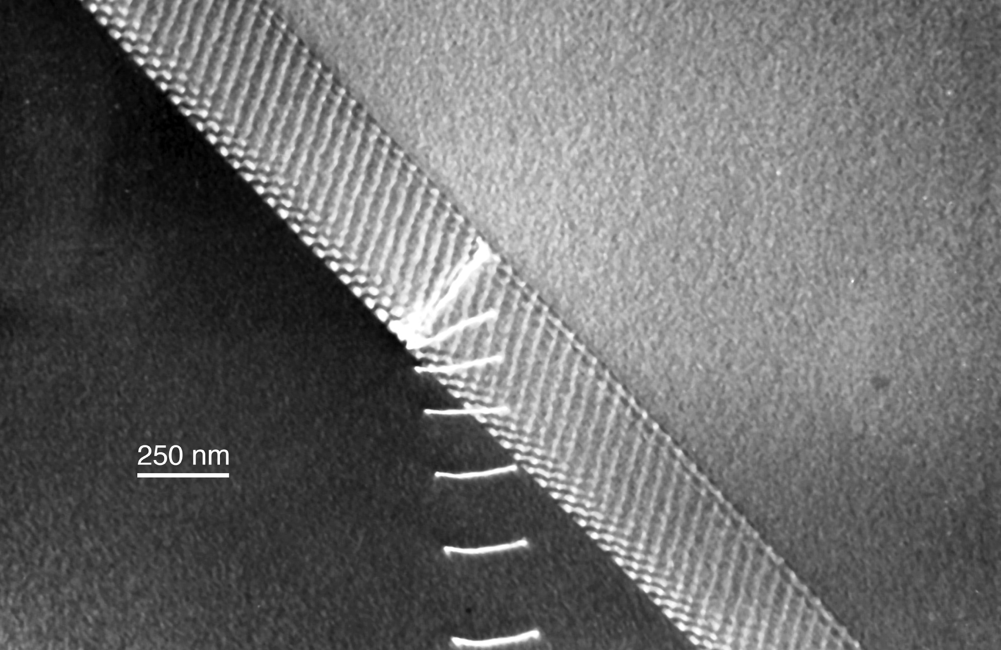
Notes:
3.25” x 5”

Slide 41
B
F_{j}
x
l_{j}
A
Notes:
2.55” x 3”, tiff.

Slide 42
F_{j}
F_{j}
0
1
X_{j}
Notes:
2.7” x 3”, tiff.

Slide 43
exper.
values
500
Read-Shockley
(large angle parameters)
400
γ, mJ/m²
Van der Merwe
300
200
Read-Shockley
(small angle parameters)
100
0
4
8
12
16
20
θ, degrees
Notes:
3.45” x 5”, tiff.

Slide 44
Notes:
5.55” x 2”, tiff.

